Slide 1
IR FOR PROSA

Slide 2
Prosa
Modules
BEHAVIOR time • jobs • schedules • service • arrival sequences • readiness
MODELS tasks • arrivals • processor • priority • preemption • readiness
ANALYSIS DEFINITIONS workload • interference • RBF • DBF • SBF • busy interval • schedulability
ABSTRACT ANALYSES Generic RTA frameworks
RESULTS Concrete verified scheduling analyses such as FP / EDF / resource / preemption ...
RTS Paper | Prosa Library
Basic definitions of the system | Behavior
Mathematical task/ resource model | Models
Analysis definitions and bounds | Analysis
Theorem and Proof Arguments | Results
Notes:
Papers describe one coherent theory, but spread it across prose, equations, definitions, and proofs.
Prosa organizes the same knowledge into reusable formal modules.
Translation therefore requires recovering the theory—not merely translating sentences into Rocq syntax.

Slide 3
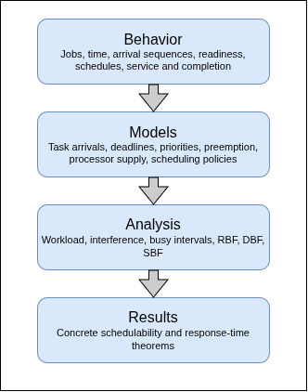
How Prosa Organized Real time systems knowledge
Notes:
Diagram Link: https://drive.google.com/file/d/1teh-nk2viVrXPcGrf3sGBu52NBK5Gomk/view?usp=sharing
Notes:
Behavior Fundamental semantic vocabulary: jobs, arrival times, schedules, service, completion model Assumptions restricting possible systems: periodic/sporadic arrivals, EDF/FP, preemption, processor mode lanalysis.definitions Quantities such as workload, interference, response time, request/demand/supply bounds analysis.facts and analysis.abstract Reusable lemmas and generic proof frameworks results Instantiated schedulability or response-time theorems implementation Computable versions, refined search spaces, and executable analyses

Slide 4
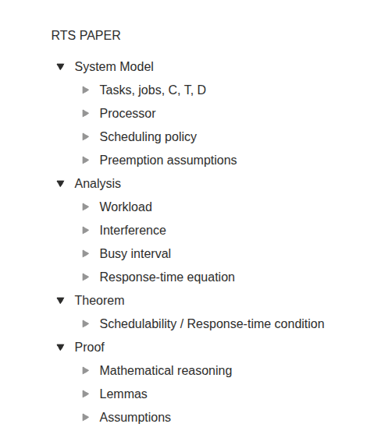
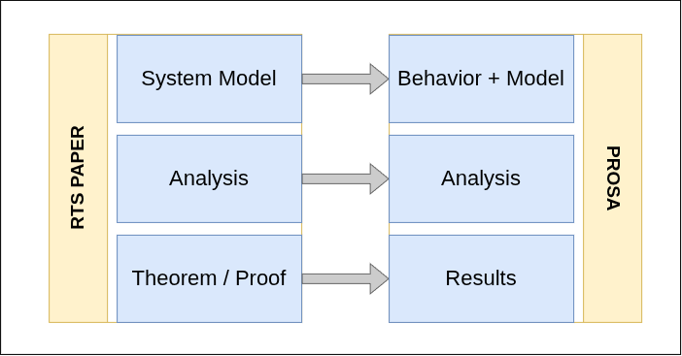
How an RTS Paper Is Structured
Notes:
Diagram Link: https://drive.google.com/file/d/1teh-nk2viVrXPcGrf3sGBu52NBK5Gomk/view?usp=sharing

Slide 5
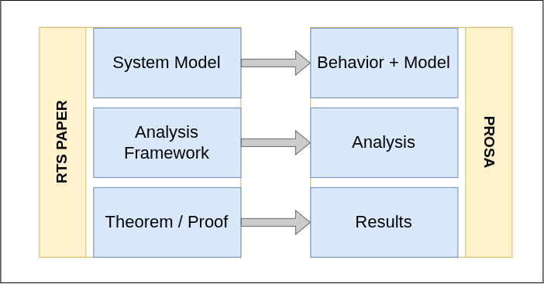
How an RTS Paper Is Structured
Notes:
Diagram Link: https://drive.google.com/file/d/1teh-nk2viVrXPcGrf3sGBu52NBK5Gomk/view?usp=sharing

Slide 6
Why direct paper-to-Prosa translation is unsafe
Consider the following line:
“Tasks are scheduled using a preemptive hierarchical scheduler on a uniprocessor.”
This single sentence contains several independent formal commitments:
Processor model → uniprocessor
Preemption model → fully preemptive
Scheduler structure → hierarchical
Scheduling policy → FP or EDF
Resource model → probabilistic provisioning
Notes:
A direct generator may recognize “EDF” and overlook the other commitments. The IRs make each commitment explicit and independently traceable.

Slide 7
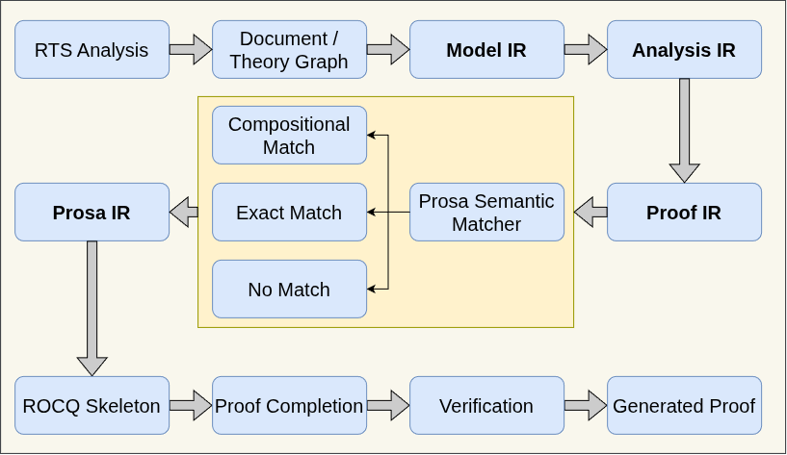
Our Design
Notes:
ModelIR establishes the world.
AnalysisIR defines how that world is measured.
ProofIR states what must be proved using that model and analysis.
ProsaIR records how those semantics can be realized in Prosa.
Diagram Link: https://drive.google.com/file/d/1teh-nk2viVrXPcGrf3sGBu52NBK5Gomk/view?usp=sharing

Slide 8
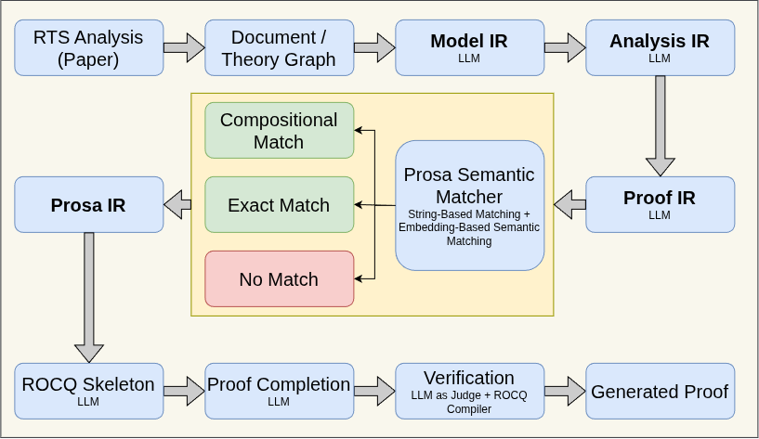
Our Design
Notes:
ModelIR establishes the world.
AnalysisIR defines how that world is measured.
ProofIR states what must be proved using that model and analysis.
ProsaIR records how those semantics can be realized in Prosa.
Diagram Link: https://drive.google.com/file/d/1teh-nk2viVrXPcGrf3sGBu52NBK5Gomk/view?usp=sharing

Slide 9
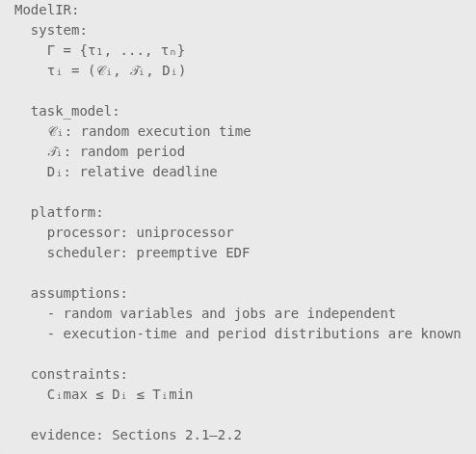
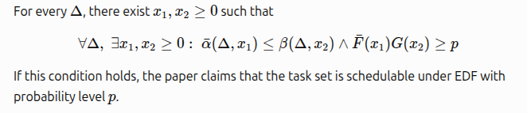
Model IR
What system is being analyzed?
Notes:
ModelIR defines which systems and executions the theorem is talking about.

Slide 10
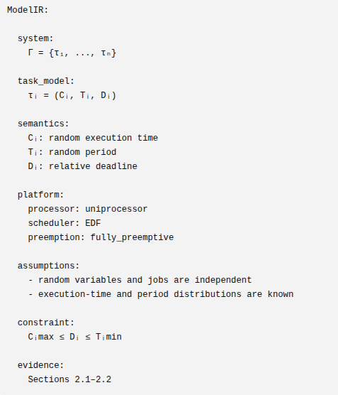
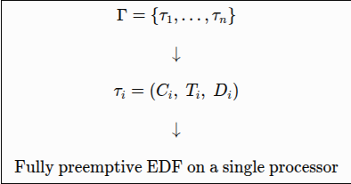
Model IR
What system is being analyzed?
Notes:
ModelIR defines which systems and executions the theorem is talking about.

Slide 11
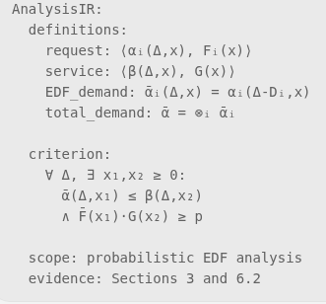
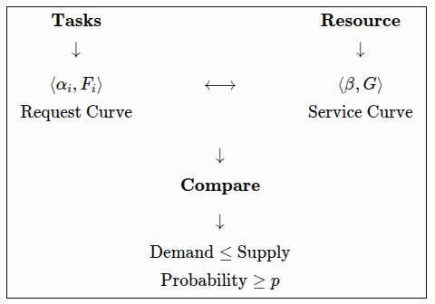
Analysis IR
How the system is being analyzed?
Notes:
AnalysisIR defines the analytical quantities and the mechanically checkable test—it does not yet claim that the test is correct.
AnalysisIR contains:
Definitions of analytical quantities.
Relations between quantities.
Schedulability criteria.
Analysis-specific assumptions.
References back to the model concepts they depend on.

Slide 12
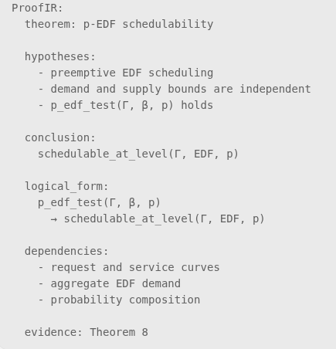
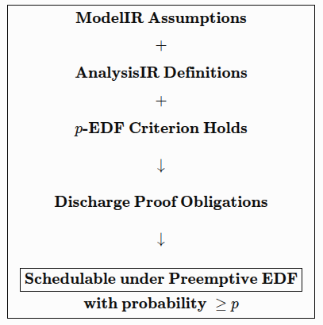
Proof IR
What is being claimed and why?
Notes:
ProofIR captures the theorem connecting the analytical test to the desired real-time guarantee.

Slide 13
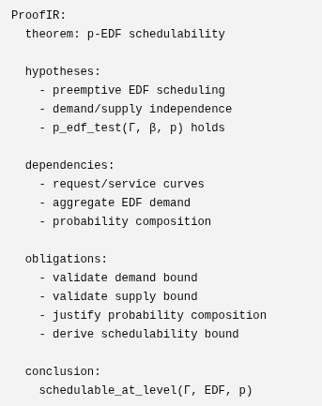
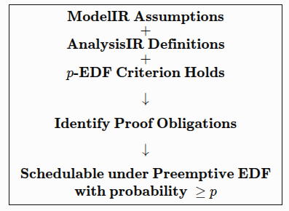
Proof IR
What is being claimed and why?
Notes:
ProofIR captures the theorem connecting the analytical test to the desired real-time guarantee.

Slide 14
Constructing ProsaIR
The three source IRs are converted into individual semantic requirements:
R1: jobs execute on a uniprocessor
R2: scheduling follows fully preemptive EDF
R3: tasks have relative deadlines
R4: task demand is represented by request/demand bounds
R5: processor availability is represented by a service bound
R6: execution times and periods are random variables
R7: curves carry CDF-based probability guarantees
R8: demand and service probabilities compose under independence
R9: the p-EDF condition implies probabilistic schedulability

Slide 15
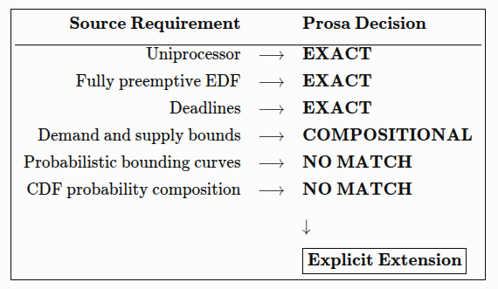
Semantic Matching

Slide 16
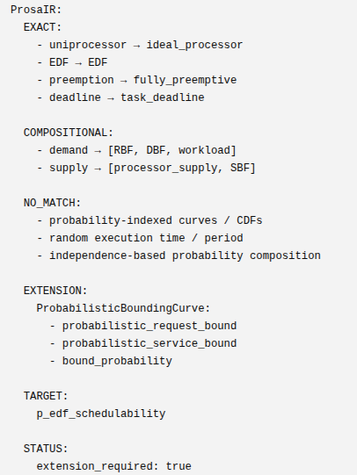
Prosa IR
ProsaIR is not another summary of the previous IRs.
It is a formalization plan showing what Prosa already supports, what must be composed, and what requires an extension.
Notes:
ProofIR: source-oriented
ProsaIR: target-oriented

Slide 17
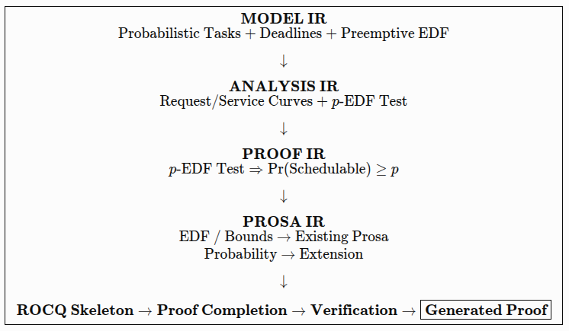
Final Picture

