Slide 1
Smartphone Data Analysis & Budget Prediction Using Machine Learning
Name:- Sadit Reyaz.

Slide 2
Problem Statement & Objective
Problem Statement
Smartphone companies collect large amounts of customer, product, and rating data.
Analyzing this data helps understand customer preferences and product pricing.
Manual analysis is difficult because of the large amount of data.
Objective
Analyze smartphone datasets.
Merge multiple datasets into one dataset.
Perform exploratory data analysis (EDA).
Create a new feature called Marketing_Budget.
Build a Linear Regression model to predict the marketing budget.

Slide 3
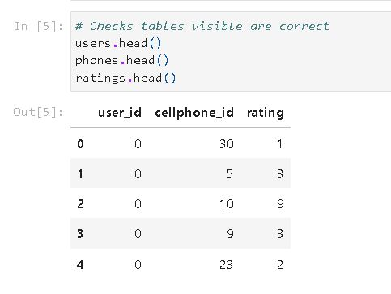
Dataset Description
The Project uses three datasets:
Users Dataset:
User ID
Name
Region
Salary
Age
Gender
Occupation
Cellphones Dataset:
Brand
Model
Price
Ram
Battery
Screen Size
Ratings Dataset:
User ID
Cellphone ID
Rating

Slide 4
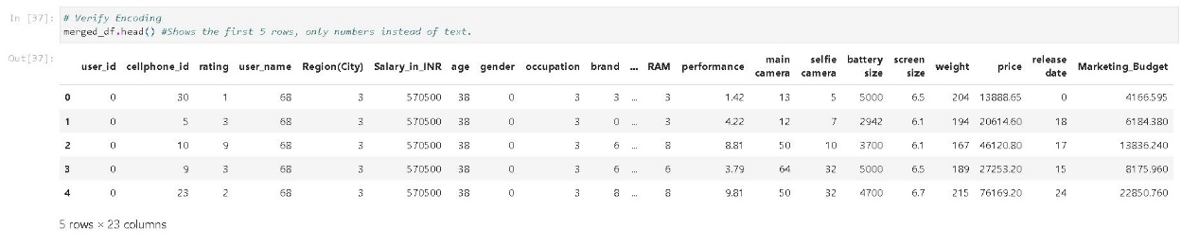
Data Cleaning & Merging
Missing values were checked.
The datasets were merged using User ID and Cellphone ID.
Duplicate records were removed.
A single merged dataset was created.
The merged dataset contains all important smartphone information.

Slide 5
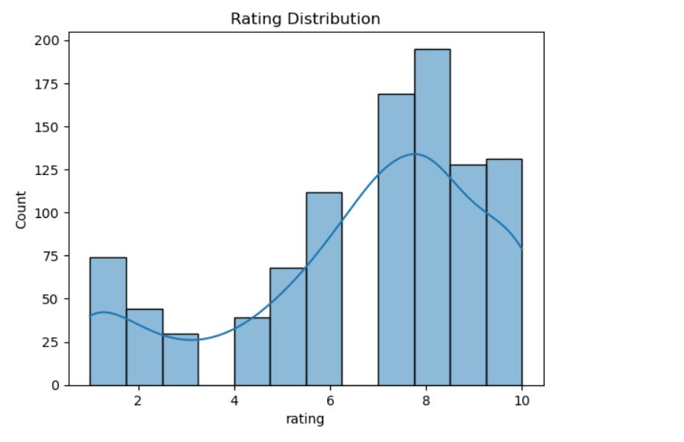
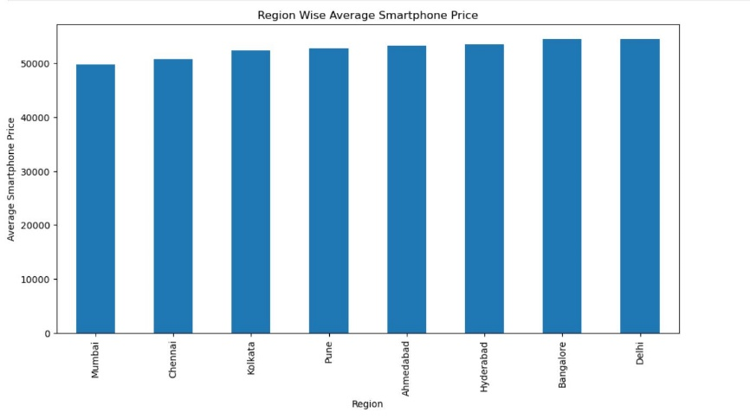
Exploratory Data Analysis(EDA)
Distribution of ratings was analyzed.
Relationship between smartphone price and ratings was studied.
Region-wise average smartphone price was calculated.
Data visualization helped identify patterns.

Slide 6
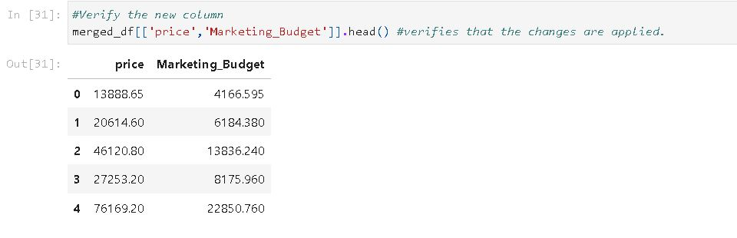
Feature Engineering
A new feature called Marketing_Budget was created.
Formula used:
Marketing_Budget = Price * 0.30
This means 30% of the smartphone price is considered as the marketing budget.
The new feature was verified after creation.

Slide 7
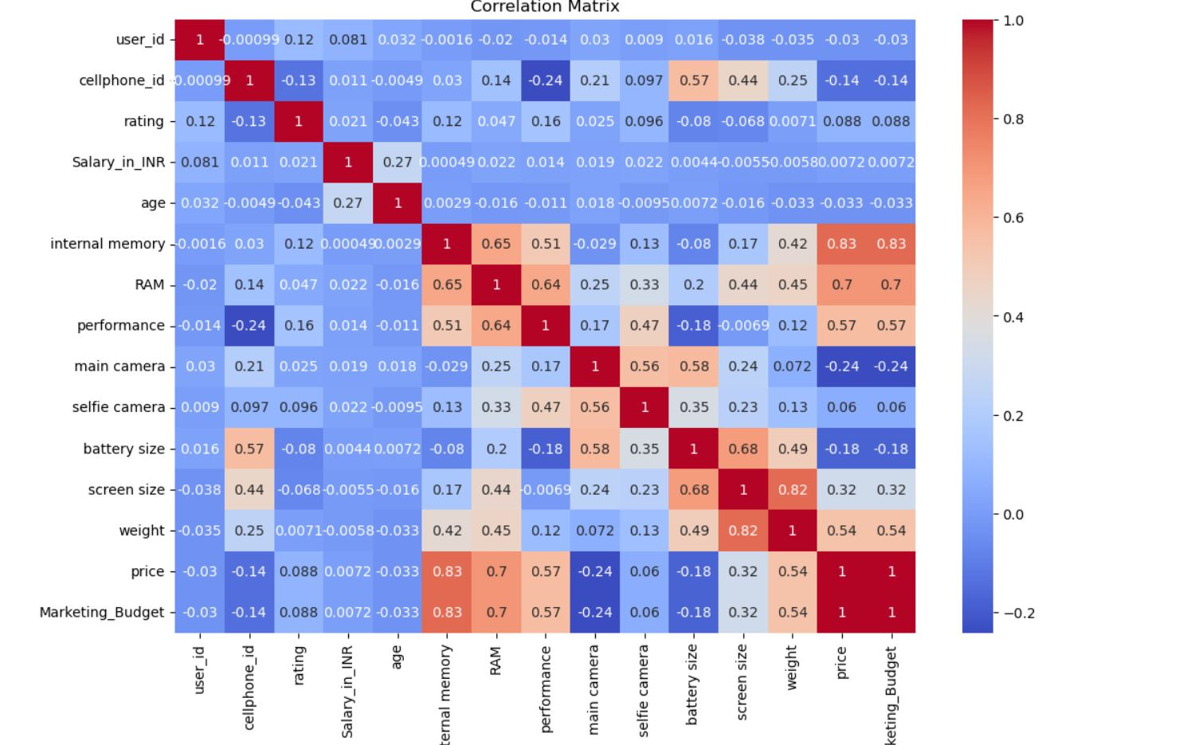
Data Preprocessing
Before training the model
Categorical columns were encoded.
Correlation analysis was performed.
Features and target variables were selected.
Data was prepared for machine learning.
The target variable is
Marketing_Budget
The feature set excludes the target variable and price.

Slide 8
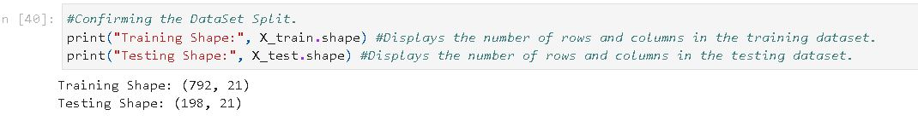
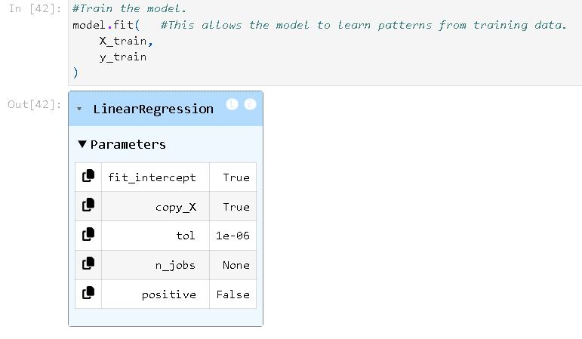
Model Building
Machine Learning Algorithm Used :- Linear Regression
Steps:-
Selected input features(X)
Selected target variable(Y)
Split the dataset into training and testing data.
Trained the Linear Regression model
Generated predictions

Slide 9
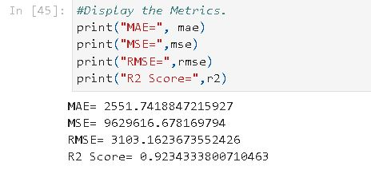
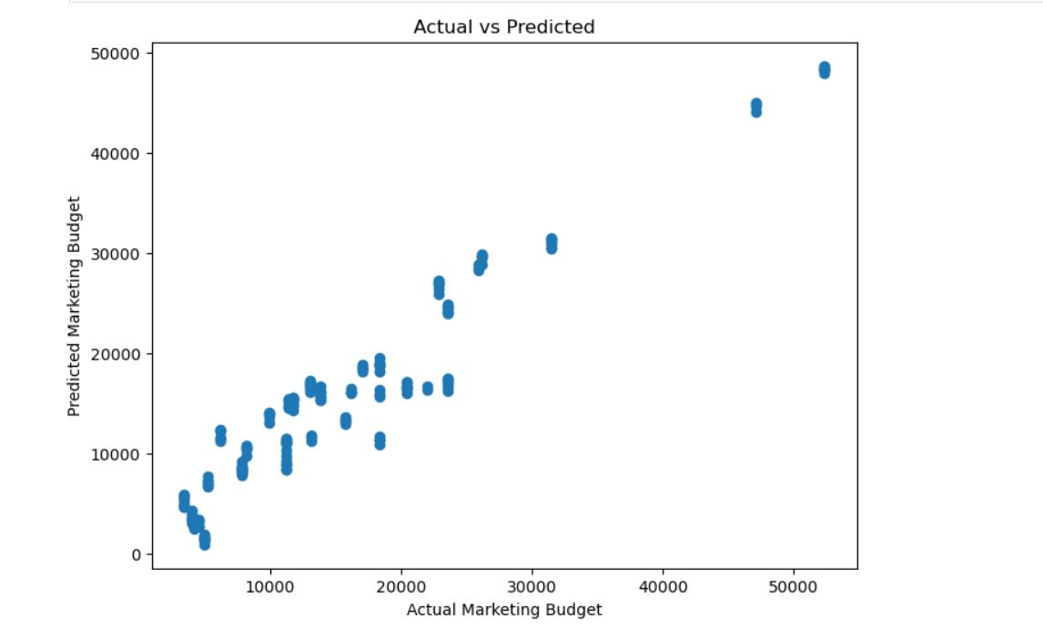
Model Evaluation
The model performance was evaluated using
Mean Absolute Error(MAE)
Mean Squared Error(MSE)
Root Mean Squared Error(RMSE)
R^2 Score
These metrics measure the prediction accuracy of the model.

Slide 10
Conclusion & Future Scope
Conclusion:
Successfully analyzed smartphone datasets.
Merged three datasets into one.
Created a new feature called Marketing_Budget.
Built a Linear Regression model.
Generate predictions successfully.
Future Scope:
Use Large Datasets.
Try advanced machine learning algorithms.
Build a web application for smartphone analysis.
Improve Prediction accuracy.

