Slide 1

Simulation of Ransomware Encryption and Prevention Strategies
This project is a sophisticated malware-inspired online communication system with encrypted data exchange, authentication, and control mechanisms. It utilizes Diffie-Hellman key exchange and ChaCha20 encryption to ensure secure communication where the cryptographic keys are never stored on local devices, making interception nearly impossible.

Slide 2
Ransomware Architecture
Cryptographic Core
Server Implementation
Client Implementation
Diffie-Hellman Key Exchange
Manages multiple client connections
SecureCommunicationClient Class
ChaCha20 Encryption
GUI Interface
AES Encryption
Performs secure key exchange
Data Targeting
Data Targeting
Encrypts/decrypts messages
Ensures data integrity

Slide 3
Communication Flow
Initialization
1
The client starts by entering the server details (host and port) in the GUI. A socket connection is established.
2
Secure Key Exchange
The server generates its private and public keys and shares its public key with the client. The client computes the shared secret using its private key and the server's public key.
Message Exchange
3
Messages entered in the client GUI are encrypted using ChaCha20 before transmission. The server decrypts the received messages and processes them.
4
Control Ransomware Attack
It takes command from the client (hacker) and executes them on the victim PC. It allows the attacker to do a Control Ransomware Attack by doing so it makes the attack more efficient, less time consuming and risk free.
Data Management
5
The client (hacker) can store received messages to a local file or refresh the message display.
6
Termination
Both client and server gracefully close the connection, ensuring no sensitive data is left unprotected.

Slide 4
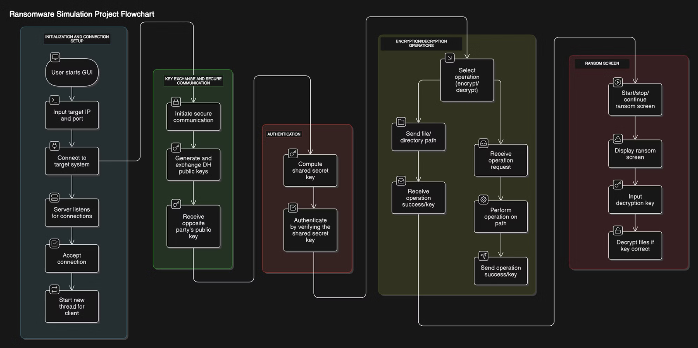
Ransomware Simulation Project Flowchart

Slide 5
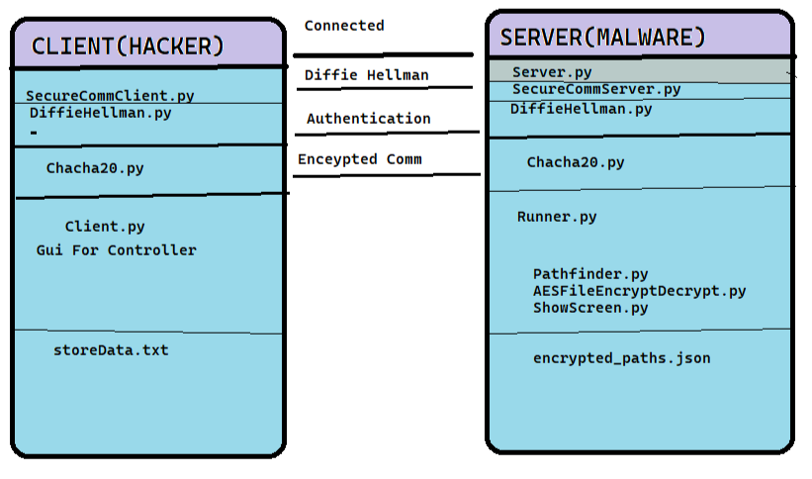

Slide 6
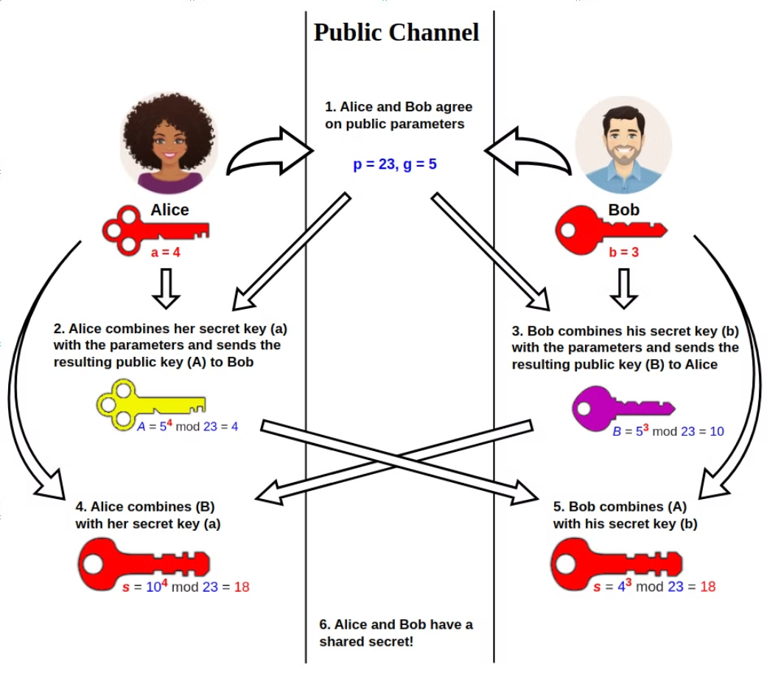
Diffie Helman Key Exchange

Slide 7
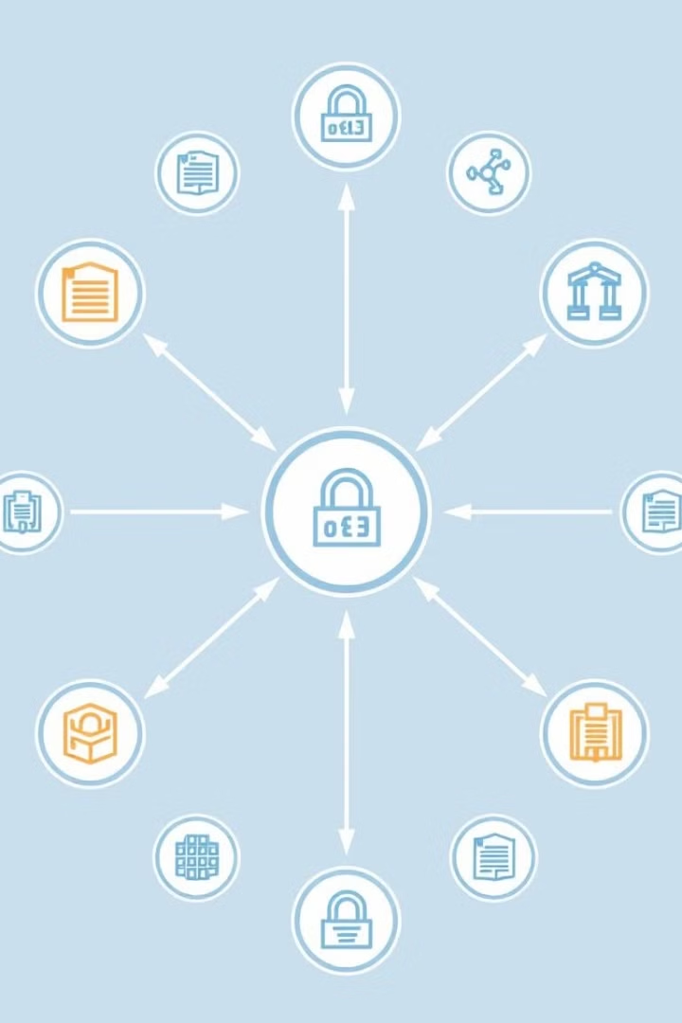
Cryptographic Algorithms
Diffie-Hellman Key Exchange
ChaCha20 Encryption
ChaCha20 is designed for fast encryption and decryption, making it ideal for real-time applications like messaging and streaming. It uses a 256-bit key and operates with a 64-byte block size, ensuring strong security with high efficiency.
Establishes a shared secret over an insecure channel. Avoids direct transmission of cryptographic keys.
AES Encryption
AES is a highly reliable symmetric encryption algorithm offering strong security with key sizes like AES-256. It uses a 128-bit block size and supports modes like CBC for secure encryption in storage and transmission. Widely used in both software and hardware for secure data.

Slide 8
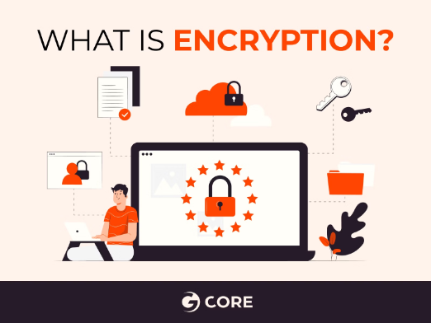
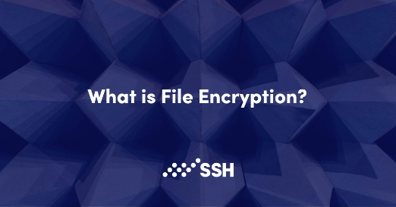
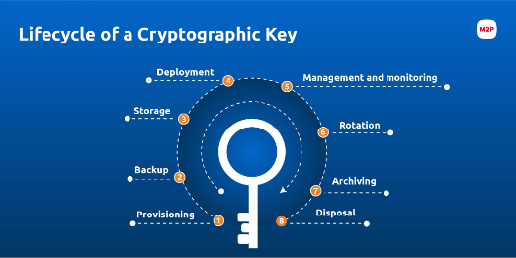
AES Encryption and Decryption
Random Key Generation
Encrypted Data Handling
File & Drive Encryption
Generates a random 32-byte AES-256 key for encryption and decryption.
Manages paths to encrypted files or directories in JSON format for easy handling of encrypted items.
Encrypts individual files, folders, and entire directory structures using AES in CBC mode with a generated initialization vector.
Get_AES_Key () retrieves the key.
Set_AES_Key () sets a new 32-byte key

Slide 9
ChaCha20 Algorithm
Overview
ChaCha20 is a fast and secure stream cipher, ideal for resource-constrained devices.
Encryption
The encrypt() method encrypts plaintext, returning a nonce and ciphertext.
1
2
3
4
Shared Encryption Key
Decryption
Uses a 32-byte shared encryption key and a 16-byte nonce (generated using os.urandom)
The decrypt() method uses the nonce and ciphertext to recover the original plaintext.

Slide 10
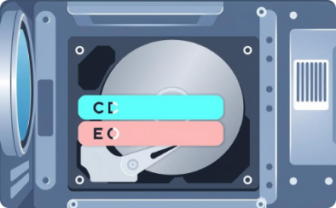
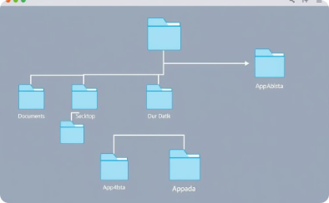
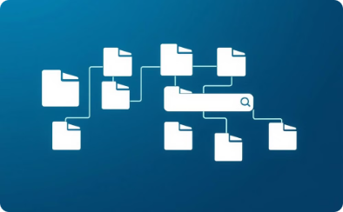

PathFinder: Automating Drive and Folder Path Discovery
Drive Discovery
System Directory Identification
Recursive Folder Search
Path Storage
Enumerates logical drives (C:, D:, E:, etc.) using the `os` library.
Stores discovered paths in a text file for later use.
Identifies system directories (Documents, Desktop, AppData) using `win32api`.
Recursively searches folders, returning all matching paths.

Slide 11
Building a Secure Ransomware Decryption GUI
—
—
User-Friendly Interface
Key Features
The RansomScreen class creates a user-friendly ransomware decryption interface using the tkinter library and PIL for image processing.
Features include a full-screen window, background image, text input for the AES key, and a submission button.
—
—
File Decryption
Security Practices
The interface reads encrypted file paths from a JSON file and attempts to decrypt them using AES decryption. Error handling manages user input errors, invalid keys, and non-existent paths.
Secure practices are ensured by removing non-existent paths from the list and saving updated paths. Visualizations are provided.

Slide 12
Protection Measures Against Malware and Ransomware
1
Maintain System Security
2
Adopt a Strict No-Trust Policy
Ensure that built-in security features such as Windows Firewall, real-time protection, and other system security mechanisms are always enabled and configured correctly. Disabling these can expose the system to unnecessary risks.
Avoid running unauthorized or cracked applications, as they often serve as vectors for malware. Always use legitimate software and trusted resources to minimize vulnerabilities.
3
Ensure Regular Updates
4
Implement Data Backups
Keep your operating system, applications, and security tools up-to-date. Regular updates often include patches for known vulnerabilities that attackers could exploit.
Regularly back up critical data to secure, offline, or cloud-based storage solutions. This practice ensures data recovery in case of a ransomware attack, reducing downtime and data loss.

Slide 13





Future Directions
Advanced Features
1
Scalability
2
Enhanced GUI
3
AI Integration
4
Cross-Platform Support
5

Slide 14
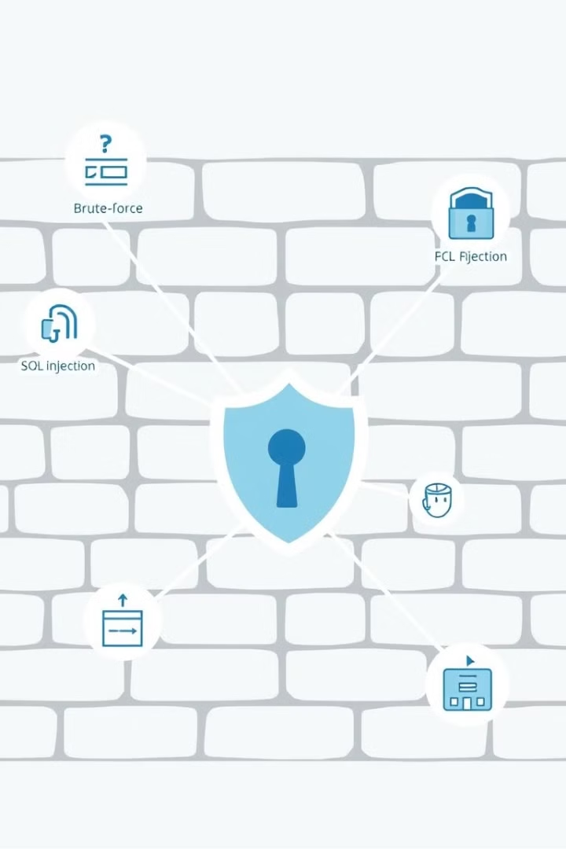



Firewall Bypass Techniques
Encryption
Open Ports
Steganography
Attacker use encryption to disguise malicious traffic, making it difficult for firewalls to detect threats.
Open ports or poorly configured firewall rules are leveraged to gain unauthorized access.
Malicious code is hidden in images, videos, or documents to bypass security systems.

Slide 15
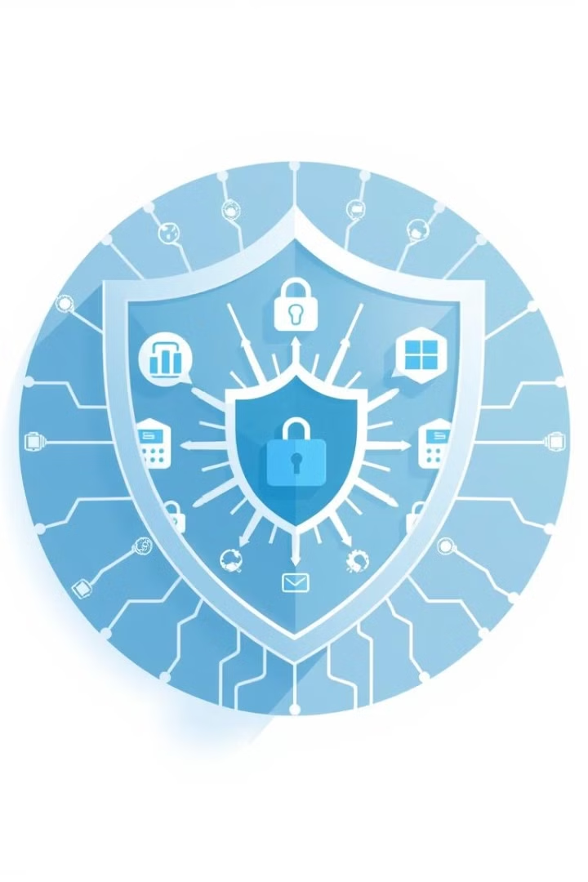
Conclusion
This project provides a comprehensive simulation of ransomware encryption and prevention strategies. It highlights the importance of secure communication protocols, robust cryptographic algorithms, and proactive security measures to mitigate the risks posed by malware and ransomware. By understanding the intricacies of these threats, we can develop more effective defenses and protect our digital assets.

