Slide 1
ACM-ICPC
Association for Computing Machinery (ACM) - International Collegiate Programming Contest (ICPC)

Slide 2
What is ACM-ICPC?
The "Olympics of Programming Competitions". Oldest, largest, and most prestigious programming contest in the world.
The ACM-ICPC is a multi-tier, team-based, programming competition. It operates according to the rules and regulations formulated by the ACM.
The top team takes home $12,000 along with the ACM ICPC 2014 Gold medal. Three other teams getting Gold Medal are awarded $6,000. Each Silver Medal team gets $3,000 and each Bronze Medal team is awarded $1,500.
Apart from that, Participants, coaches and registered staff (including volunteer helpers) receive complimentary membership to the ACM for a year.
And more important than all, the winners also get some super bragging rights and job offers from some of the top software companies in the world!

Slide 3
Regionals & World Finals
ICPC Regionals: The regionals are organized by the local universities of different regions spread across the globe. The winners of these regional rounds of the contest get to represent the country in the ACM ICPC World Finals.Every regional contest site gets a "slot," which is an invitation for the team to compete in the World Finals. Typically, all the "slots" are allocated by December 31 every year. Additional slots may also be allocated based on student and institution participation, geographic coverage, and team performance. A few bonus slots are allocated each year for growth, innovation, and hosting. So depending on the number of slots that each regional site gets, that many number of top teams it can send to the World Finals.
Also each regional site can have multiple rounds to select the best teams amongst those who apply. Typically they have an online contest, out of which selected teams are called for the onsite contest. These contests happen from the month of October to December.
World Finals: The pick of the crop from every regional site locks horn at the World Finals.

Slide 4
Eligibility
To meet the basic eligibility requirements for the contest you must be:
Willing and able to compete in the world finals
Enrolled in a degree program at an institution that can sponsor you
Competing only for one institution for the calendar year
You should not have participated in more than 2 contest finals prior to this attempt
You should not have participated in more than 5 contest regionals prior to this attempt
You cannot participate in more than 2 teams in the same year

Slide 5
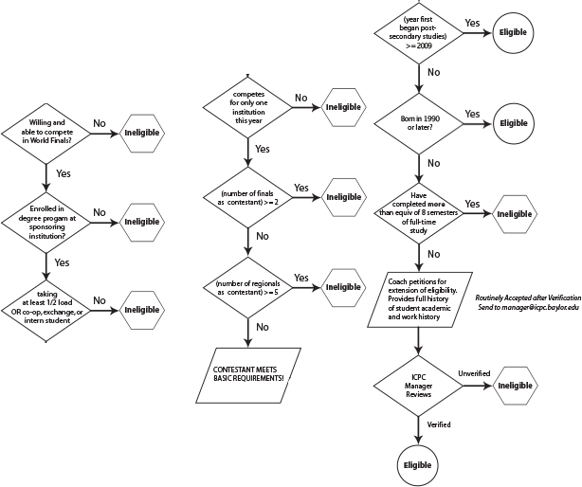

Slide 6
Contest Format
It is a team contest.
Each team should have three members.
Each team must be headed by a coach, who must be a university faculty or staff member.
The coach can head multiple teams
8 to 10 problems of varying difficulty levels and mostly being algorithmic in nature.

Slide 7
Attendance
All team members are expected to attend the day's activities, starting with Registration. No team member may participate in the Contest unless s/he is present for the start of the Contest.
Exceptions can be made by the Registrar in consultation with the Contest Director. If there is a known issue, such as the GRE, the team member should notify the Registrar and request an exception in advance.
In the event an exception is granted:
No adjustments/allowances will be made to the team or the late team member—the Contest will end 5 hours after it starts.
No recap of the information provided at Orientation will be provided, and no consideration (time or any other) will be given if any of that information is requested and cannot be provided in a timely manner.

Slide 8
Permitted Materials
With a few exceptions only, contestants may not bring ANY electronic devices onto the Contest floor. This rule includes electronic calculators, watches with calculators, PDAs, cellular phones, pagers, laptops, and personal audio and/or video players. We will be collecting these items in the computer labs. If you don't want to leave them at home, we suggest that you arrange with your coach or other non-contestant to hold the items for you during the contest. We will allow watches without calculator or programming functions, medical devices such as glucometers, and cameras. Although care will be taken, the Contest Officials accept no responsibility for the return or the return condition of any items they hold.
As a reminder, you may not bring machine-readable versions of software or data. In other words, leave the floppies, CDs, DVDs, USB flash disks, etc., at home. We do plan to disable floppy drives and USB ports on the workstations during the contest.
You may bring non-electronic resources such as textbooks and paper documents. [Please note that the World Finals has more restrictive rules about the materials that may be brought to the contest.] During the contest, you may use any online documentation that has been installed as part of the contest environment.

Slide 9
Permitted Resources
During the contest, contestants are to use only the network to submit contest problems or questions, and get responses from the contest officials. Connecting to any other computer on the LAN or Internet, either before or during the contest, with telnet, FTP, Web browser, email, or any other network application is grounds for expulsion from the contest.

Slide 10
Conduct of the Contest
C, C++, and Java will be the contest languages. Other languages may be added for future contests if the languages are supported at the World Finals and there is sufficient demand.
Submitted source files must be no larger than 300000 bytes.
Notification of both accepted and rejected runs will continue through the end of the contest.
Scores will continue to be updated through the end of the contest.
All teams who solve at least one problem will be ranked.
Ranking will be determined:
first by number of problems solved;
second by total elapsed time to each solution (measured to the second) plus a 1200-second (20-minute) penalty per rejected submission for problems that are eventually solved;
and third by fewest number of rejected submissions for problems that are eventually solved.
During the Contest, team members are permitted to communicate with their own team mates or contest officials only.

Slide 11
Computing and Judging Environment
Each team will be assigned a work area that includes a computer workstation, a small table desktop, and three chairs.
Each team will have a machine of its own to use during the contest. During the contest, contestants are to use the network only to submit contest problems or questions and get responses from the contest officials. Connecting to any other computer on the LAN or Internet, either before or during the contest, with telnet, FTP, Web browser, email, or any other network application is grounds for expulsion from the contest.
This year the Southern California Regional Contest will be using CentOS 6.4 as the host OS for the environment. We will be supplying Eclipse as the only IDE but including vim, emacs and other standard command line editors. You can download the latest live CD/DVD .iso image. Run in your favorite virtual host or burn a disk to help in practicing.
In past contests there have been numerous requests to be able to save and take home your source code. Well this year you can! The contest will be providing one USB per team that you will be able to copy your code to and take with you at the end of the contest. This will not include the practice session.
Lastly, the contest has finally as a new judging system. The new system is web based and called DOMJudge. Please download and read the Team Manual for information on how to use the DOMJudge interface.

Slide 12
Platform and Software
Platform
Pentium-IV PCs
CentOS 6.4 Linux (32-bit)
GNOME Desktop 2.28.
standard installation of Linux: AWK, Python, perl, and etc. These tools simply tag along with the installation process. Any languages or programs beyond the tagalongs, the compilers, and the tools stated below are installed at the convenience and discretion of the environment manager.
Programming Languages
C, C++, Java
Programs will be compiled using the Standard Template Library libstdc++ (-l stdc++).
Editors
Eclipse, ed, emacs, gedit, nano, vim
Resources
UNIX manual pages - Java html-based API docs (Javadoc) - C++ STL documentation from SGI

Slide 13
Judging
After you have submitted a source file for judging, your submission will be run with one or several sets of input data and the results reviewed. It is the judges' intent never to reveal directly or indirectly the specific input data the judges use to test contestant programs. The judges will respond to your submission with one of the following messages. If a submission contains more than one type of error, the response will still contain only one message. The judges will report only the first error seen, which may not necessarily be the error that occurs first or most frequently in the output.
The judges will attempt to return responses within a few minutes of submission. If it takes longer, we either are having to deal with a large number of submissions or are having other problems. (Typically, the very first submission for a problem will take slightly longer than usual to judge; also, the last half hour of the contest is usually extremely busy. Programs that require more CPU time or that have infinite loops will also take longer to judge for obvious reasons.)

Slide 14
Accepted
You have solved the problem.
Not Executable
The judges were unable to compile or link your program. Check whether
you submitted the correct source file;
the source file has the proper extension for its language;
you tested the compilation before submitting the file.
No expression or line number information will be returned to contestants.
Run Time Error
Your program crashed during execution or an assertion failed. In the former case, the judges' response will also include a description of the signal received by the program, e.g., "Segmentation Fault." If an assertion failed, the message will state, "Assertion Failed." In neither case will expression, file, or line number information be returned to contestants.
Time Limit Exceeded
Your program ran for more than 60 CPU seconds.
Wrong Answer
Your program did not produce the expected results.
Presentation Error
The output of your program is incorrectly formatted. Check that the significant digits, delimiters, whitespace, spelling, etc., in your program's output conform to that given in the problem description.

Slide 15
Standard I/O
Standard Input
A sequential file,
automatically opened for reading when a program begins,
automatically closed when a program terminates.
Standard Output
Is A sequential file,
automatically opened for writing when a program begins,
automatically flushed and closed when a program terminates.
Reading from standard input and writing to standard output differ according to the programming language

Slide 16
EOF – End Of File
End-of-file is a testable condition. In this region, contestants are expected to know how to read a file until end-of-file, without attempting to read beyond end-of-file.

Slide 17
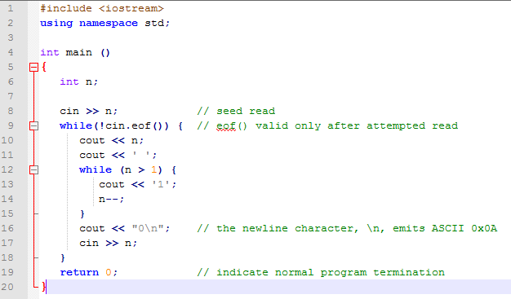
C++ EOF Solution

Slide 18
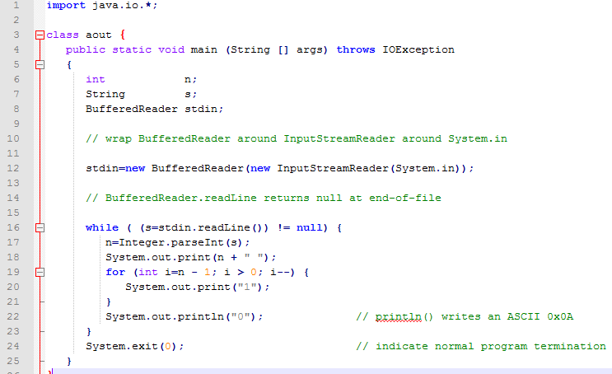
Java EOF Solutions

Slide 19
Standings
http://www.socalcontest.org/history/2013/details-2013.shtml

