Slide 1
Genic vs Non-Genic Fractionation Patterns

Slide 2
Overview of Workflow
C. sabeus 1.1 genome from NCBI
C.sabeus gtf
HSV1 KOS genome from NCBI

Slide 3
Overview of Workflow
trim_galore --phred33 --fastqc -q 30
bowtie2 –q
java -jar /programs/picard-tools-2.19.2/picard.jar MarkDuplicates I=${sample}_sorted.bam REMOVE_SEQUENCING_DUPLICATES=true ASSUME_SORTED=true REMOVE_DUPLICATES=true O=${next}/${sample}_clean.bam M=${next}/${sample}_Picard_metrics.txt

Slide 4
Overview of Workflow
cut -f3 C.sabeus_NCBI.gff | sort | grep -v "##" | uniq -c
awk '$3 == "gene"' C.sabeus_NCBI.gff > C.sabeus_NCBI.gene-filtered.gff
bedtools intersect -a ${sample}_cellular-only.bam -b C.sabeus_NCBI.gene-filtered.gff -wa -bed > ${sample}_ _genic.bed
bedtools intersect -a ${sample}_ _cellular-only.bam -b C.sabeus_NCBI.gene-filtered.gff -wa -v -bed > ${sample}_ _nongenic.bed
cut -f1-3,5 ${sample}_genic.bed > ${sample}_genic.bg
cut -f1-3,5 ${sample}_non-genic.bed > ${sample}_non-genic.bg

Slide 5
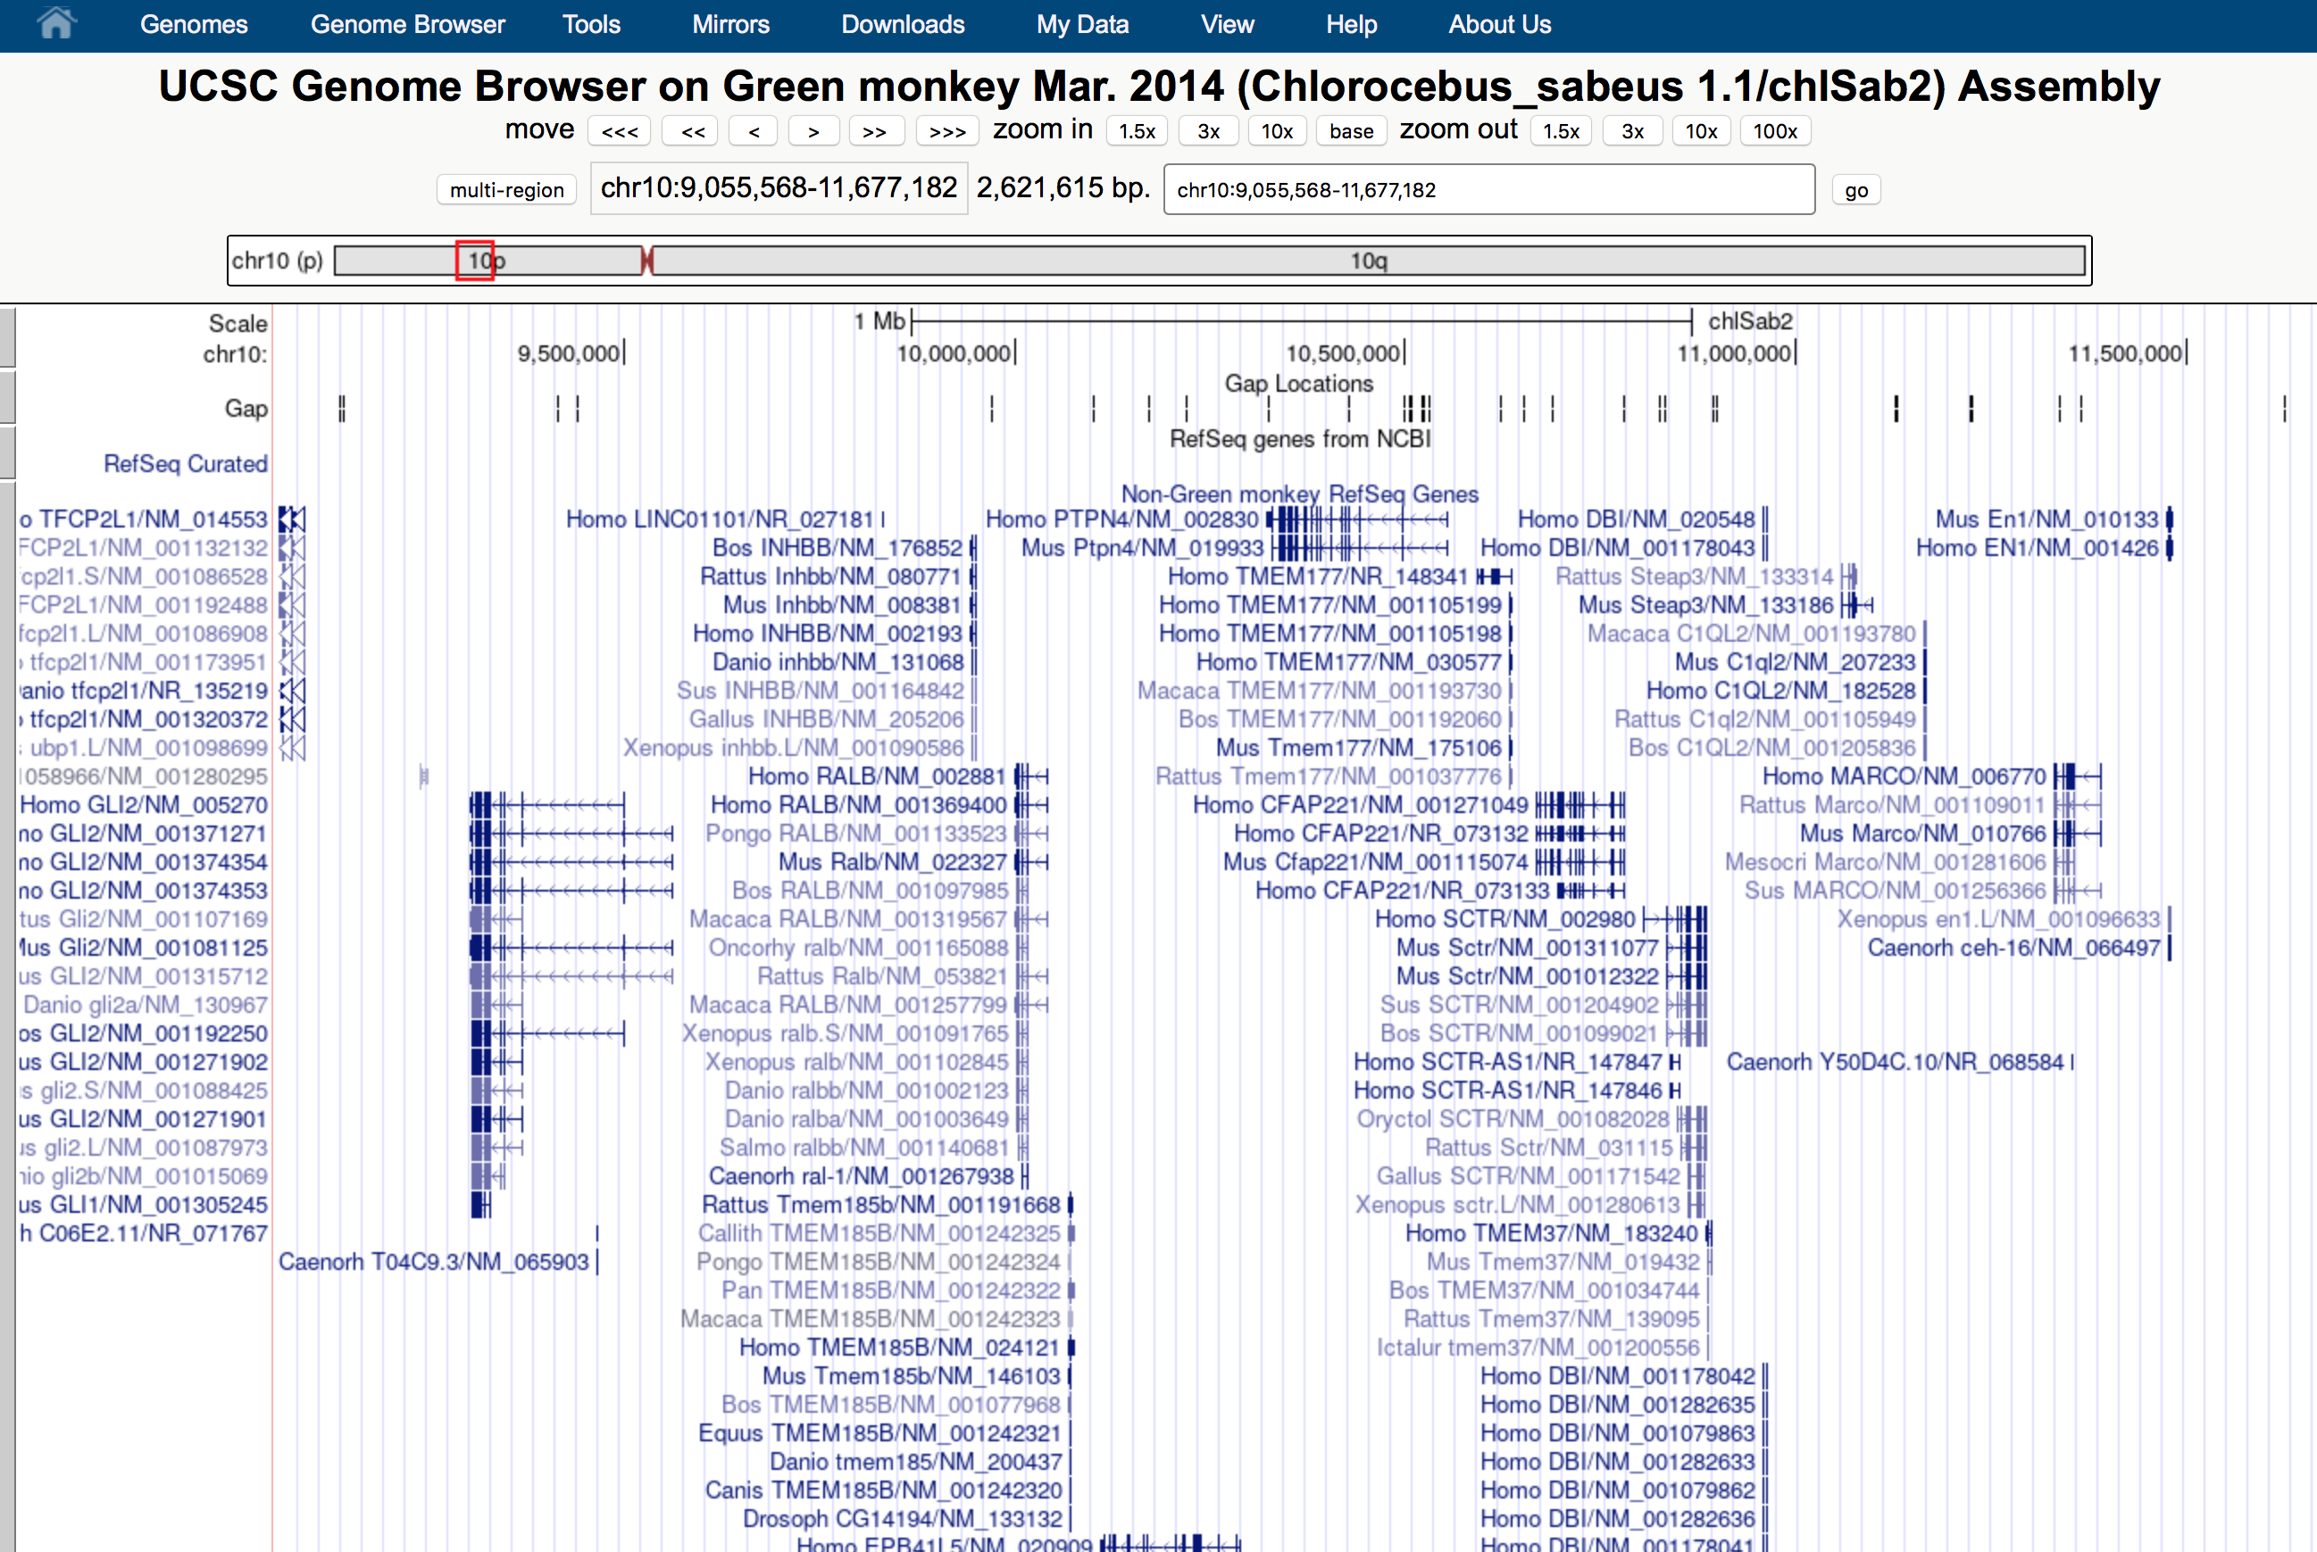

Slide 6
CHX Treatment
7hpi
Rep #1
Genic subset
Fraction 5
Non-genic subset

Slide 7
CHX Treatment
7hpi
Rep #1

Slide 8
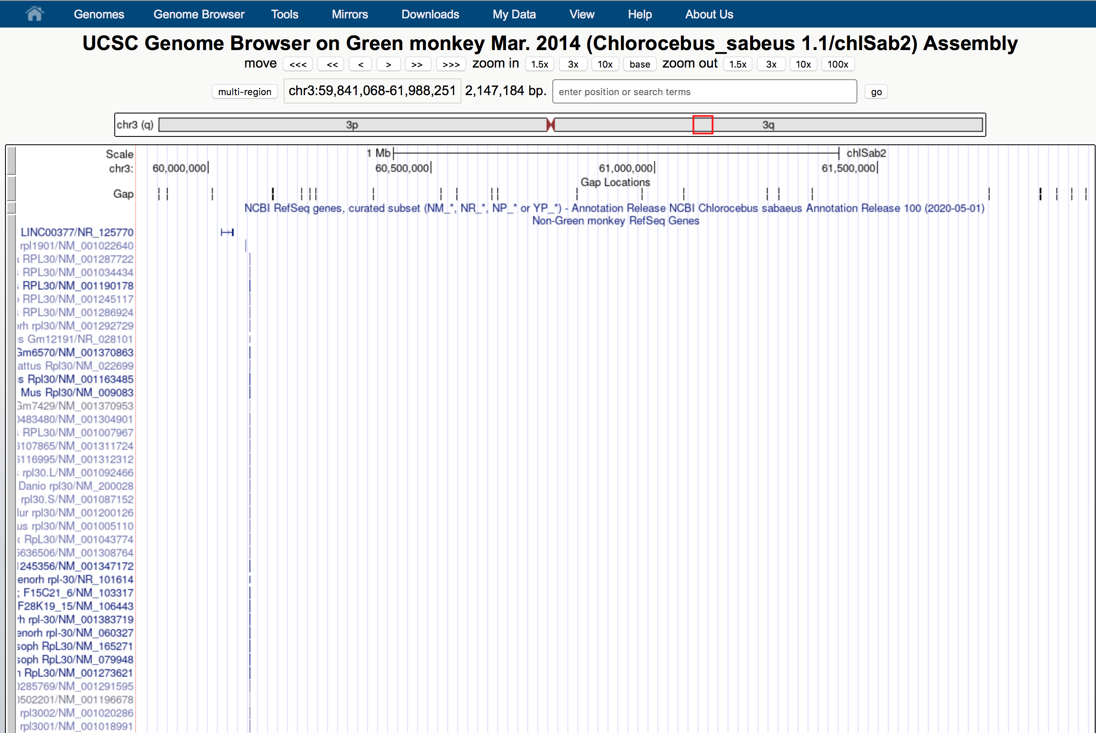

Slide 9
CHX Treatment
7hpi
Rep #1

Slide 10
CHX Treatment
7hpi
Rep #1

Slide 11
Read Count Distributions

Slide 18
Exonic vs Non-Exonic

Slide 32
Genic – Exonic – CDS
not normalized by input

Slide 44
Percentages of Cellular Reads
Normalized against corresponding input values

