Slide 1

Customer Targeting Strategy for Diamond-Blue Trust Ltd
Unlocking Customer Potential from the Dataset
[Analytics Team] – [Fola Oluwatosin]

Slide 2
Agenda
Introduction
Data Exploration
Model Development
Interpretation
Conclusion
Recommendation

Slide 3
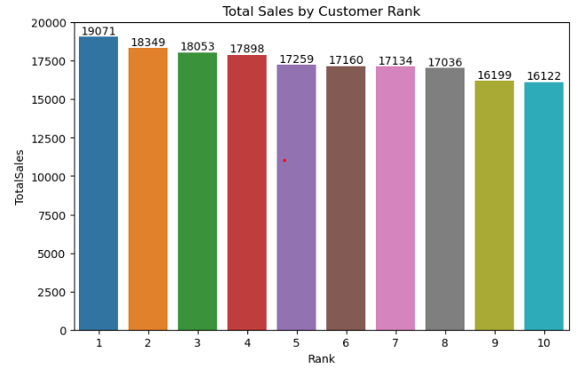
Introduction
Identifying High-Value Customers to Target.
Optimizing resources, enhancing marketing, and driving business growth through data-driven targeting.
Data Exploration: Understand data characteristics and initial insights.
Model Development: Build and refine predictive models.
Interpretation: Analyse model outputs for actionable insights.

Slide 4
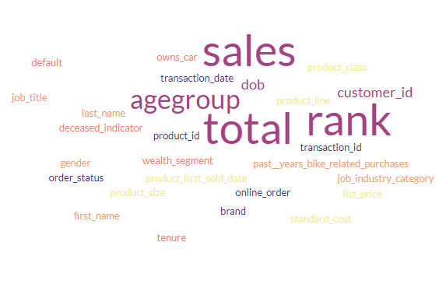
Data Exploration
Key Findings
Goals: Understand data characteristics, identify trends, and uncover potential insights.
Importance: Crucial for informed decision-making; ensures data quality and relevance.
Key Steps: Data cleaning to remove errors, visualization for pattern recognition, and initial insights for hypothesis generation.

Slide 5

Model Development
Objectives: Create predictive models to forecast customer behaviour.
Techniques: Utilize machine learning algorithms (K-Means Clustering, Principal Component Analysis(PCA) for predictive modelling.
Feature Selection: Choose relevant variables such as purchase history, demographics, and customer buying behaviour for modelling.
Feature Engineering: Create new features like customer Age group, Rank (buying behaviour) to improve model performance.

Slide 6
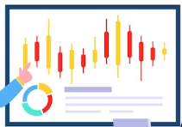
Model Development
Result
Predictive Accuracy: Present model results, of 85% accuracy in classification of customers for tailored marketing solution and retention rate.
Challenges: (Missing Values in Dataset)
We implemented data cleaning techniques to handle missing values and outliers. Additionally, we utilized imputation methods to estimate missing data points, ensuring the accuracy of our customer rankings and retention strategies.

Slide 7

Interpretation
Significance: 85% accuracy in customer clustering is impressive, but it's true value lies in actionable insights. These insights power tailored marketing solutions and retention strategies, enhancing business success
Methods: With K-means clustering on our analysis, distinct customer segments emerged.
Notably, 'purchase history' and ‘customer rank' were the top two influential factors. These insights enable us to distinctly segment customers through their buying behaviour. Optimizing revenue generation.

Slide 8
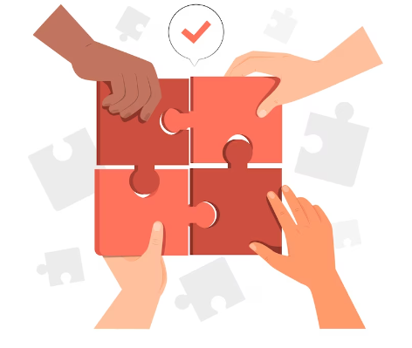
Conclusion
Focused on data-driven strategies in understanding customer behaviour, enhancing marketing efforts, and driving business growth. By accurately clustering customers and leveraging predictive models, we have unlocked actionable insights that can significantly impact the success of our business.

Slide 9

Recommendation
Target Segments: Given the customer demographics, prioritize digital marketing channels to reach the younger audience effectively.
Specific Recommendations: Tailor product/service offerings for each industry sector (financial, manufacturing, health, retail).
Strategies: Focus on localized marketing efforts in New South Wales to maximize impact and engagement.

Slide 10
Question ?
Email: folasadetosin0203@gmail.com
Telephone : 077000000++

Slide 11
Many Thanks

