Slide 1
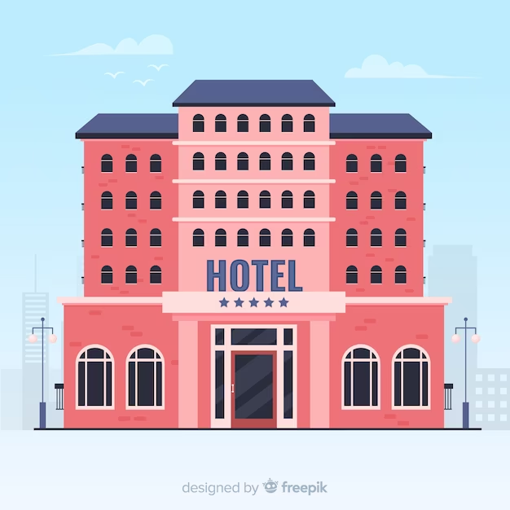
VILLAGOLD HOTEL RESERVATION PERFORMANCE
(Period of 2021 &2022)
Folasade Oluwatosin @ 10Alytics, 30-05-2023

Slide 2
Introduction
VillaGold Hotel promises excellent accommodation, business, and leisure experiences with 64 guestrooms, including 9 spacious suites. The VillaGold Hotel's guestrooms combine modern style with undeniable comfort, with artwork complementing the Asian furnishings. VillaGold’s goal is to provide world class accommodation in a siren environment for our client for all works of life.
Catered for numerous classes of customers in the last two years under review (2021 & 2022) which allows to improve services and core competences.
Highlighted key achievements and patterns of customers interaction with our hotel in the period under review.

Slide 3
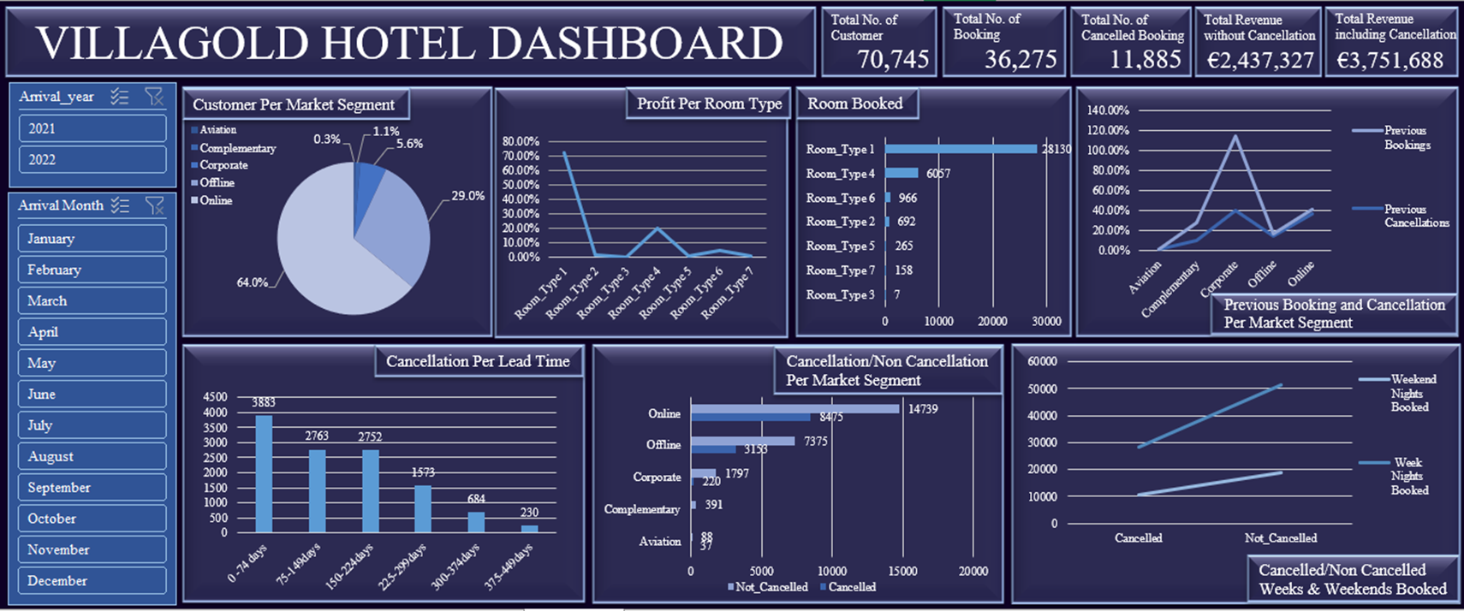
Dashboard

Slide 4
Evaluation
Key evaluations from the review period
Had 70,745 customers with total bookings of 36,275
Most of the Customers made reservation online (64%)
‘Corporate’ leads the means of booking (75.04%) previously
Clients with longer lead time had the least cancellation
‘Room Type 1’ is mostly booked and generates the highest profit (71.92%)
Weekdays are mostly booked than weekends (79,961weekdays - 29,409 weekends)

Slide 5
Recommendation
Implement a Cancellation Management Strategy
Implement policies and incentives to encourage longer stay, as longer reservation had the least cancellation.
  This include offering discounted rate for extended booking and point reward system or provide additional benefit for guest staying for a certain period or repeated guest.
Monitor cancellation trends closely and adjust strategy accordingly to minimize revenue loss due to cancellations.
  Booking cancellation should attract surcharge, fees should depend on the lead time.
Strengthen Booking Channels
Develop personalized marketing campaigns by utilizing customer segmentation insight. Tailor professional messages and offers to different customer segment based on their booking behavior and preferences.
Implement a feedback system after each booking method to discover the customer experience with their means of bookings to enhance booking methods for maximum efficiency.
Improve and maintain online present, booking system, user experience and functionality, since majority of the booking reservation is online.
  Online ads, positive customer reviews on social platforms can be used to improve brand equity and encourage foot traffic to the hotel.
Investigate (survey) for information to further boost bookings by corporate bodies. Booking from Corporate bodies had the highest booking method in the past.
Enhance diversify Room Type Offering
Analyse the demand for other room type and explore opportunity to diversify their offering. This can include new room category or renovating existing rooms to cater to different customer preference and attract a wider range of customer.
Enhance its amenities to increase its appealing further as Room Type 1 is the most booked room.

Slide 6
Thank You

