Slide 1

Group 8
Object-Oriented Programming (OOP) Presentation
University Club Management System
Object-Oriented Analysis, UML Design, and Java Implementation
Student Name | Student ID | Assigned Part
Toukir Ahmed | 251-15-216 | Problem Definition
Md Sadhin Foraji | 251-15-586 | Class Identification, Attributes & Methods
MD. Kaium Hossain Riyad | 251-15-604 | UML Class Diagram
Sadek Ahmed Raj | 251-15-511 | OOP Concepts & Relationships
Md.Saif Uddin Mahmud | 251-15-689 | Java Coding Solution & Conclusion

Slide 2

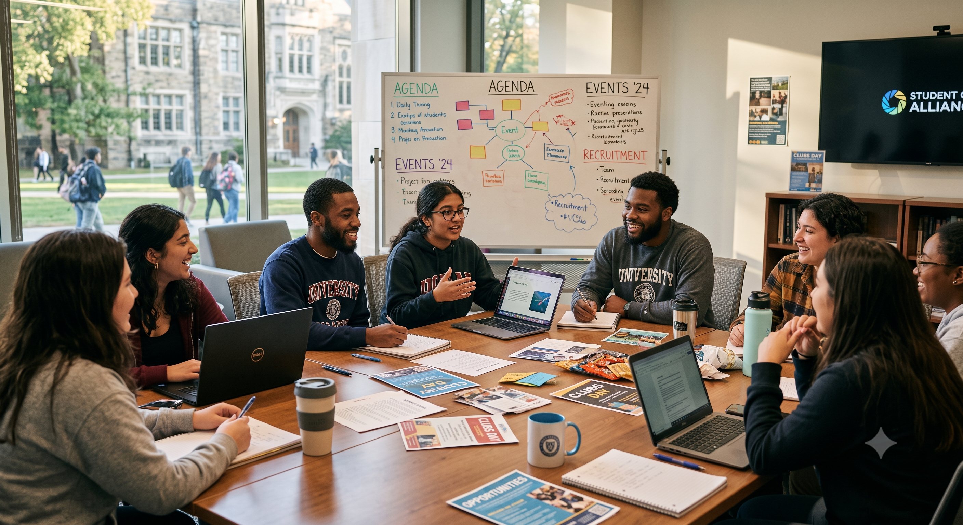

Problem Scenario
Universities have multiple clubs, members, and events to manage and track efficiently.
Our system streamlines student registrations, club details, and event schedules.
Why this is suitable for OOP: Real-world objects like Student and Club have clear attributes and distinct behaviors.
The system accurately records join and leave activities for each specific club.

Slide 3






How to Solve Real-World Problems Using OOP
1. Object Identification
2. UML Architecture
3. Java Implementation
Analyze the real-world scenario to extract distinct entities like Students, Clubs, and Events.
Design a visual blueprint mapping out attributes, methods, and structural connections.
Translate the blueprint into robust code using encapsulation, inheritance, and polymorphism.

Slide 4










Class Identification
Club
Student
Event
Acts as the central entity. It stores the club name, allocated budget, and maintains the list of enrolled members.
Represents the university user interacting with the system. It tracks the student's details and the clubs they have joined.
Manages extracurricular event details including the date, venue, and the specific club hosting the activity.

Slide 5

Attributes and Methods
Class | Attributes | Methods | Responsibility
Club | clubId, name, budget | addMember(), hostEvent() | Manages club information and member lists.
Student | studentId, name, email | joinClub(), registerEvent() | Represents university user and their actions.
Event | eventId, title, date | addParticipant(), displayDetails() | Handles event scheduling and participation.
Executive | designation, accessLevel | approveBudget(), createEvent() | Provides administrative controls for leaders.

Slide 6
System UML Class Diagram
Visualizes the overall object-oriented architecture of the University Club Management System.
Defines precise attributes, constructor methods, and structural access modifiers.
Maps core entities: User (Abstract), Admin, Student, President, Club, Membership, Event, and Notice.
Clearly outlines relationships using Inheritance, Composition, and Association notations.

Slide 7
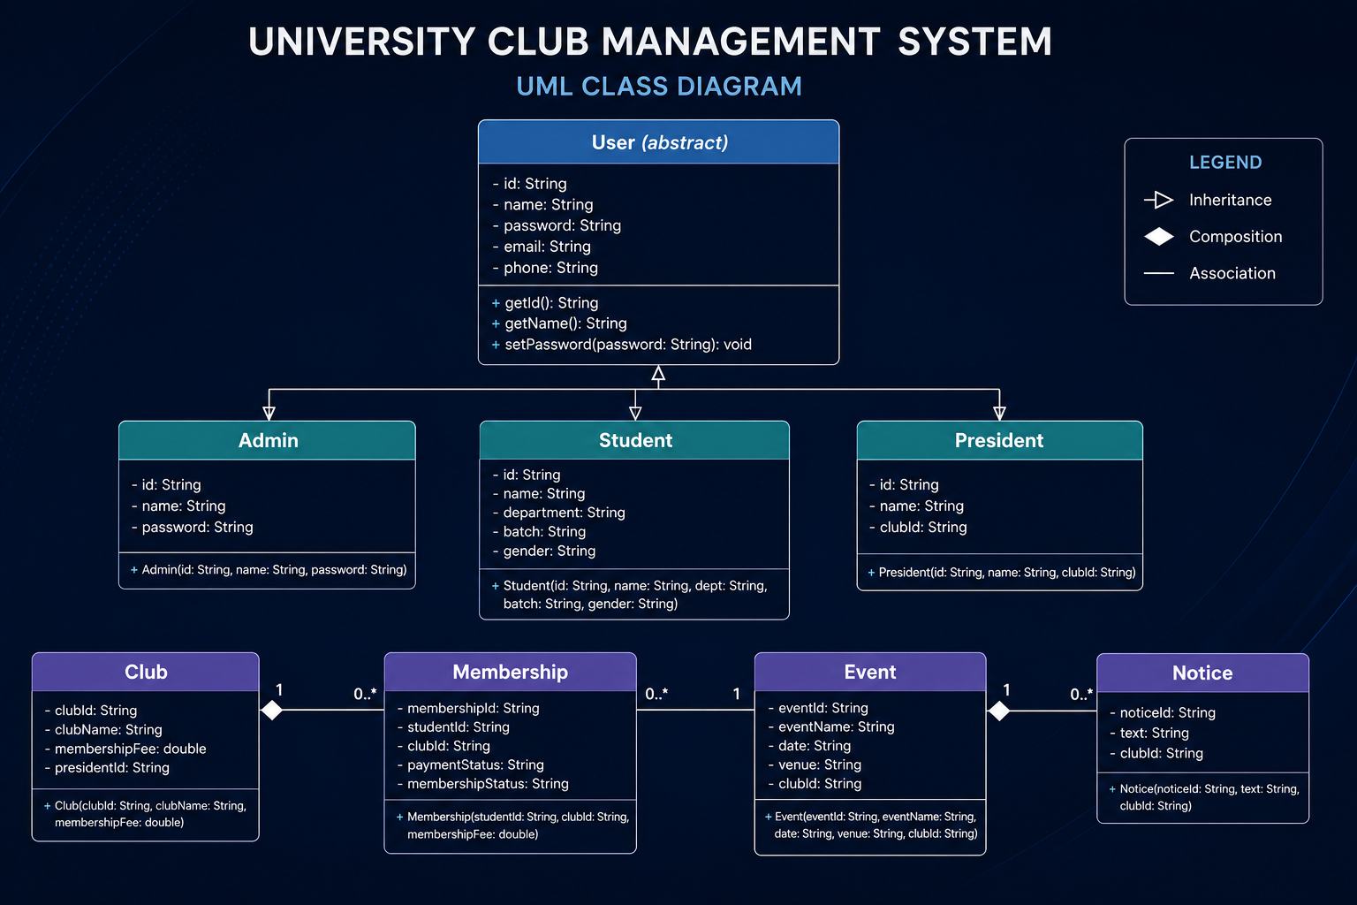


Slide 8







OOP Concepts Used
Encapsulation
Abstraction
Protects data by keeping it privates.
Accessed through public methods.
Uses getter and setter methods.
Student Info, Membership fee
Hides internal implementation.
Shows only required functionality.
Student applies for membership, and the system processes it internally.
Inheritance
Polymorphism
Reuses properties and methods.
Avoids code duplication.
Super Admin, Club President, and Student inherit from the User class.
Same method.
Different behavior.
Login ( ) works differently for each user role.

Slide 9
OOP Relationships Used
🔗 Association | Has-A Relationship
between classes
Two independent classes interact with each other.
Student ↔ Club
A student can join multiple clubs.
🔗 Aggregation | Week Has-A
🔗 Composition | Strong Has-A
One class contains another class.
Both can exist independently.
Club → Event
A club organizes multiple events.
Child object depends on the parent object.
Club → Notice
If the club is deleted, its notices are also deleted.

Slide 10
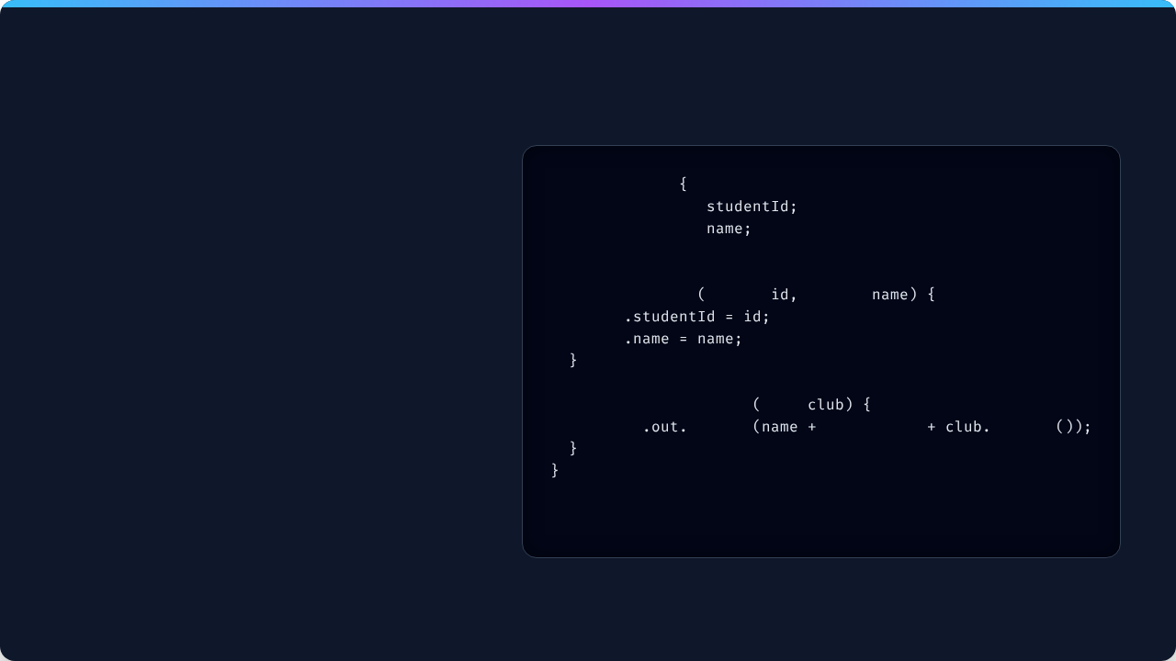
Java Coding Solution (Part 1)
Encapsulation: The studentId and name variables are marked as private.
class
Student
private
String
The Constructor initializes the Student object safely upon creation.
private
String
// Constructor
public
Student
String
String
The joinClub() method enforces business logic securely.
this
this
public void
joinClub
Club
System
println
" joined "
getName

Slide 11

Java Coding Solution (Part 2)
Inheritance: Executive uses the extends keyword to inherit from the Student class.
class
Executive
extends
Student
private
String
Polymorphism: The @Override tag is used to change the behavior of the displayRole() method dynamically.
public
Executive
String
String
String
super
this
This maps directly to our UML architecture.
@Override
public void
displayRole
System
println
"Executive Role: "

Slide 12

Group 8
Closing Summary
We successfully demonstrated how a real-world University Club scenario can be efficiently represented using Object-Oriented classes, UML relationships, and Java code.
Thank You! Questions?

