Slide 1
OSI Pitch Deck for USA Charities
By: Sade Watson (Lead Presenter, Researcher, Reviewer)
IanX.Rios (Researcher and Reviewer)
Isiah Gohagen (Presenter, Researcher, Reviewer)

Slide 2
Purpose of Presentation
The purpose is to educate client: U.S.A Charities, on OSI Model functions.
Benefits of understanding the OSI Model:
Troubleshooting | Helps identify and resolve network issues by understanding which layer a problem occurs in.
Communication | Aids in communicating technical details with IT professionals to better understand network requirements and upgrades. Moreover, seamless communication with other offices/ branches.
Scalability | Opening new offices requires easier integration of new devices and systems.
Security | Knowledge on how security measures can be properly implemented or enhanced on each layer.
Notes:
Efficient Data Exchange: When different systems can work together, data can be exchanged more efficiently. For example, a financial report generated on a Windows computer in the London office can be accessed and edited on a macOS computer in the Sydney office without compatibility problems.

Slide 3
What is the OSI Model?
Application
Presentation
Session
Network
Data Link
Physical
Transport
Layer 7
Layer 6
Open System Interconnection
A model that explains the network communication between computer systems.
Broken into seven different layers
Layer 5
Layer 4
Layer 3
Layer 2
Layer 1

Slide 4
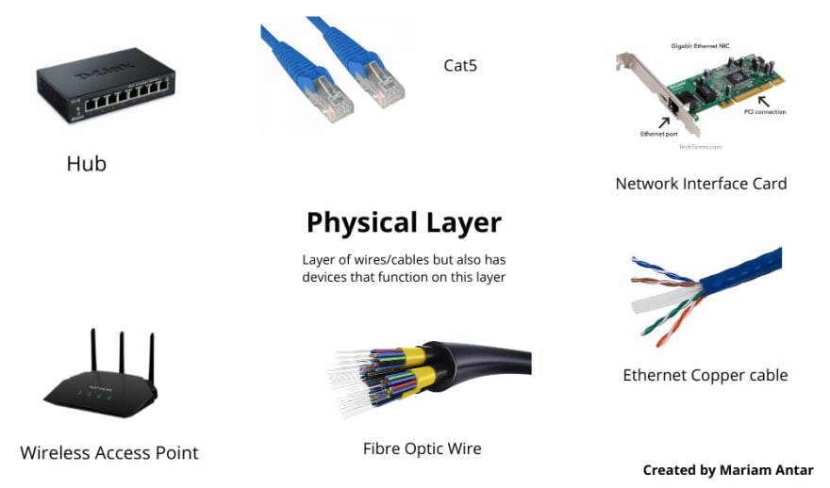
Layer 1: Physical
Responsible for the transmission and reception of raw data between a device and a physical medium​
The physical layer is the lowest layer in the OSI model and is made up of both software and hardware.​
The Protocol Data Unit or (PDU) is bits which are transmitted over the specific network topology
Application
Presentation
Session
Network
Data Link
Physical
Transport
Security measures: Surveillance, Access Control, Tamper-Proofing
Notes:
A NIC is a hardware device that enables a computer to connect to a network.
transmitted over a network cable or wireless medium

Slide 5
Layer 2: Data Link
Security Measures:
A protocol layer that moves data between nodes on a network segment.
Involves: Wi-Fi and ethernet
PDU: Frames
Divided into 2 segments LLC (Logical Link Control) and MAC (Media Access Control)
LLC focuses on managing logical connections and data flow, while MAC deals with the physical aspects of data transmission
The data link layer formats and organizes data into frames before sending it to the Network Layer
Application
Presentation
Session
Network
Data Link
Physical
Transport
MAC address filtering and port security
Notes:
Port security: Port security restricts the number of MAC addresses that can be learned on a single switch port. This prevents unauthorized devices from accessing the network by limiting access to specific, known devices.
MAC address filtering: This method allows you to configure switches to allow or deny network access based on a device's MAC address. By maintaining a list of allowed MAC addresses, you can prevent unauthorized devices from accessing the network.
Dmz - isolated network segment that acts as a neutral zone between an organizations private network
Function: The MAC layer handles interfacing with the physical layer, while the LLC layer manages flow and error control.
Addressing: The MAC sublayer uses physical addresses (MAC addresses) to identify devices, while the LLC sublayer uses logical addresses to identify communication between different network layer protocols.

Slide 6
Layer 3: Network
Security Measures:
Encapsulates frames from layer 2 into packets
PDU: Packets
Responsible for routing and forward packets delivery called datagrams, which can be sent more easily over the network.
Assigns unique IP addresses to devices
Application
Presentation
Session
Network
Data Link
Physical
Transport
Securing routers and disabling unnecessary services
Notes:
enabling communication between different networks by managing logical addressing, routing, and packet forwarding
Routing: Layer 3 determines the most efficient path for data transmission between networks

Slide 7
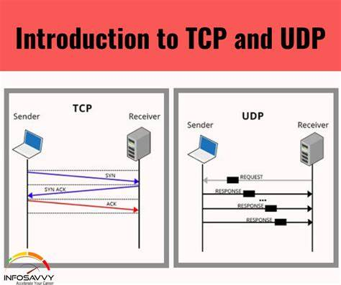
Layer 4: Transport
Receives data from layer 3 and forms segments
Responsible for providing reliable end-to-end data delivery between applications running on different devices.
Uses TCP and UDP. Ensures reliability through checksums and acknowledgements.
Its PDU are segments.
Supports higher level session management tasks done on next layer
Application
Presentation
Session
Network
Data Link
Physical
Transport
Security measures: Monitor network traffic by using IDS/IPS
Notes:
The Transport Layer provides the foundation for the Session Layer to establish, maintain, and terminate communication sessions between applications.
reliable data delivery and flow control mechanisms help ensure that data is transmitted efficiently and without error

Slide 8
Layer 5: Session
Primary function is to establish, terminate and manage communication sessions between applications.
Session establishment involves setting up a connection between two devices (simplex, half duplex, or full duplex)
Session Maintenace involves dialogue control, token management, and synchronization.
Session Termination which occurs when transfer is complete or if an error occurs. Two types of termination: Graceful and Abnormal
Security Measures: Regular updates and Patch Management
Application
Presentation
Session
Network
Data Link
Physical
Transport
Notes:
Dialogue Control: It controls the flow of data between the devices. If it's a half-duplex system (data can only flow in one direction at a time), the Session Layer keeps track of whose turn it is to communicate.
Session Layer uses tokens to prevent simultaneous attempts to change the data, which could cause conflicts. Only the device with the token can make changes, and the Session Layer ensures the token is passed on correctly.
Graceful Termination: In normal circumstances, one device sends a termination request, and the other sends an acknowledgement. The Session Layer ensures all remaining data segments are transmitted before closing the connection.
Abnormal Termination: If an error occurs or the connection is lost unexpectedly, the Session Layer attempts to recover any lost data, and if unsuccessful, terminates the session and notifies the devices involved.
TLS (Transport Layer Security) and SSL (Secure Sockets Layer) are cryptographic protocols that provide secure communication over a network. However, these protocols operate at Layer 5 (Session Layer)

Slide 9
Layer 6: Presentation
Security Measures:
This layer is responsible for translating data from application layer for the network to understand. The following also occurs at this layer:
Data formatting and translation so that the data is recognizable by both the sender and receiver. (FTP servers use ASCII or Unicode for file transfers)
Data Compression and Decompression to reduce transmission time and to optimize bandwidth. (Uses JPEG, PNG, GIF for image compression)
Providing security services such as encryption and decryption. (Web servers use SSL, TLS for secure transmission)
Application
Presentation
Session
Network
Data Link
Physical
Transport
Encryption algorithms: AES & RSA
Notes:
The Application Layer interacts with the Presentation Layer (Layer 6) by providing data for formatting, compression, or encryption before transmission. This helps to ensure that data is presented in a suitable format for the receiving application.
They operate at the Session Layer by establishing a secure connection between two devices, and at the Transport Layer by encrypting data and providing secure transmission over the network.
ES (Advanced Encryption Standard) and RSA (Rivest-Shamir-Adleman).

Slide 10
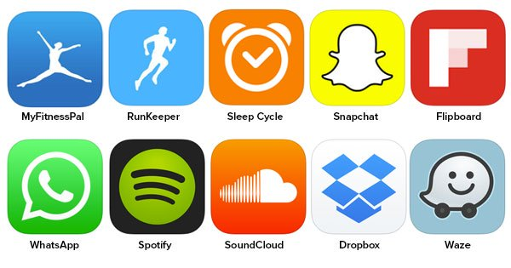
Layer 7: Application
Layer responsible for providing services and protocols that allow software applications to interact with the network.
Offers network services like file transfer, email, and web browsing.
Enables applications to communicate with each other through protocols such as HTTP, FTP, SMTP, & DNS
Security Measures: HTTPS & SSH- usage of these secure protocols
Application
Presentation
Session
Network
Data Link
Physical
Transport
Notes:
The Application Layer interacts with the Presentation Layer (Layer 6) by providing data for formatting, compression, or encryption before transmission. This helps to ensure that data is presented in a suitable format for the receiving application.
Application Layer is not the application itself, but rather the interface between the application and the network. It facilitates the exchange of data between applications and ensures that the network can provide the necessary resources to support those applications.

Slide 11


Q & A

Slide 12
Sources
What Is OSI Model? - Realpars.” RSS, www.realpars.com/blog/osi. Accessed 20 Aug. 2024. ​
Tucker, Chloe. “The OSI Model – the 7 Layers of Networking Explained in Plain English.” freeCodeCamp.Org, 17 Nov. 2021, www.freecodecamp.org/news/osi-model-networking-layers-explained-in-plain-english/. Accessed 20 Aug. 2024.​
“How the OSI Model Works on YouTube (Application and Transport Layers) // FREE CCNA // EP 5.” YouTube, YouTube, www.youtube.com/watch?v=oIRkXulqJA4. Accessed 20 Aug. 2024. ​
Wallace, K. (2020, August 14). OSI Model Deep Dive. YouTube. https://youtu.be/oVVlMqsLdro?si=Ozg_znMeoJLjed45 ​
GeeksforGeeks. (2024, March 12). Network Layer in OSI Model. GeeksforGeeks. https://www.geeksforgeeks.org/open-systems-interconnection-model-osi/#network-layer-layer-3​
GeeksforGeeks. (2022, April 29). Protocol Data Unit (PDU). Protocol Data Unit (PDU) - GeeksforGeeks
https://www.england.nhs.uk/long-read/case-study-network-failure/

