Slide 1
FEASIBILITY PRESENTATION
Smart Agriculture System
GROUP 05

Slide 2
Our Team
22/ENG/051 H.K.V.Methsandi
22/ENG/057 H.S.Hettiarachchi
22/ENG/131 R.B.U.S.S. Rathnayake

Slide 3
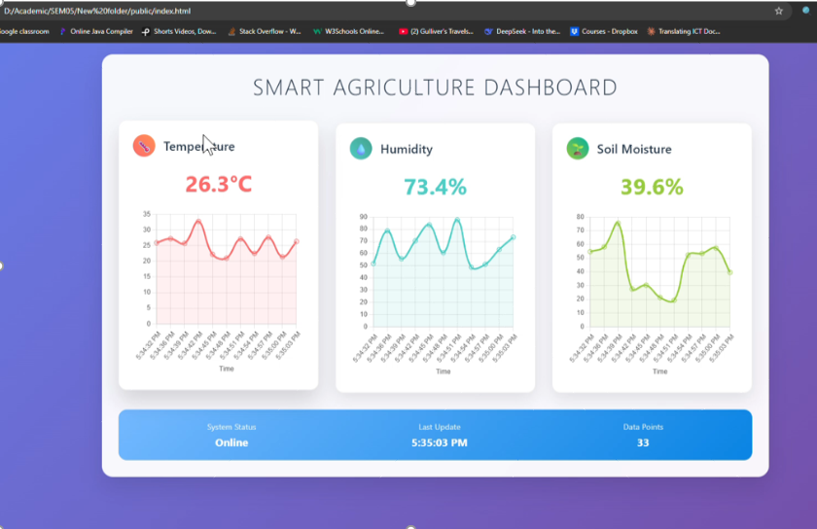
Current work done by Team members
Prototype

Slide 4
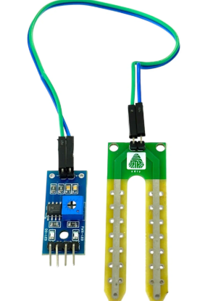
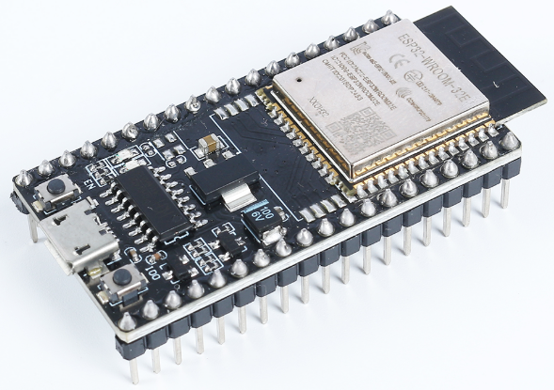
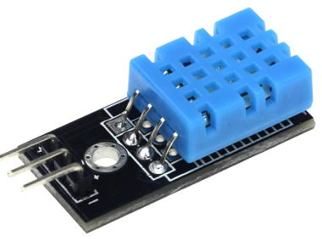
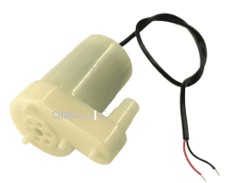
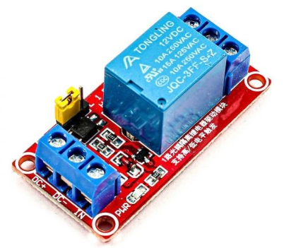
Hardware requirements

Slide 5
Hardware Requirements
ESP32 Board -: reads sensors, controls the pump, and sends data to the web dashboard via Wi-Fi.
Soil Moisture Sensor: Measures soil wetness/dryness to trigger automatic watering.
DHT11/DHT22 Sensor: Monitors ambient temperature and humidity for climate awareness.
Relay Module: Switches the water pump on/off (controlled by the ESP32).
Water Pump (DC 3V-6V): Delivers water to plants when activated by the relay.
Power Supply: Provides power to the ESP32 (USB) and pump (external battery).
Breadboard, Diodes, Resistors, Jumper wires

Slide 6
Software Requirements
Web Dashboard
Frontend-: HTML, CSS, JavaScript, React
Backend-: Node.js
Database: MySQL + Firebase Real time database
Micro Controller programming
DHT sensor library
Adafruit Unified Sensor
Firebase ESP32 by Mobizt

Slide 7
FINANCIAL FEASIBILITY
Budget
Description | Cost(LKR)
ESP32 Dev board | 1400.00
DHT11 sensor | 550.00
Soil Moisture sensor | 350.00
Relay module | 300.00
Water pump(3V-6V) | 500.00
Diodes, resistors | 50.00
Breadboard | 600.00
Jumper wire | 250.00
Total | 4000.00

Slide 8
Alternative/Backup plan
Continue Smart Agriculture System prototype without Firebase or ESP32.
Arduino Uno : Micro controller
DHT22 – Temperature & humidity sensor
Soil Moisture Sensor – To detect dry/wet soil
Relay Module + Water Pump – For automatic irrigation
LCD Display (16x2) – To show real-time values locally

Slide 9
THANK YOU

