Slide 1
PROJECT 24 · ADVANCED · PYTHON · FLASK · MYSQL · PANDAS · NUMPY · MATPLOTLIB
F l o w
Supply chain optimization & inventory forecasting — a decision-support system for the rhythm of demand, supply and stock.
S. Prabhath
THE SYSTEM NEVER PLACES AN ORDER

Slide 2
THE PROBLEM
PROJECT 24 · FLOW
Why spreadsheets fail as a replenishment system.
01
02
03
04
Typed once, never recalculated
Remembered, not measured
No audit trail
The cost
Reorder points are typed once — demand moves, the minimum level does not.
Supplier reliability is anecdotal. Variability, not the average, forces safety stock.
Six weeks later nobody can explain why 300 units were ordered.
Stockouts of items that matter, cash frozen in items that do not.
Supply chain optimization & inventory forecasting · decision support only
02

Slide 3
OBJECTIVES → DELIVERY
PROJECT 24 · FLOW
Each objective maps to code and a test.
OBJECTIVE
DELIVERED AS
Model the supply chain
MySQL: 6 tables, 2 views, PK / FK / CHECK / indexes
Serve data safely
Flask REST API: CRUD + validation + JSON error envelope
Measure suppliers
On-time rate, fill rate, lead-time CV, score, grade
Estimate reorder points
ROP = μ·L + SS, three configurable safety-stock policies
Compare with a forecast
4 models vs naive baseline, 28-day hold-out
Flag risk
STOCKOUT / AT_RISK / EXCESS thresholds + value at stake
Report
Markdown report, 9 CSV tables, Excel workbook, 10 charts
Prove correctness
199 pytest tests incl. DB-down and empty data
Supply chain optimization & inventory forecasting · decision support only
03

Slide 4
ARCHITECTURE
PROJECT 24 · FLOW
Layers with one job each.
config.py
every parameter and credential from environment variables (.env)
db.py
pooled connections, parameterised SQL, explicit transactions, driver errors mapped to API errors
api/
application factory, CRUD + analytics blueprints, validators, uniform error envelope
analytics/
pure formula module + pandas modules (demand, supplier, inventory, forecast) + pipeline
viz/
Matplotlib charts, each returning its own written interpretation
scripts/
data generator, SQL loader, analysis pipeline, document builder
Supply chain optimization & inventory forecasting · decision support only
04

Slide 5
DATABASE DESIGN
PROJECT 24 · FLOW
Keys, constraints, indexes, views.
MySQL 8 / MariaDB — plus audit tables
TABLE
KEY COLUMNS
PURPOSE
suppliers
supplier_id PK · name UNIQUE
vendor master, promised lead time
products
product_id PK · sku UNIQUE · supplier_id FK
item master, cost, manual ROP
purchase_orders
po_id PK · po_number UNIQUE · 2 FKs
order / expected / received dates
stock_transactions
transaction_id PK · product_id FK
signed perpetual ledger
demand_records
PK · (product_id, demand_date) UNIQUE
daily demand
analysis_runs / reorder_recommendations
FKs to run and product
audit trail of recommendations
on_hand is never stored — it is SUM(quantity) of the ledger, so stock can always be reconciled. Deleting a parent row with children is refused (409).
Supply chain optimization & inventory forecasting · decision support only
05

Slide 6
REST API
PROJECT 24 · FLOW
Validation before SQL. One error envelope.
No write path from analytics.
ENDPOINT
WHAT IT DEMONSTRATES
GET /api/health
service + database health, degrades to 503
POST /api/purchase-orders
date and quantity rules, FK checks, 422 details
POST /api/purchase-orders/{id}/receive
PO and ledger updated in one transaction
GET /api/analytics/reorder-recommendations
ROP, safety stock, flags, quantities
GET /api/analytics/suppliers
on-time, fill rate, lead-time CV, grade
GET /api/analytics/risks
shortage and excess lists with INR value
GET /api/analytics/forecast
forecast + hold-out metrics vs baseline
POST /api/analytics/run
stores an audit snapshot — places no orders
Supply chain optimization & inventory forecasting · decision support only
06

Slide 7
FORMULAS AND UNITS
PROJECT 24 · FLOW
Documented once, unit tested, reused everywhere.
μ_d = demand / calendar days [units/day]
σ_d = std dev of daily demand [units/day]
L = observed lead time (≥3 deliveries) else master [days]
SS = max( z(service)·σ_d·√L , days·μ_d ) [units]
ROP = μ_d·L + SS [units]
IP = on_hand + open PO quantity [units]
Q = max(0, ROP + μ_d·review − IP) [units]
DoC = on_hand / μ_d [days]
MASE < 1 ⇒ better than the naive baseline
DEFAULT POLICY
0.95 service level
90 day demand window
7 day review period
90 days cover = excess
Supply chain optimization & inventory forecasting · decision support only
07

Slide 8
RESULTS AT A GLANCE · AS OF 19 OCTOBER 2026
PROJECT 24 · FLOW
The portfolio, at a glance.
24
2
1
4
SKUS ANALYSED
STOCKOUT RISK
AT / BELOW ROP
EXCESS STOCK
71.5
4.8
6.06
13/24
INVENTORY ON HAND · LAKH ₹
SUGGESTED ORDERS · LAKH ₹ (NOT PLACED)
FORECAST MAE · BASELINE 7.90
SKUS BEATING BASELINE
Decision support: the suggested orders are calculations for a planner to review — nothing is ordered.
Supply chain optimization & inventory forecasting · decision support only
08

Slide 9
SHORTAGE AND EXCESS FLAGS
PROJECT 24 · FLOW
Rule-based, threshold-driven, configurable.
SKU
FLAG
ON HAND
ROP
SUGGEST QTY
VALUE (INR)
ELEC-HAR-1120
STOCKOUT
41
90
69
234,600
ELEC-MOD-1150
STOCKOUT
0
68
27
167,400
ELEC-SEN-1008
AT_RISK
114
128
46
75,900
DRV-CLP-2020
EXCESS
263
57
0
0
CON-GRS-4004
EXCESS
2,350
210
0
0
AUTO-CAB-0099
EXCESS
449
0
0
0
ELEC-MOD-1160
EXCESS
149
33
0
0
STOCKOUT — out of stock, or position cannot cover lead-time demand.
AT_RISK — below the reorder point but lead-time demand is covered.
EXCESS — above policy with more than the cover threshold.
Supply chain optimization & inventory forecasting · decision support only
09

Slide 10
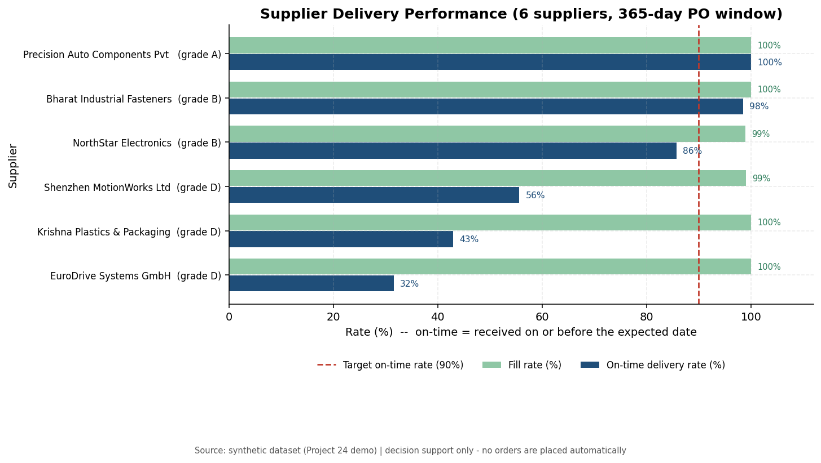
SUPPLIER PERFORMANCE
PROJECT 24 · FLOW
Punctuality and consistency, measured.
Best: Precision Auto Components Pvt Ltd — 100.0% on time, CV 0.12, grade A.
Weakest: Krishna Plastics & Packaging — 42.9% on time, CV 0.33, grade D.
The score weights consistency (1 − CV) because variability drives safety stock.
Open orders are excluded from lead-time statistics.
Supply chain optimization & inventory forecasting · decision support only
10

Slide 11
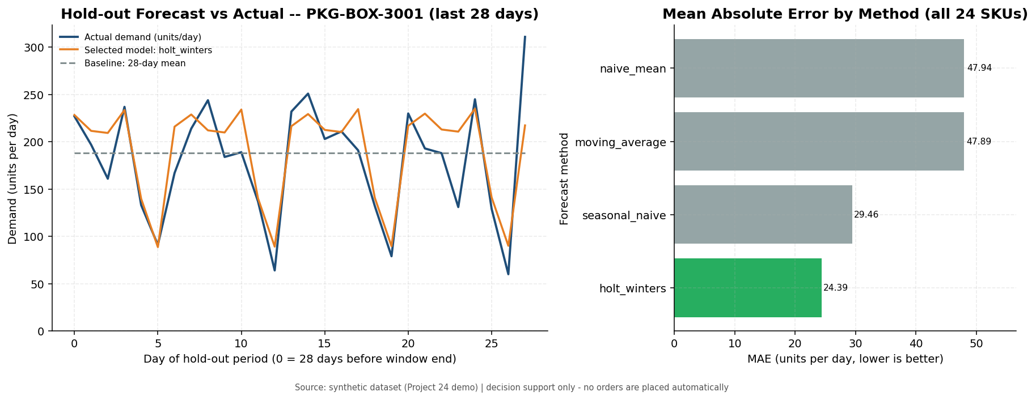
FORECASTING AGAINST A BASELINE
PROJECT 24 · FLOW
Four methods, one winner per SKU.
28-day hold-out; the naive mean is the bar to beat.
10.5%
MEAN MAE IMPROVEMENT
13 of 24
SKUS BEAT THE BASELINE
MAE 7.90 → 6.06 units/day. A model is adopted only if it wins by more than 5%.
Supply chain optimization & inventory forecasting · decision support only
11

Slide 12
TESTING
PROJECT 24 · FLOW
199 tests, five groups, real failure injection.
GROUP
TESTS
FOCUS
$ python -m pytest tests
199 passed in 55.89s
$ DB_PORT=65001 python -m pytest tests
113 passed, 85 skipped in 1.45s
Formulas
42
hand calculations, invalid inputs, boundaries
Validators
38
types, ranges, dates, cross-field rules
Analysis
33
zero-fill, ABC, reorder engine, turnover, forecast
CRUD API
45
contracts, duplicates, FKs, receipts, conflicts
Analytics API
41
parameters, empty data, DB-down, no-orders guarantee
Integration tests skip with a reason when MySQL is unreachable.
Tests never modify seeded data — they create and delete their own rows.
One test asserts the analysis creates no purchase order.
Supply chain optimization & inventory forecasting · decision support only
12

Slide 13
LIMITATIONS AND NEXT STEPS
PROJECT 24 · FLOW
Stated up front, not discovered in Q&A.
01
Safety stock ignores lead-time variability → add σ_L: SS = z·√(L·σ_d² + μ_d²·σ_L²).
02
Suggested quantity ignores MOQ, pack size and budget.
03
Open POs are trusted — a stalled order understates risk.
04
Single hold-out period → rolling-origin backtest.
05
Single warehouse, one supplier per SKU, single-line POs.
06
No authentication; in-process cache assumes a small portfolio.
07
Synthetic data: the method is demonstrated, not a business outcome.
Supply chain optimization & inventory forecasting · decision support only
13

Slide 14
WHAT THE PLANNER GETS
PROJECT 24 · FLOW
Which SKUs need action today, how much to order, and why.
Which suppliers cause the risk, and how reliable they really are.
Where cash is frozen in stock that is not moving.
A forecast tested on data it never saw — and the baseline it must beat.
An audit trail of every parameter used — and no order placed without a human.
Thank you — questions welcome.
S. Prabhath · Supply chain optimization & inventory forecasting
14

