Slide 1

Serverless Web Application in AWS
By
Sadhana Sahu Sandhya Ammasi Sindhura Gundubogula

Slide 2

what is serverless web application?
Serverless refers to an application framework for building web applications without going into the detailing of servers.
The servers are managed by cloud provider, taking care of its provisioning and allocation.

Slide 3
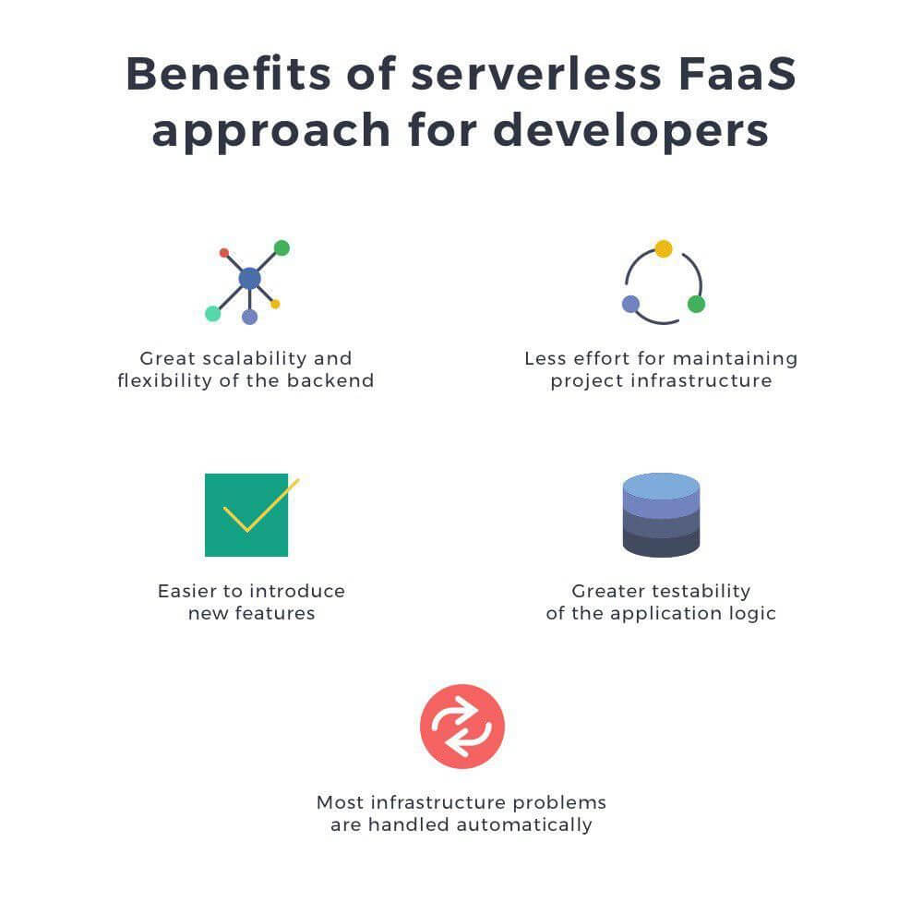
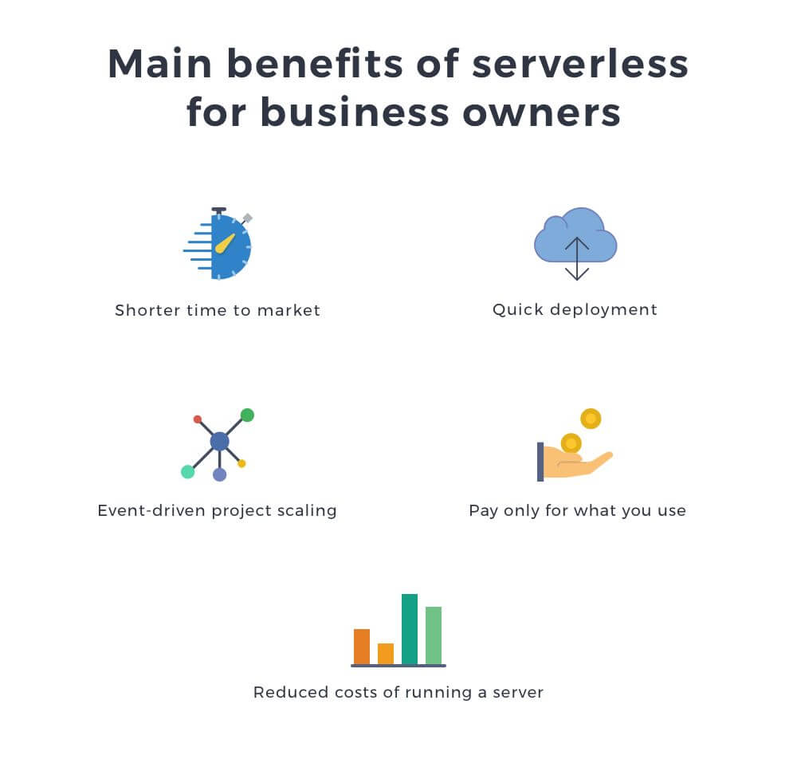
Advantages of serverless web application

Slide 4
Near By Explore Web Application
What is it?
‘Near By Explore’ is a web application which lets you explore , review and post questions about near by attractions & places in real time.
What does it do?
‘Near By Explore’ lets you login with gmail id or authenticator id.
It will fetch your location and lets you explore near by places.
You can post questions regarding any place
You can give reviews & ratings of the places you have visited.

Slide 5
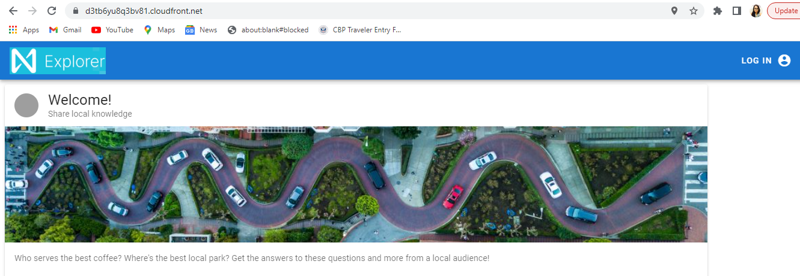
Application SS

Slide 6
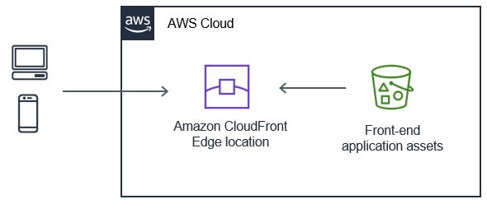
Frontend Architecture

Slide 7
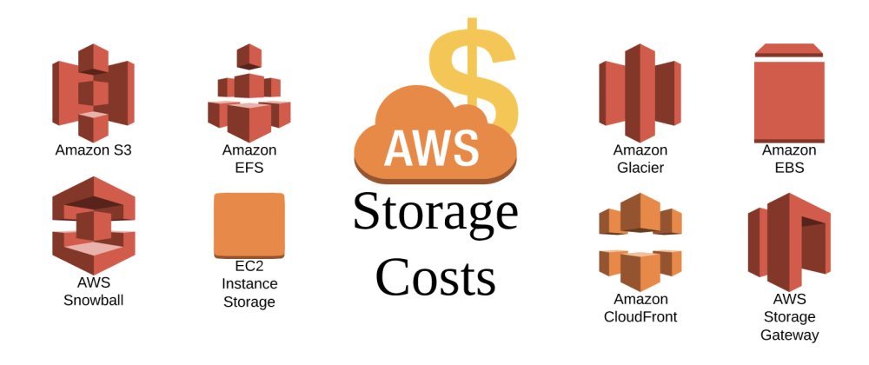
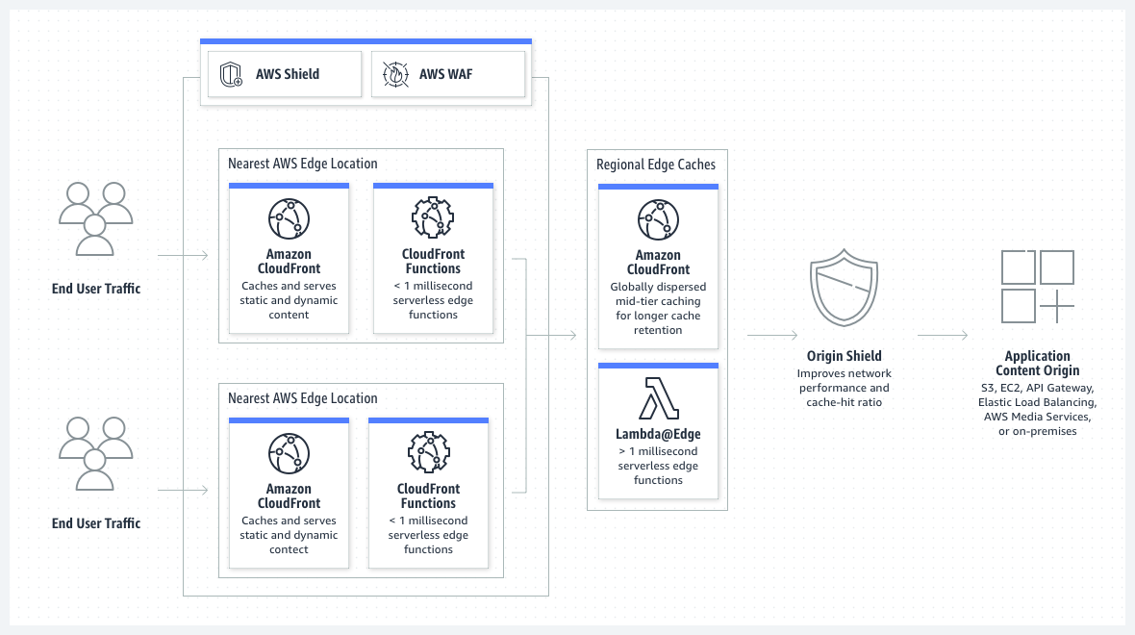
A content delivery network (CDN) service built for high performance, security, and developer convenience.

Slide 8
Amazon Simple Storage Service (Amazon S3) is an object storage service that offers industry-leading scalability, data availability, security, and performance.
customers of all sizes and industries can use it to store and protect any amount of data for a range of use cases, such as data lakes, websites, cloud-native applications, backups, archive, machine learning, and analytics.

Slide 9
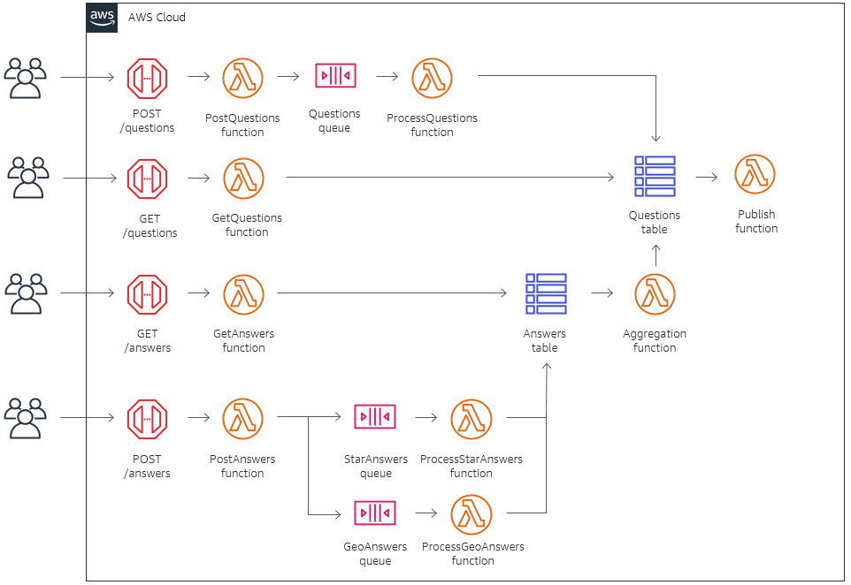
Backend Architecture

Slide 10
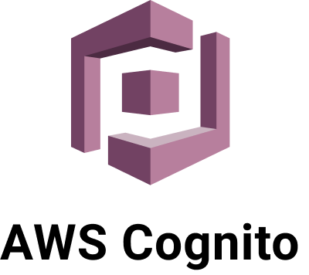



a user authentication service that lets you add access control to your web and mobile apps.
An identity store for all your apps and users
Built-in customizable UI to sign in users
Advanced security features to protect your users

Slide 11
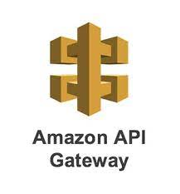
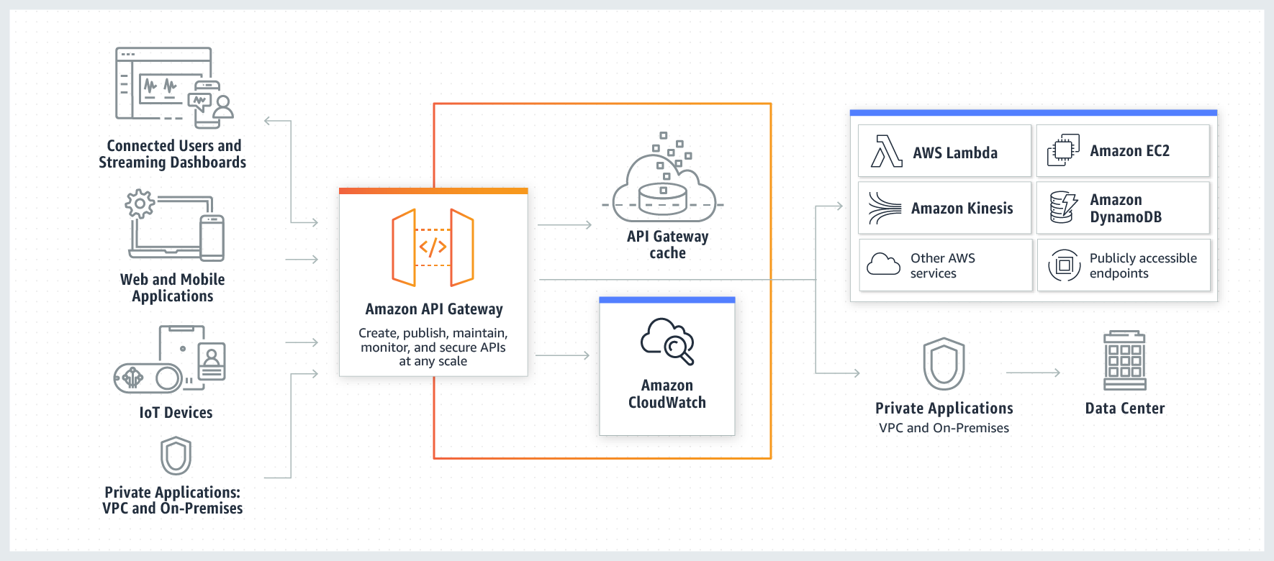
an AWS service for creating, publishing, maintaining, monitoring, and securing REST, HTTP, and WebSocket APIs at any scale.

Slide 12
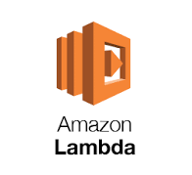
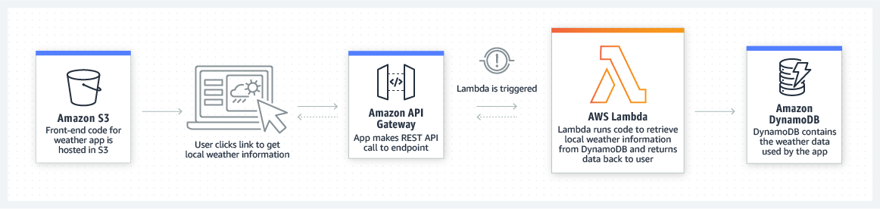
a serverless compute service that runs your code in response to events and automatically manages the underlying compute resources for you

Slide 13
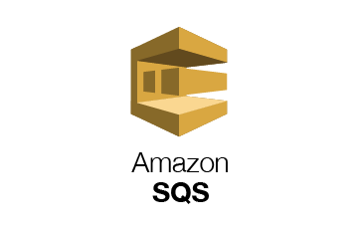
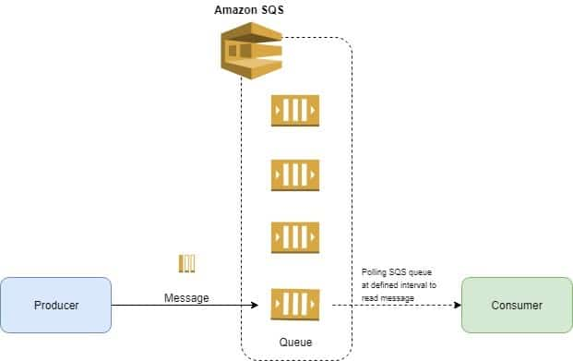
Amazon Simple Queue Service (SQS) is a fully managed message queuing service that enables you to decouple and scale microservices, distributed systems, and serverless applications
13

Slide 14
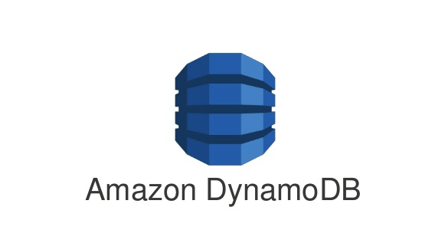
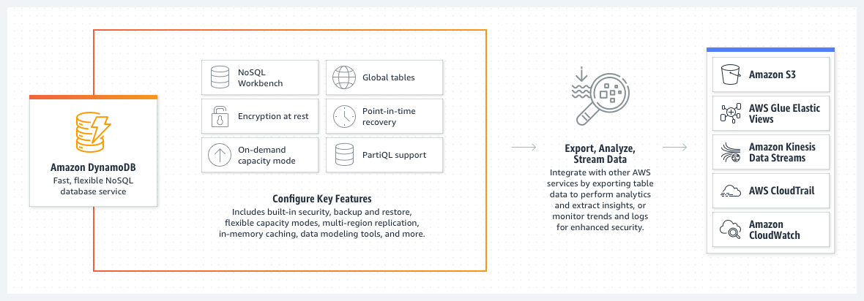
a fully managed, serverless, key-value NoSQL database designed to run high-performance applications at any scale.

Slide 15
Experimental Results

Slide 16
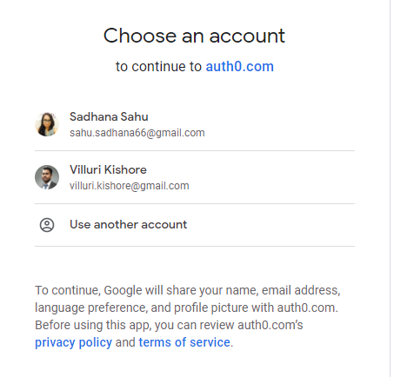
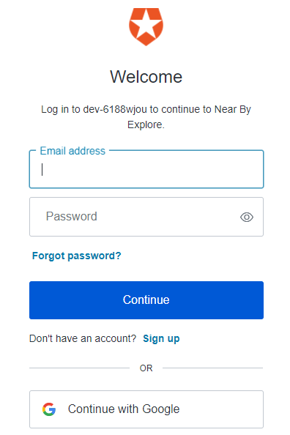

Slide 17
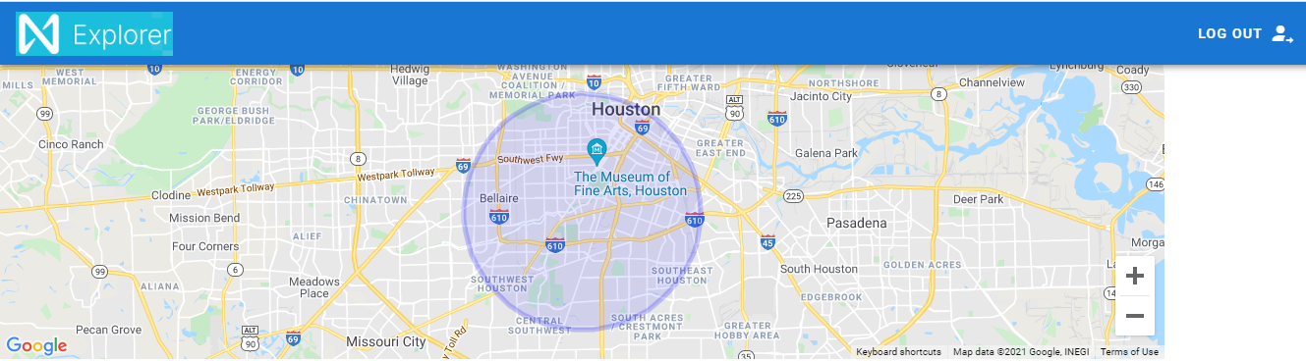
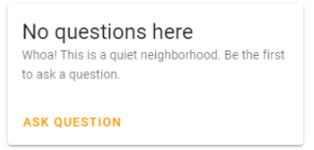

Slide 18
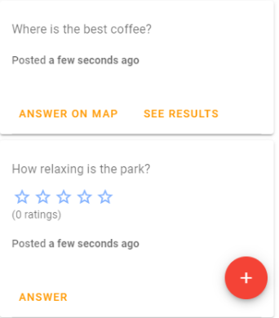
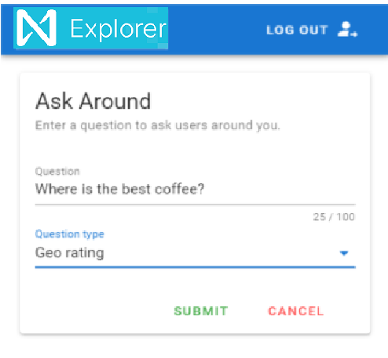

Slide 19
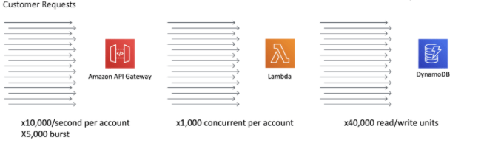
Scalability

Slide 20
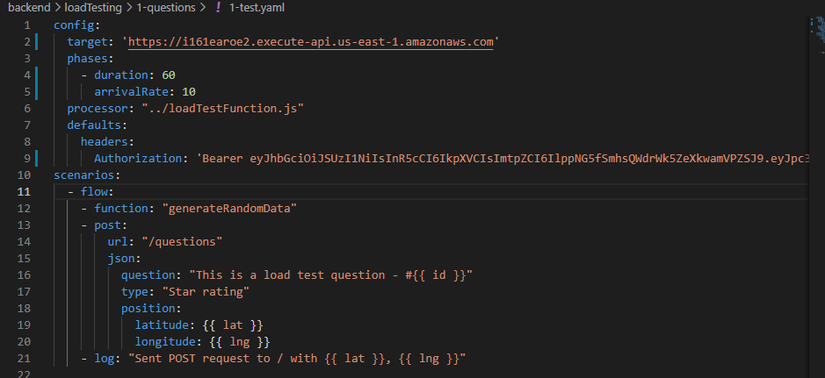
Load Testing

Slide 21
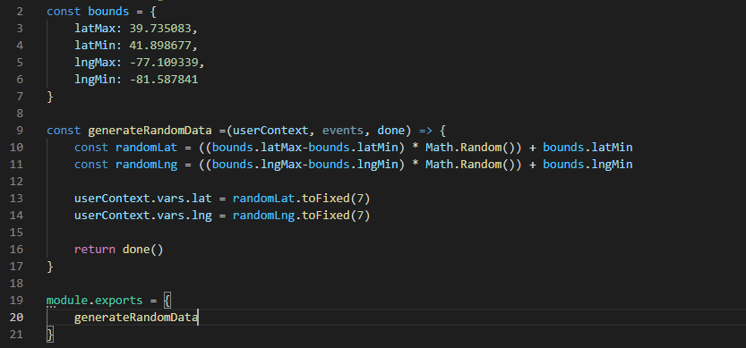
Load Testing Inputs

Slide 22
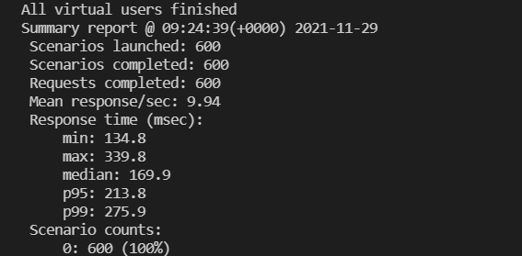
Load Testing Results
Used Artillery which is a load testing tool ,which helped us to put load onto our API gateway endpoints.

Slide 23
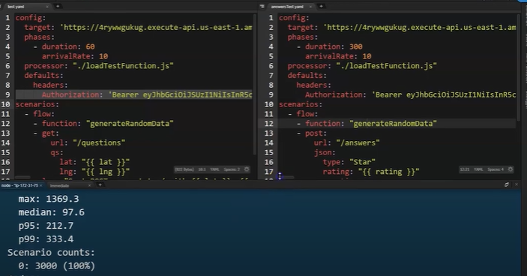
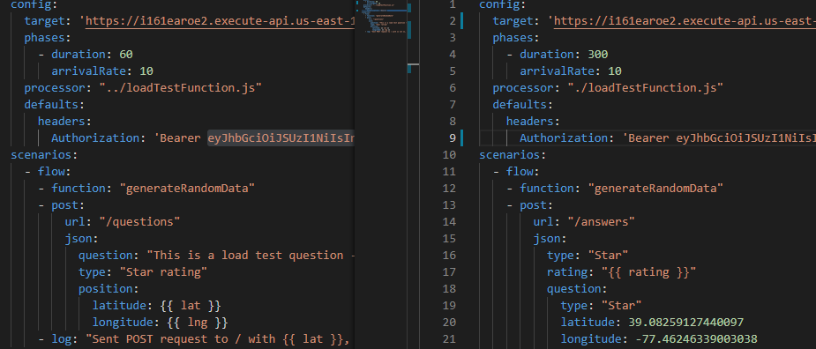

Slide 24
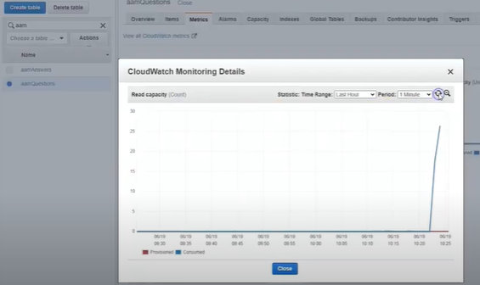
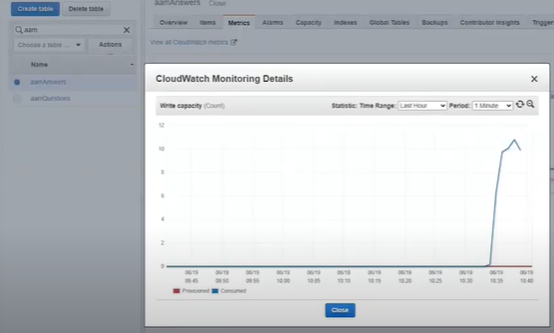

Slide 25
References
https://aws.amazon.com/serverless/build-a-web-app/
https://aws.amazon.com/getting-started/hands-on/build-serverless-web-app-lambda-apigateway-s3-dynamodb-cognito/
https://docs.aws.amazon.com/dynamodb/?id=docs_gateway
https://docs.aws.amazon.com/lambda/?id=docs_gateway
https://docs.aws.amazon.com/serverless-application-model/?id=docs_gateway
https://dev.to/cdkpatterns/watch-me-deconstruct-the-scalable-webhook-aws-serverless-pattern-lambda-api-gw-sqs-25ec

