Slide 1
Vehicle Registration System
Full Stack Web Application with React, Spring Boot and MySQL
Team
Trainer
Mallikarjun
Sadhna Gupta
Dharmendra
Yogesh
Durga Prasad
Notes:
Vehicle Registration System. Contribution percentages follow the team-provided allocation, not a commit audit. Durga Prasad contributed small frontend tasks on 5 October. The presentation date remains 6 October 2026 as requested.
Design reference: E:/LMS_PPT.pptx. Project source: E:/eclipse-workspace/vehicle-registration-system.

Slide 2
Introduction & Problem Statement
What is the project?
Problems addressed
A web application for new vehicle registration
Owner and RTO employee workspaces
Online applications with reference tracking
Renewal and Transfer Application
Scattered owner and vehicle details
Unclear application progress
Repeated corrections and follow-up
Separate payment and inspection records
Difficulty finding issued certificates
Vehicle Registration System
2
Notes:
This project demonstrates a new vehicle registration workflow. The problems listed describe the project motivation, not measured results for any government office.
Design reference: E:/LMS_PPT.pptx. Project source: E:/eclipse-workspace/vehicle-registration-system.

Slide 3
Objectives
1
Submit a new vehicle application
2
Separate owner and RTO screens
3
Track applications by reference
4
Review details and inspections
5
Manage fee rules and accounts
6
Generate the registration certificate
7
Validate inputs and workflow rules
8
Verify functionality with JUnit tests
Vehicle Registration System
3
Notes:
Current scope includes new registration, tracking, correction, simulated payment, review, inspection and certificate generation. Prior local verification recorded 18 JUnit integration tests with no failures. Renewal and transfer remain future work.
Design reference: E:/LMS_PPT.pptx. Project source: E:/eclipse-workspace/vehicle-registration-system.

Slide 4
Technology Stack
Frontend
Backend
Database & Tools
React and React Router
Create React App
Bootstrap CSS
sessionStorage
Java 21
Spring Boot 4.1.1
Spring Data JPA
Hibernate
Maven and JUnit
MySQL nexturn26
Swagger / OpenAPI
Git and GitHub
Eclipse
VS Code
Vehicle Registration System
4
Notes:
Source: pom.xml, frontend/package.json and datasource properties. The React client uses Fetch, not Axios. Built-in state hooks are useState and useEffect, with approved router hooks useNavigate and useParams.
Design reference: E:/LMS_PPT.pptx. Project source: E:/eclipse-workspace/vehicle-registration-system.

Slide 5
System Architecture
Owner or RTO employee
↓
Separation of concerns
React Frontend
↓
React manages forms and navigation
Controllers validate request DTOs
Service implementations apply business rules
Repositories persist data through JPA
REST APIs and DTOs
↓
Spring Boot Controller
↓
Service interface and implementation
↓
Repository Layer
↓
JPA / Hibernate and MySQL
Vehicle Registration System
5
Notes:
Source: controller, dto, service, service/impl, repository and entity packages. Service implementations use @Autowired. DTO mapping occurs inside service implementations without a separate mapper layer. Named runtime exceptions use a global exception handler.
Design reference: E:/LMS_PPT.pptx. Project source: E:/eclipse-workspace/vehicle-registration-system.

Slide 6
Modules & Functionality
Vehicle owner
RTO officer
Administrators
Signup and login
Apply for registration
Track by reference
Correct vehicle details
Simulated payment
View vehicles and RC
Review applications
Verify vehicle details
Request corrections
Record inspection
Approve or reject
Issue the RC
Manage fee rules
Manage employees
Manage account status
Review reports
View audit records
Vehicle Registration System
6
Notes:
Roles select frontend functionality. The current backend does not enforce role authorization. Owner and RTOEmployee remain separate account entities.
Design reference: E:/LMS_PPT.pptx. Project source: E:/eclipse-workspace/vehicle-registration-system.

Slide 7
Database & API
Main tables
Sample APIs
owner_details
rto_employees
vehicle_details
vehicle_registration_applications
owner_payment_detail
registration_certificate
registration_fee_rules
audit_logs
POST /api/auth/login
POST /api/auth/signup
GET /api/applications
POST /api/applications
GET /api/applications/{ref}
POST /api/applications/{ref}/review
GET /api/applications/{ref}/certificate
Owner has no role field. RTOEmployee stores the role.
Vehicle Registration System
7
Notes:
Source: entity @Table annotations and controller mappings in E:/eclipse-workspace/vehicle-registration-system. The slide lists the tables used for current registration workflows. Review actions share one endpoint with an action field in the request.
Design reference: E:/LMS_PPT.pptx. Project source: E:/eclipse-workspace/vehicle-registration-system.

Slide 8
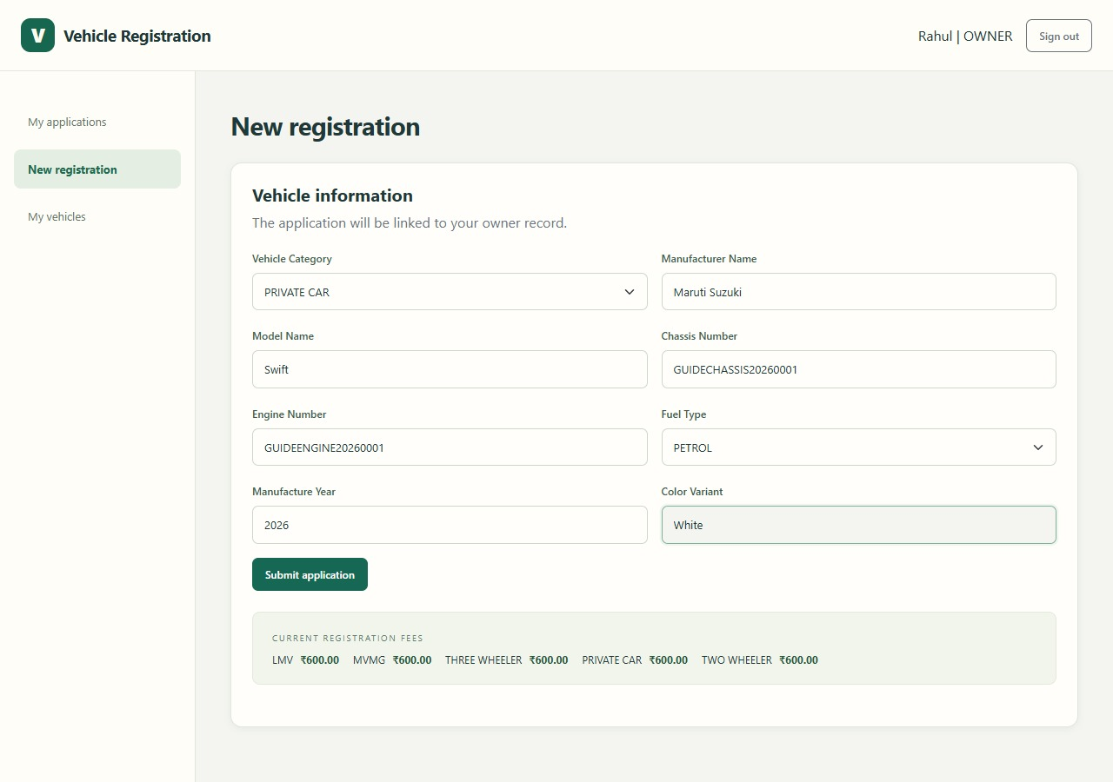
Application Workflow
1
Owner signs in
2
Submit details and receive a reference
3
RTO employee verifies the details
4
Owner completes simulated payment
5
Employee records a passed inspection
New vehicle registration form
6
Approval generates the RC number
Vehicle Registration System
8
Notes:
The current form screenshot uses fictional sample records. Backend approval requires a successful simulated payment and a passed inspection. Corrections return an application for owner resubmission. The generated RC belongs to this project and is not a government-issued certificate.
Design reference: E:/LMS_PPT.pptx. Project source: E:/eclipse-workspace/vehicle-registration-system.

Slide 9
Future scope
Vehicle services
Platform improvements
Vehicle registration renewal
Ownership transfer workflow
Document upload and download
Payment gateway integration
Backend role authorization
Cloud deployment
Thank you!
Vehicle Registration System
9
Notes:
These are proposed enhancements outside the current implementation. Source: agreed future scope from the earlier Vehicle Registration System presentation. Cloud deployment is an additional presentation proposal, not implemented functionality.
Design reference: E:/LMS_PPT.pptx. Project source: E:/eclipse-workspace/vehicle-registration-system.

