Slide 1
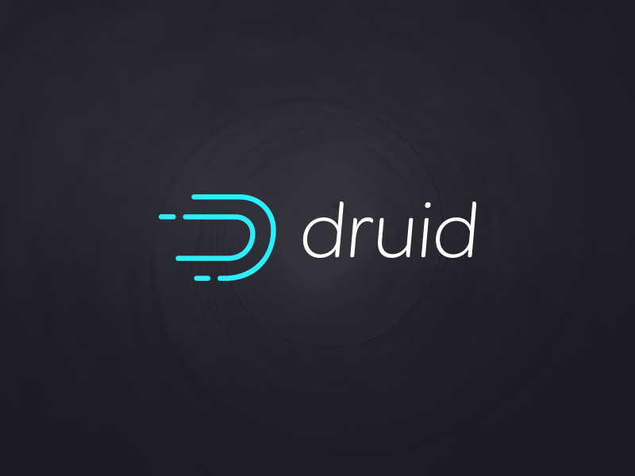
Druid
Analytics on Real time data
By Ujwal Sadhu

Slide 2
Recap
Druid is a column-oriented open-source distributed data store written in Java.
Druid is designed to quickly ingest massive quantities of event data, making that data immediately available to queries
Current Version : 0.9.0
Features
FAST AGGREGATIONS
ARBITRARY SLICE-N-DICE DATA
HIGHLY AVAILABLE
“REAL-TIME”

Slide 3
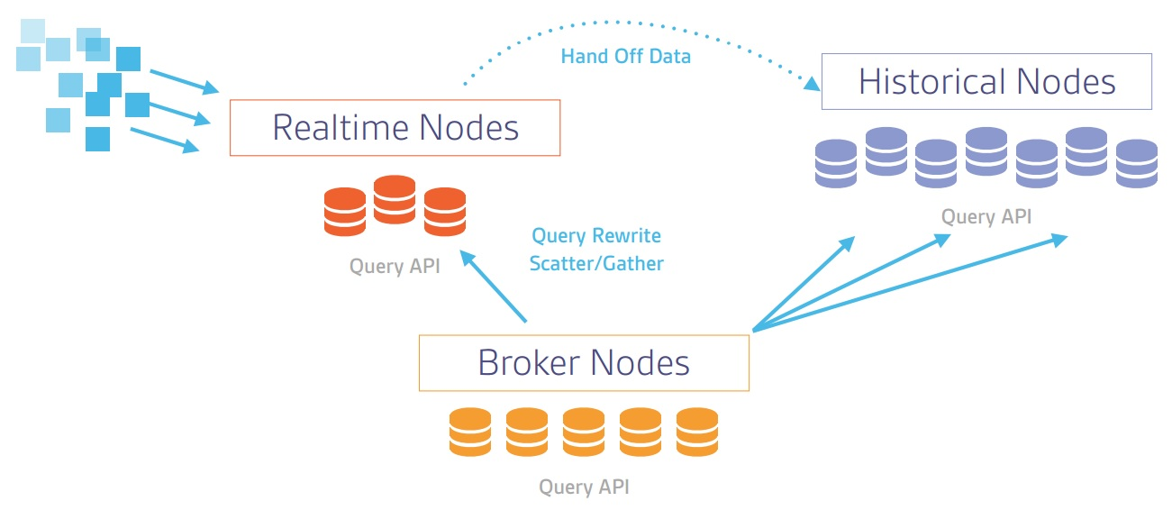
Architecture

Slide 4
Architecture
Each Druid node has a specific purpose and the nodes come together to form a fully functional system.
Historical nodes are the workhorses that handle storage and querying on "historical" data (non-realtime). Historical nodes encapsulate the functionality to load and serve the immutable blocks of data (segments) created by real-time nodes.
Coordinator nodes monitor the grouping of historical nodes to ensure that data is available, replicated and in a generally "optimal" configuration.
Broker nodes receive queries from external clients and forward those queries to Realtime and Historical nodes. When Broker nodes receive results, they merge these results and return them to the caller. For knowing topology, Broker nodes use Zookeeper to determine what Realtime and Historical nodes exist.
Indexing Service nodes form a cluster of workers to load batch and real-time data into the system as well as allow for alterations to the data stored in the system.
Realtime nodes also load real-time data into the system. They are simpler to set up than the indexing service, at the cost of several limitations for production use.

Slide 5
Installation
Prerequisites
You will need:
Java 7 or better
Node.js 4.x
Linux, Mac OS X, or other Unix-like OS (Windows is not supported)
At least 4GB of RAM
Download the Tarball from the Druid.io website and unpack it by using the following command in terminal
tar -zxvf druid-<version>-bin.tar.gz
cd druid-<version>

Slide 6
Installation
Druid requires 3 external dependencies:
A "deep storage" that acts as a data repository. This is generally distributed storage like HDFS or S3. For prototyping or experimentation on a single machine, Druid can use the local filesystem.
A "metadata storage" to hold configuration and metadata information. This is generally a small, shared database like MySQL or PostgreSQL. For prototyping or experimentation on a single machine, Druid can use a local instance of Apache Derby.
Apache Zookeeper for coordination among different pieces of the cluster.

Slide 7
Setting up Zookeeper
Run the following commands in your Terminal
curl http://www.gtlib.gatech.edu/pub/apache/zookeeper/zookeeper-3.4.6/zookeeper-3.4.6.tar.gz -o zookeeper-3.4.6.tar.gz
tar xzf zookeeper-3.4.6.tar.gz
cd zookeeper-3.4.6
cp conf/zoo_sample.cfg conf/zoo.cfg
./bin/zkServer.sh start
cd ..

Slide 8
Setting up druid Cluster
Run the given commands in the terminal to start each node
Start a Coordinator Node
java -Xmx256m -Duser.timezone=UTC -Dfile.encoding=UTF-8 -classpath config/_common:config/coordinator:lib/* io.druid.cli.Main server coordinator
Start a Historical Node
java -Xmx256m -Duser.timezone=UTC -Dfile.encoding=UTF-8 -classpath config/_common:config/historical:lib/* io.druid.cli.Main server historical
Start a Broker Node
java -Xmx256m -Duser.timezone=UTC -Dfile.encoding=UTF-8 -classpath config/_common:config/broker:lib/* io.druid.cli.Main server broker
Start a Realtime Node
java -Xmx512m -Duser.timezone=UTC -Dfile.encoding=UTF-8 -Ddruid.realtime.specFile=examples/wikipedia/wikipedia_realtime.spec -classpath config/_common:config/realtime:lib/* io.druid.cli.Main server realtime

Slide 9
Data
Druid supports 2 types of data:
Streaming Data
Batch Data
Each event has a timestamp indicating the time of the edit (in UTC time).
A list of dimensions indicating various metadata about the event (such as information about the user editing the page and where the user is a bot)
A list of metrics associated with the event (such as the number of characters added and deleted).

Slide 10
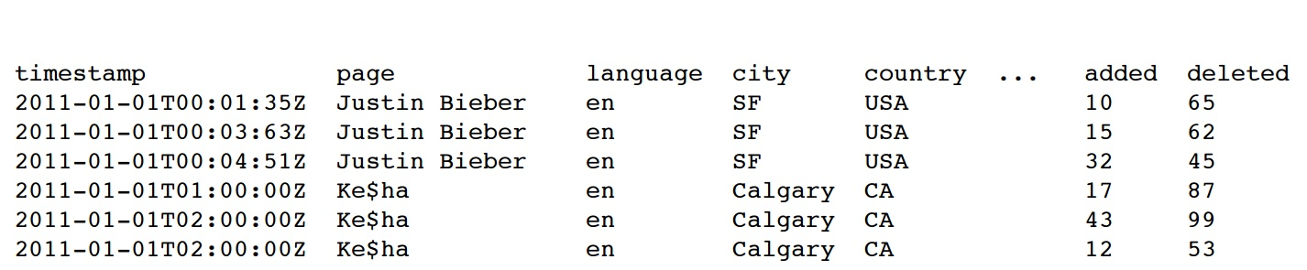
Data

Slide 11
Dimensions
Dimensions are things that we filter the data with
"page"
"language"
"user"
"unpatrolled"
"newPage"
"robot"
"anonymous"
"namespace"
"continent"
"country"
"region"
"city"

Slide 12
Metrics
Metrics are things to Aggregate with
"count"
"added"
"delta"
"deleted"

Slide 13
Querying the data
Druid has numerous query types for various use cases. Queries are composed of various JSON properties and Druid has different types of queries for different use cases.
Aggregation Queries
Timeseries
TopN
GroupBy
Metadata Queries
Time Boundary
Segment Metadata
Datasource Metadata
Search Queries
Search

Slide 14
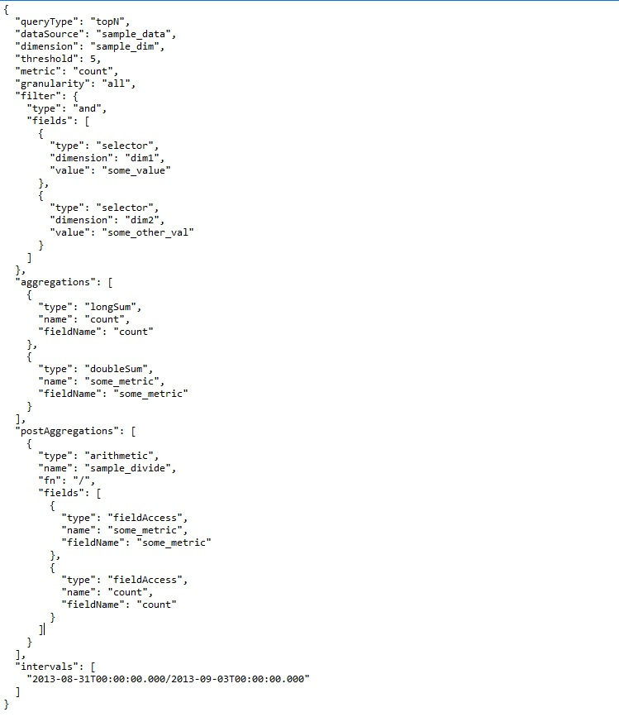
TopN

Slide 15
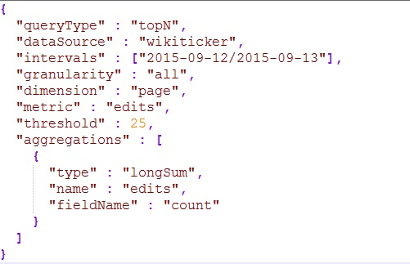
Top N

Slide 16
Demo

