Slide 1

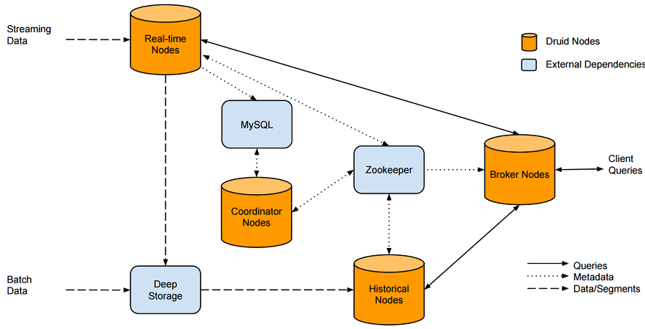
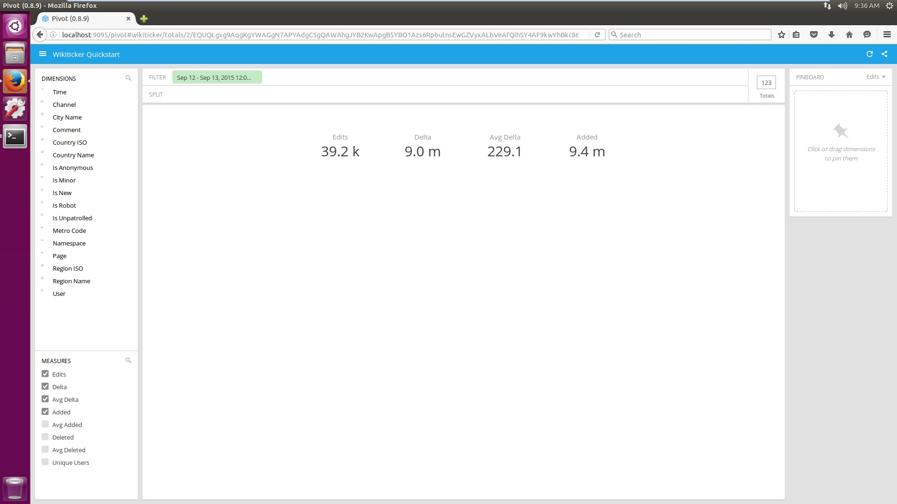
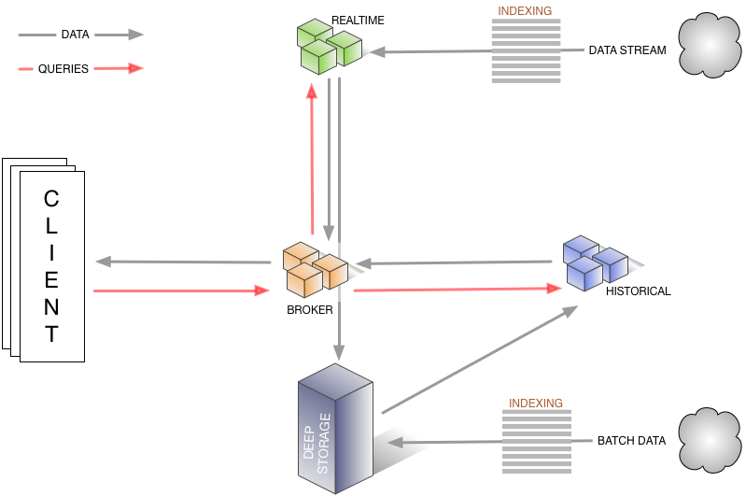

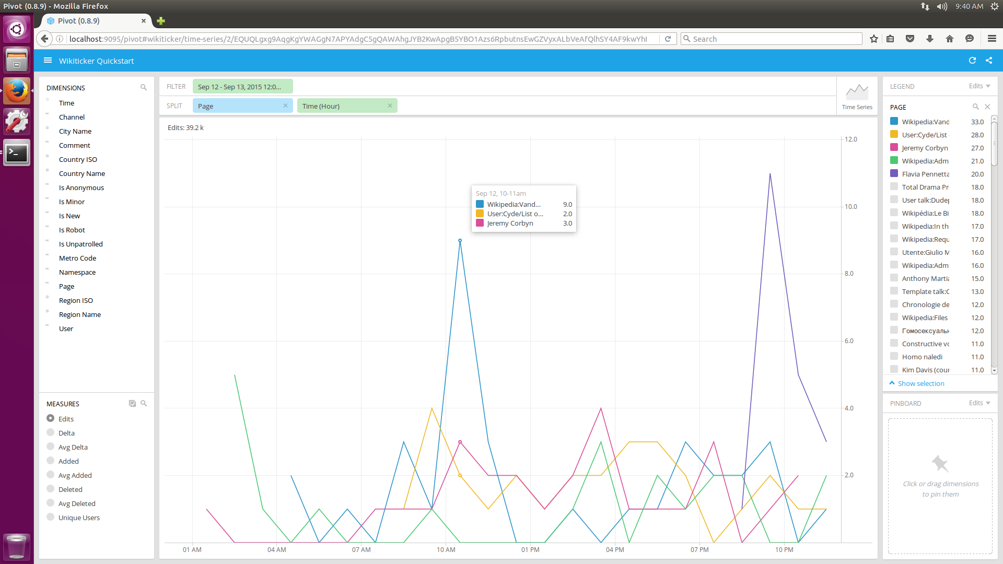
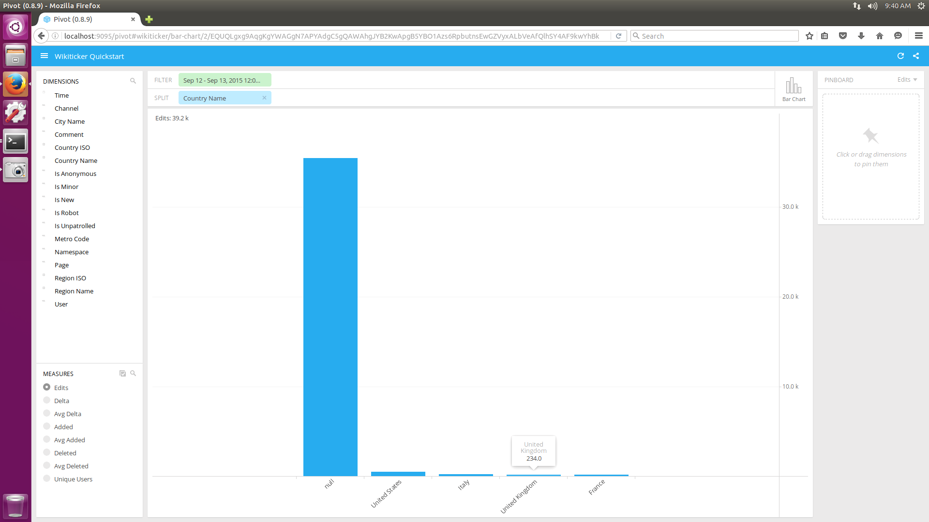
Druid: NoSql Based Analytics on Realtime Data
Ujwal Sadhu,
Prof Jeongkyu LEE
Department of Computer science
University of Bridgeport, Bridgeport, CT
Abstract
Real-time nodes also load real-time data into the system. They are simpler to set up than the indexing service, at the cost of several limitations for production use.
Druid is an open source, distributed analytics data store that powers user-facing data applications, provides fast queries on data in Hadoop, and helps you glean insights from streaming data. Real-Time data is the data that is being generated in the current moment. The data generated by the Wikipedia edits or the Twitter tweets or the data from business can be used here.
Introduction
Druid is an open source data store designed for real-time exploratory analytics on large data sets. The system combines a column-oriented storage layout, a distributed, shared-nothing architecture, and an advanced indexing structure to allow for the arbitrary exploration of billion-row tables with sub-second latencies. At a high-level, Druid collects event data into segments via real-time nodes. The real-time nodes push those segments into deep storage. Then a master node distributes those segments to compute nodes, which are capable of servicing queries. A broker node sits in front of everything and distributes queries to the right compute nodes.
Results
The Application is developed to analyze Wikipedia edits
Data model
The diagram shows how queries and data flow through this architecture
This shows the no of edits based on the edited Wikipedia page
Historical nodes are the workhorses that handle storage and querying on "historical" data (non-realtime). Historical nodes download segments from deep storage, respond to the queries from broker nodes about these segments, and return results to the broker nodes.
Coordinator nodes monitor the grouping of historical nodes to ensure that data is available, replicated and in a generally "optimal" configuration. They do this by reading segment metadata information from metadata storage to determine what segments should be loaded in the cluster, using Zookeeper to determine what Historical nodes exist, and creating Zookeeper entries to tell Historical nodes to load and drop new segments.
Broker nodes receive queries from external clients and forward those queries to Real-time and Historical nodes. When Broker nodes receive results, they merge these results and return them to the caller. For knowing topology, Broker nodes use Zookeeper to determine what Real-time and Historical nodes exist.
Indexing Service nodes form a cluster of workers to load batch and real-time data into the system as well as allow for alterations to the data stored in the system.
This shows the no of edits based on the time Wikipedia page is edited and a bar chart depiction based on the country in which most pages are edited.

