Slide 1

Medical Research Papers are Long and Hard to Read
B.Tech Final Year Project — Department of Computer Science & Engineering

Slide 2

The Problem
Medical research papers are dense, lengthy, and difficult to navigate — creating a significant barrier for practitioners, students, and researchers who need quick, actionable insights.
Length & Complexity
Papers span dozens of pages with technical jargon, making them hard to digest quickly.
Time-Consuming
Extracting key findings manually takes hours, slowing down decision-making.
Information Overload
Critical insights are buried in dense text, making it hard to locate what matters.

Slide 3
Project Objectives
This system addresses the core challenges of reading medical research by combining automated summarization with an interactive Q&A interface.
Quick Summaries
Interactive Q&A
Generate concise, structured summaries of uploaded research papers automatically.
Allow users to ask natural-language questions and receive precise answers from the paper.
Reduce Reading Time
Improve Comprehension
Cut down the time required to understand a paper from hours to minutes.
Present complex findings in plain, accessible language for broader audiences.

Slide 4

Overall Solution
The system provides a seamless four-step workflow that transforms a lengthy research paper into an interactive, easy-to-understand experience.
01
02
Upload Paper
Process Content
User submits a medical research paper through a simple web interface.
Backend parses and analyzes the document using NLP techniques.
03
04
Generate Summary
Answer Questions
A structured, concise summary is produced automatically.
Users query the paper and receive instant, context-aware responses.

Slide 5

System Architecture
The application follows a cloud-native architecture on AWS, ensuring scalability, fault tolerance, and high availability for concurrent users.
User Interface
Application Load Balancer
EC2 Backend Server
S3 & RDS Storage
Requests are routed through the Application Load Balancer to auto-scaled EC2 instances. Documents are stored in S3, metadata in RDS, and responses are returned to the user in real time.

Slide 6
AWS Services Used
The project leverages a suite of AWS services to deliver a robust, scalable, and secure cloud infrastructure.
EC2
S3
Hosts the backend application server and processing logic.
Stores uploaded research papers and generated outputs securely.
RDS
ALB
Manages structured data including summaries and user sessions.
Distributes incoming traffic across EC2 instances for high availability.
Auto Scaling
IAM & CloudWatch
Dynamically adjusts compute capacity based on real-time demand.
Manages access control and monitors system performance and logs.

Slide 7
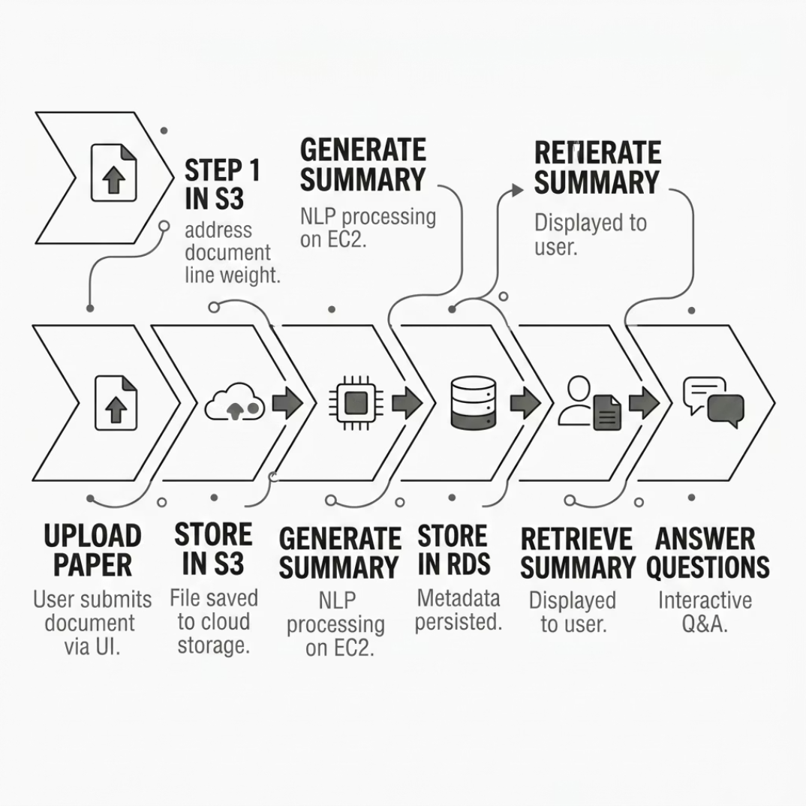

Working Flow
From upload to answer, the system follows a clear, automated pipeline that ensures every paper is processed, stored, and made queryable with minimal latency.
Upload Paper
User uploads document via the web UI.
Store in S3
File is saved to S3 bucket for durable storage.
Generate Summary
Backend processes text and creates a structured summary.
Store in RDS
Summary metadata is persisted in the database.
Retrieve & Answer
Summary is displayed; user questions are answered in real time.

Slide 8

Key Advantages
⏱ Saves Time
Reduces hours of reading to minutes of review with auto-generated summaries.
🖥 Easy to Use
Intuitive interface requires no technical expertise from the end user.
☁ Scalable
Cloud-based architecture handles growing numbers of users and documents.
🔒 Reliable
AWS S3 and RDS ensure data durability, security, and high availability.

Slide 9

Conclusion & Future Work
What We Built
Future Enhancements
This project demonstrates a practical, cloud-powered solution that simplifies how medical research papers are consumed — making complex literature accessible, searchable, and understandable for everyone.
Advanced AI Models
Integrate LLMs like GPT-4 for deeper, more accurate summarization.
Successfully deployed on AWS with end-to-end summarization and Q&A functionality.
PDF Upload Support
Add native PDF parsing for broader document compatibility.
Enhanced Chatbot
Improve conversational Q&A with multi-turn dialogue and citations.

