Slide 1


Slide 2

Online Tax Management System

Slide 3
Group Members Introduction
VU STUDENT ID : BC230213525

Slide 4

INTRODUCTION OF PROJECT
THE ELECTRONIC TAX MANAGEMENT SYSTEM IS PROPOSED WITH THE AIM TO AUTOMATE THE PROCESS OF TAX COLLECTION AND MANAGEMENT FOR BOTH TAXPAYERS AND TAX AUTHORITIES. THE PROPOSED SYSTEM AIMS TO PROVIDE A USER-FRIENDLY INTERFACE FOR TAXPAYERS TO FILE THEIR TAXES, ACCESS TAX INFORMATION, AND COMMUNICATE WITH TAX OFFICIALS. IT WILL AUTOMATE THE CALCULATION, PAYMENT, AND FILING OF TAXES, REDUCING ERRORS AND INCREASING EFFICIENCY. THE SYSTEM WILL ALSO FEATURE A SECURE BACKEND FOR TAX AUTHORITIES TO MANAGE TAXPAYER DATA, PROCESS PAYMENTS, AND GENERATE REPORTS, ENSURING COMPLIANCE AND FACILITATING BETTER DECISION-MAKING.

Slide 5
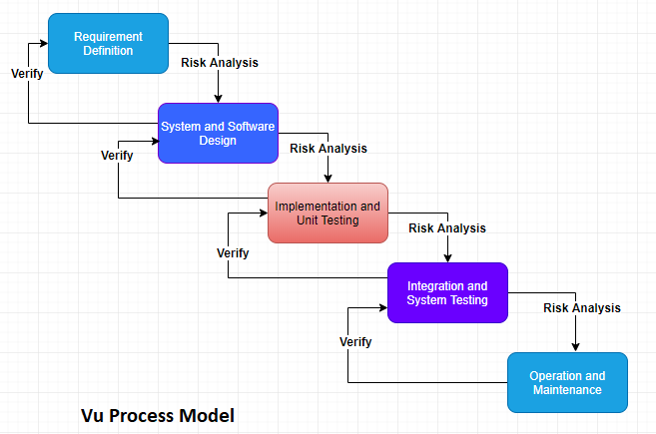
VU PROCESS MODEL

Slide 6
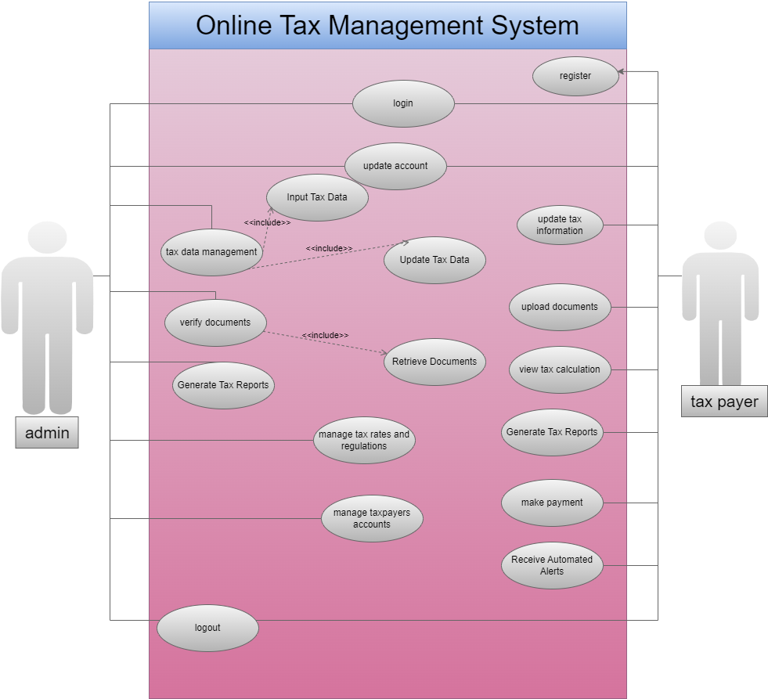
Use Case Diagram

Slide 7
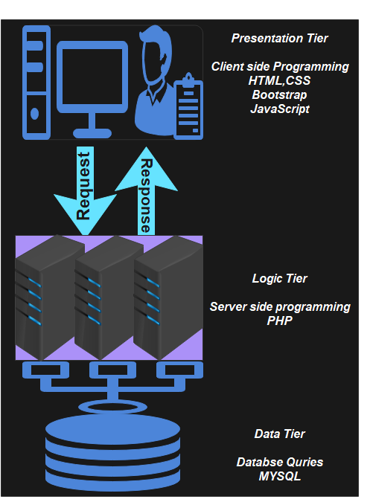
Architectural Design

Slide 8









Team Structure
Gathering Info
Planning
Testing
IFRA IQBAL
Development
Designing

Slide 9
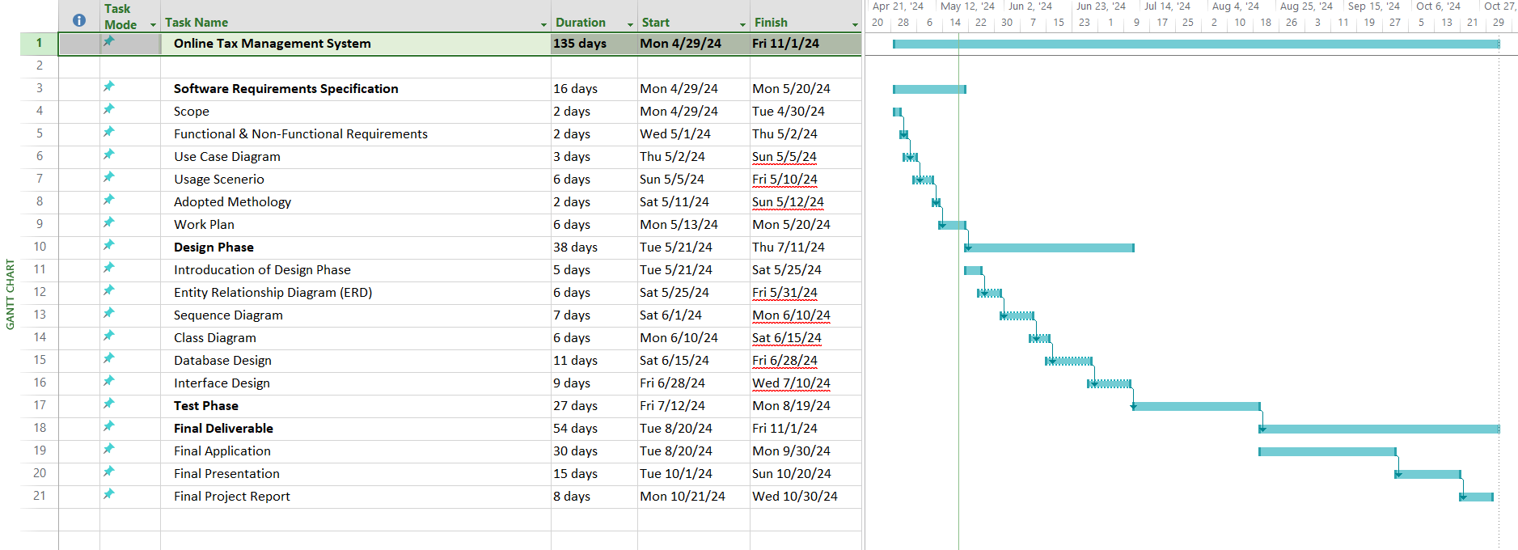
Project Schedule

Slide 10
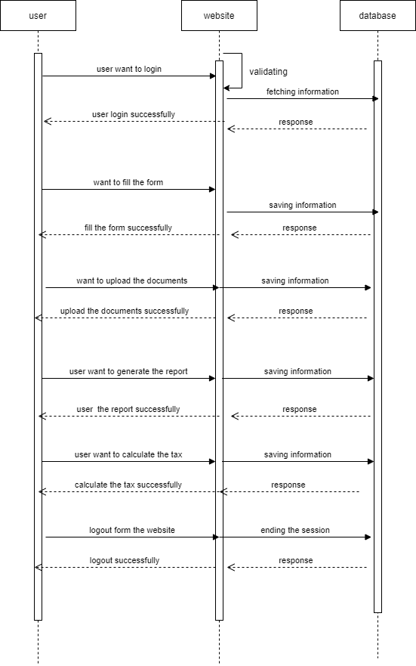
Sequence Diagrams

Slide 11
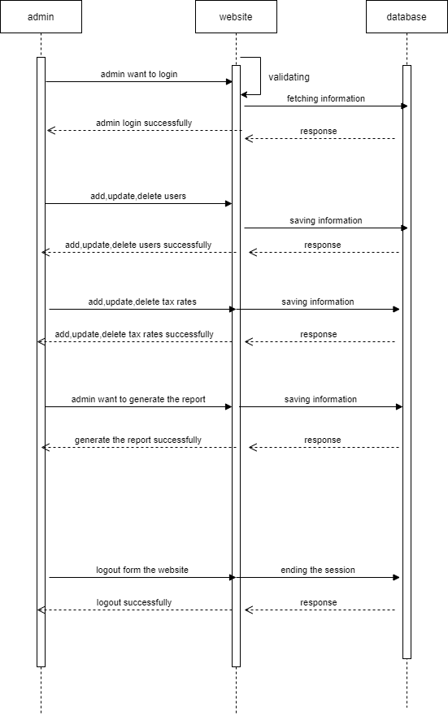

Slide 12
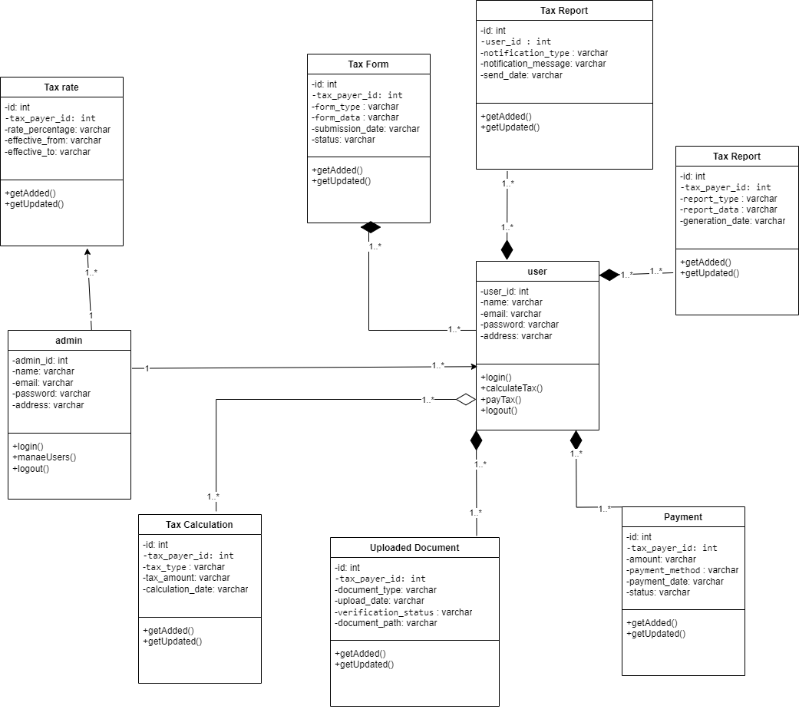
Logical Model/Class Diagram

Slide 13
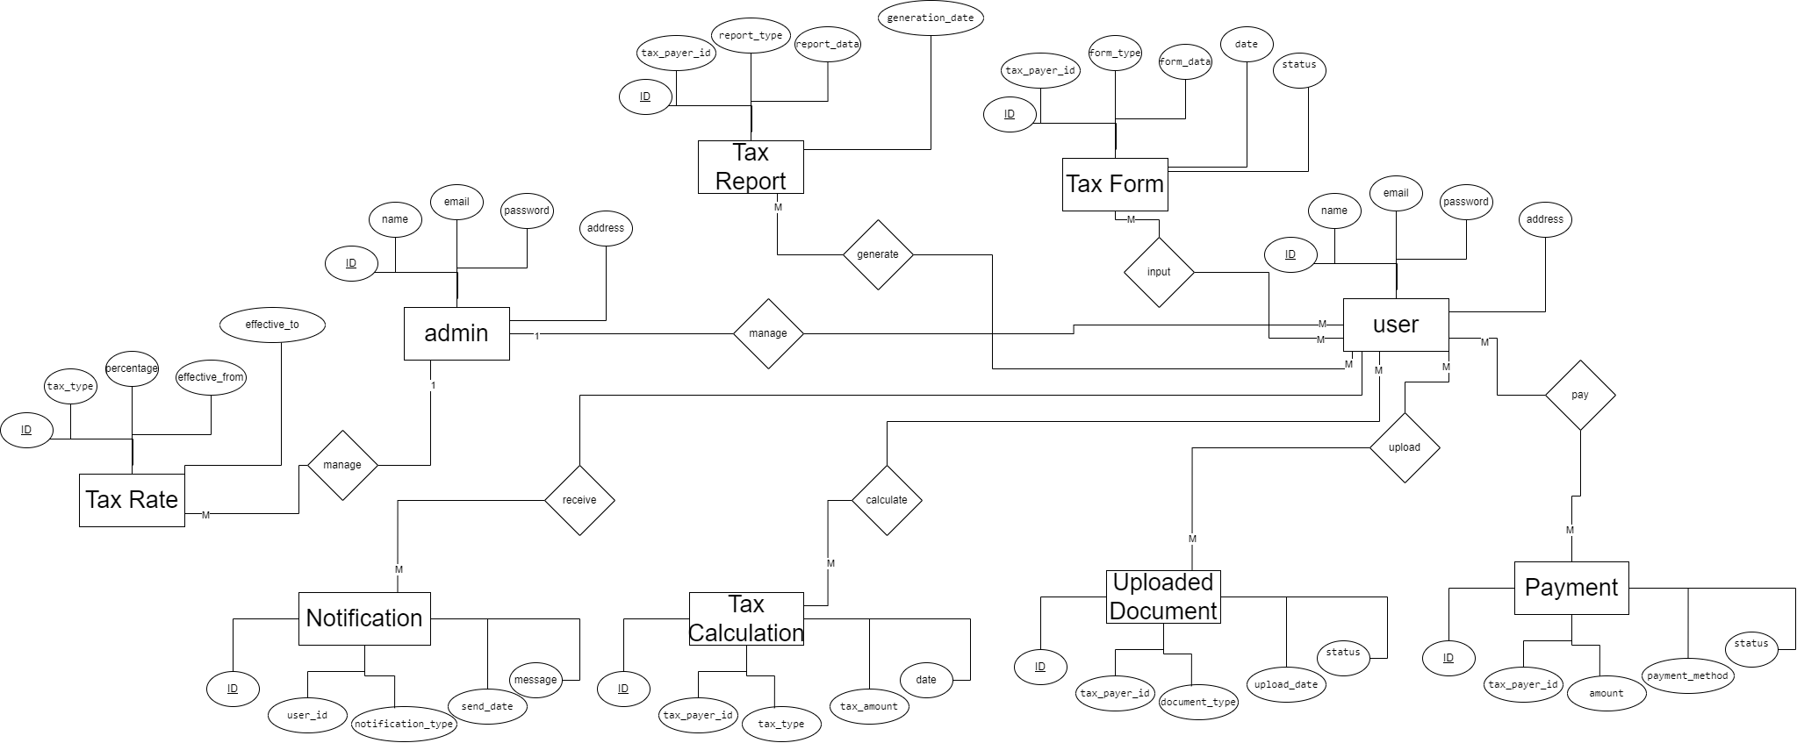
Entity-Relationship Diagram

Slide 14
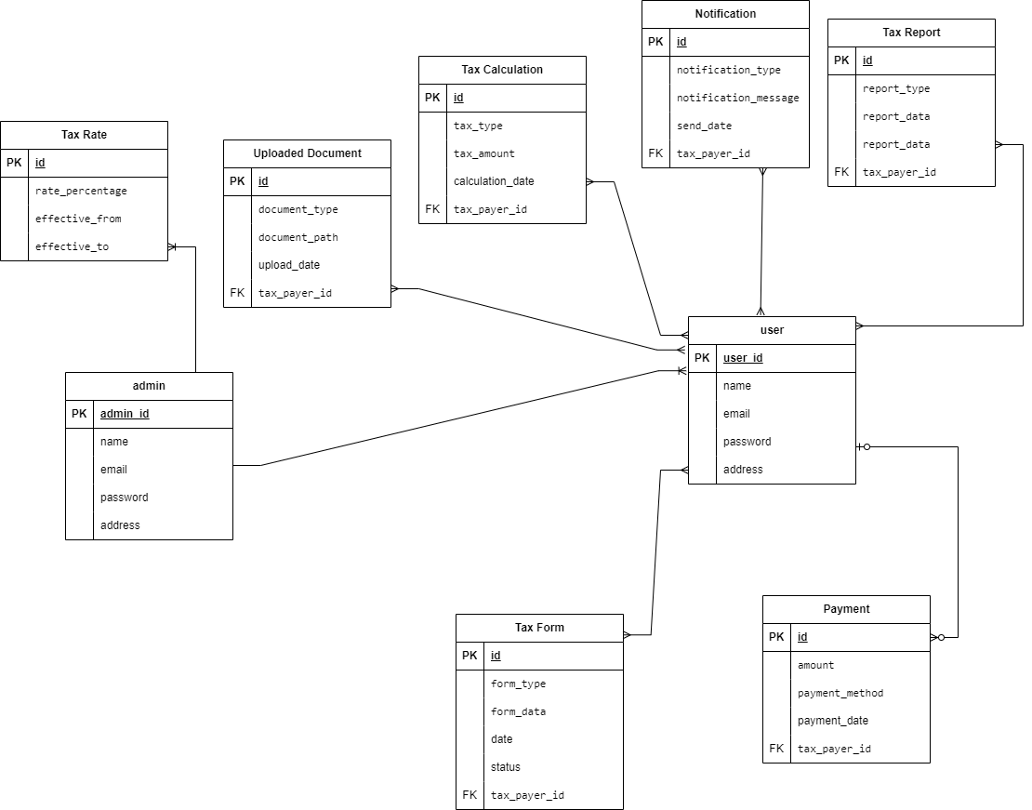
Database Diagram

Slide 15
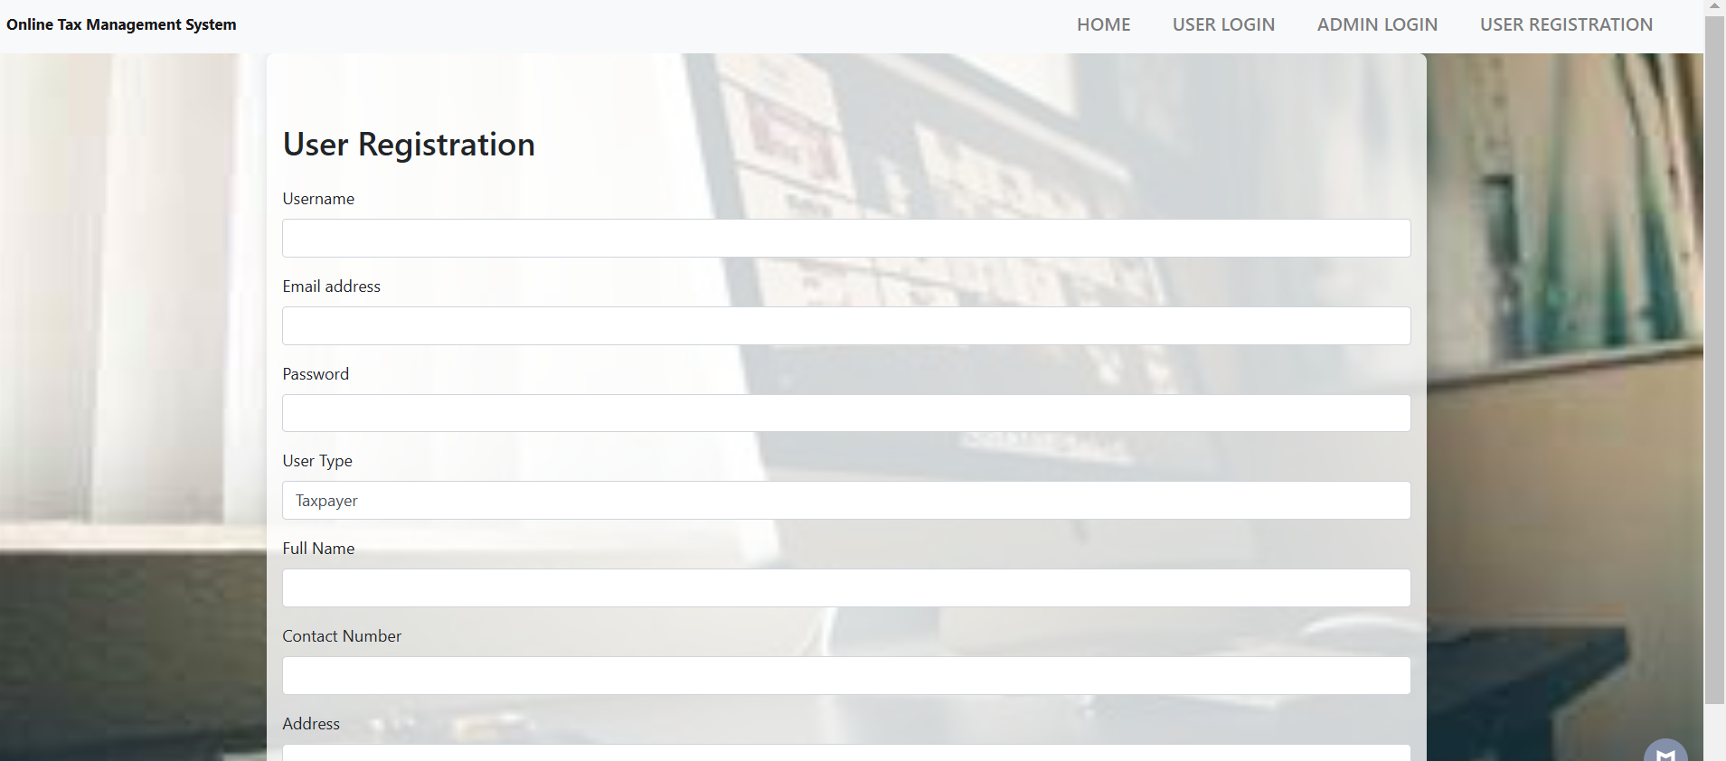
User interfaces

Slide 16
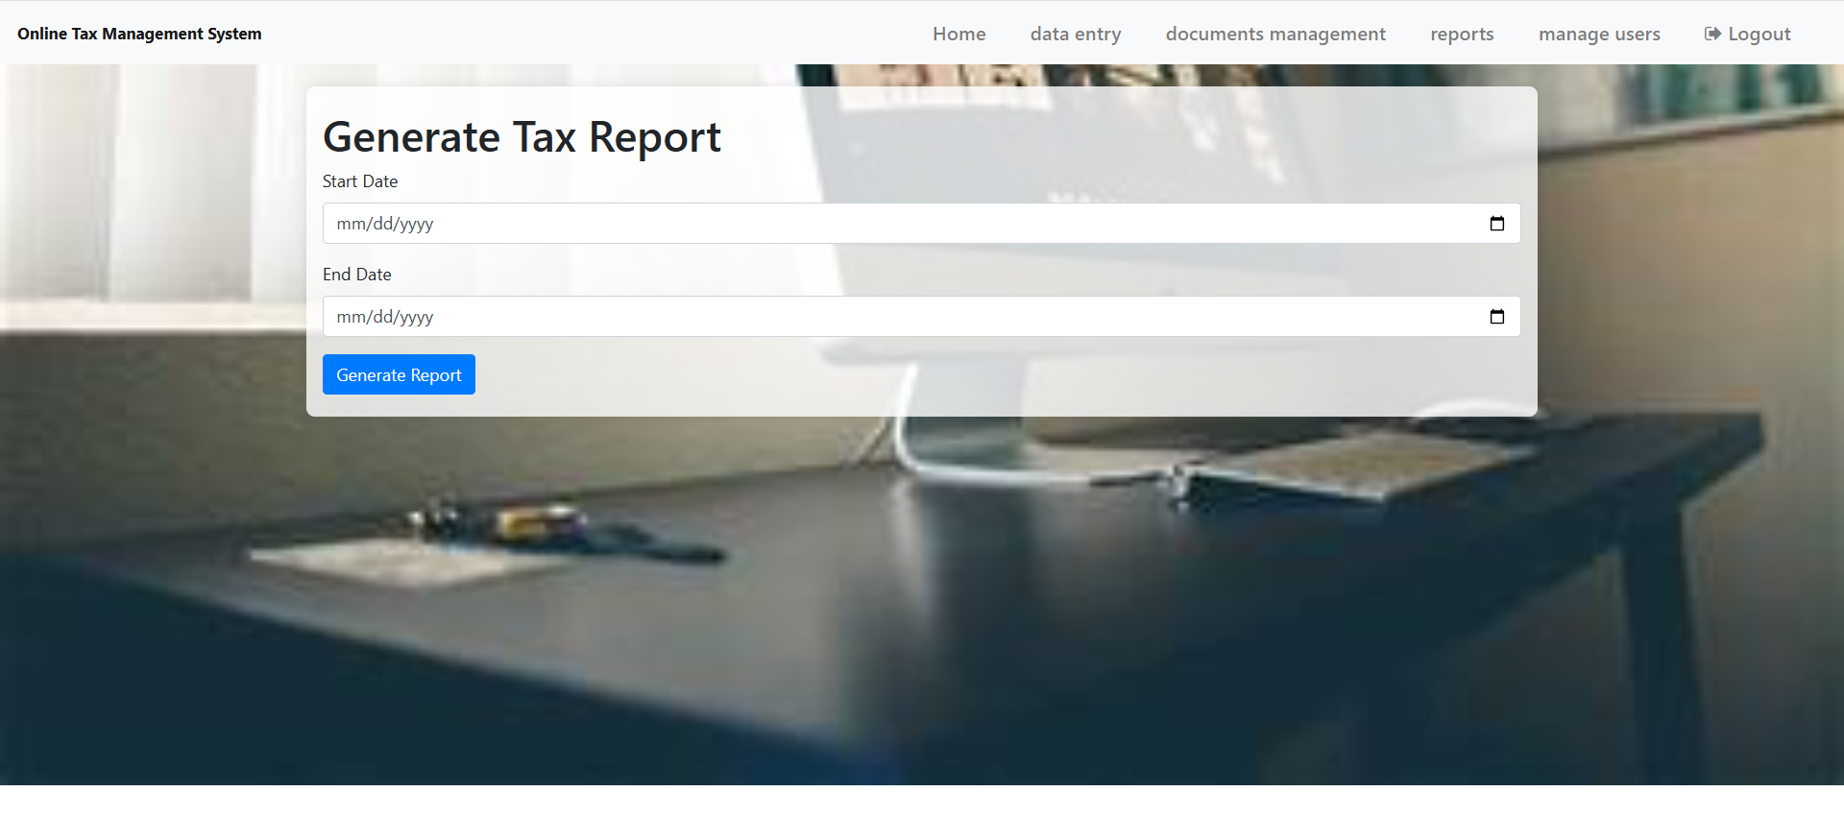

Slide 17
Tools
XAMP
PHP
Html
CSS
Bootstrap
Visual Studio Code

Slide 18
THANKS
I am very thanks full to VIRTUAL UNIVERSITY OF PAKISTAN.

