Slide 1


Telco Customer Churn Analysis CS-808 | Tools and Techniques for Data Science
Instructor Name: Dr. Fahad Ahmed Satti
Group Members:
Aaqib Ali - 453210
Sadia Noor - 450169

Slide 2


INTRODUCTION
Losing customers impacts telecom businesses financially and reputation-wise.
Conventional methods for customer retention are often generic and reactive.
The study aims to explore more effective, data-driven strategies.
Emphasis on building stronger customer relationships and seizing financial opportunities.

Slide 3
PROBLEM STATEMNT
Telecom sector struggles to retain customers due to service quality and cost concerns.
Challenges include communication gaps, fragmented data, and reliance on reactive methods.

Slide 4

PROBLEM STATEMNT
Objective:
Address customer churn through data-driven strategies for proactive solutions and improved satisfaction.
Proposed approaches:
Predict customer exits by identifying churn reasons preemptively.
Analyze customer data for tailored offers and enhanced satisfaction.
Goals: Improve customer retention, offer customization, and elevate satisfaction using data insights.

Slide 5


DATASET
Utilizing a large-scale IBM dataset for forecasting consumer behavior and enhancing retention measures.
Details:
Size: 7043 instances with 21 attributes.
Source: Kaggle, providing diverse customer-related data.

Slide 6
DATASET
Key Features:
Churn Data: Identifies clients who left in the last month (Churn column).
Services Portfolio: Lists subscribed services (phone, internet, etc.).
Customer Account Information: Includes relationship length, contract details, billing preferences, charges, and demographics.

Slide 7
DATASET
Objective: Analyze trends, predict client attrition, and design targeted retention campaigns.
Goal: Establish a robust foundation for proactive customer retention strategies.

Slide 8
DATASET OVERVIEW
The data set includes information about:
Customers who left within the last month – the column is called Churn
Services each customer has signed up for – phone, multiple lines, internet, online security, online backup, device protection, tech support, and streaming TV and movies.
Customer account information – how long they’ve been a customer, contract, payment method, paperless billing, monthly charges, and total charges.
Demographic info about customers – gender, age range, and if they have partners and dependents.
Dataset contains:
Instances: 7043
Features: 21

Slide 9
METHODOLOGY
Introduction
Data Exploration and Understanding
Data Cleaning and Preprocessing
Exploratory Data Analysis (EDA)
Model Selection and Training
Analysis of Results
SMOTE-ENN Implementation
Model Performance after SMOTE-ENN
Alternative Methodology: Neural Networks
Neural Network Results
Conclusion

Slide 10
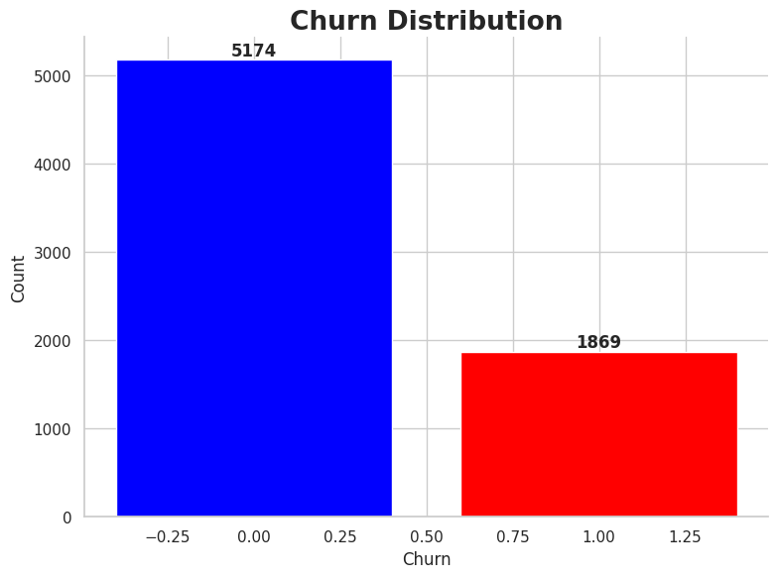
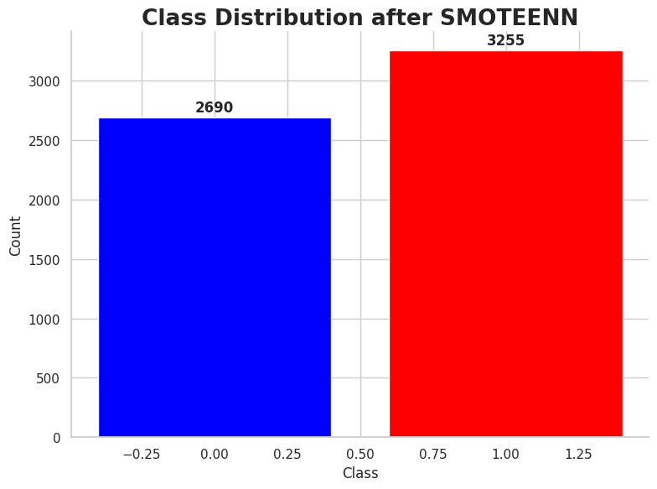
Exploratory Data Analysis (EDA)
Churn Distribution:
"No churn" customers significantly outnumber "Churn" customers (5174 vs. 1869), indicating a ratio of approximately 2.8:1.
Churn Distribution after SMOTEEN:
Churn: 3225, No Churn: 2690

Slide 11
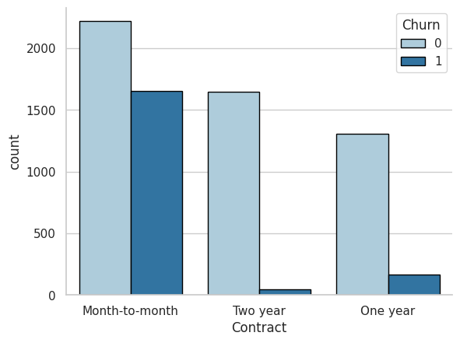
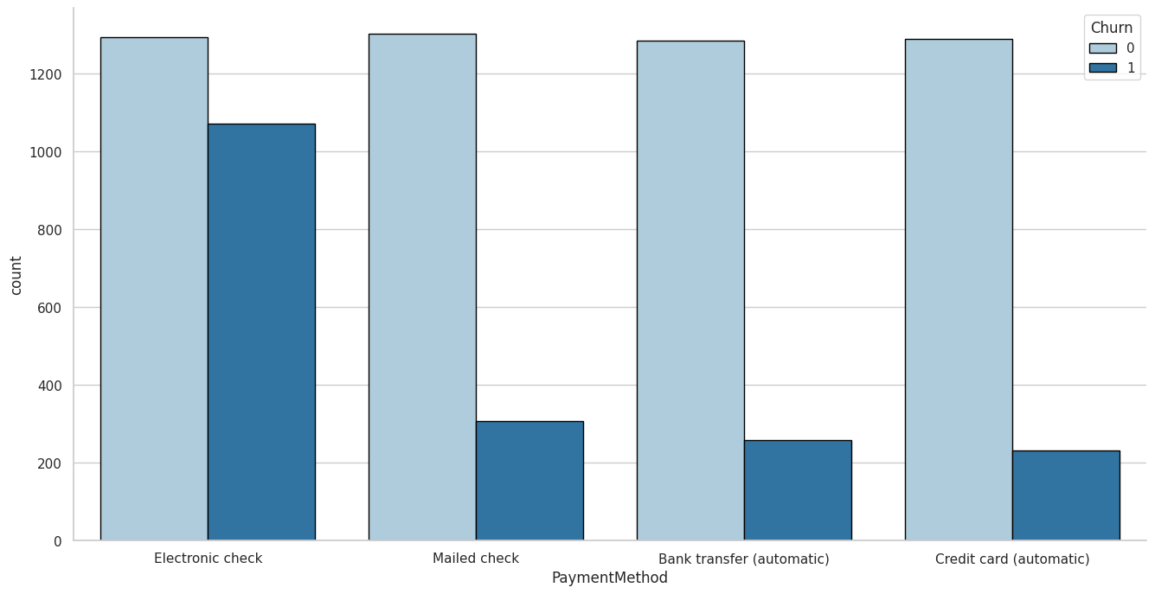
Exploratory Data Analysis (EDA)
Churn with Categorical Variables:
Customers using electronic checks for payment and those with monthly subscriptions (no contract terms) exhibit higher churn rates.

Slide 12
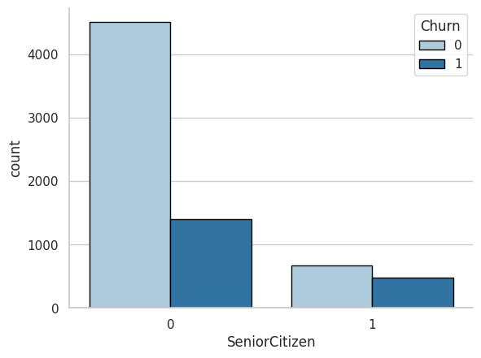
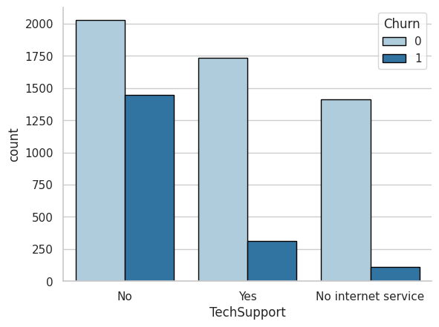
Exploratory Data Analysis (EDA)
Churn with Categorical Variables:
Customers lacking online security, tech support, and non-senior citizens are more prone to churn.

Slide 13
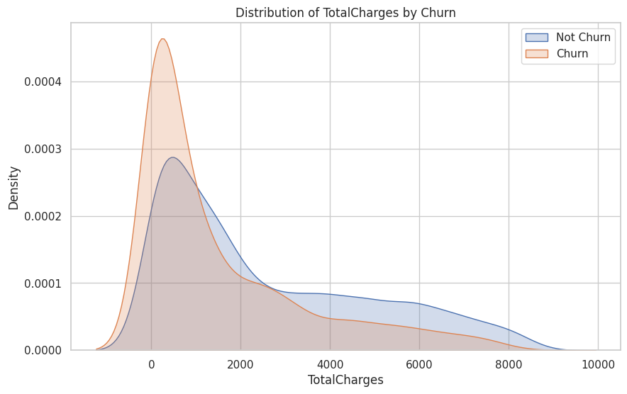
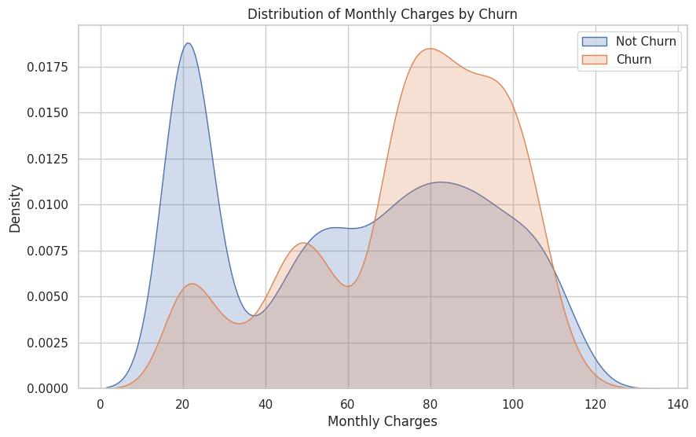
KEY INSIGHTS
Clients with lower overall costs show increased churn rates, suggesting factors beyond spending influence churn
Customers with shorter service durations and higher monthly fees are more likely to churn.

Slide 14
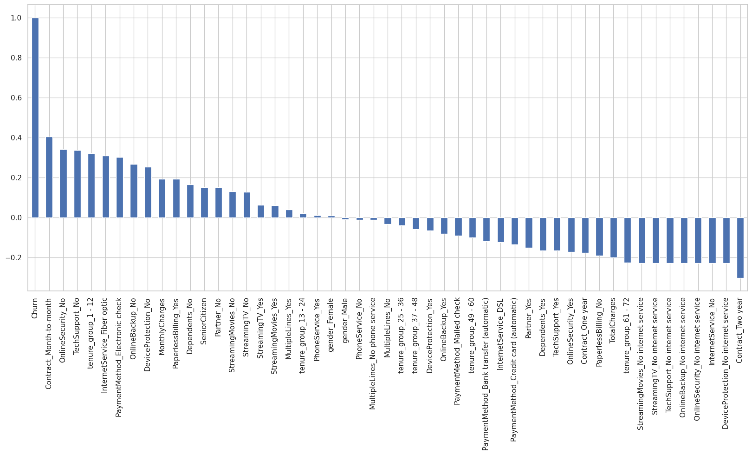
Correlation of Churn with all other features

Slide 15
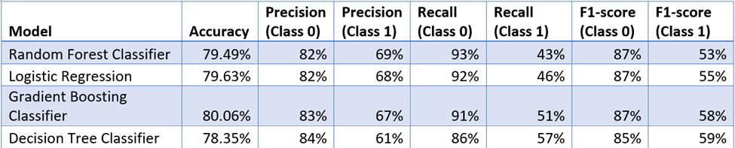
RESULTS
Models Trained:
1.Random Forest Classifier
2. Logistic Regression
3. Gradient Boosting Classifier (Outperforms)
4. Decision Tree Classifier.

Slide 16
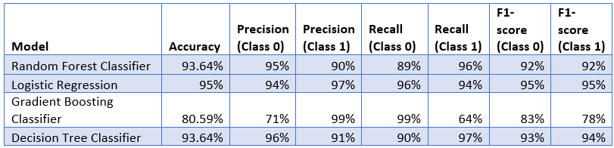
RESULTS (SMOTE-ENN)
Impact on Model Performance:
After applying SMOTE-ENN, models show improved accuracy, precision, recall, and F1 scores.

Slide 17
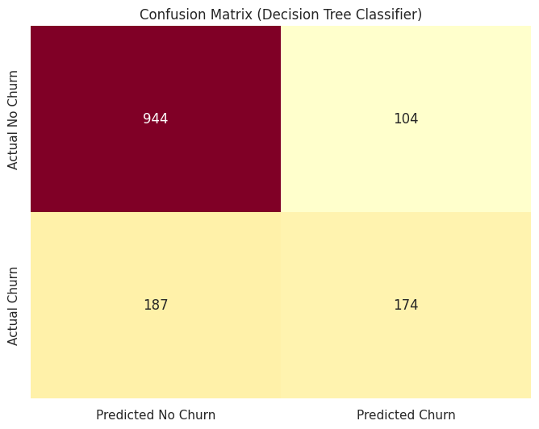
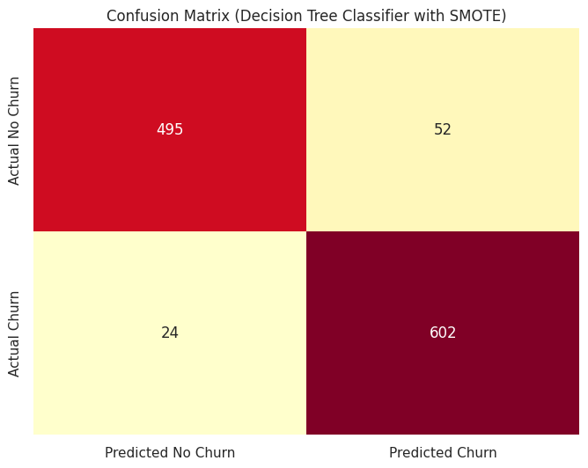
Analysis of Results

Slide 18
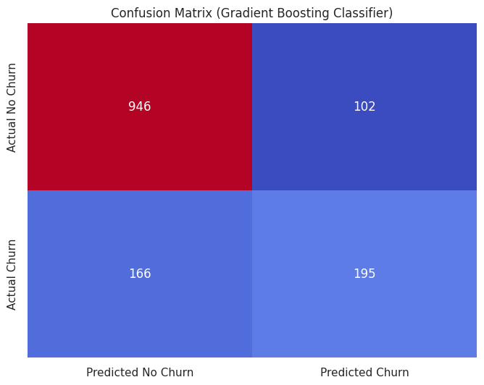
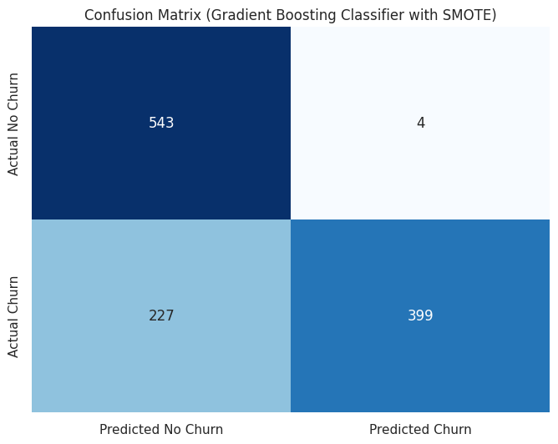
Analysis of Results

Slide 19
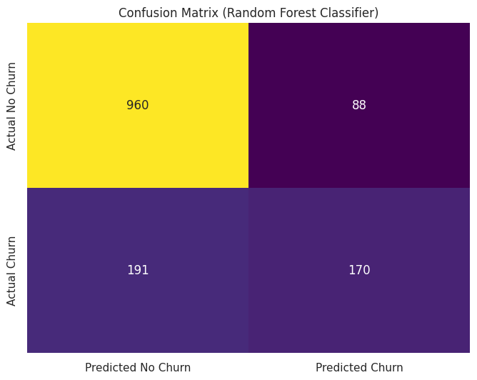
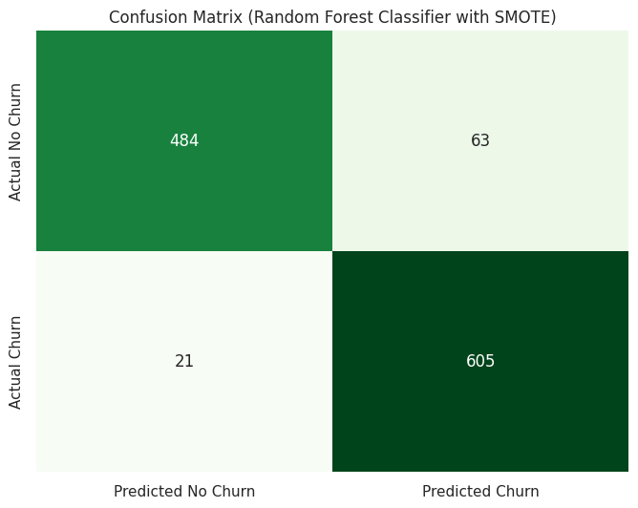
Analysis of Results

Slide 20
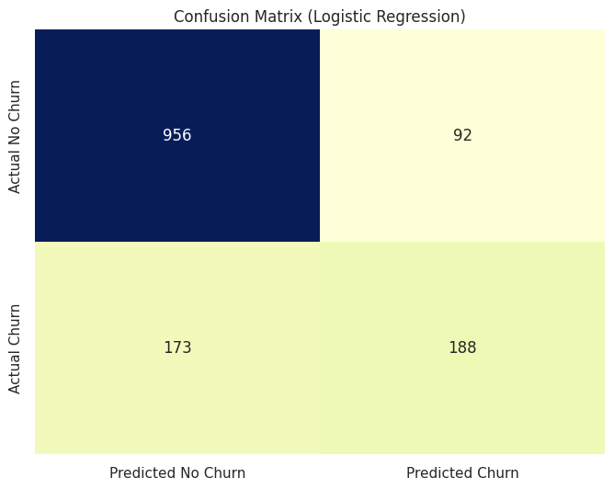
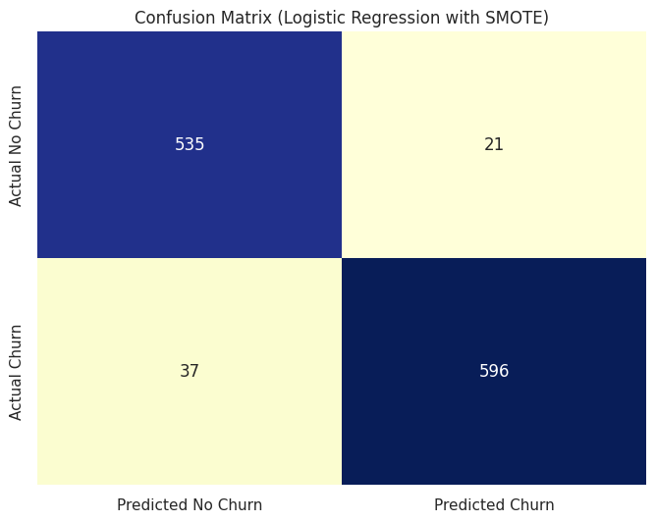
Analysis of Results

Slide 21
ALTERNATIVE METHODOLOGY
Models Introduced:
Neural Network and LSTM models applied to the balanced dataset.
Results:
Neural Network: Accuracy 93%
LSTM Model: Accuracy 94%

Slide 22
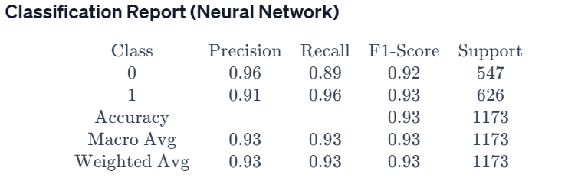
RESULTS: Neural Network
Classification Report for Neural Network illustrating the accuracy, precision, recall, and f1-Score for class 0 and 1.
0 – No Churn
1 – Churn

Slide 23
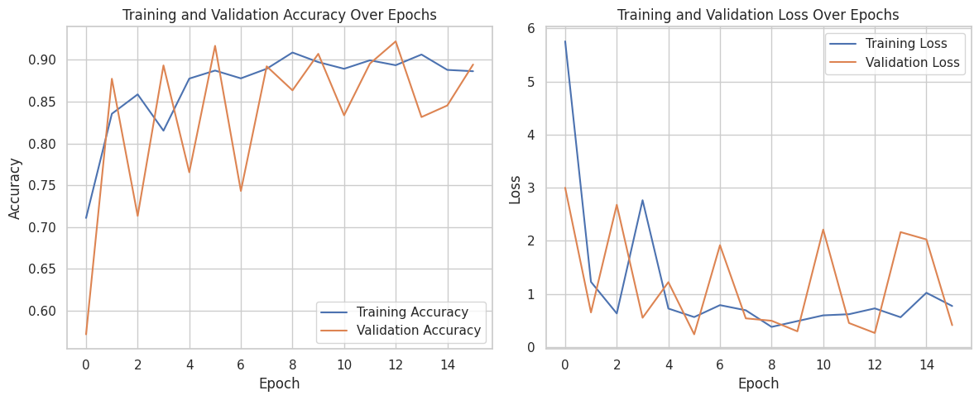
RESULTS: Neural Network
Training and Validation Accuracy
Training and Validation Loss

Slide 24
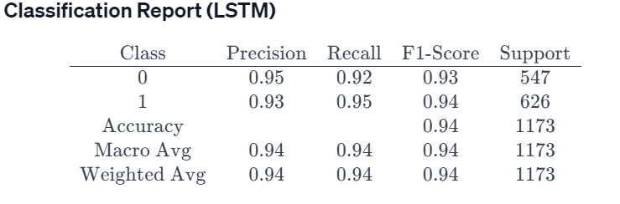
RESULTS: LSTM
Classification Report for LSTM illustrating the accuracy, precision, recall, and f1-Score for class 0 and 1.
0 – No Churn
1 – Churn

Slide 25
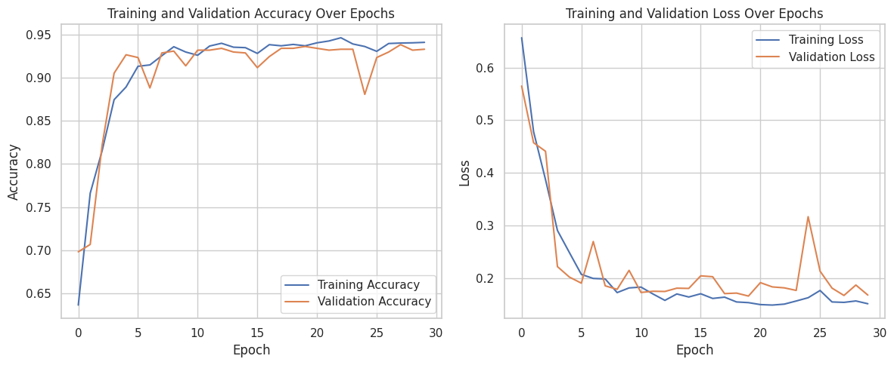
RESULTS: LSTM
Training and Validation Accuracy
Training and Validation Loss

Slide 26
CONCLUSION AND RECOMMENDATIONS
Key Takeaways:
Traditional ML models and advanced neural networks (LSTM) showcase effective churn prediction capabilities.
Recommendations focus on long-term contracts, enhanced security, tech support, and optimized services.
Future Work:
Continuous model refinement and collaboration between data scientists and industry experts are crucial for staying competitive.
Integration of customer feedback and sentiment analysis recommended for deeper insights.

