Slide 1
AI-Driven Process Scheduler
Presented By: Sadia

Slide 2
TABLE OF CONTENTS
01
02
03
Project Objective
How It Works (System Design)
Tools and Technologies
04
05
06
Scheduling Algorithms Used
AI Model Logic
Results / Expected Outcomes

Slide 3

Introduction
Process scheduling is the way an operating system decides which process gets to use the CPU and in what order. It’s important because it helps maximize CPU usage, improves system performance, ensures fairness among processes, and reduces waiting time. Common scheduling methods include FCFS (First Come First Serve), SJF (Shortest Job First), Round Robin, and Priority Scheduling.

Slide 4
Problem Statement
Traditional schedulers are static and rule-based. They:
Cannot adapt to changing workloads
Use the same scheduling policy regardless of system state
Often fail to optimize performance under different conditions

Slide 5
PROBLEM VS. SOLUTION
Problem
Solution
Traditional schedulers are static
Don’t adapt to workload changes
Can reduce performance and fairness
AI-based scheduler learns and adapts
Chooses best algorithm based on system state
Improves CPU efficiency and response time

Slide 6
01
Project Objective

Slide 7

Goal is to design an AI-powered scheduler
Learns from system behavior
Adapts scheduling decisions in real time for dynamic workloads
Improves CPU utilization, waiting time, and turnaround time
Automatically selects the most suitable scheduling algorithm

Slide 8
02
How It Works (System Design)

Slide 9
TARGET
Inputs
Process info: Burst time, priority, I/O-CPU ratio
System state: CPU load, queue length
AI Model
Uses logic (e.g., Decision Tree or Reinforcement Learning)
Chooses the best scheduling method
Output
Optimal scheduler decision in real-time

Slide 10
03
Tools and Technologies

Slide 11
Equipment and Systems
AI Libraries
Programming Language
Simulator
Metrics Evaluated
Python or C++
Scikit-learn or TensorFlow Lite
Custom-made or adapted from OS lab tools
Average waiting time, Turnaround time, CPU utilization, Context switches

Slide 12
04
Scheduling Algorithms Used

Slide 13
AI decides the best one to use based on system context
FCFS (First Come First Serve)
Executes processes in the order they arrive
Round Robin
Equal time slices for all
SJF (Shortest Job First)
Chooses shortest job
Priority Scheduling
Higher priority processes go first

Slide 14
05
AI Model Logic

Slide 15
MAIN LOGIC
Input Features
Model Type
Output
Burst time
Number of processes
CPU load
Process types (I/O or CPU-bound)
Decision Tree: Simple and explainable
Reinforcement Learning: More adaptive, complex
Scheduler choice (e.g., Round Robin or SJF)

Slide 16
06
Results / Expected Outcomes

Slide 17
Simulation Results (AI vs. Static Scheduling)
Metric | Traditional Scheduler | AI-Based Scheduler
Average Waiting Time | Higher | Lower
Turnaround Time | Moderate | Improved
CPU Utilization | Less Efficient | More Efficient
Response to Workload | Static | Adaptive
Context Switching | More Frequent | Optimized

Slide 18


Traditional VS. AI-Based Scheduling
Traditional Scheduling
AI-Based Scheduling
Can’t respond to workload changes. Limited performance
Smarter, adaptive, and optimized for performance

Slide 19
Challenges Faced
Generating realistic training data
Ensuring fast real-time AI decisions
Managing trade-off between accuracy and complexity
Testing under various load conditions

Slide 20
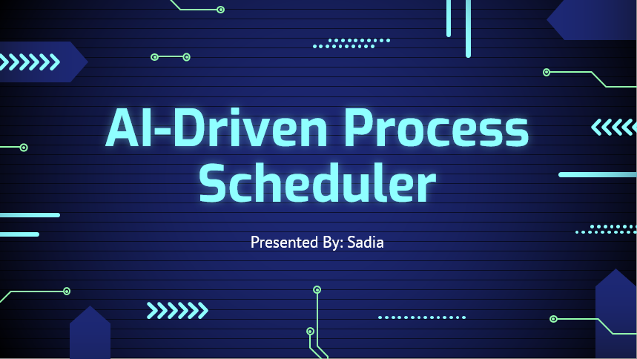
Future Scope
Real-world kernel-level implementation
Use of neural networks for better learning
Cloud-based workload prediction
Integration in smart operating systems and edge devices

Slide 21

CONCLUSIONS
AI brings adaptability and intelligence to CPU scheduling.
With real-time learning, an AI scheduler can boost performance and efficiency better than traditional static methods.
This project is a step toward next-generation smart operating systems.

Slide 22
Do you have any questions?
Thanks!
A PICTURE IS WORTH A THOUSAND WORDS

