Slide 1
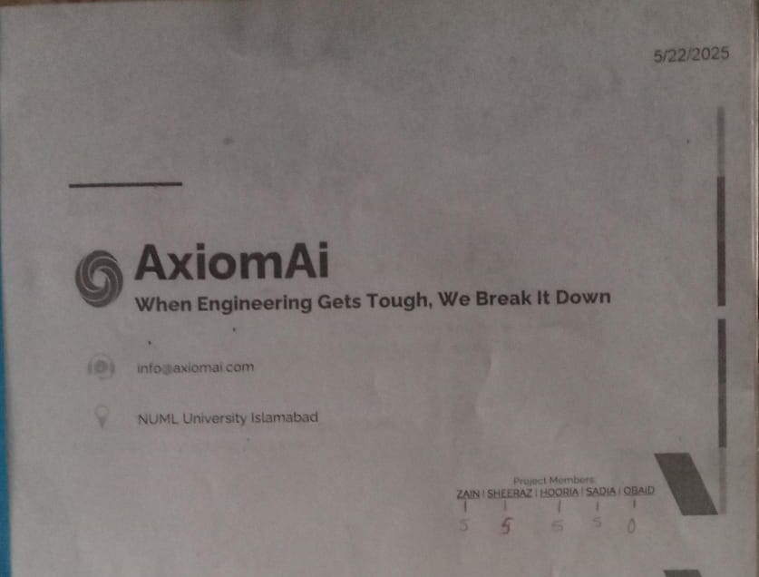

Slide 2


AxiomAi When Engineering Gets Tough, We Break It Down
info@axiomai.com
NUML University Islamabad
Project Members: ZAIN | SHEERAZ | HOORIA | SADIA | OBAID

Slide 3
Problem
Education
🎓 Engineering students struggle to understand complex concepts during video lectures.
Tools
📚 Traditional tools like notes and textbooks lack real-time, personalized support.
The goal
💡 Students need instant, simplified explanations tailored to their level.

Slide 4



Solution
AxiomAi – An AI assistant that simplifies engineering videos.
Integrates with YouTube to detect technical terms in real-time.
Provides clickable definitions, AI-generated explanations, and revision tools.

Slide 5
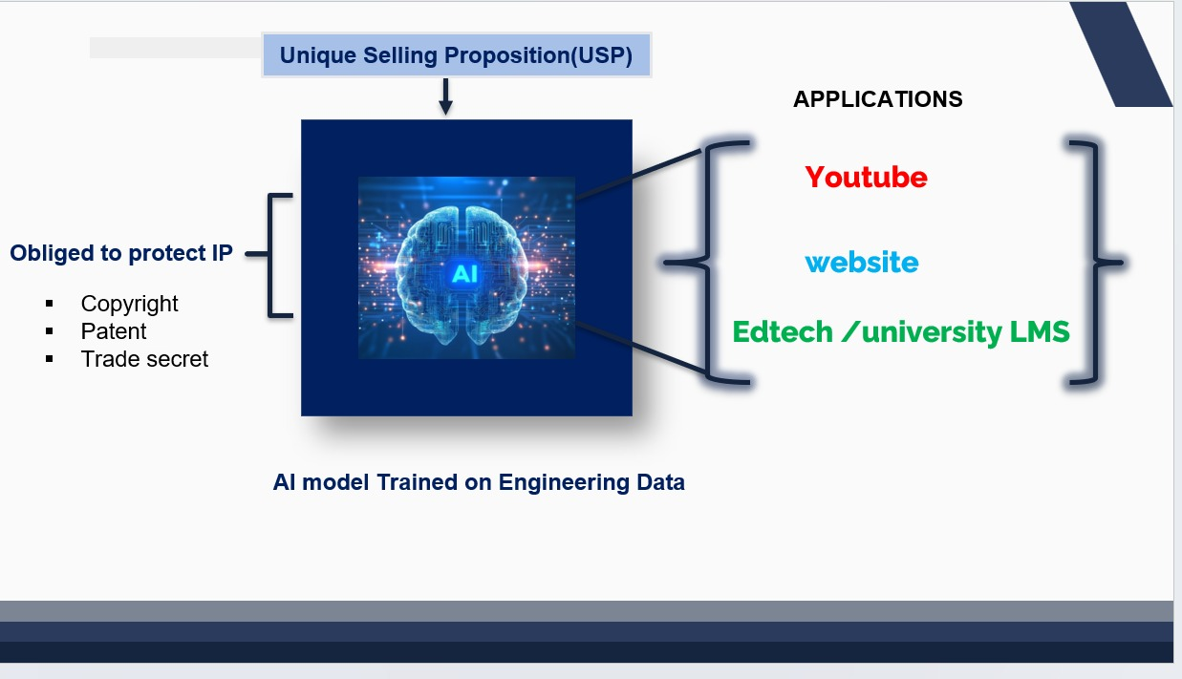

Slide 6
Opportunity & Target Market
EdTech market: $215B (2024) → $773B (2033)
$215B in 2024
Target Audience:
University students (18–26), STEM majors
EdTech companies, universities, MOOC platforms
$773B in 2033
AI in Education: Growing 38% CAGR

Slide 7
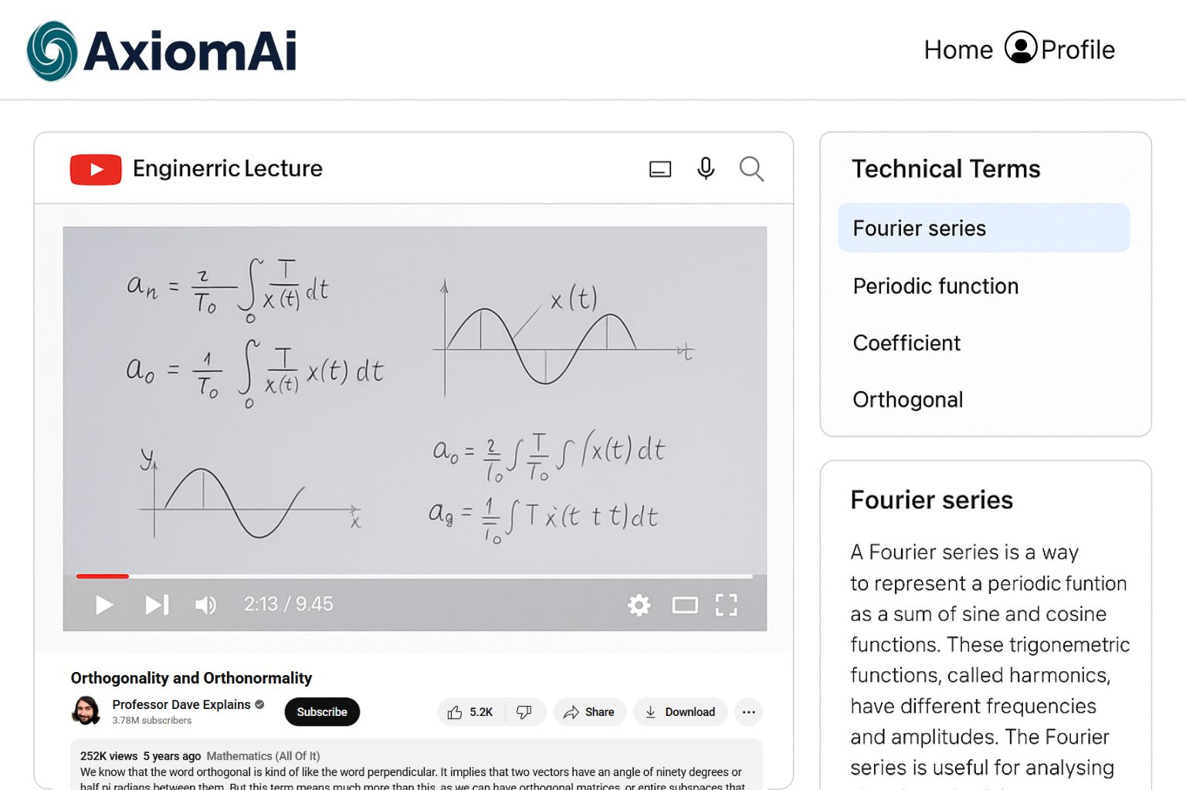
Prototype
Extracts technical terms from video/audio
Web app + Chrome extension
Explains concepts using
textbook-trained models
Mobile apps, LMS integration

Slide 8
Competition
PLATFORM | Ai Support | Focus on Engineering | Real-Time Video Help
Khan Academy | ❌ | ❌ | ❌
Coursera | ❌ | ❌ | ❌
Socratic | ✅ | ❌ | ❌
AxiomAi | ✅ | ✅ | ✅

Slide 9
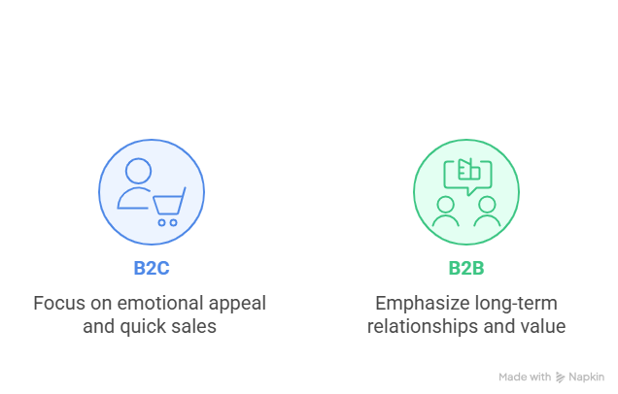
Marketing and Sales
B2C (Students)
B2B (Institutions):
YouTube ads
Student ambassador programs
Freemium-to-paid conversion
Direct outreach
Demos & pilots
Licensing deals

Slide 10
Management Team
Team
Advisor
Sadia | Project Manager
Sheeraz Ali | Ai Developer
Zain Ali | Front End
Hooria Sajid | Marketing
Ubaid | Back End
Ma’am Maryam | AI/NLP
Dr Naveed | Inovation
Mr. Kamran | Business

Slide 11
RS 500,000
OR
173 Monthly users (RS 500 Each)
Financial Snapshot
Estimated Year 1 Cost:
Break-Even:
2 university clients (PKR 500,000/year each)
Revenue Model
B2C Subscriptions
B2B Licensing

Slide 12
Business Milestones
2025
2026
2027
Business Plan, Mentor onbording
Beta Testing
First License Deal
National Scaling,
Seed Funding
Q2
Q3
Q4
Q1
Q2
Q3
UP
MVP Development
Chrome Extention Release
Mobile App,
Multi Language Support

Slide 13
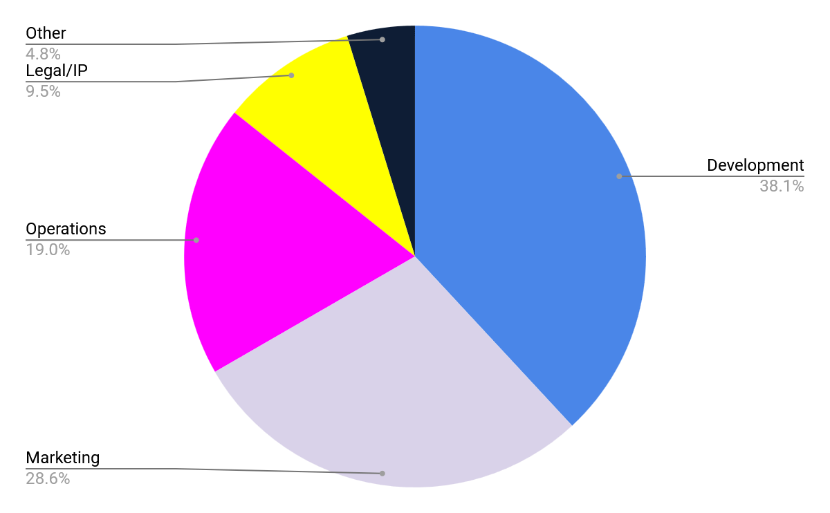
Funding Required
Finalize MVP
Cloud & GPU infrastructure
Marketing campaigns
IP registration
Other
Funding Required:

Slide 14
Summary
Point 1
Point 2
Point 3
Solving a real student pain point
Unique AI-powered solution tailored for engineering
Validated market need with growth potential
Point 4
Point 5
Passionate, capable founding team
Scalable business model (B2C + B2B)

Slide 15
Thanks!
Do you have any questions?
"Let’s revolutionize engineering education together!"

