Slide 1
CU Admission Shelter
Submitted by:
Md.Zahin Uddin,
Swapnil Diganta Thakur,
Sadia Sharmin ,
Akramul Houqe
ID : 17701052
17701079,
17701088,
17701096
Dept. of Computer Science & Engineering
University of Chittagong
Date: 12/02/2020
Course Title: Web engineering Lab Course Code: CSE-616

Slide 2
Outline
Motivation
Information Gathering
Feasibility Analysis
Entity-Relationship (ER) Diagram
Data Flow Diagram (DFD)
Use Case Diagram
Features of Our Proposed System
System Development Approach
Testing and Maintenance
Snapshot of the Implemented System
Conclusion

Slide 3
Motivation
In Existing System:
Difficult to find a place for staying
Needs a lot of time to contact with a university student
Quering for a place through social medium like facebook
Individual query kills a lot of time
Tension of finding a place may affect student’s concentration of
study.
The target of our project is trying to mitigate this problems .

Slide 4
Motivation
CU Admission Shelter
Online based system
Secure
Time-efficient
Easy to use

Slide 5
Information Gathering
We interviewed a number of people who are related with our developed system :
Local College Students
Current University Students

Slide 6
Feasibility Analysis
Manual System
CU Admission Shelter System
Needs to be active in
social media
Time consuming
Costly
No need to be active in
social media
Time saving
No significant cost

Slide 7
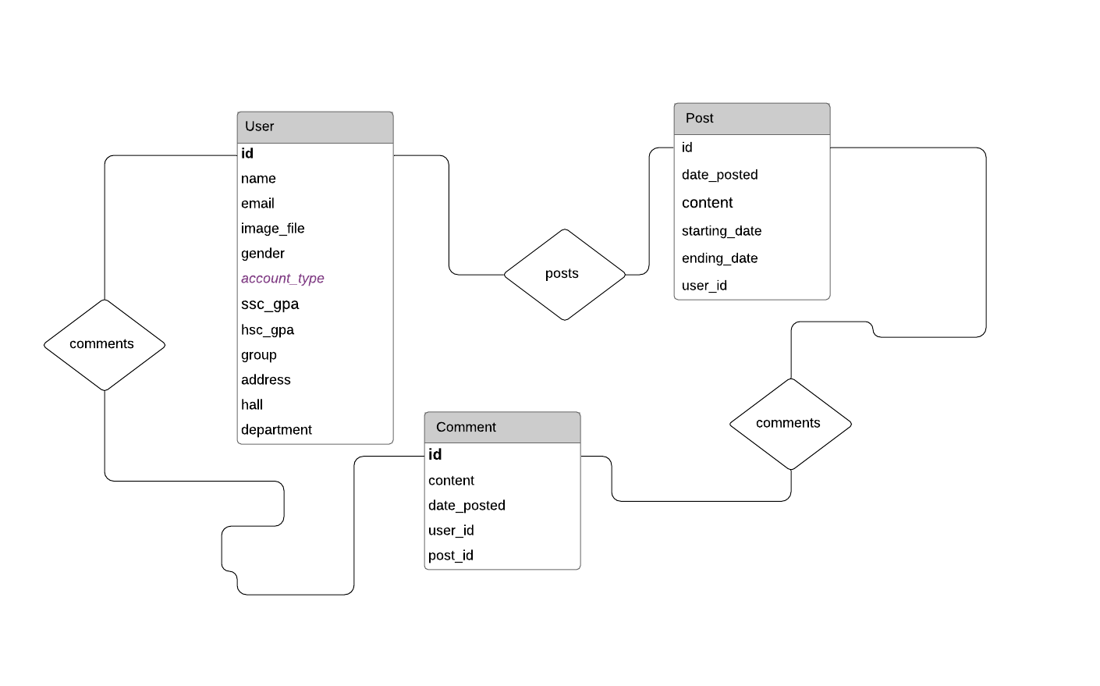
E-R Diagram

Slide 8
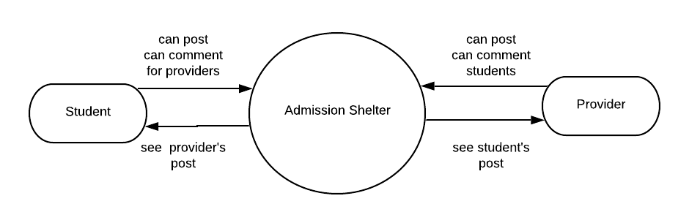
Data Flow Diagram (Level 0)

Slide 9
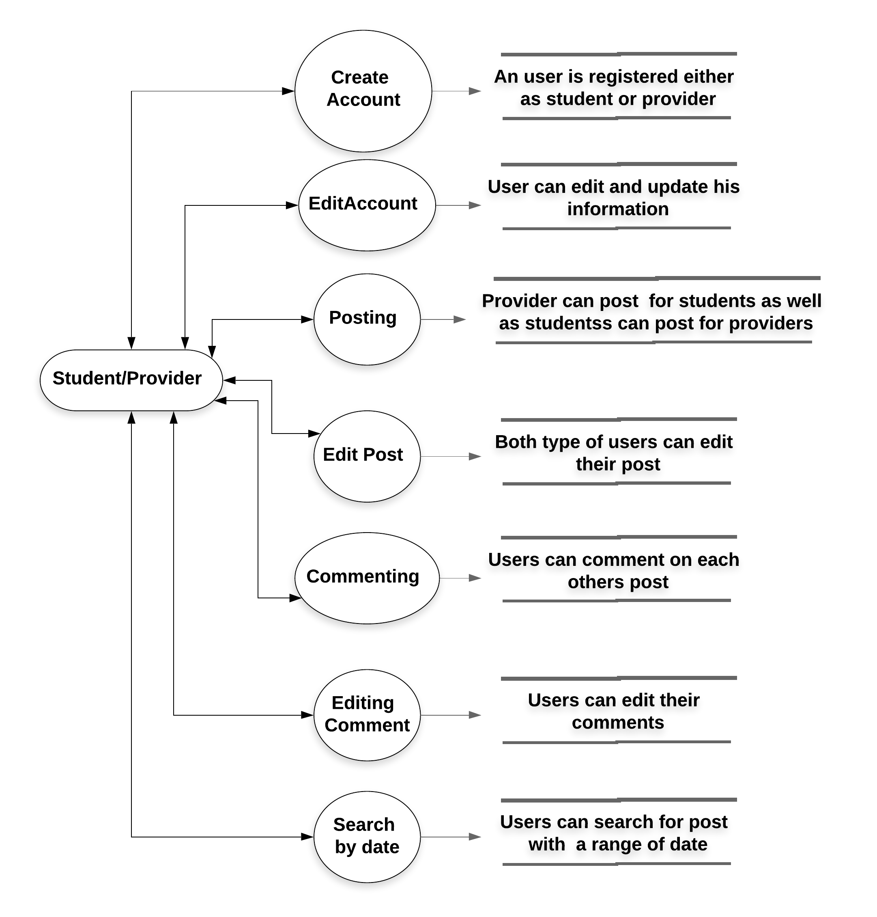
Data Flow Diagram (Level 1)

Slide 10
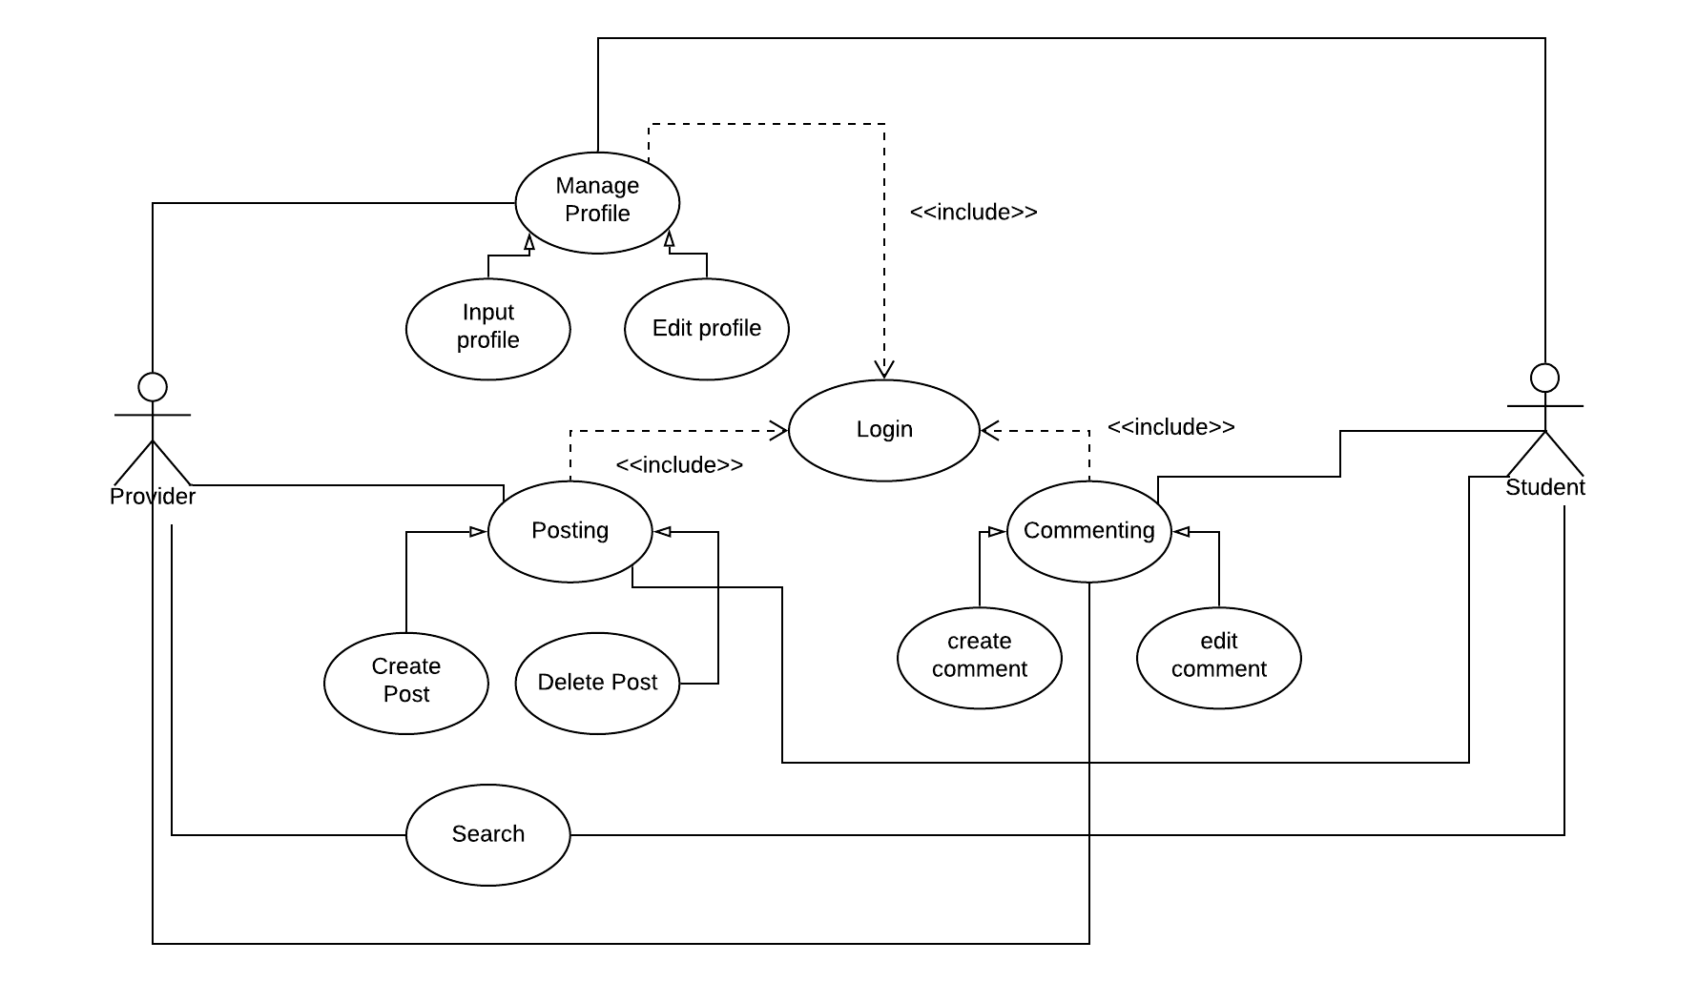
Use Case Diagram

Slide 11
Features of Our Proposed System
Used flask web framework
Student and Providers can create and edit profile
JQuery form validation during registration
Search seat based on date
IFrame for map
Retrieve the user's information
Students and Providers can create and view post
Students and Providers can edit post and delete post
Comment on post , edit comment and delete comment
View Hall details and visit University website and Admission test website

Slide 12
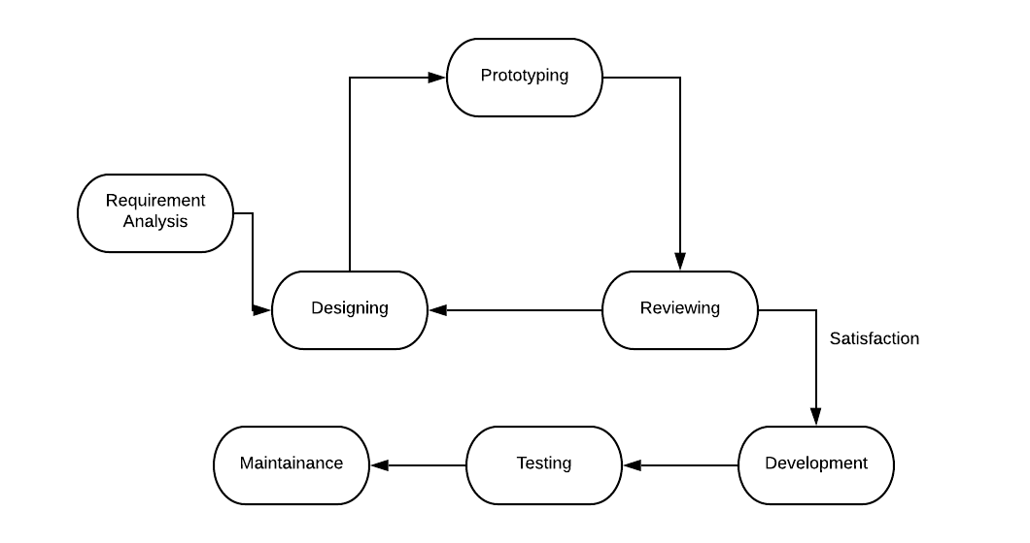
System Development Approach

Slide 13
Testing
Unit testing
Integration testing
Link testing
Functionality Testing
Interface testing
Database Testing

Slide 14
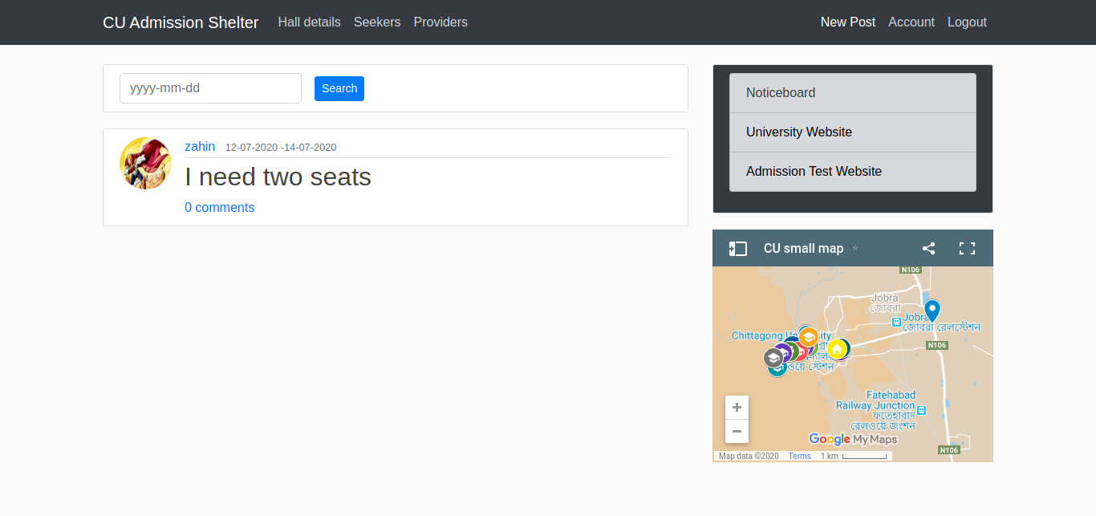
Project Demonstration
Home page

Slide 15
Conclusion
This project is for helping those students who are very much in need of a safe place in their “Admission” time.
Our created system will ease their load as they don’t have to worry about getting a good place to stay
Our plan is to improve this site which will work for all universities in our country

