Slide 1
Internship
Under
Minds Solvit Pvt LTD
Submitted by:
SADIA TAZEEN
(3pd15scn12)

Slide 2
Contents:
Introduction about Industry
Objectives
Description of training
Proposed case study
Conclusion

Slide 3
About Industry: Minds Solvit Pvt Ltd
Introduction: First IT company in Hyd/Kar.
History: Established in 2013.
Departments: Software development team
UI Team
QA department: CEO Testing Team
Solutions QA Team
Product QA Team
Automation Testing Team
Business Analyst
Marketing Team

Slide 4
Continue…….!!!!
Services: website designing, web development, web consulting, online applications development, search engine optimization and other types of internet marketing solutions.
Major Milestone:
“Entrepreneur of the year in IT for the year 2015” by Silicon India Magazine.
“Indian Leadership Award for Industrial Development”.
“Fastest Growing Indian Company Excellence Award”.
“Awarded One among top twenty Software QA Companies in India by Silicon India Magazine”.

Slide 5
Objectives:
Software development methodology → AGILE
Distributed Version Control System → GITHUB
Front end frame work →BOOTSTRAP

Slide 6
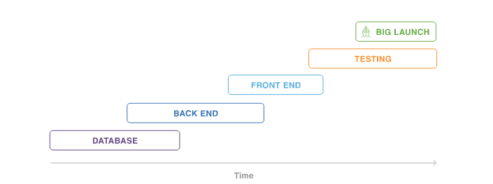
Software development methodology → AGILE
AGILE is a methodology that promotes continuous iteration of development and testing throughout the software development life cycle of the project.
Waterfall versus Agile:

Slide 7
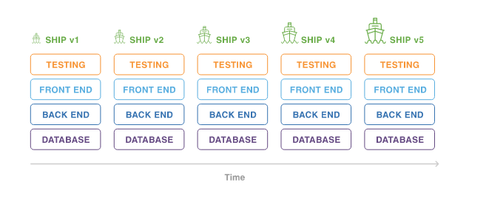
Continue….!!!
Advantages are:
1)It removes the critical path.
2)It interacts with the product during the development.
Build Great Agile Program:
Roadmap
Requirements
Backlogs
Delivery Vehicles
Run on trust

Slide 8
Distributed Version Control System →GITHUB
Terminologies:
Local repository
Branches
Push
Pull
Commits
Advantages:
Free & open source
Fast & Small
Implicit backup
Security
No need of powerful hardware
Easier Branching

Slide 9
Front-end framework→ BOOTSTRAP
Bootstrap is the most popular HTML,CSS & JavaScript framework for developing websites.
It is a free front-end framework for faster & easier web development.
It include HTML & CSS based design templates for Typography,Forms,Bottons,Tables,Navigation,Models,Images etc.
It has the ability to create responsive designs for phones & large desktops.
How to get Bootstrap?
Download from getbootstrap.com
Include bootstrap from a CDN

Slide 10
Advantages of Bootstrap:
Easy to use: With a basic knowledge of HTML & CSS
Responsive feature: In a phone & Tablets, Desktops.
Browser Compatibility: It is compatible with all modern browsers(Internet Explorer, Chrome, Firefox, Opera, Safari) etc.
It contains beautiful and functional built-in components which are easy to customize.
Best of all it is open source.

Slide 11
Proposed case study
Development team
This team deals with the different development technological tools like
Mongo DB,
Node js,
Express js etc.
Testing Team
This team deals with the different testing tools on automation & manual testing like
Test rail
Jera
Selenium
Jmeter etc.

Slide 12
THANK YOU
***********

