Slide 1
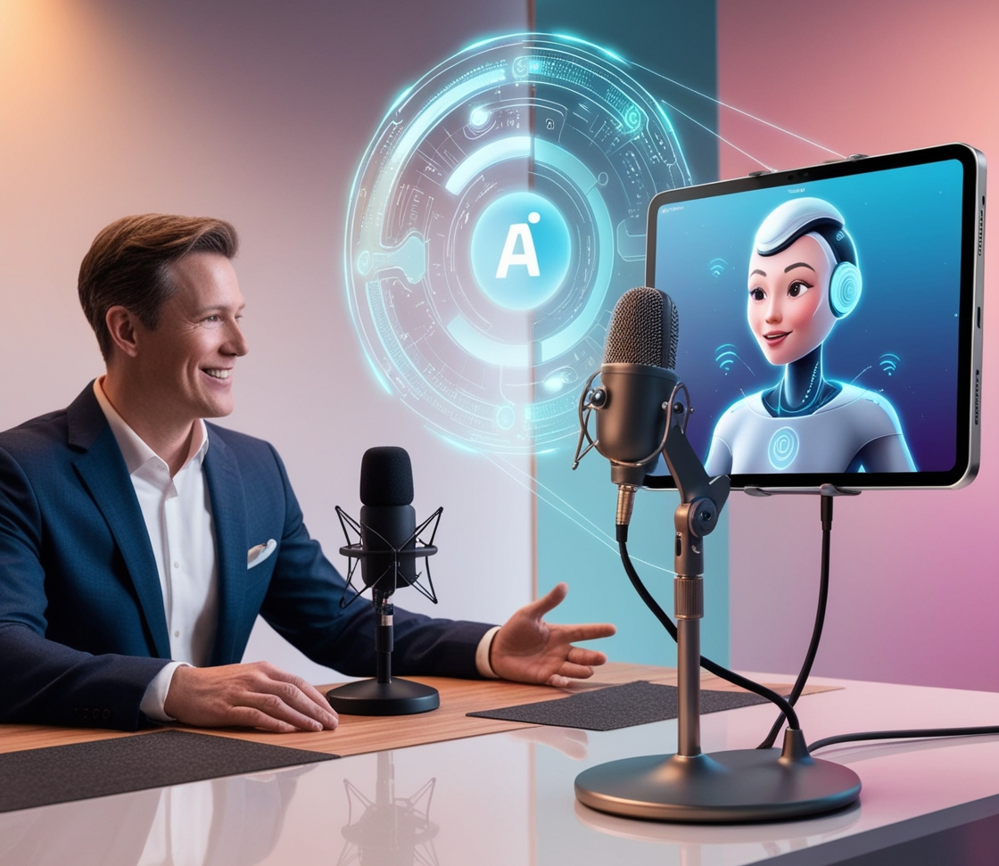

PodVerse
Scope Presentation
GROUP MEMBERS
SUPERVISOR
Ms. Saneeha Amir
Department of Computer Science
Rabeea Chughtai
SP22-BCS-079
Sadia Imran
SP22-BCS-087
18 December 2024

Slide 2
High Costs
Equipment, editing, and platform costs make quality podcasting expensive.
Problem Statement
/02
Aspiring journalists, small business owners, entrepreneurs, and content creators face barriers in podcast production, These challenges hinder consistent, high-quality content creation and limit audience reach.
Skills Gap
Limited technical skills or time for production and editing work.
Guest Access
Limited access to reliable or notable guests for consistent episodes.
02
Audience Reach
Difficulty reaching a broad audience, limiting growth potential.
03
01
04

Slide 3
Problem Statement
/02
Aspiring journalists, small business owners, entrepreneurs, and content creators face barriers in podcast production, These challenges hinder consistent, high-quality content creation and limit audience reach.
High Costs
Equipment, editing, and platform costs make quality podcasting expensive.
Skills Gap
Limited technical skills or time for production and editing work.
Guest Access
Limited access to reliable or notable guests for consistent episodes.
02
03
Audience Reach
Difficulty reaching a broad audience, limiting growth potential.
01
04

Slide 4
Problem Solution
/03
Voice Simulation
AI agent as hosts and guests enable creators to produce diverse and engaging content independently.
01

Slide 5
Problem Solution
/03
Recording, Editing, and Publishing
Streamlined processes reduce technical barriers and save time.
02

Slide 6
Problem Solution
/03
Intuitive design ensures accessibility for users with minimal technical expertise.
User-Friendly Interface
03

Slide 7
Problem Solution
/03
04
Avatar Videos
enabling users to build their brands and share their stories effectively with their target audiences.

Slide 8

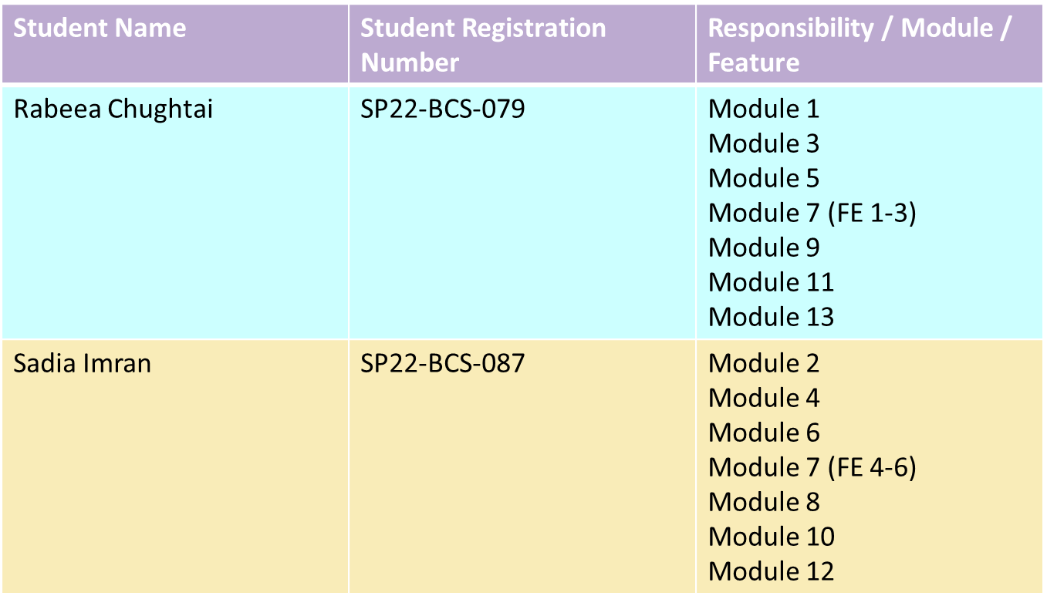
MODULE-BASED WORK DIVISION

Slide 9
/05
MODULES
01
User Authentication
Enables secure account creation, login, and session management to ensure only authorized users access the platform.
02
Voice Cloning
Allows users to record, preview, and clone voices, with access to an AI-generated voice library for enhanced customization.
03
Voice Cloning
Allows users to record, preview, and clone voices, with access to an AI-generated voice library for enhanced customization.
04
Voice Cloning
Allows users to record, preview, and clone voices, with access to an AI-generated voice library for enhanced customization.

Slide 10
/05
MODULES
01
User Authentication
Enables secure account creation, login, and session management to ensure only authorized users access the platform.
02
Voice Cloning
Allows users to record, preview, and clone voices, with access to an AI-generated voice library for enhanced customization.
03
Voice Cloning
Allows users to record, preview, and clone voices, with access to an AI-generated voice library for enhanced customization.
04
Voice Cloning
Allows users to record, preview, and clone voices, with access to an AI-generated voice library for enhanced customization.

Slide 11
/05
MODULES
01
User Authentication
Enables secure account creation, login, and session management to ensure only authorized users access the platform.
Voice Cloning
02
Allows users to record, preview, and clone voices, with access to an AI-generated voice library for enhanced customization.
03
Voice Cloning
Allows users to record, preview, and clone voices, with access to an AI-generated voice library for enhanced customization.
04
Voice Cloning
Allows users to record, preview, and clone voices, with access to an AI-generated voice library for enhanced customization.

Slide 12
/05
MODULES
01
User Authentication
Enables secure account creation, login, and session management to ensure only authorized users access the platform.
Voice Cloning
02
Allows users to record, preview, and clone voices, with access to an AI-generated voice library for enhanced customization.
Agent Customization
03
Enables users to personalize their AI agent with a name, voice, and avatar to match their podcast style.
04
Voice Cloning
Allows users to record, preview, and clone voices, with access to an AI-generated voice library for enhanced customization.

Slide 13
/05
MODULES
01
User Authentication
Enables secure account creation, login, and session management to ensure only authorized users access the platform.
02
Voice Cloning
Allows users to record, preview, and clone voices, with access to an AI-generated voice library for enhanced customization.
Agent Customization
03
Enables users to personalize their AI agent with a name, voice, and avatar to match their podcast style.
Podcast Creation & Publishing
04
Simplifies podcast production with real-time recording, minimal editing tools, and export options for publishing.

Slide 14
/06
MODULES
05
User Authentication
Enables secure account creation, login, and session management to ensure only authorized users access the platform.
06
Voice Cloning
Allows users to record, preview, and clone voices, with access to an AI-generated voice library for enhanced customization.
07
Voice Cloning
Allows users to record, preview, and clone voices, with access to an AI-generated voice library for enhanced customization.

Slide 15
/06
MODULES
05
Multimedia Content Upload
Automates creating podcast videos with avatars, audio, and visuals for enhanced presentation..
06
Voice Cloning
Allows users to record, preview, and clone voices, with access to an AI-generated voice library for enhanced customization.
07
Voice Cloning
Allows users to record, preview, and clone voices, with access to an AI-generated voice library for enhanced customization.

Slide 16
/06
MODULES
05
Multimedia Content Upload
Automates creating podcast videos with avatars, audio, and visuals for enhanced presentation..
06
Subscription & Payment
Manages access to content with free trials, secure payments, and subscription control, ensuring continued service.
07
Voice Cloning
Allows users to record, preview, and clone voices, with access to an AI-generated voice library for enhanced customization.

Slide 17
/06
MODULES
05
Multimedia Content Upload
Automates creating podcast videos with avatars, audio, and visuals for enhanced presentation..
06
Subscription & Payment
Manages access to content with free trials, secure payments, and subscription control, ensuring continued service.
FAQs Chatbot
07
Offers instant, accurate answers to user queries about the platform, improving user experience and support.

Slide 18
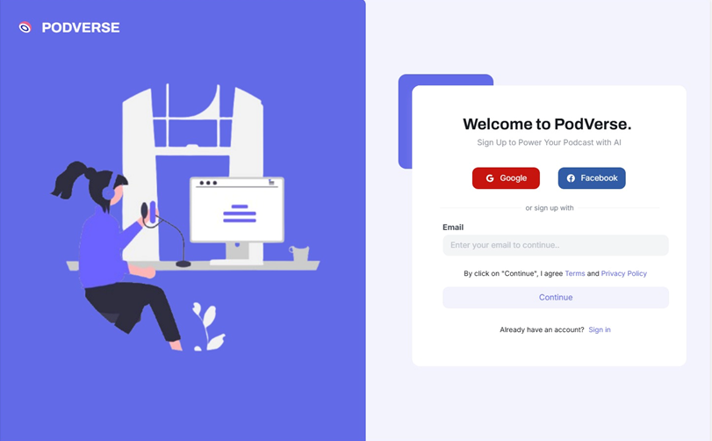
Product Prototype
/07
reallyygreatsite.com

Slide 19
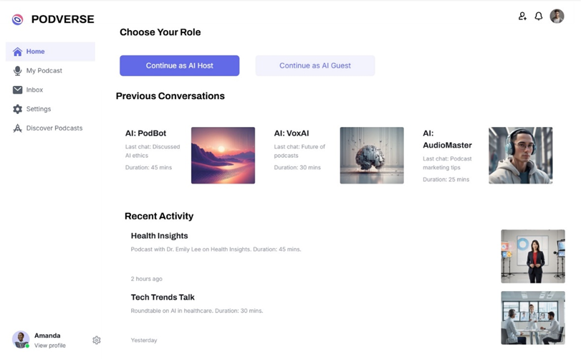
Product Prototype
/08
reallyygreatsite.com

Slide 20
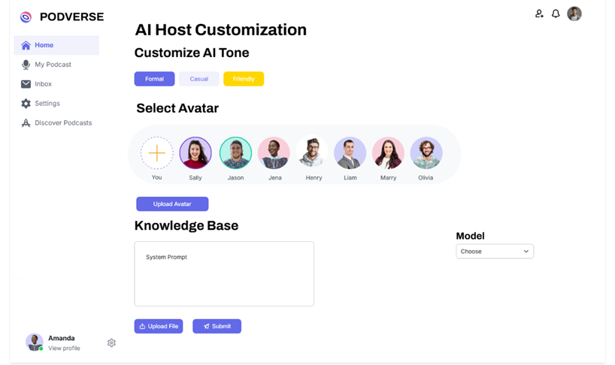
Product Prototype
/09
reallyygreatsite.com

Slide 21
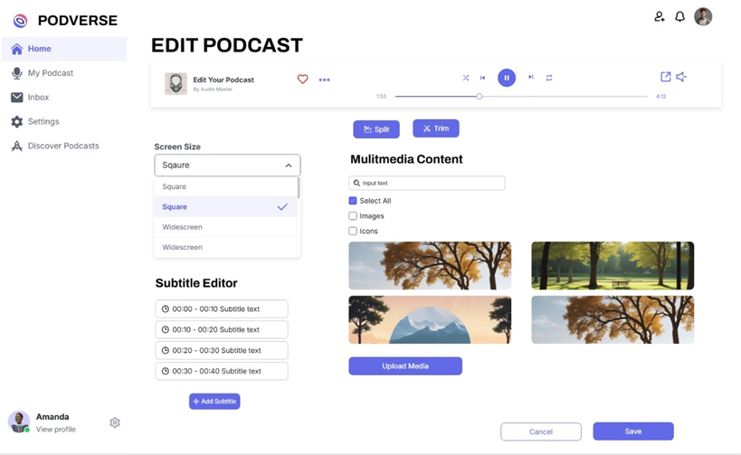
Product Prototype
/10
reallyygreatsite.com

Slide 22
/11
Thank You

