Slide 1
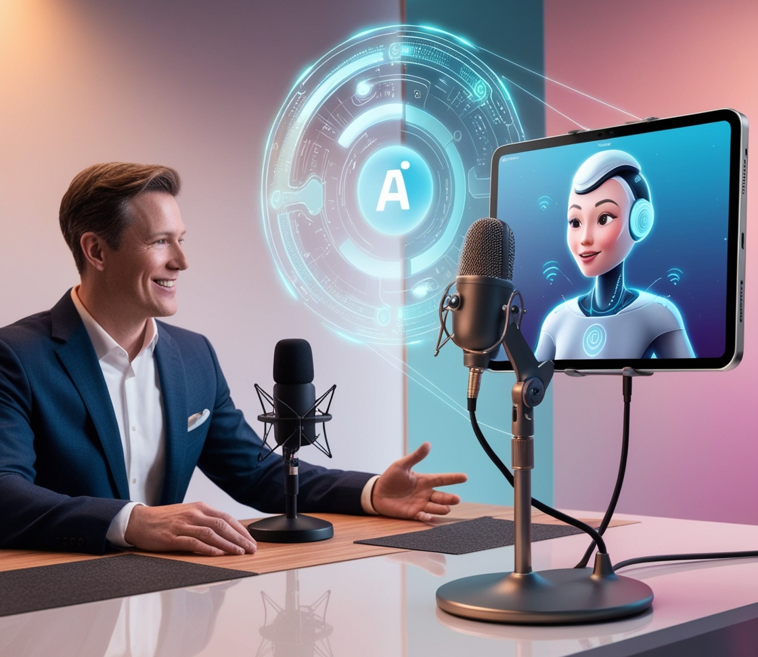

PodVerse
SRS Presentation
GROUP MEMBERS
SP22-BCS-079 Rabeea Chughtai
SP22-BCS-087 Sadia Imran
SUPERVISOR
Ms. Saadia Maqbool
Department of Computer Science
10th March 2025

Slide 2
High Costs
Equipment, editing, and platform costs make quality podcasting expensive.
Problem Statement
/02
Aspiring journalists, small business owners, entrepreneurs, and content creators face barriers in podcast production, These challenges hinder consistent, high-quality content creation and limit audience reach.
Skills Gap
Limited technical skills or time for production and editing work.
Guest Access
Limited access to reliable or notable guests for consistent episodes.
02
Audience Reach
Difficulty reaching a broad audience, limiting growth potential.
03
01
04

Slide 3
Problem Statement
/02
Aspiring journalists, small business owners, entrepreneurs, and content creators face barriers in podcast production, These challenges hinder consistent, high-quality content creation and limit audience reach.
High Costs
Equipment, editing, and platform costs make quality podcasting expensive.
Skills Gap
Limited technical skills or time for production and editing work.
Guest Access
Limited access to reliable or notable guests for consistent episodes.
02
03
Audience Reach
Difficulty reaching a broad audience, limiting growth potential.
01
04

Slide 4
AI-powered hosts and guests dynamically interact in podcasts, ensuring smooth discussions without requiring real guest coordination.
Problem Solution
/03
Seamless Hosting
AI agent as hosts and guests interacts in podcasts, ensuring smooth discussions without requiring real guest coordination.
01

Slide 5
Problem Solution
/03
Voice Cloning
Voice cloning technology enables users to create realistic voices, offering personalized narration and branding.
02

Slide 6
Problem Solution
Users can seamlessly export, distribute, and monetize podcasts with built-in publishing and audience engagement tools.
/03
Effortless Publishing
03

Slide 7
Problem Solution
/03
04
Video Creation
PodVerse generates video podcasts by syncing avatars and visual elements with the audio, creating engaging content.

Slide 8





/09
MODULES
01
User Authentication & Profile Management
Enables secure account creation, login, password recovery, profile customization, and activity tracking for a personalized experience.
02
Voice Cloning
Allows users to record, upload, preview, and clone voices, with access to voice library for enhanced customization.
03
Knowledge Base Setup
Enables data uploads, processing, retrieve accurate podcast information from structured data.
04
RAG Retrieval
Enhances AI accuracy by retrieving and ranking knowledge base information to provide fact-based, quality responses.

Slide 9


/14
MODULES
05
Agent Customization
Empowers users to personalize AI agents with names, voices, and avatars.
06
Podcast Audio Creation
Provides tools for recording, editing, and exporting podcast audio in MP3/WAV.
07
AI Host
Manages podcast flow, introduces topics, and summarizes episodes.
08
AI Guest
Responds dynamically to user queries, adding depth to conversations.
09
Podcast Video Creation & Publishing
Transforms audio podcasts into engaging video content with avatars, templates, split-screen layouts, and publishing.

Slide 10

/19
MODULES
10
Subscription & Payment
Manages user subscriptions, payments, renewals, and secure transactions for premium content access.
11
FAQs Chatbot
Offers instant support through an AI chatbot for user queries.
12
Audience Engagement
Enhances interaction through notifications, trending content highlights, podcast summaries, and a communication platform.
13
Admin Panel & Analytics
Provides administrative tools for user management, content moderation, subscription handling, and podcast performance analytics.

Slide 11
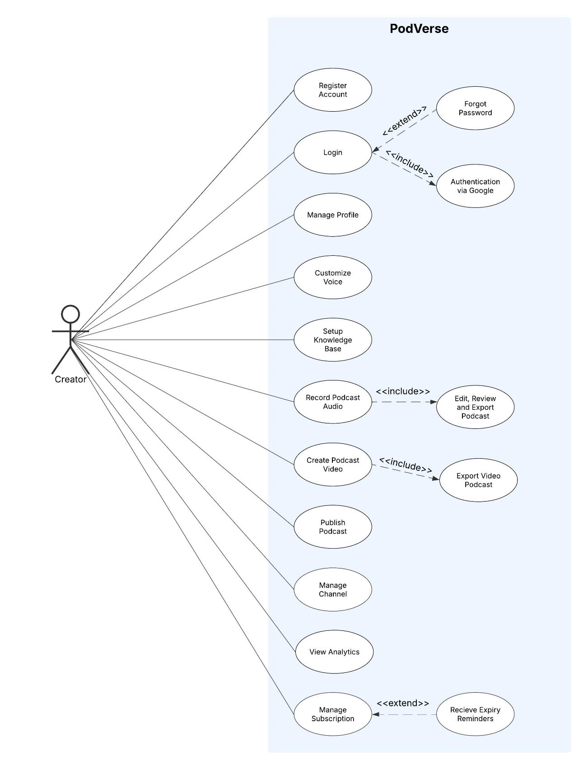
Creator Use Case Diagram
/07
reallyygreatsite.com

Slide 12
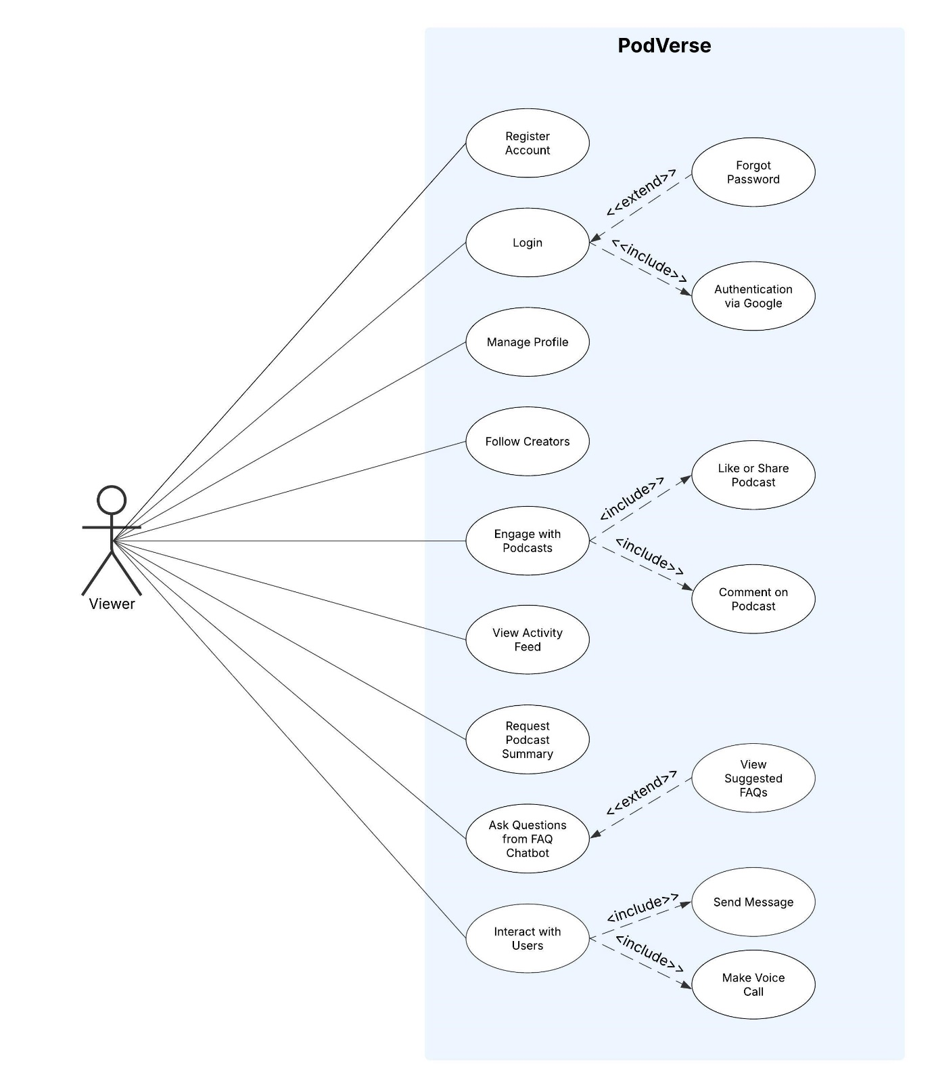
Viewer Use Case Diagram
/07
reallyygreatsite.com

Slide 13
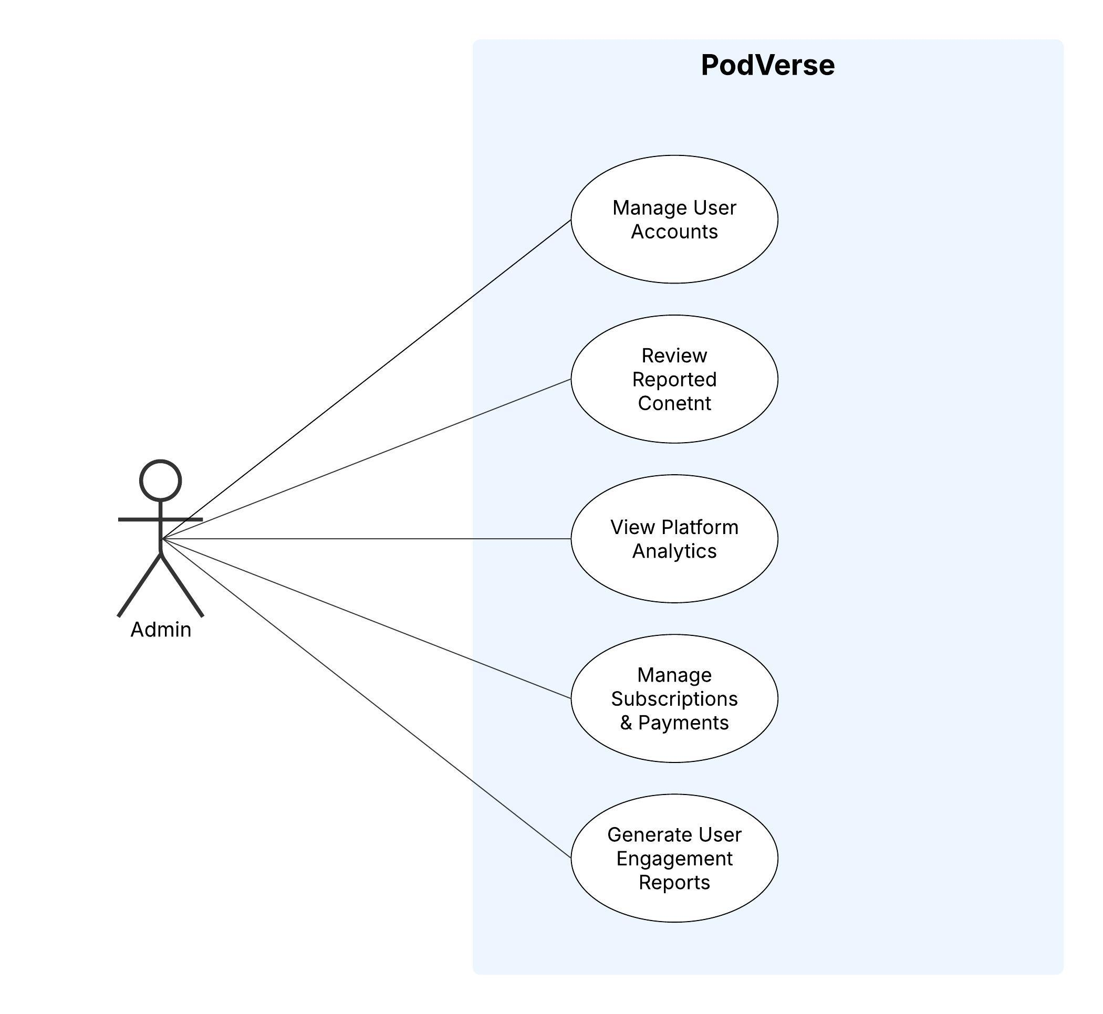
Admin Use Case Diagram
/07
reallyygreatsite.com

Slide 14

Core Functional Requirements
Identifier | FR-50
Title | PodcastSession.StartRecording
Requirement | The system shall allow users to start recording a podcast session with AI-generated or real co-hosts.
Source | Rabeea
Rationale | Enables users to create and capture podcast content.
Business Rule | BR-22: Recording must start only after user confirmation.
Dependencies | FR-51
Priority | High
Identifier | FR-72
Title | PodcastAI.HostIntroduction
Requirement | The AI Host shall introduce the episode and set the discussion agenda.
Source | Rabeea
Rationale | Provides a structured and engaging podcast experience.
Business Rule | BR-43: AI introductions must align with the selected episode theme.
Dependencies | FR-71
Priority | High
Identifier | FR-73
Title | PodcastAI.GuestResponses
Requirement | The AI Guest shall dynamically respond to user queries and share insights.
Source | Sadia
Rationale | Ensures an interactive and engaging podcast conversation.
Business Rule | BR-44: AI responses must be contextually relevant.
Dependencies | FR-72
Priority | High
Identifier | FR-116
Title | Admin.TakeActionOnReportedContent
Requirement | The system shall allow admins to approve, remove, or warn users regarding reported content.
Source | Admin
Rationale | Enables proper handling of flagged content.
Business Rule | BR-89: All actions must be logged for audit purposes.
Dependencies | FR-115
Priority | High

Slide 15


/10
Non-Functional Requirements
Performance
Generate podcast within standard time.
Security
All passwords and transactions must be encrypted.
Only authenticated users can create or edit podcasts.
Usability
Designed for ease of use, especially for non-technical users.
Integrity
Podcast recordings should remain unaltered unless edited by the user.

Slide 16
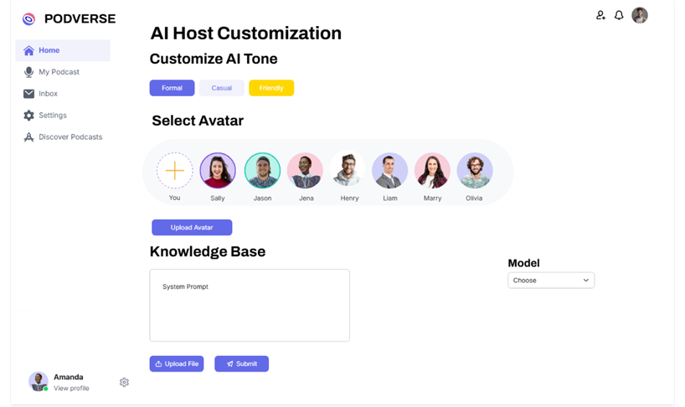
Product Prototype
/09
reallyygreatsite.com

Slide 17
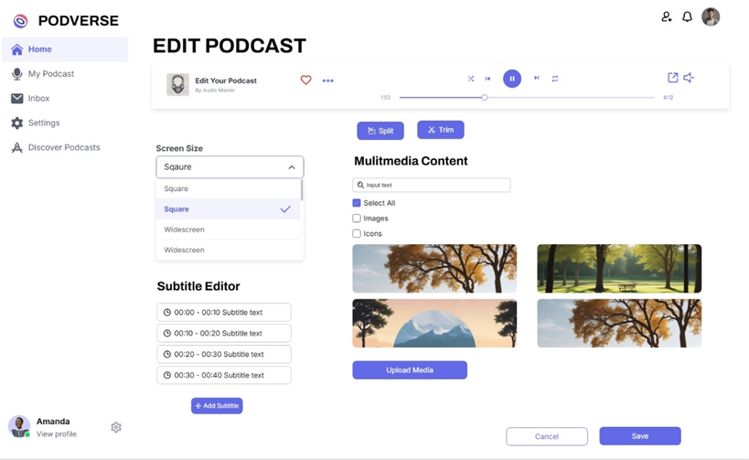
Product Prototype
/10
reallyygreatsite.com

Slide 18
/11
Thank You

