Slide 1
Chapter 22
Software Configuration Management
Slide Set to accompany
Software Engineering: A Practitioner’s Approach, 7/e
by Roger S. Pressman
Slides copyright © 1996, 2001, 2005, 2009 by Roger S. Pressman
For non-profit educational use only
May be reproduced ONLY for student use at the university level when used in conjunction with Software Engineering: A Practitioner's Approach, 7/e. Any other reproduction or use is prohibited without the express written permission of the author.
All copyright information MUST appear if these slides are posted on a website for student use.
These slides are designed to accompany Software Engineering: A Practitioner’s Approach, 7/e (McGraw-Hill, 2009) Slides copyright 2009 by Roger Pressman.
1

Slide 2
Software configuration
The output of the software process is information that may be divided into three broad categories:
(1) computer programs (both source level and executable forms),
(2) work products that describe the computer programs (targeted at various stakeholders), and
(3) data or content (contained within the program or external to it). The
items that comprise all information produced as part of the software process are collectively called a software configuration.
These slides are designed to accompany Software Engineering: A Practitioner’s Approach, 7/e (McGraw-Hill, 2009) Slides copyright 2009 by Roger Pressman.

Slide 3
Baselines
A baseline is a software configuration management concept that helps you to control change without seriously impeding justifiable change. The IEEE (IEEE Std. No. 610.12-1990) defines a baseline as:
A specification or product that has been formally reviewed and agreed upon, that thereafter serves as the basis for further development, and that can be changed only through formal change control procedures.
For example, the elements of a design model have been documented and reviewed. Errors are found and corrected. Once all parts of the model have been reviewed, corrected, and then approved, the design model becomes a baseline.
These slides are designed to accompany Software Engineering: A Practitioner’s Approach, 7/e (McGraw-Hill, 2009) Slides copyright 2009 by Roger Pressman.

Slide 4
THE SCM REPOSITORY
A database that acts as the center for both accumulation and storage of software engineering information.
The SCM repository is the set of mechanisms and data structures that allow a software team to manage change in an effective manner.
These slides are designed to accompany Software Engineering: A Practitioner’s Approach, 7/e (McGraw-Hill, 2009) Slides copyright 2009 by Roger Pressman.

Slide 5
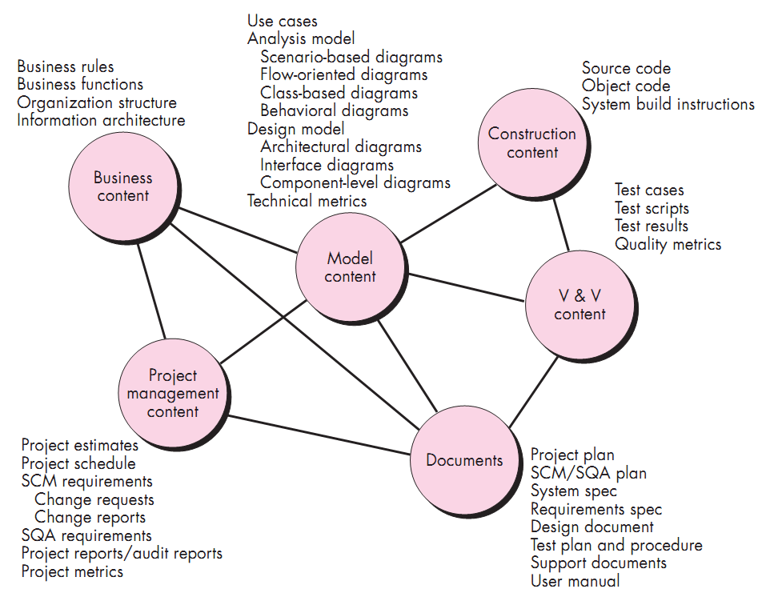
Content of the repository
These slides are designed to accompany Software Engineering: A Practitioner’s Approach, 7/e (McGraw-Hill, 2009) Slides copyright 2009 by Roger Pressman.

Slide 6
SCM Features- SCM Tools
Versioning
Dependency tracking and change management
Requirements tracing
Configuration management
Audit trails
These slides are designed to accompany Software Engineering: A Practitioner’s Approach, 7/e (McGraw-Hill, 2009) Slides copyright 2009 by Roger Pressman.

Slide 7
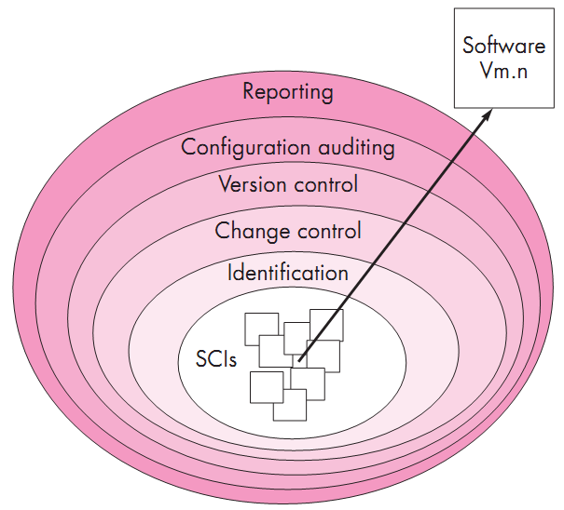
Layers of the SCM process
These slides are designed to accompany Software Engineering: A Practitioner’s Approach, 7/e (McGraw-Hill, 2009) Slides copyright 2009 by Roger Pressman.

Slide 8
Version Control
A version control system implements or is directly integrated with four major capabilities:
(1) a project database (repository) that stores all relevant configuration objects,
(2) a version management capability that stores all versions of a configuration object (or enables any version to be constructed using differences from past versions),
(3) a make facility that enables you to collect all relevant configuration objects and construct a specific version of the software.
(4) issues tracking (also called bug tracking) capability that enables the team to record and track the status of all outstanding issues associated with each configuration object.
These slides are designed to accompany Software Engineering: A Practitioner’s Approach, 7/e (McGraw-Hill, 2009) Slides copyright 2009 by Roger Pressman.

Slide 9
Version Control- Change Sets
A change set “captures all changes to all files in the configuration along with the reason for changes and details of who made the changes and when.”
These slides are designed to accompany Software Engineering: A Practitioner’s Approach, 7/e (McGraw-Hill, 2009) Slides copyright 2009 by Roger Pressman.

Slide 10
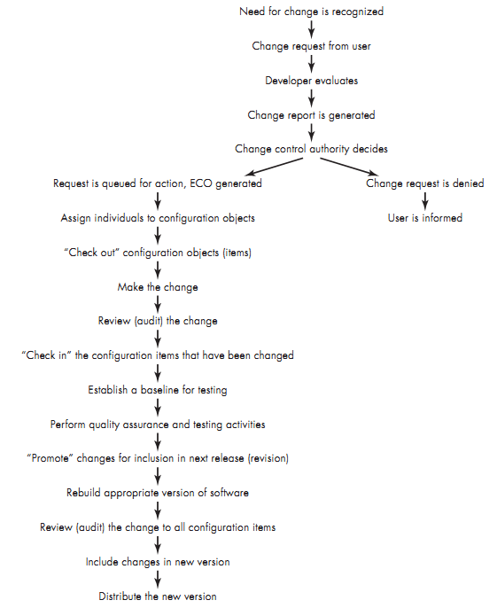
Change Control
Process
These slides are designed to accompany Software Engineering: A Practitioner’s Approach, 7/e (McGraw-Hill, 2009) Slides copyright 2009 by Roger Pressman.

