Slide 1
Chapter 27
Project Scheduling
Slide Set to accompany
Software Engineering: A Practitioner’s Approach, 7/e
by Roger S. Pressman
Slides copyright © 1996, 2001, 2005, 2009 by Roger S. Pressman
For non-profit educational use only
May be reproduced ONLY for student use at the university level when used in conjunction with Software Engineering: A Practitioner's Approach, 7/e. Any other reproduction or use is prohibited without the express written permission of the author.
All copyright information MUST appear if these slides are posted on a website for student use.
These slides are designed to accompany Software Engineering: A Practitioner’s Approach, 7/e (McGraw-Hill 2009). Slides copyright 2009 by Roger Pressman.

Slide 2
Why Are Projects Late?
an unrealistic deadline established by someone outside the software development group
changing customer requirements that are not reflected in schedule changes;
an honest underestimate of the amount of effort and/or the number of resources that will be required to do the job;
predictable and/or unpredictable risks that were not considered when the project commenced;
technical difficulties that could not have been foreseen in advance;
human difficulties that could not have been foreseen in advance;
miscommunication among project staff that results in delays;
a failure by project management to recognize that the project is falling behind schedule and a lack of action to correct the problem
These slides are designed to accompany Software Engineering: A Practitioner’s Approach, 7/e (McGraw-Hill 2009). Slides copyright 2009 by Roger Pressman.

Slide 3
Scheduling Principles
compartmentalization—define distinct tasks
interdependency—indicate task interrelationship
effort validation—be sure resources are available
defined responsibilities—people must be assigned
defined outcomes—each task must have an output
defined milestones—review for quality
These slides are designed to accompany Software Engineering: A Practitioner’s Approach, 7/e (McGraw-Hill 2009). Slides copyright 2009 by Roger Pressman.

Slide 4
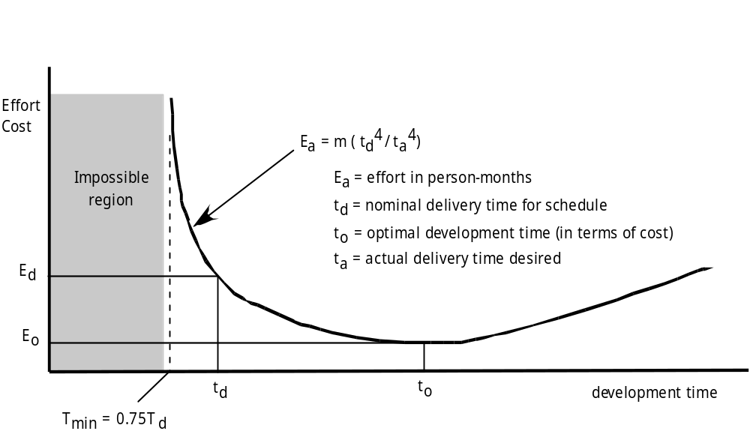
Effort and Delivery Time
These slides are designed to accompany Software Engineering: A Practitioner’s Approach, 7/e (McGraw-Hill 2009). Slides copyright 2009 by Roger Pressman.

Slide 5
Effort Allocation
“front end” activities
  customer communication
  analysis
  design
  review and modification
construction activities
  coding or code generation
testing and installation
  unit, integration
  white-box, black box
  regression
40-50%
15-20%
30-40%
These slides are designed to accompany Software Engineering: A Practitioner’s Approach, 7/e (McGraw-Hill 2009). Slides copyright 2009 by Roger Pressman.

Slide 6
Defining Task Sets
determine type of project
assess the degree of rigor required
identify adaptation criteria
select appropriate software engineering tasks
These slides are designed to accompany Software Engineering: A Practitioner’s Approach, 7/e (McGraw-Hill 2009). Slides copyright 2009 by Roger Pressman.

Slide 7
Timeline Charts
Tasks
Week 1
Week 2
Week 3
Week 4
Week n
Task 1
Task 2
Task 3
Task 4
Task 5
Task 6
Task 7
Task 8
Task 9
Task 10
Task 11
Task 12
These slides are designed to accompany Software Engineering: A Practitioner’s Approach, 7/e (McGraw-Hill 2009). Slides copyright 2009 by Roger Pressman.

Slide 8
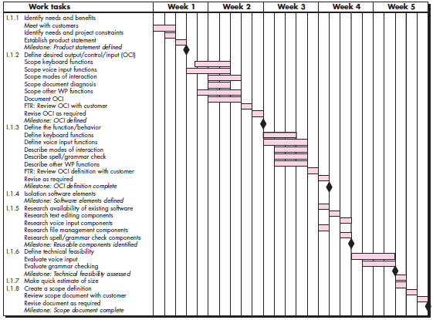
Use Automated Tools to
Derive a Timeline Chart
These slides are designed to accompany Software Engineering: A Practitioner’s Approach, 7/e (McGraw-Hill 2009). Slides copyright 2009 by Roger Pressman.

Slide 9
Schedule Tracking
  conduct periodic project status meetings in which each team member reports progress and problems.
  evaluate the results of all reviews conducted throughout the software engineering process.
  determine whether formal project milestones (the diamonds shown in Figure 27.3) have been accomplished by the scheduled date.
  compare actual start-date to planned start-date for each project task listed in the resource table.
  meet informally with practitioners to obtain their subjective assessment of progress to date and problems on the horizon.
  use earned value analysis to assess progress quantitatively.
These slides are designed to accompany Software Engineering: A Practitioner’s Approach, 7/e (McGraw-Hill 2009). Slides copyright 2009 by Roger Pressman.

Slide 10
Progress on an OO Project-I
Technical milestone: OO analysis completed
    All classes and the class hierarchy have been defined and reviewed.
    Class attributes and operations associated with a class have been defined and reviewed.
    Class relationships (Chapter 8) have been established and reviewed.
    A behavioral model (Chapter 8) has been created and reviewed.
    Reusable classes have been noted.
Technical milestone: OO design completed
    The set of subsystems (Chapter 9) has been defined and reviewed.
    Classes are allocated to subsystems and reviewed.
    Task allocation has been established and reviewed.
    Responsibilities and collaborations (Chapter 9) have been identified.
    Attributes and operations have been designed and reviewed.
    The communication model has been created and reviewed.
These slides are designed to accompany Software Engineering: A Practitioner’s Approach, 7/e (McGraw-Hill 2009). Slides copyright 2009 by Roger Pressman.

Slide 11
Progress on an OO Project-II
Technical milestone: OO programming completed
    Each new class has been implemented in code from the design model.
    Extracted classes (from a reuse library) have been implemented.
    Prototype or increment has been built.
Technical milestone: OO testing
    The correctness and completeness of OO analysis and design models has been reviewed.
    A class-responsibility-collaboration network (Chapter 6) has been developed and reviewed.
    Test cases are designed and class-level tests (Chapter 19) have been conducted for each class.
    Test cases are designed and cluster testing (Chapter 19) is completed and the classes are integrated.
    System level tests have been completed.
These slides are designed to accompany Software Engineering: A Practitioner’s Approach, 7/e (McGraw-Hill 2009). Slides copyright 2009 by Roger Pressman.

Slide 12
Earned Value Analysis (EVA)
Earned value
  is a measure of progress
  enables us to assess the “percent of completeness” of a project using quantitative analysis rather than rely on a gut feeling
  “provides accurate and reliable readings of performance from as early as 15 percent into the project.” [Fle98]
These slides are designed to accompany Software Engineering: A Practitioner’s Approach, 7/e (McGraw-Hill 2009). Slides copyright 2009 by Roger Pressman.

Slide 13
Computing Earned Value-I
The budgeted cost of work scheduled (BCWS) is determined for each work task represented in the schedule.
  BCWS_{i} is the effort planned for work task i.
  To determine progress at a given point along the project schedule, the value of BCWS is the sum of the BCWS_{i} values for all work tasks that should have been completed by that point in time on the project schedule.
The BCWS values for all work tasks are summed to derive the budget at completion, BAC. Hence,
BAC = ∑ (BCWS_{k}) for all tasks k
These slides are designed to accompany Software Engineering: A Practitioner’s Approach, 7/e (McGraw-Hill 2009). Slides copyright 2009 by Roger Pressman.

Slide 14
Computing Earned Value-II
Next, the value for budgeted cost of work performed (BCWP) is computed.
  The value for BCWP is the sum of the BCWS values for all work tasks that have actually been completed by a point in time on the project schedule.
“the distinction between the BCWS and the BCWP is that the former represents the budget of the activities that were planned to be completed and the latter represents the budget of the activities that actually were completed.” [Wil99]
Given values for BCWS, BAC, and BCWP, important progress indicators can be computed:
    Schedule performance index, SPI = BCWP/BCWS
    Schedule variance, SV = BCWP – BCWS
    SPI is an indication of the efficiency with which the project is utilizing scheduled resources.
These slides are designed to accompany Software Engineering: A Practitioner’s Approach, 7/e (McGraw-Hill 2009). Slides copyright 2009 by Roger Pressman.

Slide 15
Computing Earned Value-III
Percent scheduled for completion = BCWS/BAC
  provides an indication of the percentage of work that should have been completed by time t.
Percent complete = BCWP/BAC
  provides a quantitative indication of the percent of completeness of the project at a given point in time, t.
Actual cost of work performed, ACWP, is the sum of the effort actually expended on work tasks that have been completed by a point in time on the project schedule. It is then possible to compute
    Cost performance index, CPI = BCWP/ACWP
    Cost variance, CV = BCWP – ACWP
These slides are designed to accompany Software Engineering: A Practitioner’s Approach, 7/e (McGraw-Hill 2009). Slides copyright 2009 by Roger Pressman.

Slide 16
Example 27.12
Assume you are a software project manager and that you’ve been asked to compute earned value statistics for a small software project.
The project has 56 planned work tasks that are estimated to require 582 person-days to complete.
At the time that you’ve been asked to do the earned value analysis, 12 tasks have been completed.
However the project schedule indicates that 15 tasks should have been completed.
The following scheduling data (in person-days) are available:
These slides are designed to accompany Software Engineering: A Practitioner’s Approach, 7/e (McGraw-Hill 2009). Slides copyright 2009 by Roger Pressman.

Slide 17
Example
Task Planned Effort Actual Effort
1 12.0 12.5
2 15.0 11.0
3 13.0 17.0
4 8.0 9.5
5 9.5 9.0
6 18.0 19.0
7 10.0 10.0
8 4.0 4.5
9 12.0 10.0
10 6.0 6.5
11 5.0 4.0
12 14.0 14.5
13 16.0 —
14 6.0 —
15 8.0 —
Given Total Task = 56; Effort Estimated= 582 Person Day
BCWP= 126.50
ACWP= 127.50
BCWS= 156.50
These slides are designed to accompany Software Engineering: A Practitioner’s Approach, 7/e (McGraw-Hill 2009). Slides copyright 2009 by Roger Pressman.

Slide 18
Example, contd.
BAC = 582.00
SPI = BCWP/ BCWS = 126.5/ 156.5 = 0.808307
SV = BCWP - BCWS = 126.5 - 156.5 = -30 person-day
% schedule for completion = BCWS/ BAC = 156.5/ 582.00 = 26.89%
% complete = BCWP/ BAC = 126.5/ 582.00 = 21.74%
CPI = BCWP/ ACWP = 0.99
CV = BCWP – ACWP = -1
These slides are designed to accompany Software Engineering: A Practitioner’s Approach, 7/e (McGraw-Hill 2009). Slides copyright 2009 by Roger Pressman.

