Slide 1


Slide 2

Android Agriculture-Seed Experiment using Image Processing

Slide 3
Group Members Introduction
My name is Sadia Rani. I am working on this project alone and only member of this group. My VUID is bc190400747.

Slide 4

INTRODUCTION OF PROJECT
Seed testing is the foundation of all other seed technologies. Seed testing is used for control of quality parameters during seed handling, and test results are submitted to customers as documentation on seed quality.
Seed testing can be done for many reasons, including research purposes or to see if seed storage techniques are working or not.
This is an interesting android project.

Slide 5
INTRODUCTION OF PROJECT
This application will help the farmers to detect if the seeds they are using defected or not defected.
This application will detect the type of seeds and give every information about it to the users.
This application itself will test the seed using Image processing. This application will make it easy for the customers to buy any type of seed.

Slide 6
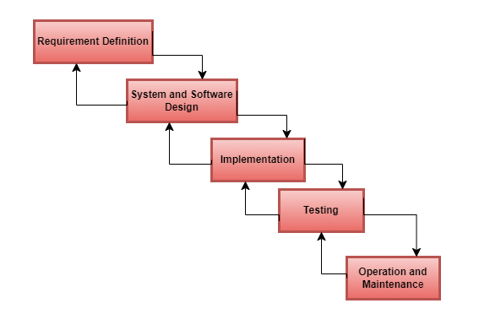
.
Process Model

Slide 7
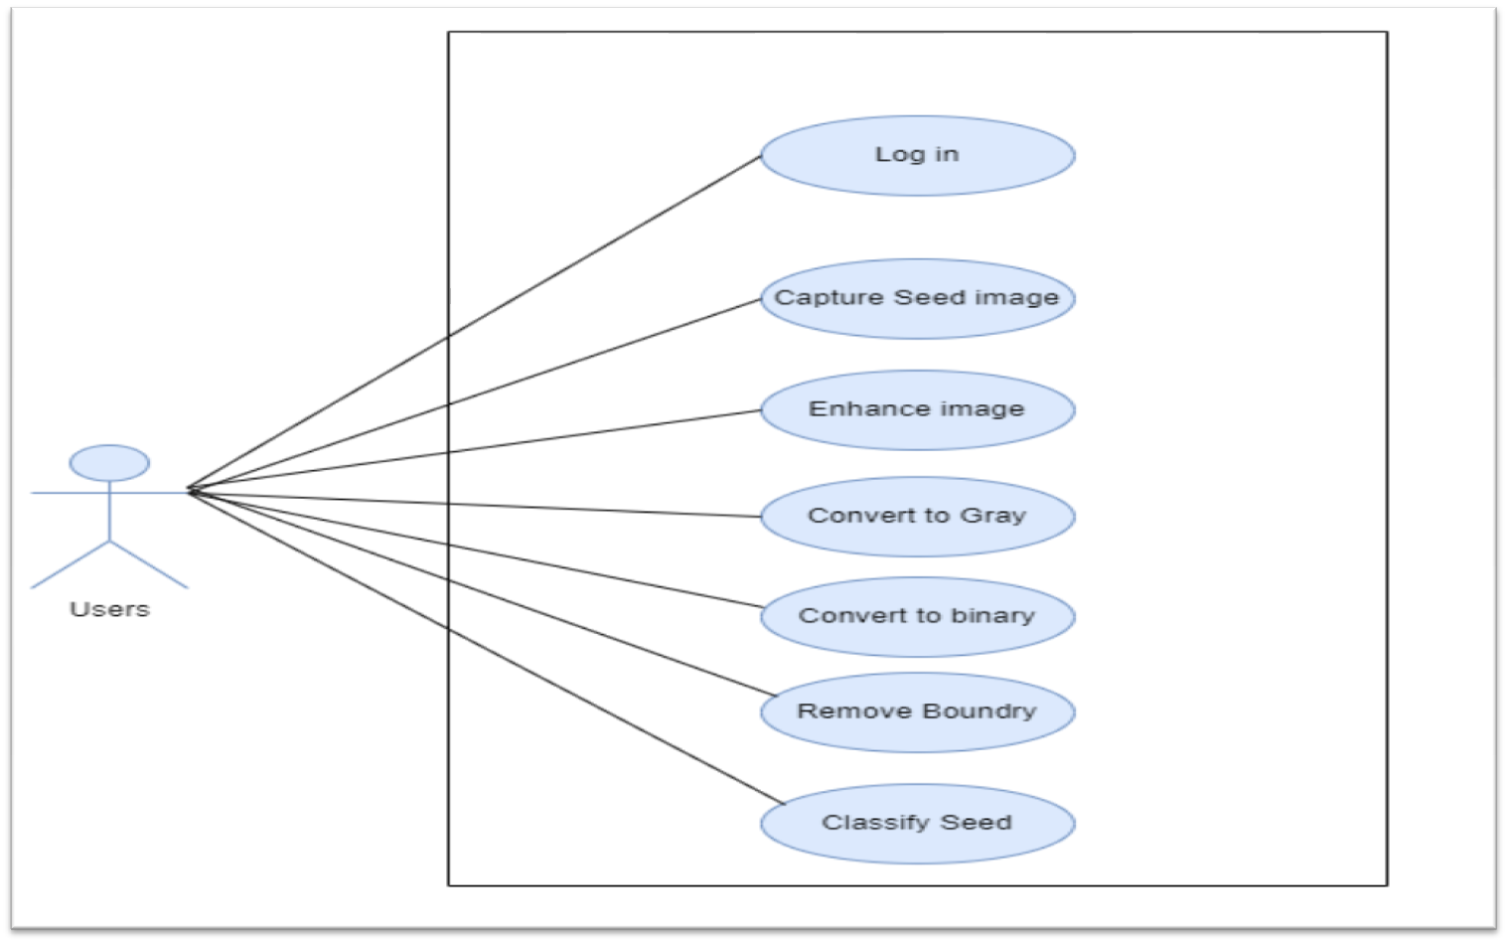
Use Case Diagram

Slide 8
Business Rules Catalog
1. Input Image
Take an input seed image from seed lot by using digital camera.
2. Image Enhancement
Image enhancement is the process of adjusting digital images so that the results are more suitable for display or further image analysis. For example, you can remove noise, sharpen, or brighten an image, making it easier to identify key features.

Slide 9
3. RGB to Gray Conversion Convert image as gray image.
4. Gray to Binary conversion
Sharp filtering The gray image must be sharpened for a good vision.
5. Boundary Removal
6. Classification of Seed The farmer is supposed to login, and their data will be stored. They simply need to take a picture of the seed through the app, and it will show the result. The recent search history would be stored in the database using SQLite.

Slide 10
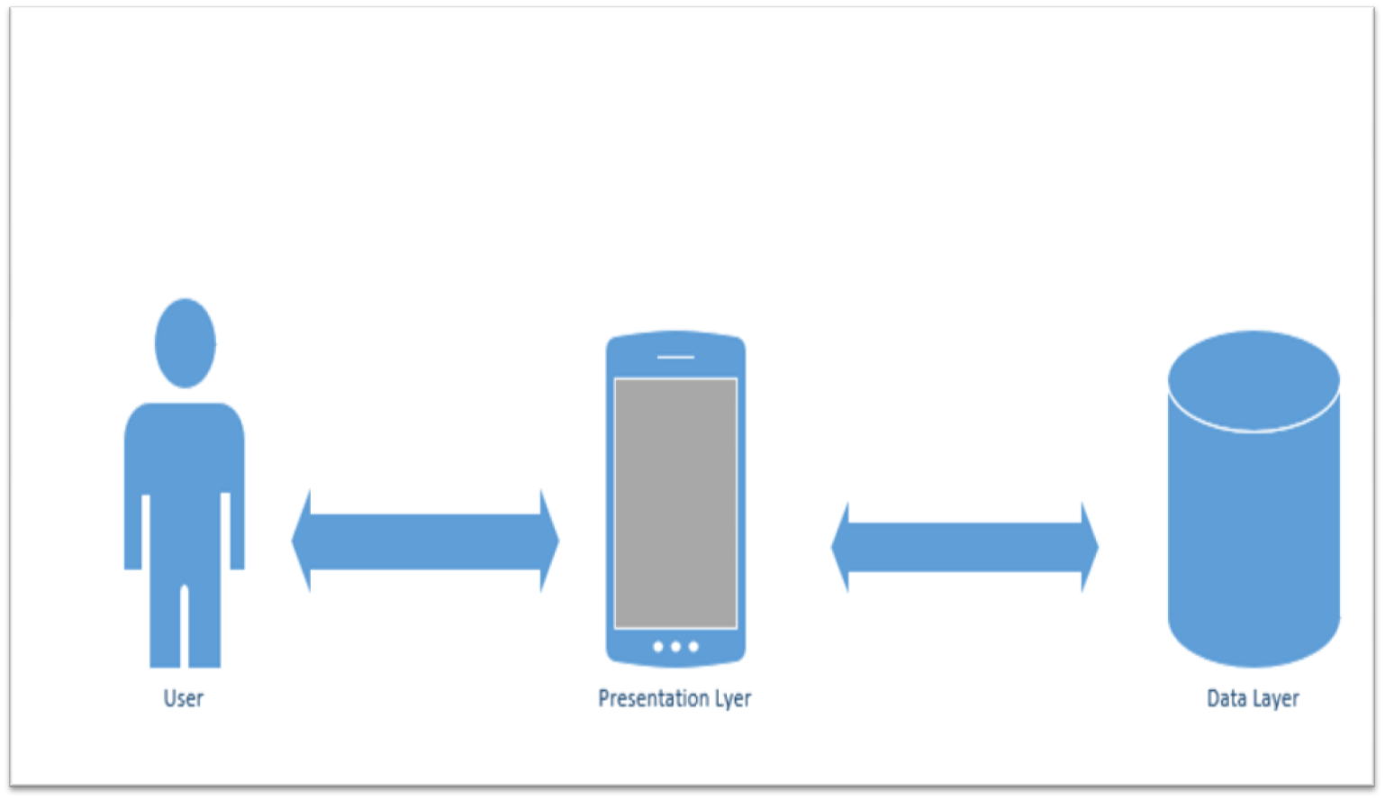
Architectural Design

Slide 11
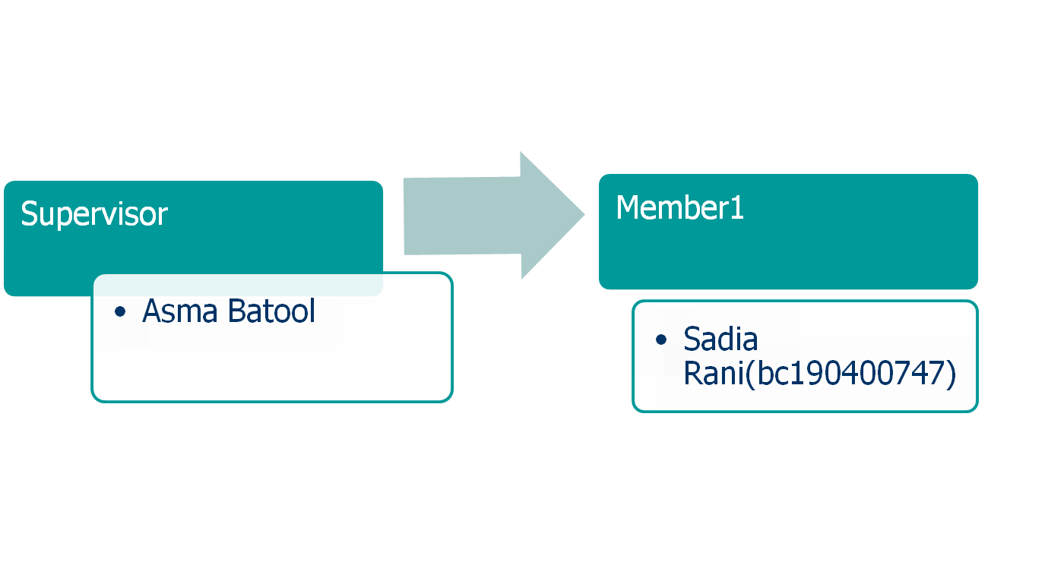
Team Structure

Slide 12
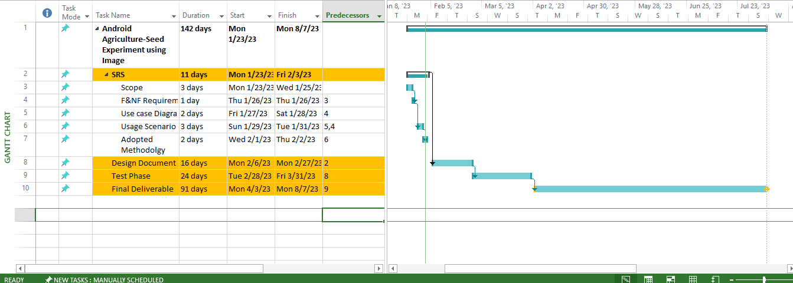
Project Schedule

Slide 13
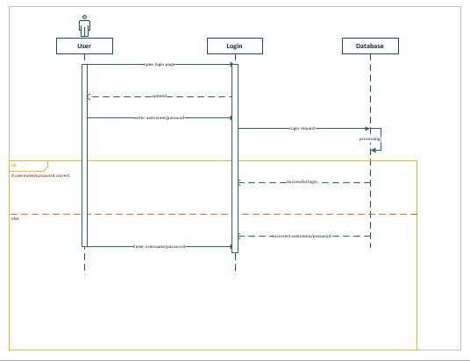
Sequence Diagrams

Slide 14
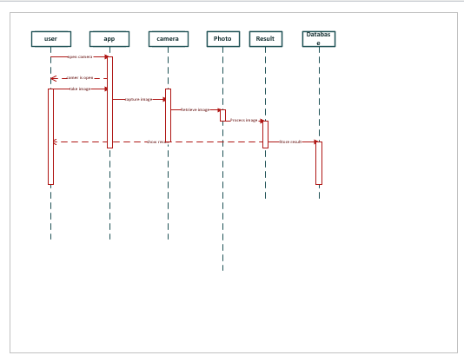
Sequence Diagrams

Slide 15
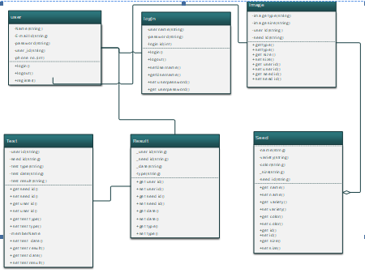
Logical Model/Class Diagram

Slide 16
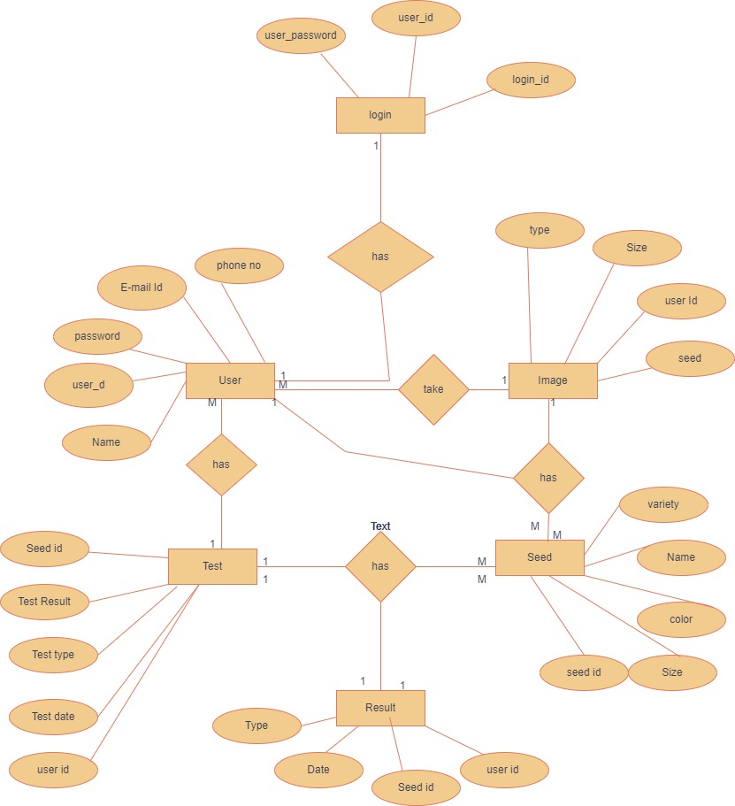
Entity-Relationship Diagram

Slide 17
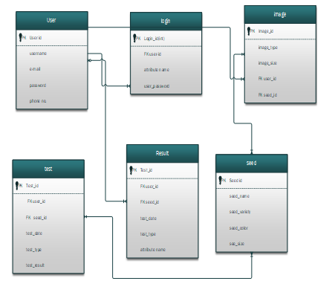
Database Diagram

Slide 18
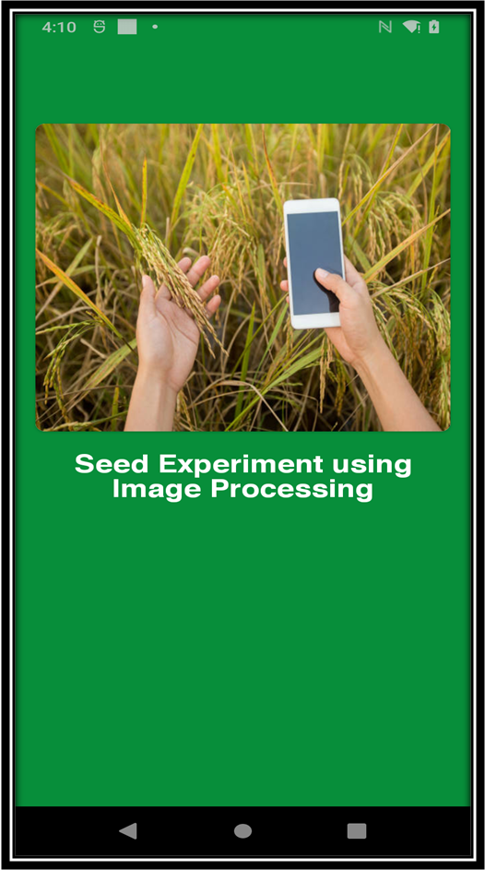
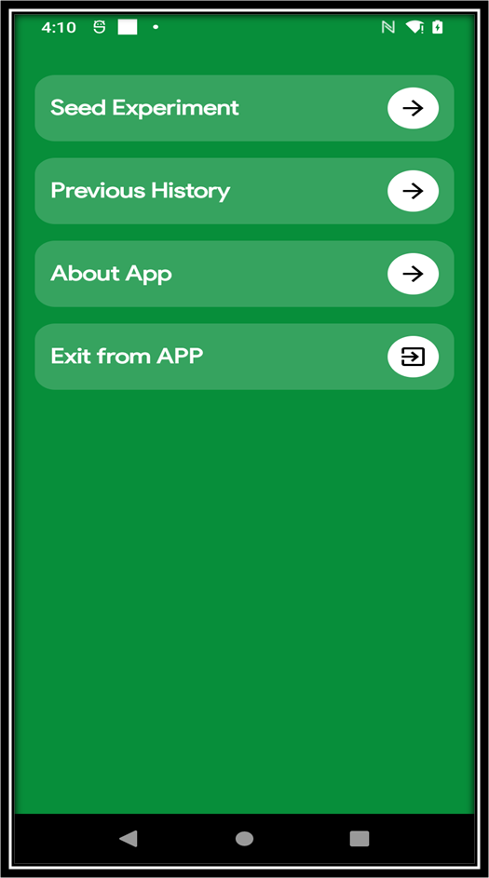
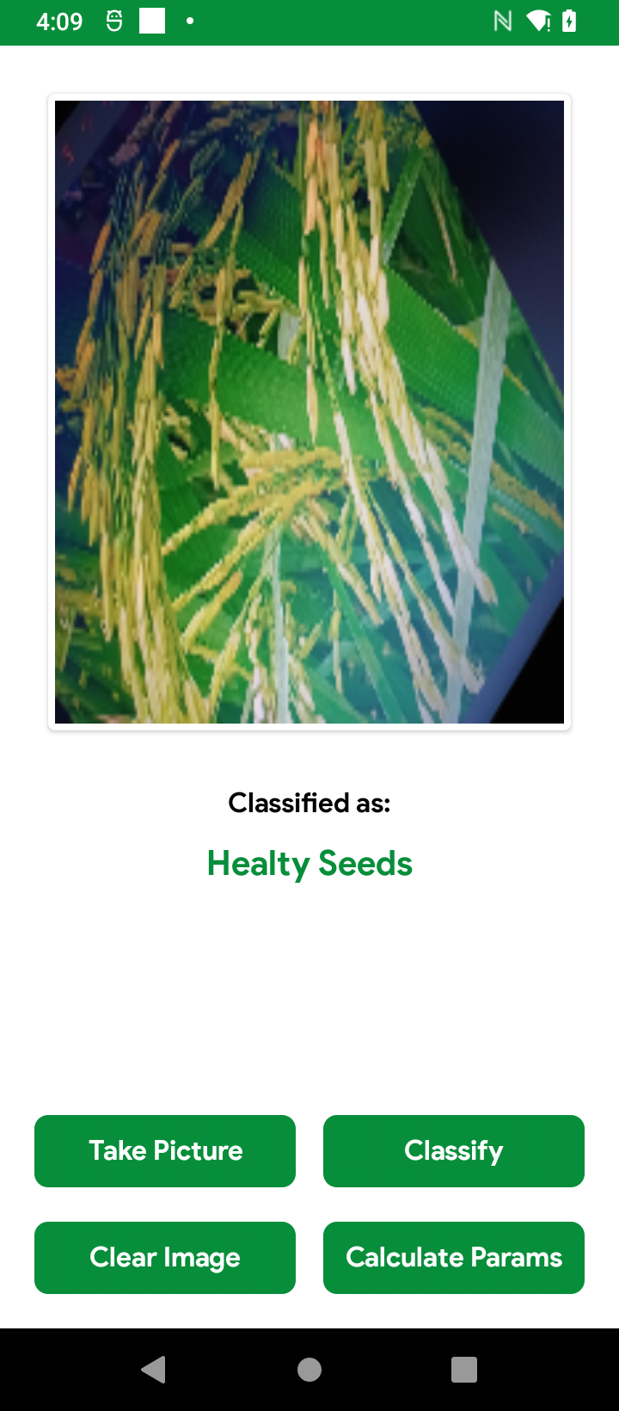
User Interfaces

Slide 19
Tools
Android Studio
Google teachable machine
TensorflowLite
MS Word
MS PowerPoint
MS Visio
Draw.io

