Slide 1
AgriTech
Smart Agriculture supervision system

Slide 2
TEAM MEMBERS
NAME | ID
SADIA AFRIN RIDITA | 193014033
SUMAIYA JANNAT | 193014037
Md. Alamin Biswas Plabon | 193014055
Rahmuna Afrin | 193014056
TAMANNA KHANAM | 193014030

Slide 3
Problem Domain/Area
Unemployment Problem
Proper use /Emplementation of Technology
Lack of Agricultural Equipments in Rural Area

Slide 4
Expected Data and Features
My profile(Login)
Farmar
soil
sensor
Product
CUSTOMER

Slide 5
Home
Purchase
Buy and sell any type of seeds/
vegetable
To know the soil condition
Customer
Farmer
Sensor

Slide 6


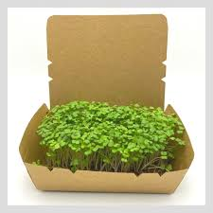
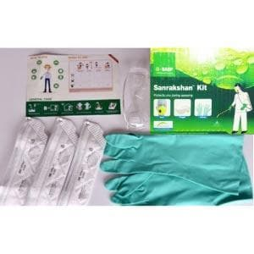
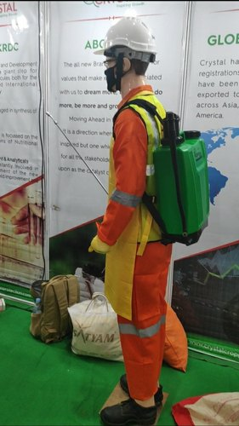
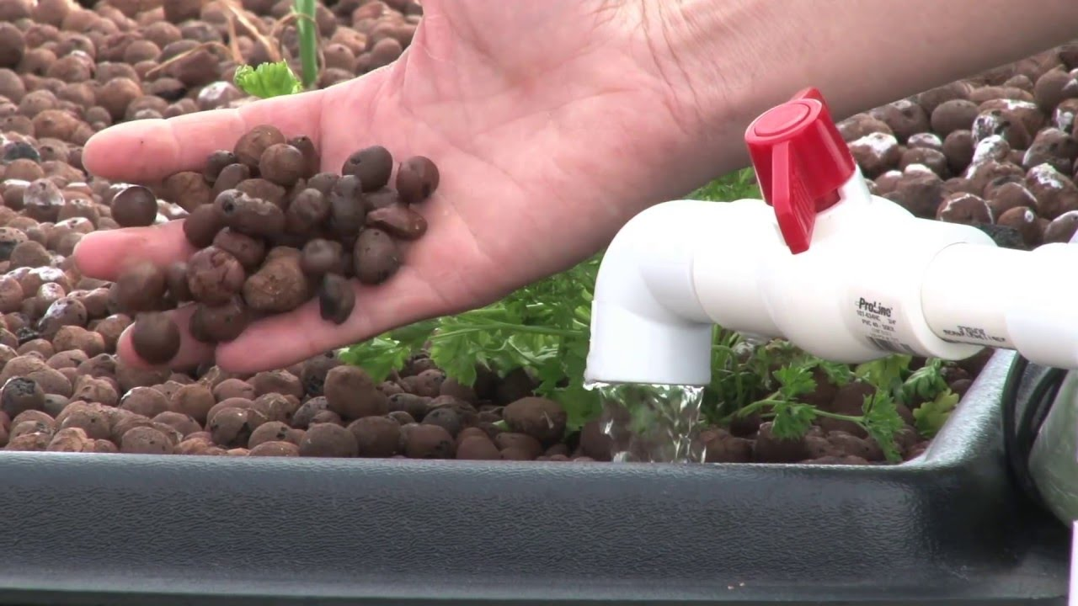
PRODUCTS AVAILABILITY

Slide 7
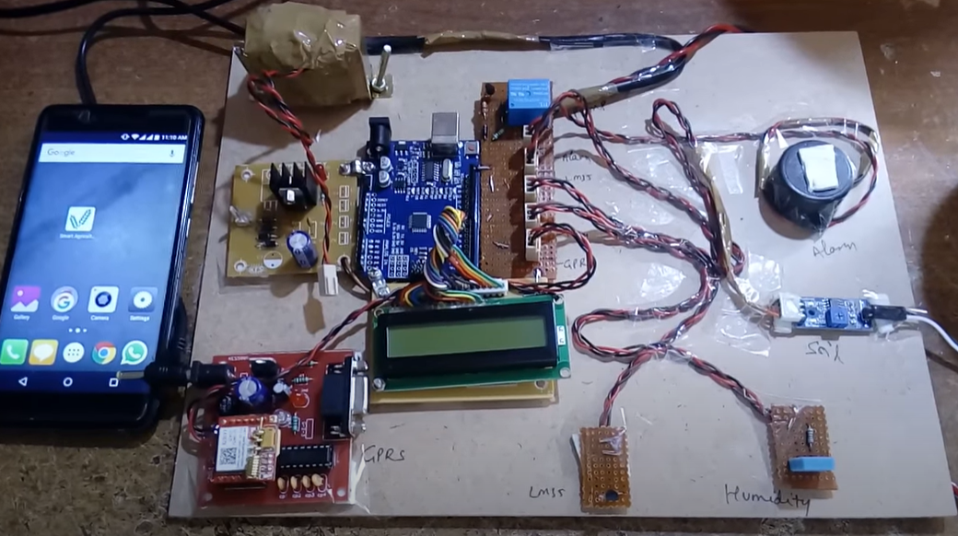
IOT Based SENSOR
Temperature
Humidity
Moisture
Water level
Idea Source - https://www.youtube.com/watch?v=Rr3KZ5QU3Xs

Slide 8
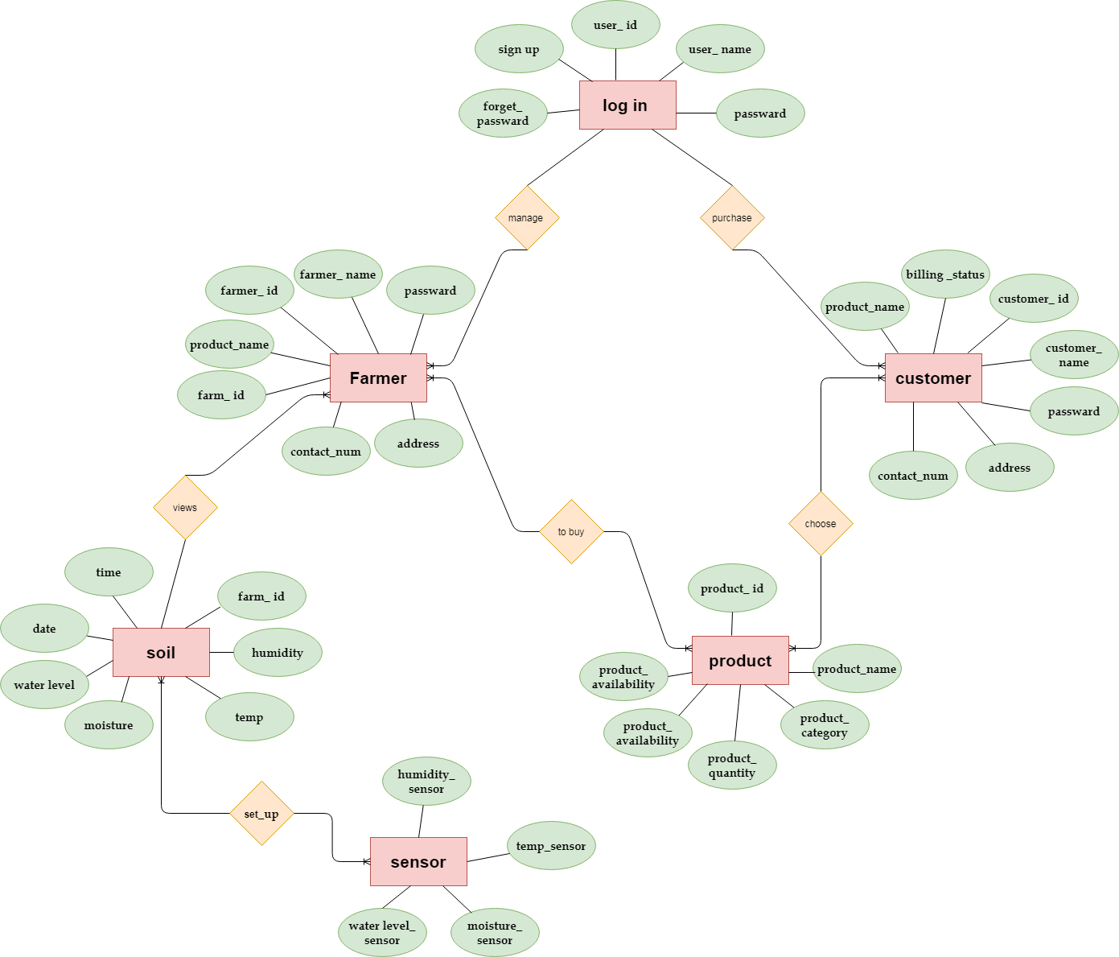

Slide 9
Thank You

