Slide 1
Laptop Price prediction
Using machine learning

Slide 2
Group Members
Md. Shamsur Rahman Khan – 1911843042
Sadia Sabrina Prome - 1911859042

Slide 3
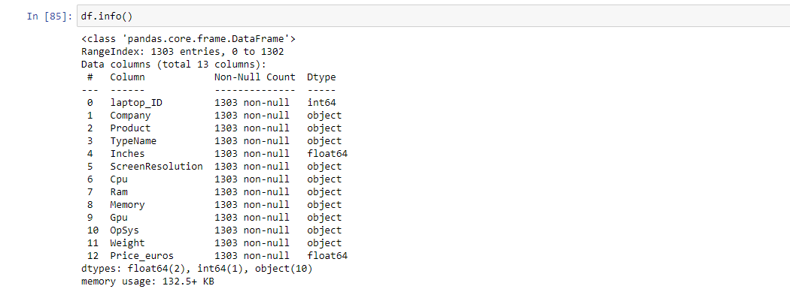
Data insight :
Here we have total 1303 rows and 13 columns, among them 9 are categorical and 3 are numerical (Weight, Price & Inches)

Slide 4
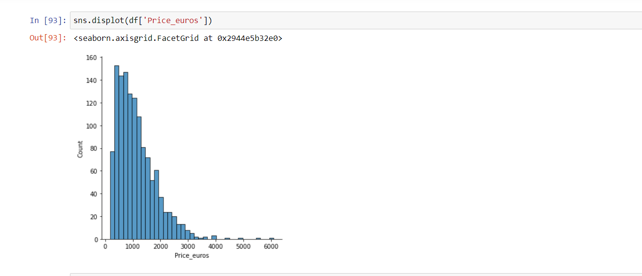
Histogram for the numerical features:
1. Price
This is the histogram of Price, where in x-axis we have plotted price and in y-axis the number of laptop counts. Here we can see, when the price is less there are more number of laptops available and when the price increases the number of laptops decreases

Slide 5
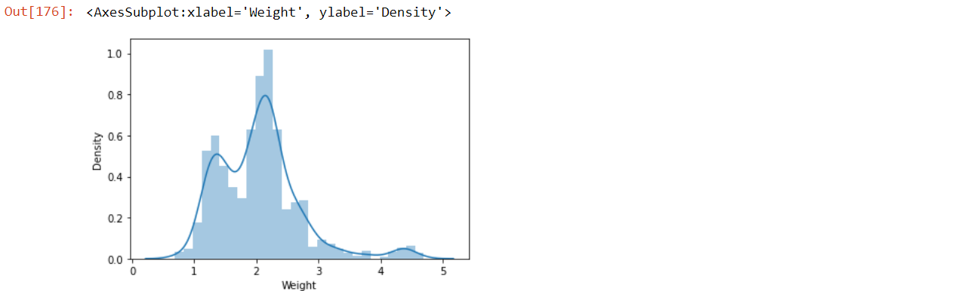
2. Weight
This is the histogram of Weight , where in x-axis we have plotted weight and in y-axis the number of laptop density. Here we can see that, in our data set the majority number of laptops belongs to 2-2.7 kg and after that in between 1.5-1.7 kg.

Slide 6
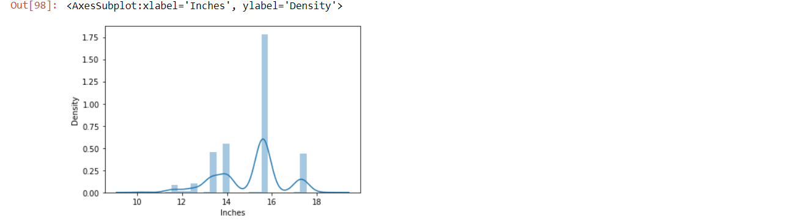
3. Inches:
This is the histogram of Inches, where in x-axis we have plotted Inches and in y-axis the number of laptop density. Here we can see, in our dataset majority of laptops are 16 inches, then 14 inches.

Slide 7
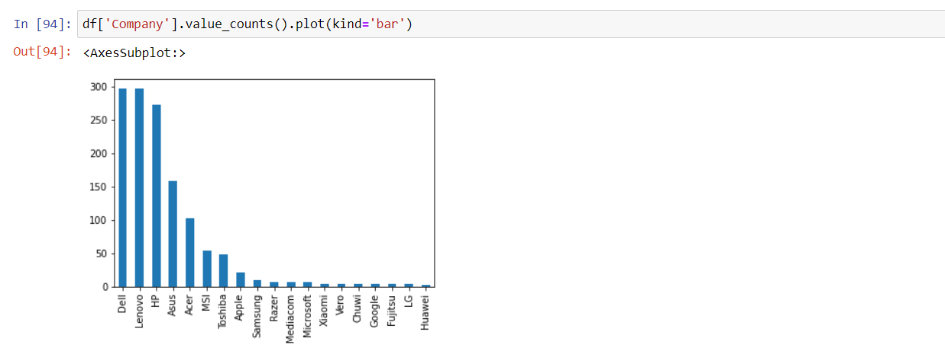
Bar Chart for the categorical features:
1. Company:
This is the bar chart of companies, we have total 19 companies, Majority numbers of laptop belongs to Dell & Lenovo and the lowest amount of laptop belongs to Huawei.

Slide 8
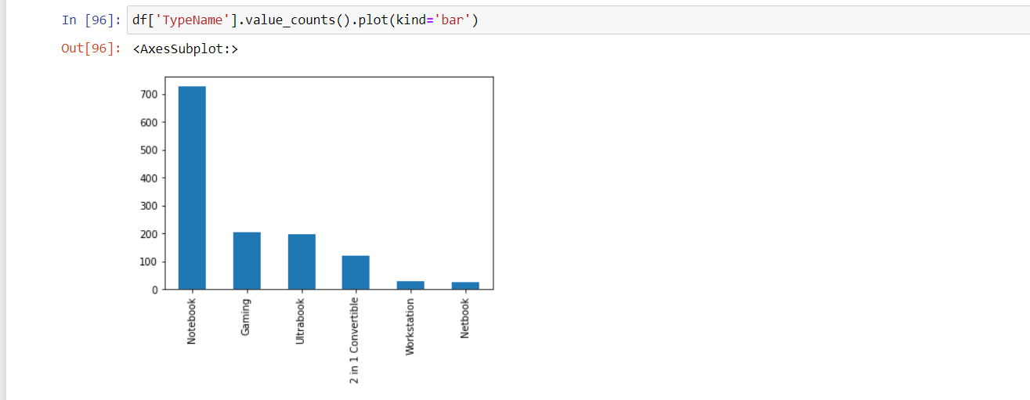
2. TypeName:
This is the bar chart of TypeName, it has 6 Type Name. The majority of the laptops belong to Notebook type then Gaming and then Ultrabook. There are a few laptops of Netbook type.

Slide 9
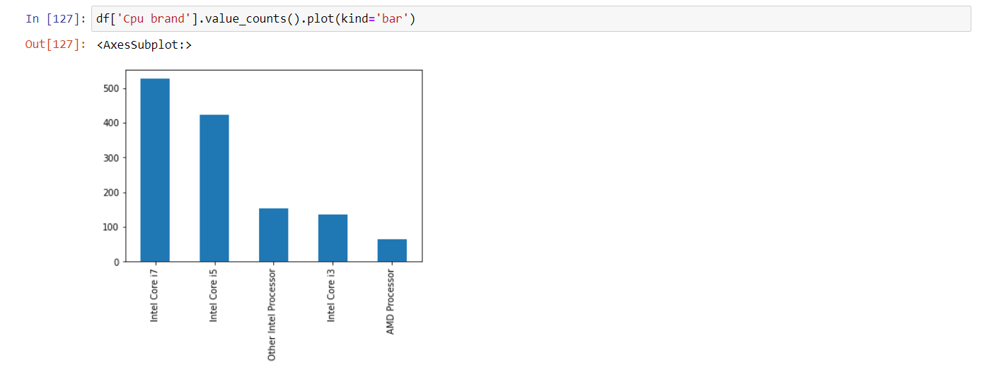
3. Cpu Brand:
This is the bar chart of Cpu brand, it has 5 types of Cpu brands. Most of the laptop belongs to Intel core i7 then respectively Intel core i5 and the least number of laptop belongs to AMD processor

Slide 10
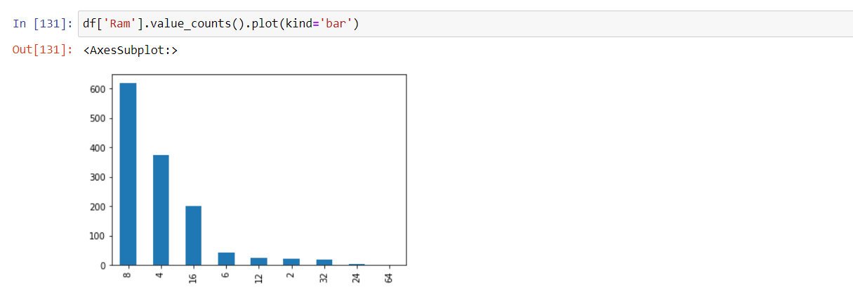
4. Ram:
This is the bar chart of RAM, it has ram of (2,4,6,8,16,24,32,64 GB). There are more laptops of 8 gb ram then 4 gb. There are quite a few laptops of 24 gb and 64 gb

Slide 11
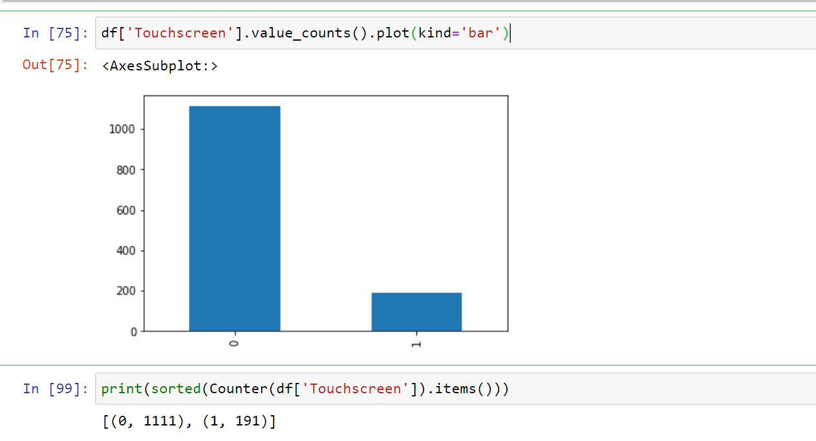
5.ScreenResolution - Touchscreen:
This is the bar chart of touchscreen. Here, 0 means this is not touchscreen and 1 means it is touchscreen. Here we have 1111 laptops without touchscreen and 191 with touchscreen.

Slide 12
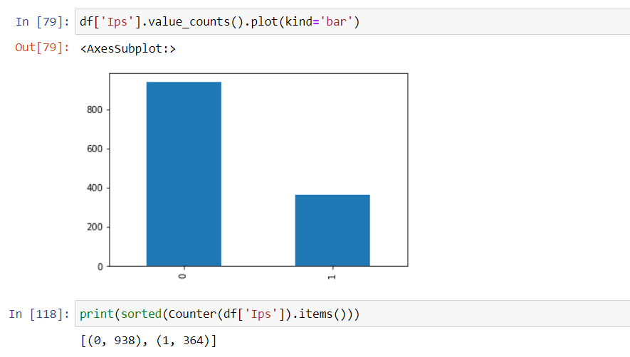
6. ScreenResolution - IPS:
This is the bar chart of IPS display. Here, 0 means it has no IPS display and 1 means it has a IPS display. Here we have 938 laptops without IPS display and 364 lsptops with IPS display.

Slide 13
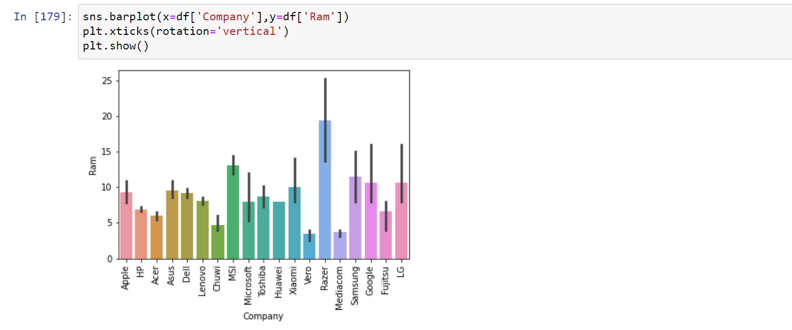
Bar plot for Categorical vs. categorical:
1. Company vs. Ram:
This is the bar plot of company vs. ram where in x-axis we have plotted the company and in y-axis we have ram. Razer company has the highest ram and the Vero has the lowest ram.

Slide 14
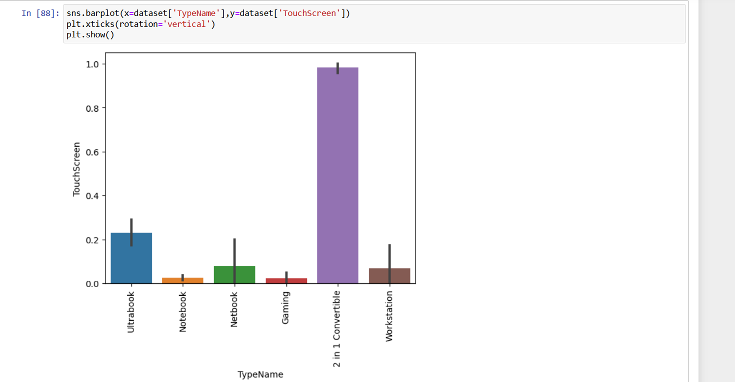
2. Type Name vs. Touchscreen:
This is the bar plot of Type name vs. Touch Screen, where in x-axis we have plotted the type name and in y-axis we have Touchscreen Display. 2 in 1 Convertible has the highest number touchscreen display and the Notebook and Gaming has the lowest number Touchscreen display.

Slide 15
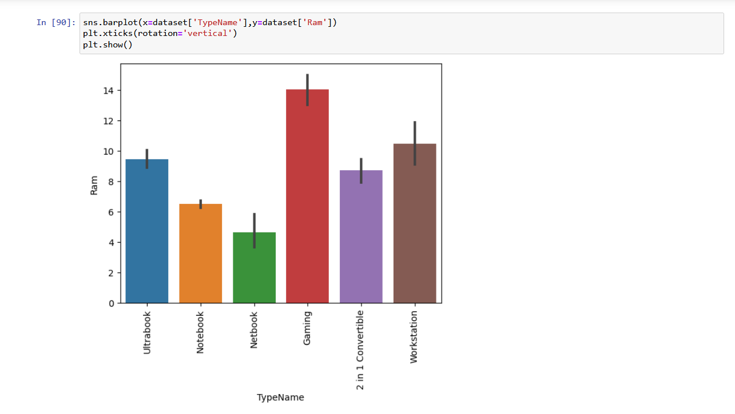
3. Type Name vs. Ram:
This is the bar plot of Type Name vs. Ram, where in X axis we have plotted TypeName and in Y axis we have Ram, Here we can see that Gaming laptop has the highest number of ram and Netbook has the lowest number
of ram.

Slide 16
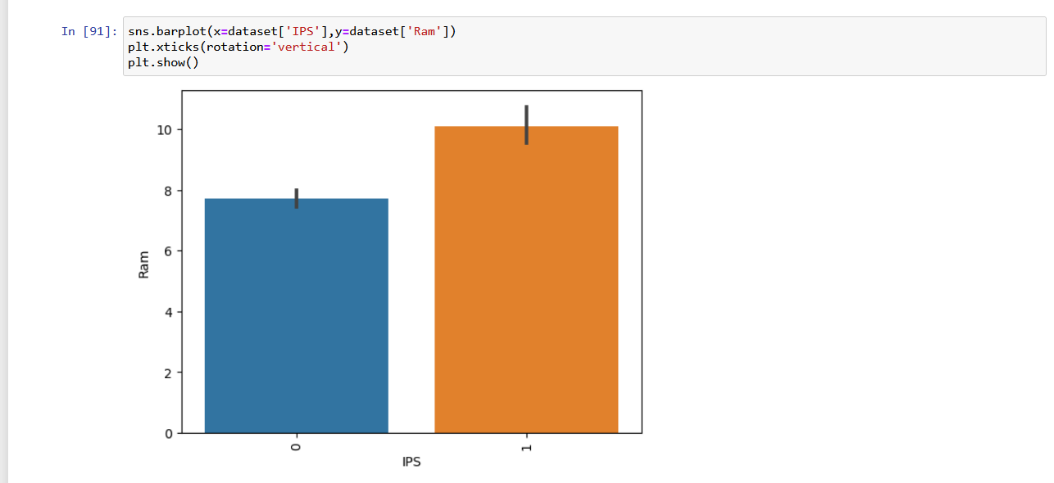
4. IPS vs. RAM:
This is the bar plot of IPS display vs. Ram, where in X axis we have plotted IPS and in Y axis we have plotted Ram, Here we can see that laptops with IPS display has the higher number of ram than the laptops which doesn’t have IPS display.

Slide 17
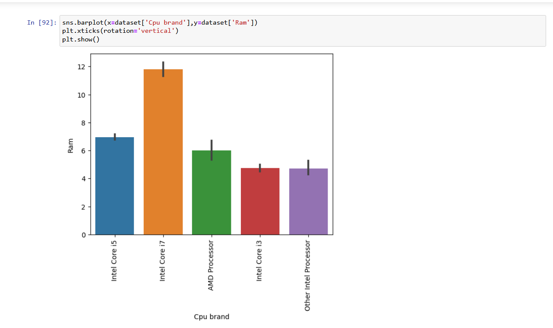
5.Cpu brand vs. Ram:
This is the bar plot of CPU brand vs. Ram, where in X axis we have plotted CPU brand and in Y axis we have plotted Ram, Here we can see that intel core i7 has the highest number of ram and intel core i3 and other intel processor has the lowest number of ram respectively.

Slide 18
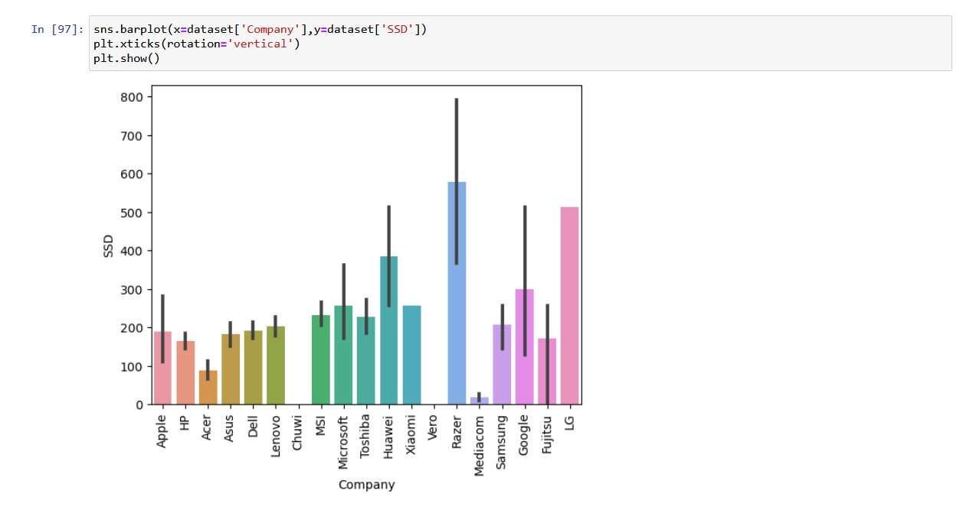
6. Company vs. SSD:
This is the bar plot of Company vs. SSD, where in X axis we have plotted Company and in Y axis we have plotted SSD, Here we can see that Razer company has the highest number of SSD and Chuwi and Vero has the lowest number of SSD.

Slide 19
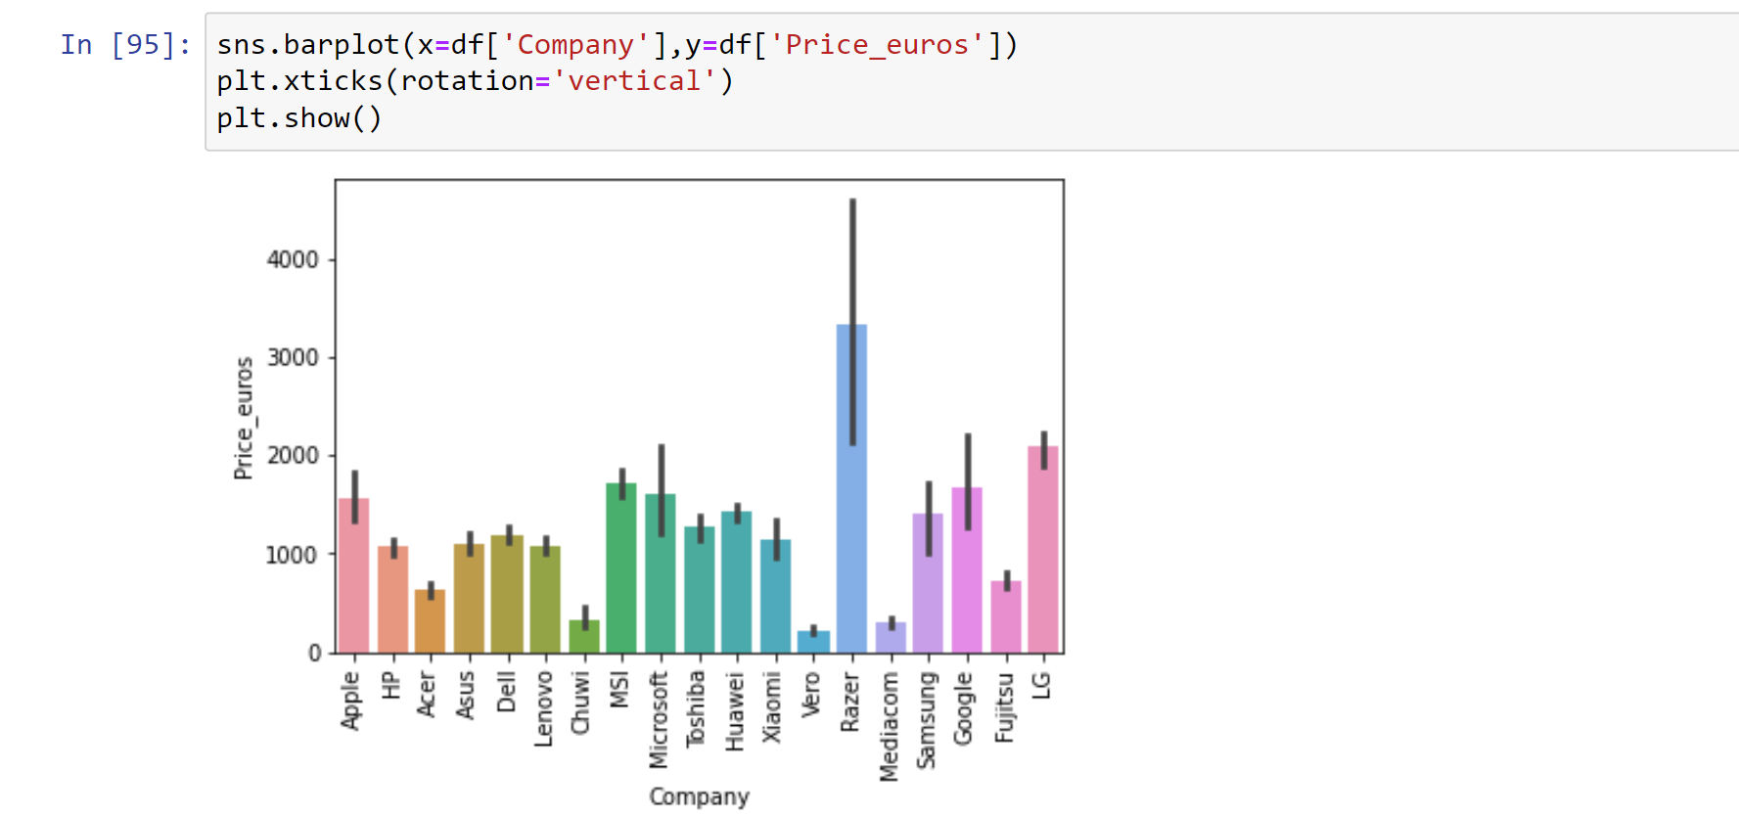
Bar plot for Categorical vs. Numerical:
1.Company vs. Price
This is the bar plot of company vs. price. In the x-axis we have plotted company and in the y-axis is the price. The highest price laptop belongs to ‘Razer’ company and the lowest price is of ‘Vero’ company laptops.

Slide 20
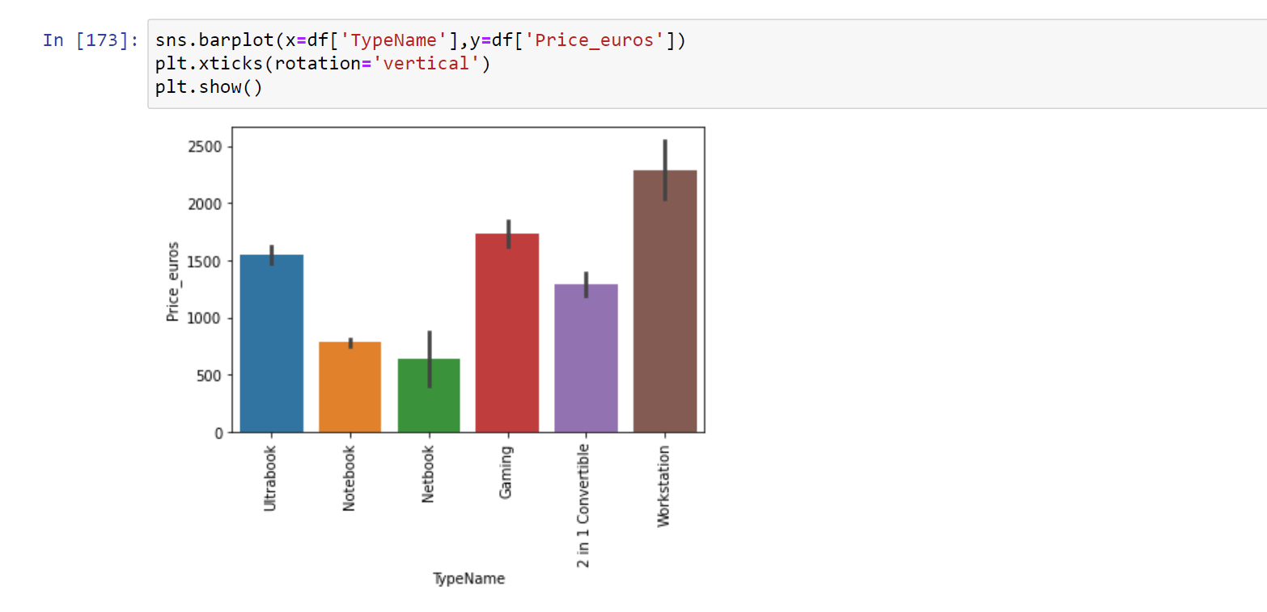
2.Type Name vs. Price
This is the bar plot of Type Name vs. Price. In the x-axis we have plotted TypeName and in the y-axis is the price. The highest price laptop belongs to ‘Workstation’ and the lowest price is of ‘Netbook laptops’.

Slide 21
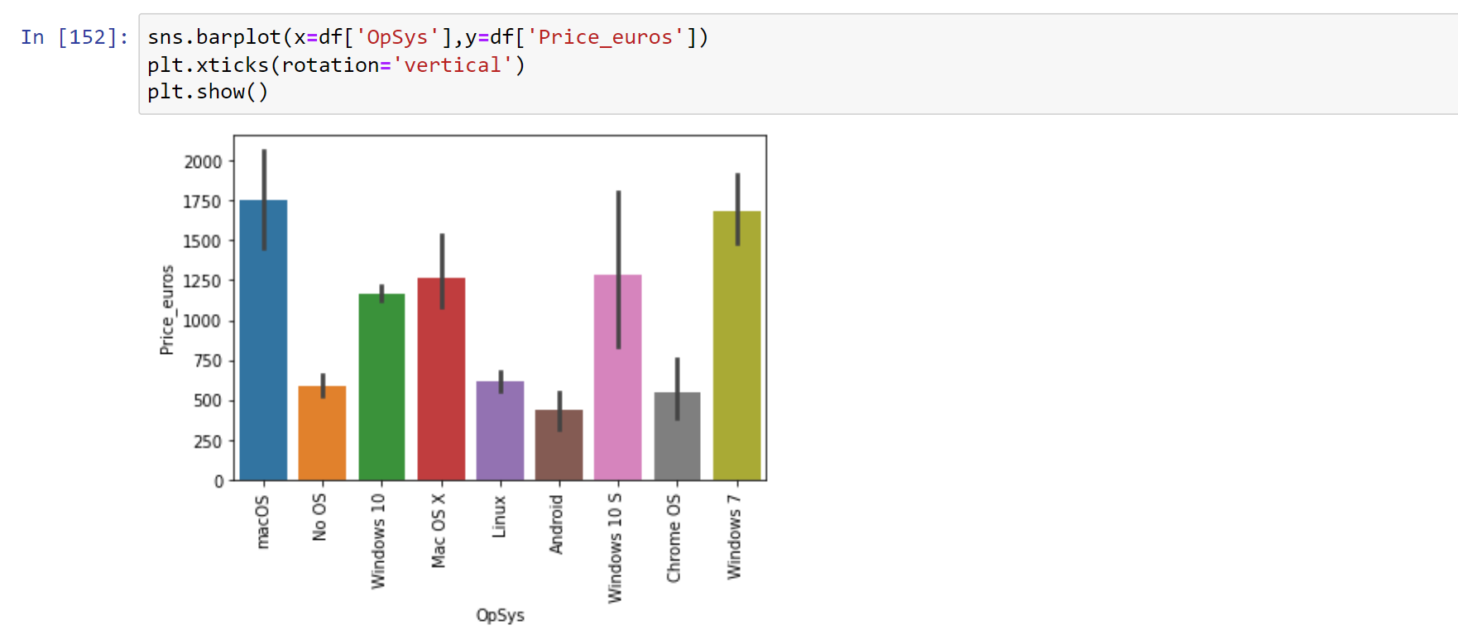
3. Operating System vs. Price:
This is the bar plot of Operating system vs. Price. In the x-axis we have plotted Operating system and in the y-axis is the price. ‘MacOs’ and ‘windows 7’ has the highest price and the lowest price is of ‘android’ operating system.

Slide 22
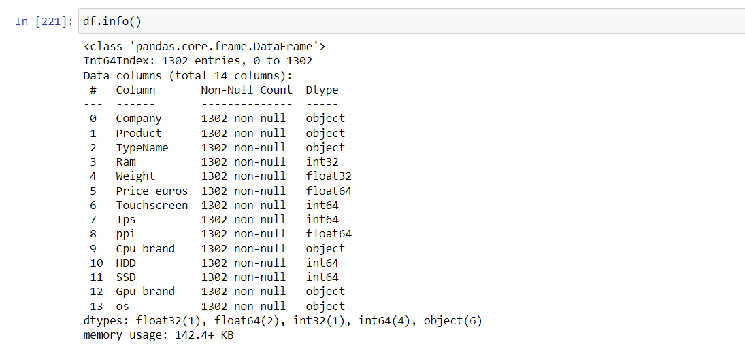
Modified Data Insight
This is our modified data insight, we modified this according to our necessity

Slide 23
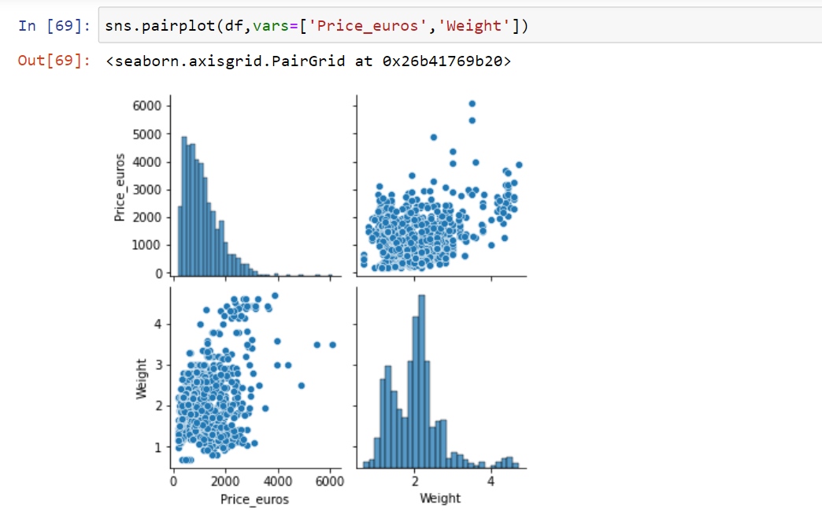
Numerical vs. Numerical pairplot:
1. Price vs. Weight vs. Ram:
Here, this is the pair plot for price vs. weight, where we can see the two histograms two scatterplots.

Slide 24
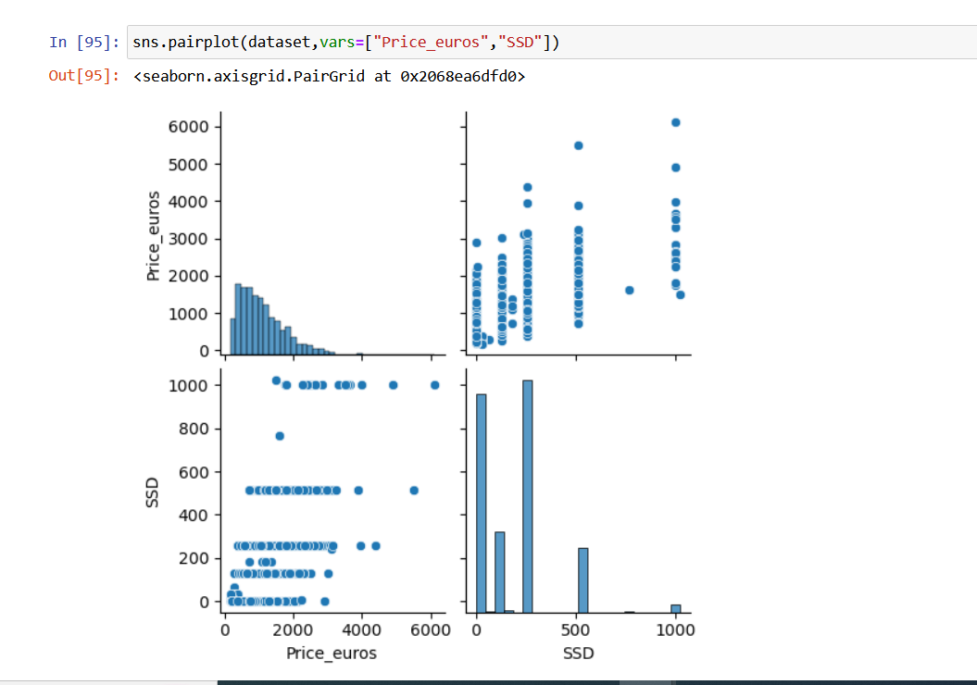
2. Price vs. SSD:
Here, this is the pair plot for Price vs. SSD, where we can see the two histograms two scatterplots.

Slide 25
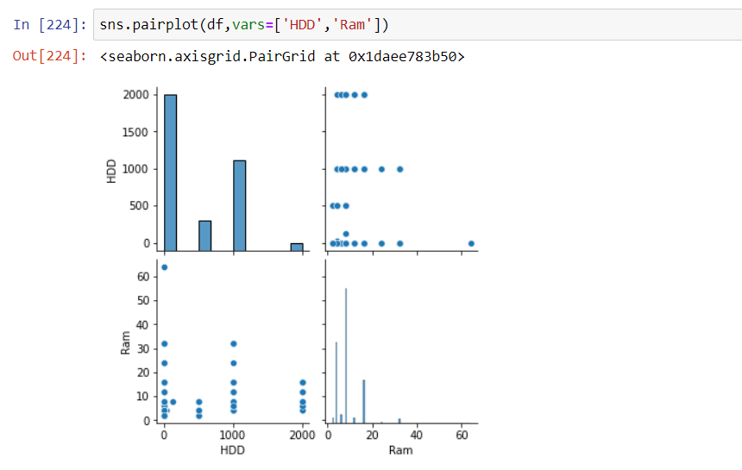
3. HDD vs. Ram:
Here, this is the pair plot for HDD vs. Ram, where we can see the two histograms two scatterplots.

Slide 26
Missing data handling
In our dataset we don’t have any missing data. If we had then either we dropped the row or put the mean/median value

Slide 27
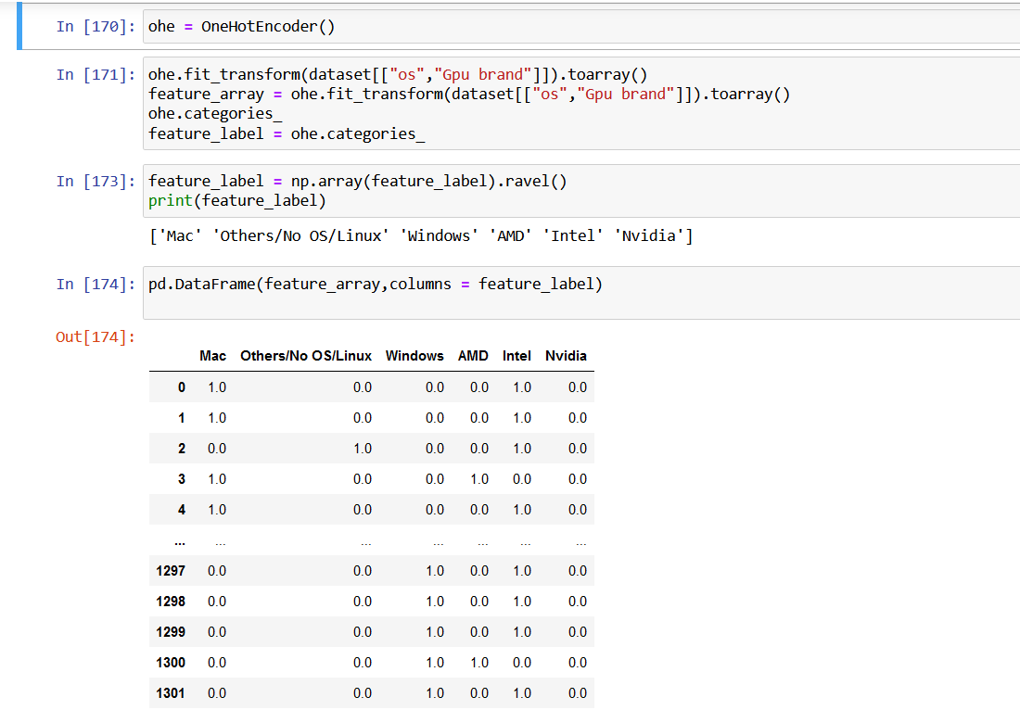
One hot encoding for categorical features: 1. OS and Gpu Brand:
There are 3 types of Operating System and 3 types of GPU Brand which have been converted into numerical value by one hot encoding. So, in total it has new 6 columns now.

Slide 28
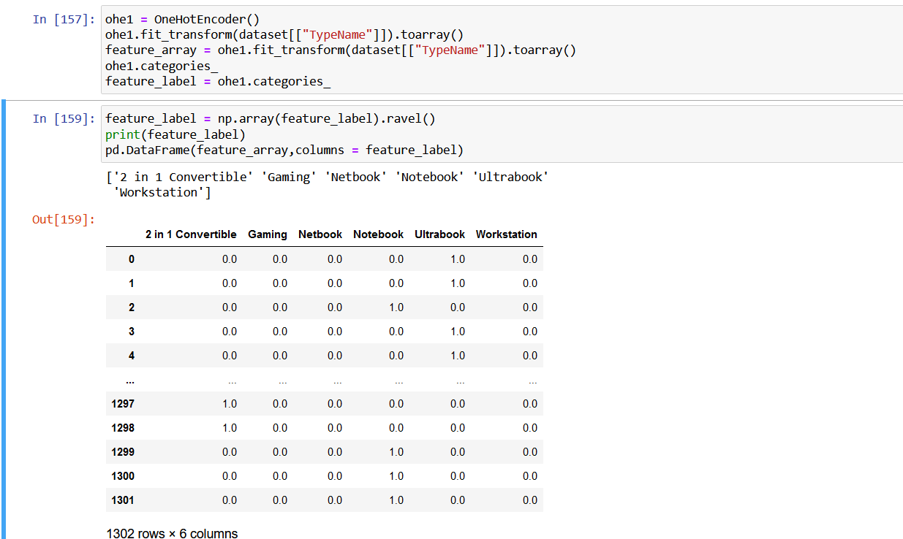
2. TypeName:
There are 6 types of Laptop TypeName. Which was a categorical feature. We converted into numerical feature by using One-Hot Encoding.

Slide 29
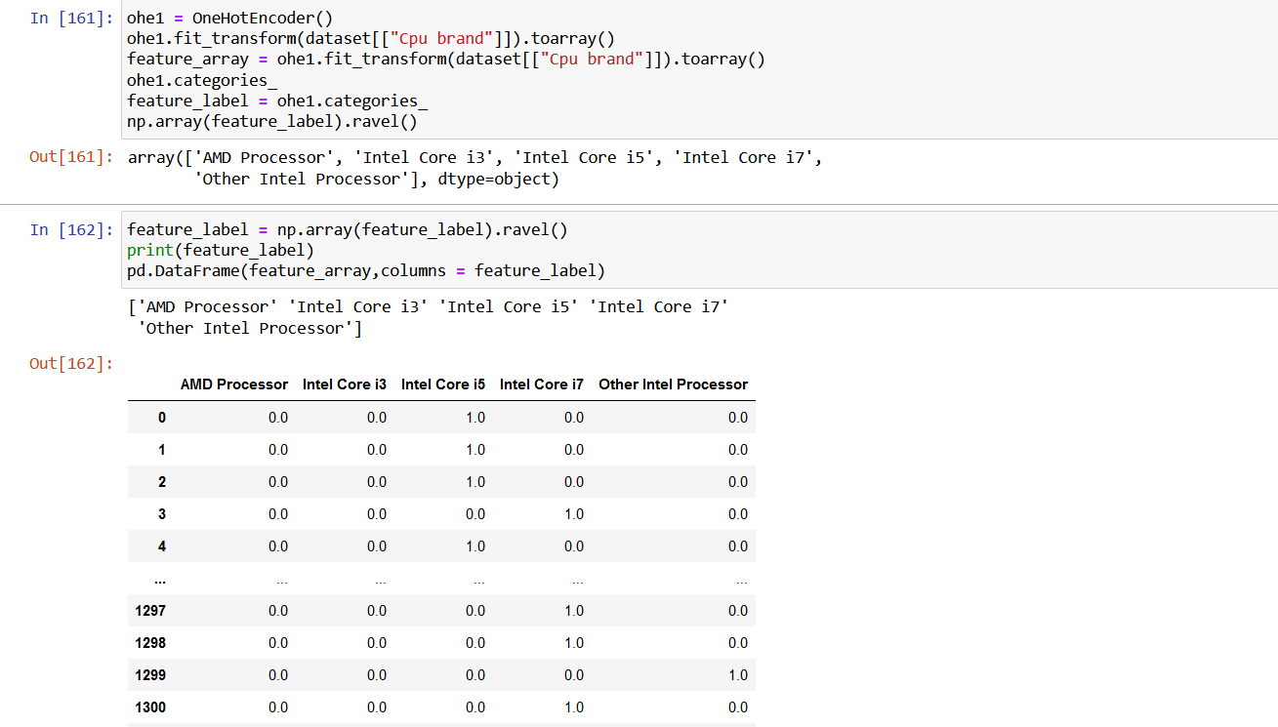
3. CPU brand:
There are 5 CPU brands which was the categorical feature, we have applied one hot encoding to convert it into a numerical feature.

Slide 30
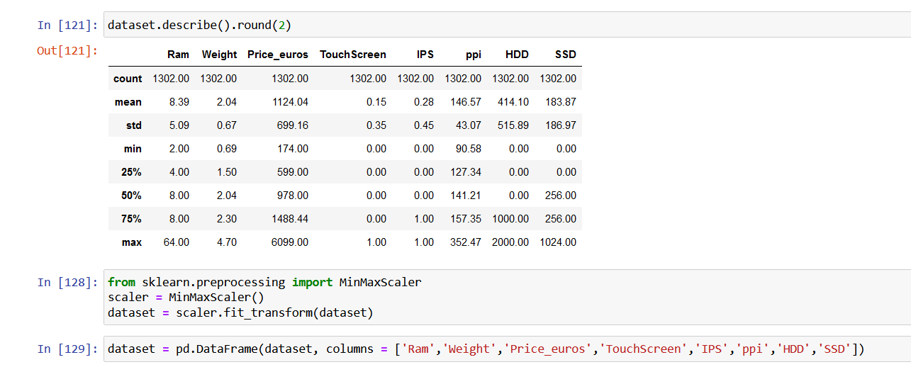
Normalization for numerical:
Before Normalization
Here, we can see that the range of maximum and minimum value is different for all numerical features.

Slide 31
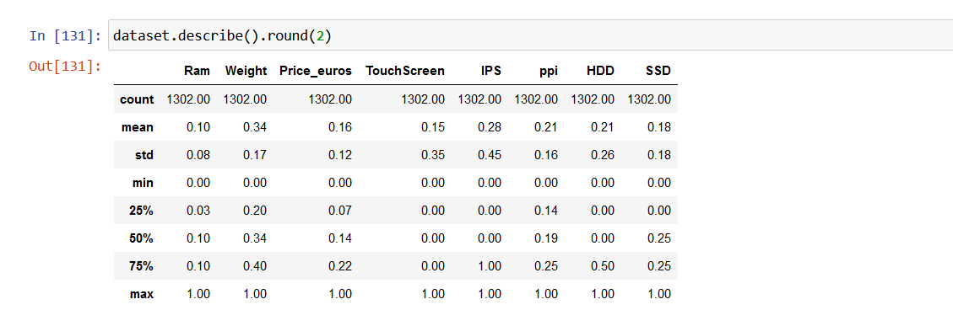
After Normalization
So we have used Normalization to rescale the range from minimum 0 to maximum 1.

Slide 32
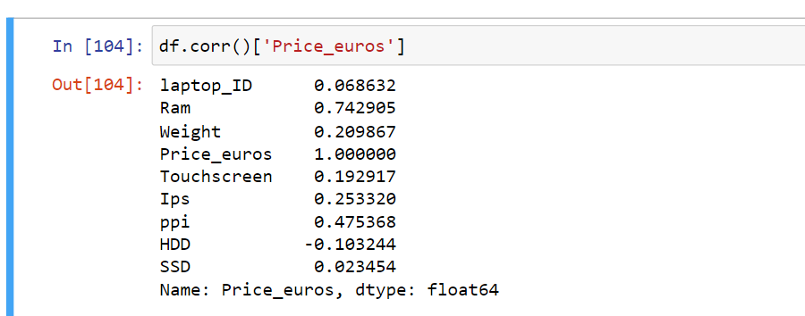
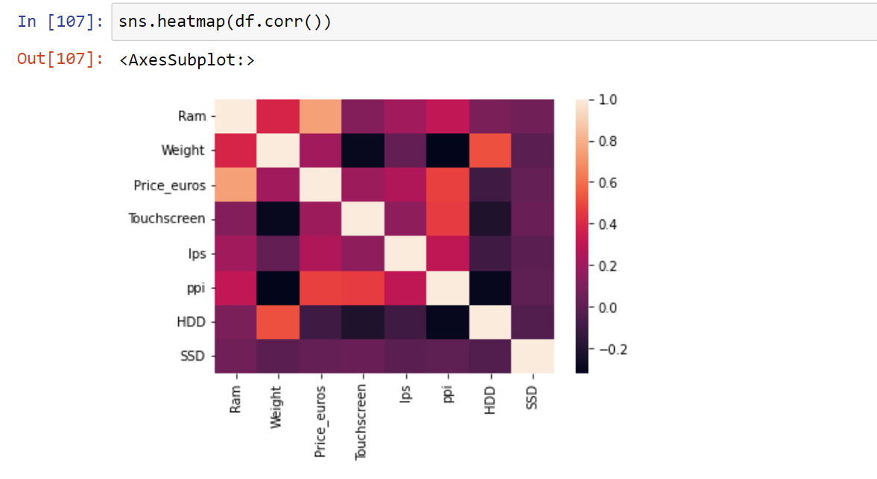
Correlation Matrix
Here, we can see that every features has a strong positive or negative correlation with the output. But laptop ID is close to 0. It is not closely related so we can drop this feature.

Slide 33
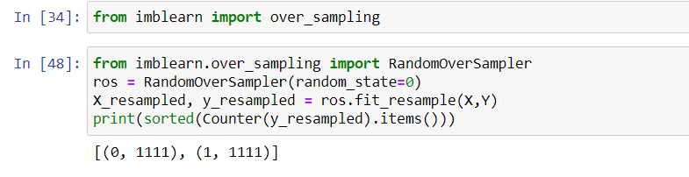
Data Balancing technique:
For Touchscreen:
Before Oversampling
After Oversampling
Laptops with Not Touchscreen : 1111
Laptops With Touchscreen : 1111
Laptops with Not Touchscreen : 1111
Laptops With Touchscreen : 191

Slide 34
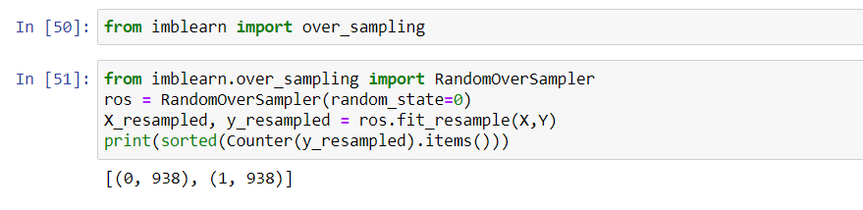
For Ips Display:
Before Oversampling
After Oversampling
Laptops with Not Ips display : 938
Laptops With Ips display : 938
Laptops with Not Ips Display : 938
Laptops With Ips display : 364

Slide 35
Thank You

