Slide 1
Data Structures and Algorithms (AT70.02)
Comp. Sc. and Inf. Mgmt.
Asian Institute of Technology
Instructor: Prof. Sumanta Guha
Slide Sources: CLRS “Intro. To Algorithms” book website
(copyright McGraw Hill)
adapted and supplemented

Slide 2
CLRS “Intro. To Algorithms”
Ch. 26: Maximum Flow

Slide 3
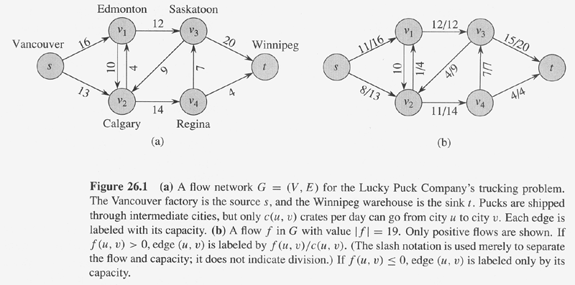
A flow network G = (V, E) is a directed graph in which each edge (u,v) ∈ E
has a capacity c(u,v) ≥ 0. If (u,v) ∉ E, set c(u,v) = 0. Moreover, there are
two distinguished vertices, a source s and sink t, and we assume that every
vertex v lies on some path from s to t.
A flow in G is a real-valued function f : V x V → R satisfying:
Capacity constraint : For all u, v ∈V, f(u,v) ≤ c(u,v).
Skew symmetry : For all u, v ∈V, f(u,v) = – f(v,u).
Flow conservation : For all u ∈ V – {s, t}, ∑_{v∈V} f(u,v) = 0.
The value of the flow f is defined to be |f| = ∑_{v∈V} f(s,v).
The maximum flow problem is to find the flow of maximum value.
Only positive flows are
shown in the flow graph

Slide 4
There may be a distinction between actual shipment and flows.
E.g., if we ship 8 units from v₁ to v₂ (edge cap. 10) and 3 units from v₂ to v₁
(edge cap. 4), then it is wrong to say f(v₁, v₂) = 8 and f(v₂, v₁) = 3 as that
would be a violation of skew-symmetry.
We should consider the net flow, which is 5 from v₁ to v₂, and say
f(v₁, v₂) = 5 and f(v₂, v₁) = -5. In other words, we should always take a net
so that flow is positive in one direction and negative in the other.
Practically, too, it’s a “waste” to ship 8 in one direction and 3 in the opposite!

Slide 5
Implicit summation notation: f(X, Y) = ∑_{x∈X}∑_{y∈Y} f(x, y)
Lemma 26.1: Let G = (V,E) be a flow network and f be a flow in G.
Then the following equalities hold:
For all X ⊆ V, we have f(X, X) = 0.
For all X, Y ⊆ V, we have f(X, Y) = – f(Y, X).
For all X, Y, Z ⊆ V with X ∩ Y = ∅, we have
f(X ∪ Y, Z) = f(X, Z) + f(Y, Z) and f(Z, X∪Y) = f(Z, X) + f(Z, Y).
Proof: Routine.
Ex: Use the lemma to prove that the value of the flow |f| is equal to ∑_{v∈V} f(v,t), i.e., the total flow out of the source is equal to the total flow into the sink. Equivalently, f(s, V) = f(V, t).
Hint: |f| = f(s, V) = f(V, V) – f(V – s, V) = –f(V – s, V) = f(V, V – s) = …

Slide 6
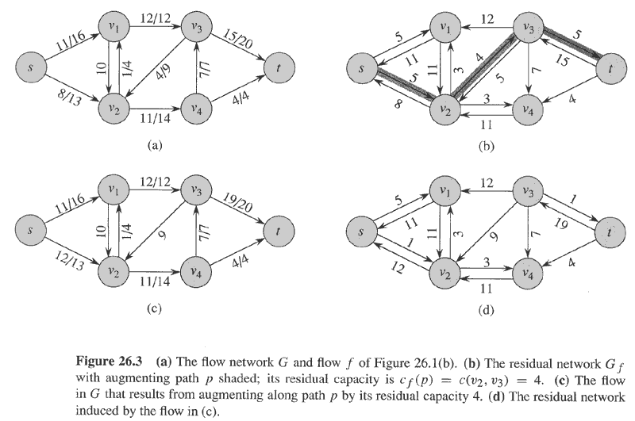
Let f be a flow in a flow network G = (V, E) with source s and sink t. The amount of additional flow we can push from a vertex u to a vertex v before exceeding the capacity c(u,v) is the residual capacity of (u, v) given by
c_{f}(u, v) = c(u, v) – f(u, v)
Given a flow f in flow network G = (V, E), the residual network of G induced by f is G_{f} = (V, E_{f}), where
E_{f} = {(u, v) ∈ V x V : c_{f}(u, v) > 0}
Each edge of the residual network is called a residual edge and its capacity is given by c_{f}.

Slide 7
Lemma 26.2: Let G = (V, E) be a flow network with source s and
sink t, and let f be a flow in G. Let G_{f} be the residual network of G
induced by f, and let f’ be a flow in G_{f}. Then the flow sum f + f’
defined by
(f + f’)(u, v) = f(u, v) + f’(u, v)
is a flow in G with value |f + f’| = |f| + |f’|.
Proof: Routine.

Slide 8
Given a flow f in a flow network G = (V, E), an augmenting path p is a simple path from source s to sink t in the residual network G_{f}.
The maximum amount by which we increase the flow on each edge in an augmenting path p is the residual capacity of p, given by
c_{f}(p) = min{c_{f}(u, v) : (u, v) is on p}

Slide 9
Lemma 26.3: Let G = (V, E) be a flow network, let f be a flow in G,
and let p be an augmenting path in G_{f}. Define a function
f_{p} : V x V → R by
c_{f}(p), if (u, v) is on p,
f_{p}(u, v) = –c_{f}(p), if (v, u) is on p,
0, otherwise.
Then f_{p} is a flow in G_{f} with value |f_{p}| = c_{f}(p) > 0.
Corollary 26.4: Let G = (V, E) be a flow network, let f be a flow in
G, and let p be an augmenting path in G_{f}. Let f_{p} be defined as
above. Define a function f’ : V x V → R by f’ = f + f_{p}. Then f’ is a
flow in G with value |f’| = |f| + |f_{p}| > |f|.
Proofs: Routine.

Slide 10
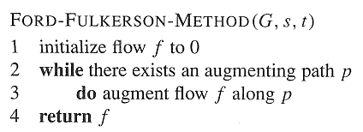

Slide 11
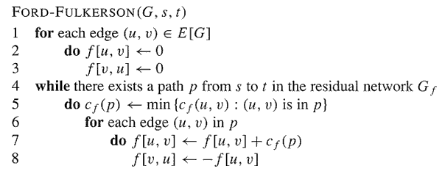
Ford-Fulkerson

Slide 12
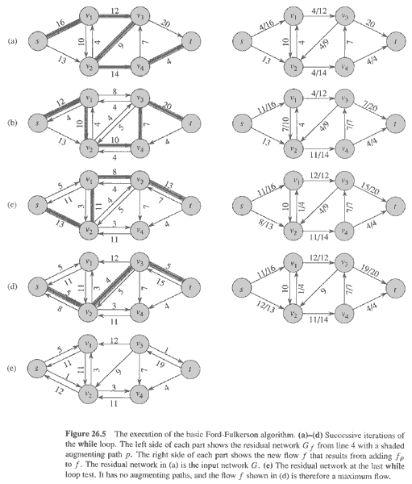

Slide 13
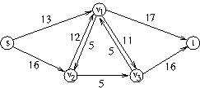
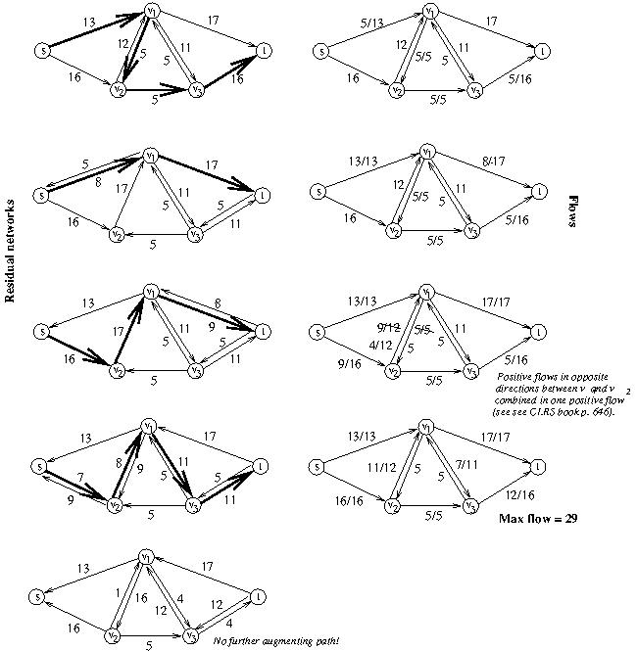
Input flow network
Chosen path bold

Slide 14
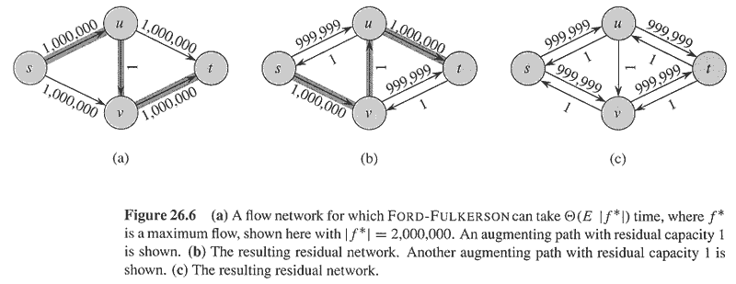
Analysis of Ford-Fulkerson: Assume the capacities of all edges are integers. Then, a
straightforward implementation of Ford-Fulkerson takes O(E|f*|) time, where f* is the
maximum flow found by the algorithm:
Lines 1-3 take Ө(E) time.
The while loop of lines 4-8 is executed at most |f*| times since the value of the flow increases
by at least 1 at each iteration. Moreover, each iteration of the while loop takes O(E) time if
either depth-first or breadth-first search is used to find a path in the residual network.
Therefore, total time = O(E + E|f*|) = O(E|f*|).

Slide 15
Edmonds-Karp
Edmonds-Karp = Ford-Fulkerson using breadth-first search in
line 4 to find an augmenting path,
i.e., the augmenting path found is shortest in terms of the
number of edges.
Edmonds-Karp runs in O(VE²) time…

Slide 16
Analysis of Edmonds-Karp
Lemma 26.8: If the Edmonds-Karp algorithm is run on a flow
network G = (V, E) with source s and sink t, then for all vertices
v ∈ V – {s, t}, the shortest distance δ_{f}(s, v) in the residual network
G_{f} increases monotonically with each flow augmentation.
Theorem 26.9: If the Edmonds-Karp algorithm is run on a flow
network G = (V, E) with source s and sink t, then the total number
of flow augmentations performed by the algorithm is O(VE).
Since, breadth-first search can be implemented in O(E) time, the
running time of Edmonds-Karp is O(VE * E) = O(VE²).

Slide 17
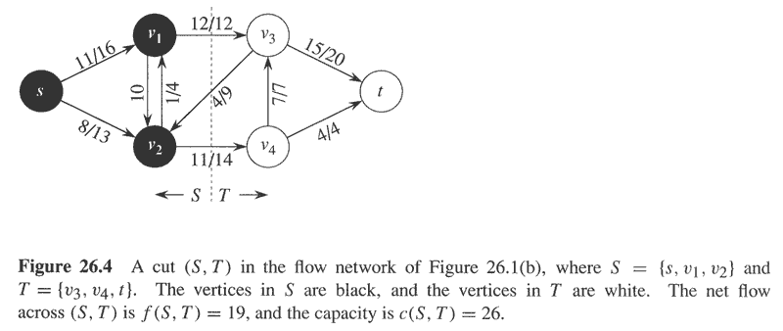
A cut (S, T) of a flow network G = (V, E) is a partition of V into S and T = V – S, such that s ∈ S and t ∈ T.
If f is a flow then the net flow across the cut (S, T) is defined to be f(S, T).
The capacity of the cut (S, T) is defined to be c(S, T). Of course, f(S, T) ≤ c(S, T).
A minimum cut of a network is a cut whose capacity is minimum over all possible cuts of the network.
Lemma 26.5: Let f be a flow in a network G with source s and sink t, and let
(S, T) be a cut of G. Then the net flow across (S, T) is f(S, T) = |f|.
Remark: In other words, the net flow across any cut is the same (= value of flow).
Proof: Have to show that f(S, T) = f(s, V) (Hint: f(S, T) = f(S, V) – f(S, V-T) = f(S, V) – f(S, S) = f(S, V) = …)
Corollary 26.6: The value of any flow f in a flow network G is bounded from above
by the capacity of any cut of G.
Proof: …

Slide 18
Theorem 26.7 (Max-flow min-cut theorem):
If f is a flow in a flow network G = (V, E) with source s and sink t,
then the following conditions are equivalent:
f is a maximum flow in G.
The residual network G_{f} contains no augmenting paths.
|f| = c(S, T) for some cut (S, T) of G.
Proof: (1) ⇒ (2) ⇒ (3) ⇒ (1)…

Slide 19
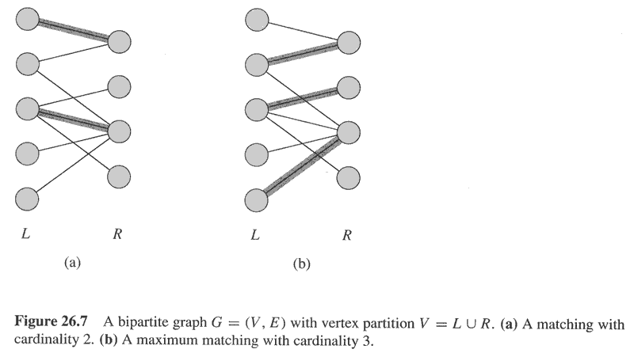
Maximum Bipartite Matching
A bipartite graph is a graph
G = (V, E) s.t. the vertex set
can be partitioned V = L ∪ R
where L and R are disjoint and
every edge in E goes between
L and R.
A matching in an undirected graph G = (V, E) is a subset of edges M ⊆ E,
such that for all vertices v ∈ V, at most one edge of M is incident on v.
Vertex v is matched by matching M if some edge of M is incident on v;
otherwise, v is unmatched.
A maximum matching is a matching with maximum number of edges, i.e.,
M is a maximum matching if |M| ≥ |M’|, for any other matching M’.

Slide 20
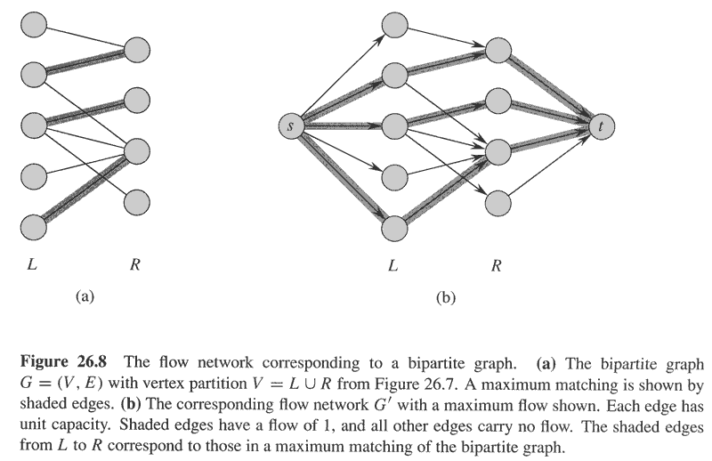
Lemma 26.10: Let G = (V, E) be a bipartite graph with vertex partition V = L ∪ R,
and let G’ = (V’, E’) be its corresponding flow network. If M is a matching in G, then
there is an integer-valued flow f in G’ with value |f| = |M|. Conversely, if f is an
integer-valued flow in G’, then there is a matching M in G with cardinality |M| = |f|.
Theorem 26.11 (Integrality Theorem): If the capacity function c takes on only integral
values, then the maximum flow f produced by the Ford-Fulkerson method has the
property that |f| is an integer. Moreover, for all vertices u and v, f(u, v) is an integer.
Corollary 6.12: The cardinality of a maximum matching M in a bipartite graph G equals
the value of a maximum flow in its corresponding flow network.

Slide 21
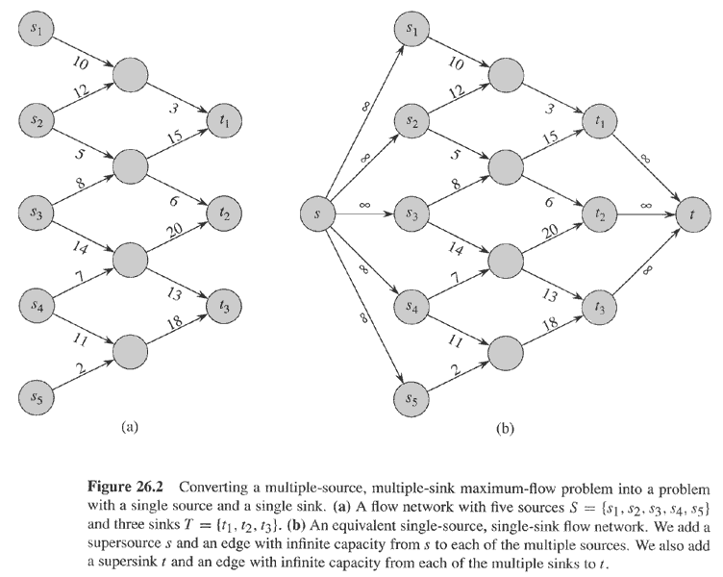
Converting a multiple-source multiple-sink max flow problem into
a single-source single-sink problem by adding a supersource and
a supersink.

Slide 22
Problems
Ex. 26.1-2
Ex. 26.1-5
Ex. 26.1-6
Ex. 26.1-8
Ex. 26.2-1
Ex. 26.2-2
Ex. 26.2-3
Ex. 26.2-4
Ex. 26.3-1
Ex. 26.3-4
Prob. 26-3
Prob. 26-4

