Slide 1
Logistics Routing Plans: Max Flow Problem
Objectives and Agenda:
1. Examples for flow of materials over limited capacity channels
2. Finding maximum flows: Ford-Fulkerson Method

Slide 2
Logistics supply problem: Example 1
Legend:
Node: Sub-station
Edge: Power line
Weight: Line capacity
WanChai
NorthPoint
Western
5
Central
20
10
15
20
15
15
25
PokFuLam
HappyValley
40
20
40
20
Aberdeen
30
20
50
20
RepulseBay
40
Power Station
Lamma
What is the maximum power we can supply to Wan Chai for a Light-n-Sound Show?

Slide 3
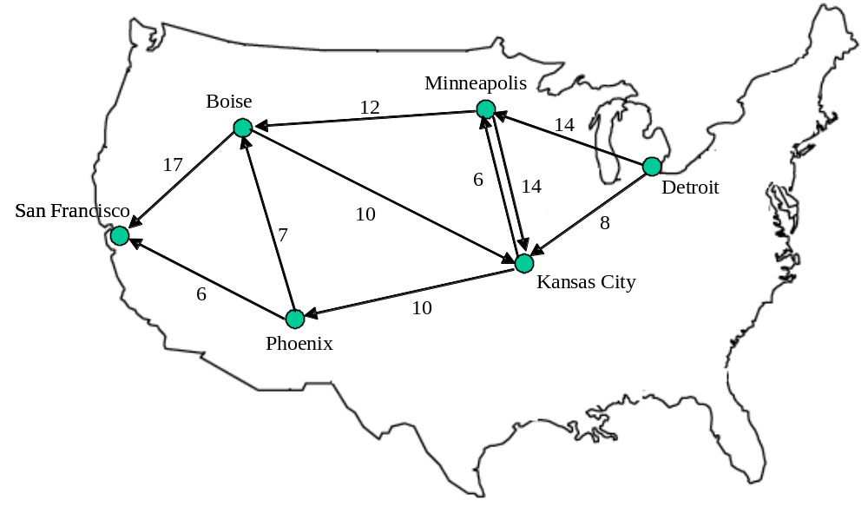
Logistics supply problem: Example 2
Legend:
nodes: train line junctions;
edges: rail line;
weights: max no. of compartments/day
Maximum number of compartments per day from Detroit→ SF ?

Slide 4
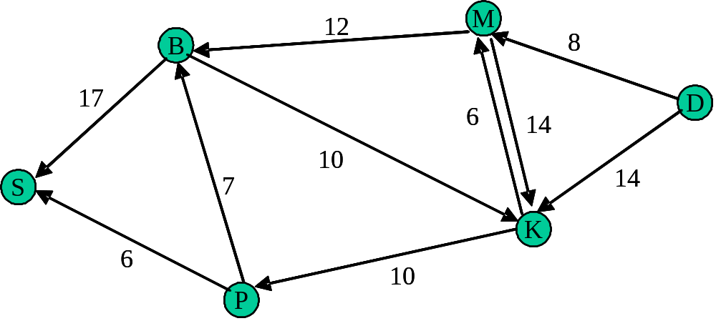
Maximum Flow Problem: definitions
SINK:
Node with net inflow;
Consumption point
CAPACITY:
Maximum flow
on an edge
SOURCE:
Node with net outflow:
Production point
Efficient method to solve such problems: Ford-Fulkerson Method

Slide 5
Ford-Fulkerson Method..
Three fundamental concepts:
1. Flow cancellation
2. Augmentation flow
3. Residual network

Slide 6
Ford-Fulkerson Method: Flow Cancellation
Flow Cancellation: Compute the NET FLOW between a pair of nodes
14
Network
a
b
6
5/14
Flow: 5 units, a → b, 3 units b → a
a
b
3/6
2/14
Net flows:
a
b
6
14
Additional 7 units from b → a ?!
a
b
5/6

Slide 7
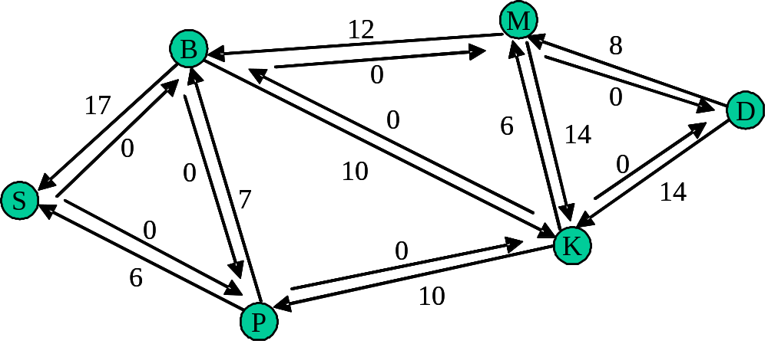
Ford-Fulkerson Method: Augmenting Path
Augmenting Path: any path from source → sink with positive capacity
Examples
Path | Capacity
<D, M, B, S> | 8
<D, M, K, P, S> | 6
…

Slide 8
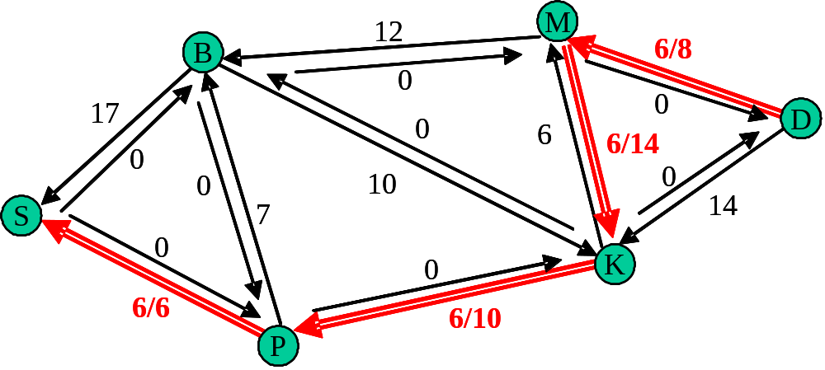
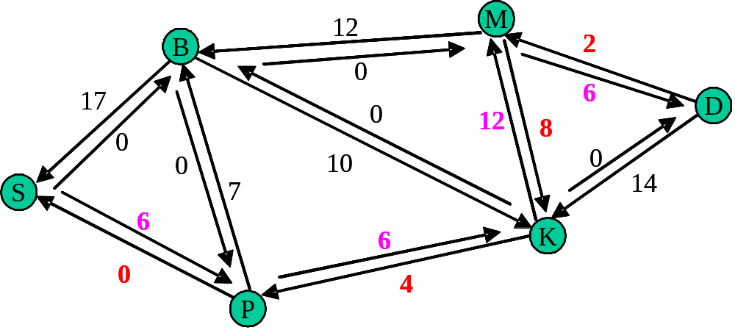
Ford-Fulkerson Method: Residual network
Given a Network G, with flow, | f |, on path p
Flow cancellation
residual
network
Notes:
Residual network: cancel as much flow as possible, and update the residual capacity of affected links.

Slide 9
Ford-Fulkerson Method..
Initialize the network: zero flow
any augmenting path p
in network ?
Residual
network
Carries
Max Flow
NO
YES
Apply maximum flow allowed on p
Compute residual network

Slide 10
Ford-Fulkerson Method: Initialize
Step 1. Add 0-capacity links to pair ‘one-way’ edges
Step 1

Slide 11
Ford-Fulkerson Method: Find an augmentation path
Step 2. Find a positive flow from Source → Sink
Flow, f = 6 units

Slide 12
Ford-Fulkerson Method...
Step 3. Update the residual network due to flow f
Current total flow: 6

Slide 13
Ford-Fulkerson Method….
Augmentation path: <D, M, B, S>
Max flow: 2
Current total flow: 6+2
Residual network
10
M
B
0
2
15
8
D
0
0
12
12
8
2
8
0
10
0
0
10
0
14
7
14
S
7
6
6
K
6
6
0
0
4
4
P

Slide 14
Ford-Fulkerson Method…..
10
M
Augmentation path: <D, K, M, B, S>
Max flow: 10
B
0
2
15
8
D
0
0
12
12
8
2
8
0
10
0
0
10
0
14
7
14
S
7
6
6
6
K
6
0
0
4
4
Current total flow: 6+2+10
Residual network
P
0
M
B
0
12
5
8
D
0
0
2
18
12
10
10
0
10
0
7
4
S
7
6
K
6
0
4
P

Slide 15
Ford-Fulkerson Method……
0
M
Augmentation path: <D, K, P, B, S>
Max flow: 4
B
0
12
5
8
D
0
0
2
18
12
10
10
0
10
0
7
4
S
7
6
6
K
0
4
P
Current total flow: 6+2+10+4
Residual network
0
M
B
0
12
1
8
D
0
No more
Augmentation paths
➔ DONE
0
2
18
16
14
10
4
3
10
S
0
6
10
K
0
0
P

Slide 16
Ford-Fulkerson Method: Proof
Property 1: We can add augmentation flows
Network G, flow f1 → residual network G_{f1}
Network G_{f1}, flow f2 → residual network G_{f1, f2}
Network G, flow (f1 + f2) → residual network G_{f1, f2}
=> We can solve the problem in stages!

Slide 17
Ford-Fulkerson Method: Proof..
Property 2: Every source-containing bag has same net outflow
Network G, flow f, amount: | f |
Each source-containing bag, net outflow = |f|
12/12
Example:
Compare net flow out of
blue bag and red bag
M
6/8
B
6/17
6/6
0/14
D
6/10
6/14
0/7
S
K
Why ?
6/6
6/10
P
Notes:
Law of conservation of mass: In steady state, no node should be collecting extra material.

Slide 18
Ford-Fulkerson Method: Proof...
Definition: Outflow capacity of a bag = total capacity of outflows
12/12
M
6/8
B
6/17
6/6
0/14
D
6/10
6/14
0/7
S
K
6/6
6/10
P
Examples:
Outflow capacity of red bag = 8+6+10 = 24
Outflow capacity of blue bag = 12+10 = 22
Notes:
Law of conservation of mass: In steady state, no node should be collecting extra material.

Slide 19
Ford-Fulkerson Method: Proof….
Suppose, at termination, total flow in network = f*
Using f*, we have no augmentation path from source → sink
OUT-OF-BAG:
Set of nodes with no augmentation
path from source
IN-BAG:
Set of nodes with augmentation
path from source
Residual network, G_{f*}
0
0
Source
Sink
0
0
=> Existence of | f | > |f*| impossible!
Notes:
After Ford-Fulkerson terminates, let flow= f*, with total flow volume = | f* |.
(1) Construct the residual network; (2) For all nodes that have possible augmentation paths
from source, color them red; all nodes to which there is no augmentation path, color them blue.
(3) Construct a bag around red nodes; (4) The outflow capacity of this bag must be zero.
(5) Therefore the network is carrying maximum flow already, which must be | f* |.

Slide 20
Concluding remarks
How to find augmenting paths ?
-- Need to search all possibilities on the network
Classical terminology: The Max-flow Min-cut theorem
(c) Applications:
(i) Transportation Logistics (ships, airlines, trains)
(ii) Design of supply networks
(water, sewage, chemical plant, food processing, roads)
next topic: Project management using CPM/PERT
Notes:
Max-flow Min-cut theorem: The maximum possible flow in a network (from source to sink) is exactly
equal to the minimum outflow capacity among all possible source-containing bags.

Slide 21
Ford-Fulkerson Method..

Slide 22
Ford-Fulkerson Method..

