Slide 1
Network Monitoring and Wireshark
CSE 322

Slide 2
Acknowledgement
https://studylib.net/doc/17803129/cap6135--malware-and-software-vulnerability-analysis-netw...
https://slideplayer.com/slide/5692294/
http://ilta.ebiz.uapps.net/ProductFiles/productfiles/672/wireshark.ppt
UC Berkley course “EE 122: Intro to Communication Networks”
  http://www.eecs.berkeley.edu/~jortiz/courses/ee122/presentations/Wireshark.ppt
Other resources:
  http://openmaniak.com/wireshark_filters.php

Slide 3
Motivation for Network Monitoring
Essential for Network Management
  Router and Firewall policy
  Detecting abnormal/error in networking
  Access control
Security Management
  Detecting abnormal traffic
  Traffic log for future forensic analysis

Slide 4
Tools Overview
Tcpdump
  Unix-based command-line tool used to intercept packets
    Including filtering just the packets of interest
  Reads “live traffic” from interface specified using -i option …
  … or from a previously recorded trace file specified using -r option
    You create these when capturing live traffic using -w option
Tshark
  Tcpdump-like capture program that comes w/ Wireshark
  Very similar behavior and flags to tcpdump
Wireshark
  GUI for displaying tcpdump/tshark packet traces

Slide 5
tcpdump Example
Ran tcpdump on a Unix machine
Example: first few lines of the output
01:46:28.808262 IP danjo.CS.Berkeley.EDU.ssh > adsl-69-228-230-7.dsl.pltn13.pacbell.net.2481: . 2513546054:2513547434(1380) ack 1268355216 win 12816
01:46:28.808271 IP danjo.CS.Berkeley.EDU.ssh > adsl-69-228-230-7.dsl.pltn13.pacbell.net.2481: P 1380:2128(748) ack 1 win 12816
01:46:28.808276 IP danjo.CS.Berkeley.EDU.ssh > adsl-69-228-230-7.dsl.pltn13.pacbell.net.2481: . 2128:3508(1380) ack 1 win 12816
01:46:28.890021 IP adsl-69-228-230-7.dsl.pltn13.pacbell.net.2481 > danjo.CS.Berkeley.EDU.ssh: P 1:49(48) ack 1380 win 16560

Slide 6
What Does a Line Convey?
Timestamp
This is an IP packet
Source host name
Source port number (22)
01:46:28.808262 IP danjo.CS.Berkeley.EDU.ssh >
adsl-69-228-230-7.dsl.pltn13.pacbell.net.2481: . 2513546054:2513547434(1380) ack 1268355216 win 12816
Destination host name
Destination port number
TCP specific information
Different output formats for different packet types

Slide 7
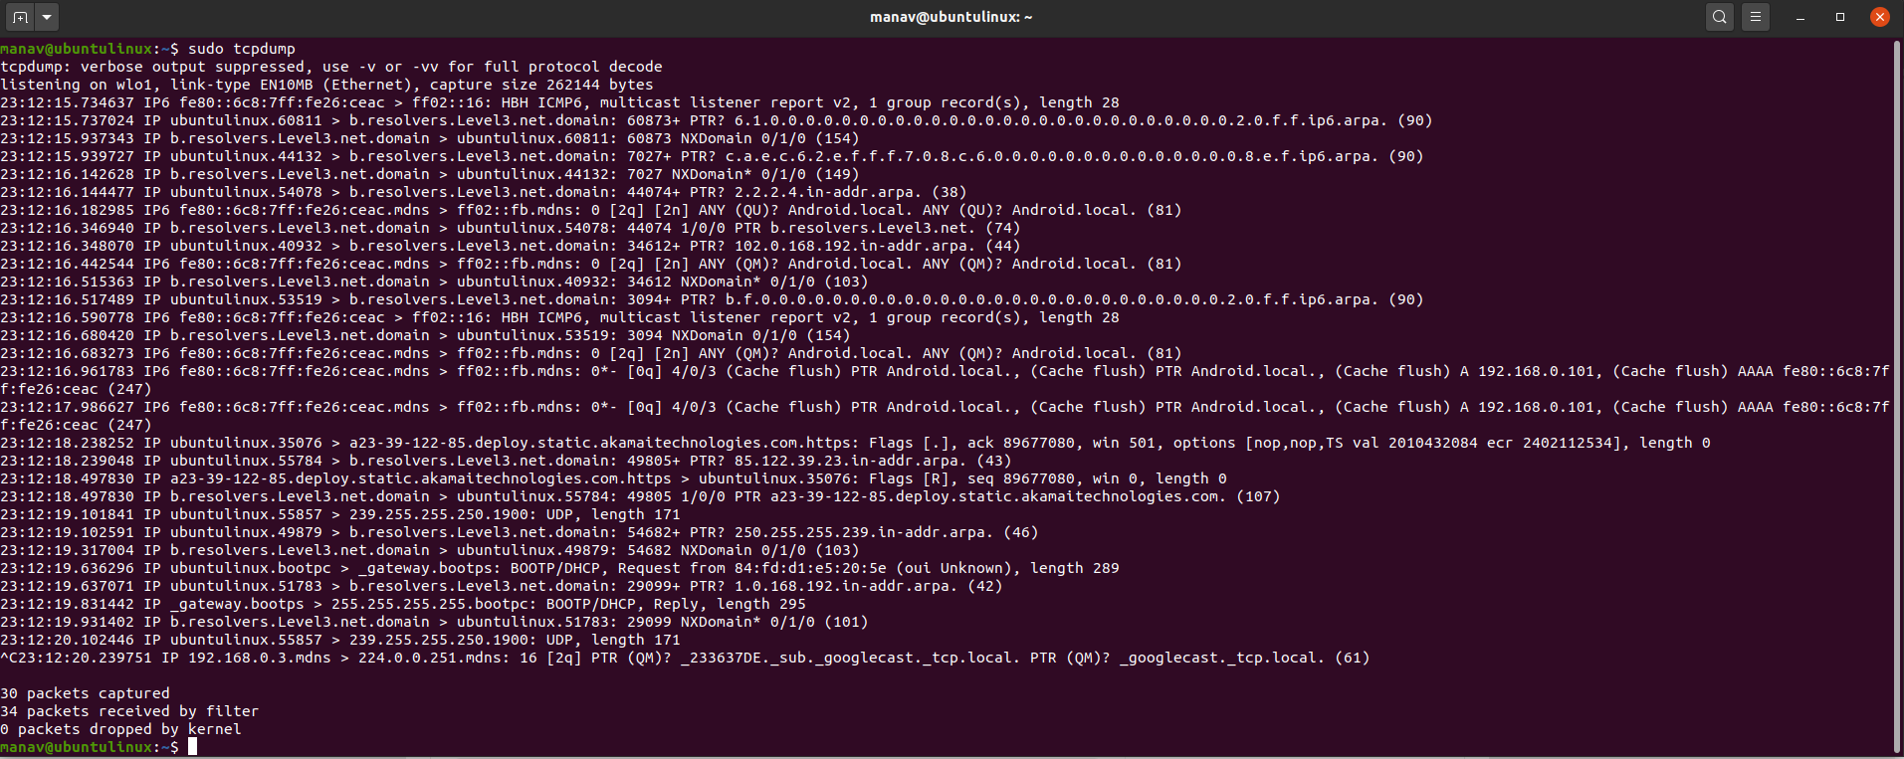

Output from tcpdump
Link: https://www.geeksforgeeks.org/tcpdump-command-in-linux-with-examples/

Slide 8
Similar Output from Tshark
1190003744.940437 61.184.241.230 -> 128.32.48.169 SSH Encrypted request packet len=48
1190003744.940916 128.32.48.169 -> 61.184.241.230 SSH Encrypted response packet len=48
1190003744.955764 61.184.241.230 -> 128.32.48.169 TCP 6943 > ssh [ACK] Seq=48 Ack=48 Win=65514 Len=0 TSV=445871583 TSER=632535493
1190003745.035678 61.184.241.230 -> 128.32.48.169 SSH Encrypted request packet len=48
1190003745.036004 128.32.48.169 -> 61.184.241.230 SSH Encrypted response packet len=48
1190003745.050970 61.184.241.230 -> 128.32.48.169 TCP 6943 > ssh [ACK] Seq=96 Ack=96 Win=65514 Len=0 TSV=445871583 TSER=632535502

Slide 9
Demo 1 – Basic Run
Syntax:
tcpdump [options] [filter expression]
To do -
  $ sudo tcpdump –i eth0
    Sudo command allows you to run tcpdump in root privilege
  On your own Unix machine, you can run it using “sudo” or directly run “tcpdump” if you have root privilege
Observe the output
Notes:
Depending on the kind of traffic, make some general observations – sources, destinations, kinds of traffic, DNS requests etc. Too much of output.

Slide 10
Filters
We are often not interested in all packets flowing through the network
Use filters to capture only packets of interest to us

Slide 11
Demo 2
Capture only udp packets
  tcpdump “udp”
Capture only tcp packets
  tcpdump “tcp”

Slide 12
Demo 2 (contd.)
Capture only UDP packets with destination port 53 (DNS requests)
  tcpdump “udp dst port 53”
Capture only UDP packets with source port 53 (DNS replies)
  tcpdump “udp src port 53”
Capture only UDP packets with source or destination port 53 (DNS requests and replies)
  tcpdump “udp port 53”

Slide 13
Running tcpdump
Requires superuser/administrator privileges on Unix
  http://www.tcpdump.org/
  You can do it on your own Unix machine
  You can install a Linux OS in Vmware on your windows machine
Tcpdump for Windows
  WinDump: http://www.winpcap.org/windump/
    Free software
    Might have compatibility issues

Slide 14

So What is WireShark?
Packet sniffer/protocol analyzer
Open Source Network Tool
Latest version of the ethereal tool
# | Wireshark | Tcpdump
1 | A GUI tool to catch data packets | A CLI-based packet capturing tool
2 | It does packet analysis, decode data payloads if the encryption keys are identified, and recognize data payloads from file transfers such as smtp, http, etc. | Tcpdump only provides do a simple analysis of such types of traffic, such as DNS queries
3 | It has advanced network interfaces | It has conventional interfaces
4 | Good for complex filters | Used for simple filters
5 | It provides decoding of protocol-based packet capturing | It is less efficient in decoding compared to Wireshark

Slide 15

Scope of WireShark
Internet and all …
Application
Web, Email, VOIP
Application
Transport
TCP, UDP
Transport
Network
IP
Network
Data Link
Ethernet, cellular
Data Link
Physical link

Slide 16
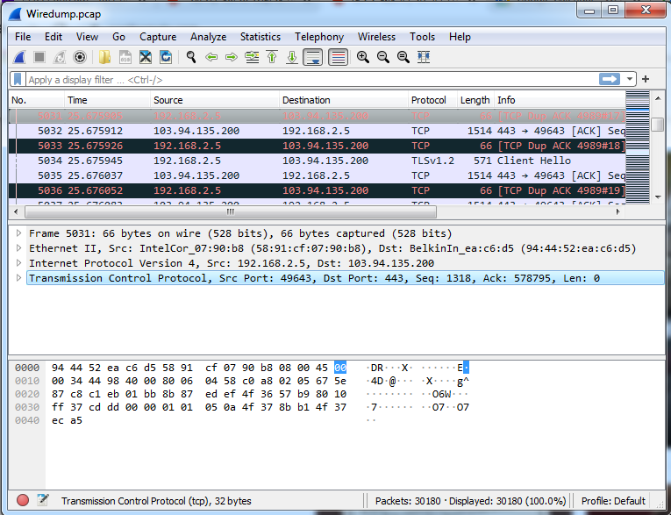
Wireshark Interface

Slide 17
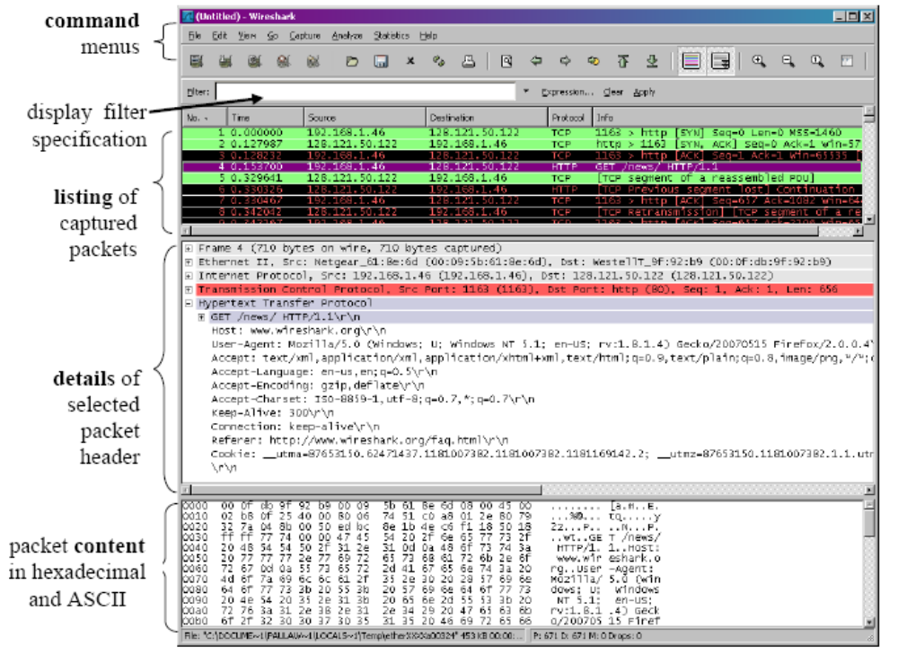
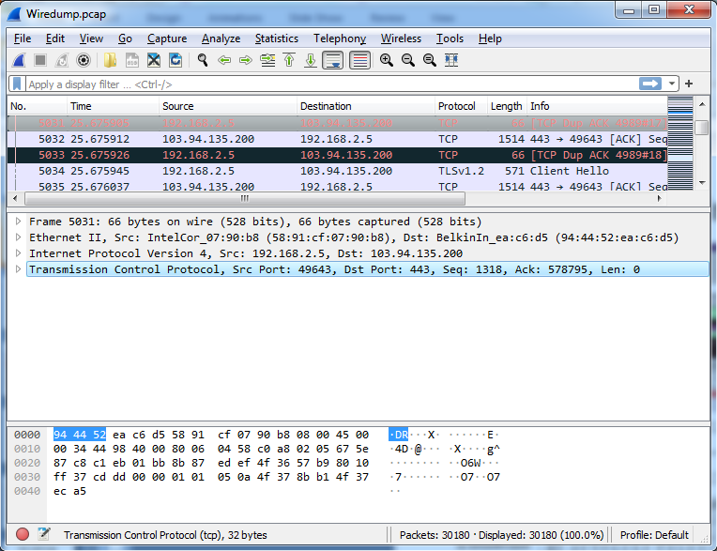
Wireshark Interface – Different Parts

Slide 18
Status Bar

Slide 19
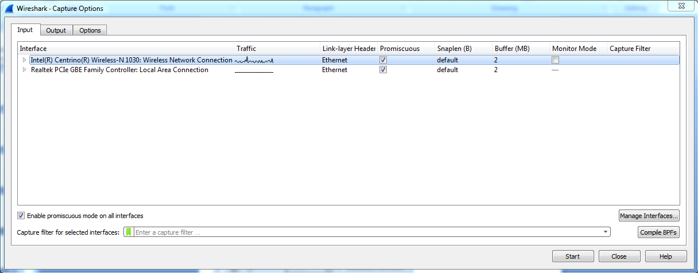
Capture Options
Promiscuous mode is used to capture all traffic
Sometime this does not work
  Driver does not support
  You are on a switched LAN

Slide 20
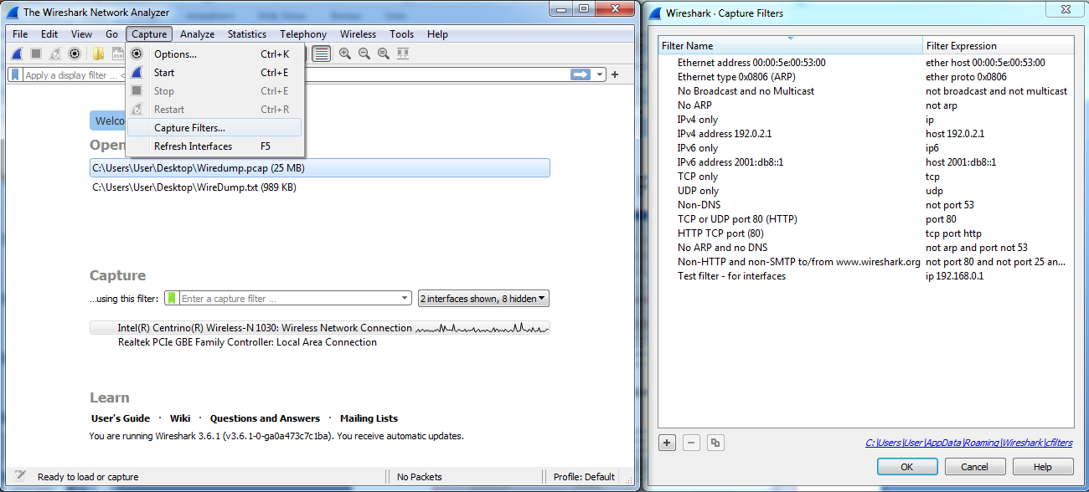
Capture Filter

Slide 21
Capture Filter Examples
host 10.1.11.24
host 192.168.0.1 and host 10.1.11.1
tcp port http
ip
not broadcast not multicast
ether host 00:04:13:00:09:a3

Slide 22
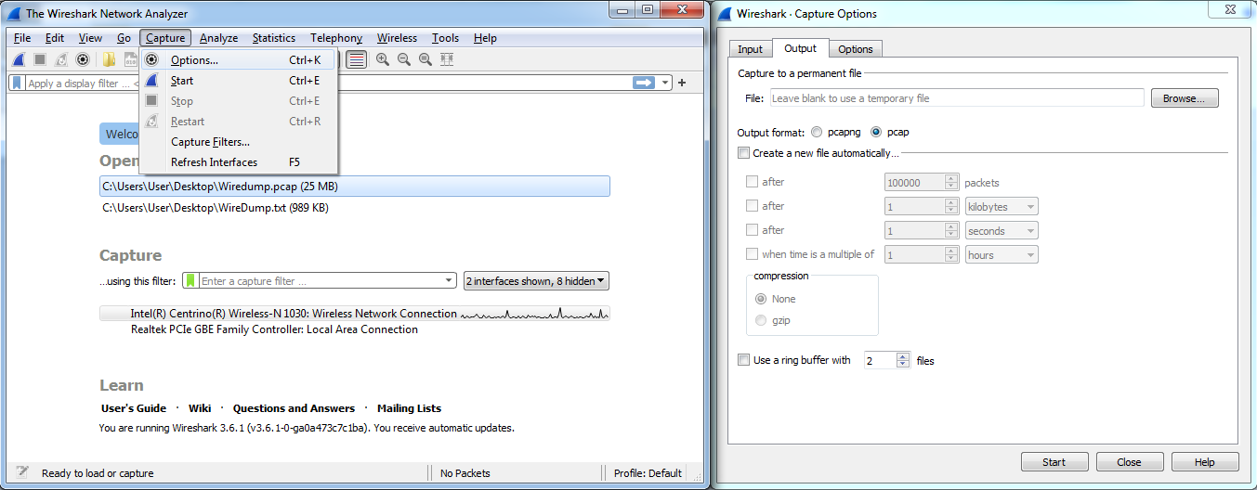
Capture Options
Ring buffer
  Addresses a common issue many analysts encounter when capturing packets - huge traces
  When you use a Ring Buffer, you can define how many files you want to capture and various parameters that affects the file size (# of packets, bytes, and time)
Link: https://www.networkcomputing.com/networking/working-ring-buffer-wireshark-files

Slide 23
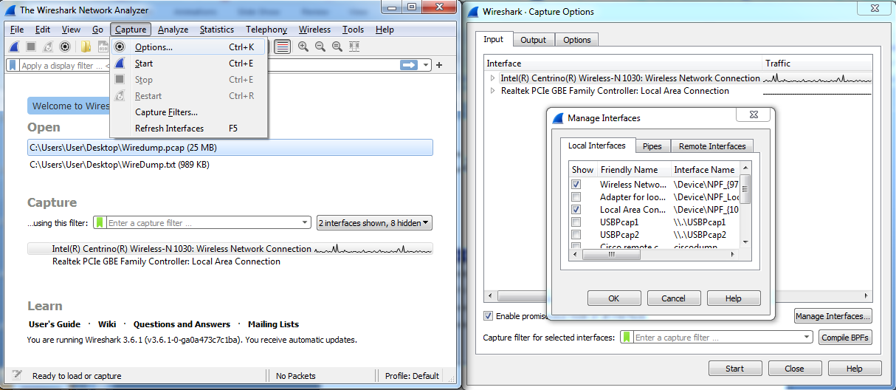
Capture Interfaces

Slide 24
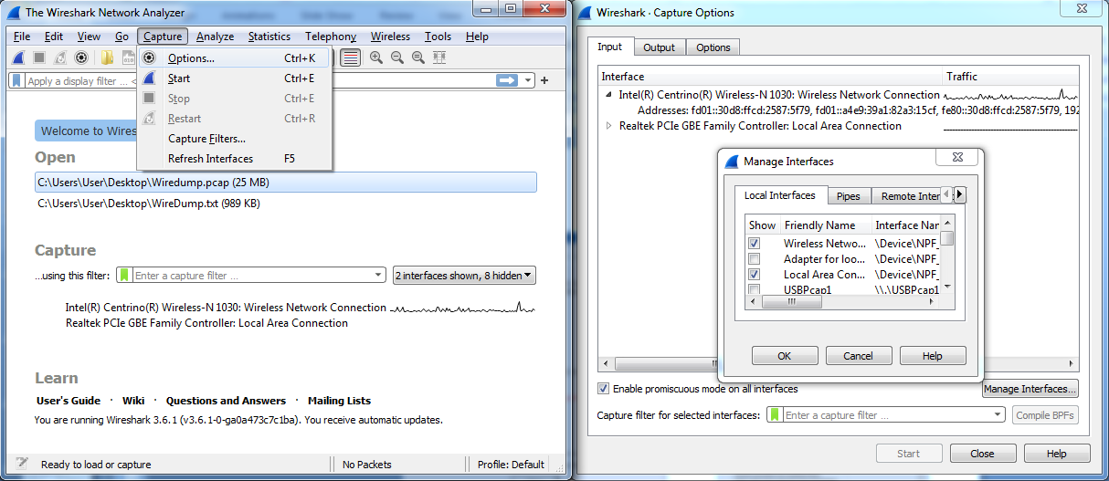
Interface Details

Slide 25
Display Filters (Post-Filters)
Display filters (also called post-filters) only filter the view of what you are seeing
  In analysis
  All packets in the capture still exist in the trace
Display filters use their own format and are much more powerful then capture filters

Slide 26
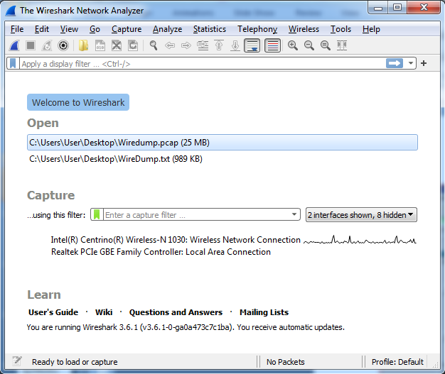
Display Filter

Slide 27
Display Filter Examples
ip.src==10.1.11.00/24
ip.addr==192.168.1.10 && ip.addr==192.168.1.20
tcp.port==80 || tcp.port==3389
!(ip.addr==192.168.1.10 && ip.addr==192.168.1.20)
(ip.addr==192.168.1.10 && ip.addr==192.168.1.20) && (tcp.port==445 || tcp.port==139)
(ip.addr==192.168.1.10 && ip.addr==192.168.1.20) && (udp.port==67 || udp.port==68)
tcp.dstport == 80

Slide 28
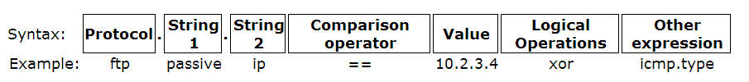
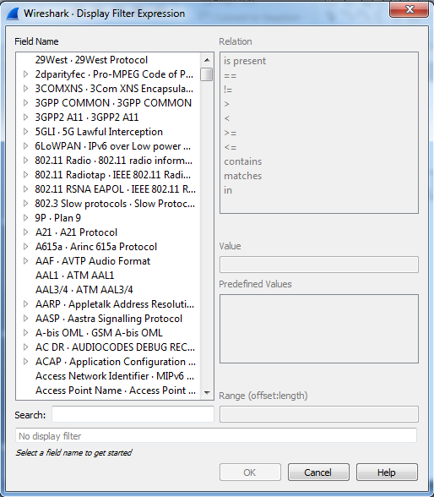
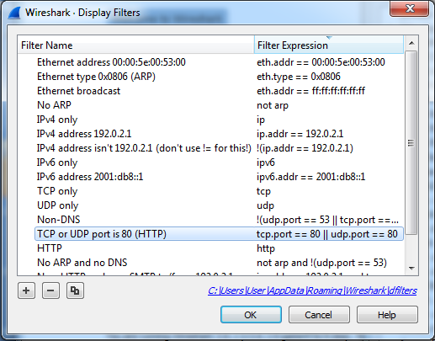
Display Filter

Slide 29
TCP Segment Structure
32 bits
URG: urgent data
(generally not used)
counting
by bytes
of data
(not segments!)
source port #
dest port #
sequence number
ACK: ACK #
valid
acknowledgement number
head
len
not
used
U
Receive window
A
P
R
S
F
PSH: push data now
# bytes
rcvr willing
to accept
checksum
Urg data pnter
RST, SYN, FIN:
connection estab
(setup, teardown
commands)
Options (variable length)
application
data
(variable length)
Internet
checksum
(as in UDP)

Slide 30
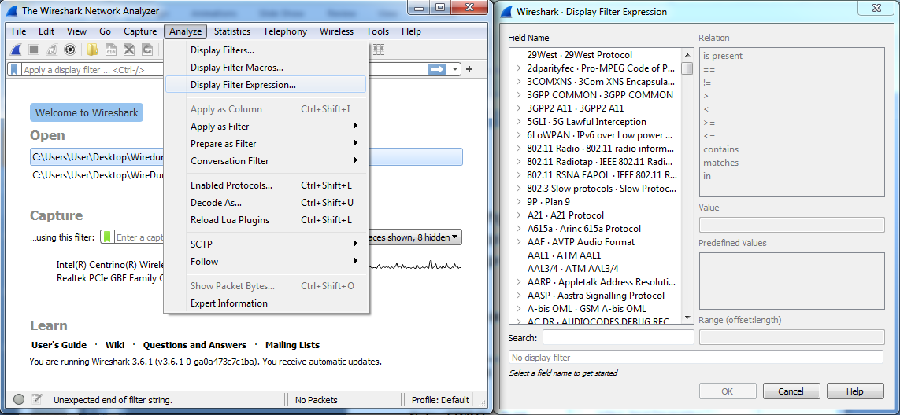

Display Filter
String1, String2 (Optional settings):
  Sub protocol categories inside the protocol.
  Look for a protocol and then click on the "+" character.
  Example:
  tcp.srcport == 80
  tcp.flags == 2
    SYN packet
    Tcp.flags.syn==1
  tcp.flags == 18
    SYN/ACK
  TCP Flag field:

Slide 31
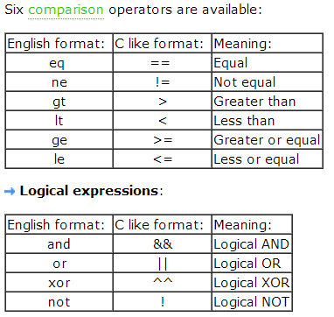
Display Filter Expressions
snmp || dns || icmp
  Display the SNMP or DNS or ICMP traffics.
tcp.port == 25
  Display packets with TCP source or destination port 25.
tcp.flags
  Display packets having a TCP flag.
tcp.flags == 0x02
  Display packets with a TCP SYN flag.
If the filter syntax is correct, it will be highlighted in green,
otherwise if there is a syntax mistake it will be highlighted in red.
Correct syntax
Wrong syntax

Slide 32
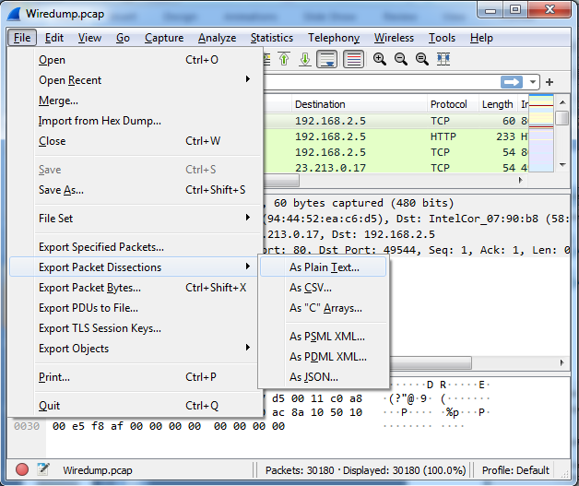
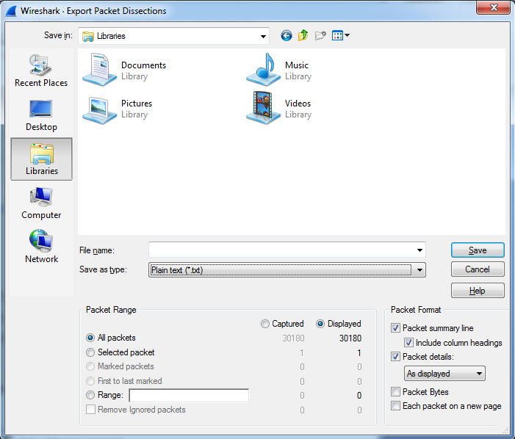
Save Filtered Packets after Using Display Filter
We can also save all filtered packets in text file for further analysis
Operation:
File→Export packet dissections
→as “plain text” file
1). In “packet range” option, select “Displayed”
2). Choose “summary line” or “detail”

Slide 33
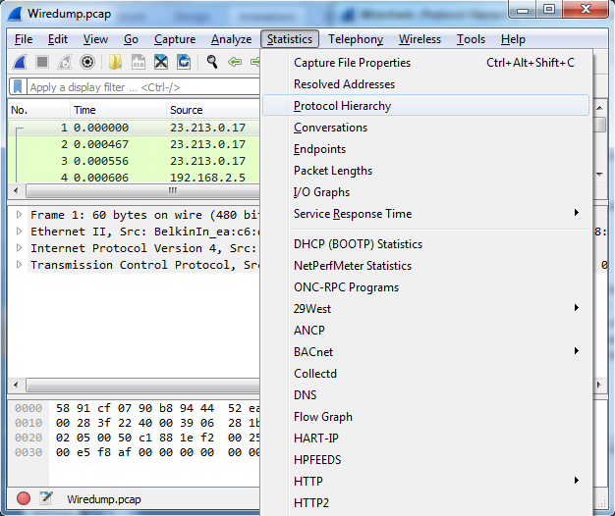
Protocol Hierarchy

Slide 34
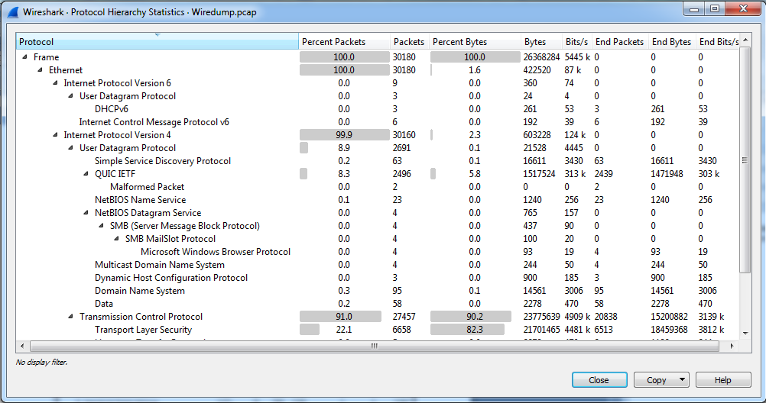
Protocol Hierarchy (contd.)

Slide 35
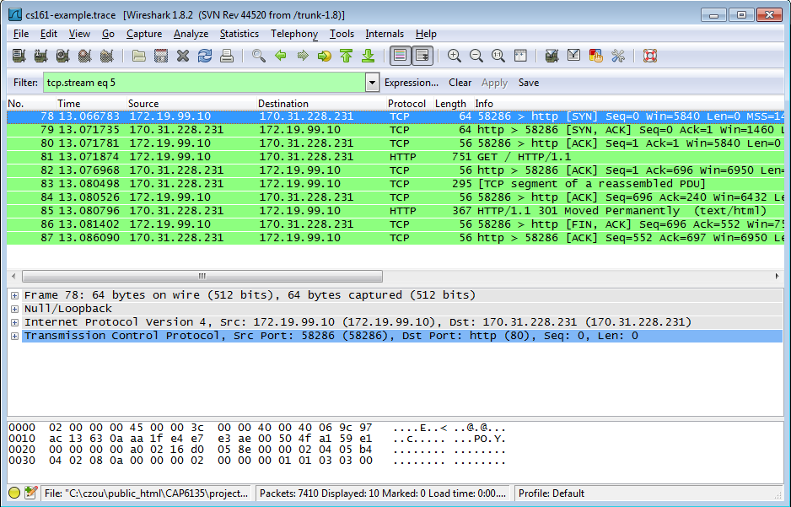
Filter out/in Single TCP Stream
When click “filter out this TCP stream” in previous page’s box, new filter string will contain like:
  http and !(tcp.stream eq 5)
So, if you use “tcp.stream eq 5” as filter string, you keep this HTTP session
Old version

Slide 36
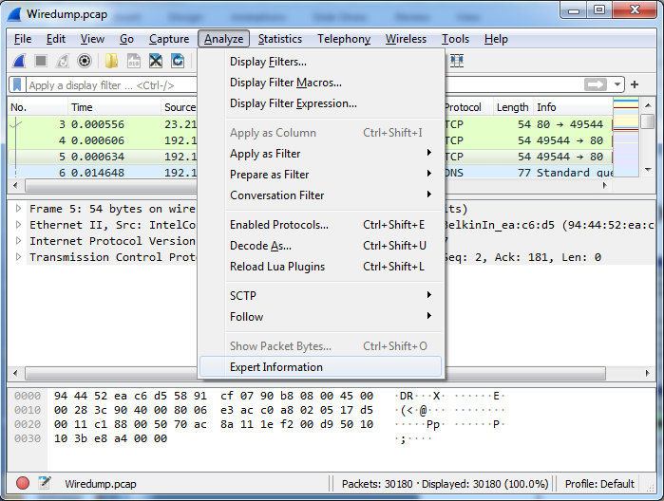
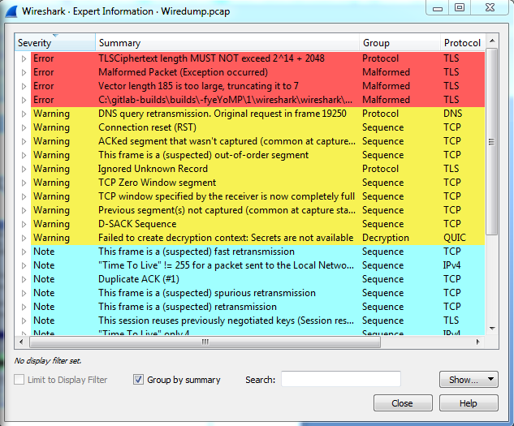
Expert Info

Slide 37
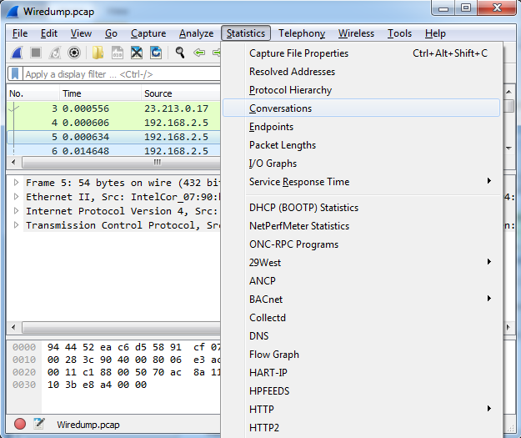
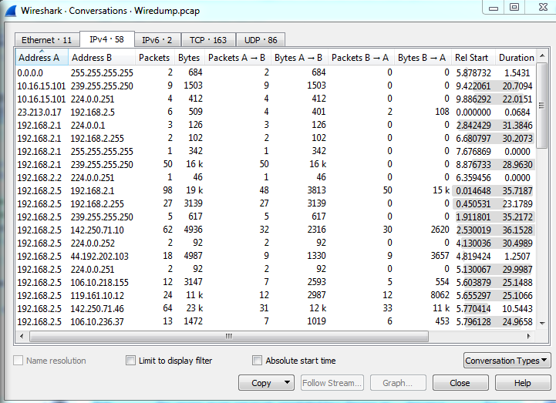
Conversations
Use the “Copy” button to copy all text into clipboard (file)
  Analyze the file to get what statistics you want

Slide 38
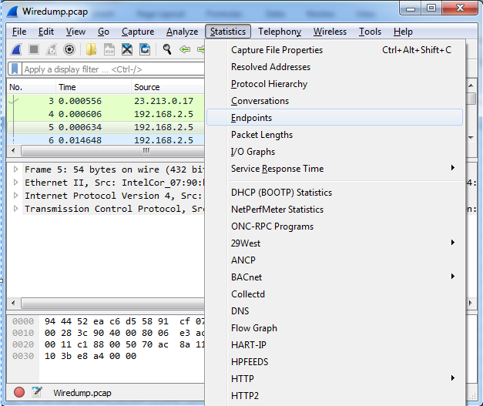
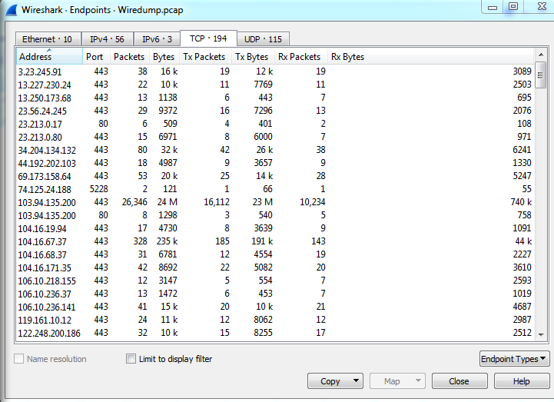
Find EndPoint Statistics
You can sort by field
Use the “Copy” button to copy all text into clipboard (file)
  Analyze the file to get what statistics you want

Slide 39
On-line Wireshark Trace Files
Public available .pcap files:
  http://www.netresec.com/?page=PcapFiles
http://www.tp.org/jay/nwanalysis/traces/Lab%20Trace%20Files/
Wiki Sample capture
  https://wiki.wireshark.org/SampleCaptures

Slide 40
Example Trace File and Questions
Network Forensic Puzzle Contests
  http://forensicscontest.com/2010/02/03/puzzle-4-the-curious-mr-x
SharkFest'15 Packet Challenge
  https://sharkfest.wireshark.org/assets/presentations15/packetchallenge.zip

Slide 41
Source of Installer
https://www.wireshark.org/download.html

Slide 42
Thank You
Acknowledgement: Web sources

