Slide 1
Food Price Prediction
A.B.M.Shajadul Karim
1821373042
Tasmim Hassan
1822157642
Sadik Munha
1931437042
Section: 4

Slide 2


Agenda
A
Project About
Statistics
Average time
Regularization & Optimization
Learning Curve

Slide 3
Project About
Russia's shelling of Ukrainian port infrastructure and grain warehouses affects food prices, so this data was collected in order to draw attention to this problem. Please support Ukraine - https://savelife.in.ua/en/donate-en/#donate-army-card-monthly Data were getting from - https://shop.silpo.ua (one shop), https://metro.zakaz.ua/uk/, https://www.atbmarket.com

Slide 4
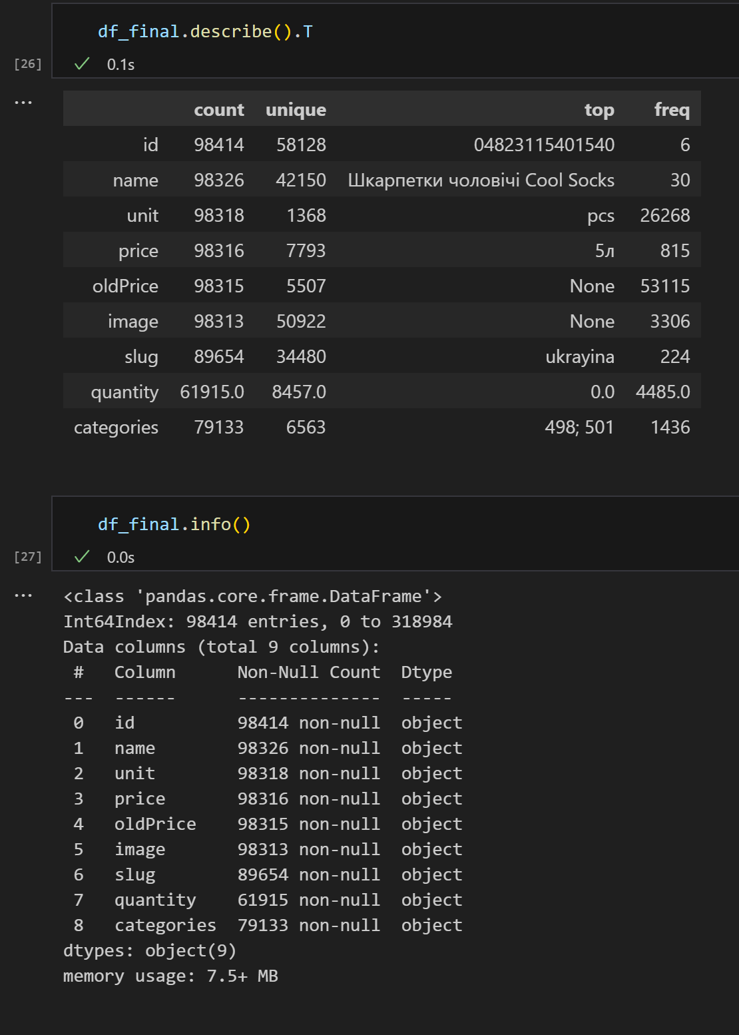
Dataset statistics
Total size after merging: (98414, 9)
Number of classes: 9
Number of samples: 98414

Slide 5
Average time
Logistic Regression: score 0.01
Nearest Neighbor: The accuracy of the KNN regressor on test data is 0.02
Random Forest: Score: MSE train: 1166842382.354, test: 2971330614.258 R^2 train: 0.447, test: 0.025
Average time 5s

Slide 6
Regularization & Optimization
L2 regularization & Ridge were used for optimization

Slide 7
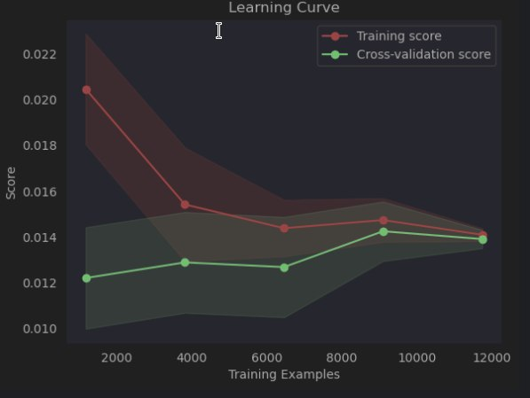
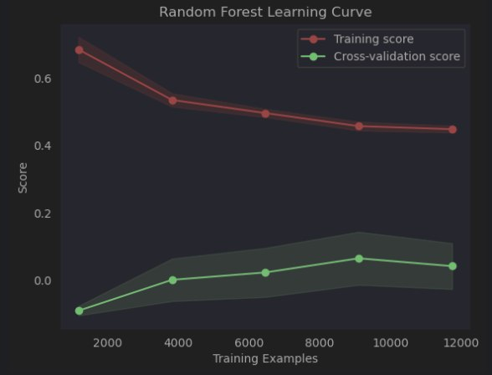
Learning Curve

Slide 8
Thank You

