Slide 1
Welcome to Our Presentation

Slide 2
Group members:
Ishraq Ahmed (UG02-45-17-006)
Arafat sharif (UG02-45-17-008)
Mahfujur Rahman (UG02-45-17-010)
Mst.Mahbuba Nilufa Yesmin (UG02-45-17-011)
Afshana Rimi (UG02-45-17-022)
Sadikur Rahman (UG02-45-17-027)
Tanvir Reyan (UG02-42-16-022)

Slide 3
E-commerce Website

Slide 4
What is an e-commerce website?
An e-commerce website is a website that allows you to buy and sell of goods, digital products or services online.

Slide 5
Why Ecommerce Website?
We all know that online shopping are becomming populer day by day. Nowadays People love to buy things from online. So old businessman and other new businessman wants to create their personal website for selling products online. So the demand of a e-commerce website is huge.

Slide 6
Aim
Our main aim is to create a user friendly website in which A customer can easily buy products from the shop and user(admin) can easyly see the income/loss per month by individual category.

Slide 7
Advantages
Faster buying process.
Store and product listing creation.
Cost reduction.
Affordable advertising and marketing.
Flexibility for customers.
No reach limitations.
Product and price comparison.
Faster response to buyer/market demands.

Slide 8
Software and tools
Tools:
A computer with a operating system(windows10)
Internet connection.
Software:
Xampp
Internet browser (chorome,mozila,opera etc.)
Text editor(brackets)
Language:
HTML,CSS,JavaScript
Bootstrap

Slide 9
Features of the site
Fully responsive website (compatible for all device)
Shops
Category and sub category
Shopping cart
Product details
User Profile
Customer register
Customer login
Contact

Slide 10
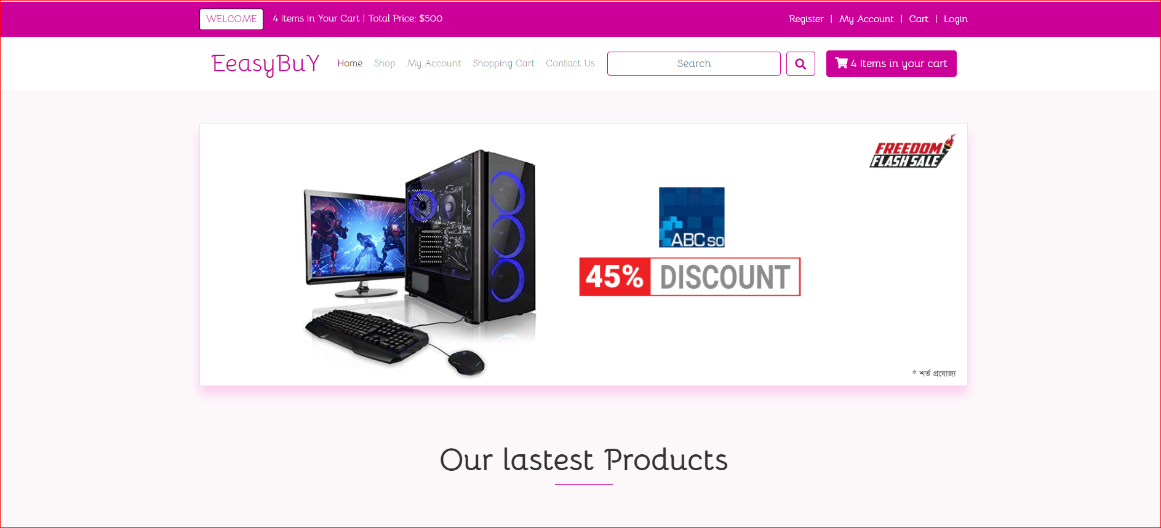
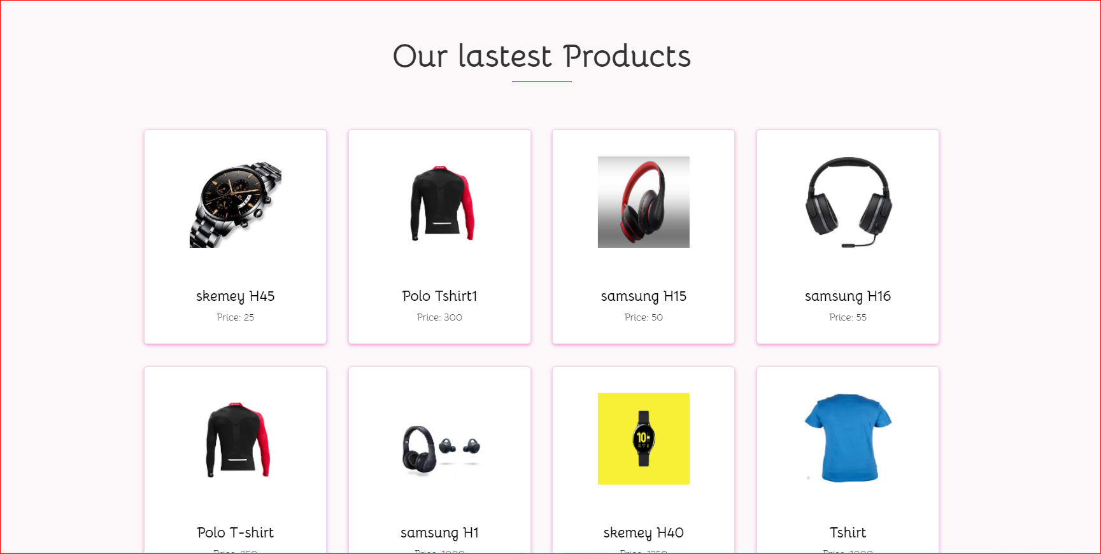
Home page

Slide 11
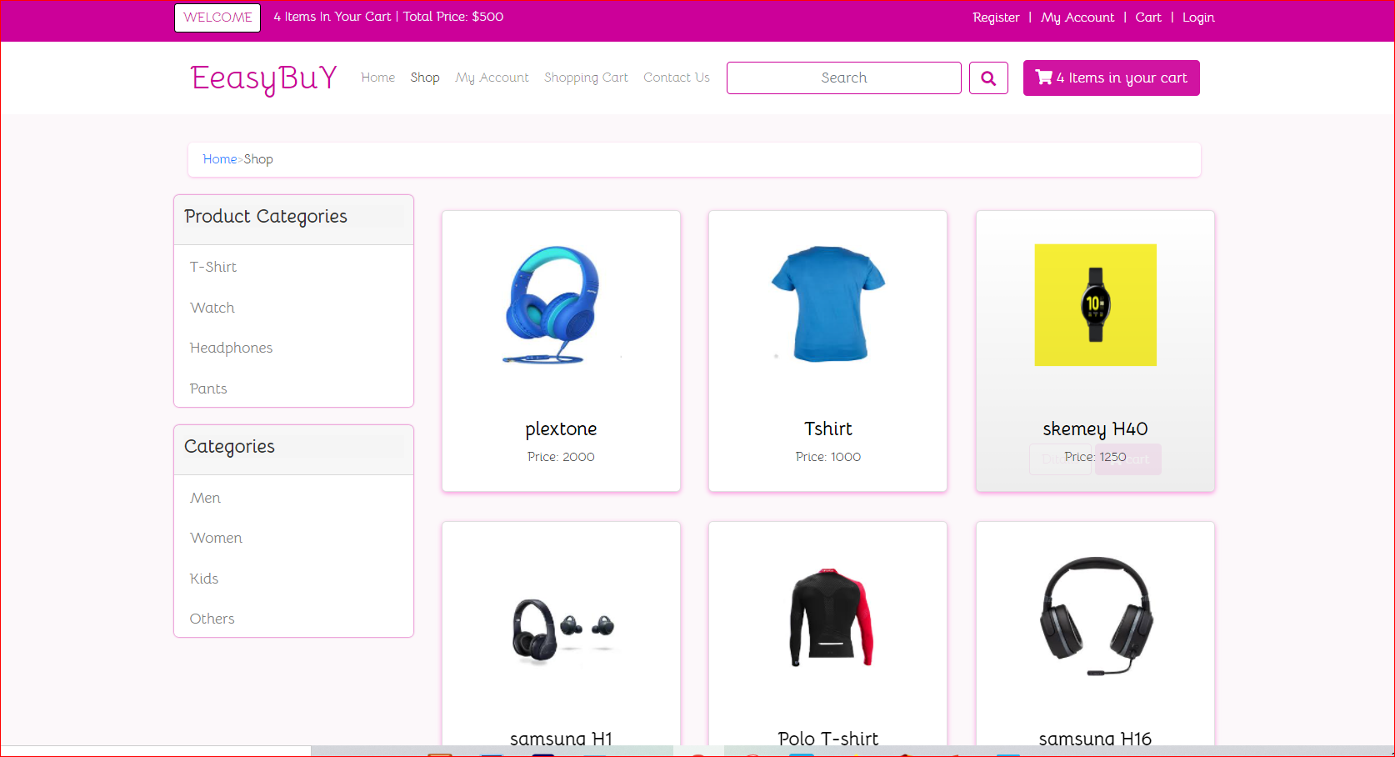
Shop page

Slide 12
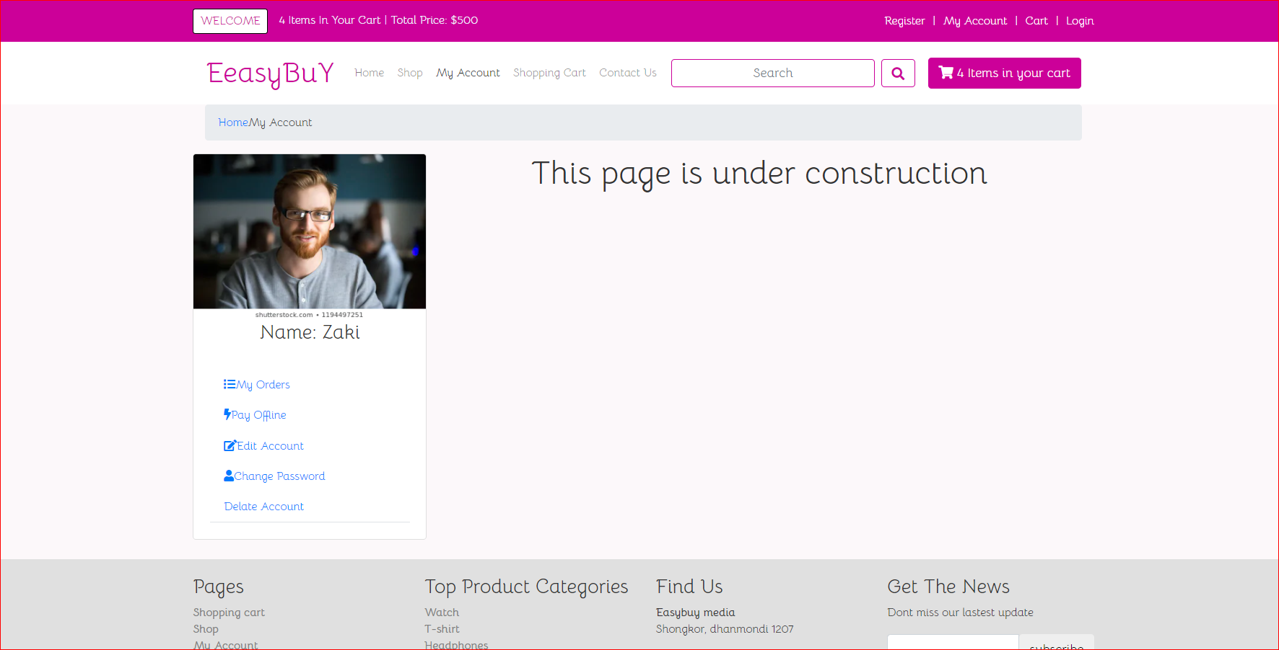
My account page

Slide 13
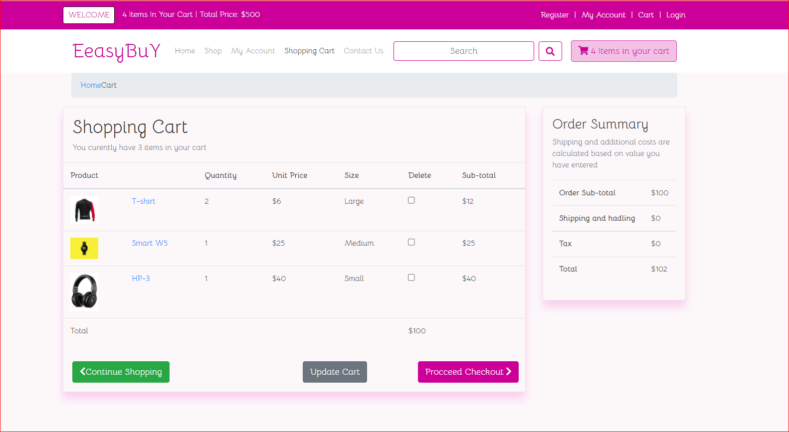
Shopping cart
Shopping cart

Slide 14
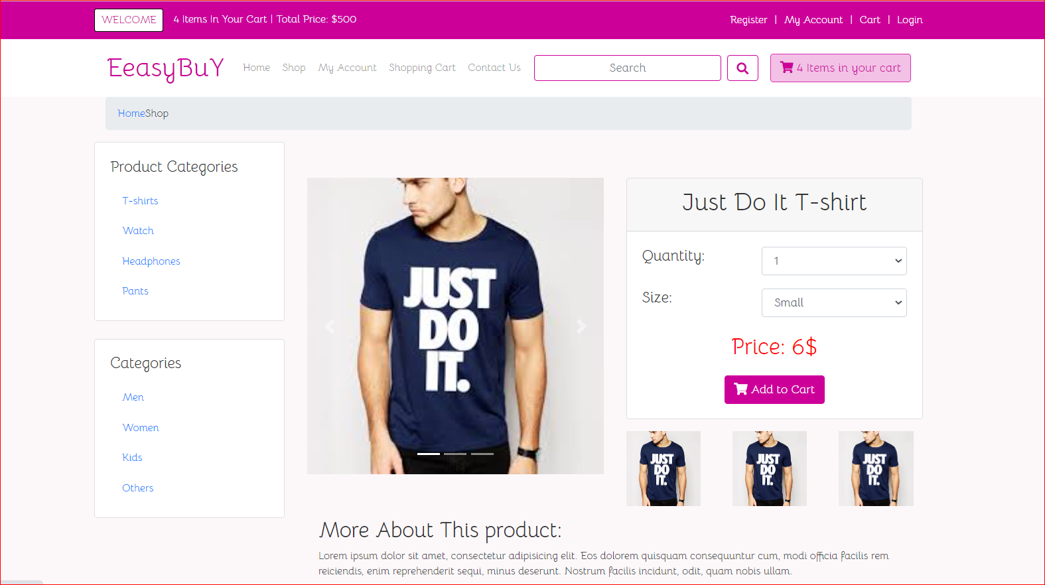
Products details

Slide 15
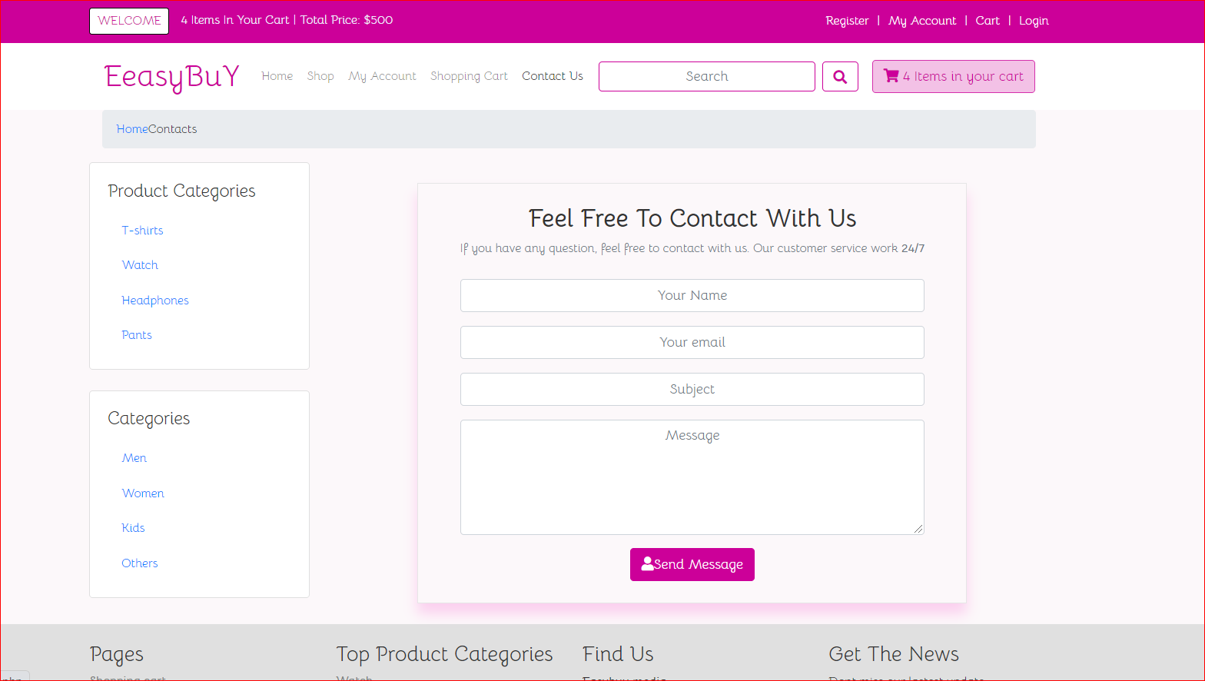
Contact page

Slide 16
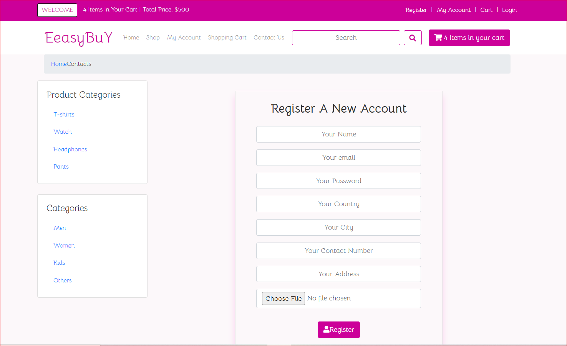
Register page

Slide 17
Future task
Create individual seller id in which they can add product and sell product like evaly and daraz.

Slide 18
Future features of the website
Fully Responsive Design (Front end and backend)
Using bootstrap
HTML,CSS,Jquery, Javascript
Fully Dynamic Website Using Laravel framework.
Dynamic category/subcategory
Dynamic product, banner etc.
Shopping cart
Coupon (Duration time)
Fully operational search option
Stock and out of stock showing
Multiple language support(Bangla and English)
Payment system
Multiple users role
Showing monthly total income(profit) or losses per individual category.

Slide 19
Problems We May Face
Creating tables for the website
Setup online payment method
Adding discount and cuppon
Make a fully operational admin panel which shows monthly income/loss per individual category.

Slide 20
Conclusion
E-commerce still represents one of the business methods that take advantage if done the right way, even if the stock market and commodities fell, but E-Commerce still able to survive and receive high transaction. E-commerce has a tremendous opportunity in the course of or business in Malaysia. In addition, it is also to introducing new techniques and styles in a transaction. Use the extensive E-Commerce in the Internet world is actually much better to bring the goodness of the individual or the state.

Slide 21
Thank You All
Thank You All

Slide 22
Any Questions?

