Slide 1
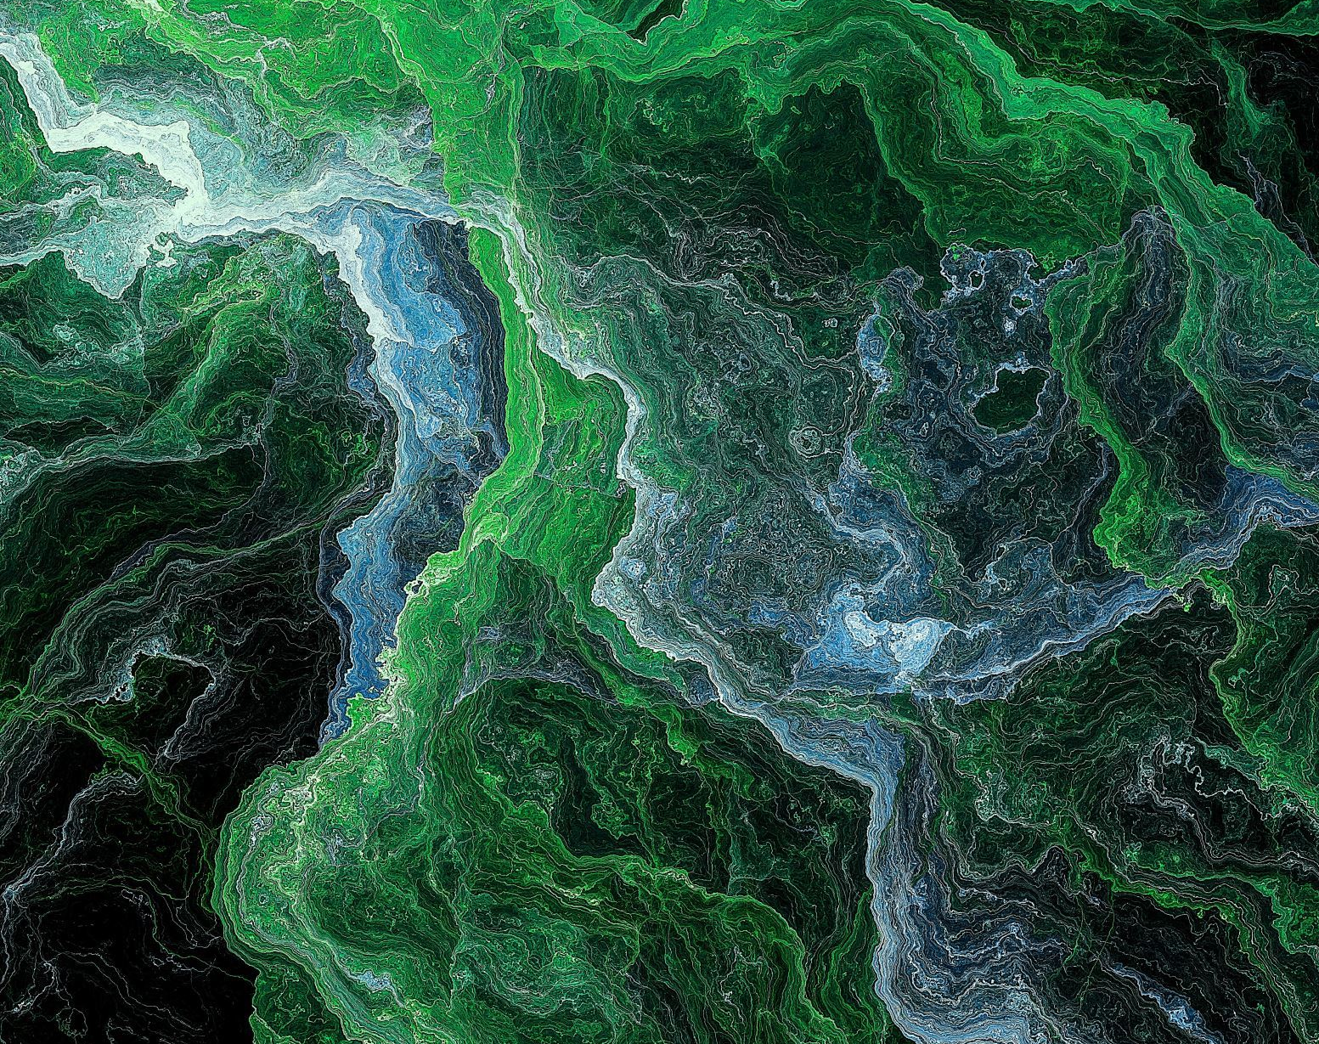
GENERATIVE MODEL FOR ANTICANCER PEPTIDE.
RESEARCH TASK - 3
Research Tracking – Sadik Bhattarai
NSCL LAB

Slide 2
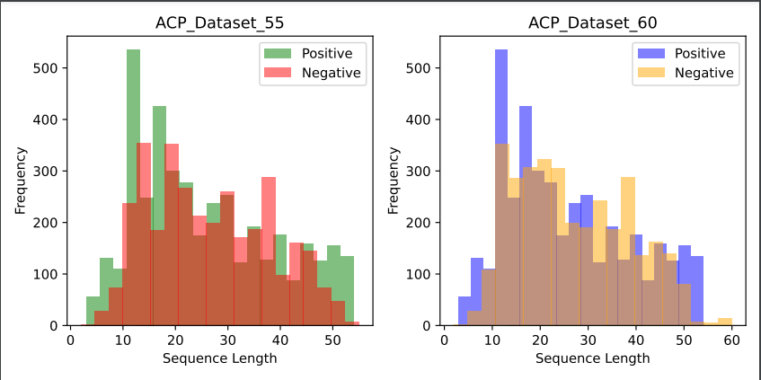
Dataset Creation
This unique dataset are created combiniing the datasets from multiple sources and reviewed method.
Dataset Creations : created a new dataset called as composite training dataset for training of GAN
Fig 1 : Anticancer peptide dataset creation and details

Slide 3
MODELS FOR GENERATION
Transfer Learning with Fine Tuning approach
DIFFUSION MODELS
GAN MODEL
Autoregressive Models, LSTM, BILSTM, AUTOREGRESSIVE, AUTOENCODER MODEL)

Slide 4
Generation of Anticancer peptide
Prepare a dataset (anticancer peptides(experimentally verified).
Preprocess the training dataset and evalution of datasets *.
Design a Generative Network *.
Check Relevancy or fidelity of Training and generated samples *.
Screening method for generated peptides (Target Specific) - Check for to which cancer cell lines does this peptide belongs to and select the target(for this dataset is available)*.
Rrosetta for modelling the peptides (check for pyrx too)*.
Docking - Pocket Specific Docking and Flexible Docking (rosetta)- Binding affinity*.
MD simulation of the complex and check for the stability, bonding information and many more*.

Slide 5
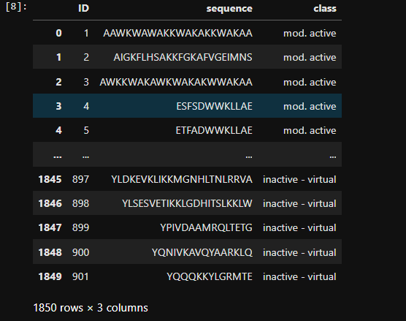
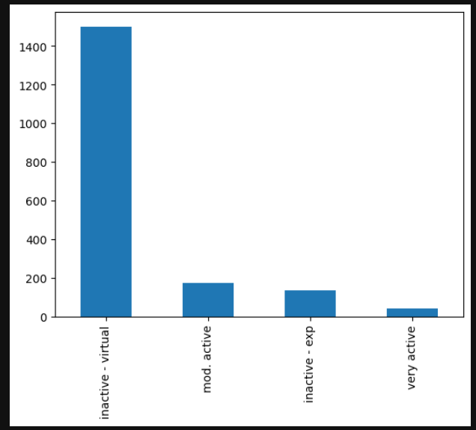
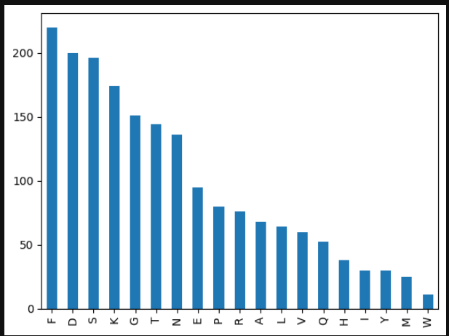
Experimental Work
We retreived a anticancer peptide dataset from Kaggle.

Slide 6
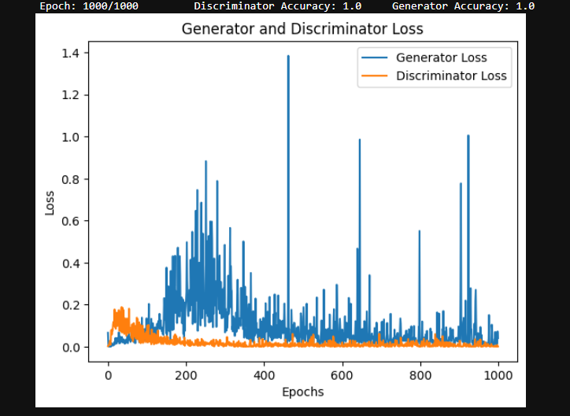
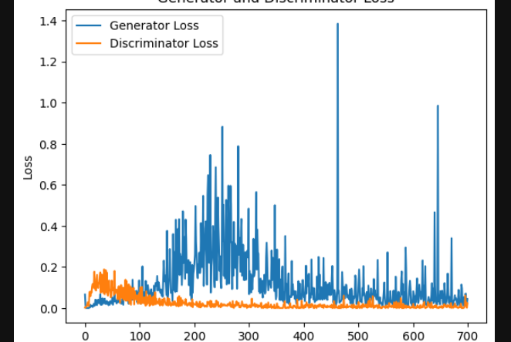
Training result
Fig : Training of the Dense layer GAN network.
This training curve signify that the model suffers a convergence failure where discriminator loss becomes close to zero and generator also decrease to zero.

Slide 7

Thank you

