Slide 1
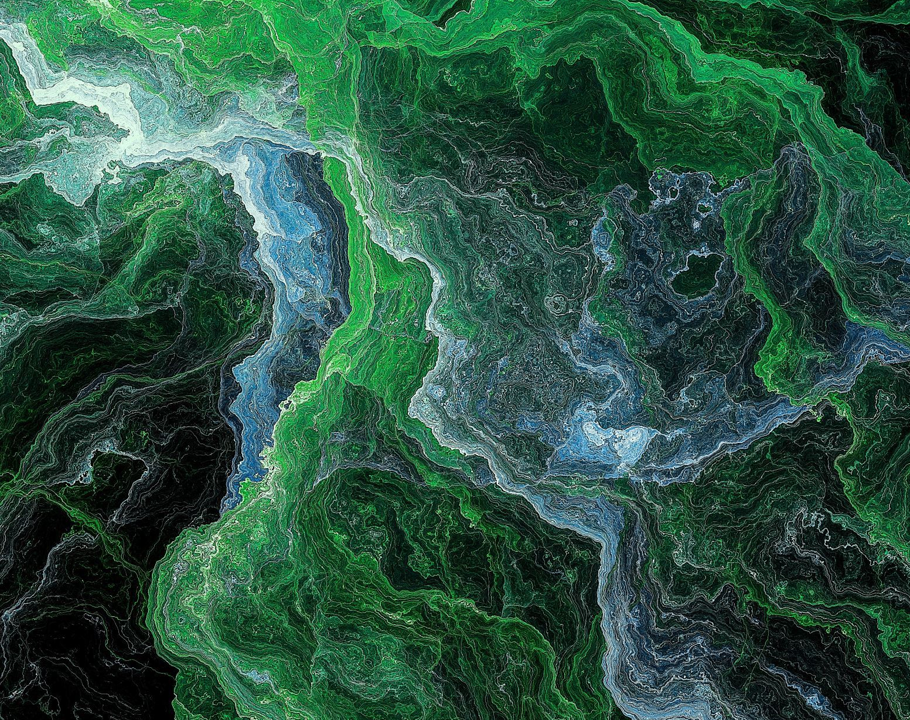
GENERATIVE MODEL FOR ANTICANCER PEPTIDE.
RESEARCH TASK - 3
Research Tracking – Sadik Bhattarai
NSCL LAB

Slide 2
Paper title
Paper Link
Take Home Message
Interesting Figures
Other notes

Slide 3
Paper title : Bioactive peptides for anticancer therapies (Review)
Paper Link https://www.ncbi.nlm.nih.gov/pmc/articles/PMC10189813/
Take Home Message:
Anticancer peptides (ACPs) are gaining attention as novel therapeutic and diagnostic candidates for cancer treatment due to their advantages over conventional methods.
ACPs exhibit high efficacy in inducing cancer cell death and have been developed as drugs and vaccines, undergoing evaluation in clinical trials.
ACPs offer increased specificity and toxicity towards malignant cells while reducing side effects on normal cells, making them promising for targeted cancer therapies.
most classical anticancer drugs lack the property to distinguish cancer cells from normal ones, thus resulting in systemic toxicity and adverse side effects (e.g., anaemia, gastrointestinal mucositis, alopecia, or cardiotoxicity).
Interesting Figures
Other notes

Slide 4
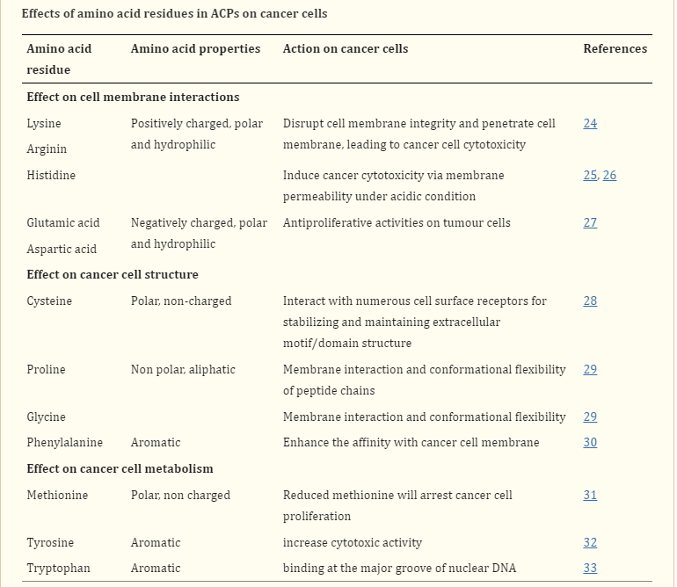
Effects of Each Residues in ACP on cancer cells
https://www.ncbi.nlm.nih.gov/pmc/articles/PMC10189813/

Slide 5





Composition difference between healthy cell and Cancer cells
The membrane of malignant normally carries a net negative charge because of the presence of a higher number of anionic components such as the phospholipid phosphatidylserine, O-glycosylated mucins, sialylated gangliosides and heparin sulphate than normal cells, which contributes to the selective cytotoxic property of ACPs.
Cholestrol Biomarkers: Normal cells have large amounts of cholesterol which works as a protective layer to modulate the cell fluidity and block the entrance or passage of cationic ACPs.
In contrast, most malignant cells have increased membrane fluidity, due to the low content of cholesterol in cell membranes, which may make them susceptible to ACPs.
In addition, cancer cells also contain an increased number of microvilli, in contrast to healthy cells.
The presence of microvilli with irregular size and shape on cancer cells can increase the surface area of cells for ACP binding and interactions, influences cell adhesion, and the communications between cancer cells and their environments, and facilities the specific interaction of ACPs with cancer cells.
Certain membrane active peptides disrupt the membrane of mitochondria causing the release of cytochrome c, which induce oligomerization of Apaf-1, activation of caspase-9 and the transformation of pro-caspase-3 to caspase-3, initiating apoptosis in many cancer cells.
For example, the cationic membrane-active peptide (KLAKLAKKLAKLAK) has been shown to target mitochondria and trigger apoptosis after fusing to a CNGRC homing domain

Slide 6
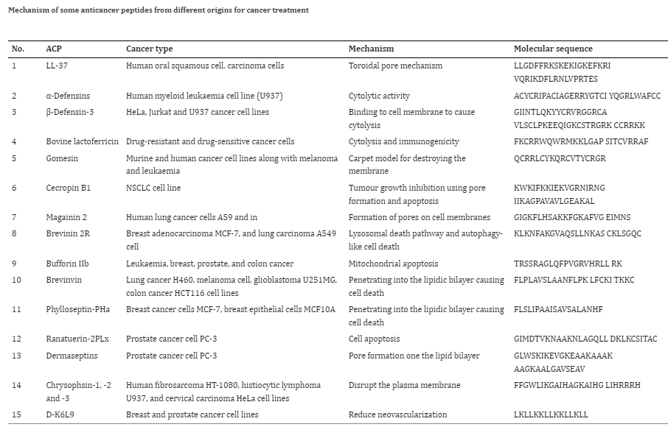
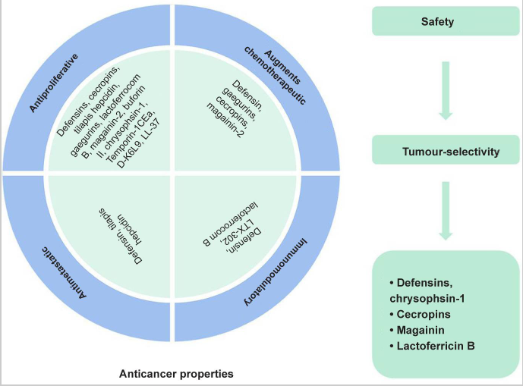
List of bioactive peptides with potentials for anticancer therapies

Slide 7
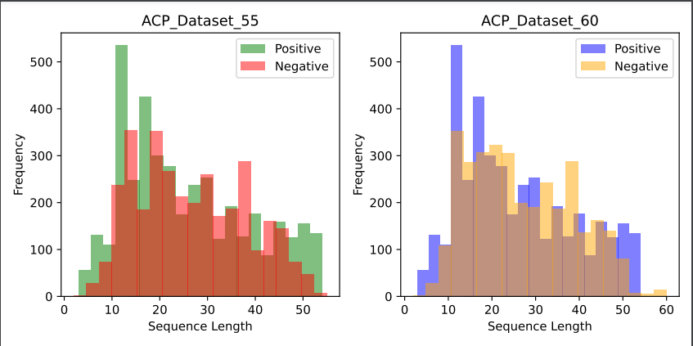
Dataset Creation
This unique dataset are created combiniing the datasets from multiple sources and reviewed method.
Dataset Creations : created a new dataset called as composite training dataset for training of GAN
Fig 1 : Anticancer peptide dataset creation and details

Slide 8
MODELS FOR GENERATION
Transfer Learning with Fine Tuning approach
DIFFUSION MODELS
GAN MODEL **
Autoregressive Models, LSTM, BILSTM, AUTOENCODER MODEL, Transformer Based Generative Models)

Slide 9
Generation of Anticancer peptide
Prepare a dataset (anticancer peptides(experimentally verified).
Preprocess the training dataset and evalution of datasets *.
Design a Generative Network *.
Check Relevancy or fidelity of Training and generated samples *.
Screening method for generated peptides (Target Specific) - Check for to which cancer cell lines you want to target (for this dataset is available)*.
Rrosetta for modelling the peptides (check for pyrx too)*.
Docking - Pocket Specific Docking and Flexible Docking (rosetta)- Binding affinity*.
MD simulation of the complex and check for the stability, bonding information and many more*.

Slide 10
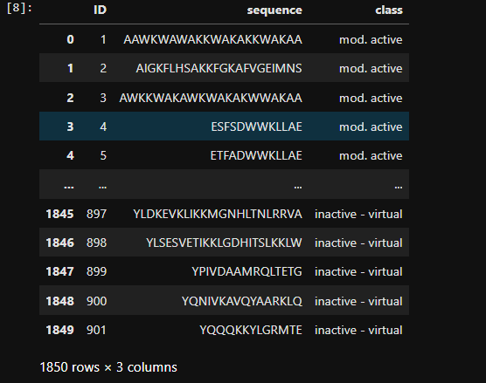
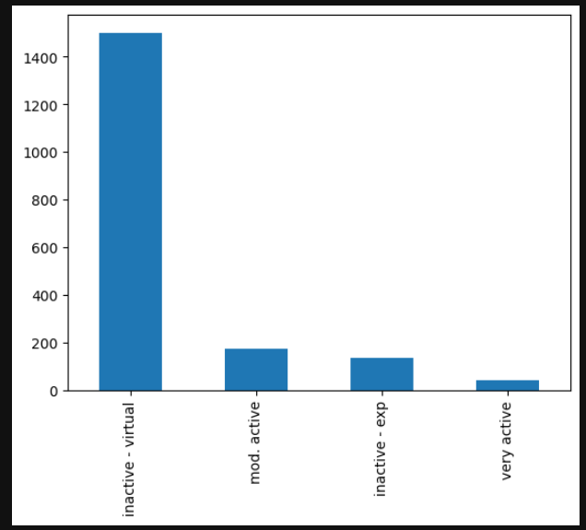
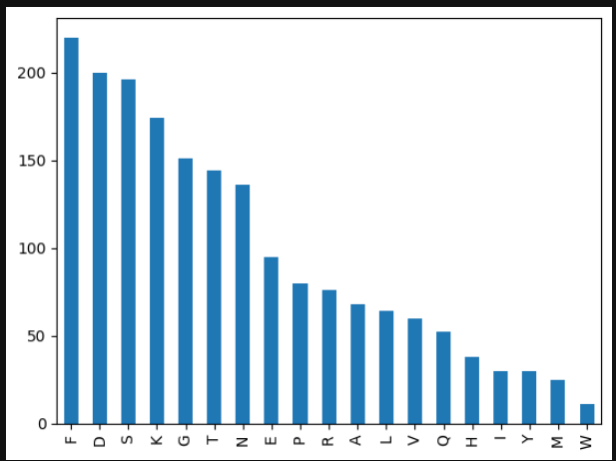
Experimental Work
We retreived a anticancer peptide dataset from Kaggle.

Slide 11
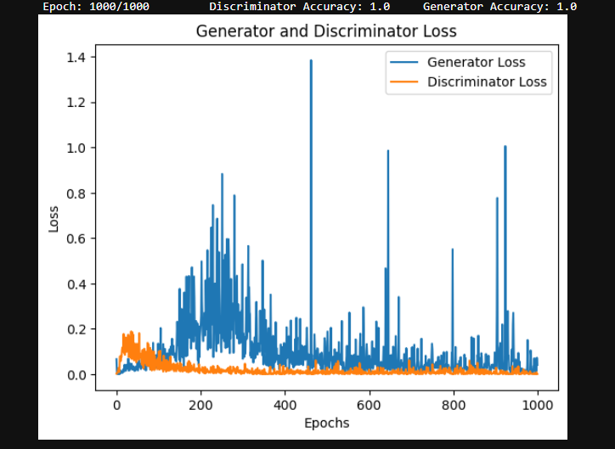
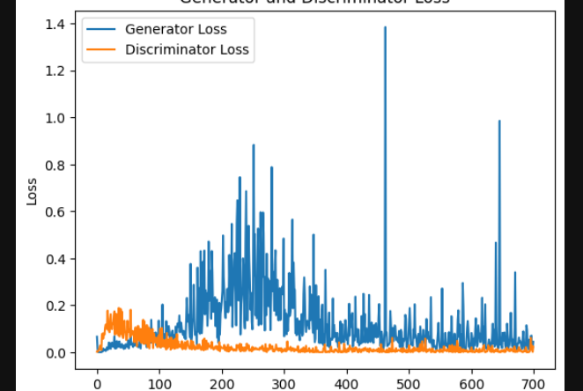
Training result
Fig : Training of the Dense layer GAN network.
This training curve signify that the model suffers a convergence failure where discriminator loss becomes close to zero and generator also decrease to zero.

Slide 12

Wasserteiner Gan

Slide 13
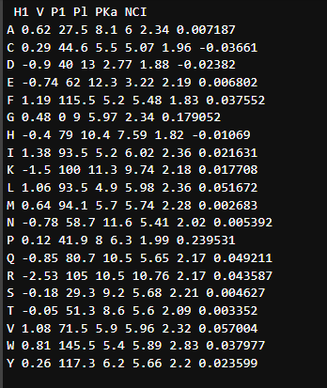
Wasserteiner GAN
Dataset Preparation : Perfomed data cleaning where we remove the peptides containing non-natural amino acid.
Featurization : Paramertized the dataset using PC6 encoding method.
Building a Wasserteiner Model ...

Slide 14

Thank you

