Slide 1


Word search puzzle solver
CSE -316
Course Instructor
Presented by
Name: Sadik Saroar
ID: 212002136
MD. Nura Alam Sabuj
192002062
Dept of CSE
Wahia Tasnim
Lecturer, CSE
Green University of Bangladesh
10-062024
Sum-24
‹#›

Slide 2
Introduction
CSE -316
Objective: Introduce the purpose and significance of the project.
Content: Brief overview of word search puzzles and their popularity
10-062024
Sum-24
Student Management System
‹#›

Slide 3
Problem Statement
CSE -316
Objective: Define the problem that your project aims to solve.
Content:
Challenges in solving word search puzzles manually.
Need for an automated solution.
10-062024
Sum-24
Student Management System
‹#›

Slide 4
CSE -316
Solution Overview
Objective: Present a high-level view of your solution.
Content:
Description of the algorithm used.
How the solver works
10-062024
Sum-24
Student Management System
‹#›

Slide 5
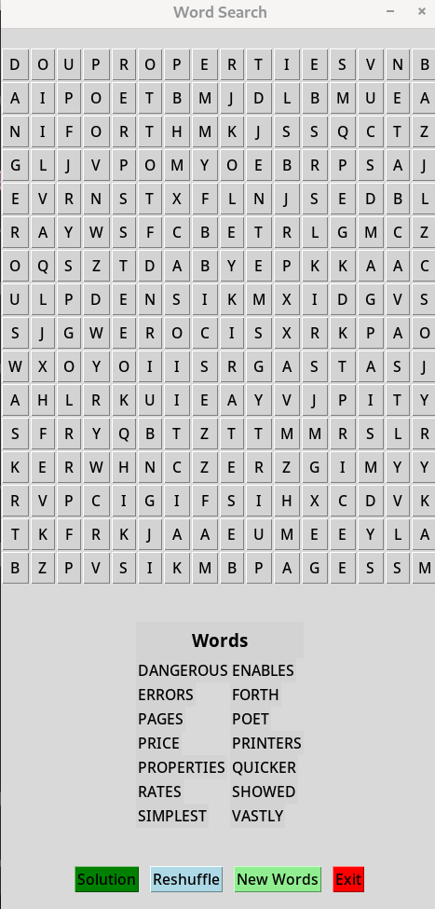
Implementation Details:
CSE -316
10-062024
Sum-24
Student Management System
‹#›

Slide 6
Demonstration
CSE -316
Objective: Demonstrate the solver in action.
Content:
Screenshots or video demo of the solver working on the example puzzle.
Results output.
10-062024
Sum-24
Student Management System
‹#›

Slide 7
Performance Evaluation
CSE -316
Objective: Evaluate the performance of your solver.
Content:
Time complexity analysis.
Comparison with other existing solutions, if applicable.
Accuracy and speed.
10-062024
Sum-24
Student Management System
‹#›

Slide 8
Future Work
CSE -316
Objective: Outline potential future improvements.
Content:
Enhancements to the algorithm.
Additional features (e.g., handling larger grids, more complex patterns).
10-062024
Sum-24
Student Management System
‹#›

Slide 9
Conclusion
CSE -316
Objective: Summarize the project and its outcomes.
Content:
Recap of the problem and the solution.
Key takeaways and achievements.
10-062024
Sum-24
Student Management System
‹#›

