Slide 1


Operating system
CSE-309
Course Instructor
Presenter
Name: Sadik Saroar
ID: 212002136
Israt Jahan
ID: 213002052
Sharifur Rahman
Lecturer, CSE
Green University of Bangladesh
Summer : 24
PROJECT : student Management system
10-06-2024

Slide 2
Introduction
CSE-309
Overview: Introduction to the system and its purpose.
Objective: To manage student data efficiently using a shell script.
Summer : 24
PROJECT : student Management system
10-06-2024

Slide 3
Features
CSE-309
Authentication: User login with username and password.
Add Student: Add new student records.
View Students: View all student records.
Search: Search for students by ID or name.
Update: Update student information.
Delete: Delete student records.
Reports: Generate various reports such as CGPA report, student count, and list of student names.
Export/Import: Export and import student data to/from a file.
Summer : 24
PROJECT : student Management system
10-06-2024

Slide 4
Authentication Function
CSE-309
Demonstration:
Live or simulated demonstration of the system
Showcase key functionalities and user interactions
Highlight ease of use and efficiency
Summer : 24
PROJECT : student Management system
10-06-2024

Slide 5
Implementation Details:
CSE-309
Implementation Details:
Explanation of how Shell-Script is utilized
Challenges faced during implementation
Tools and technologies used alongside Shell-Script
Summer : 24
PROJECT : student Management system
10-06-2024

Slide 6
CSE-309
Future Enhancements
Potential improvements or additional features
Scalability considerations
Integration with other systems or platforms
Summer : 24
PROJECT : student Management system
10-06-2024

Slide 7
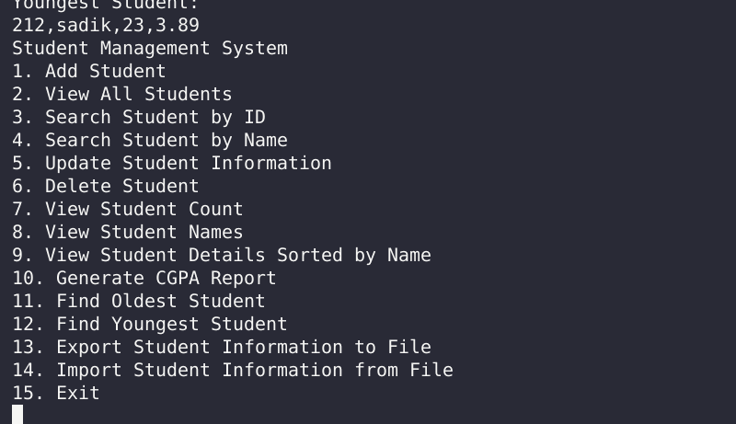
Project OutPut
CSE-309
Summer : 24
PROJECT : student Management system
10-06-2024

Slide 8
Conclusion
CSE-309
Summary of key points discussed
Recap of the benefits of the Student Management System
Encouragement for feedback and suggestions
Summer : 24
PROJECT : student Management system
10-06-2024

Slide 9
Conclusion
CSE-309
Thank You
Summer : 24
PROJECT : student Management system
10-06-2024

