Slide 1
FINANCIAL SALES DASHBOARD
Task 4 · Dashboard Design
Mohammad Sadique
Data Analyst Intern · Elevate Labs
04 June 2026

Slide 2
DATASET OVERVIEW
Microsoft Financials.csv
Key Columns
📊 Rows
Sales
700 records
Profit
🌍 Countries
COGS
USA, Canada, Germany, France, Mexico
Units Sold
📅 Time Period
Gross Sales
2013 – 2014
Discounts
📦 Products
Segment
Paseo, VTT, Velo, Amarilla, Montana, Carretera
Product
🏢 Segments
Country
Government, Small Business, Enterprise, Midmarket, Channel Partners
Date / Month / Year

Slide 3
KPIs CHOSEN & WHY
💰
📈
📦
🏭
Total Sales
Total Profit
Units Sold
Total COGS
117.87M
16.89M
1.12M
100.98M
Why this KPI?
Why this KPI?
Why this KPI?
Why this KPI?
Measures overall revenue performance across all segments and countries.
Tracks business health — how much is retained after costs.
Indicates product demand and sales volume trends.
Monitors cost efficiency — higher COGS = lower margins.

Slide 4
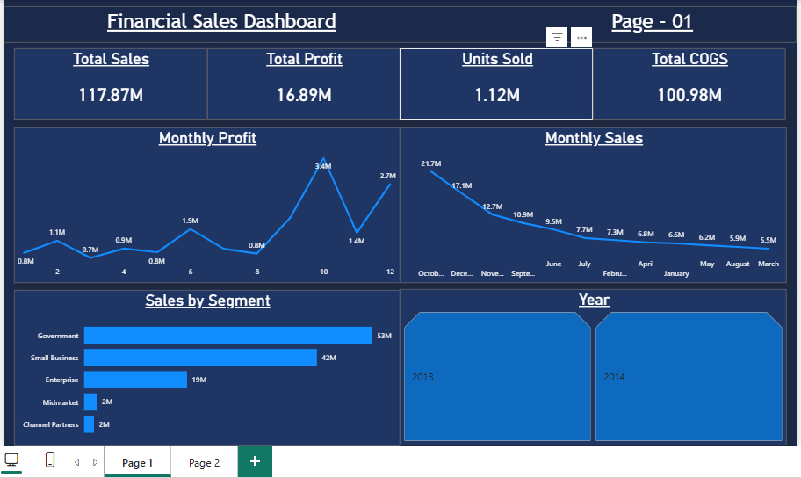
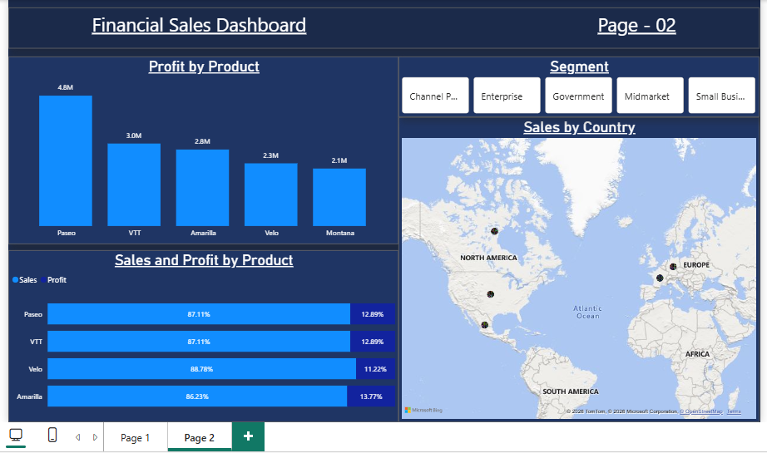
DASHBOARD SCREENSHOTS
PAGE 1
PAGE 2
[ Insert Screenshot of Page 1 here ]
Sales Overview
Product & Country Analysis
[ Insert Screenshot of Page 2 here ]
✅ 4 KPI Cards
✅ Top 4 Products by Profit
✅ Monthly Profit Line Chart
✅ Sales & Profit by Product
✅ Monthly Sales Line Chart
✅ Sales by Country Map
✅ Sales by Segment Bar Chart
✅ Segment Slicer
✅ Year Slicer

Slide 5
KEY INSIGHTS FROM THE DASHBOARD
🏆
Paseo Leads Profit
🏛️
Government Dominates Sales
Paseo is the top-performing product with ₹4.8M in profit — significantly ahead of VTT (3.0M) and Amarilla (2.8M). Focus sales efforts on Paseo for maximum return.
The Government segment drives 53M in sales — more than Small Business (42M) and Enterprise (19M) combined. B2G relationships are the primary revenue engine.
📉
COGS is High vs Profit
📅
Seasonal Sales Pattern
Total COGS of 100.98M against Sales of 117.87M shows a tight margin of ~14.3%. Cost optimization is a critical area for profitability improvement.
Sales peak in October (21.7M) and decline through March (5.5M). Q4 is the strongest quarter — inventory and promotions should be planned accordingly.

Slide 6
TOOLS & TECHNIQUES USED
⚡
📊
🧮
🗺️
Power BI Desktop
Microsoft Financials.csv
DAX Formula
Visuals Used
• Interactive dashboard creation
• 700-row financial dataset
• Profit Margin % = DIVIDE(
• KPI Cards, Line Charts
• 2-page layout with navigation
• Kaggle open dataset
• SUM(Profit), SUM(Sales))
• Bar & Clustered Bar Charts
• DAX measures for KPIs
• 2013–2014 sales data
• Custom calculated measure
• Map Visual, Slicers
Mohammad Sadique · Elevate Labs Data Analyst Internship · 04 June 2026

