Slide 1

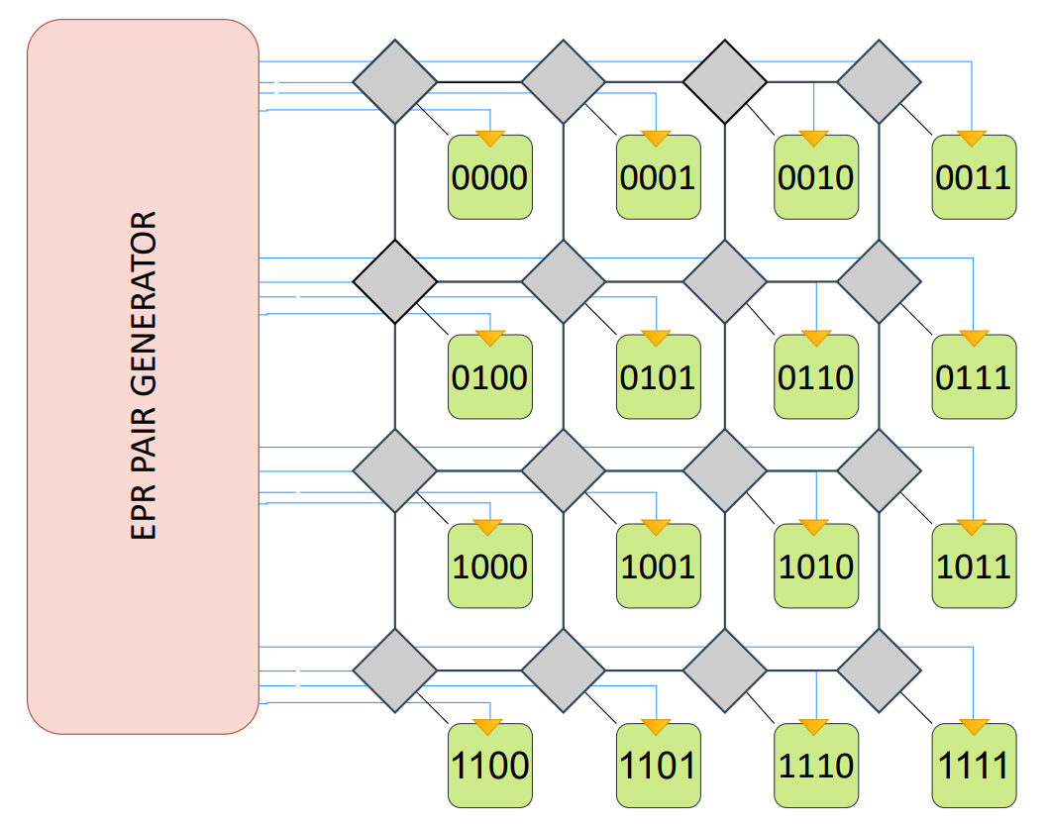
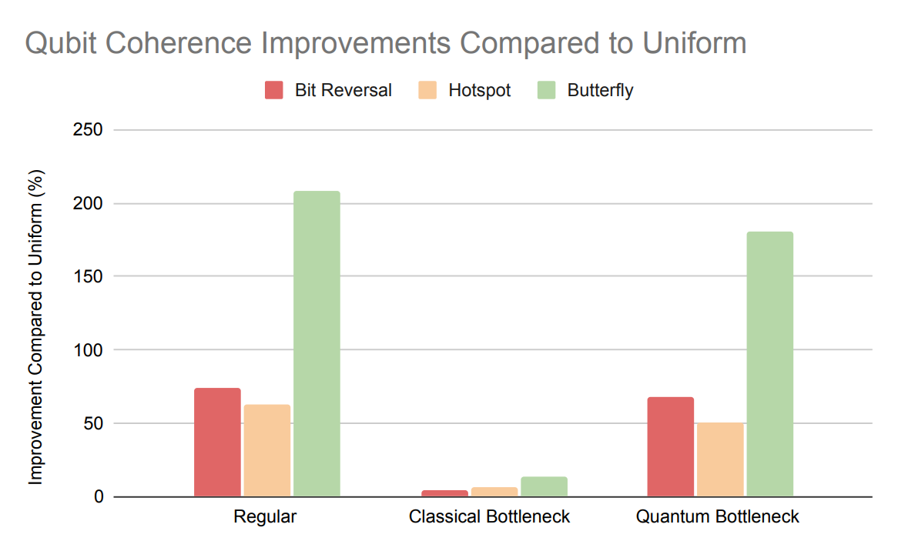
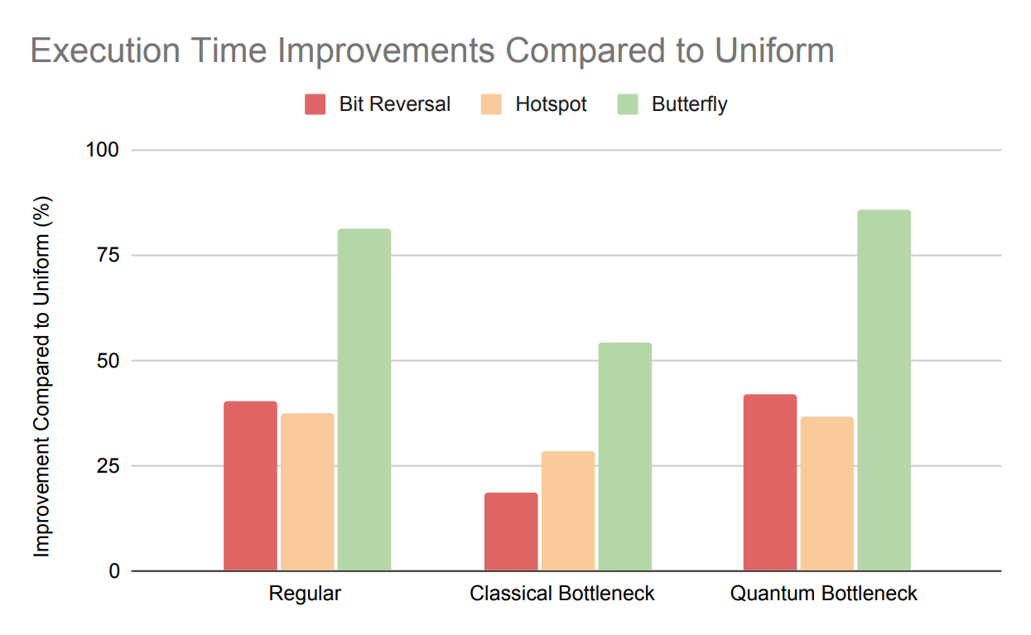
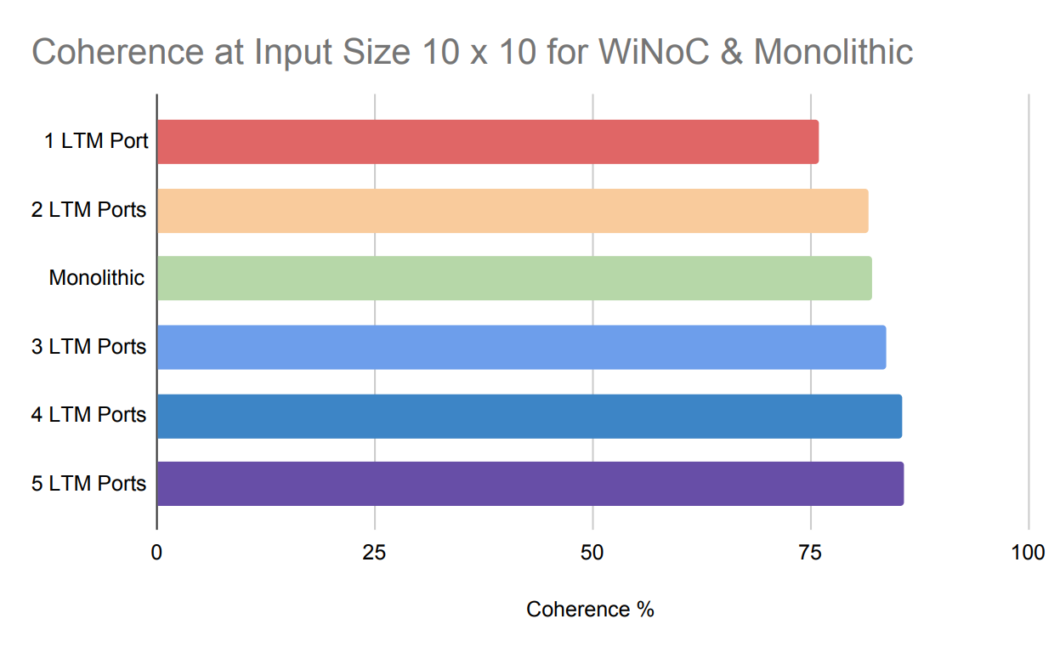
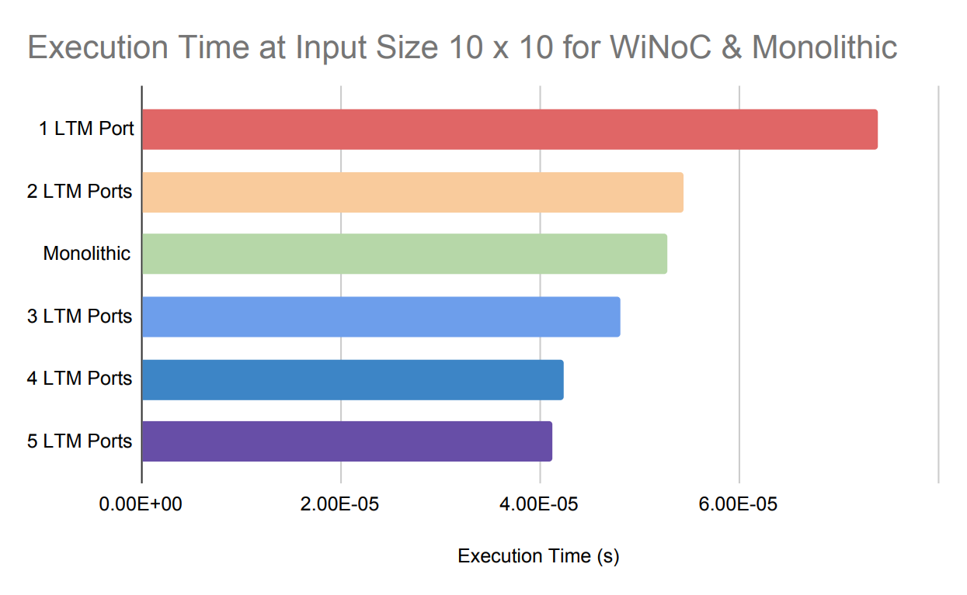
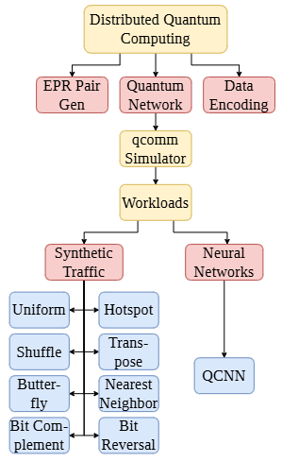
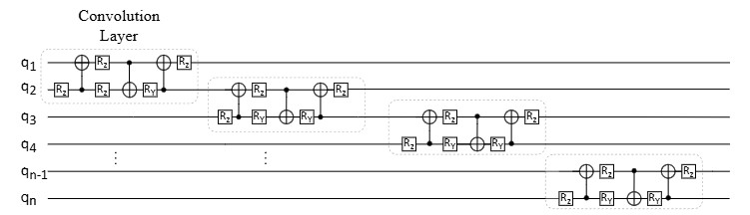
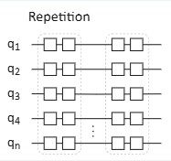
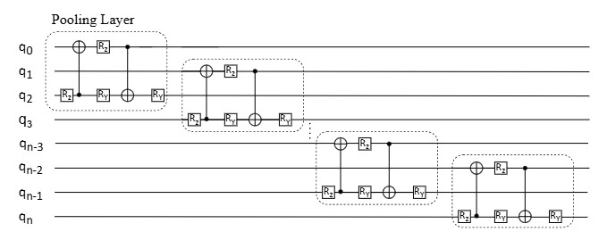

Assessing Neural Network Workloads on Multicore Quantum Architectures
Sadit Joarder, Daniel Kotlyar, Rahaf Al Ostwani, Justin Dang, Ethan Wong, Seham Al Abdul Wahid, Farah Mohammadi, Arghavan Asad
Department of Electrical, Computer, and Biomedical Engineering, Toronto Metropolitan University
Introduction
Methodology
Results
20 Million Qubits to break 2048-bit encryption key in 8 hours
1 Thousand Qubits in IBM's Condor
Architecture
Butterfly Is Best and Hotspot Scales
NoC Topology: 4x4 2D Mesh
Qubits Per Core: 10
Routing Algorithm: XY
LTM Ports Per Core: 2
Link Width: 8 bits
Mapping: Sequential/Random
Simulator: qcomm
The Problem: The current Noisy Intermediate-Scale Quantum (NISQ) era suffers from high noise and a limited number of qubits
The Solution: Distributed Quantum Computing (DQC) using a Quantum Network-on-Chip (QNoC) design can scale up available qubits
LTM Ports Make QCNN Better on WiNoC
Objectives
Stress Testing Synthetic Traffic
Zero Bottleneck: Default parameter settings in qcomm
Classical Bottleneck: Quantum parameters improved by 20x
Quantum Bottleneck: Classical parameters improved by 20x
Swept simulations from 200 to 1000 quantum gates
Goal: Evaluate scalability trade-offs of 8 synthetic traffic patterns and Quantum Convolutional Neural Network (QCNN) workloads on a QNoC
Significance: Improving efficiency for massive computational tasks, such as training Large Language Models (LLMs), which currently require millions of qubits
QCNN on Mesh vs. Monolithic Platform
Compared under usage of NoC and wireless NoC (WiNoC)
Swept simulations from 1x1 to 10x10 input sizes
Circuit built in Python using IBM's QCNN layers and Qiskit's ZFeatureMap for encoding
1.45% higher qubit coherence
8.91% faster execution time
Conclusion
DQC is a viable path for running heavy neural network workloads in the NISQ era
Standard mesh networks bottleneck machine learning traffic, but WiNoC provides the necessary low-latency shortcuts to make QCNNs feasible
Development of specialized routing protocols that optimize for localized traffic and integrate hybrid wired/wireless quantum interconnects
Link to GitHub repository, paper, and references.

