Slide 1
Presentation on paper
“Hashtags, Emotions, and Comments: A Large-Scale Dataset to Understand Fine-Grained Social Emotions to Online Topics”
Group members:
Name: Sadiul Arefin Rafi
ID: 20101120
Name: Muhtasim Fuad Ayon
ID: 18101698
Name: Bedria Durdana
ID: 17341004
Name: SK Safoan
ID: 17301160
Name: Ashfaqur Rahman
ID: 16301160

Slide 2
Introduction
The paper examined baseline performance to predict a topic’s possible social emotions in a multilabel classification setting.
It infers social emotions from online topics.
It will help to predict various applications such as topic analysis and event detection.
The application of the work can improve human-computer interactions.
Presented by
Sadiul Arefin Rafi, ID: 20101120

Slide 3
Data Collection
24 emoji options based on Sina Weibo
Trending hashtags were tracked from April-May 2020
Historical hot topics were taken from a website for November 2019-April 2020
Emotion votes were searched and parsed using the Selenium package
Results were gathered by searching and parsing through the lxml package
Biases were removed based on hashtags with less than 100 votes
Presented by
Bedria Durdana, ID: 17341004

Slide 4
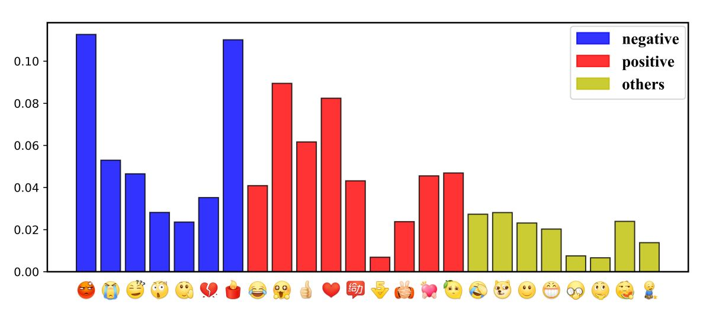
Data Analysis
This dataset contains more:
Instances for less words
Voters
Emotions
It focused on the highest discussed topics in real life via hashtags.
The relation between keywords and emotion votes was also analysed.
Presented by
Bedria Durdana, ID: 17341004

Slide 5
Experiment Setup
For Chinese word segmentation the authors used Pkuseg.
An extension of SGM is being used to leverage user comments.
Text rank is being used to extract keywords from comments.
Model performance is better than human results.
SGM exhibits a performance drop for long hashtags.
Presented by
Ashfaqur Rahman, ID: 16301160

Slide 6
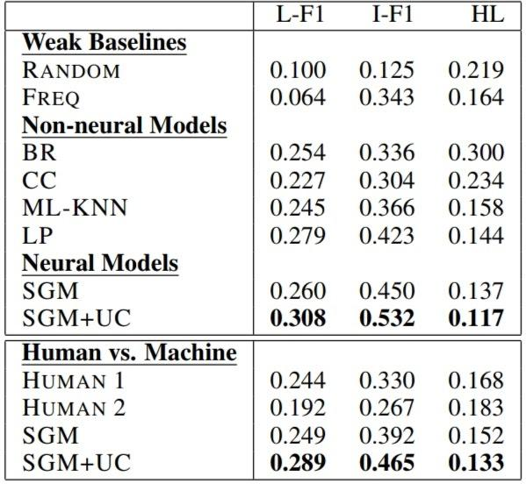
Experimental Results
SGM performs better than the non-neural baselines.
model performance is better than human results.
SGM+UC performs better results for external features from user comment results than SGM
Presented by
SK Safoan, ID: 17301160
Figure 1

Slide 7
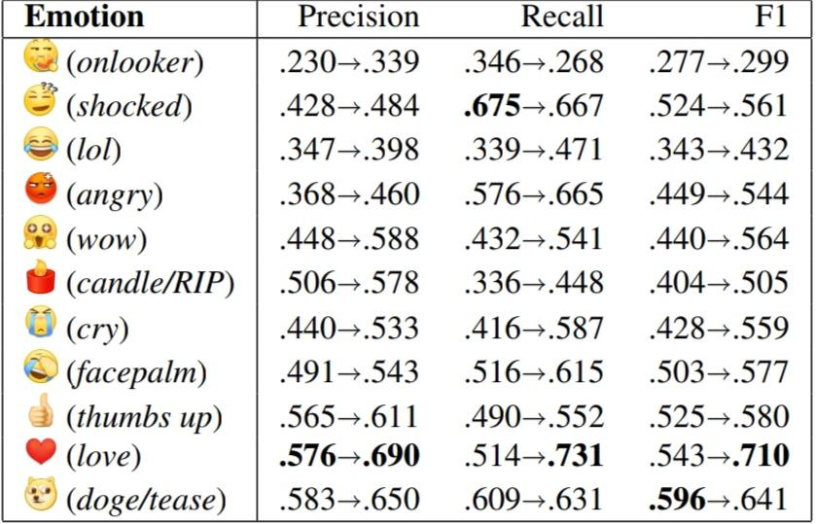
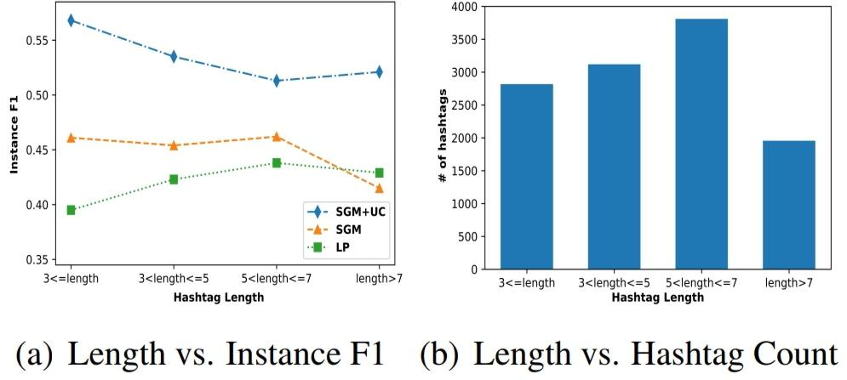
Experimental Results
Results over varying emotions(Figure 2)
Results over varying topic length(Figure 3)
Figure 2
Figure 3

Slide 8
Conclusion
Often it’s quite hard to make sense of reader’s response because of -
Informal hashtags
Uncommon words/emotions
Focusing on the negative impact while also ignoring the good stories
Incapability of predicting emotions properly
Therefore, to further progress regarding this issue, we need to focus on managing a good balance on reducing disparity of emotions.
Presented by
MD.MUHTASIM FUAD AYON, ID: 18101698

