Slide 1
COURSE TITLE: : Statistics and Probability COURSE CODE: STA 102
Instructor: Md. Ershadul Haque, PhD
Professor, Department of Statistics, DU
&
Adjunct Faculty, EWU, Bangladesh

Slide 2
Introduction to Statistics
It is difficult to define statistics in a few words
its dimension, scope, function, use and importance are constantly changing over time.
The science of statistics is essentially a branch of applied mathematics and may be regarded as mathematics, applied to observational data (according to Fisher)
The science of learning from data.
Statistics is a field of study concerned with (1) the collection, organization, summarization, and analysis of data; and (2) the drawing of inferences about a body of data when only a part of the data is observed.

Slide 3
Variable and its type
A characteristic whose value varies from person to person, object to object or from phenomenon to phenomenon. For example: Height, Weight, Age, Family size, Number of accidents in a highway, Temperature, Yearly rainfall etc.
Qualitative Variable: A variable whose numerical measurement is not possible but whose characteristics can be categorized and assigned by numbers is known as a qualitative variable. Example: gender (male=1, female=2), Eye color (Brown=1, Blue=2, Gray=3, Others=4), Crime occurrence frequency in a region (Very often=1, Often=2, Not often=3, Not at all =4) etc.

Slide 4
Variable and its type
Quantitative variable: A variable whose resulting observations are numeric and thus possesses a natural ordering. Example: age, blood pressure, longevity of lives, day temperature, yearly rainfall etc.
A quantitative variable can be either (a) Discrete or (b) Continuous.
a) Discrete variable: A discrete variable can assume only isolated values. Example: number of correct answer in a MCQ test of 10 questions, number of defective items in a lot of 50 items, number of IC chip in a memory board, number of new customer in a bank (in a year) etc.
b) Continuous variable: Theoretically, a continuous variable can assume any value within its domain. Example: age, height, weight, lifetime of a cellular phone battery, and call duration (in sec) etc.

Slide 5
Scale of Measurement/ Level of measurement
Measurement is a process of assigning number to some characteristics or variables according to scientific rules.
Data can be classified according to levels of measurement.
The level of measurement of the data dictates the calculations that can be done to summarize and present the data.
It will also determine the statistical tests that should be performed.
Variables can be measured under four levels or scales of measurement. The measurement scales are:
Nominal scale
Ordinal scale
Interval scale
Ratio scale

Slide 6
Level of Measurement (cont…)
Nominal Scale
For the nominal level of measurement, observations of a qualitative variable can only be classified and counted as numbers are assigned to the variable values for identification only.
There is no particular order to the labels.
For example: consider the variable hair color which can be categorized as brown (1), black (2) and red (3).
However, the numbers do not permissible in doing mathematics. To explain, 1 + 2 does not equal 3; that is, brown + black does not yield red.

Slide 7
Level of Measurement (cont…)
Ordinal Scale
The next higher level of data is the ordinal level. In this level, observations of a qualitative variable are represented by sets of labels that have relative importance. Hence, observations can be ranked or ordered so that numbers are assigned to the variable values for identification as well as for ranking. Arithmetic operation cannot be done with this scale.
Ordinal scales are often used for measures of satisfaction, happiness, and so on. For example (1) Excellent (2) Satisfactory (3) neutral (4) Dissatisfactory (5) Very dissatisfactory.
Here, we don't really know what the difference is between excellent and satisfactory - or if it's the same degree of satisfaction as between dissatisfactory and very dissatisfactory. We just know that satisfactory is more than neutral and excellent is more than satisfactory. It's all in the order. To explain, 2 - 1 does not equal 5-4.

Slide 8
Level of Measurement (cont…)
Interval Scale
The interval level of measurement is the next highest level. It includes all the characteristics of the ordinal level, but in addition, the difference between values is a constant size.
Under this level, numbers are assigned to the variable values in such a way that the measurement scale is broken down on a scale of equal units and the zero value on the scale is not absolutely zero. For example: temperature (F), IQ score, etc.
Suppose the temperatures on three consecutive days in Dhaka are 82, 87, and 68. These temperatures can be easily ranked, but we can also determine the difference between temperatures.
This is possible because 1F represents a constant unit of measurement. Equal differences between two temperatures are the same, regardless of their position on the scale. That is, the difference between 10F and 15F is 5, the difference between 50 and 55 degrees is also 5 degrees.
It is also important to note that 0 is just a point on the scale. It does not represent the absence of the condition. Zero degrees does not represent the absence of heat, just that it is cold! In fact 0 degrees Fahrenheit is about 18 degrees on the Celsius scale.

Slide 9
Level of Measurement (cont…)
Ratio Scale
Practically all quantitative data is recorded on the ratio level of measurement. The ratio level is the “highest” level of measurement. It has all the characteristics of the interval level, but in addition, the 0 point is meaningful and the ratio between two numbers is meaningful.
Under this level, numbers are assigned to the variable values in such a way that the measurement scale is broken down on a scale of equal units and the zero value on the scale is absolutely zero. For example: age, height, weight, call duration, etc.

Slide 10
Classification of variable by level of measurement
Variables
Qualitative
hair color, gender, Happiness
Quantitative
family size , yearly rainfall (mm), IQ score
Nominal
hair color, gender
Ordinal
Happiness
Interval
IQ score
Ratio
family size

Slide 11
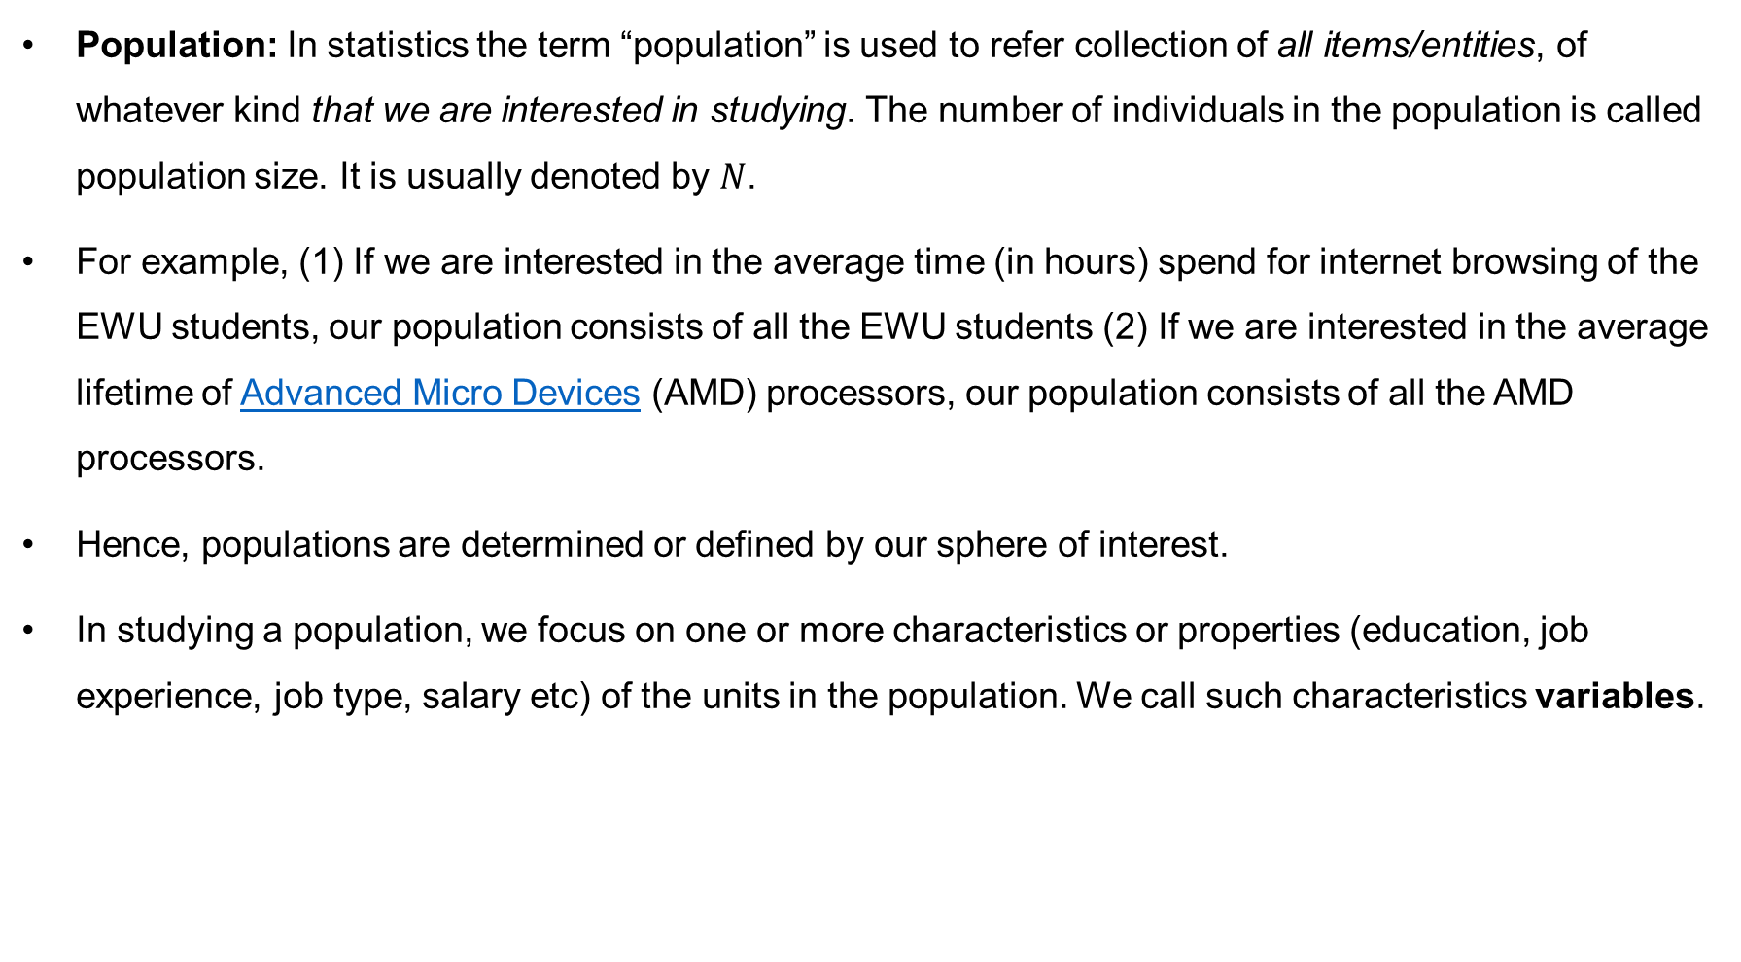
Terminologies
Population: In statistics the term “population” is used to refer collection of all items/entities, of whatever kind that we are interested in studying. The number of individuals in the population is called population size. It is usually denoted by $N$.
For example, (1) If we are interested in the average time (in hours) spend for internet browsing of the EWU students, our population consists of all the EWU students (2) If we are interested in the average lifetime of Advanced Micro Devices (AMD) processors, our population consists of all the AMD processors.
Hence, populations are determined or defined by our sphere of interest.
In studying a population, we focus on one or more characteristics or properties (education, job experience, job type, salary etc) of the units in the population. We call such characteristics variables.

Slide 12
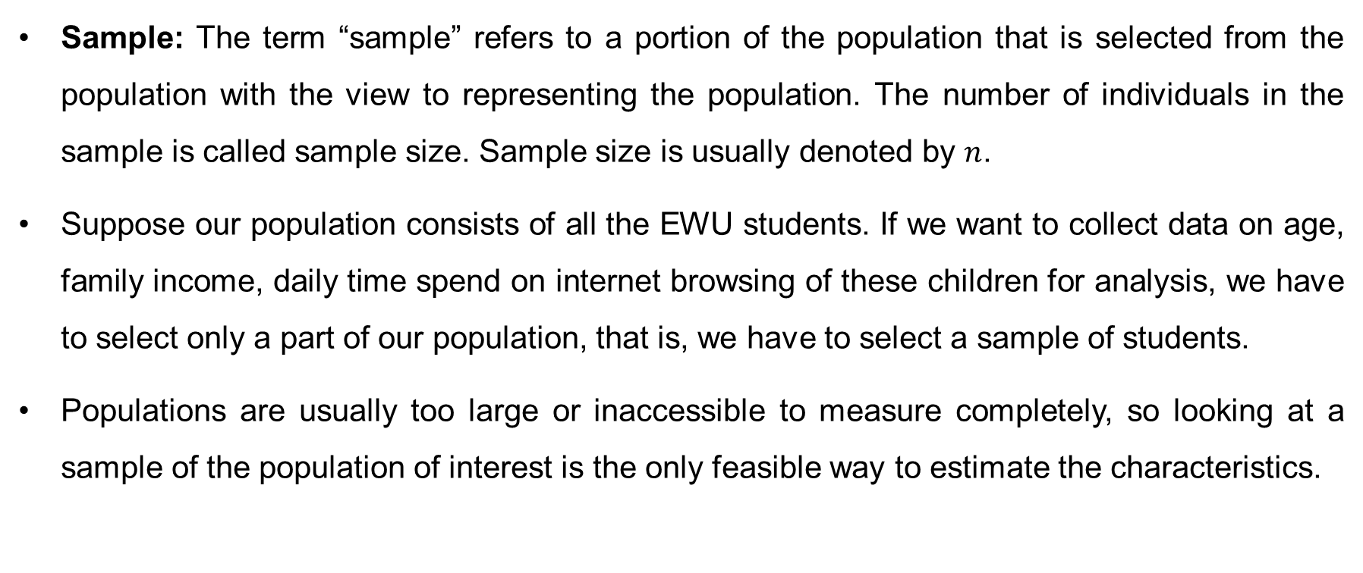
Terminologies (cont…)
Sample: The term “sample” refers to a portion of the population that is selected from the population with the view to representing the population. The number of individuals in the sample is called sample size. Sample size is usually denoted by $n$.
Suppose our population consists of all the EWU students. If we want to collect data on age, family income, daily time spend on internet browsing of these children for analysis, we have to select only a part of our population, that is, we have to select a sample of students.
Populations are usually too large or inaccessible to measure completely, so looking at a sample of the population of interest is the only feasible way to estimate the characteristics.

Slide 13
Methods of Data Collection
Data: The raw material of statistics is data. Data can be defined as the values for the variables assigned to specific units.
Sources of statistical data: Statistical data may be broadly categorized as primary data and secondary data. (1) Primary data come mainly from direct field operation. (2) Secondary data are usually procured from already published or unpublished documents rather than undertaking, first-hand field investigation. The main sources of secondary data in our country are BBS, ICDDR’B, BRAC, NIPORT and some other NGOs.
There are several methods of collecting primary data, particularly in surveys and descriptive researches. Important ones are: (i) observation method, (ii) interview method, (iii) through questionnaires, (iv) through schedules

Slide 14
Descriptive and Inferential Statistics
Two branches of Statistics: (1) Descriptive statistics and (2) Inferential statistics.
Descriptive statistics: The methods of statistics that help to describe, show or summarize data in a meaningful way (patterns might emerge from the data). However, they do not allow us to make conclusions beyond the data we have analyzed (cannot conclude regarding the population).
The main focus of descriptive statistics is to summarize and display data.
The elements of descriptive statistics include tables, graphs and numerical summary tools.
Inferential statistics: This method uses theory of probability to make inferences about the population, based on a random sample.
It covers a large variety of techniques that allow us to make actual claims about a population based on a sampled data.

Slide 15
Tabulation: The Frequency Distribution
To group a set of observations we select a set of contiguous, nonoverlapping intervals such that each value in the set of observations can be placed in one, and only one, of the intervals. These intervals are usually referred to as class intervals. For example, age of the employee (in years) of a company may be classified (grouped) in some class intervals such as 35-39, 40-44, 45-49, 50-54,…, 70-74 etc.
Class limits are the lower and upper values that define the class intervals. For example, for the class intervals 35-39, 40-44, 45-49, 50-54,…, 70-74; 35 is the lower limit of 1st class, 40 is the lower limit of 2nd class and so on; and 39 is the upper limit of 1st class, 44 is the upper limit of 2nd class and so on.
Considering the underlying continuity of our variable, and assuming that the data were rounded to the nearest whole number, we find it convenient to think of 34.5 and 39.5 as the true limits of this first interval; and 39.5 and 44.5 as the true limits of this second interval.
These true limits are called the class boundaries.

Slide 16
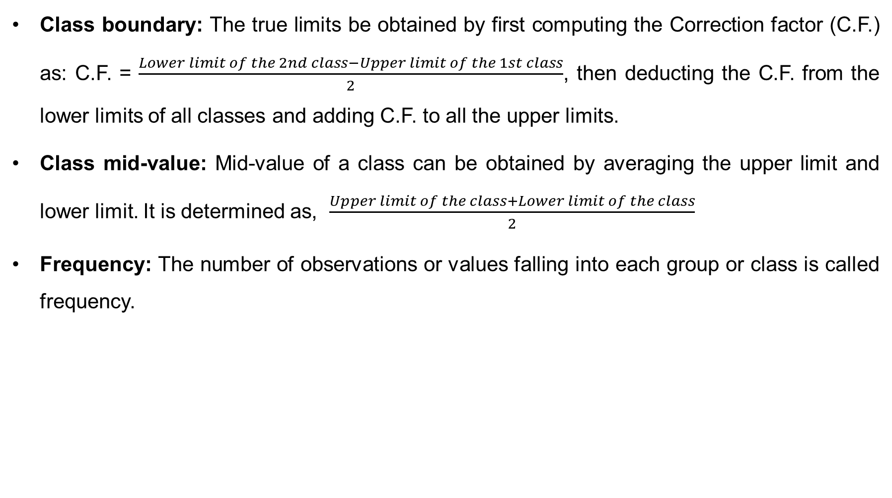
Grouped Data: The Frequency Distribution (cont…)
Class boundary: The true limits be obtained by first computing the Correction factor (C.F.) as: C.F. = $\frac{Lower limit of the 2nd class−Upper limit of the 1st class}{2}$, then deducting the C.F. from the lower limits of all classes and adding C.F. to all the upper limits.
Class mid-value: Mid-value of a class can be obtained by averaging the upper limit and lower limit. It is determined as, $\frac{Upper limit of the class+Lower limit of the class}{2}$
Frequency: The number of observations or values falling into each group or class is called frequency.

Slide 17
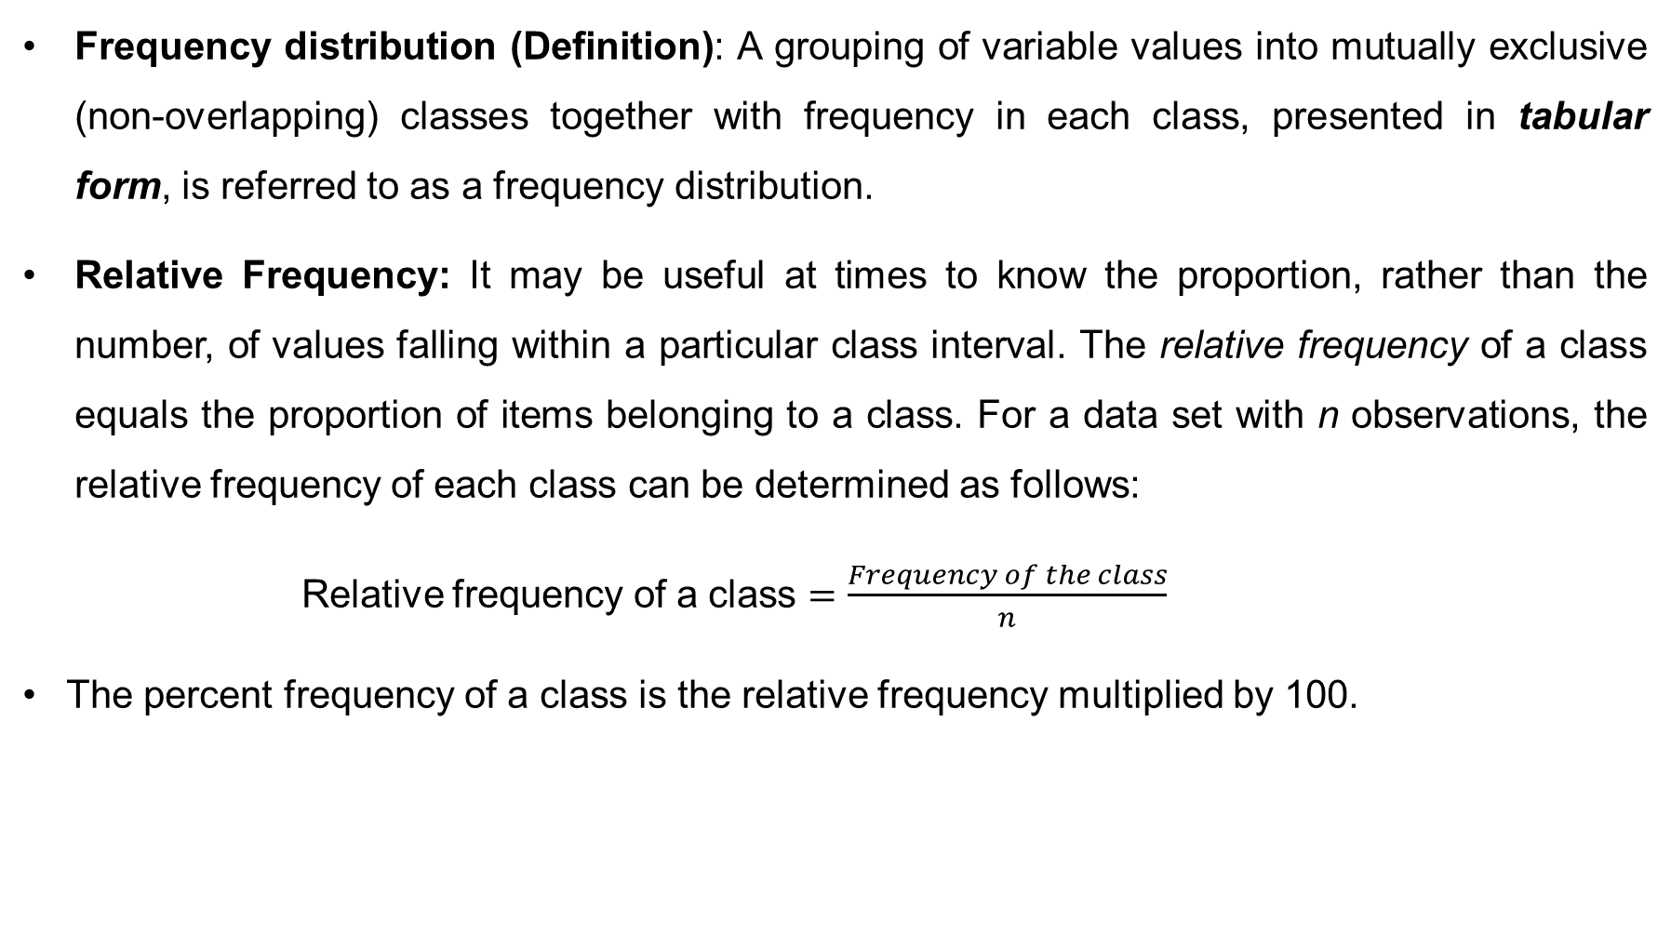
Grouped Data: The Frequency Distribution (cont…)
Frequency distribution (Definition): A grouping of variable values into mutually exclusive (non-overlapping) classes together with frequency in each class, presented in tabular form, is referred to as a frequency distribution.
Relative Frequency: It may be useful at times to know the proportion, rather than the number, of values falling within a particular class interval. The relative frequency of a class equals the proportion of items belonging to a class. For a data set with n observations, the relative frequency of each class can be determined as follows:
Relative frequency of a class $=\frac{Frequency of the class}{n}$
The percent frequency of a class is the relative frequency multiplied by 100.

Slide 18
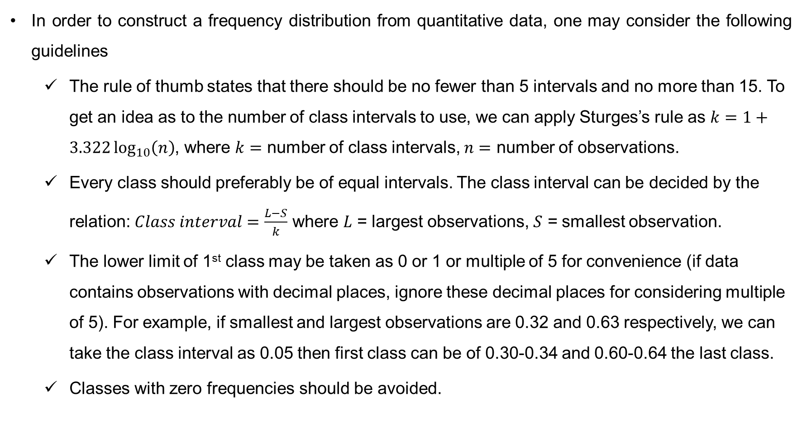
How to Construct a Frequency Distribution
In order to construct a frequency distribution from quantitative data, one may consider the following guidelines
The rule of thumb states that there should be no fewer than 5 intervals and no more than 15. To get an idea as to the number of class intervals to use, we can apply Sturges’s rule as $k=1+3.322\log_{10}\left(n\right)$, where $k=$ number of class intervals, $n=$ number of observations.
Every class should preferably be of equal intervals. The class interval can be decided by the relation: $Class interval=\frac{L−S}{k}$ where $L$ = largest observations, $S$ = smallest observation.
The lower limit of 1st class may be taken as 0 or 1 or multiple of 5 for convenience (if data contains observations with decimal places, ignore these decimal places for considering multiple of 5). For example, if smallest and largest observations are 0.32 and 0.63 respectively, we can take the class interval as 0.05 then first class can be of 0.30-0.34 and 0.60-0.64 the last class.
Classes with zero frequencies should be avoided.

Slide 19

Constructing a Frequency Distribution
Example: A sample consist of following data which specifies the life of 40 laptop batteries of a particular brand recorded to the nearest tenth of a year
2.2, 3.4, 2.5, 3.3, 4.7, 4.1, 1.6, 4.3, 3.1, 3.8, 3.5, 3.1, 3.4, 3.7, 3.2, 4.5, 3.3, 3.6, 4.4, 2.6, 3.2 3.8, 2.9, 3.2, 3.9, 3.7, 3.1, 3.3, 4.1, 3.0, 3.0, 4.7, 3.9, 1.9, 4.2, 2.6, 3.7, 3.1, 3.4, 3.5
Show the frequency distribution.
Solution: Here, $n=40$. We can apply Sturges’s rule to get an idea about number of class intervals, $k$
as follows $k=1+3.322\log_{10}\left(n\right)=6.32≈7$
Table-1: Frequency Distributions of life of laptop batteries
Life (in year) | Frequency | Relative frequency
1.6-2.0 | 2 | 2/40 = 0.05
2.1-2.5 | 2 | 0.05
2.6-3.0 | 5 | 0.125
3.1-3.5 | 15 | 0.375
3.6-4.0 | 8 | 0.20
4.1-4.5 | 6 | 0.15
4.6-5.0 | 2 | 0.05
Total | 40 | 1.0

Slide 20
Graphical Presentation
Graphical presentation is one of the important ways of presenting statistical data in the form of geometrical figures like points, lines, bars, rectangles, circles etc.
The importance of graphical presentation (diagrams and graphs):
Diagram and graphs can present the data into simple and intelligible form.
Diagrams are generally more attractive and impressive than the numerical figures.
Diagrams help in deriving the required information in less time and without any mental strain.
The graphs and diagrams facilitate comparison of two or more set of data at a time.

Slide 21
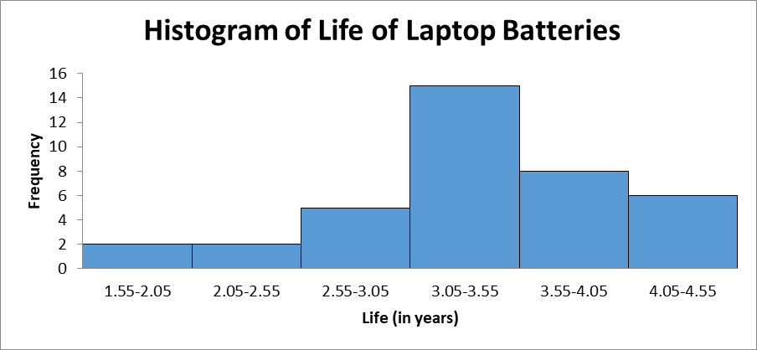
Histogram
A graph in which the classes boundaries are placed on the horizontal axis and the class frequencies on the vertical axis is known as Histogram. The class frequencies are represented by the heights of the bars, and the bars are drawn adjacent to each other.

Slide 22
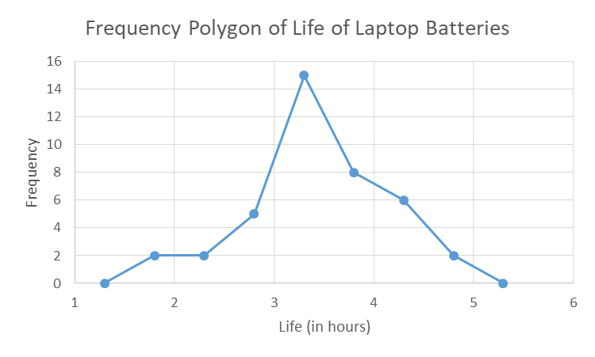
Frequency Polygon
If class mid-values are placed on the X-axis, and either the corresponding frequencies or the relative frequencies or the percent frequencies on the Y-axis and add the adjacent co-ordinate points by a straight line, the resulting graph is a frequency polygon.
The frequency polygon should begin and end at the base line.
A frequency polygon also shows the shape of a distribution and is similar to a histogram.
Both the histogram and the frequency polygon allow us to get a quick picture of the main characteristics of the data (highs, lows, points of concentration, etc.).

Slide 23
Cumulative Frequency Polygon (Ogive)
A graph of a cumulative distribution, called an ogive, shows data values (class boundary) on the horizontal axis and either the cumulative frequencies, the cumulative relative frequencies, or the cumulative percent frequencies on the vertical axis.
Example: Consider the data on the life of laptop batteries.
(a) Show the cumulative frequency distribution.
(b) What proportion of laptop had life less than 3.25 years?
(c) What proportion of laptop had life more than 4.25 years?

Slide 24
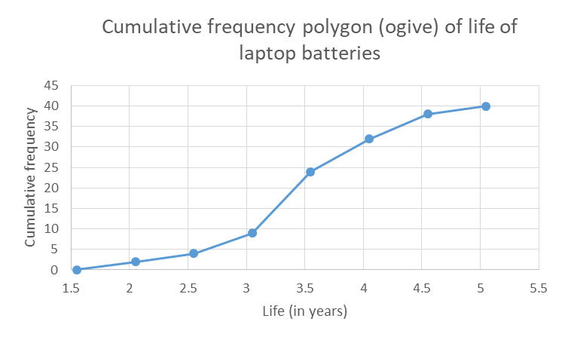
Cumulative Frequency Polygon (Ogive)
Table: Cumulative frequency distributions for the data on the life of laptop batteries
Life (in year) | Cumulative frequency
Less than 2.05 | 2
Less than 2.55 | 4
Less than 3.05 | 9
Less than 3.55 | 24
Less than 4.05 | 32
Less than 4.55 | 38
Less than 5.05 | 40

Slide 25
Summarizing Qualitative Data
Example-1: The following example demonstrates the construction and interpretation of a frequency distribution for qualitative data. Coke Classic, Diet Coke, Dr. Pepper, Pepsi-Cola, and Sprite are five popular soft drinks. Assume that the following data show the soft drink selected in a sample of 50 soft drink purchases.
Coke Classic Diet Coke Pepsi-Cola Diet Coke Coke Classic Coke Classic Dr. Pepper Diet Coke Pepsi-Cola Pepsi-Cola Coke Classic Dr. Pepper Sprite Coke Classic Diet Coke Coke Classic Coke Classic | Sprite Coke Classic Diet Coke Coke Classic Diet Coke Coke Classic Sprite Pepsi-Cola Coke Classic Coke Classic Coke Classic Pepsi-Cola Coke Classic Sprite Dr. Pepper Pepsi-Cola Diet Coke | Pepsi-Cola Coke Classic Coke Classic Coke Classic Pepsi-Cola Dr. Pepper Coke Classic Diet Coke Pepsi-Cola Pepsi-Cola Pepsi-Cola Pepsi-Cola Coke Classic Dr. Pepper Pepsi-Cola Sprite

Slide 26
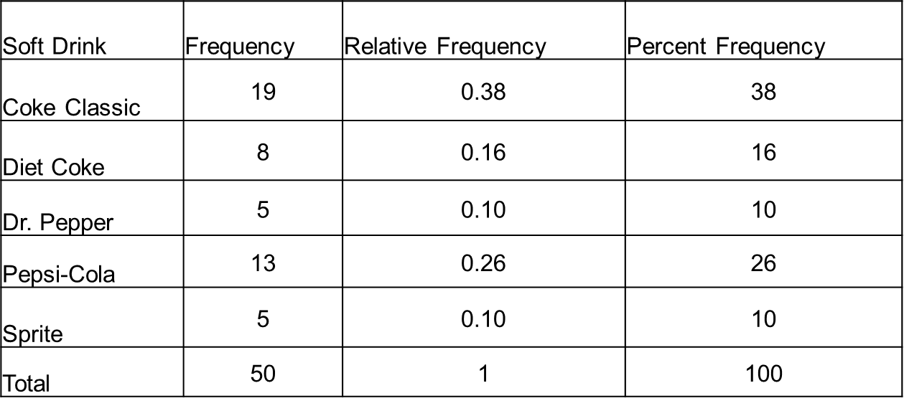
Summarizing Qualitative Data (cont…)
Table-1: Frequency Distributions of Soft Drink Purchases
This frequency distribution provides a summary of how the 50 soft drink purchases are distributed across the five soft drinks.
It offers more insight than the original data given in the example-1.
Viewing the frequency distribution, we see that Coke Classic is the leader, Pepsi-Cola is second, Diet Coke is third, and Sprite and Dr. Pepper are tied for fourth. The frequency distribution summarizes information about the popularity of the five best-selling soft drinks.
From the percent frequency distribution, we see that 38% of the purchases were Coke Classic, 16% of the purchases were Diet Coke, and so on. We can also note that 38% +26% +16% = 80% of the purchases were the top three soft drinks.

Slide 27
Bar Chart
The most common graphic form to present a qualitative variable is a bar chart.
A graph that shows qualitative classes on the horizontal axis and the class frequencies on the vertical axis. The class frequencies are proportional to the heights of the bars.
The following bar chart is a graphical presentation of the frequency distribution of soft drink purchases given in Table-1.

Slide 28

Pie Chart
Another useful type of chart for depicting qualitative information is a pie chart. It is especially useful for illustrating nominal level data.
A chart that shows the proportion or percentage that each class represents of the total number of frequencies.
To draw a pie chart, total frequency is equated to ${360}^{0}$. Then find the angles corresponding to the component values of the total and finally draw a circle with these angles of the components. The resulting circle is a Pie chart. Pie chart for the frequency distribution of soft drink purchases is as follows

Slide 29
Exercise
Problem-1: Classify the following variables (categorical / discrete / continuous) and mention their levels of measurement (nominal / ordinal / interval / ratio); ) lifetime of an Advanced Micro Devices (AMD) processor, number of spots per square-meter of a metal sheet, Student’s ID number, Economic status (poor, middle, rich).
Problem-2: You are interested in the average lifetime of AMD processors. You collected data from 50 randomly selected AMD processors. The average (mean) lifetime of these processors is 5.4 years. Identify (i) population (ii) sample (iii) parameter (iv) statistic in this context.
Problem-3: A recent study of home technologies reported the number of hours of personal computer usage per week for a sample of 30 persons. The data is given below
5.2, 5.9, 7.8, 7.9, 8.1, 8.3, 8.8, 8.9, 9.1, 9.1, 9.4, 9.6, 10.0, 10.4, 10.6, 10.7, 11.0, 11.0, 11.1, 11.3, 11.5, 11.8, 12.3, 12.7, 12.7, 13.3, 13.4, 13.5, 14.3, 14.9
(a) Use these data to construct: (i) A frequency distribution (ii) A relative frequency distribution (iii) A cumulative frequency distribution (iv) A cumulative relative frequency distribution
(b) Draw a histogram and comment.
(c) Draw an ogive and hence estimate percentage of the measurements are (i) less than 8? (ii) more than 11 (iii) between 8 and 11?

Slide 30
Thank You

