Slide 1
COURSE TITLE: : Statistics and Probability COURSE CODE: STA 102 Topics: Numerical Measures: Measures of Central Tendency & Location
Instructor: Md. Ershadul Haque, PhD
Professor, Department of Statistics, DU
&
Adjunct Faculty, EWU, Bangladesh

Slide 2
Describing data: Numerical measures
We will discuss two numerical ways of describing a set of data, namely, measures of central tendency (measures of location) and measures of dispersion.
In any data set, the values often show a tendency to cluster around a particular value. This clustering behavior is called central tendency.
The measure of central tendency (or averages) are numerical values that describe this concentration of data around the center.
These measures serve as numerical indicators of the “center,” or the most typical/representative value of a data set. Here are some examples:
The average time to change home-ownership in Dhaka is 11.8 years.
The CEO of company-A received 568 pieces of mail per week, on the average.
The average American home has more TV sets than people. There are 2.73 TV sets and 2.55 people in the typical home.

Slide 3
Measures of Central Tendency
Different measures of central tendency
Mean (Arithmetic, Geometric, Harmonic)
Median
Mode
Few Special measures of central tendency
Pooled mean
Weighted mean

Slide 4
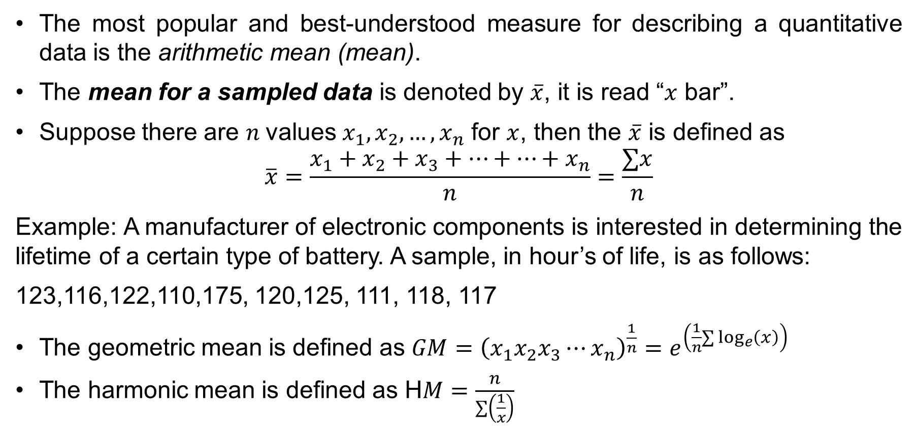
Mean
The most popular and best-understood measure for describing a quantitative data is the arithmetic mean (mean).
The mean for a sampled data is denoted by $\overline{x}$, it is read “$x$ bar”.
Suppose there are $n$values $x_{1}, x_{2}, …,x_{n}$ for $x$, then the $\overline{x}$ is defined as
$$\overline{x}=\frac{x_{1}+x_{2}+x_{3}+…+…+x_{n}}{n}=\frac{∑x}{n}$$
Example: A manufacturer of electronic components is interested in determining the lifetime of a certain type of battery. A sample, in hour’s of life, is as follows:
123,116,122,110,175, 120,125, 111, 118, 117
The geometric mean is defined as $GM={\left(x_{1}x_{2}x_{3}⋯x_{n}\right)}^{\frac{1}{n}}=e^{\left(\frac{1}{n}∑\log_{e}\left(x\right)\right)}$
The harmonic mean is defined as H$M=\frac{n}{∑\left(\frac{1}{x}\right)}$

Slide 5
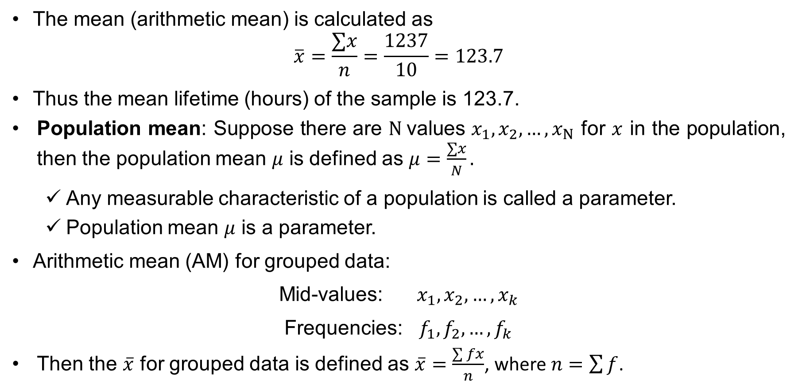
Mean
The mean (arithmetic mean) is calculated as
$$\overline{x}=\frac{∑x}{n}=\frac{1237}{10}=123.7$$
Thus the mean lifetime (hours) of the sample is 123.7.
Population mean: Suppose there are $N$values $x_{1}, x_{2}, …,x_{N}$ for $x$ in the population, then the population mean $μ$ is defined as $μ=\frac{∑x}{N}.$
Any measurable characteristic of a population is called a parameter.
Population mean $μ$ is a parameter.
Arithmetic mean (AM) for grouped data:
Mid-values: $x_{1}, x_{2}, …,x_{k}$
Frequencies: $f_{1}, f_{2}, …,f_{k}$
Then the $\overline{x}$ for grouped data is defined as $\overline{x}=\frac{\sum{fx}}{n}$, where $n=\sum{f}$.

Slide 6
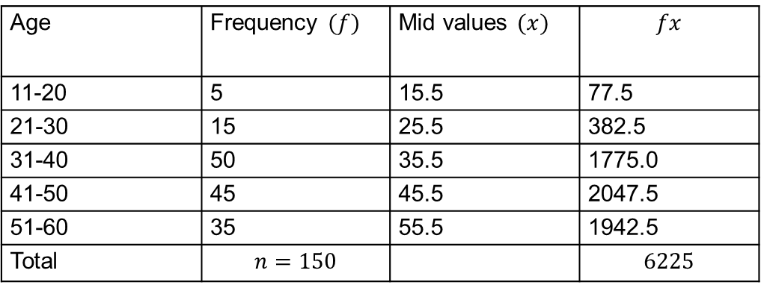

Mean (cont…)
The following frequency distribution shows the frequency distribution of ages of 150 subjects
Table: Frequency distribution of ages of 150 subjects
To compute the mean (arithmetic mean), we have constructed the following table
The mean (arithmetic mean) is calculated as$\overline{x}=\frac{\sum{fx}}{n}=\frac{6225}{150}=41.5$
Age | Frequency
11-20 | 5
21-30 | 15
31-40 | 50
41-50 | 45
51-60 | 35
Age | Frequency $(f)$ | Mid values $(x)$ | $$fx$$
11-20 | 5 | 15.5 | 77.5
21-30 | 15 | 25.5 | 382.5
31-40 | 50 | 35.5 | 1775.0
41-50 | 45 | 45.5 | 2047.5
51-60 | 35 | 55.5 | 1942.5
Total | $$n=150$$ |  | $$6225$$

Slide 7
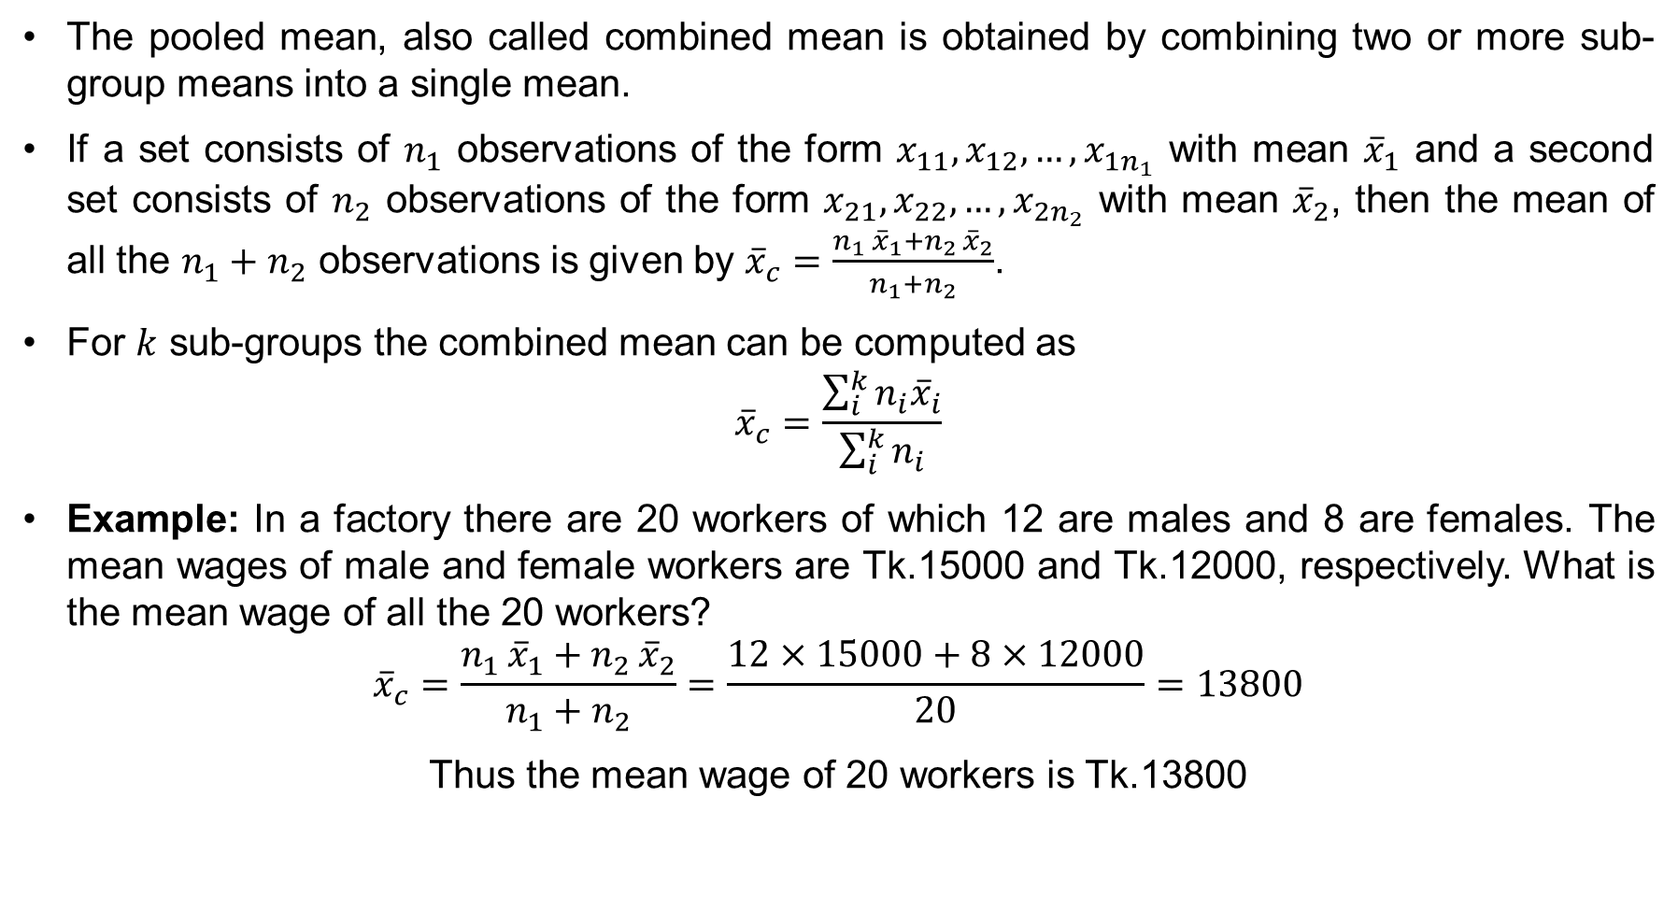
Pooled Mean
The pooled mean, also called combined mean is obtained by combining two or more sub-group means into a single mean.
If a set consists of $n_{1}$ observations of the form $x_{11}, x_{12}, …,x_{1n_{1}}$ with mean ${\overline{x}}_{1}$ and a second set consists of $n_{2}$ observations of the form $x_{21}, x_{22}, …,x_{2n_{2}}$ with mean ${\overline{x}}_{2}$, then the mean of all the $n_{1}+n_{2}$ observations is given by ${\overline{x}}_{c}=\frac{n_{1 }{\overline{x}}_{1}+n_{2 }{\overline{x}}_{2}}{n_{1}+n_{2}}$.
For $k$ sub-groups the combined mean can be computed as
$${\overline{x}}_{c}=\frac{\sum_{i}^{k}{n_{i}{\overline{x}}_{i}}}{\sum_{i}^{k}{n_{i}}}$$
Example: In a factory there are 20 workers of which 12 are males and 8 are females. The mean wages of male and female workers are Tk.15000 and Tk.12000, respectively. What is the mean wage of all the 20 workers?
$${\overline{x}}_{c}=\frac{n_{1 }{\overline{x}}_{1}+n_{2 }{\overline{x}}_{2}}{n_{1}+n_{2}}=\frac{12×15000+8×12000}{20}=13800$$
Thus the mean wage of 20 workers is Tk.13800

Slide 8
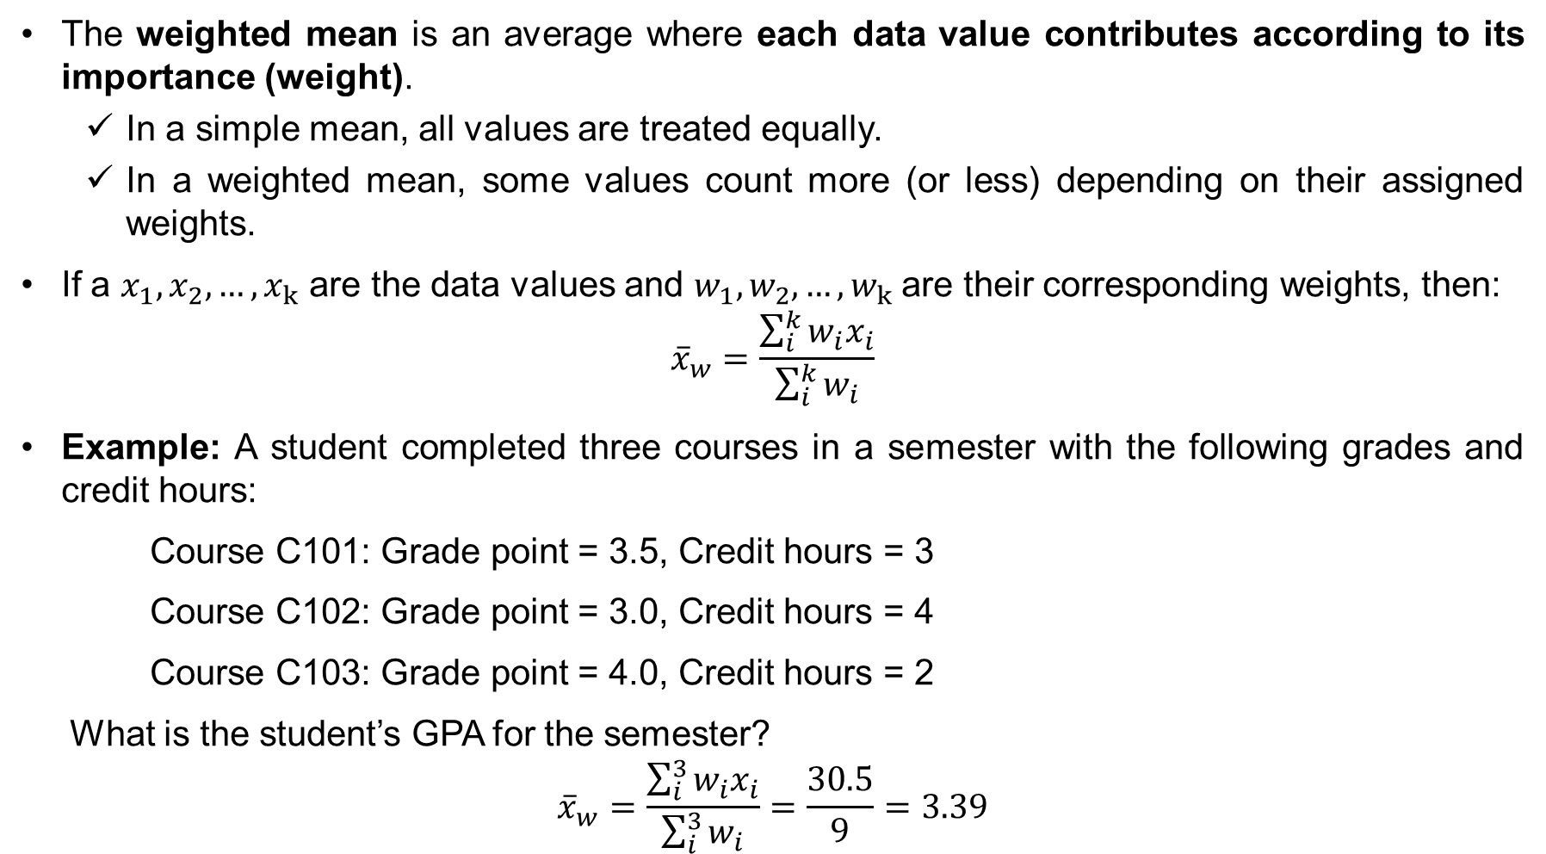
Weighted Mean
The weighted mean is an average where each data value contributes according to its importance (weight).
In a simple mean, all values are treated equally.
In a weighted mean, some values count more (or less) depending on their assigned weights.
If a $x_{1}, x_{2}, …,x_{k}$ are the data values and $w_{1}, w_{2}, …,w_{k}$ are their corresponding weights, then:
$${\overline{x}}_{w}=\frac{\sum_{i}^{k}{w_{i}x_{i}}}{\sum_{i}^{k}{w_{i}}}$$
Example: A student completed three courses in a semester with the following grades and credit hours:
Course C101: Grade point = 3.5, Credit hours = 3
Course C102: Grade point = 3.0, Credit hours = 4
Course C103: Grade point = 4.0, Credit hours = 2
What is the student’s GPA for the semester?
$${\overline{x}}_{w}=\frac{\sum_{i}^{3}{w_{i}x_{i}}}{\sum_{i}^{3}{w_{i}}}=\frac{30.5}{9}=3.39$$

Slide 9
Problems on Special Mean
Problem-1: A factory has two types (A & B) of workers in the production. A recent study has found that the effective work hours among the type-A workers is 5 hours and among the type-B workers is 6 hours. If 150 type-A workers and 100 type-B workers works together, find the average effective work hours.
Problem-2: A factory has two types (A & B) of workers in the production. A recent study has found that the effective work hours among the type-A workers is 5 hours and among the type-B workers is 6 hours. If 60% type-A workers and 40% type-B workers works together, find the average effective work hours.

Slide 10

Properties of Arithmetic Mean
Property-1: The sum of the deviations of the values $x_{1}, x_{2}, …,x_{n}$ from their arithmetic mean is zero. Symbolically, $\sum_{i=1}^{n}{\left(x_{i}−\overline{x}\right)}=0$
Property-2: The arithmetic mean is sensitive to extreme values. In other words, the arithmetic mean is affected by extreme values.
Property-3: The arithmetic mean is considered the most stable measure of central tendency because it uses all observations and shows the least fluctuation across different samples of the same population.

Slide 11
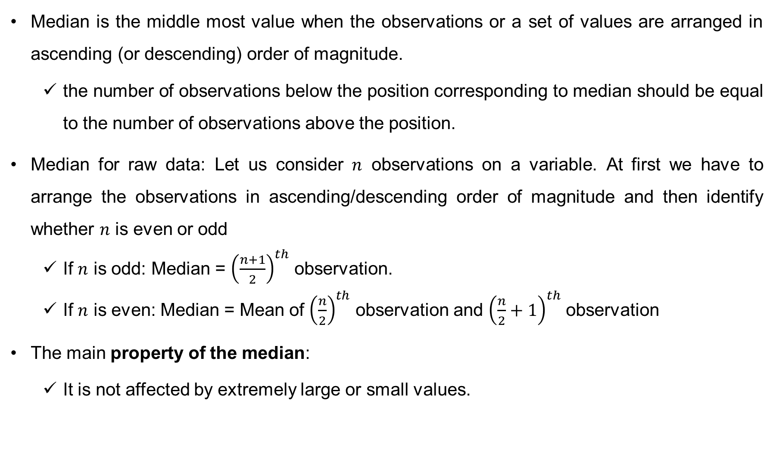
Median
Median is the middle most value when the observations or a set of values are arranged in ascending (or descending) order of magnitude.
the number of observations below the position corresponding to median should be equal to the number of observations above the position.
Median for raw data: Let us consider $n$ observations on a variable. At first we have to arrange the observations in ascending/descending order of magnitude and then identify whether $n$ is even or odd
If $n$ is odd: Median = ${\left(\frac{n+1}{2}\right)}^{th}$ observation.
If $n$ is even: Median = Mean of ${\left(\frac{n}{2}\right)}^{th}$ observation and ${\left(\frac{n}{2}+1\right)}^{th}$ observation
The main property of the median:
It is not affected by extremely large or small values.

Slide 12
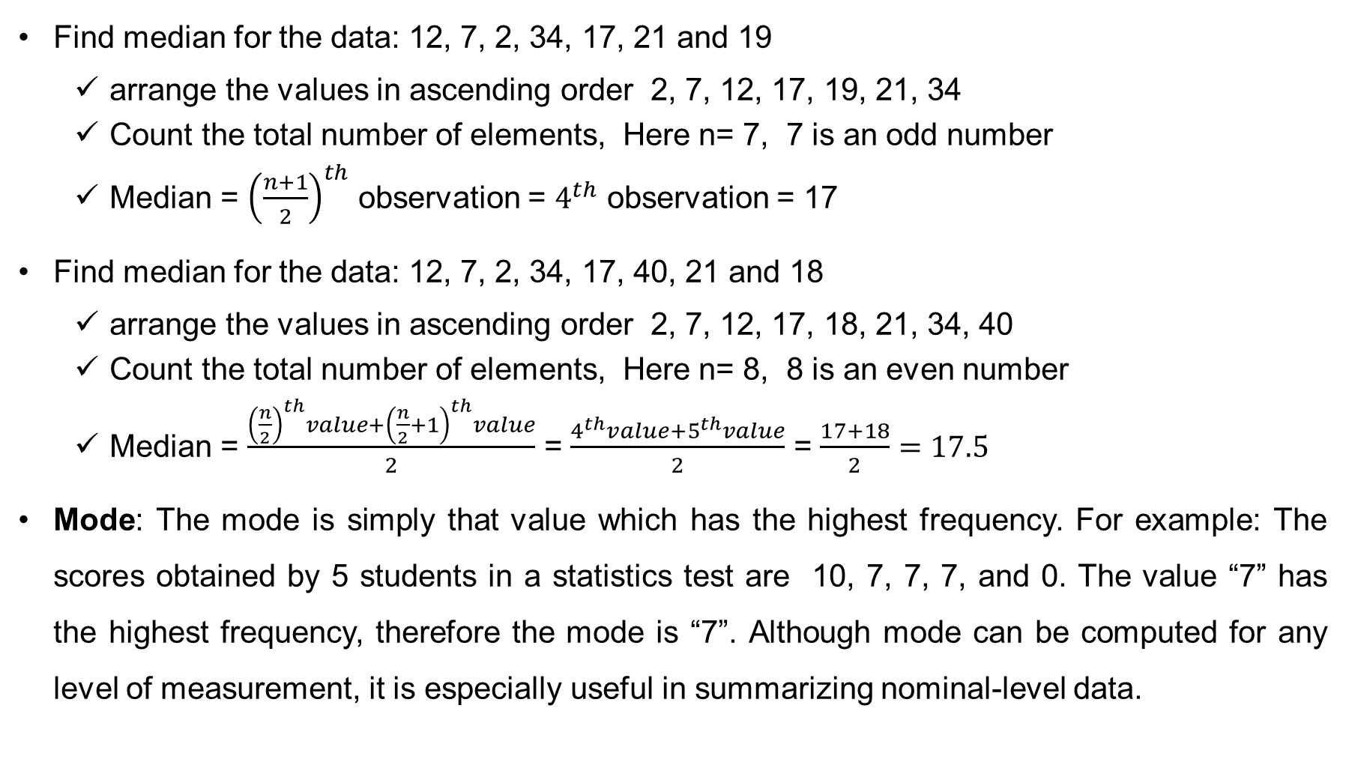
Find median for the data: 12, 7, 2, 34, 17, 21 and 19
arrange the values in ascending order 2, 7, 12, 17, 19, 21, 34
Count the total number of elements, Here n= 7, 7 is an odd number
Median = ${\left(\frac{n+1}{2}\right)}^{th}$ observation = $4^{th}$ observation = 17
Find median for the data: 12, 7, 2, 34, 17, 40, 21 and 18
arrange the values in ascending order 2, 7, 12, 17, 18, 21, 34, 40
Count the total number of elements, Here n= 8, 8 is an even number
Median = $\frac{{\left(\frac{n}{2}\right)}^{th}value+{\left(\frac{n}{2}+1\right)}^{th}value}{2}$ = $\frac{4^{th}value+5^{th}value}{2}$ = $\frac{17+18}{2}=17.5$
Mode: The mode is simply that value which has the highest frequency. For example: The scores obtained by 5 students in a statistics test are 10, 7, 7, 7, and 0. The value “7” has the highest frequency, therefore the mode is “7”. Although mode can be computed for any level of measurement, it is especially useful in summarizing nominal-level data.

Slide 13
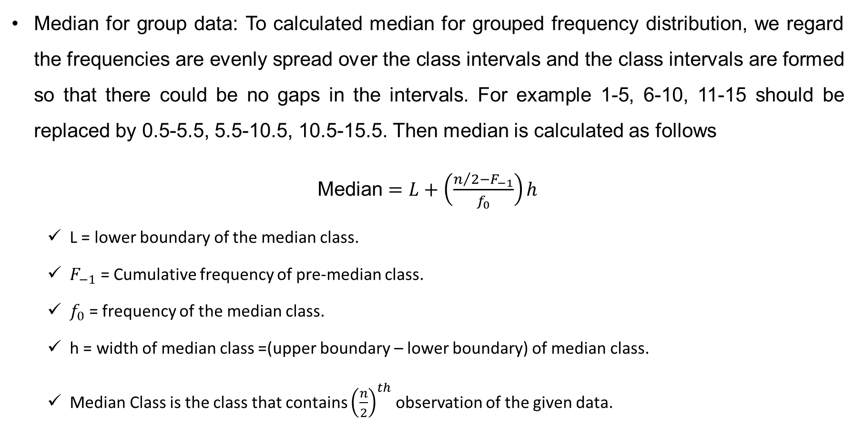
Median for Grouped data
Median for group data: To calculated median for grouped frequency distribution, we regard the frequencies are evenly spread over the class intervals and the class intervals are formed so that there could be no gaps in the intervals. For example 1-5, 6-10, 11-15 should be replaced by 0.5-5.5, 5.5-10.5, 10.5-15.5. Then median is calculated as follows
Median $=L+\left(\frac{n/2−F_{−1}}{f_{0}}\right)h$
L = lower boundary of the median class.
$F_{−1}$ = Cumulative frequency of pre-median class.
$f_{0}$ = frequency of the median class.
h = width of median class =(upper boundary – lower boundary) of median class.
Median Class is the class that contains ${\left(\frac{n}{2}\right)}^{th}$ observation of the given data.

Slide 14
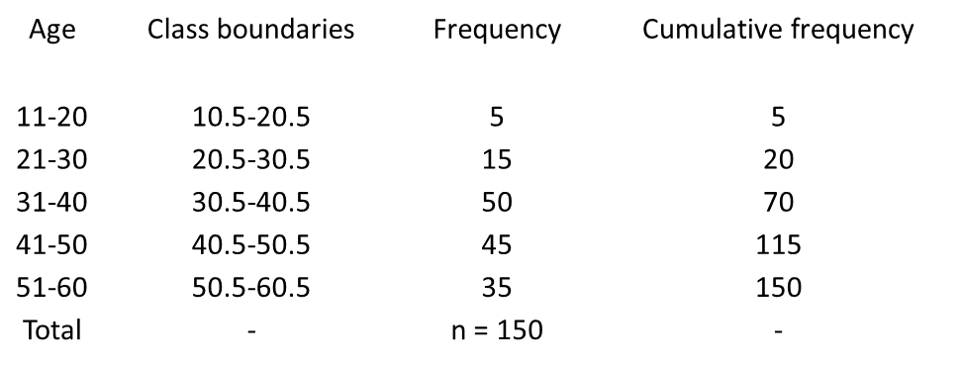

Median for grouped data (cont…)
Calculate the median age (in years) of workers from the following data
To compute the median age of workers, we have constructed the following table
The median class is that contains the 75th value
Median = 40.5 + $\frac{75−70}{45}×10$ = 40.5 + 1.11 = 41.61
Age | Frequency
11-20 | 5
21-30 | 15
31-40 | 50
41-50 | 45
51-60 | 35

Slide 15
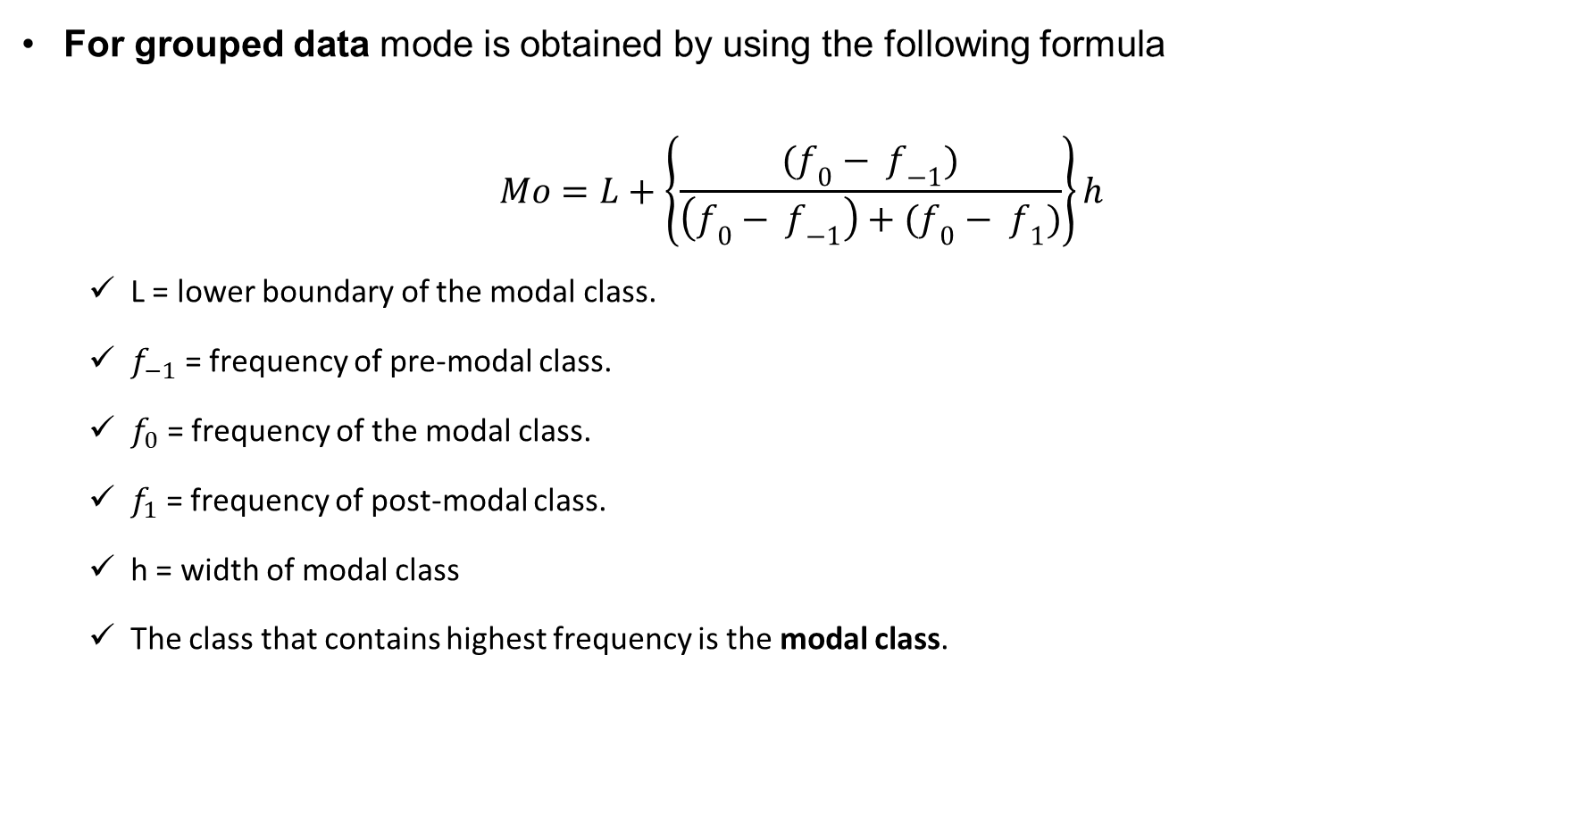
Mode for grouped data
For grouped data mode is obtained by using the following formula
$$Mo=L+\left\{\frac{(f_{0}− f_{−1})}{\left(f_{0}− f_{−1}\right)+(f_{0}− f_{1})}\right\}h$$
L = lower boundary of the modal class.
$f_{−1}$ = frequency of pre-modal class.
$f_{0}$ = frequency of the modal class.
$f_{1}$ = frequency of post-modal class.
h = width of modal class
The class that contains highest frequency is the modal class.

Slide 16

Mode for grouped data (cont…)
Calculate the modal age (in years) of workers from the following data
The class boundaries of modal class is 30.5-40.5, the highest frequency belongs to this class.
Mode = 30.5 + $\frac{50−15}{\left(50−15\right)+(50−45)}×10$ = 30.5 + 8.75 = 39.25
Age | Frequency
11-20 | 5
21-30 | 15
31-40 | 50
41-50 | 45
51-60 | 35

Slide 17
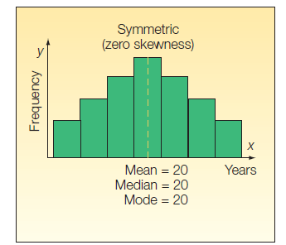
The Relative Positions of the Mean, Median, and Mode
For any symmetric distribution, the mode, median, and mean are located at the center and are always equal.
The term skewness refers to the lack of symmetry (asymmetry) relative to an normal distribution (symmetric distribution). Any departure of a distribution from symmetry leads to an asymmetric distribution and in such case, we call this distribution as skewed.
The skewness may be either positive or negative.

Slide 18
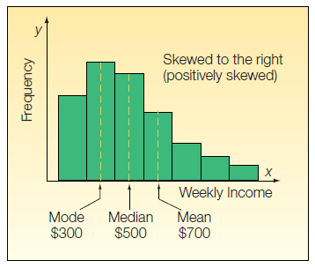

Positively skewed distribution
Skewness is said to be positive if the right side tail is longer than the left side tail.
When the skewness is positive, the associated distribution is positively skewed. For a positively skewed distribution, the following relationship hold:
$Mode<Median<Mean$.

Slide 19
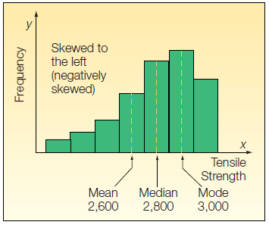

Negatively skewed distribution
Skewness is said to be negative if the left side tail is longer than the right side tail.
When the skewness is negative, we call the distribution a negatively skewed. For a negatively skewed distribution $Mean<Median<Mode$.

Slide 20
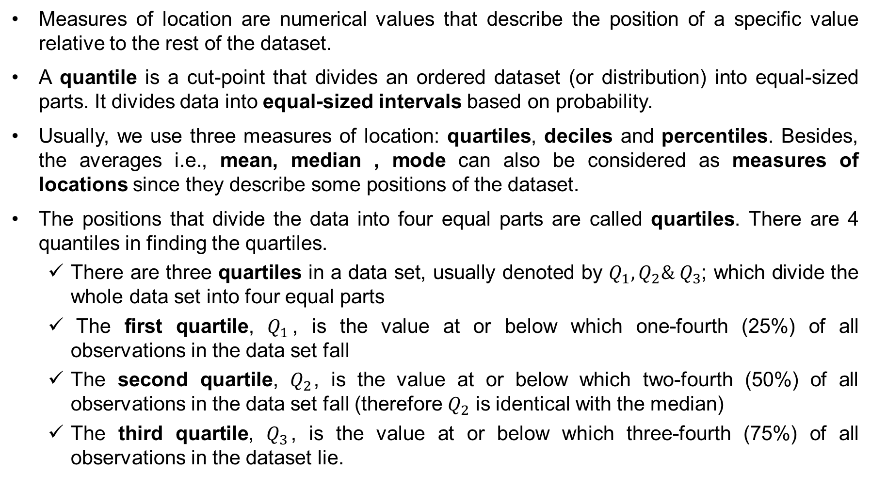
Measures of Location
Measures of location are numerical values that describe the position of a specific value relative to the rest of the dataset.
A quantile is a cut-point that divides an ordered dataset (or distribution) into equal-sized parts. It divides data into equal-sized intervals based on probability.
Usually, we use three measures of location: quartiles, deciles and percentiles. Besides, the averages i.e., mean, median , mode can also be considered as measures of locations since they describe some positions of the dataset.
The positions that divide the data into four equal parts are called quartiles. There are 4 quantiles in finding the quartiles.
There are three quartiles in a data set, usually denoted by $Q_{1}, Q_{2}\& Q_{3}$; which divide the whole data set into four equal parts
The first quartile, $Q_{1}$, is the value at or below which one-fourth (25%) of all observations in the data set fall
The second quartile, $Q_{2}$, is the value at or below which two-fourth (50%) of all observations in the data set fall (therefore $Q_{2}$ is identical with the median)
The third quartile, $Q_{3}$, is the value at or below which three-fourth (75%) of all observations in the dataset lie.

Slide 21
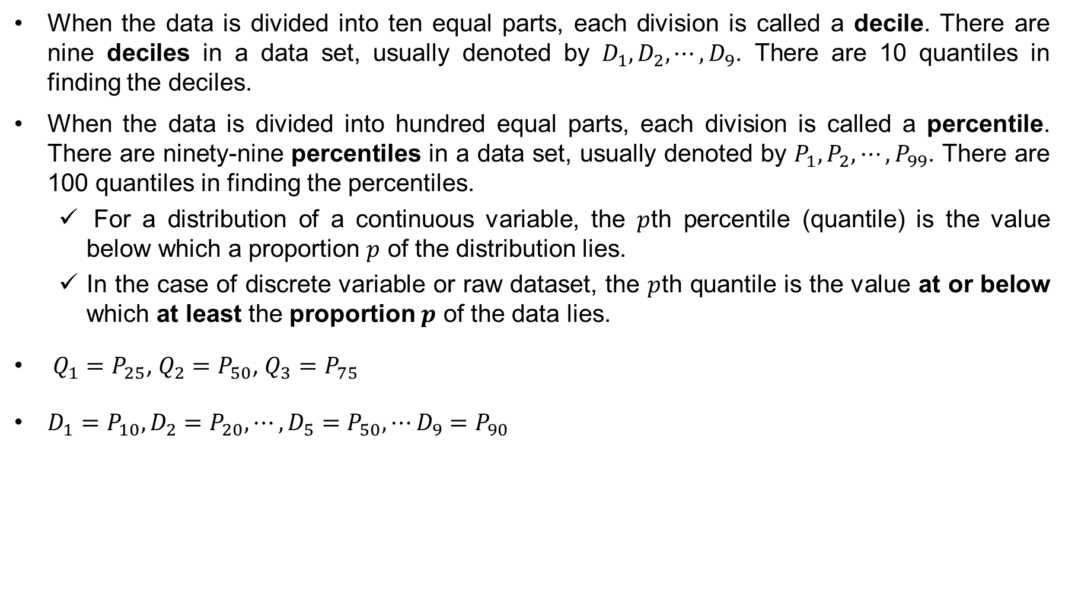
Measures of Location
When the data is divided into ten equal parts, each division is called a decile. There are nine deciles in a data set, usually denoted by $D_{1}, D_{2}, ⋯, D_{9}$. There are 10 quantiles in finding the deciles.
When the data is divided into hundred equal parts, each division is called a percentile. There are ninety-nine percentiles in a data set, usually denoted by $P_{1}, P_{2}, ⋯, P_{99}$. There are 100 quantiles in finding the percentiles.
For a distribution of a continuous variable, the $p$th percentile (quantile) is the value below which a proportion $p$ of the distribution lies.
In the case of discrete variable or raw dataset, the $p$th quantile is the value at or below which at least the proportion $p$ of the data lies.
$Q_{1}=P_{25}$, $Q_{2}=P_{50}$, $Q_{3}=P_{75}$
$D_{1}=P_{10},D_{2}=P_{20},⋯, D_{5}=P_{50}, ⋯D_{9}=P_{90}$

Slide 22
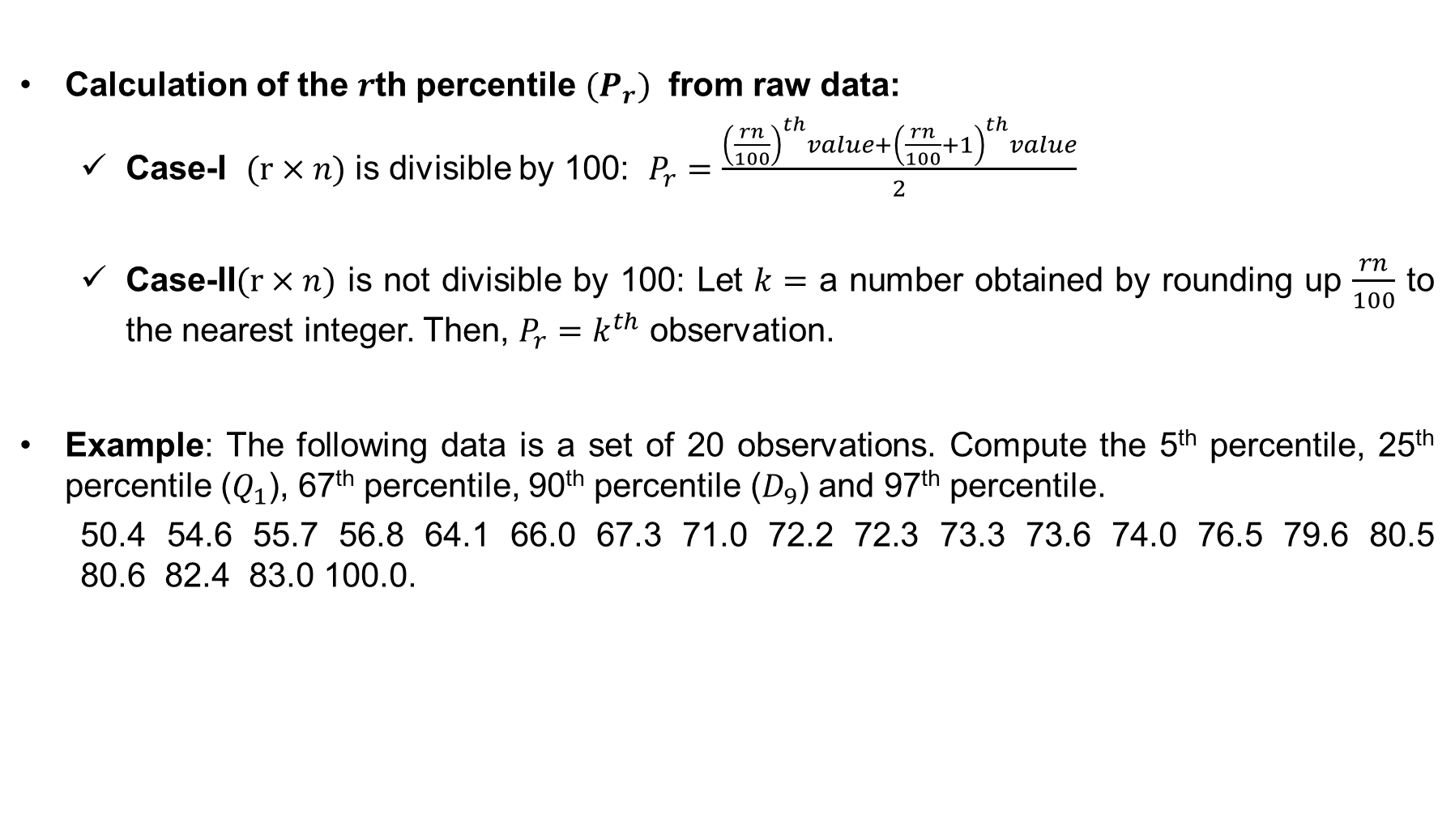
The Percentiles
Calculation of the $r$th percentile ${(P}_{r})$ from raw data:
Case-I $(r×n)$ is divisible by 100: $P_{r}=\frac{{\left(\frac{rn}{100}\right)}^{th}value+{\left(\frac{rn}{100}+1\right)}^{th}value}{2}$
Case-II$(r×n)$ is not divisible by 100: Let $k=$ a number obtained by rounding up $\frac{rn}{100}$ to the nearest integer. Then, $P_{r}=k^{th}$ observation.
Example: The following data is a set of 20 observations. Compute the 5th percentile, 25th percentile ($Q_{1}$), 67th percentile, 90th percentile ($D_{9}$) and 97th percentile.
50.4 54.6 55.7 56.8 64.1 66.0 67.3 71.0 72.2 72.3 73.3 73.6 74.0 76.5 79.6 80.5 80.6 82.4 83.0 100.0.

Slide 23
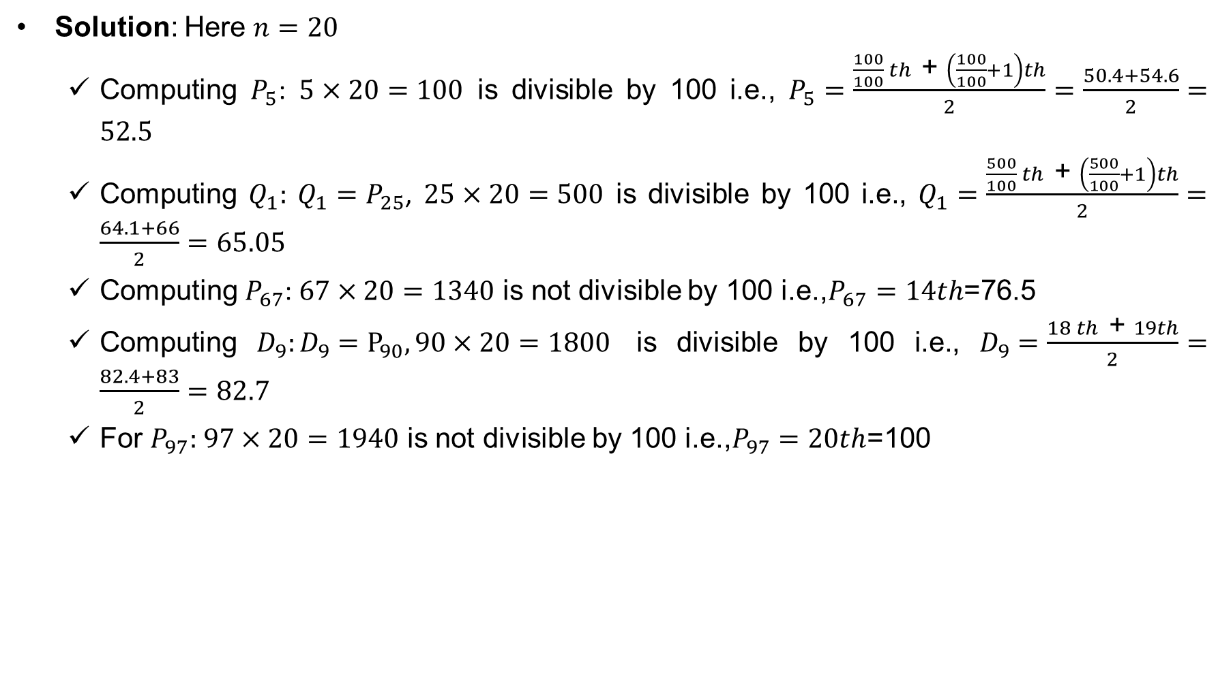
The Percentiles
Solution: Here $n=20$
Computing $P_{5}$: $5×20=100$ is divisible by 100 i.e., $P_{5}=\frac{\frac{100}{100} th \text{+} \left(\frac{100}{100}+1\right)th}{2}=\frac{50.4+54.6}{2}=52.5$
Computing $Q_{1}: Q_{1}=P_{25}$, $25×20=500$ is divisible by 100 i.e., $Q_{1}=\frac{\frac{500}{100} th \text{+} \left(\frac{500}{100}+1\right)th}{2}=\frac{64.1+66}{2}=65.05$
Computing $P_{67}$: $67×20=1340$ is not divisible by 100 i.e.,$P_{67}=14th$=76.5
Computing $D_{9}:D_{9}=P_{90}, 90×20=1800$ is divisible by 100 i.e., $D_{9}=\frac{18 th \text{+} 19th}{2}=\frac{82.4+83}{2}=82.7$
For $P_{97}:$ $97×20=1940$ is not divisible by 100 i.e.,$P_{97}=20th$=100

Slide 24
Exercise
Problem-1: The following data show the number of spam e-mails received by the office of the EWU in 14 consecutive weeks:
1, 5, 2, 12, 6, 8, 0, 10, 32, 7, 3, 9, 4, 2
(a) Compute the mean, median and mode. Based on these values, describe the shape of the
distribution of data?
(b) Find the 10th and 95th percentiles; 7th decile; 1st and 3rd quartiles.

Slide 25
Exercise (cont…)
Problem-2: The following table gives the age distribution for the number of deaths in New York State due to accidents for residents age 25 and older.
(a) Compute the mean, median and mode. Based on these values, describe the shape of the
distribution of data?
(b) Find the15th percentiles; 4th decile; 1st and 3rd quartiles.

Slide 26
Thank You

