Slide 1
COURSE TITLE: : Statistics and Probability COURSE CODE: STA 102 Topics: Numerical Measures: Measures of Dispersion
Instructor: Md. Ershadul Haque, PhD
Professor, Department of Statistics, DU
&
Adjunct Faculty, EWU, Bangladesh

Slide 2
Measures of Dispersion
The measurement of scatteredness of the values in a dataset is called a measure of dispersion or measure of variation.
A measure of dispersion is a numerical value that indicates the degree to which the observations in a dataset differ from one another or from a measure of central tendency (mean, median, or mode).
It represents how far the data values spread out from the center.
Since it is (based on distance) a distance measure, it cannot be negative.
It becomes zero when there is no spread at all, i.e., when all values are identical.

Slide 3
Measures of Dispersion
Necessity: A measure of central value (average) alone cannot adequately describe a set of observations (two datasets may have the same mean but very different spreads). Furthermore, It fails to give us any idea about the formulation of the data sets. For this reason, it is necessary to study the dispersion (variability) along with average for describing a dataset. For example: consider Dataset A: [4, 5, 5, 6] & Dataset B: [1, 3, 5, 11]
Both have a mean of 5, but:
Dataset A's values are tightly packed around 5.
Dataset B's values are more spread out — much more variability.
Without a measure of dispersion, you’d miss that difference completely.

Slide 4
Measures of Dispersion
Purposes : Measure of dispersion is important for the following purposes:
(1) To understand the reliability of an average.
A smaller dispersion means the average is more representative; a larger dispersion means the average is less reliable.
Example: Two classes may have the same average exam score, but one class may have scores tightly clustered, while the other has scores widely scattered.
(2) To identify uniformity or diversity
A measure of dispersion tells whether data values are homogeneous (similar) or heterogeneous (very different).
For example, salary distribution in a company: low dispersion means equality, high dispersion means inequality.

Slide 5
Measures of Dispersion
Purposes:
(3) To compare the variability between datasets
Dispersion helps compare consistency across groups.
For example, comparing production quality across factories or comparing variability of stock returns between companies.
(4) To detect outliers and anomalies
Large dispersion or unusually high spread may indicate outliers.

Slide 6
Different measure of dispersion
Absolute measures of dispersion: When dispersion is measured in original units then it is called absolute dispersion. The four important absolute measures of dispersion are as follows:
Range
Quartile deviation
Mean deviation
Variance and Standard deviation

Slide 7
Different measure of dispersion
Relative measures of dispersion: It is a unit free measure of dispersion. When the various sets of data are expressed in different units, the absolute measures are not comparable. Even with identical units of measurements, when the average values of two or more set are very much different, the absolute measures give misleading conclusion. In such cases relative measures of dispersion should be used. The four important relative measures of dispersion are as follows:
Coefficient of range
Coefficient of quartile deviation
Coefficient of mean deviation
Coefficient of variation

Slide 8
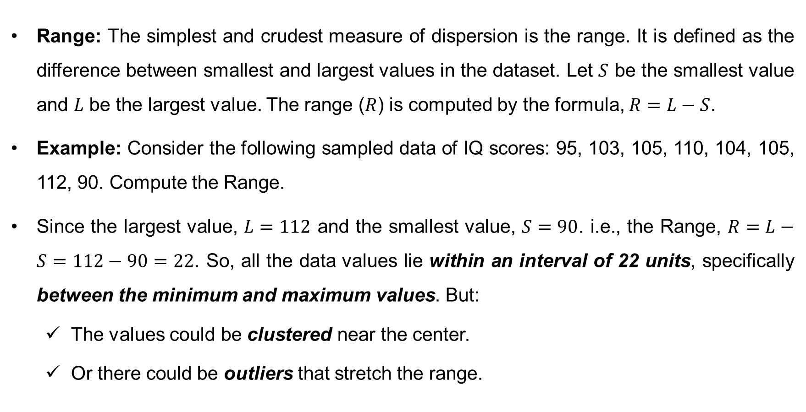
Measure of Dispersion: Range
Range: The simplest and crudest measure of dispersion is the range. It is defined as the difference between smallest and largest values in the dataset. Let $S$ be the smallest value and $L$ be the largest value. The range ($R$) is computed by the formula, $R=L−S$.
Example: Consider the following sampled data of IQ scores: 95, 103, 105, 110, 104, 105, 112, 90. Compute the Range.
Since the largest value, $L=112$ and the smallest value, $S=90$. i.e., the Range, $R=L−S=112−90=22$. So, all the data values lie within an interval of 22 units, specifically between the minimum and maximum values. But:
The values could be clustered near the center.
Or there could be outliers that stretch the range.

Slide 9
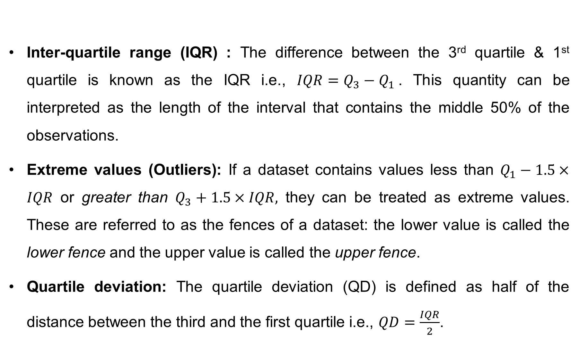
Measure of Dispersion: Quartile deviation
Inter-quartile range (IQR) : The difference between the 3rd quartile & 1st quartile is known as the IQR i.e., $IQR=Q_{3}−Q_{1}$. This quantity can be interpreted as the length of the interval that contains the middle 50% of the observations.
Extreme values (Outliers): If a dataset contains values less than $Q_{1}−1.5×IQR$ or greater than $Q_{3}+1.5×IQR,$ they can be treated as extreme values. These are referred to as the fences of a dataset: the lower value is called the lower fence and the upper value is called the upper fence.
Quartile deviation: The quartile deviation (QD) is defined as half of the distance between the third and the first quartile i.e., $QD=\frac{IQR}{2}$.

Slide 10
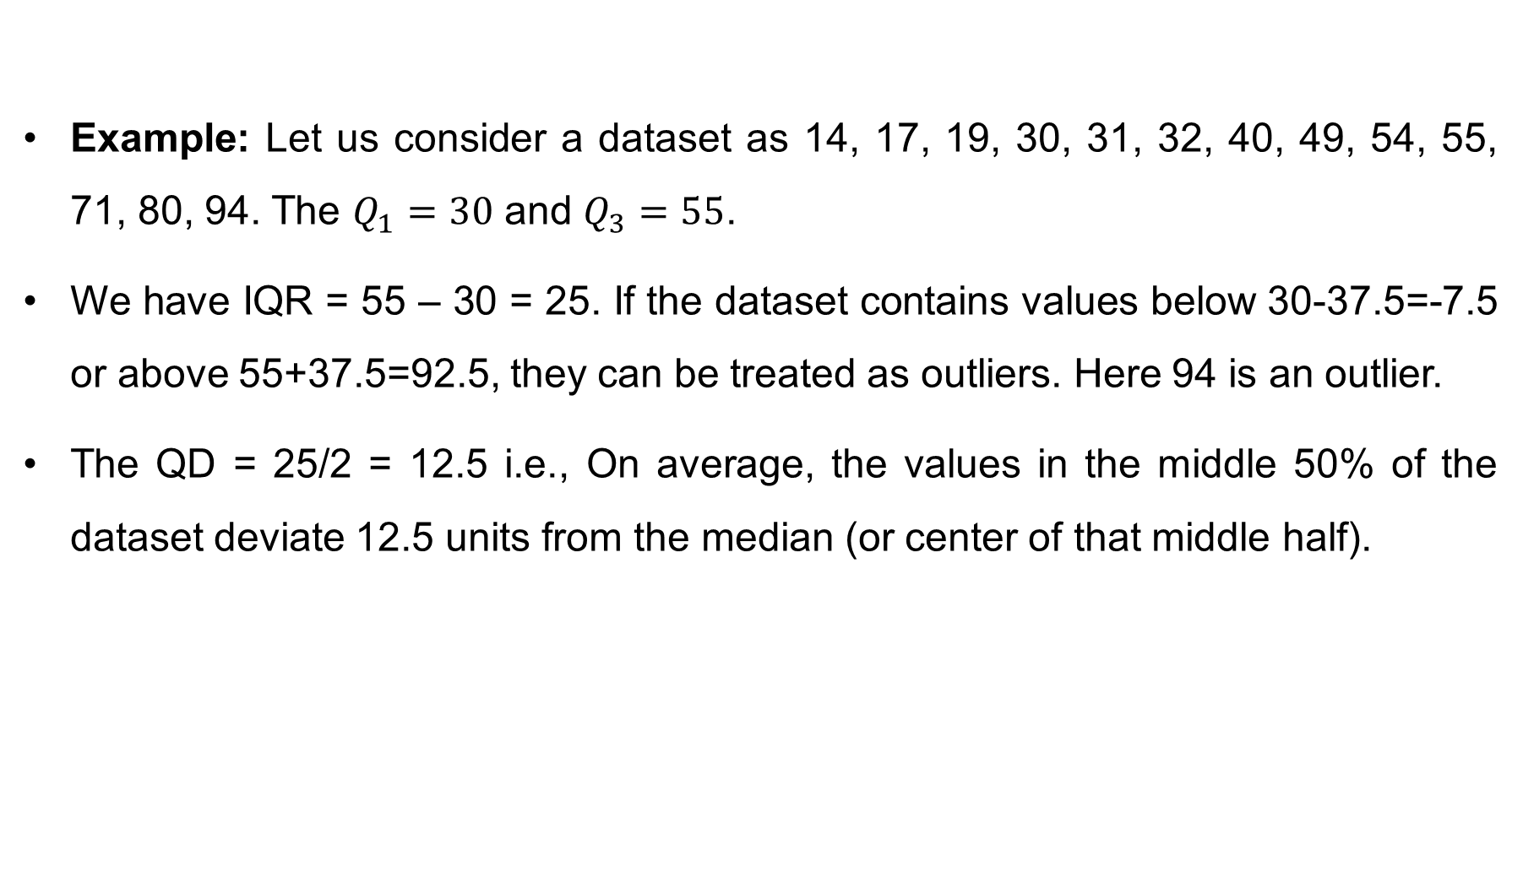
Measure of Dispersion: Quartile deviation
Example: Let us consider a dataset as 14, 17, 19, 30, 31, 32, 40, 49, 54, 55, 71, 80, 94. The $Q_{1}=30$ and $Q_{3}=55$.
We have IQR = 55 – 30 = 25. If the dataset contains values below 30-37.5=-7.5 or above 55+37.5=92.5, they can be treated as outliers. Here 94 is an outlier.
The QD = 25/2 = 12.5 i.e., On average, the values in the middle 50% of the dataset deviate 12.5 units from the median (or center of that middle half).

Slide 11
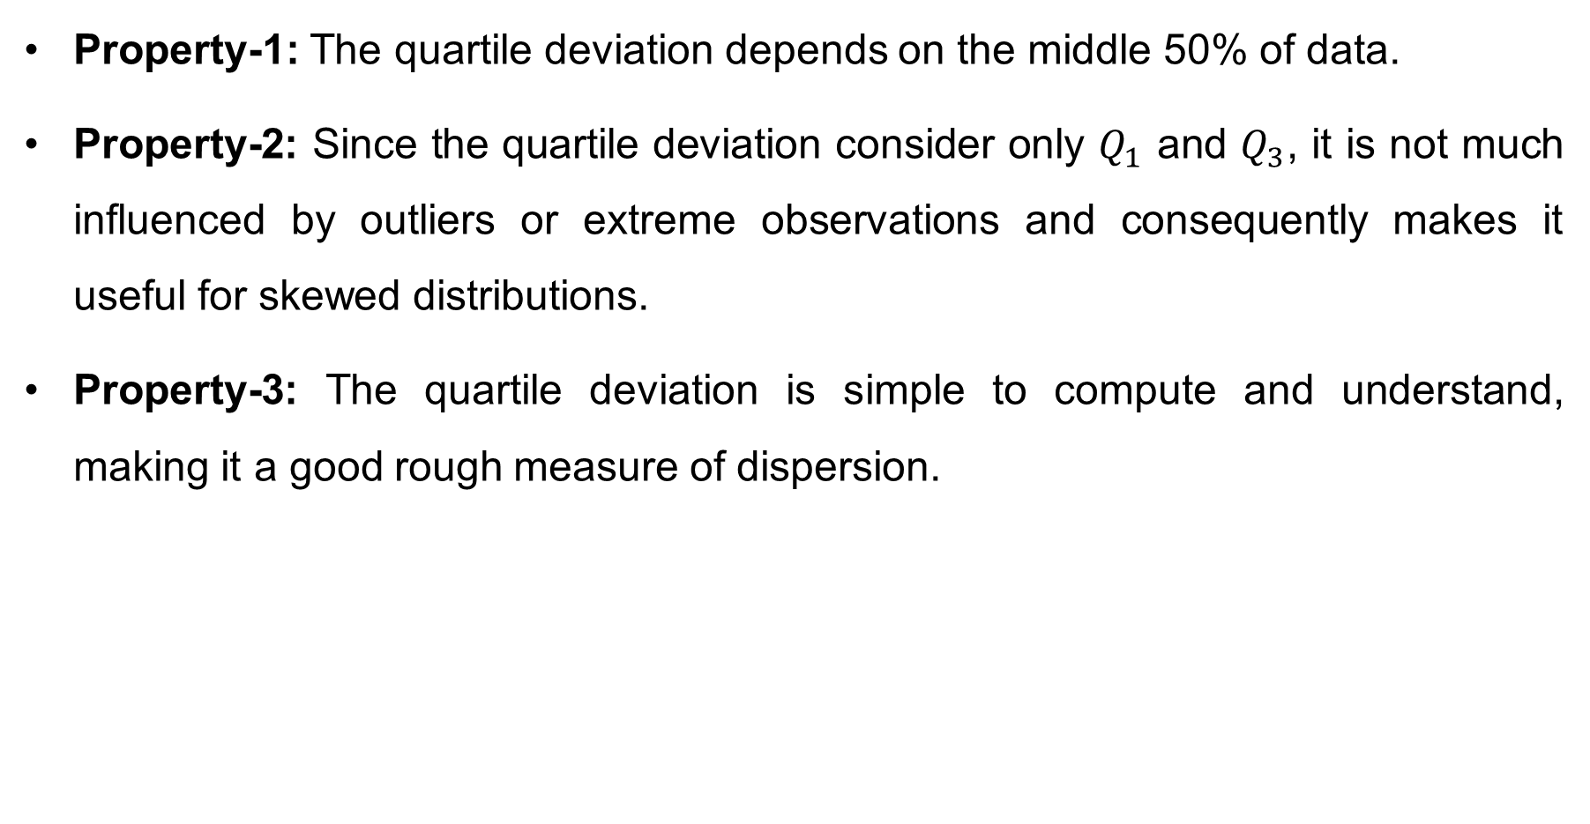
Properties of quartile deviation
Property-1: The quartile deviation depends on the middle 50% of data.
Property-2: Since the quartile deviation consider only $Q_{1}$ and $Q_{3}$, it is not much influenced by outliers or extreme observations and consequently makes it useful for skewed distributions.
Property-3: The quartile deviation is simple to compute and understand, making it a good rough measure of dispersion.

Slide 12
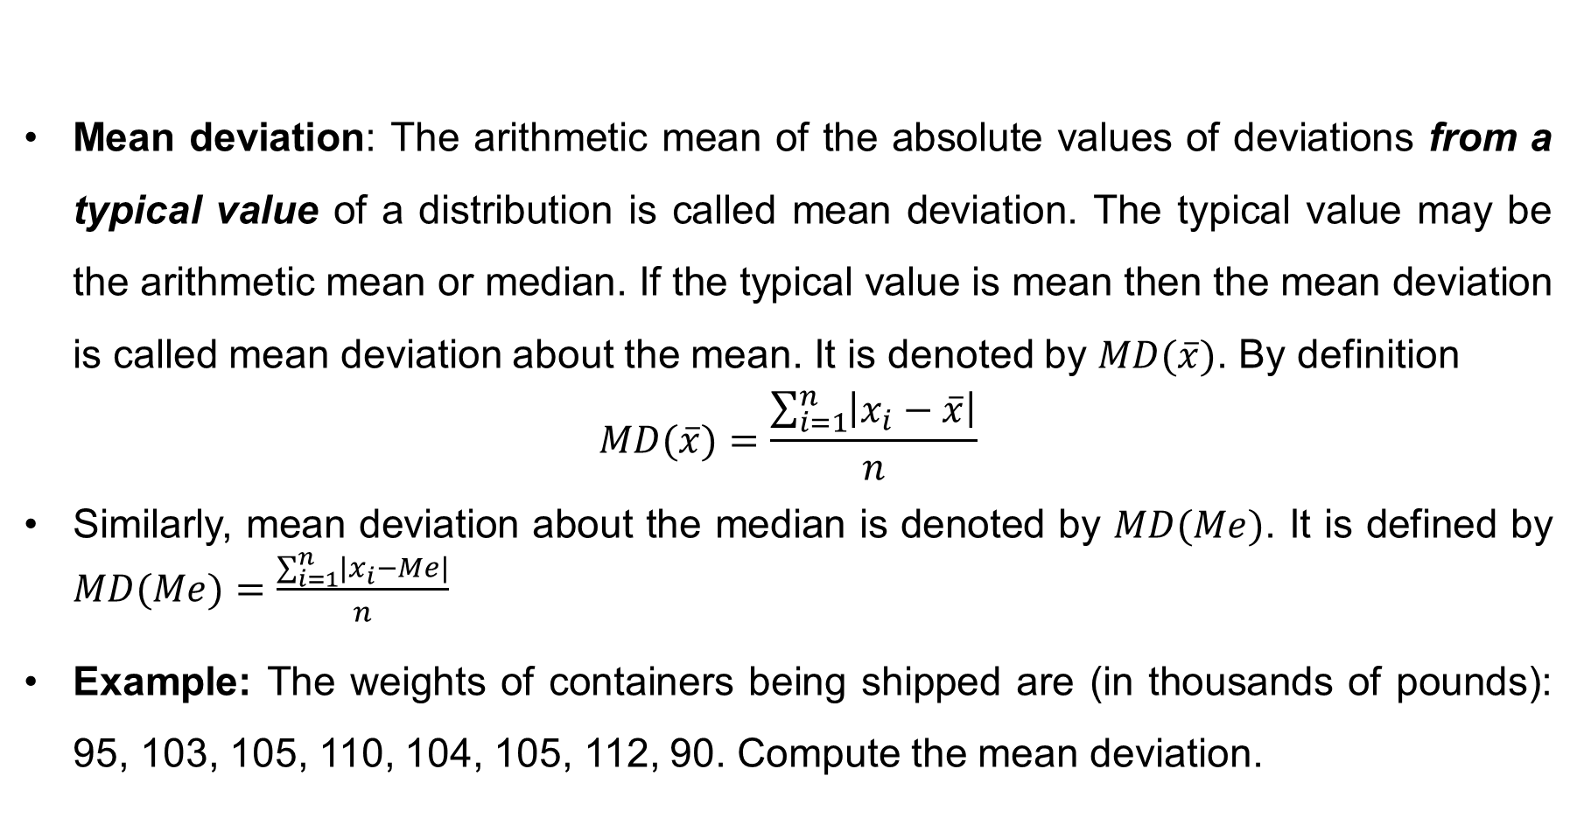
Measure of Dispersion: Mean deviation
Mean deviation: The arithmetic mean of the absolute values of deviations from a typical value of a distribution is called mean deviation. The typical value may be the arithmetic mean or median. If the typical value is mean then the mean deviation is called mean deviation about the mean. It is denoted by $MD(\overline{x})$. By definition
$$MD(\overline{x})=\frac{\sum_{i=1}^{n}{\left|x_{i}−\overline{x}\right|}}{n}$$
Similarly, mean deviation about the median is denoted by $MD(Me)$. It is defined by $MD(Me)=\frac{\sum_{i=1}^{n}{\left|x_{i}−Me\right|}}{n}$
Example: The weights of containers being shipped are (in thousands of pounds): 95, 103, 105, 110, 104, 105, 112, 90. Compute the mean deviation.

Slide 13
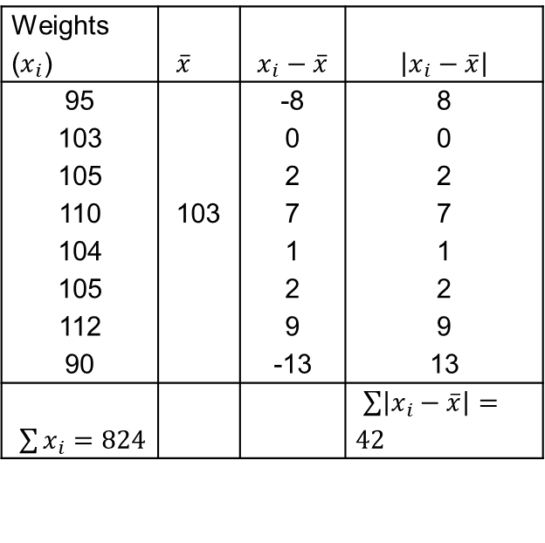

Measure of Dispersion: Mean deviation (cont…)
To compute the mean deviation, we can construct the following table
Here $n=8$, we have $MD(\overline{x})=\frac{\sum_{i=1}^{n}{\left|x_{i}−\overline{x}\right|}}{n}=\frac{42}{8}=5.25$
The mean deviation of weights of the containers is 5.25 thousand pounds. The weights of the containers deviates, on average by 5.25 thousand pounds from the mean.
Weights ($x_{i}$) | $\overline{x}$ | $$x_{i}−\overline{x}$$ | $$\left|x_{i}−\overline{x}\right|$$
95 |  | -8 | 8
103 |  | 0 | 0
105 |  | 2 | 2
110 | 103 | 7 | 7
104 |  | 1 | 1
105 |  | 2 | 2
112 |  | 9 | 9
90 |  | -13 | 13
$\sum{x_{i}}=824$ |  |  | $\sum{\left|x_{i}−\overline{x}\right|}=42$

Slide 14
Properties of mean deviation
Property-1: The mean deviation is minimized if computed from the median.
Property-2: The mean deviation about the arithmetic mean cannot exceed the standard deviation.
Property-3: The mean deviation is less influenced by extreme values than standard deviation (because it takes absolute values, not squares). However, it is less useful mathematically than standard deviation in advanced statistical work.

Slide 15
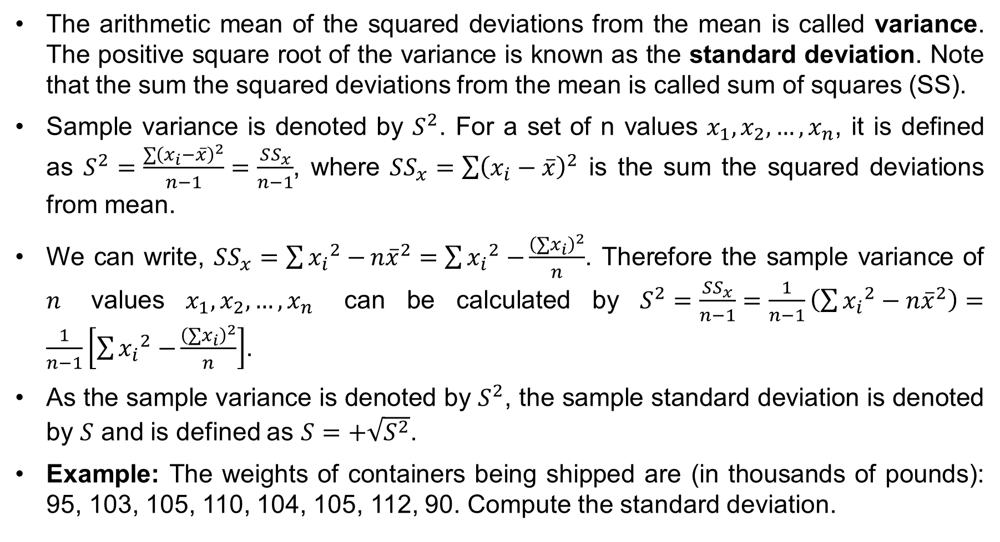
Measures of Dispersion: The Standard Deviation
The arithmetic mean of the squared deviations from the mean is called variance. The positive square root of the variance is known as the standard deviation. Note that the sum the squared deviations from the mean is called sum of squares (SS).
Sample variance is denoted by $S^{2}$. For a set of n values $x_{1}, x_{2}, …,x_{n}$, it is defined as $S^{2}=\frac{\sum{{\left(x_{i}−\overline{x}\right)}^{2}}}{n−1}=\frac{SS_{x}}{n−1}$, where $SS_{x}=\sum{{\left(x_{i}−\overline{x}\right)}^{2}}$ is the sum the squared deviations from mean.
We can write, $SS_{x}=\sum{{x_{i}}^{2}−}n{\overline{x}}^{2}=\sum{{x_{i}}^{2}−}\frac{{\left(∑x_{i}\right)}^{2}}{n}$. Therefore the sample variance of $n$ values $x_{1}, x_{2}, …,x_{n}$ can be calculated by $S^{2}=\frac{SS_{x}}{n−1}=\frac{1}{n−1}\left(\sum{{x_{i}}^{2}}−n{\overline{x}}^{2}\right)=\frac{1}{n−1}\left[\sum{{x_{i}}^{2}−}\frac{{\left(∑x_{i}\right)}^{2}}{n}\right]$.
As the sample variance is denoted by $S^{2}$, the sample standard deviation is denoted by $S$ and is defined as $S=+\sqrt{S^{2}}$.
Example: The weights of containers being shipped are (in thousands of pounds): 95, 103, 105, 110, 104, 105, 112, 90. Compute the standard deviation.

Slide 16
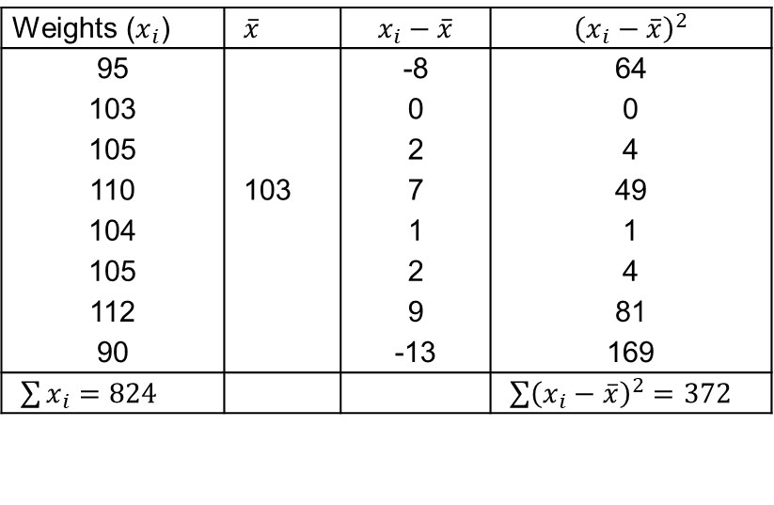
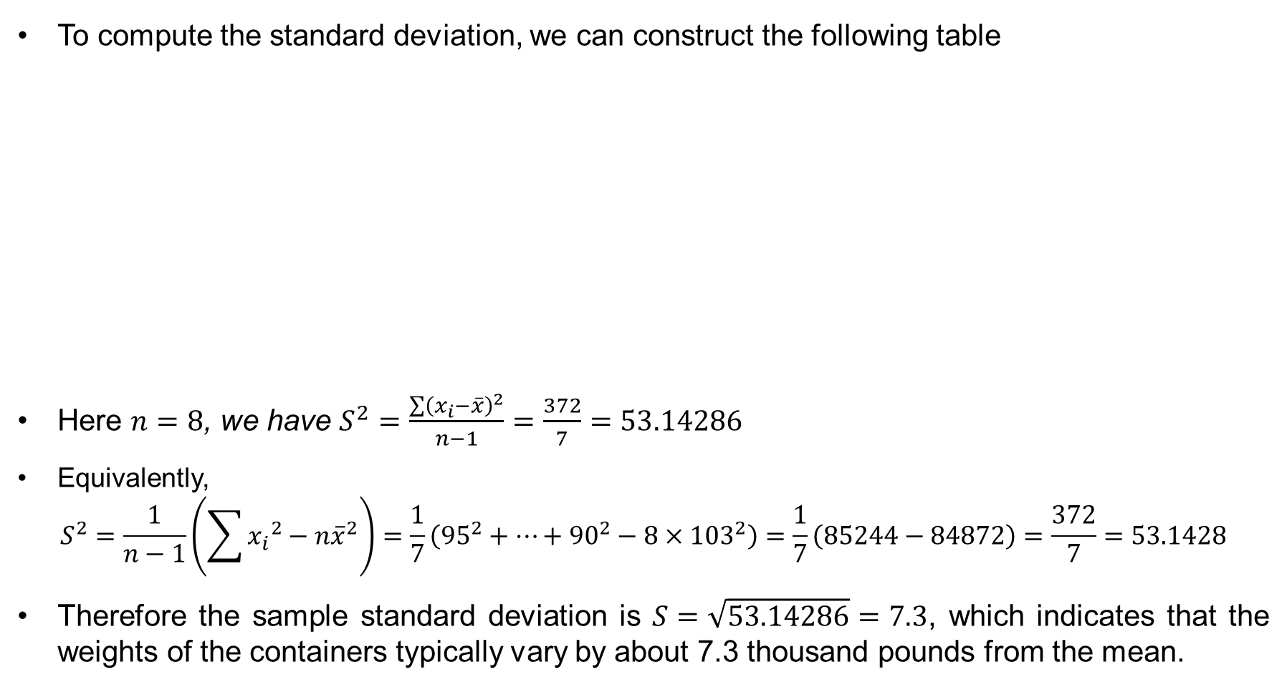
Standard deviation (cont…)
To compute the standard deviation, we can construct the following table
Here $n=8$, we have $S^{2}=\frac{\sum{{\left(x_{i}−\overline{x}\right)}^{2}}}{n−1}=\frac{372}{7}=53.14286$
Equivalently,
$$S^{2}=\frac{1}{n−1}\left(\sum{{x_{i}}^{2}}−n{\overline{x}}^{2}\right)=\frac{1}{7}\left({95}^{2}+⋯+{90}^{2}−8×{103}^{2}\right)=\frac{1}{7}\left(85244−84872\right)=\frac{372}{7}=53.1428$$
Therefore the sample standard deviation is $S=\sqrt{53.14286}=7.3$, which indicates that the weights of the containers typically vary by about 7.3 thousand pounds from the mean.
Weights ($x_{i}$) | $\overline{x}$ | $$x_{i}−\overline{x}$$ | $${\left(x_{i}−\overline{x}\right)}^{2}$$
95 |  | -8 | 64
103 |  | 0 | 0
105 |  | 2 | 4
110 | 103 | 7 | 49
104 |  | 1 | 1
105 |  | 2 | 4
112 |  | 9 | 81
90 |  | -13 | 169
$\sum{x_{i}}=824$ |  |  | $\sum{{\left(x_{i}−\overline{x}\right)}^{2}}=372$

Slide 17
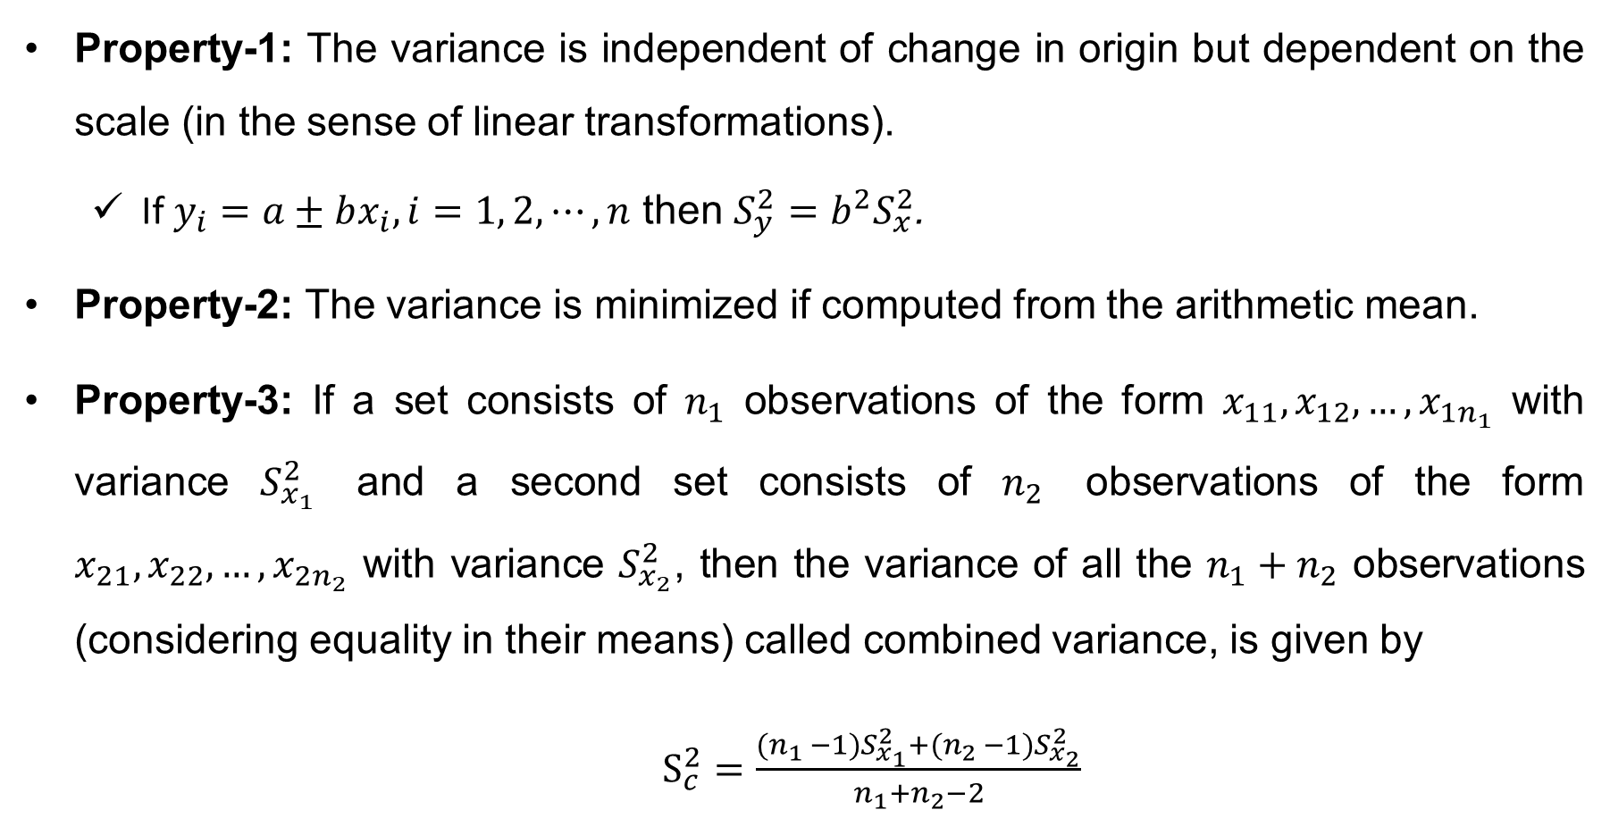
Properties of Variance
Property-1: The variance is independent of change in origin but dependent on the scale (in the sense of linear transformations).
If $y_{i}=a±bx_{i}, i=1, 2, ⋯, n$ then $S_{y}^{2}=b^{2}S_{x}^{2}$.
Property-2: The variance is minimized if computed from the arithmetic mean.
Property-3: If a set consists of $n_{1}$ observations of the form $x_{11}, x_{12}, …,x_{1n_{1}}$ with variance $S_{x_{1}}^{2}$ and a second set consists of $n_{2}$ observations of the form $x_{21}, x_{22}, …,x_{2n_{2}}$ with variance $S_{x_{2}}^{2}$, then the variance of all the $n_{1}+n_{2}$ observations (considering equality in their means) called combined variance, is given by
$S_{c}^{2}=\frac{{(n}_{1 }−1)S_{x_{1}}^{2}+{(n}_{2 }−1)S_{x_{2}}^{2}}{n_{1}+n_{2}−2}$

Slide 18
How to Interpret the Standard deviation
The standard deviation is used to compare the spread in two or more data sets if mean values are similar. A small standard deviation indicates “observations are located close to mean”. Conversely, a large standard deviation indicates “observations are widely scattered about the mean”.
For a single dataset, the uses of standard deviation can be best explained by the Chebyshev’s theorem or the Empirical rule.

Slide 19
Empirical Rule
For a symmetrical, bell-shaped/normal frequency distribution
approximately 68 percent of the observations will lie within plus and minus one standard deviation of the mean. For instance, if mean is 100 and standard deviation is 10 then about 68% observations will be between 90 and 110.
about 95 percent of the observations will lie within plus and minus two standard deviations of the mean. For instance, if mean is 100 and standard deviation is 10 then about 95% observations will be between 80 and 120.
practically all (about 99 percent) will lie within plus and minus three standard deviations of the mean. For instance, if mean is 100 and standard deviation is 10 then about 99% observations will be between 70 and 130.

Slide 20
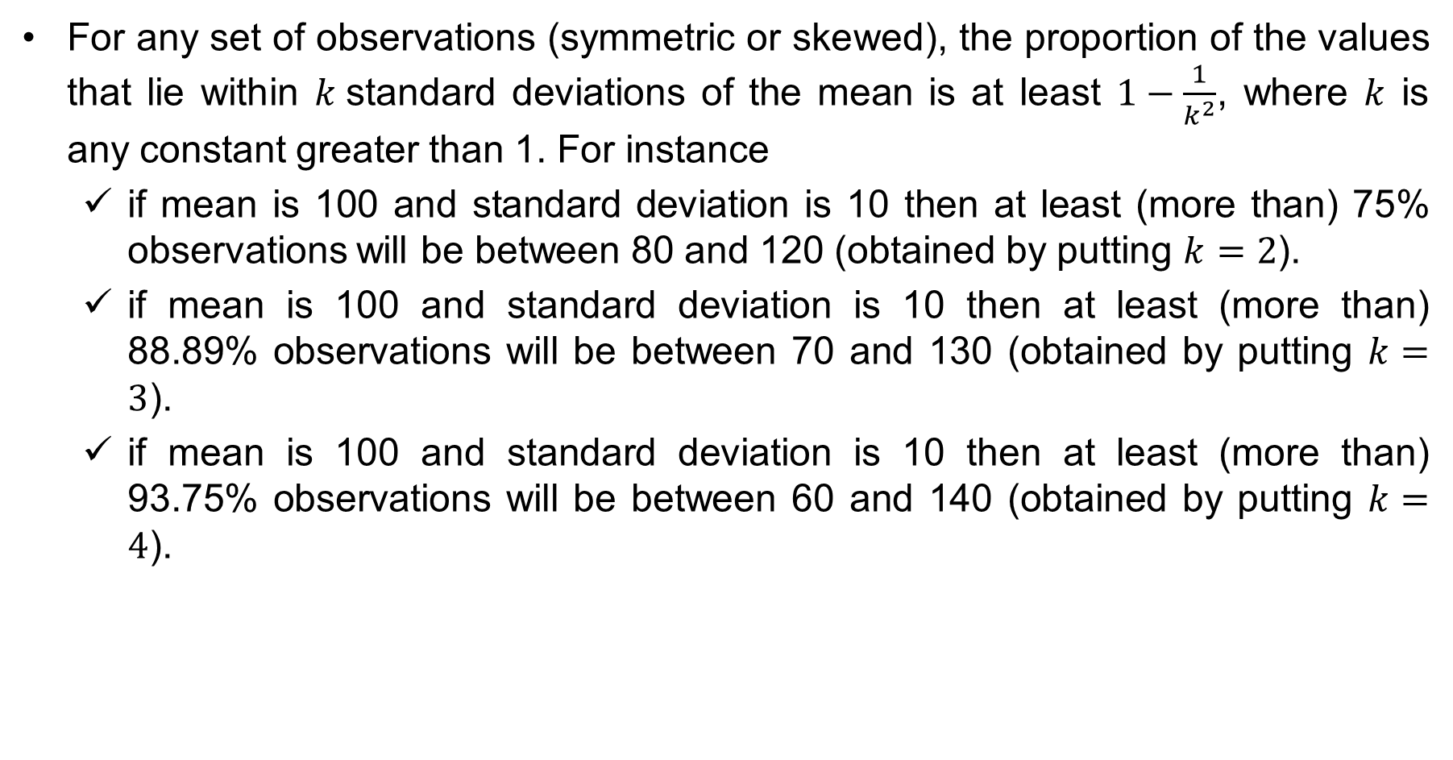
Chebyshev’s theorem
For any set of observations (symmetric or skewed), the proportion of the values that lie within $k$standard deviations of the mean is at least $1−\frac{1}{k^{2}}$, where $k$ is any constant greater than 1. For instance
if mean is 100 and standard deviation is 10 then at least (more than) 75% observations will be between 80 and 120 (obtained by putting $k=2$).
if mean is 100 and standard deviation is 10 then at least (more than) 88.89% observations will be between 70 and 130 (obtained by putting $k=3$).
if mean is 100 and standard deviation is 10 then at least (more than) 93.75% observations will be between 60 and 140 (obtained by putting $k=4$).

Slide 21
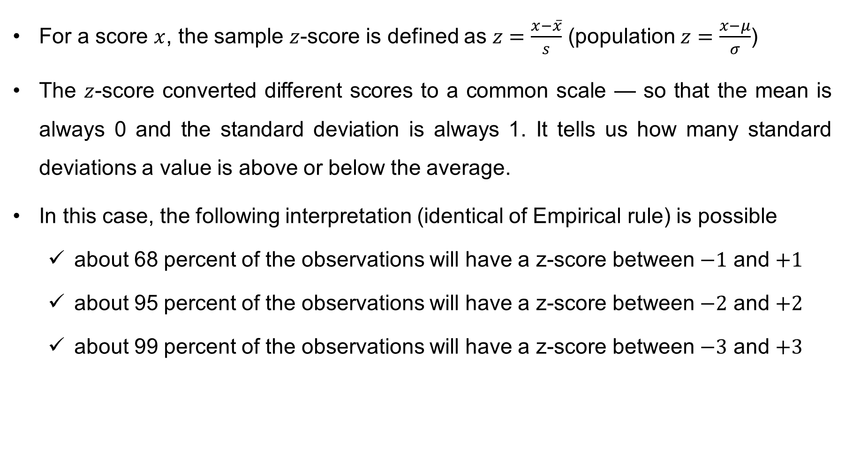
Use of Standard Deviation: Z-score
For a score $x$, the sample $z$-score is defined as $z=\frac{x−\overline{x}}{s}$ (population $z=\frac{x−μ}{σ}$)
The $z$-score converted different scores to a common scale — so that the mean is always 0 and the standard deviation is always 1. It tells us how many standard deviations a value is above or below the average.
In this case, the following interpretation (identical of Empirical rule) is possible
about 68 percent of the observations will have a z-score between $−1$ and $+1$
about 95 percent of the observations will have a z-score between $−2$ and $+2$
about 99 percent of the observations will have a z-score between $−3$ and $+3$

Slide 22
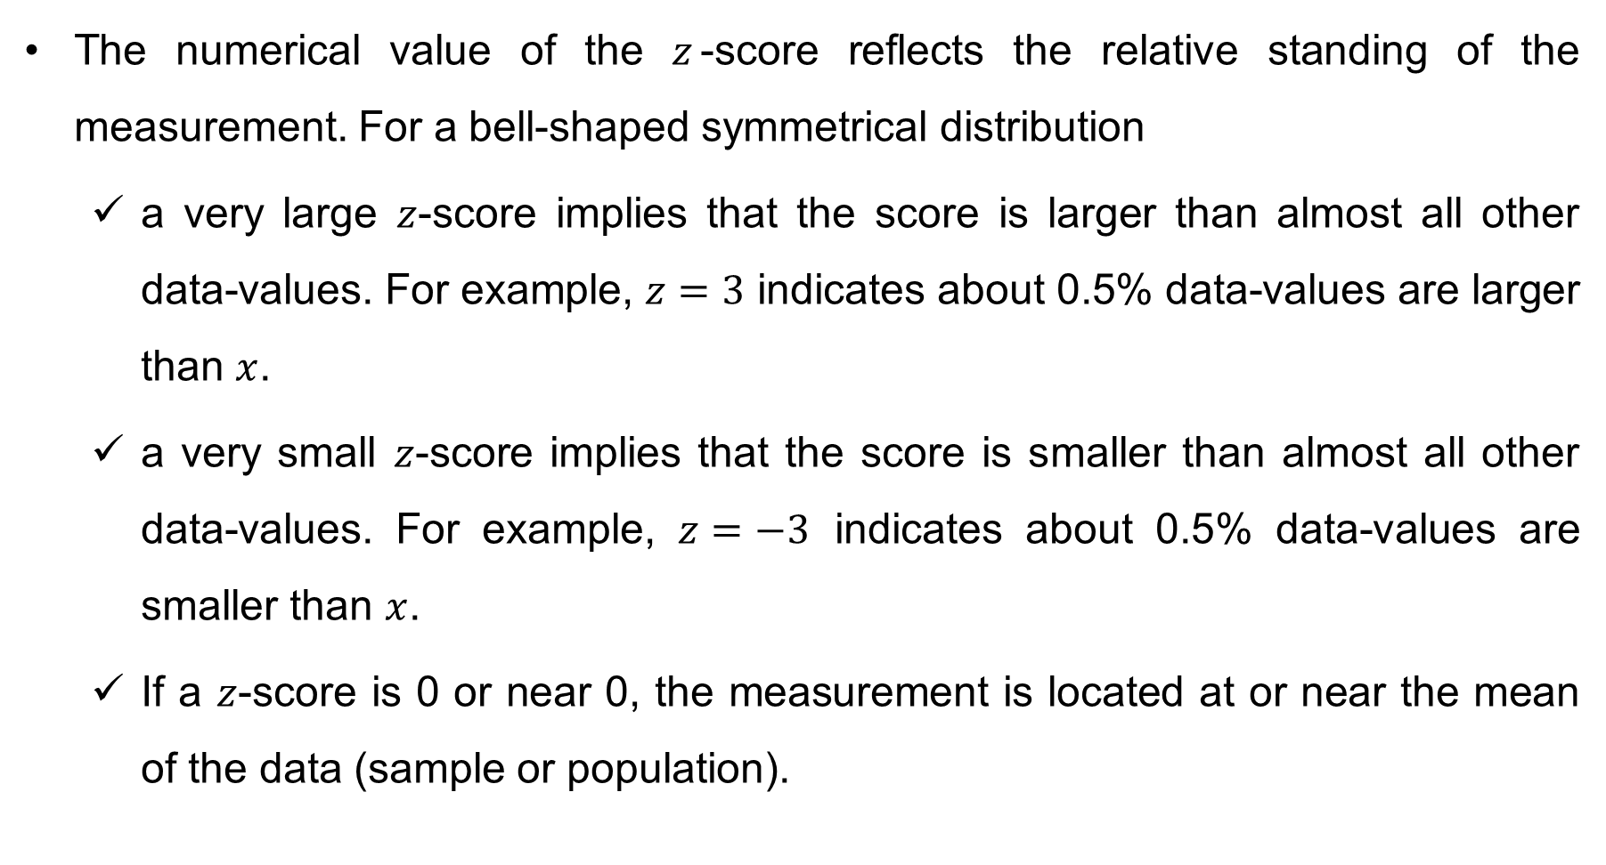
Use of Standard Deviation: Z-score
The numerical value of the $z$-score reflects the relative standing of the measurement. For a bell-shaped symmetrical distribution
a very large $z$-score implies that the score is larger than almost all other data-values. For example, $z=3$ indicates about 0.5% data-values are larger than $x$.
a very small $z$-score implies that the score is smaller than almost all other data-values. For example, $z=−3$ indicates about 0.5% data-values are smaller than $x$.
If a $z$-score is 0 or near 0, the measurement is located at or near the mean of the data (sample or population).

Slide 23
Why Z-score is necessary
The Problem: Comparing Apples and Oranges
Suppose in one department (A) , the average application processing time is 10 days with a SD of 2 days.
In another (B), the average is 30 days with a SD of 5 days.
How do we compare whether a 13-day processing time in the first department is ‘faster’ or ‘slower’ compared to a 34-day processing time in the second department?
They’re on totally different scales.
The Solution: Standardizing (convert different scores to a common scale) with Z-scores
We use a formula to compute the score: Z = (your value - mean)/SD
Once everything is on the same scale, we can compare across different situations
A: z = 1.5 (proportion below 1.5 is 0.933)
B: z = 0.8 (proportion below 0.8 is 0.788)

Slide 24
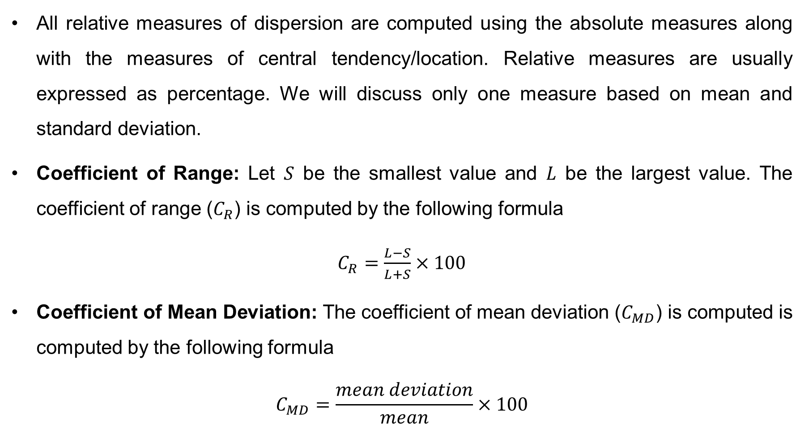
Relative Measures of Dispersion
All relative measures of dispersion are computed using the absolute measures along with the measures of central tendency/location. Relative measures are usually expressed as percentage. We will discuss only one measure based on mean and standard deviation.
Coefficient of Range: Let $S$ be the smallest value and $L$ be the largest value. The coefficient of range ($C_{R}$) is computed by the following formula
$C_{R}=\frac{L−S}{L+S}×100$
Coefficient of Mean Deviation: The coefficient of mean deviation ($C_{MD}$) is computed is computed by the following formula
$$C_{MD}=\frac{mean deviation}{mean}×100$$

Slide 25
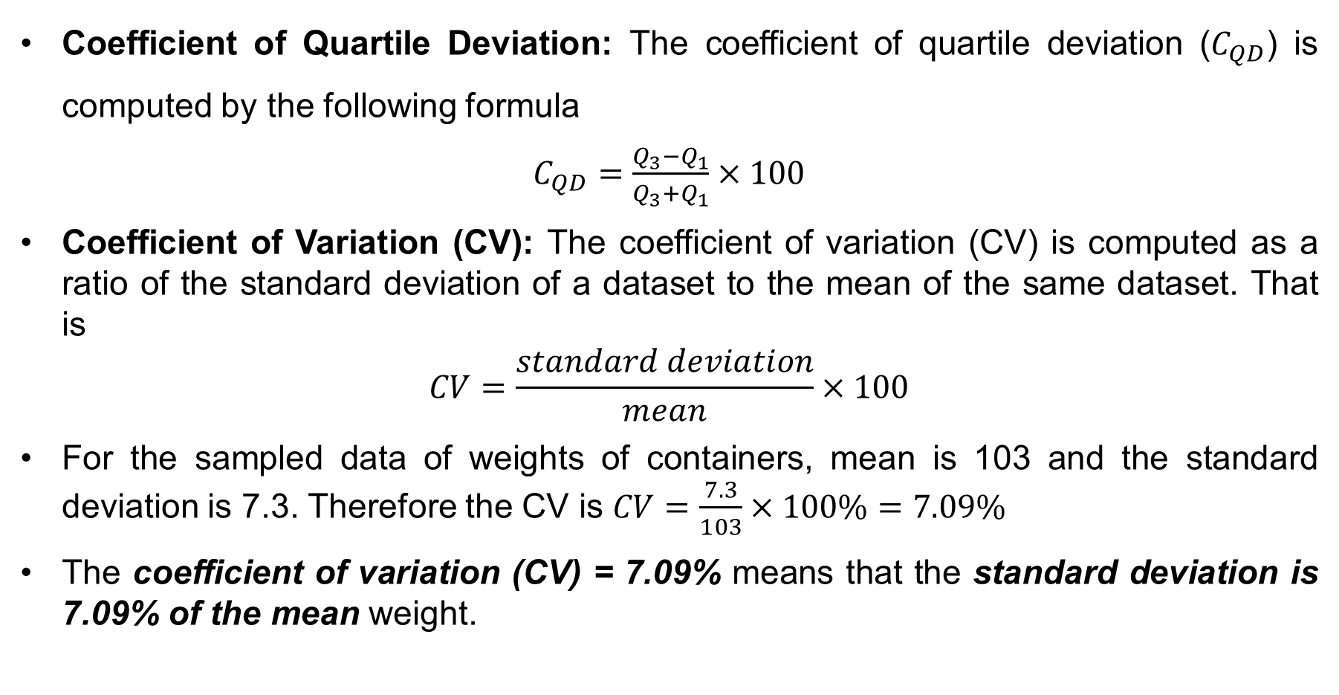
Relative Measures of Dispersion (cont…)
Coefficient of Quartile Deviation: The coefficient of quartile deviation ($C_{QD}$) is computed by the following formula
$C_{QD}=\frac{Q_{3}−Q_{1}}{Q_{3}+Q_{1}}×100$
Coefficient of Variation (CV): The coefficient of variation (CV) is computed as a ratio of the standard deviation of a dataset to the mean of the same dataset. That is
$$CV=\frac{standard deviation}{mean}×100$$
For the sampled data of weights of containers, mean is 103 and the standard deviation is 7.3. Therefore the CV is $CV=\frac{7.3}{103}×100\%=7.09\%$
The coefficient of variation (CV) = 7.09% means that the standard deviation is 7.09% of the mean weight.

Slide 26
Box and Whisker Plot
A box and whisker plot (or box plot) is a simple graph that shows how data is spread out from its center and whether it is balanced or skewed. It gives a quick picture of the center, spread, and shape of the data.
The box plot is built from what we call the five-number summary:
The smallest value in the data,
The first quartile
The median
The third quartile
The largest value in the data.

Slide 27
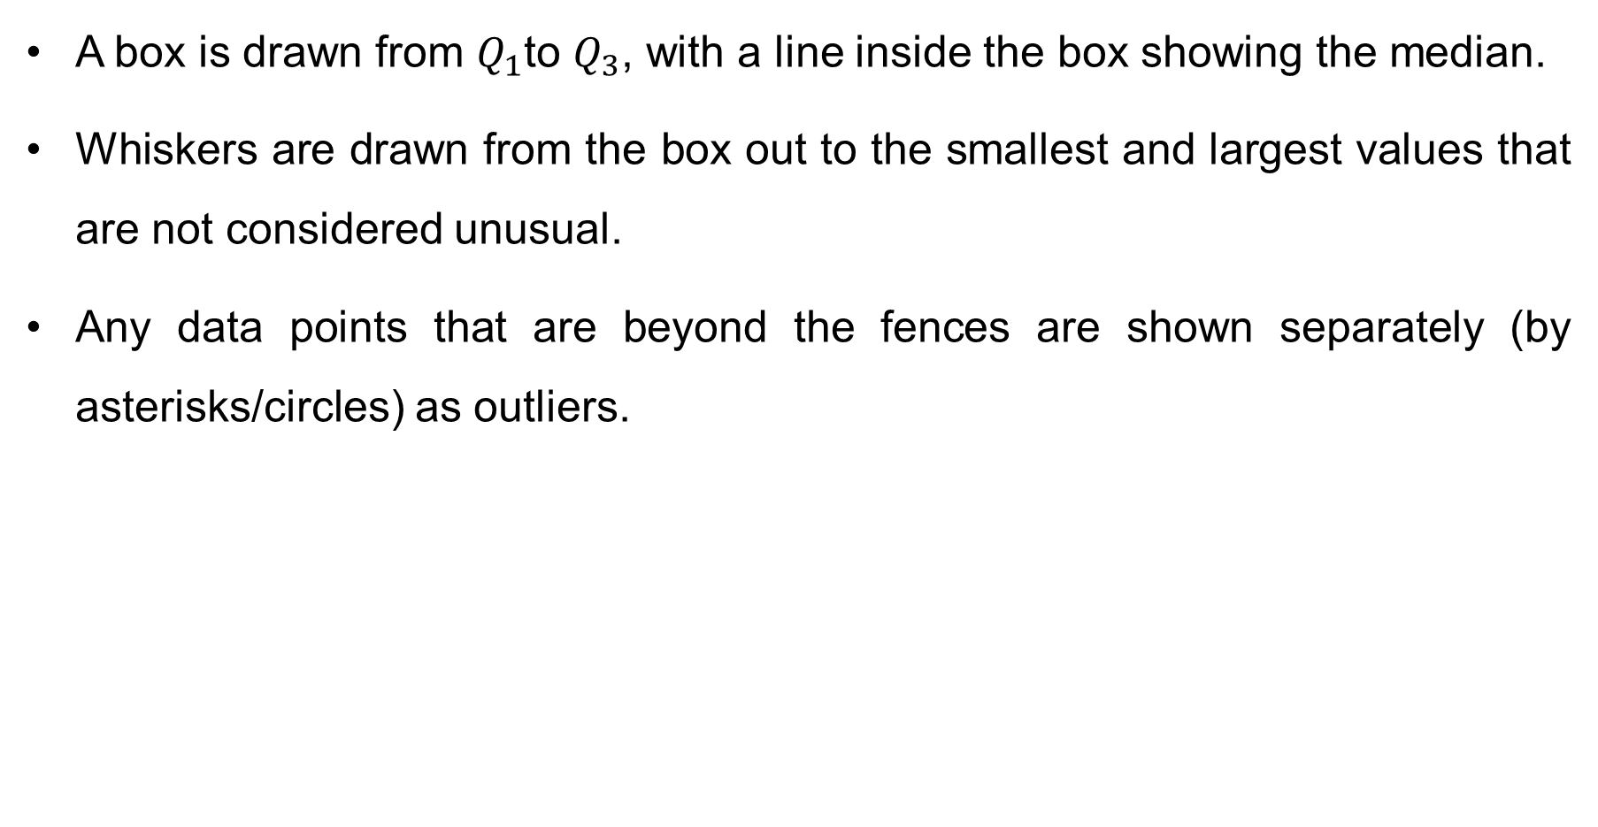
How a box plot is drawn
A box is drawn from $Q_{1}$to $Q_{3}$, with a line inside the box showing the median.
Whiskers are drawn from the box out to the smallest and largest values that are not considered unusual.
Any data points that are beyond the fences are shown separately (by asterisks/circles) as outliers.

Slide 28
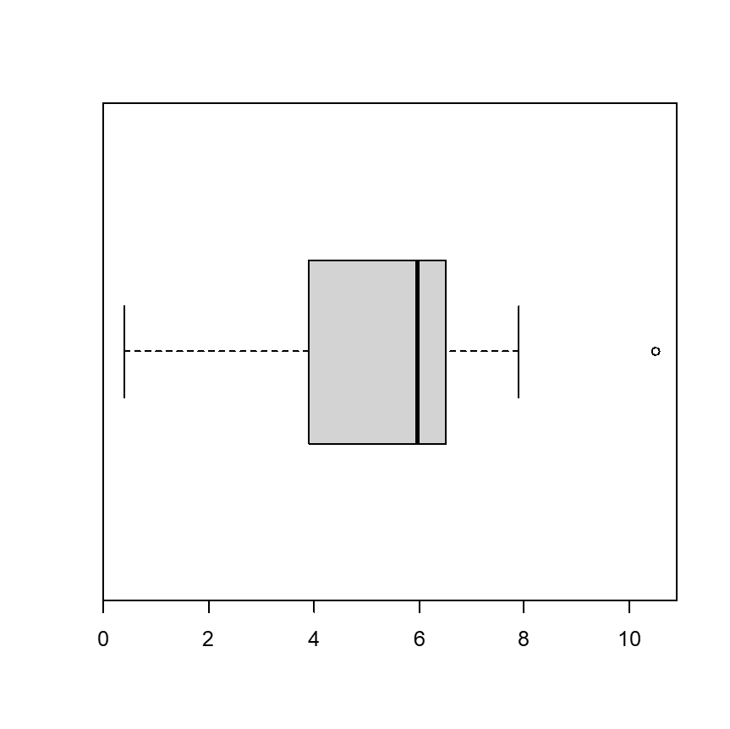
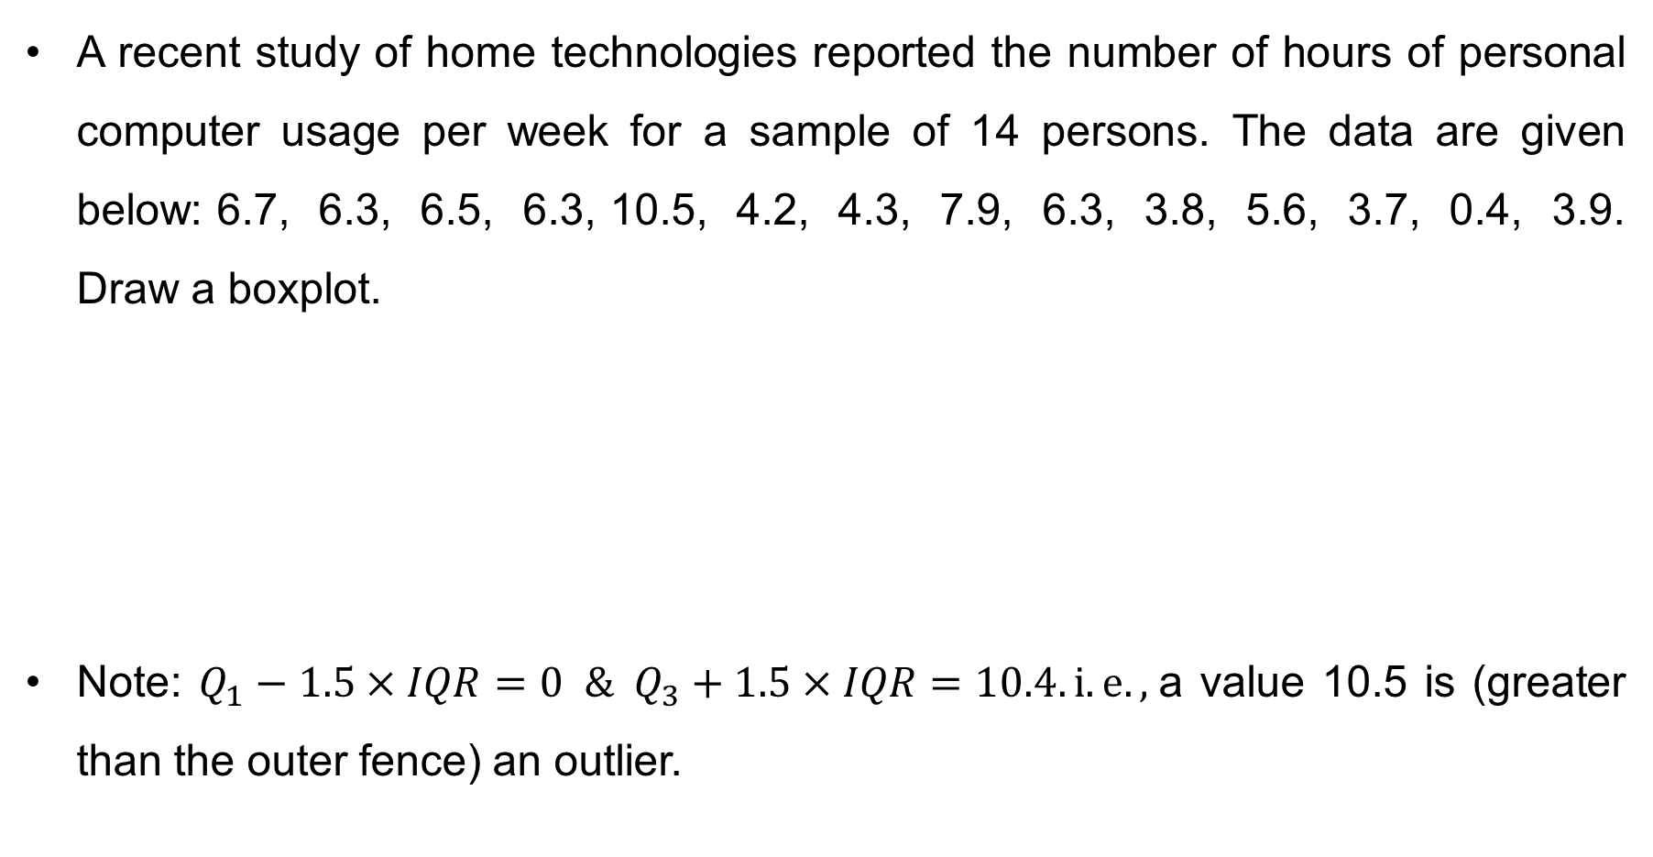
Drawing a boxplot
A recent study of home technologies reported the number of hours of personal computer usage per week for a sample of 14 persons. The data are given below: 6.7, 6.3, 6.5, 6.3, 10.5, 4.2, 4.3, 7.9, 6.3, 3.8, 5.6, 3.7, 0.4, 3.9. Draw a boxplot.
Note: $Q_{1}−1.5×IQR=0 \& Q_{3}+1.5×IQR=10.4. i.e.,$a value 10.5 is (greater than the outer fence) an outlier.

Slide 29
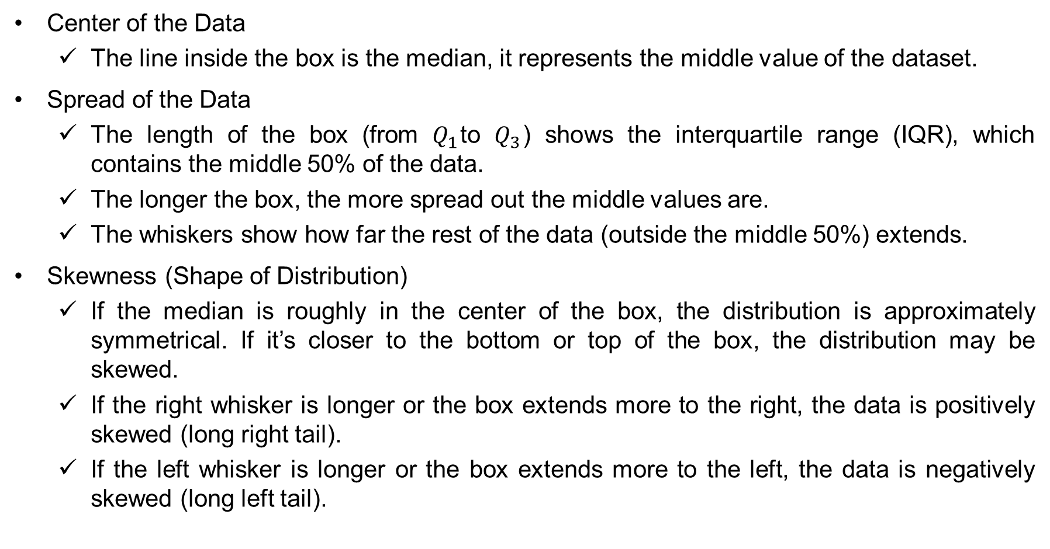
How to Interpret a Boxplot
Center of the Data
The line inside the box is the median, it represents the middle value of the dataset.
Spread of the Data
The length of the box (from $Q_{1}$to $Q_{3}$) shows the interquartile range (IQR), which contains the middle 50% of the data.
The longer the box, the more spread out the middle values are.
The whiskers show how far the rest of the data (outside the middle 50%) extends.
Skewness (Shape of Distribution)
If the median is roughly in the center of the box, the distribution is approximately symmetrical. If it’s closer to the bottom or top of the box, the distribution may be skewed.
If the right whisker is longer or the box extends more to the right, the data is positively skewed (long right tail).
If the left whisker is longer or the box extends more to the left, the data is negatively skewed (long left tail).

Slide 30
How to Interpret a Boxplot
Outliers
Any points plotted outside the whiskers are considered outliers (unusually small or large values).
These values may indicate rare events, errors, or important insights depending on the context.
Comparisons
Boxplots are very useful for comparing two or more groups side by side.
Look at differences in medians (centers), spreads (IQRs), and outliers to compare groups.

Slide 31
Exercise
Problem-1: A CSE department is evaluating the lifetime of laptop batteries (in hours) used by students in their lab. They collected data from 30 laptops over several semesters. The aim is to detect outliers in battery performance and visualize the data using a box plot.
Dataset: Laptop Battery Life (in hours):
5.2, 4.9, 5.5, 6.0, 4.8, 5.1, 6.2, 5.0, 5.3, 4.7,
4.5, 6.5, 5.8, 6.1, 5.9, 4.6, 5.4, 4.2, 6.3, 6.8,
5.6, 5.7, 4.4, 6.4, 5.0, 3.9, 7.0, 3.8, 7.2, 3.7
(a) Identify any outlier(s) in the dataset. Show your reasoning clearly.
(b) Calculate the mean and median of the dataset.
(c) Which measure (mean or median) gives a more accurate description of the central tendency in this case? Justify your answer with reference to your calculations and the presence of the outlier.
(d) Draw a box plot and explain the plot clearly.

Slide 32
Exercise
Problem-2: The following dataset represents the execution times of 10 independent cloud-based data processing jobs submitted to a computing cluster. Each value indicates how long (in seconds) it took for a job to be processed from start to completion. In computer systems and performance engineering, such data help evaluate system efficiency, load balancing, and consistency in response times. By analyzing dispersion measures, one can determine whether processing performance is stable or erratic across tasks.
Dataset: 32, 28, 35, 40, 25, 38, 42, 45, 27, 36
(a) Compute the range, variance, and standard deviation of the given data and comment on the variability of the processing times.
(b) Assume the data approximately follow a bell-shaped (normal) distribution. Determine the intervals and the percentage of jobs expected to complete within: (i) 1 standard deviation, (ii) 2 standard deviations, and (iii) 3 standard deviations from the mean. Interpret the results.
(c) Using Chebyshev’s theorem, determine at least what percentage of data values lie within (i) 1.5 standard deviations, (ii) 3 standard deviations from the mean. Interpret the results.
(d) If a new job took 50 seconds, calculate its z-score and interpret it (Is it unusually high or low compared to the others?).

Slide 33
Exercise
Problem-3: The following dataset contains the monthly data transfer volumes (in gigabytes) recorded for a company’s cloud servers over ten consecutive months. The values indicate the total data usage or bandwidth consumption per month. Such analysis is essential in network performance monitoring and capacity planning, as it helps identify variability, growth trends, and outlier months with unusually high or low usage.
Dataset: 100, 120, 115, 130, 140, 125, 135, 150, 155, 160
(a) Compute the range, variance, standard deviation, and CV of the given data and explain whether the data transfer rate is highly variable or relatively stable.
(b) Assume the data approximately follow a bell-shaped (normal) distribution. Apply the 68–95–99 rule to determine the interval within which most monthly transfer rates are expected to lie. Interpret the results.
(c) Use Chebyshev’s theorem to calculate the minimum proportion of monthly data rates expected to fall within (i) 2 standard deviations, (i) 2 standard deviations, (iii) (i) 4 standard deviations of the mean. Interpret the results.
(d) Suppose one month the transfer rate was 180 GB. Compute its z-score. Interpret its meaning: Is this month’s usage exceptionally high compared to typical months?

Slide 34
Thank You

