Slide 1
COURSE TITLE: : Statistics and Probability COURSE CODE: STA 102 Topics: Correlation & Regression
Instructor: Md. Ershadul Haque, PhD
Professor, Department of Statistics, DU
&
Adjunct Faculty, EWU, Bangladesh

Slide 2
Correlation and Regression Analysis
Correlation: The linear relationship between two interval/ratio scale variables is called correlation.
Correlation analysis: Correlation analysis is the statistical tool we can use to describe the degree to which one variable is linearly related to another.
Types of correlation: (i) Positive correlation and (ii) Negative correlation
If the relationship between two variables is such that the increase/decrease of one accomplished by the increase/decrease of another variable, then the correlation is called positive correlation.
If the relationship between two variables is such that the increase/decrease of one accomplished by the decrease/ increase of another variable, then the correlation is called negative correlation.

Slide 3
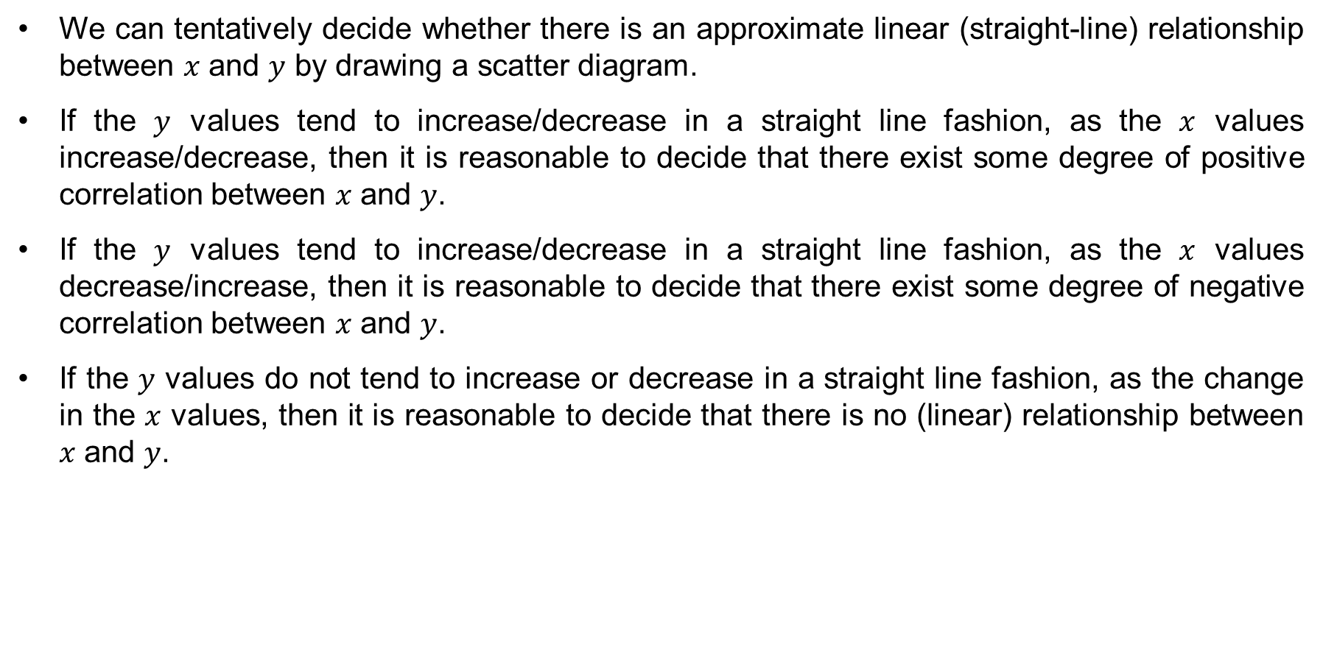
Scatter diagram
We can tentatively decide whether there is an approximate linear (straight-line) relationship between $x$ and $y$ by drawing a scatter diagram.
If the $y$ values tend to increase/decrease in a straight line fashion, as the $x$ values increase/decrease, then it is reasonable to decide that there exist some degree of positive correlation between $x$ and $y$.
If the $y$ values tend to increase/decrease in a straight line fashion, as the $x$ values decrease/increase, then it is reasonable to decide that there exist some degree of negative correlation between $x$ and $y$.
If the $y$ values do not tend to increase or decrease in a straight line fashion, as the change in the $x$ values, then it is reasonable to decide that there is no (linear) relationship between $x$ and $y$.

Slide 4
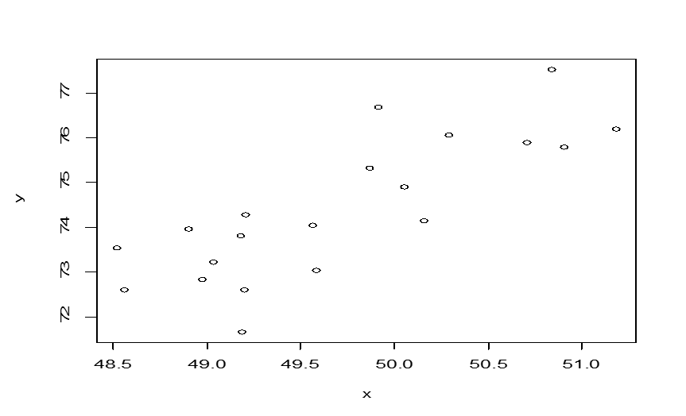

Scatter diagram: Visual representation of correlation
From the scatter diagram, we can observe that there exists a positive correlation between $x$ and $y.$

Slide 5
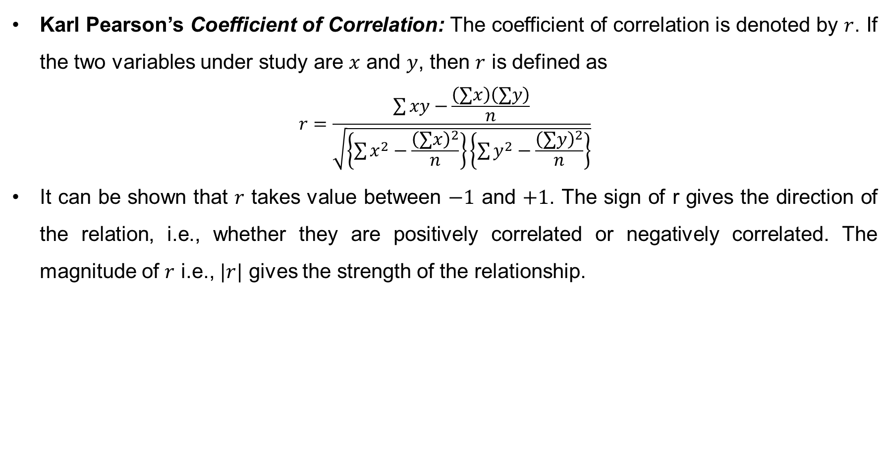
Coefficient of Correlation
Karl Pearson’s Coefficient of Correlation: The coefficient of correlation is denoted by $r$. If the two variables under study are $x$ and $y$, then $r$ is defined as
$$r=\frac{\sum{xy−}\frac{\left(∑x\right)\left(∑y\right)}{n}}{\sqrt{\left\{\sum{x^{2}−\frac{{\left(∑x\right)}^{2}}{n}}\right\}\left\{\sum{y^{2}−\frac{{\left(∑y\right)}^{2}}{n}}\right\}}}$$
It can be shown that $r$ takes value between $−1$ and $+1$. The sign of r gives the direction of the relation, i.e., whether they are positively correlated or negatively correlated. The magnitude of $r$ i.e., $|r|$ gives the strength of the relationship.

Slide 6
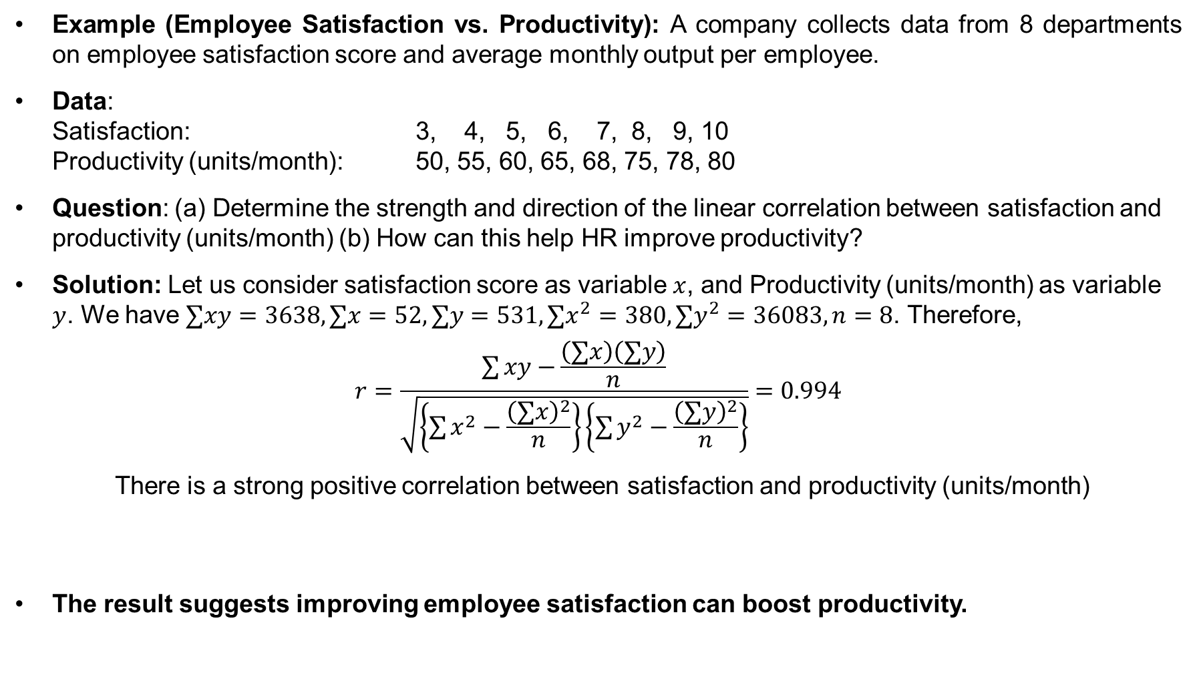
Coefficient of Correlation (cont…)
Example (Employee Satisfaction vs. Productivity): A company collects data from 8 departments on employee satisfaction score and average monthly output per employee.
Data: Satisfaction: 3, 4, 5, 6, 7, 8, 9, 10 Productivity (units/month): 50, 55, 60, 65, 68, 75, 78, 80
Question: (a) Determine the strength and direction of the linear correlation between satisfaction and productivity (units/month) (b) How can this help HR improve productivity?
Solution: Let us consider satisfaction score as variable $x$, and Productivity (units/month) as variable $y$. We have $∑xy=3638, ∑x=52, ∑y=531, ∑x^{2}=380, ∑y^{2}=36083, n=8$. Therefore,
$$r=\frac{\sum{xy−}\frac{\left(∑x\right)\left(∑y\right)}{n}}{\sqrt{\left\{\sum{x^{2}−\frac{{\left(∑x\right)}^{2}}{n}}\right\}\left\{\sum{y^{2}−\frac{{\left(∑y\right)}^{2}}{n}}\right\}}}=0.994$$
There is a strong positive correlation between satisfaction and productivity (units/month)
The result suggests improving employee satisfaction can boost productivity.

Slide 7
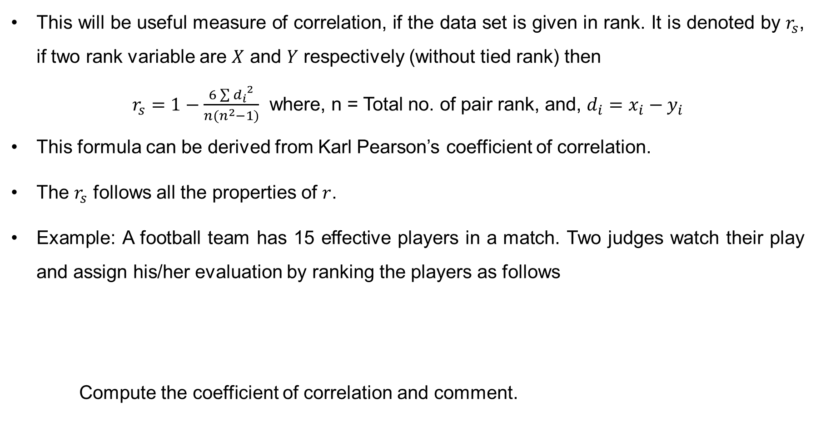
Spearman’s Rank Correlation Coefficient
This will be useful measure of correlation, if the data set is given in rank. It is denoted by $r_{s}$, if two rank variable are $X$ and $Y$ respectively (without tied rank) then
$r_{s}=1−\frac{6\sum{{d_{i}}^{2}}}{n(n^{2}−1)}$ where, n = Total no. of pair rank, and, $d_{i}=x_{i}−y_{i}$
This formula can be derived from Karl Pearson’s coefficient of correlation.
The $r_{s}$ follows all the properties of $r$.
Example: A football team has 15 effective players in a match. Two judges watch their play and assign his/her evaluation by ranking the players as follows
Compute the coefficient of correlation and comment.

Slide 8
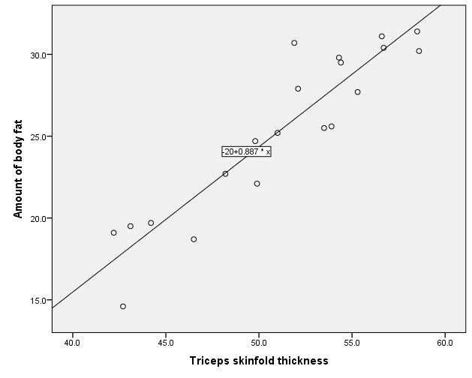
Regression Analysis
The regression analysis is a technique of studying the dependence of one variable (called dependent variable), on one or more variables (called explanatory variables), with a view to estimating or predicting the population mean or average value of the dependent variable in terms of the known or fixed values of the independent variables.
Simple Linear Regression: It includes only one independent variable. It is usually referred by drawing a particular straight line through a scatter plot.

Slide 9
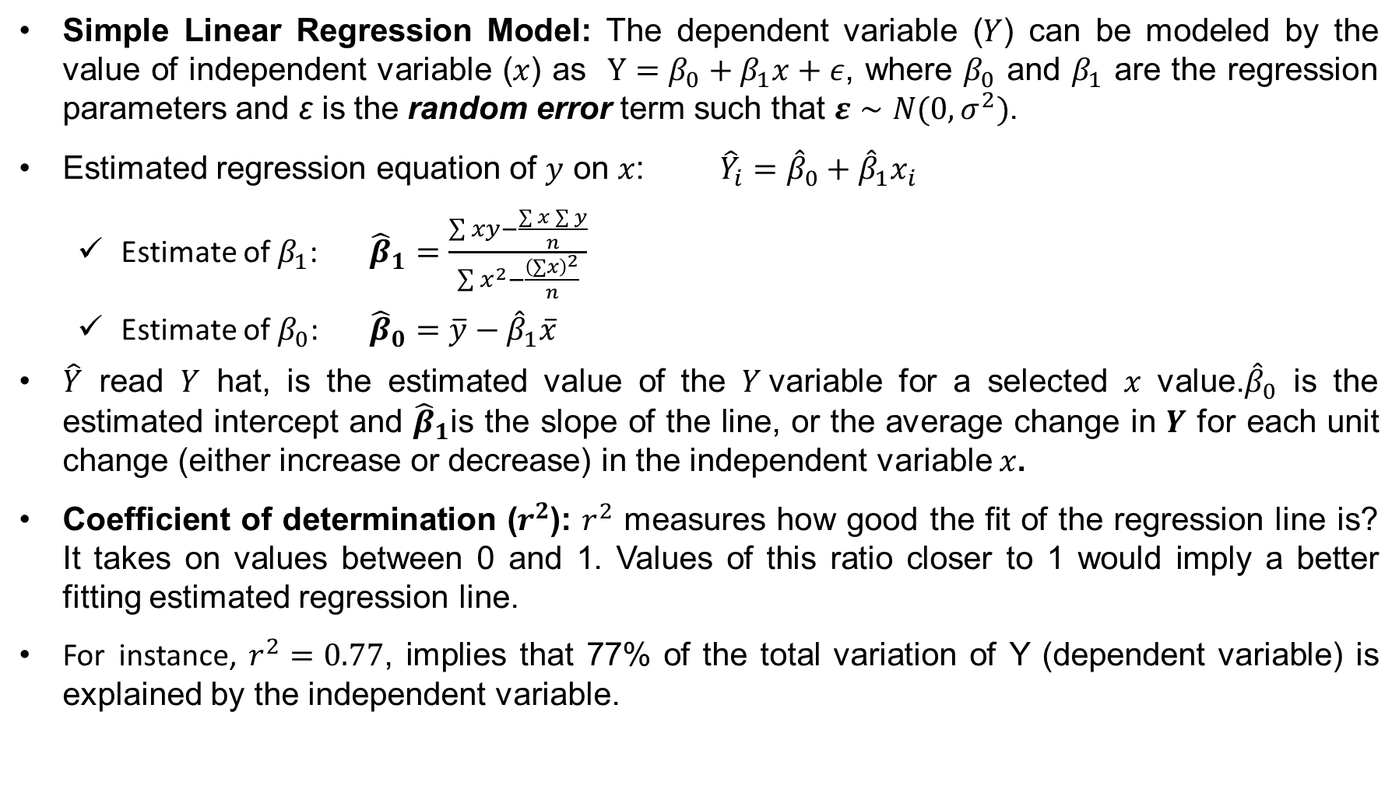
Simple Linear Regression Model
Simple Linear Regression Model: The dependent variable ($Y$) can be modeled by the value of independent variable ($x$) as $Y=β_{0}+β_{1}x+ε$, where $β_{0}$ and $β_{1}$ are the regression parameters and ε is the random error term such that $ε∼N(0,σ^{2})$.
Estimated regression equation of $y$ on $x$: ${\hat{Y}}_{i}={\hat{β}}_{0}+{\hat{β}}_{1}x_{i}$
Estimate of $β_{1}$: ${\hat{β}}_{1}=\frac{\sum{xy−\frac{\sum{x}\sum{y}}{n}}}{\sum{x^{2}}−\frac{{\left(∑x\right)}^{2}}{n}}$
Estimate of $β_{0}$: ${\hat{β}}_{0}=\overline{y}−{\hat{β}}_{1}\overline{x}$
$\hat{Y}$ read $Y$ hat, is the estimated value of the $Y$variable for a selected $x$ value.${\hat{β}}_{0}$ is the estimated intercept and ${\hat{β}}_{1}$is the slope of the line, or the average change in $Y$ for each unit change (either increase or decrease) in the independent variable $x$.
Coefficient of determination ($r^{2}$): $r^{2}$ measures how good the fit of the regression line is? It takes on values between 0 and 1. Values of this ratio closer to 1 would imply a better fitting estimated regression line.
For instance, $r^{2}=0.77$, implies that 77% of the total variation of Y (dependent variable) is explained by the independent variable.

Slide 10
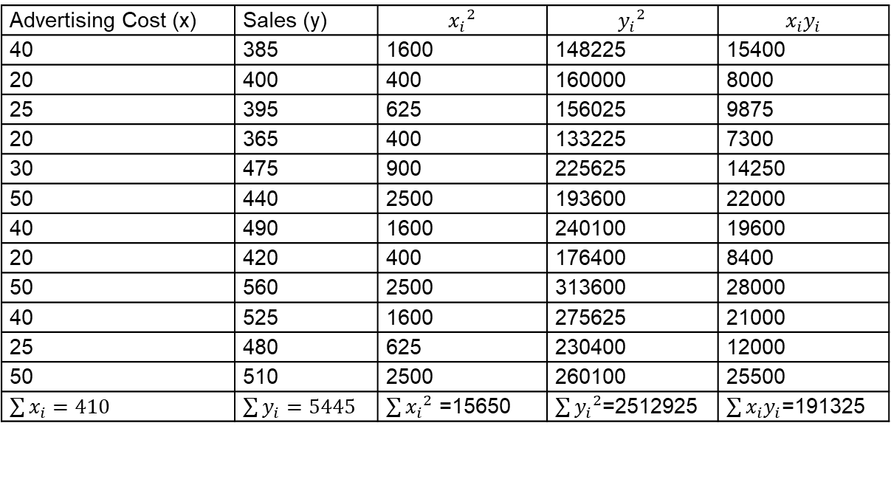

Simple Linear Regression (cont…)
Example: A study was made by a retail merchant to determine the relation between weekly advertising expenditures and sales. The following data were recorded from a sample:
Find which one is the dependent variable and which is the independent variable.
Estimate the regression equation and interpret the parameters.
What is the expected sale in a week with advertising cost $45?
Let us consider advertising cost as variable $x$, and sales as variable $y$.
Advertising Cost ($) | 40 | 20 | 25 | 20 | 30 | 50 | 40 | 20 | 50 | 40 | 25 | 50
Sales ($) | 385 | 400 | 395 | 365 | 475 | 440 | 490 | 420 | 560 | 525 | 480 | 510
Advertising Cost (x) | Sales (y) | $${x_{i}}^{2}$$ | $${y_{i}}^{2}$$ | $$x_{i}y_{i}$$
40 | 385 | 1600 | 148225 | 15400
20 | 400 | 400 | 160000 | 8000
25 | 395 | 625 | 156025 | 9875
20 | 365 | 400 | 133225 | 7300
30 | 475 | 900 | 225625 | 14250
50 | 440 | 2500 | 193600 | 22000
40 | 490 | 1600 | 240100 | 19600
20 | 420 | 400 | 176400 | 8400
50 | 560 | 2500 | 313600 | 28000
40 | 525 | 1600 | 275625 | 21000
25 | 480 | 625 | 230400 | 12000
50 | 510 | 2500 | 260100 | 25500
$\sum{x_{i}}=410$ | $\sum{y_{i}}=5445$ | $\sum{{x_{i}}^{2}}$ =15650 | $\sum{{y_{i}}^{2}}$=2512925 | $\sum{x_{i}y_{i}}$=191325

Slide 11
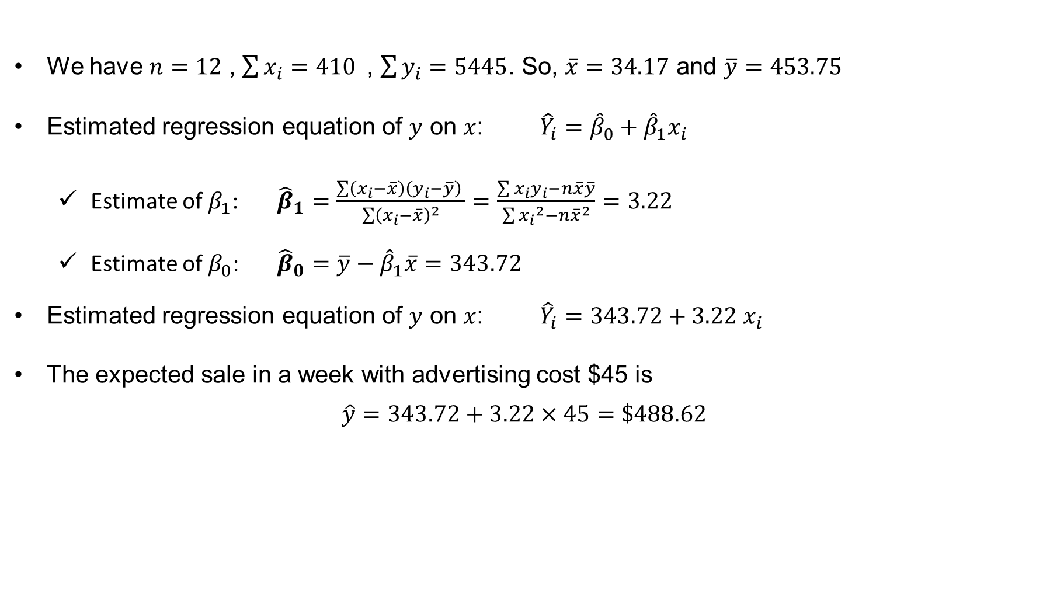
Simple Linear Regression (cont…)
We have $n=12$ , $\sum{x_{i}}=410$, $\sum{y_{i}}=5445$. So, $\overline{x}=34.17$ and $\overline{y}=453.75$
Estimated regression equation of $y$ on $x$: ${\hat{Y}}_{i}={\hat{β}}_{0}+{\hat{β}}_{1}x_{i}$
Estimate of $β_{1}$: ${\hat{β}}_{1}=\frac{\sum{\left(x_{i}−\overline{x}\right)}\left(y_{i}−\overline{y}\right) }{\sum{{\left(x_{i}−\overline{x}\right)}^{2}}}=\frac{\sum{x_{i}y_{i}−n\overline{x}\overline{y}}}{\sum{{x_{i}}^{2}−n{\overline{x}}^{2}}}=3.22$
Estimate of $β_{0}$: ${\hat{β}}_{0}=\overline{y}−{\hat{β}}_{1}\overline{x}=343.72$
Estimated regression equation of $y$ on $x$: ${\hat{Y}}_{i}=343.72+3.22 x_{i}$
The expected sale in a week with advertising cost $45 is
$$\hat{y}=343.72+3.22×45=\$488.62$$

Slide 12
Exercise
Problem-1: A company wants to analyze the relationship between Advertising Spend ($1,000s) and Sales Revenue ($1,000s) to determine whether increasing the budget for advertising leads to increased sales.
Month | Advertising Spend (X) | Sales Revenue (Y)
1 | 2.0 | 25.0
2 | 2.5 | 27.5
3 | 3.0 | 31.0
4 | 3.5 | 34.0
5 | 4.0 | 36.5
6 | 4.5 | 39.5
7 | 5.0 | 41.0
8 | 5.5 | 44.0
9 | 6.0 | 46.5
10 | 6.5 | 49.0
11 | 7.0 | 51.0
12 | 7.5 | 54.5

Slide 13

Exercise
Problem-1 (Continued):
a) Draw a scatter diagram. What does it suggest?
b) Find the correlation coefficient.
c) Fit a simple linear regression model: $Y=β_{0}+β_{1}x+ε$.
d) How much sales revenue increases for each additional $1,000 spent on advertising.
e) Estimate sales for a given ad budget (e.g., $6,500).
f) How much of the variability in sales revenue is explained by ad spending?

