Slide 1
COURSE TITLE: : Statistics and Probability COURSE CODE: STA 102 Topics: Probability: Basic Concept, Independence, Bayes’ Theorem
Instructor: Md. Ershadul Haque, PhD
Professor, Department of Statistics, DU
&
Adjunct Faculty, EWU, Bangladesh

Slide 2
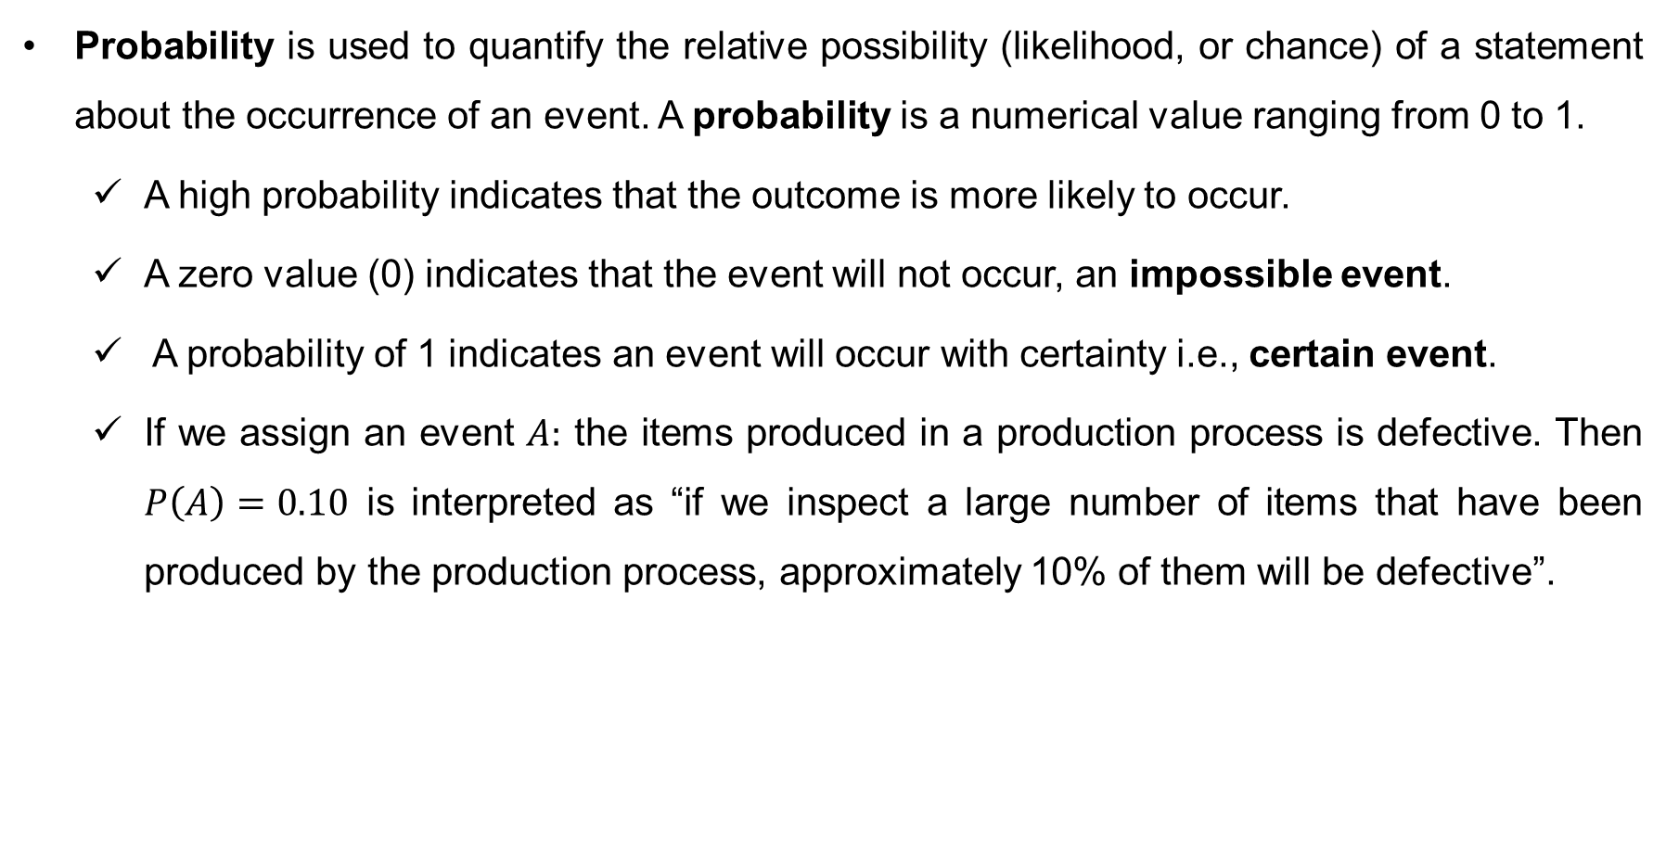
Probability
Probability is used to quantify the relative possibility (likelihood, or chance) of a statement about the occurrence of an event. A probability is a numerical value ranging from 0 to 1.
A high probability indicates that the outcome is more likely to occur.
A zero value (0) indicates that the event will not occur, an impossible event.
A probability of 1 indicates an event will occur with certainty i.e., certain event.
If we assign an event $A:$ the items produced in a production process is defective. Then $P\left(A\right)=0.10$ is interpreted as “if we inspect a large number of items that have been produced by the production process, approximately 10% of them will be defective”.

Slide 3
Terminologies in Probability
Random Experiment: The process that can results in different outcomes, even though it is repeated in the same manner every time. The following are some examples of random experiment:
flipping a coin
rolling a die
counting the number of accidents per day in a highway
counting the number of defective items in the lot containing 50 items
measuring the waiting time of customers wait in a queue of ATM booth

Slide 4
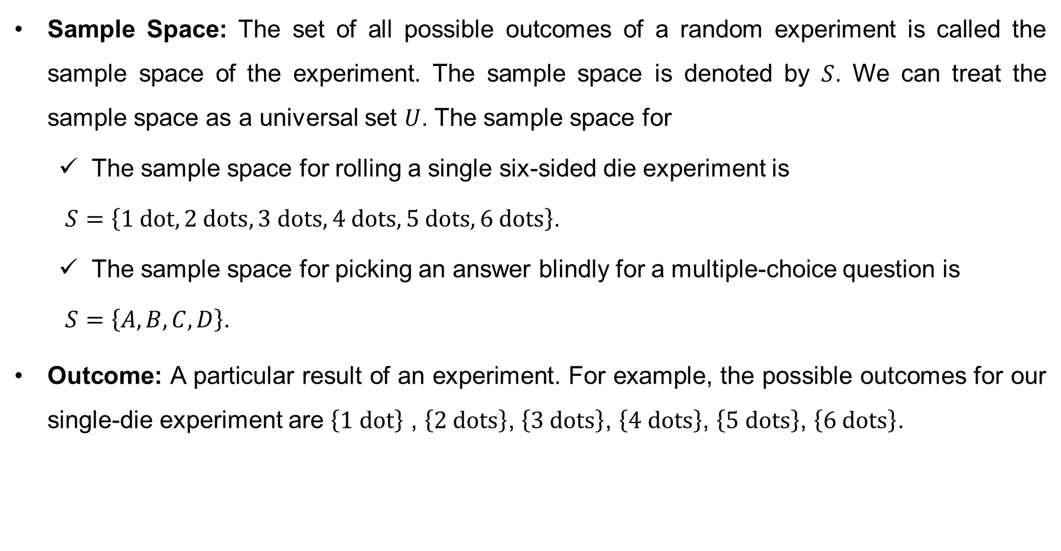
Terminologies in Probability (cont…)
Sample Space: The set of all possible outcomes of a random experiment is called the sample space of the experiment. The sample space is denoted by $S$. We can treat the sample space as a universal set $U$. The sample space for
The sample space for rolling a single six-sided die experiment is
$S=\left\{1 dot, 2 dots, 3 dots, 4 dots, 5 dots, 6 dots\right\}$.
The sample space for picking an answer blindly for a multiple-choice question is
$S=\left\{A, B, C, D\right\}$.
Outcome: A particular result of an experiment. For example, the possible outcomes for our single-die experiment are $\left\{1 dot\right\}$ , $\left\{2 dots\right\}$, $\left\{3 dots\right\}$, $\left\{4 dots\right\}$, $\left\{5 dots\right\}$, $\left\{6 dots\right\}$.

Slide 5
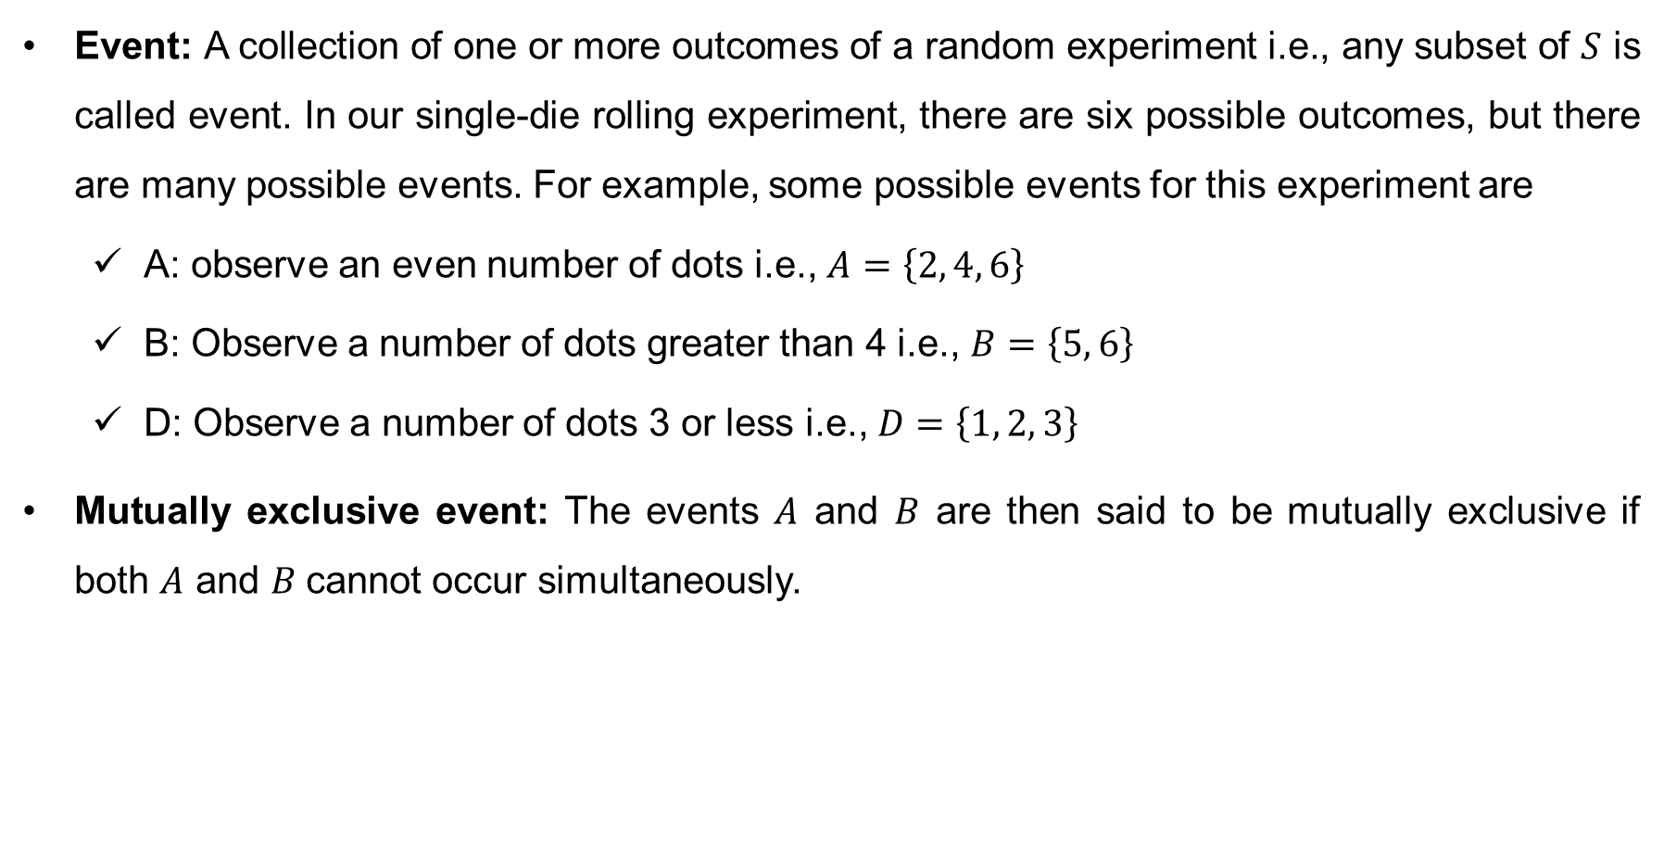
Terminologies in Probability (cont…)
Event: A collection of one or more outcomes of a random experiment i.e., any subset of $S$ is called event. In our single-die rolling experiment, there are six possible outcomes, but there are many possible events. For example, some possible events for this experiment are
A: observe an even number of dots i.e., $A=\left\{2, 4, 6\right\}$
B: Observe a number of dots greater than 4 i.e., $B=\left\{5, 6\right\}$
D: Observe a number of dots 3 or less i.e., $D=\left\{1, 2, 3\right\}$
Mutually exclusive event: The events $A$ and $B$ are then said to be mutually exclusive if both $A$ and $B$cannot occur simultaneously.

Slide 6
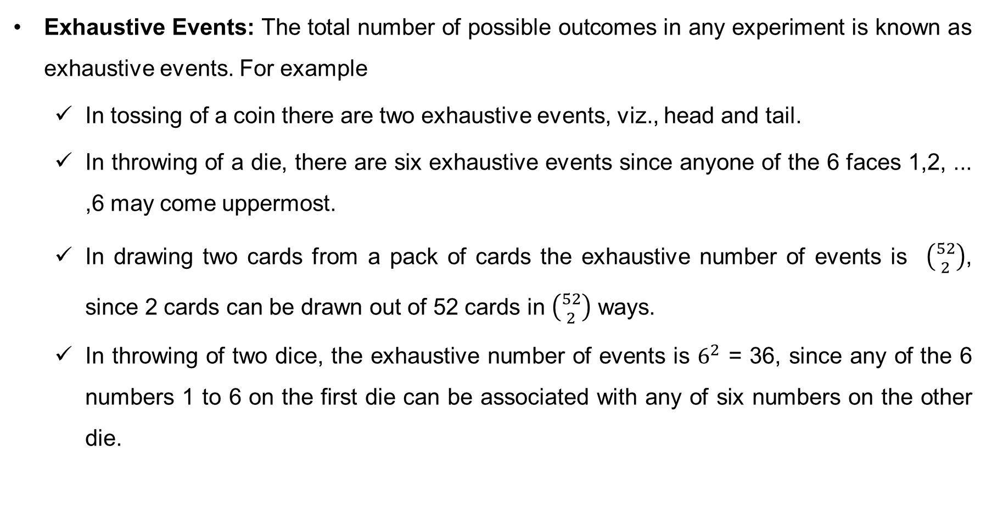
Terminologies in Probability (cont…)
Exhaustive Events: The total number of possible outcomes in any experiment is known as exhaustive events. For example
In tossing of a coin there are two exhaustive events, viz., head and tail.
In throwing of a die, there are six exhaustive events since anyone of the 6 faces 1,2, ... ,6 may come uppermost.
In drawing two cards from a pack of cards the exhaustive number of events is $\left({52 \atop 2}\right)$, since 2 cards can be drawn out of 52 cards in $\left({52 \atop 2}\right)$ ways.
In throwing of two dice, the exhaustive number of events is $6^{2}$ = 36, since any of the 6 numbers 1 to 6 on the first die can be associated with any of six numbers on the other die.

Slide 7
Terminologies in Probability (cont…)
Favorable Events: The favorable event in an experiment is the outcomes which involve the happening of the event. For example
In drawing a card from a pack of cards the number of outcomes favorable to drawing of an ace is 4, for drawing a spade is 13 and for drawing a red card is 26
In throwing of two dice, the number of outcomes favorable to getting the sum 5 is : (1,4) (4,1) (2,3) (3,2), i.e., 4.
Equally likely events: Outcomes of a trial are set to be equally likely if taking into consideration all the relevant evidences, there is no reason to expect one in preference to the others. For example
In tossing an unbiased or uniform coin, head or tail ate equally likely events
In throwing an unbiased die, all the six faces are equally likely to come.

Slide 8
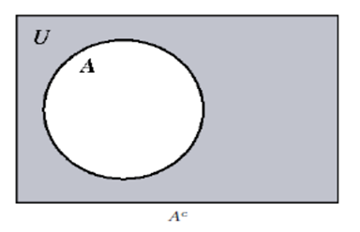
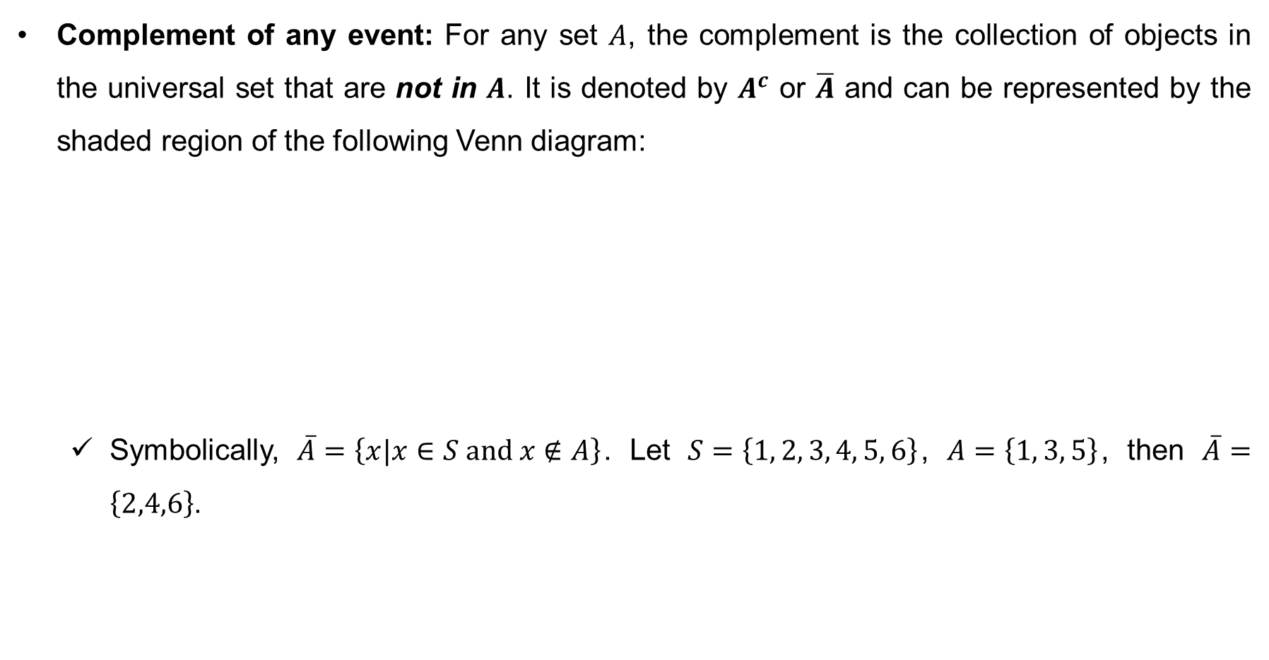
Some basic event operations
Complement of any event: For any set $A$, the complement is the collection of objects in the universal set that are not in $A$. It is denoted by $A^{c}$ or $\overline{A}$ and can be represented by the shaded region of the following Venn diagram:
Symbolically, $\overline{A}=\left\{x|x∈S and x∉A\right\}$. Let $S=\left\{1, 2, 3, 4, 5, 6\right\}$, $A=\left\{1, 3, 5\right\}$, then $\overline{A}=\left\{2,4,6\right\}$.

Slide 9

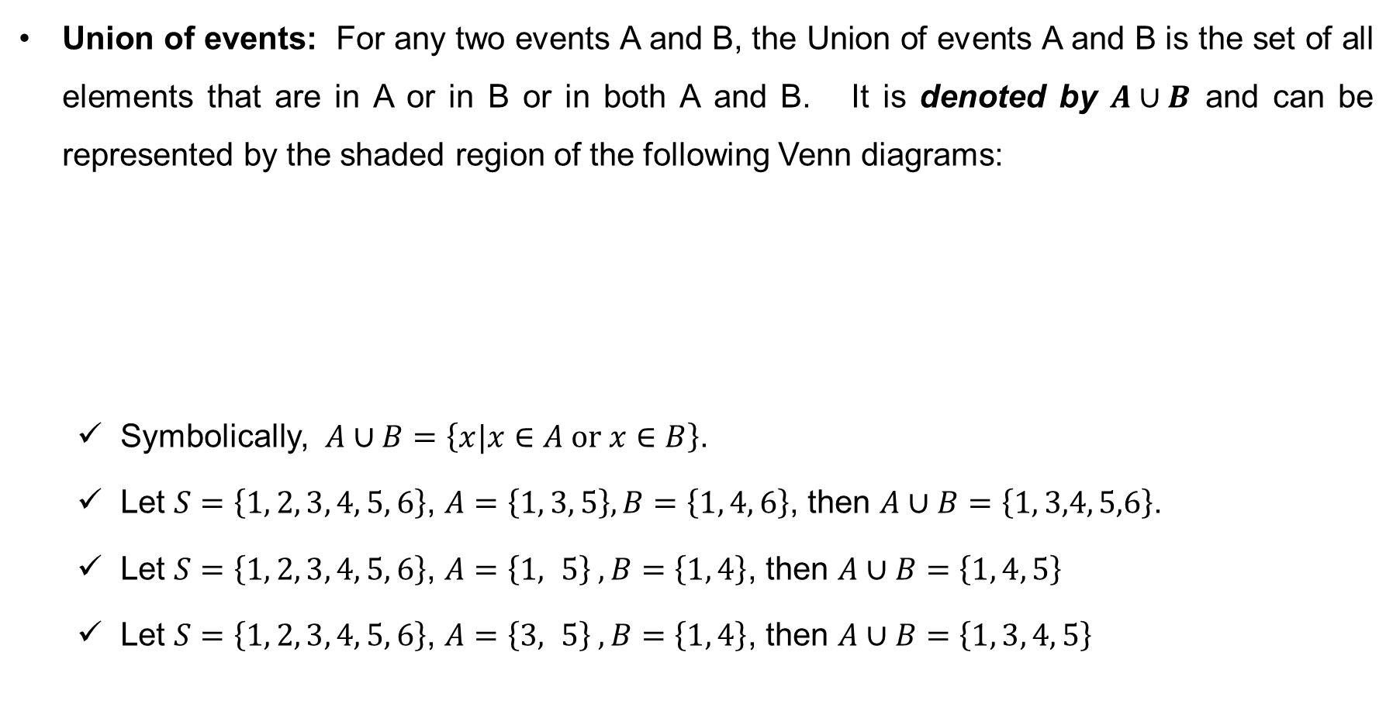
Some basic event operations (cont…)
Union of events: For any two events A and B, the Union of events A and B is the set of all elements that are in A or in B or in both A and B. It is denoted by $A∪B$ and can be represented by the shaded region of the following Venn diagrams:
Symbolically, $A∪B=\left\{x|x∈A or x∈B\right\}$.
Let $S=\left\{1, 2, 3, 4, 5, 6\right\}$, $A=\left\{1, 3, 5\right\}, B=\left\{1, 4, 6\right\}$, then $A∪B=\left\{1, 3,4, 5,6\right\}$.
Let $S=\left\{1, 2, 3, 4, 5, 6\right\}$, $A=\left\{1, 5\right\} , B=\left\{1, 4\right\}$, then $A∪B=\left\{1, 4, 5\right\}$
Let $S=\left\{1, 2, 3, 4, 5, 6\right\}$, $A=\left\{3, 5\right\} , B=\left\{1, 4\right\}$, then $A∪B=\left\{1, 3, 4, 5\right\}$

Slide 10
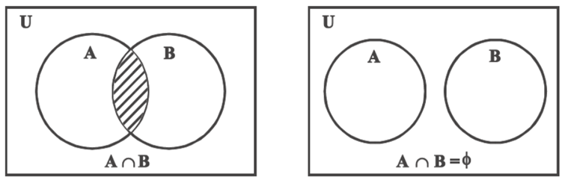
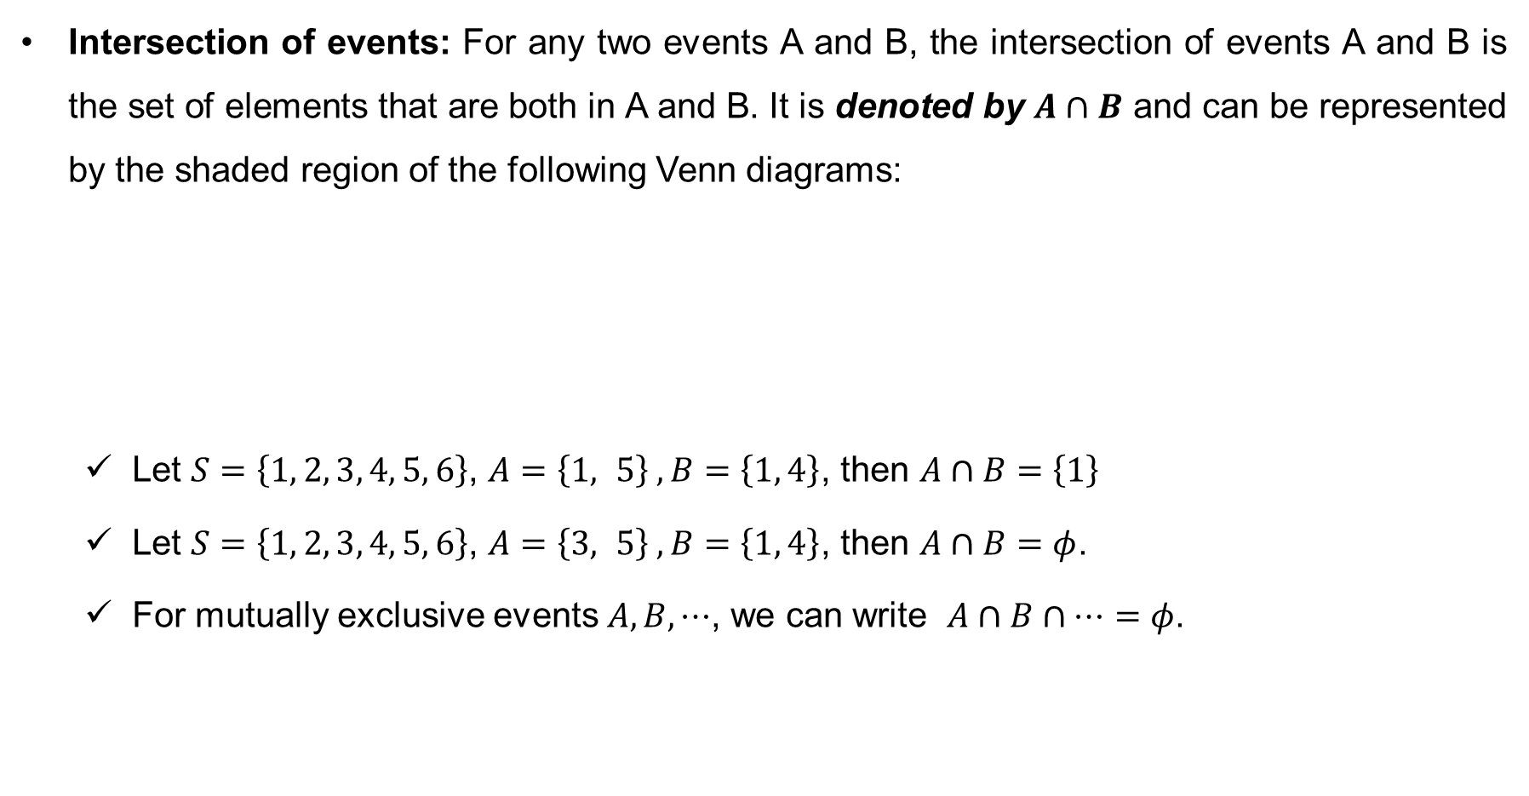
Some basic event operations (cont…)
Intersection of events: For any two events A and B, the intersection of events A and B is the set of elements that are both in A and B. It is denoted by $A∩B$ and can be represented by the shaded region of the following Venn diagrams:
Let $S=\left\{1, 2, 3, 4, 5, 6\right\}$, $A=\left\{1, 5\right\} , B=\left\{1, 4\right\}$, then $A∩B=\left\{1\right\}$
Let $S=\left\{1, 2, 3, 4, 5, 6\right\}$, $A=\left\{3, 5\right\} , B=\left\{1, 4\right\}$, then $A∩B=φ$.
For mutually exclusive events $A, B,⋯$, we can write $A∩B∩⋯=φ$.

Slide 11
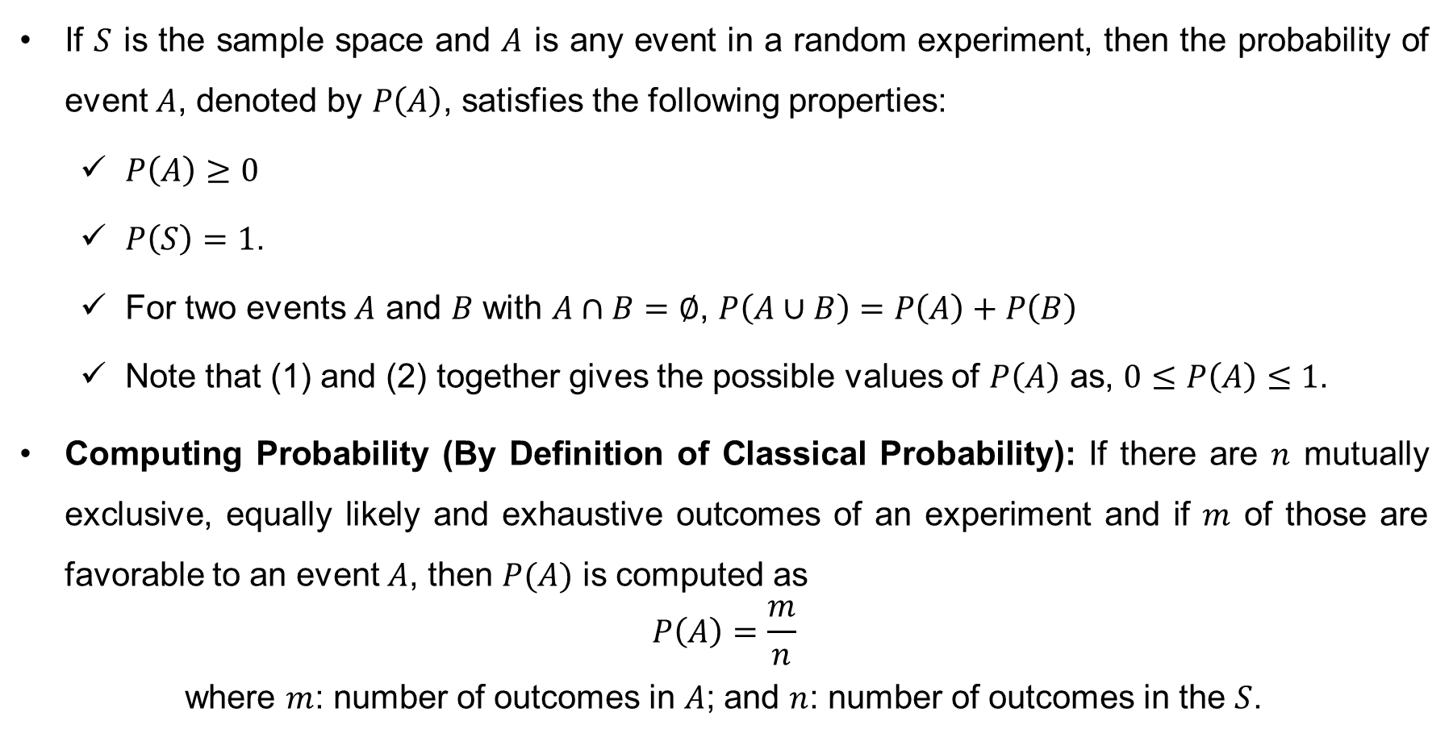
Axioms of Probability
If $S$ is the sample space and $A$ is any event in a random experiment, then the probability of event $A$, denoted by $P\left(A\right)$, satisfies the following properties:
$P\left(A\right)≥0$
$P\left(S\right)=1$.
For two events $A$ and $B$ with $A∩B=∅$, $P\left(A∪B\right)=P\left(A\right)+P\left(B\right)$
Note that (1) and (2) together gives the possible values of $P\left(A\right)$ as, $0≤P\left(A\right)≤1$.
Computing Probability (By Definition of Classical Probability): If there are $n$ mutually exclusive, equally likely and exhaustive outcomes of an experiment and if $m$ of those are favorable to an event $A$, then $P(A)$ is computed as
$$P\left(A\right)=\frac{m}{n}$$
where $m$: number of outcomes in $A$; and $n$: number of outcomes in the $S$.

Slide 12
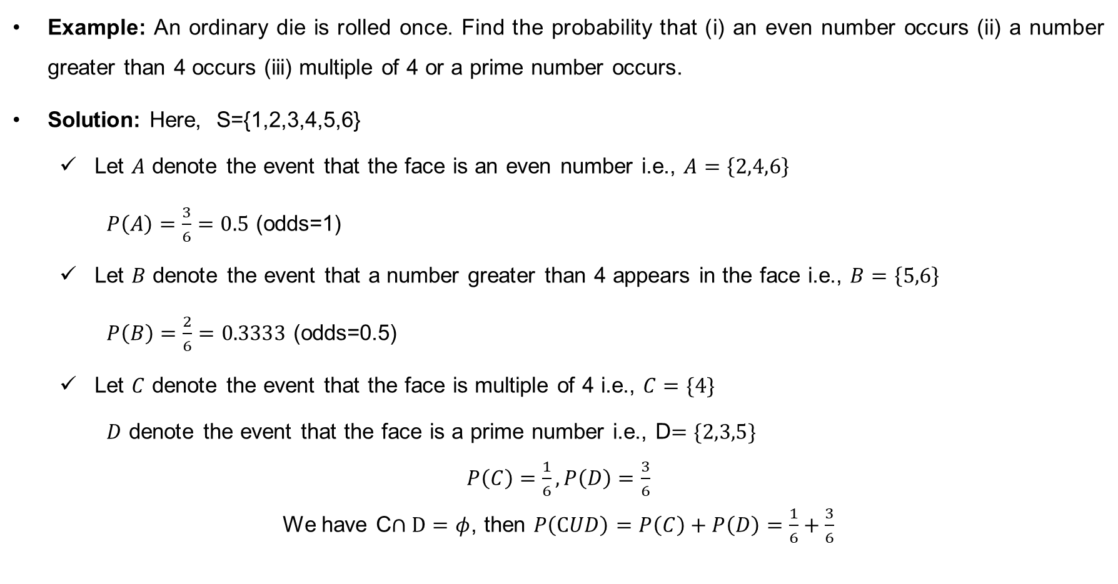
Classical probability (cont…)
Example: An ordinary die is rolled once. Find the probability that (i) an even number occurs (ii) a number greater than 4 occurs (iii) multiple of 4 or a prime number occurs.
Solution: Here, S={1,2,3,4,5,6}
Let $A$ denote the event that the face is an even number i.e., $A=\left\{2,4,6\right\}$
$P\left(A\right)=\frac{3}{6}=0.5$ (odds=1)
Let $B$ denote the event that a number greater than 4 appears in the face i.e., $B=\left\{5,6\right\}$
$P\left(B\right)=\frac{2}{6}=0.3333$ (odds=0.5)
Let $C$ denote the event that the face is multiple of 4 i.e., $C=\{4\}$
$D$ denote the event that the face is a prime number i.e., D$=\{2,3,5\}$
$P\left(C\right)=\frac{1}{6}, P\left(D\right)=\frac{3}{6}$
We have C$∩D=φ$, then $P\left(CUD\right)=P\left(C\right)+P\left(D\right)=\frac{1}{6}+\frac{3}{6}$

Slide 13
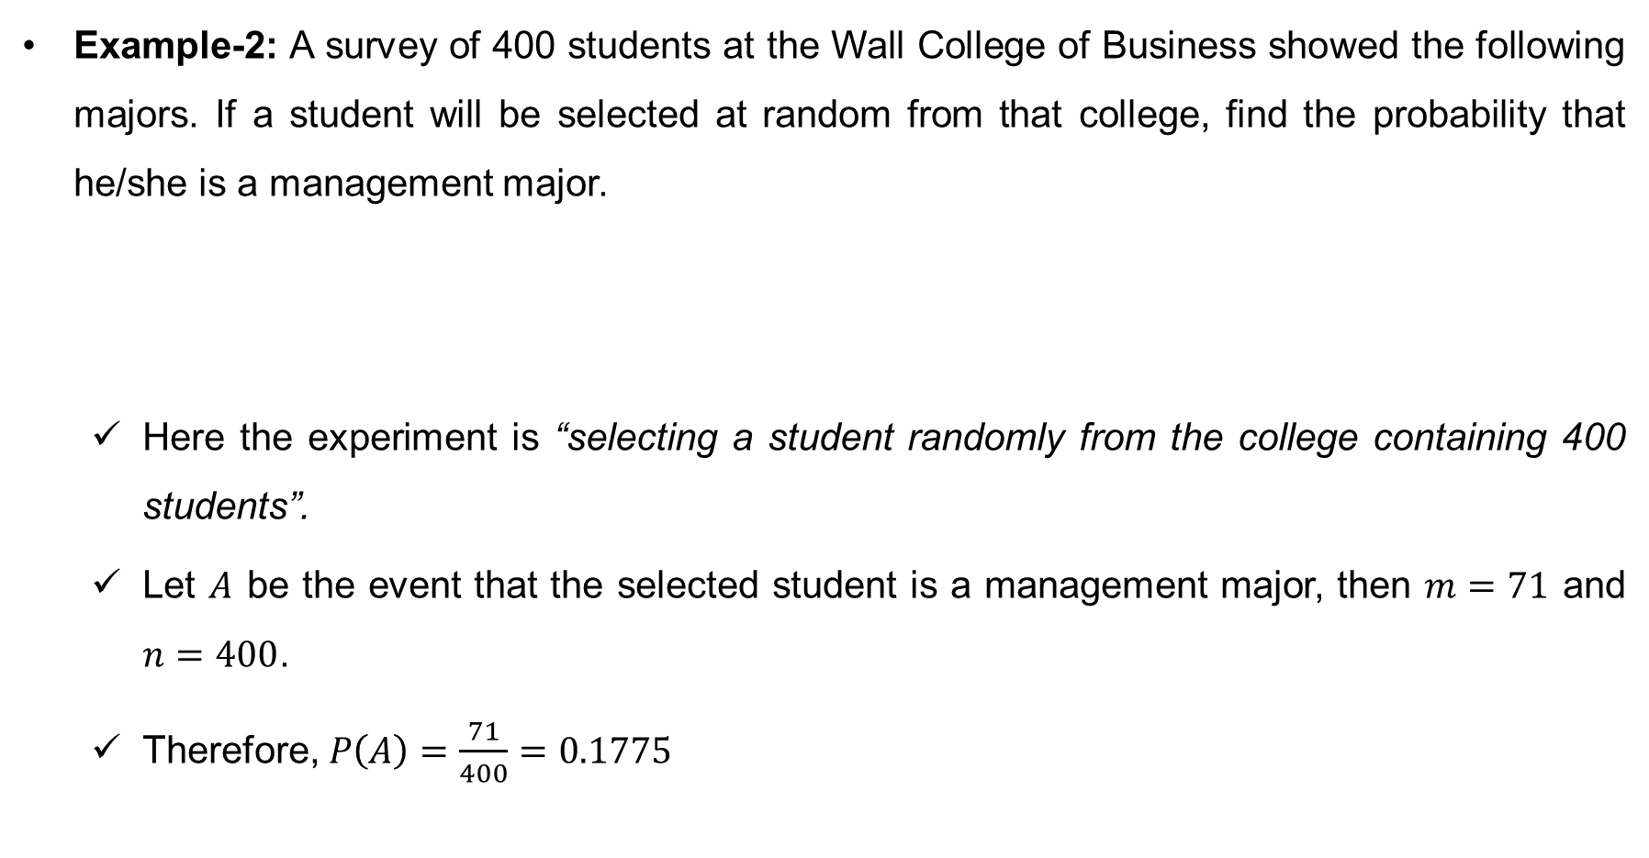
Classical probability (cont…)
Example-2: A survey of 400 students at the Wall College of Business showed the following majors. If a student will be selected at random from that college, find the probability that he/she is a management major.
Here the experiment is “selecting a student randomly from the college containing 400 students”.
Let $A$ be the event that the selected student is a management major, then $m=71$ and $n=400$.
Therefore, $P\left(A\right)=\frac{71}{400}=0.1775$
Accounting | 118
Finance | 59
Info. Systems | 75
Management | 71
Marketing | 117

Slide 14

Properties of probability
Theorem: Probability has the following properties, for any events $A$ and $B$.
$P\left(A^{c}\right)=1−P\left(A\right)$
If $A⊆B$, then $P\left(A\right)≤P(B)$.
$P\left(A∪B\right)=P(A)+P\left(B\right)−P(A∩B)$, where the term $P(A∩B)$ is the probability of the joint event $A$ and $B$ or simply the joint probability.

Slide 15
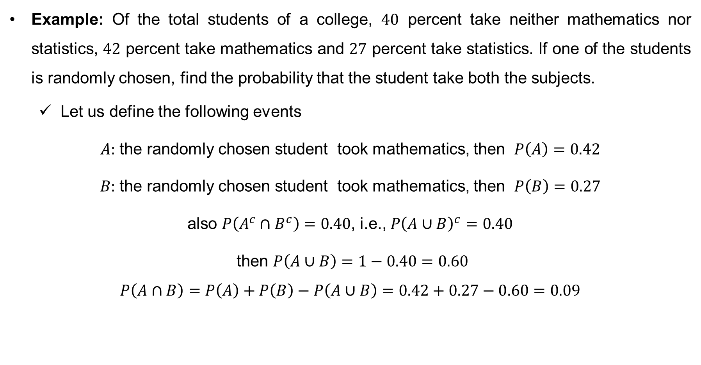
Properties of probability (cont…)
Example: Of the total students of a college, $40$ percent take neither mathematics nor statistics, $42$ percent take mathematics and $27$ percent take statistics. If one of the students is randomly chosen, find the probability that the student take both the subjects.
Let us define the following events
$A:$ the randomly chosen student took mathematics, then $P\left(A\right)=0.42$
$B:$ the randomly chosen student took mathematics, then $P\left(B\right)=0.27$
also $P\left(A^{c}∩B^{c}\right)=0.40$, i.e., $P{\left(A∪B\right)}^{c}=0.40$
then $P\left(A∪B\right)=1−0.40=0.60$
$$P\left(A∩B\right)=P\left(A\right)+P\left(B\right)−P\left(A∪B\right)=0.42+0.27−0.60=0.09$$

Slide 16
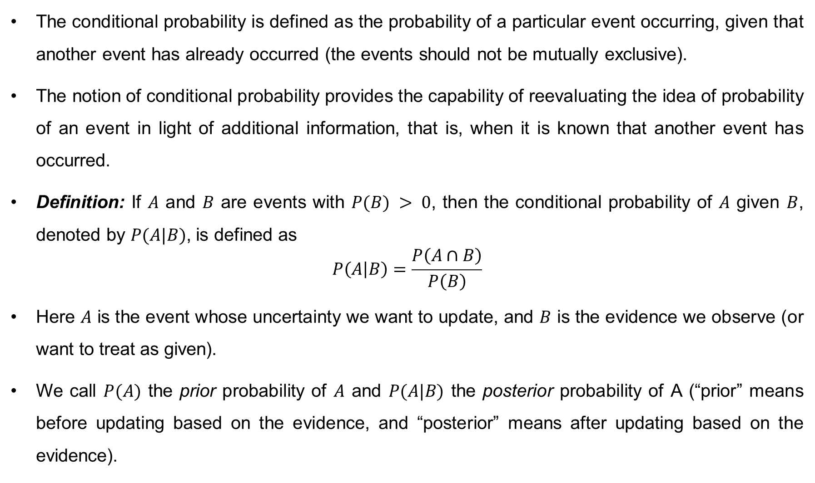
Conditional Probability
The conditional probability is defined as the probability of a particular event occurring, given that another event has already occurred (the events should not be mutually exclusive).
The notion of conditional probability provides the capability of reevaluating the idea of probability of an event in light of additional information, that is, when it is known that another event has occurred.
Definition: If $A$ and $B$ are events with $P(B) > 0$, then the conditional probability of $A$ given $B$, denoted by $P(A|B)$, is defined as
$$P\left(A | B\right)=\frac{P\left(A∩B\right)}{P\left(B\right)}$$
Here $A$ is the event whose uncertainty we want to update, and $B$ is the evidence we observe (or want to treat as given).
We call $P(A)$ the prior probability of $A$ and $P(A|B)$ the posterior probability of A (“prior” means before updating based on the evidence, and “posterior” means after updating based on the evidence).

Slide 17
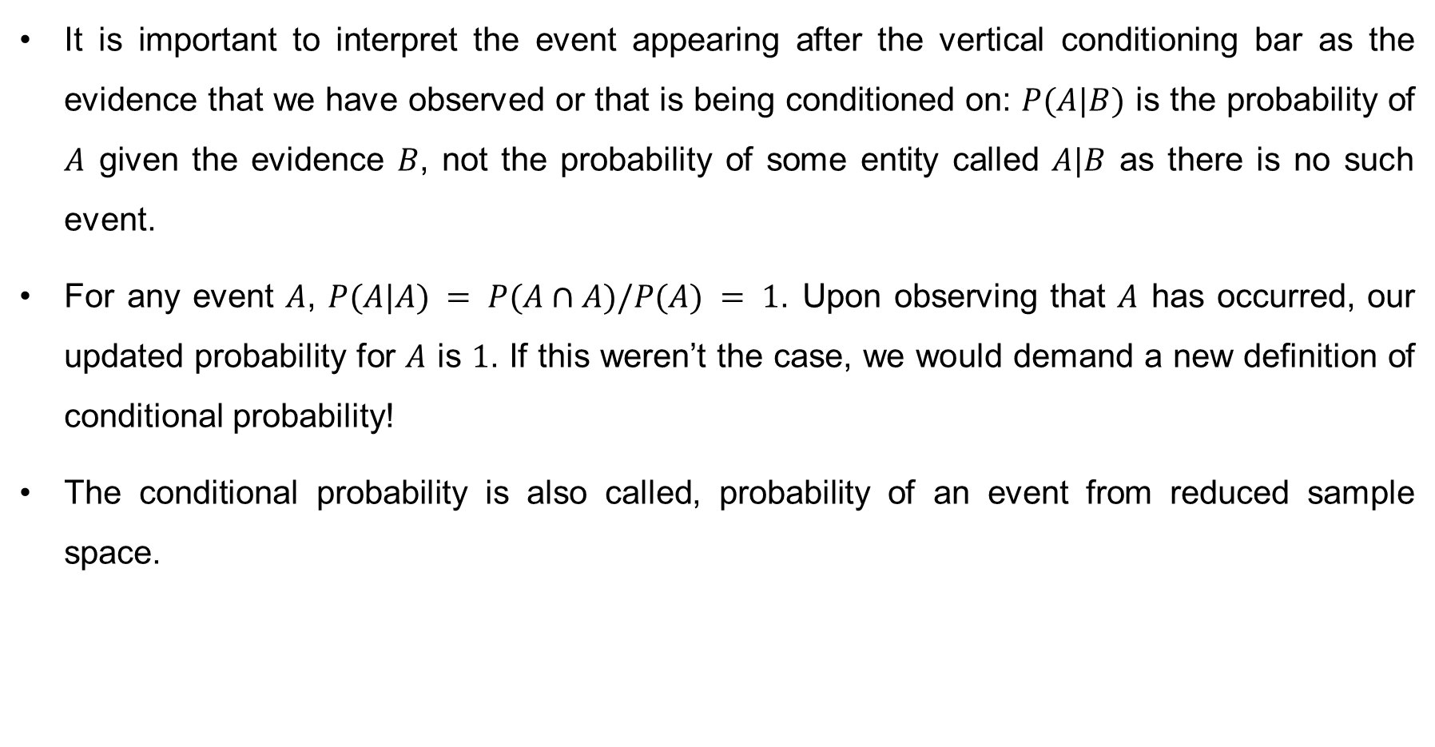
Conditional Probability (cont…)
It is important to interpret the event appearing after the vertical conditioning bar as the evidence that we have observed or that is being conditioned on: $P(A|B)$ is the probability of $A$ given the evidence $B$, not the probability of some entity called $A|B$ as there is no such event.
For any event $A$, $P(A|A) = P(A∩A)/P(A) = 1$. Upon observing that $A$ has occurred, our updated probability for $A$ is $1$. If this weren’t the case, we would demand a new definition of conditional probability!
The conditional probability is also called, probability of an event from reduced sample space.

Slide 18
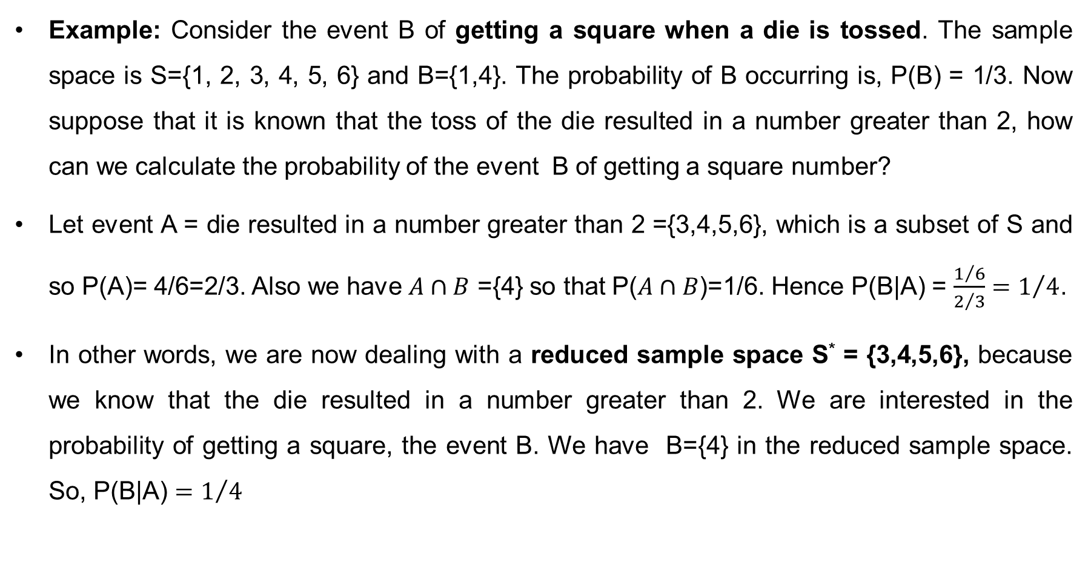
Conditional Probability (cont…)
Example: Consider the event B of getting a square when a die is tossed. The sample space is S={1, 2, 3, 4, 5, 6} and B={1,4}. The probability of B occurring is, P(B) = 1/3. Now suppose that it is known that the toss of the die resulted in a number greater than 2, how can we calculate the probability of the event B of getting a square number?
Let event A = die resulted in a number greater than 2 ={3,4,5,6}, which is a subset of S and so P(A)= 4/6=2/3. Also we have $A∩B$ ={4} so that P($A∩B$)=1/6. Hence P(B|A) = $\frac{1/6}{2/3}=1/4$.
In other words, we are now dealing with a reduced sample space S* = {3,4,5,6}, because we know that the die resulted in a number greater than 2. We are interested in the probability of getting a square, the event B. We have B={4} in the reduced sample space. So, P(B|A) $=1/4$

Slide 19
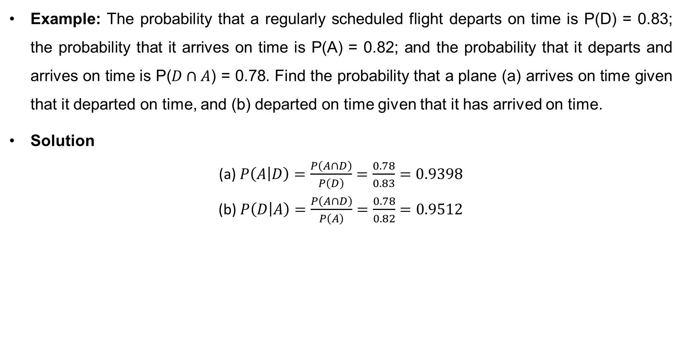
Conditional Probability (cont…)
Example: The probability that a regularly scheduled flight departs on time is P(D) = 0.83; the probability that it arrives on time is P(A) = 0.82; and the probability that it departs and arrives on time is P($D∩A$) = 0.78. Find the probability that a plane (a) arrives on time given that it departed on time, and (b) departed on time given that it has arrived on time.
Solution
(a) $P\left(A | D\right)=\frac{P\left(A∩D\right)}{P\left(D\right)}=\frac{0.78}{0.83}=0.9398$
(b) $P\left(D | A\right)=\frac{P\left(A∩D\right)}{P\left(A\right)}=\frac{0.78}{0.82}=0.9512$

Slide 20
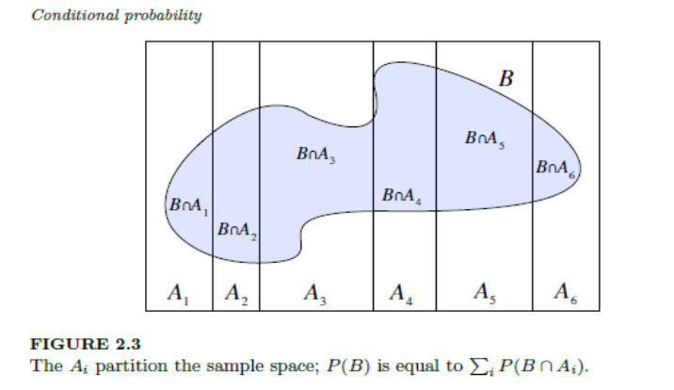
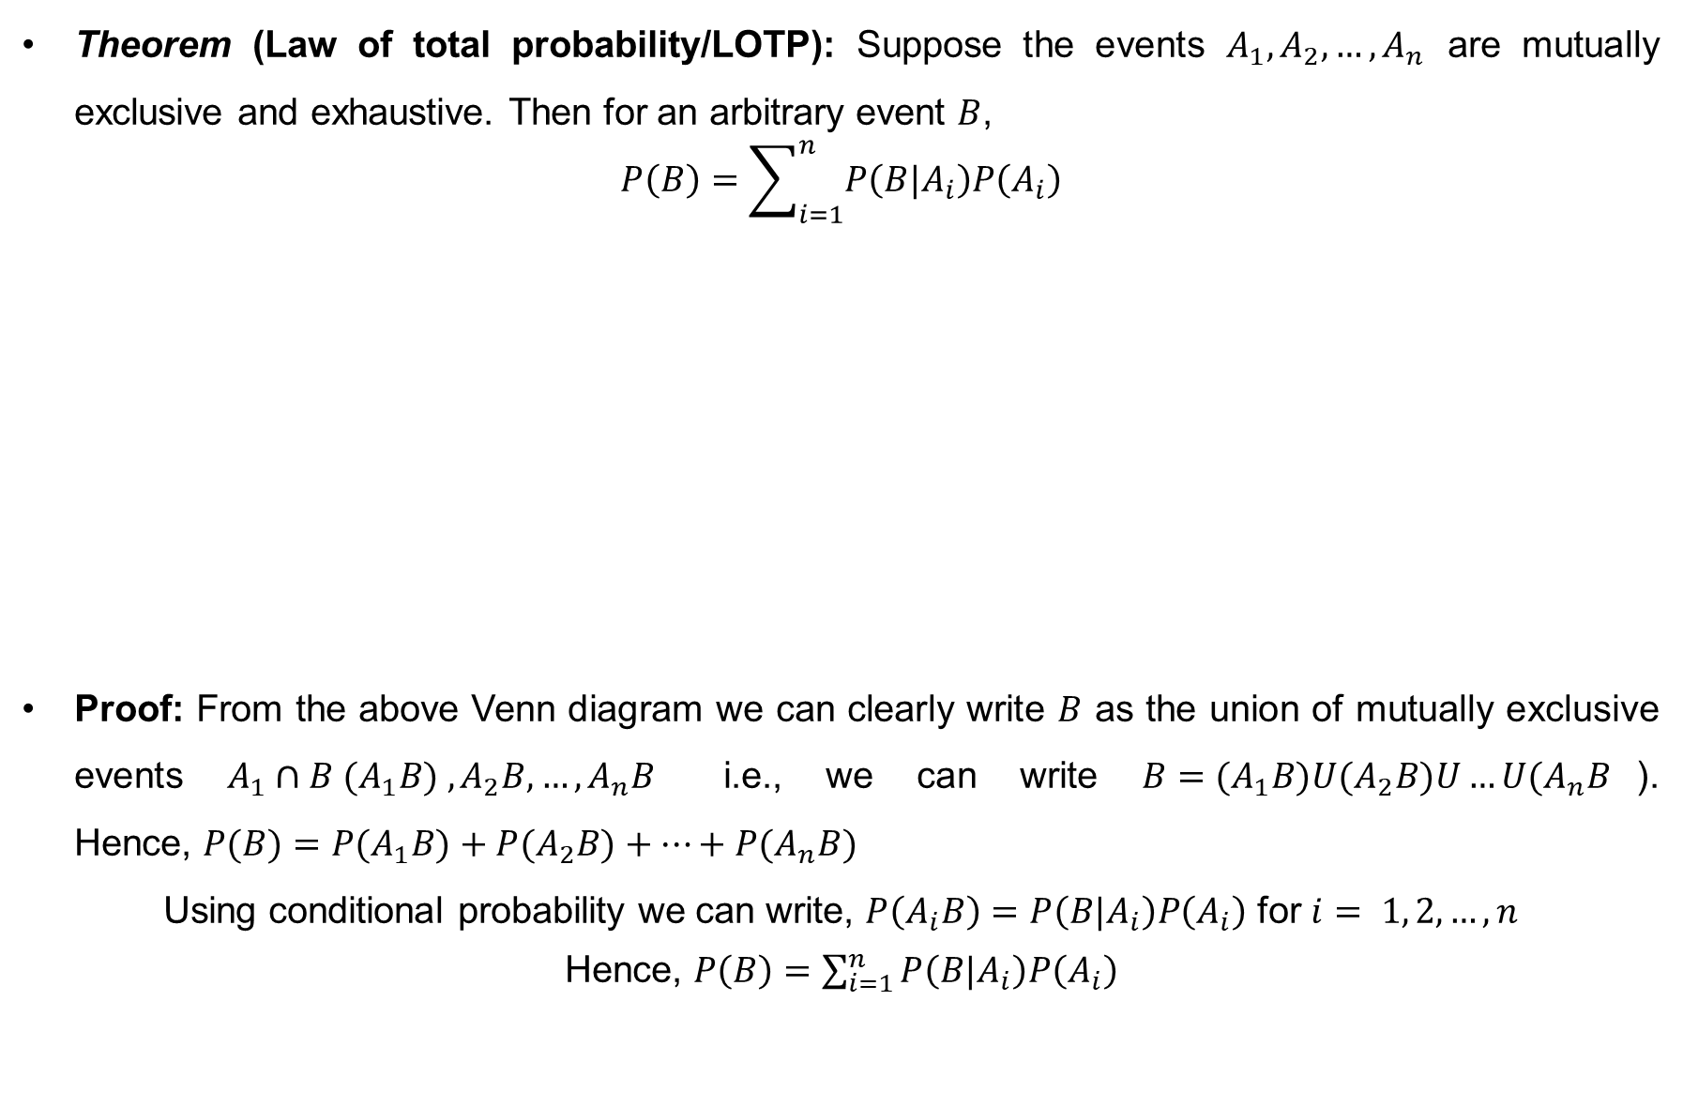
Law of total probability
Theorem (Law of total probability/LOTP): Suppose the events $A_{1}, A_{2},…, A_{n}$ are mutually exclusive and exhaustive. Then for an arbitrary event $B$,
$$P\left(B\right)=\sum_{i=1}^{n}{P\left(B|A_{i}\right)P\left(A_{i}\right)}$$
Proof: From the above Venn diagram we can clearly write $B$ as the union of mutually exclusive events ${A_{1}∩B (A}_{1}B) , A_{2}B, …, A_{n}B$ i.e., we can write $B={(A}_{1}B)U{(A}_{2}B)U…U{(A}_{n}B$). Hence, $P(B)=P(A_{1}B)+P(A_{2}B)+…+P(A_{n}B)$
Using conditional probability we can write, $P\left(A_{i}B\right)=P\left(B|A_{i}\right)P\left(A_{i}\right)$ for $i= 1, 2, …, n$
Hence, $P\left(B\right)=\sum_{i=1}^{n}{P\left(B|A_{i}\right)P\left(A_{i}\right)}$

Slide 21
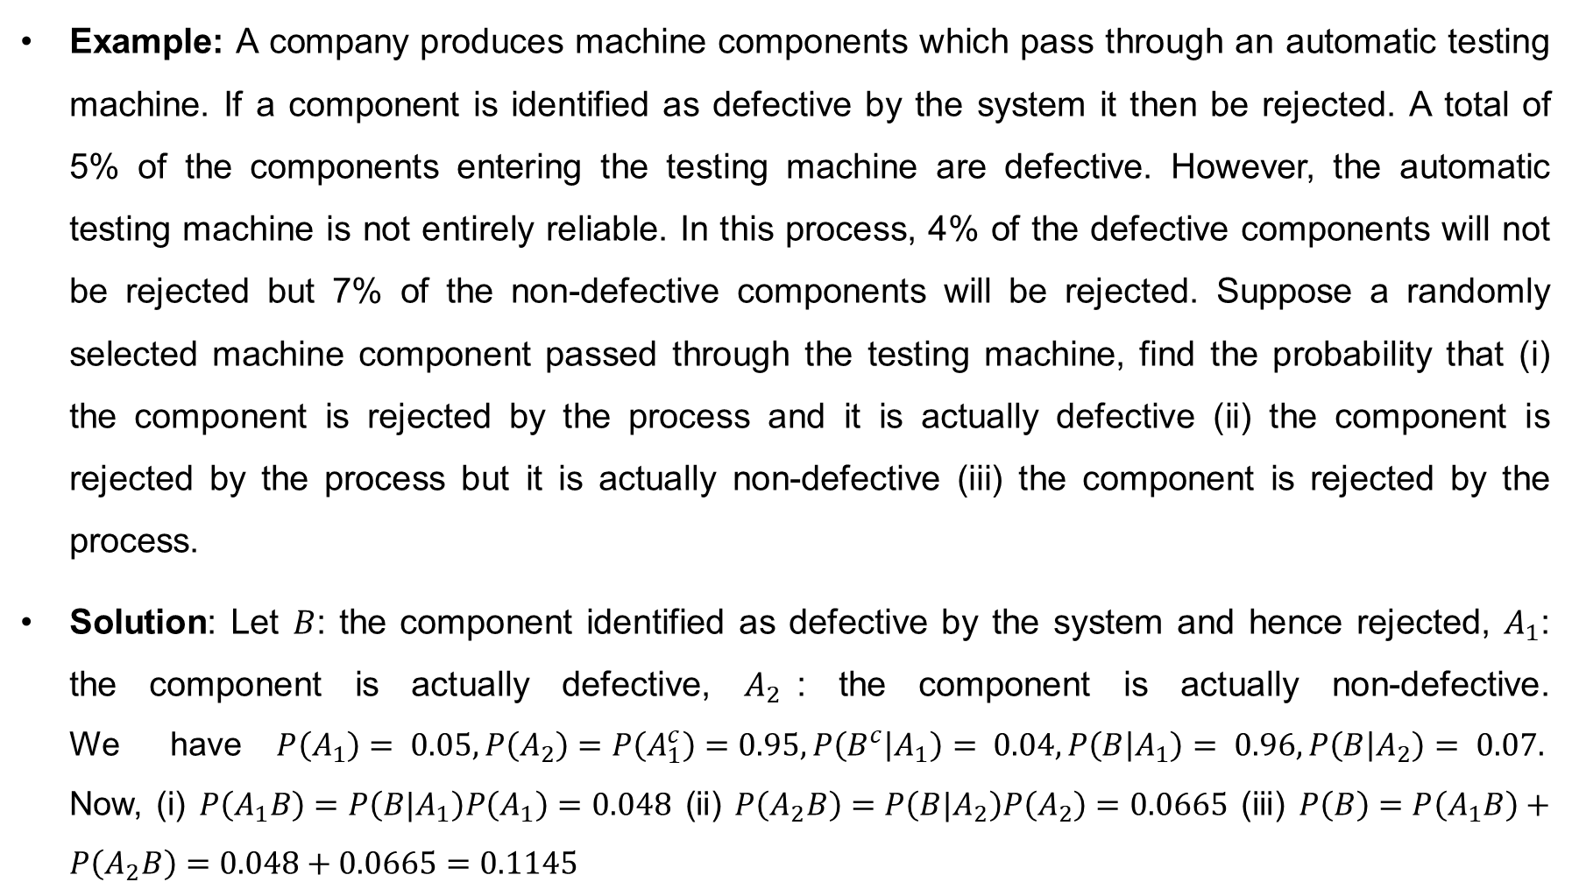
Law of total probability (cont…)
Example: A company produces machine components which pass through an automatic testing machine. If a component is identified as defective by the system it then be rejected. A total of 5% of the components entering the testing machine are defective. However, the automatic testing machine is not entirely reliable. In this process, 4% of the defective components will not be rejected but 7% of the non-defective components will be rejected. Suppose a randomly selected machine component passed through the testing machine, find the probability that (i) the component is rejected by the process and it is actually defective (ii) the component is rejected by the process but it is actually non-defective (iii) the component is rejected by the process.
Solution: Let $B$: the component identified as defective by the system and hence rejected, $A_{1}$: the component is actually defective, $A_{2}$: the component is actually non-defective. We have$P\left(A_{1}\right)= 0.05, P\left(A_{2}\right)=P\left(A_{1}^{c}\right)=0.95, P\left(B^{c} | A_{1}\right)= 0.04, P\left(B | A_{1}\right)= 0.96, P\left(B | A_{2}\right)= 0.07.$ Now, (i) $P\left(A_{1}B\right)=P\left(B|A_{1}\right)P\left(A_{1}\right)=0.048$ (ii) $P\left(A_{2}B\right)=P\left(B|A_{2}\right)P\left(A_{2}\right)=0.0665$ (iii) $P\left(B\right)=P\left(A_{1}B\right)+P\left(A_{2}B\right)=0.048+0.0665=0.1145$

Slide 22
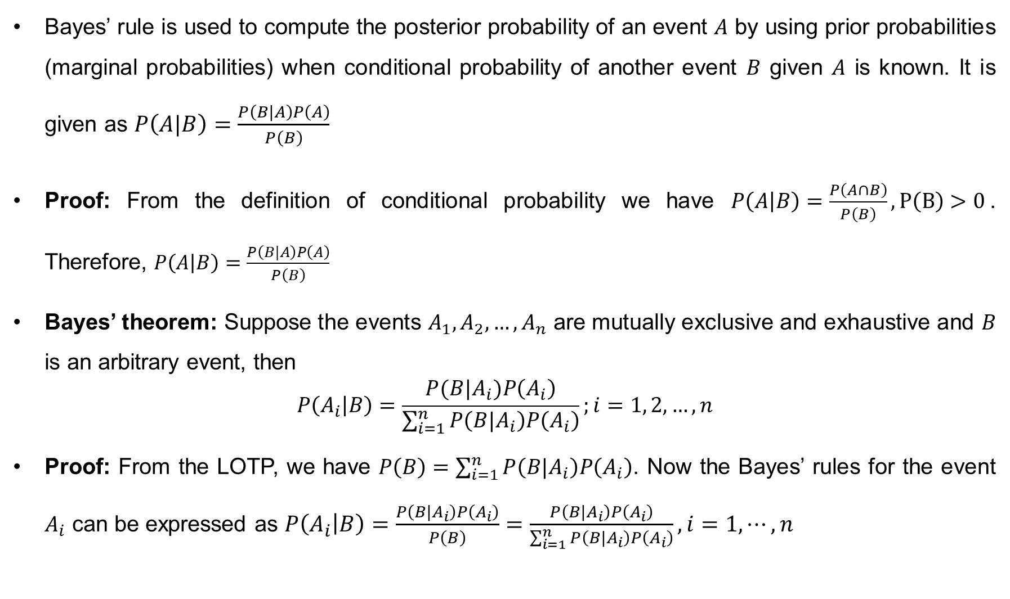
Bayes’ rule
Bayes’ rule is used to compute the posterior probability of an event $A$ by using prior probabilities (marginal probabilities) when conditional probability of another event $B$ given $A$ is known. It is given as $P\left(A|B\right)=\frac{P\left(B|A\right)P\left(A\right)}{P\left(B\right)}$
Proof: From the definition of conditional probability we have $P\left(A | B\right)=\frac{P\left(A∩B\right)}{P\left(B\right)}, P\left(B\right)>0$. Therefore, $P\left(A | B\right)=\frac{P\left(B|A\right)P\left(A\right)}{P\left(B\right)}$
Bayes’ theorem: Suppose the events $A_{1}, A_{2},…, A_{n}$ are mutually exclusive and exhaustive and $B$ is an arbitrary event, then
$$P\left(A_{i} | B\right)=\frac{P(B|A_{i})P\left(A_{i}\right)}{\sum_{i=1}^{n}{P\left(B|A_{i}\right)P\left(A_{i}\right)}};i=1, 2, …,n$$
Proof: From the LOTP, we have $P\left(B\right)=\sum_{i=1}^{n}{P\left(B|A_{i}\right)P\left(A_{i}\right)}$. Now the Bayes’ rules for the event $A_{i}$ can be expressed as $P\left(A_{i} | B\right)=\frac{P\left(B|A_{i}\right)P\left(A_{i}\right)}{P\left(B\right)}=\frac{P\left(B|A_{i}\right)P\left(A_{i}\right)}{\sum_{i=1}^{n}{P\left(B|A_{i}\right)P\left(A_{i}\right)}}, i=1,⋯, n$

Slide 23
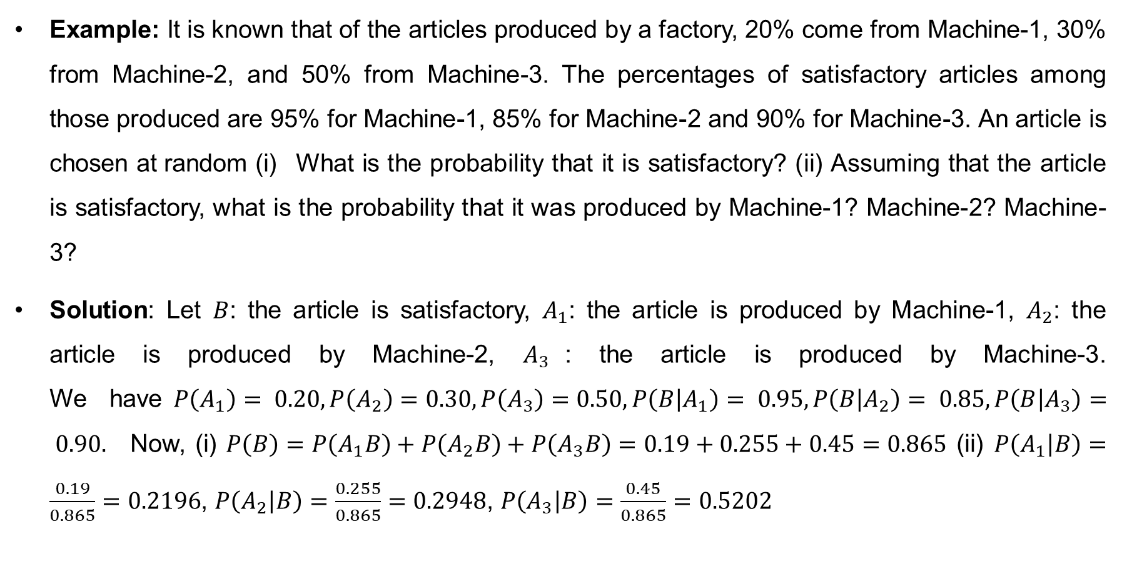
Bayes’ theorem (cont…)
Example: It is known that of the articles produced by a factory, 20% come from Machine-1, 30% from Machine-2, and 50% from Machine-3. The percentages of satisfactory articles among those produced are 95% for Machine-1, 85% for Machine-2 and 90% for Machine-3. An article is chosen at random (i) What is the probability that it is satisfactory? (ii) Assuming that the article is satisfactory, what is the probability that it was produced by Machine-1? Machine-2? Machine-3?
Solution: Let $B$: the article is satisfactory, $A_{1}$: the article is produced by Machine-1, $A_{2}$: the article is produced by Machine-2, $A_{3}$: the article is produced by Machine-3. We have$P\left(A_{1}\right)= 0.20, P\left(A_{2}\right)=0.30,P\left(A_{3}\right)=0.50, P\left(B | A_{1}\right)= 0.95, P\left(B | A_{2}\right)= 0.85, P\left(B | A_{3}\right)= 0.90.$ Now, (i) $P\left(B\right)=P\left(A_{1}B\right)+P\left(A_{2}B\right)+P\left(A_{3}B\right)=0.19+0.255+0.45=0.865$ (ii) $P\left(A_{1} | B\right)=\frac{0.19}{0.865}=0.2196$, $P\left(A_{2} | B\right)=\frac{0.255}{0.865}=0.2948$, $P\left(A_{3} | B\right)=\frac{0.45}{0.865}=0.5202$

Slide 24
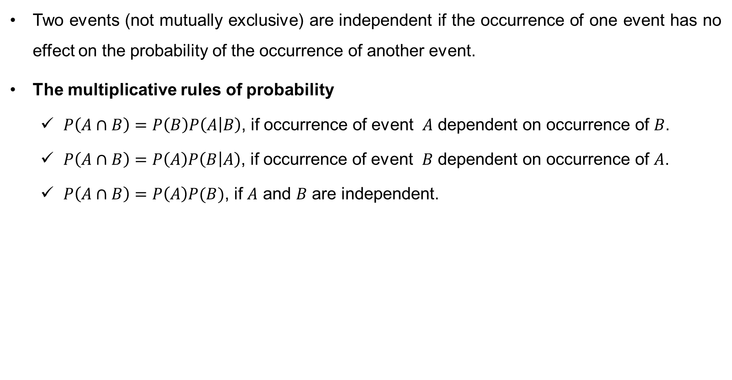
Independence of Events
Two events (not mutually exclusive) are independent if the occurrence of one event has no effect on the probability of the occurrence of another event.
The multiplicative rules of probability
$P\left(A∩B\right)=P\left(B\right)P\left(A | B\right)$, if occurrence of event $A$ dependent on occurrence of $B$.
$P\left(A∩B\right)=P\left(A\right)P\left(B | A\right)$, if occurrence of event $B$ dependent on occurrence of $A$.
$P\left(A∩B\right)=P\left(A\right)P(B)$, if $A$ and $B$ are independent.

Slide 25
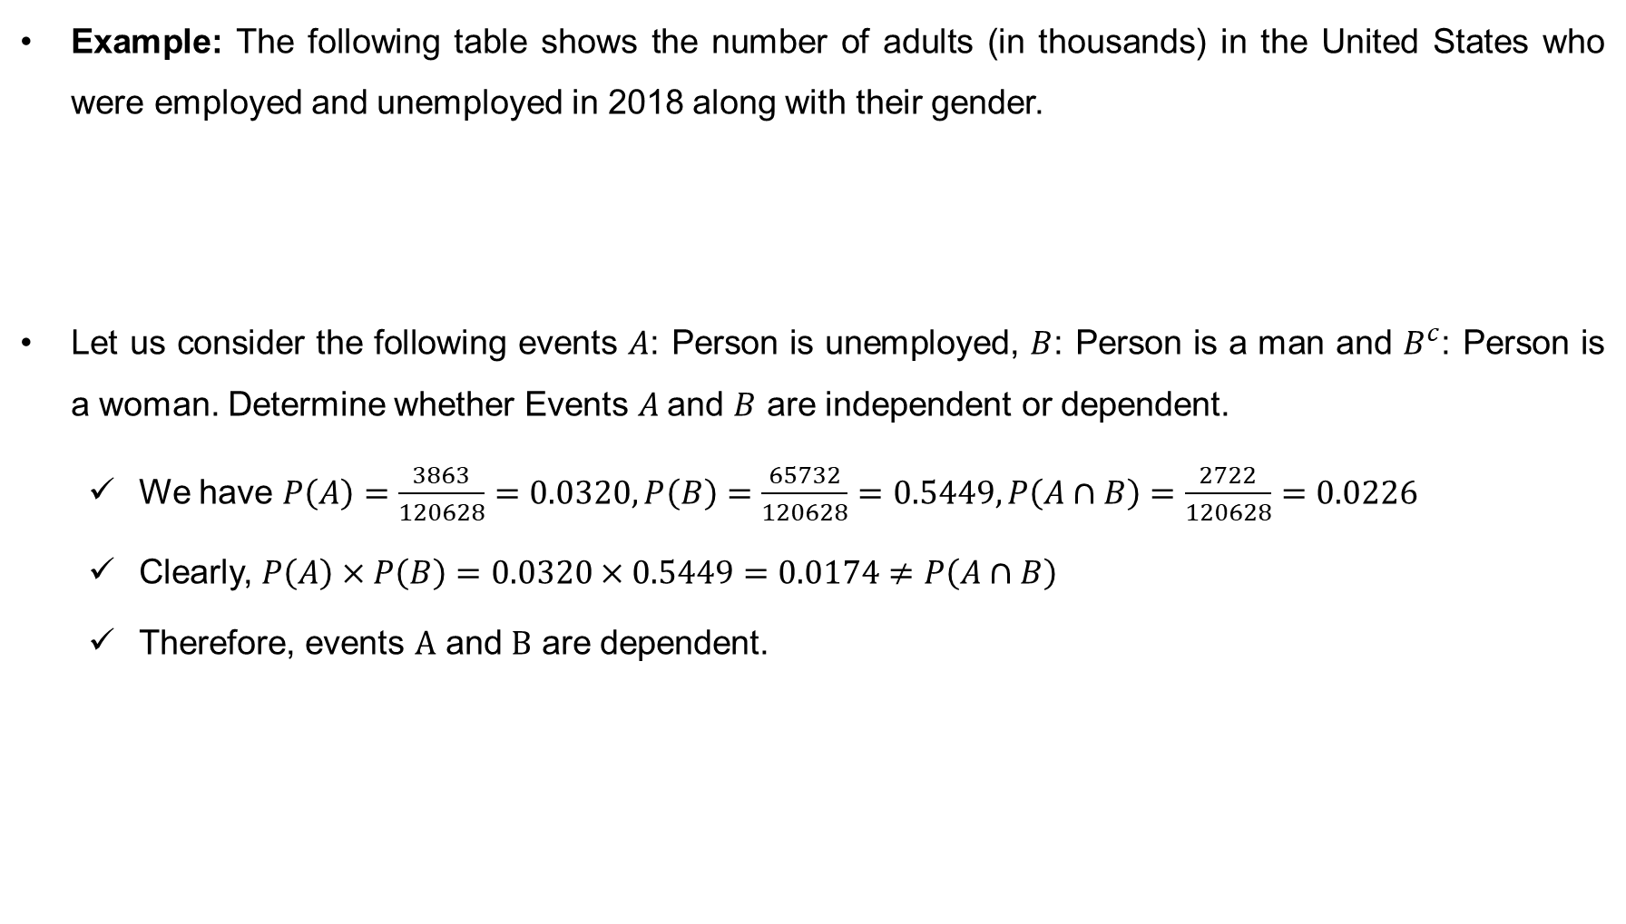
Independence of Events (cont…)
Example: The following table shows the number of adults (in thousands) in the United States who were employed and unemployed in 2018 along with their gender.
Let us consider the following events $A$: Person is unemployed, $B$: Person is a man and $B^{c}$: Person is a woman. Determine whether Events $A$and $B$ are independent or dependent.
We have $P\left(A\right)=\frac{3863}{120628}=0.0320, P\left(B\right)=\frac{65732}{120628}=0.5449, P\left(A∩B\right)=\frac{2722}{120628}=0.0226$
Clearly, $P\left(A\right)×P\left(B\right)=0.0320×0.5449=0.0174≠P\left(A∩B\right)$
Therefore, events $A$ and $B$ are dependent.
 | Men | Women | Total
Unemployed | 2722 | 1141 | 3863
Employed | 63010 | 53755 | 116765
Total | 65732 | 54896 | 120628

Slide 26
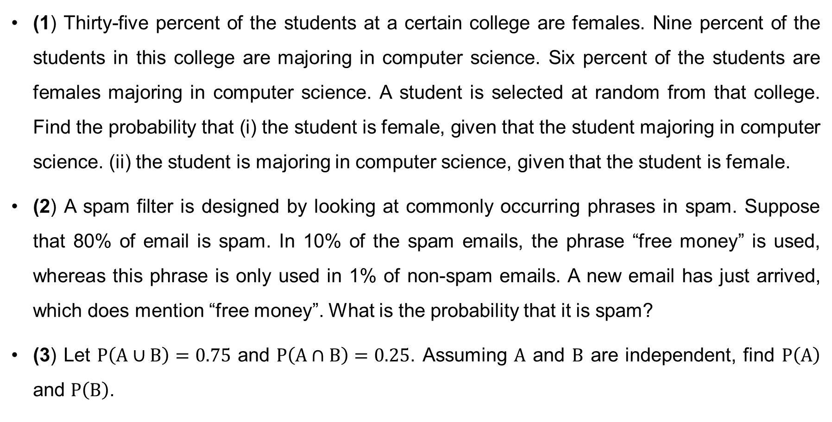
Exercise
(1) Thirty-five percent of the students at a certain college are females. Nine percent of the students in this college are majoring in computer science. Six percent of the students are females majoring in computer science. A student is selected at random from that college. Find the probability that (i) the student is female, given that the student majoring in computer science. (ii) the student is majoring in computer science, given that the student is female.
(2) A spam filter is designed by looking at commonly occurring phrases in spam. Suppose that 80% of email is spam. In 10% of the spam emails, the phrase “free money” is used, whereas this phrase is only used in 1% of non-spam emails. A new email has just arrived, which does mention “free money”. What is the probability that it is spam?
(3) Let $P\left(A∪B\right)=0.75$ and $P\left(A∩B\right)=0.25$. Assuming $A$ and $B$ are independent, find $P\left(A\right)$ and $P\left(B\right)$.

Slide 27
Exercise (cont…)
(4) An insurance company classifies drivers as good, medium, or poor risks. Drivers who apply to for insurance fall into these three groups in the proportions: 30%, 50%, and 20%, respectively. The probabilities of a good-risk, medium-risk, and poor-risk drivers will have an accident are 0.01, 0.03, and 0.10, respectively. Suppose the company sells Mr. Brophy an insurance policy and he has an accident. What is the probability that Mr. Brophy was a good-risk driver?
(5) A town has 2 fire engines A and B. They are operating independently. The probability that a specific engine is available when needed is 0.96. (a) What is the probability that only one fire engine is available when needed? (b) What is the probability that at least one fire engine is available when needed? (c) What is the probability that neither is available when needed?

Slide 28
Thank You

