Slide 1
COURSE TITLE: : Statistics and Probability COURSE CODE: STA 102 Topics: Random variable and Its Probability Distribution
Instructor: Md. Ershadul Haque, PhD
Professor, Department of Statistics, DU
&
Adjunct Faculty, EWU, Bangladesh

Slide 2
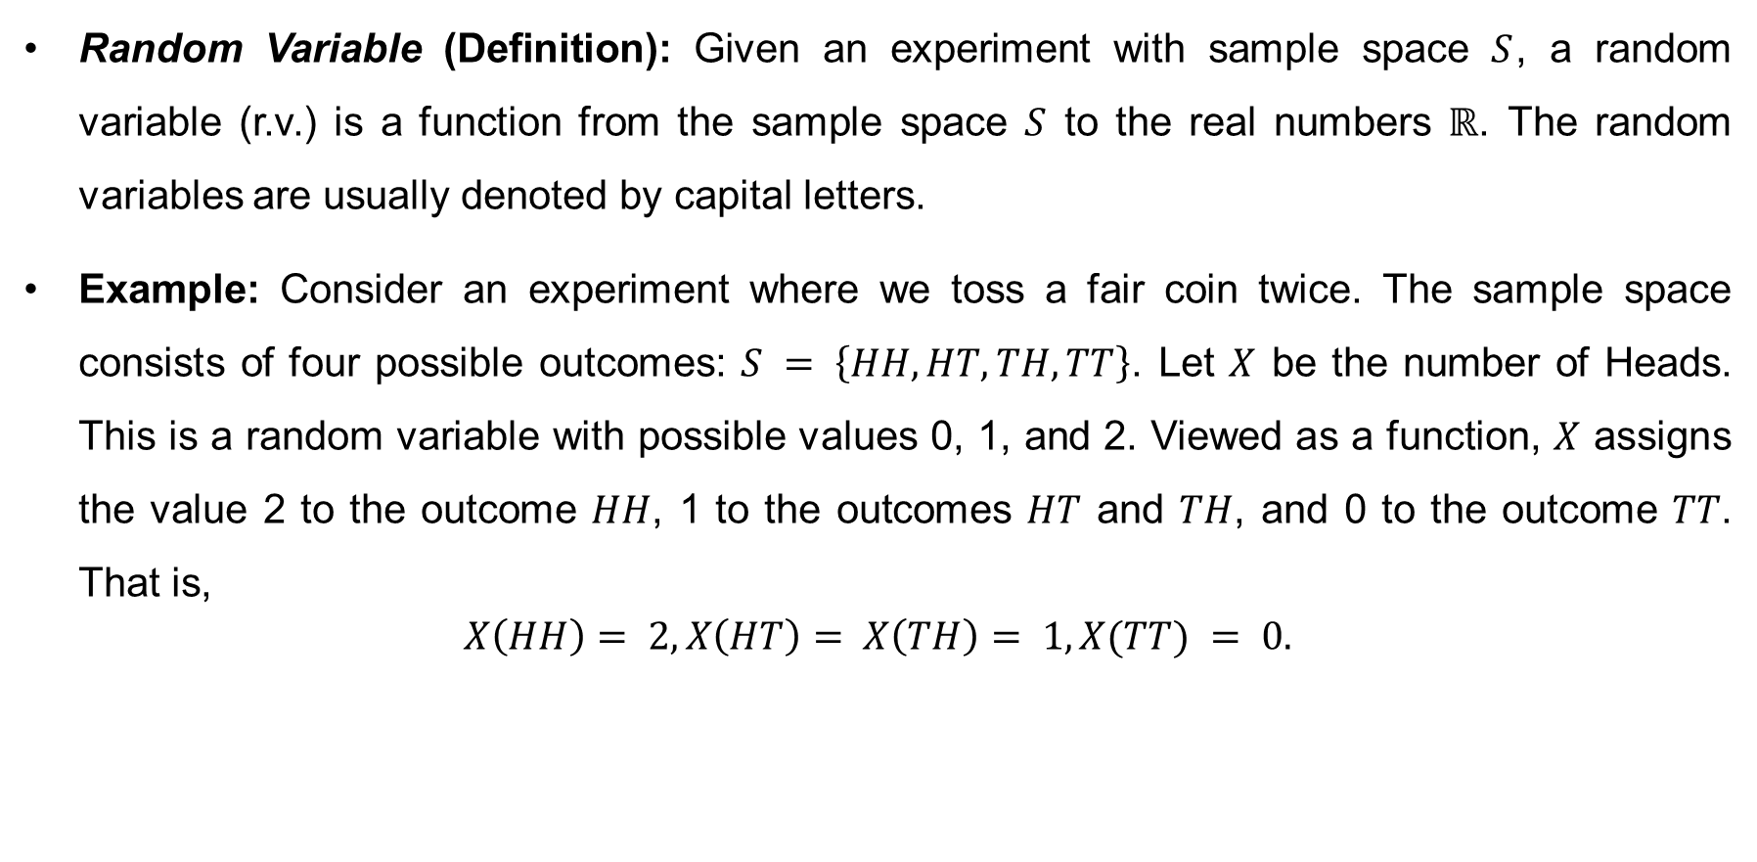
Random Variables and Its Probability Distributions
Random Variable (Definition): Given an experiment with sample space $S$, a random variable (r.v.) is a function from the sample space $S$ to the real numbers $ℝ$. The random variables are usually denoted by capital letters.
Example: Consider an experiment where we toss a fair coin twice. The sample space consists of four possible outcomes: $S = \left\{HH,HT,TH,TT\right\}$. Let $X$ be the number of Heads. This is a random variable with possible values 0, 1, and 2. Viewed as a function, $X$ assigns the value 2 to the outcome $HH$, 1 to the outcomes $HT$ and $TH$, and 0 to the outcome $TT$. That is,
$$X\left(HH\right)= 2,X\left(HT\right)= X\left(TH\right)= 1,X(TT) = 0.$$

Slide 3
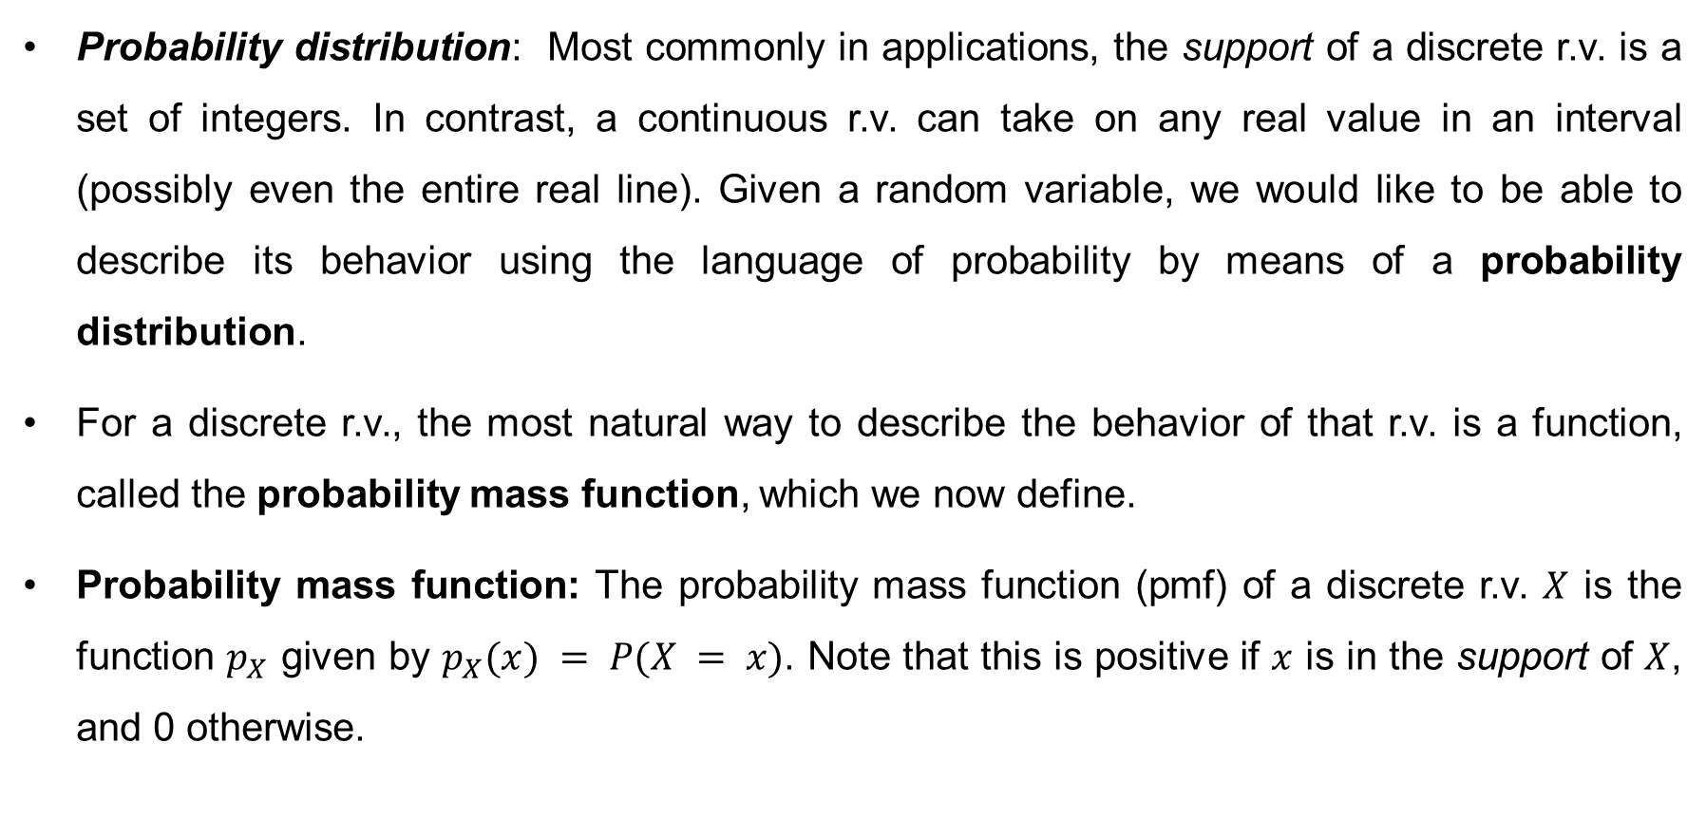
Probability Distributions
Probability distribution: Most commonly in applications, the support of a discrete r.v. is a set of integers. In contrast, a continuous r.v. can take on any real value in an interval (possibly even the entire real line). Given a random variable, we would like to be able to describe its behavior using the language of probability by means of a probability distribution.
For a discrete r.v., the most natural way to describe the behavior of that r.v. is a function, called the probability mass function, which we now define.
Probability mass function: The probability mass function (pmf) of a discrete r.v. $X$ is the function $p_{X}$ given by $p_{X}(x) = P(X = x)$. Note that this is positive if $x$ is in the support of $X$, and 0 otherwise.

Slide 4
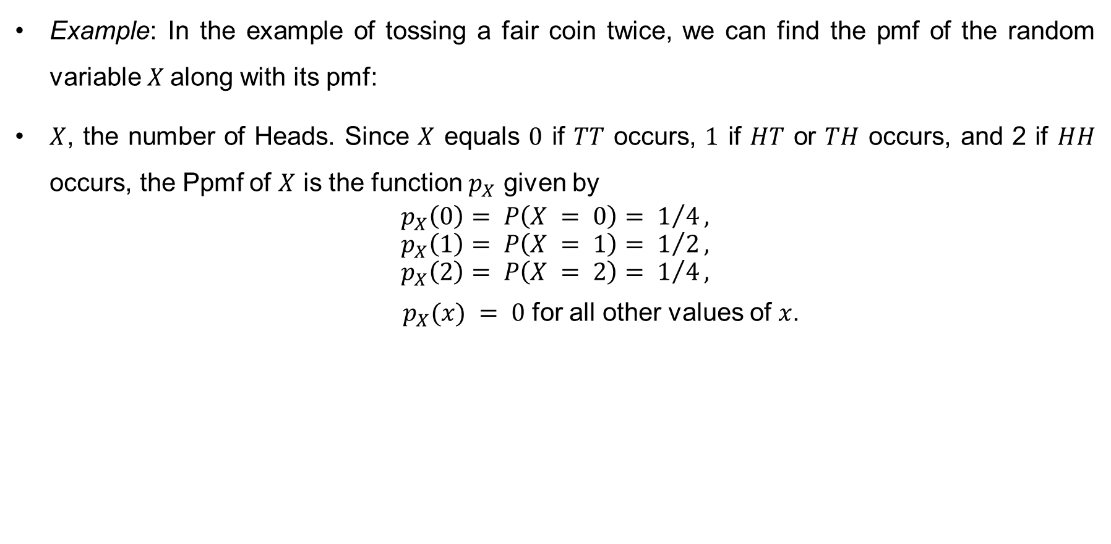
Probability Distributions (cont…)
Example: In the example of tossing a fair coin twice, we can find the pmf of the random variable $X$along with its pmf:
$X$, the number of Heads. Since $X$ equals $0$ if $TT$ occurs, $1$ if $HT$ or $TH$ occurs, and 2 if $HH$ occurs, the Ppmf of $X$ is the function $p_{X}$ given by
$$p_{X}\left(0\right)= P\left(X = 0\right)= 1/4,$$
$$p_{X}\left(1\right)= P\left(X = 1\right)= 1/2,$$
$$p_{X}\left(2\right)= P\left(X = 2\right)= 1/4,$$
$p_{X}(x) = 0$ for all other values of $x$.

Slide 5
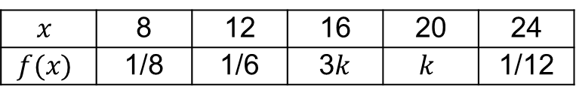
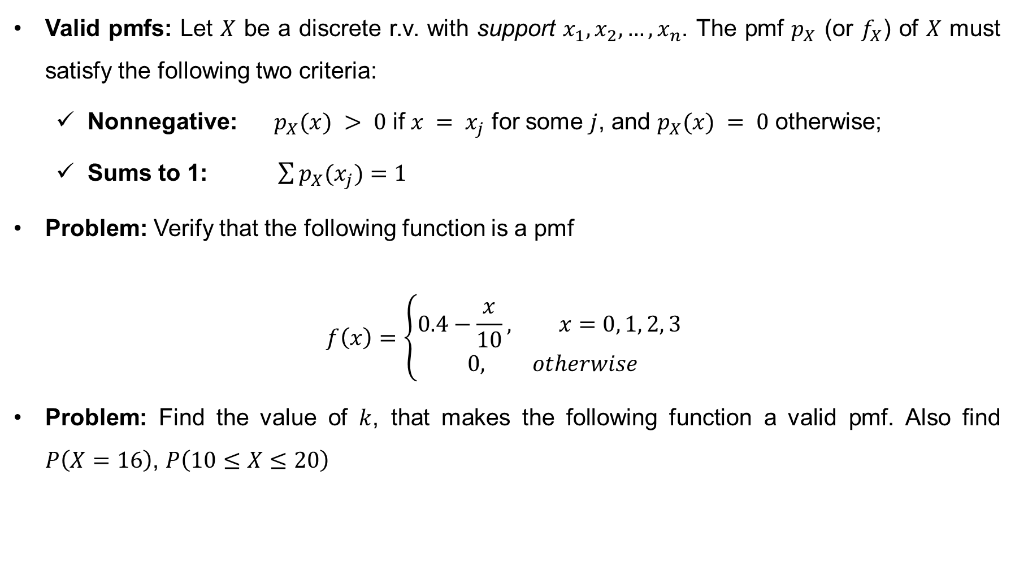
Probability Distributions (cont…)
Valid pmfs: Let $X$ be a discrete r.v. with support $x_{1},x_{2}, …, x_{n}$. The pmf $p_{X}$ (or $f_{X}$) of $X$ must satisfy the following two criteria:
Nonnegative: $p_{X}(x) > 0$ if $x = x_{j}$ for some $j$, and $p_{X}(x) = 0$ otherwise;
Sums to 1: $\sum{p_{X}(x_{j})}=1$
Problem: Verify that the following function is a pmf
$$f\left(x\right)=\left\{\begin{aligned}0.4−\frac{x}{10}, x=0, 1, 2, 3 \\ 0, otherwise\end{aligned}\right.$$
Problem: Find the value of $k$, that makes the following function a valid pmf. Also find $P\left(X=16\right)$, $P\left(10≤X≤20\right)$
$$x$$ | 8 | 12 | 16 | 20 | 24
$$f(x)$$ | 1/8 | 1/6 | 3$k$ | $$k$$ | 1/12

Slide 6
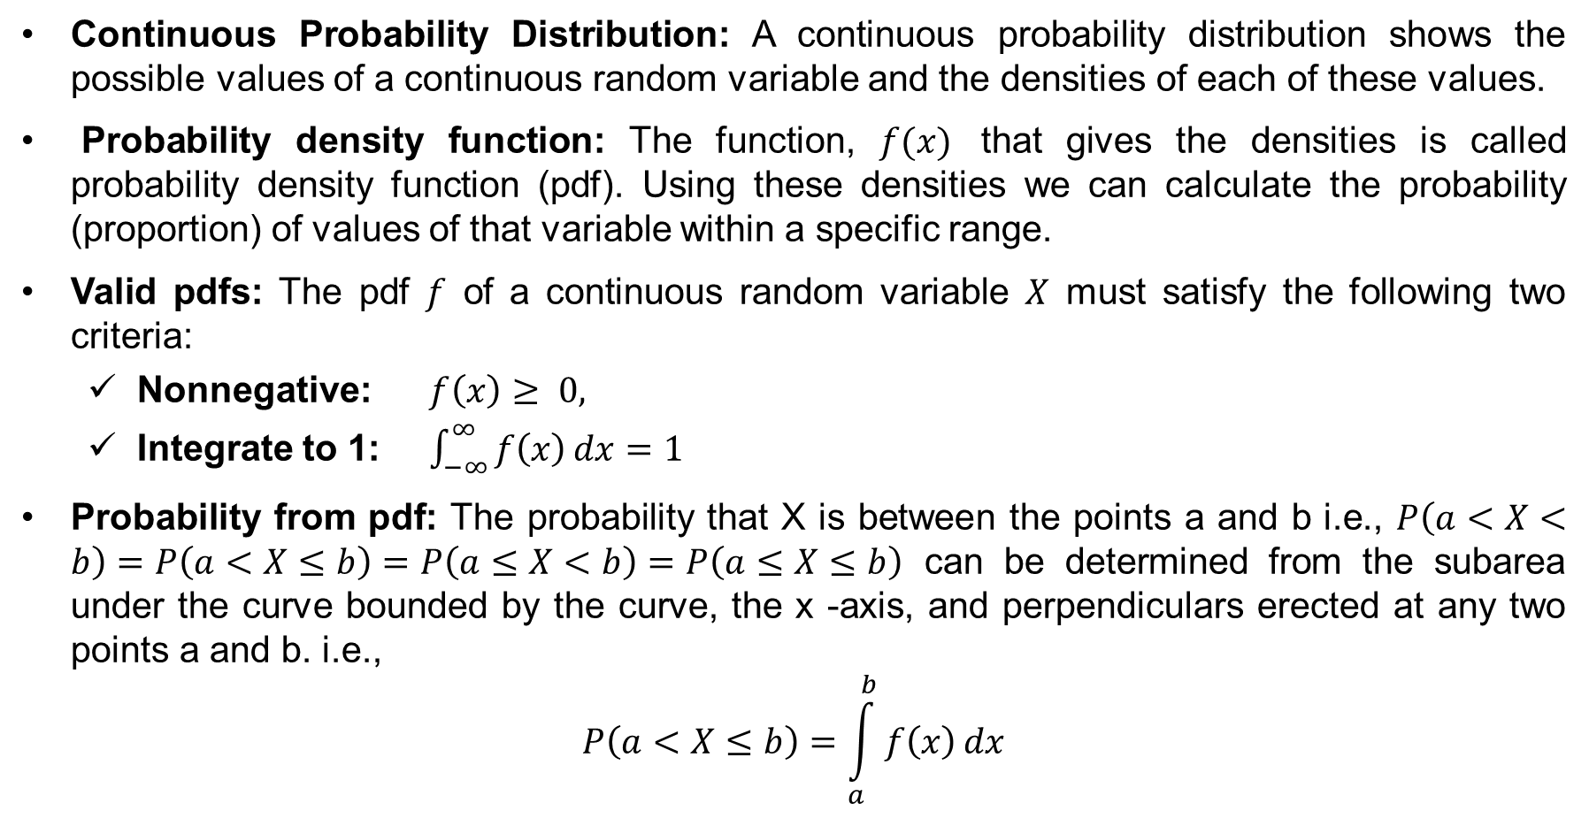
Probability Distributions (cont…)
Continuous Probability Distribution: A continuous probability distribution shows the possible values of a continuous random variable and the densities of each of these values.
Probability density function: The function, $f(x)$ that gives the densities is called probability density function (pdf). Using these densities we can calculate the probability (proportion) of values of that variable within a specific range.
Valid pdfs: The pdf $f$ of a continuous random variable $X$ must satisfy the following two criteria:
Nonnegative: $f\left(x\right)≥ 0,$
Integrate to 1: $\int_{−∞}^{∞}{f\left(x\right)dx=1}$
Probability from pdf: The probability that X is between the points a and b i.e., $P\left(a<X<b\right)=P\left(a<X≤b\right)=P\left(a≤X<b\right)=P\left(a≤X≤b\right)$ can be determined from the subarea under the curve bounded by the curve, the x -axis, and perpendiculars erected at any two points a and b. i.e.,
$$P\left(a<X≤b\right)=\int_{a}^{b}{f\left(x\right)dx}$$

Slide 7
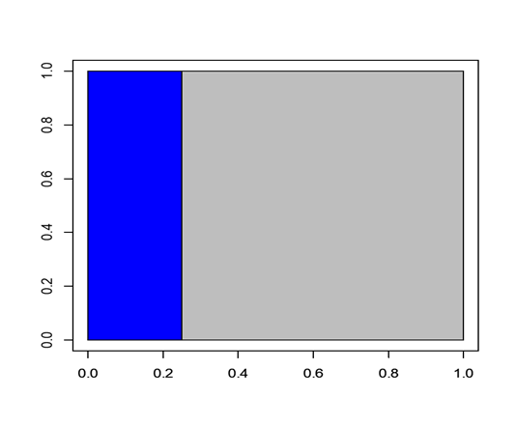
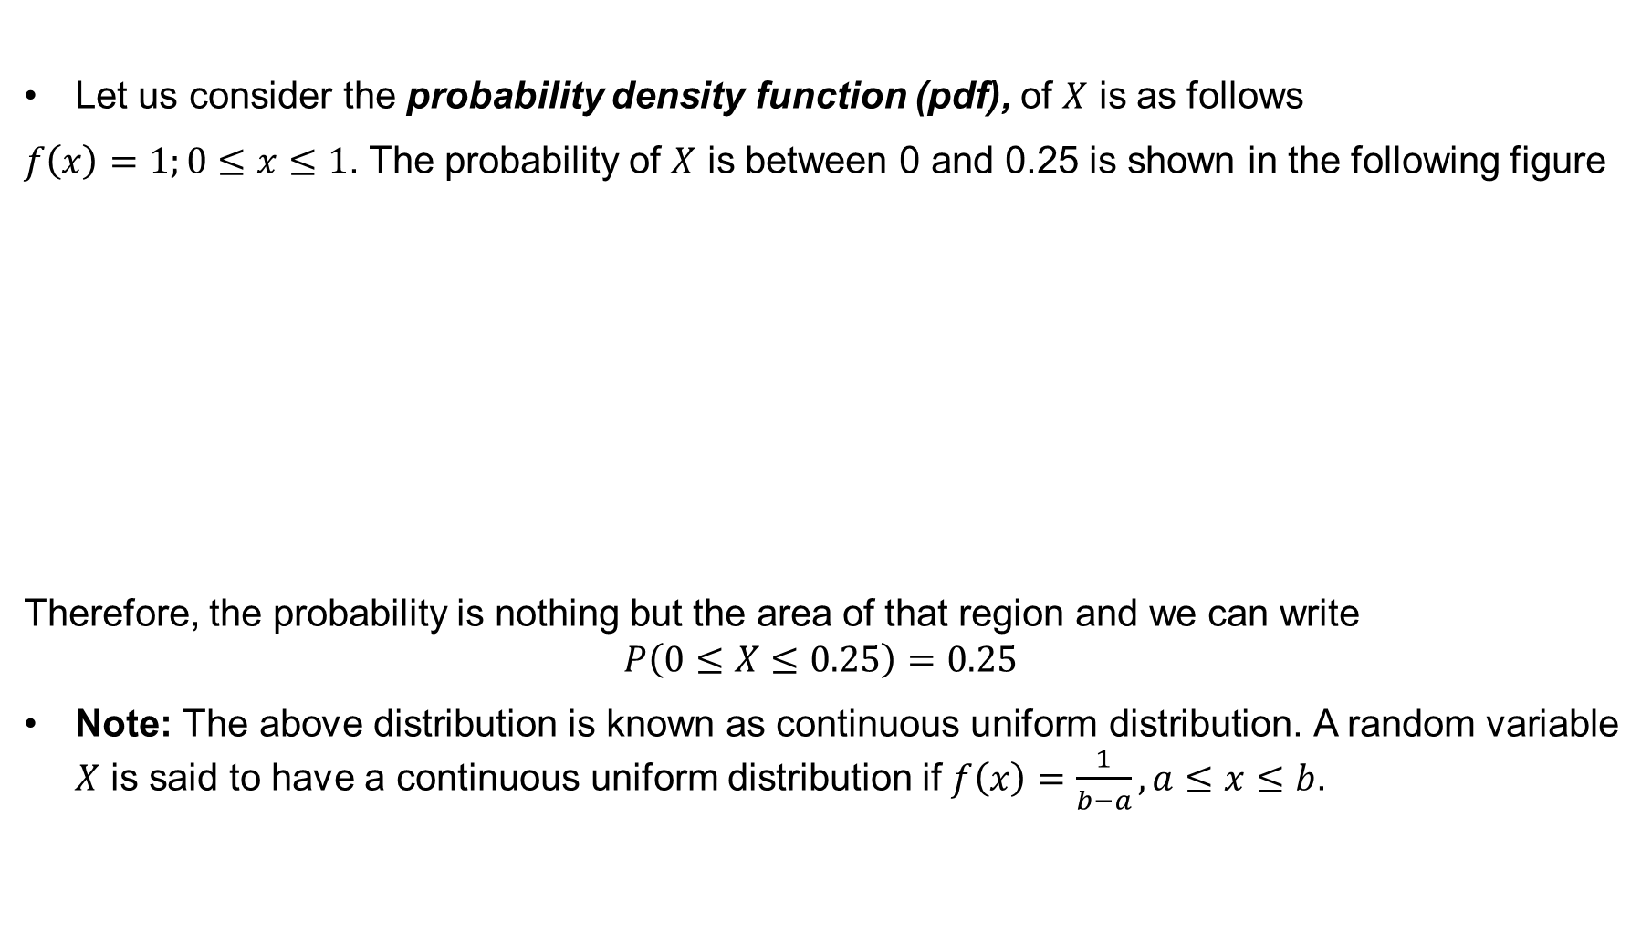
Probability Distributions (cont…)
Let us consider the probability density function (pdf), of $X$ is as follows
$f\left(x\right)=1;0≤x≤1$. The probability of $X$ is between 0 and 0.25 is shown in the following figure
Therefore, the probability is nothing but the area of that region and we can write
$$P\left(0≤X≤0.25\right)=0.25$$
Note: The above distribution is known as continuous uniform distribution. A random variable $X$ is said to have a continuous uniform distribution if $f\left(x\right)=\frac{1}{b−a},a≤x≤b$.

Slide 8
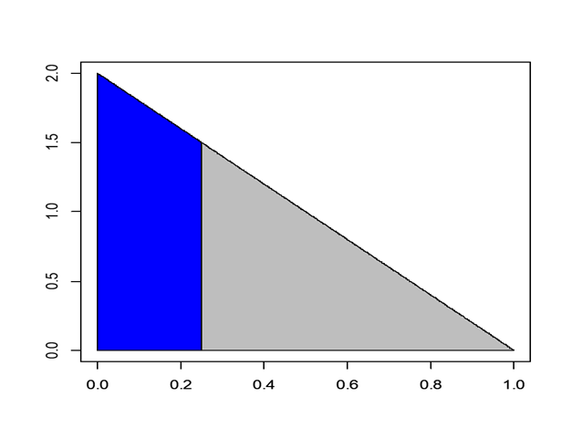

Probability Distributions (cont…)
Let us consider another pdf of $X$ as follows
$$f\left(x\right)=2\left(1−x\right);0≤x≤1$$
The probability of $X$ is between 0 and 0.25 is shown in the following figure
Therefore, the probability is nothing but the area of that region
$P\left(0≤X≤0.25\right)=???$

Slide 9
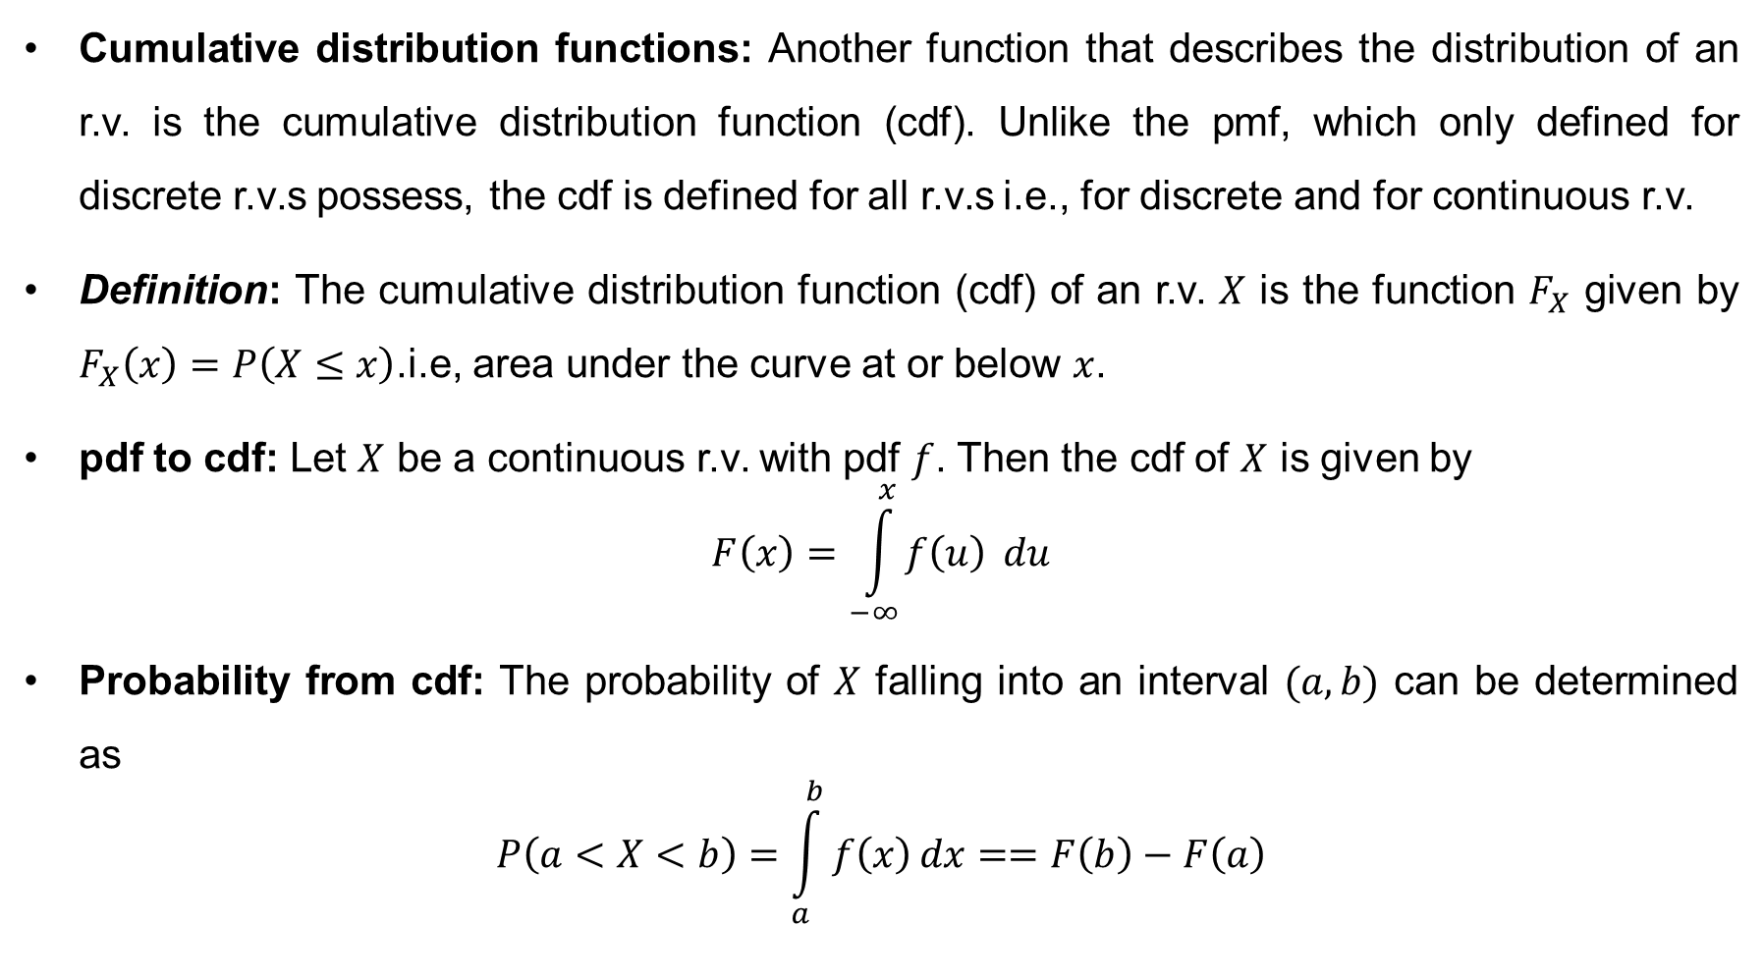
Probability Distributions (cont…)
Cumulative distribution functions: Another function that describes the distribution of an r.v. is the cumulative distribution function (cdf). Unlike the pmf, which only defined for discrete r.v.s possess, the cdf is defined for all r.v.s i.e., for discrete and for continuous r.v.
Definition: The cumulative distribution function (cdf) of an r.v. $X$ is the function $F_{X}$ given by $F_{X}\left(x\right)=P\left(X≤x\right)$.i.e, area under the curve at or below $x$.
pdf to cdf: Let $X$ be a continuous r.v. with pdf $f$. Then the cdf of $X$ is given by
$$F\left(x\right)=\int_{−∞}^{x}{f\left(u\right)} du$$
Probability from cdf: The probability of $X$ falling into an interval $(a,b)$ can be determined as
$$P\left(a<X<b\right)=\int_{a}^{b}{f\left(x\right)dx}==F\left(b\right)−F\left(a\right)$$

Slide 10
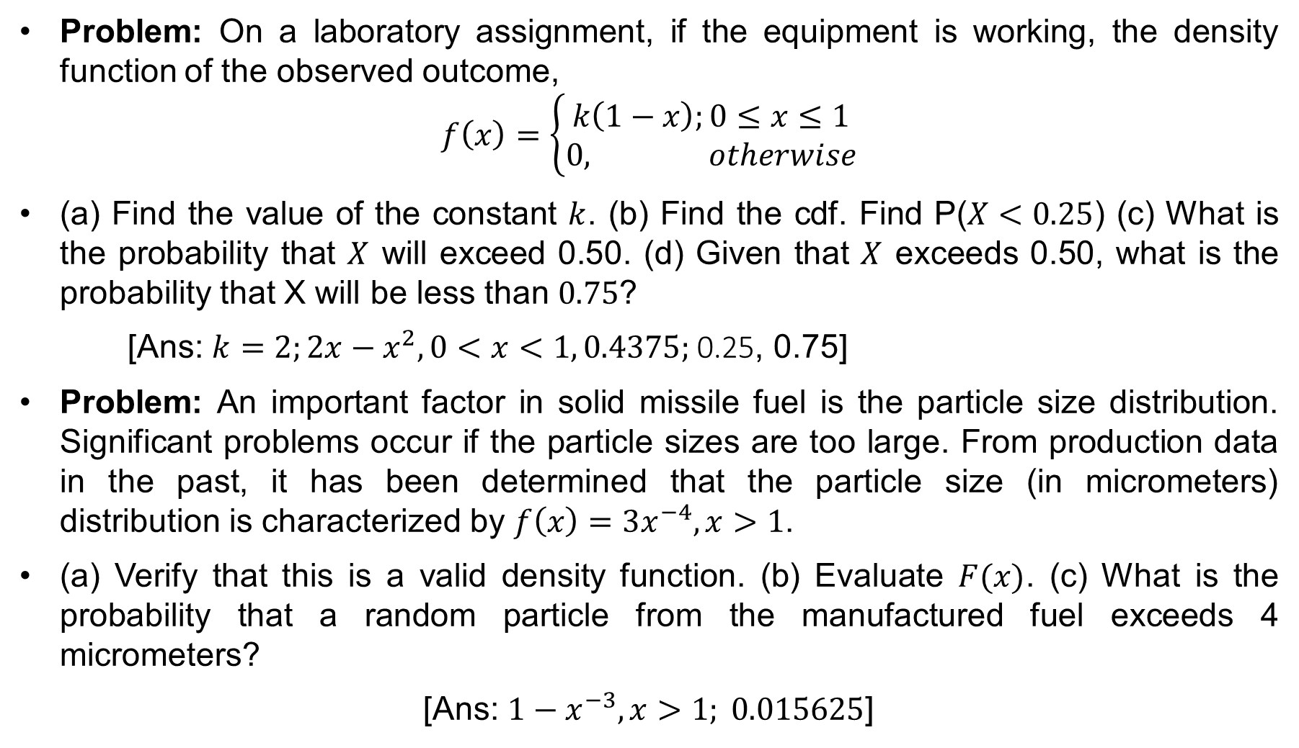
Probability Distributions (cont…)
Problem: On a laboratory assignment, if the equipment is working, the density function of the observed outcome,
$$f\left(x\right)=\left\{\begin{aligned}k\left(1−x\right);0≤x≤1 \\ &0, otherwise\end{aligned}\right.$$
(a) Find the value of the constant $k$. (b) Find the cdf. Find P($X<0.25$) (c) What is the probability that $X$ will exceed 0.50. (d) Given that $X$ exceeds 0.50, what is the probability that X will be less than $0.75$?
[Ans: $k=2;2x−x^{2},0<x<1, 0.4375;$0.25, 0.75]
Problem: An important factor in solid missile fuel is the particle size distribution. Significant problems occur if the particle sizes are too large. From production data in the past, it has been determined that the particle size (in micrometers) distribution is characterized by $f\left(x\right)=3x^{−4}, x>1$.
(a) Verify that this is a valid density function. (b) Evaluate $F(x)$. (c) What is the probability that a random particle from the manufactured fuel exceeds 4 micrometers?
[Ans: $1−x^{−3},x>1; 0.015625$]

Slide 11
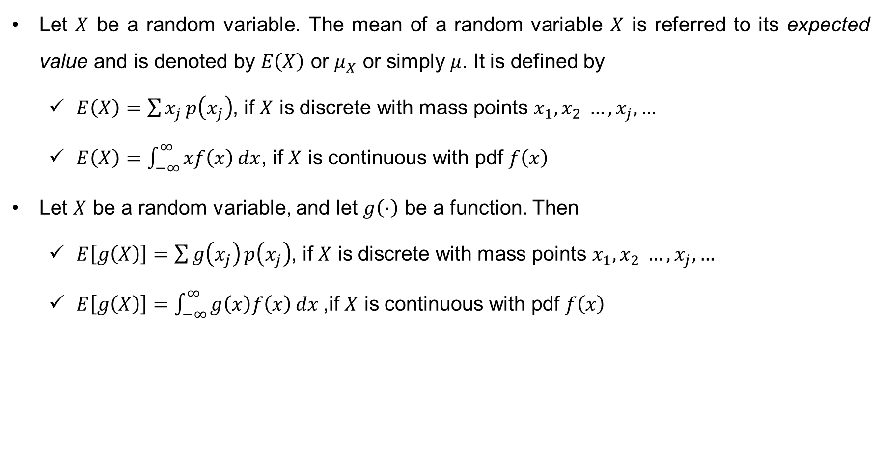
Mathematical Expectation
Let $X$ be a random variable. The mean of a random variable $X$ is referred to its expected value and is denoted by $E\left(X\right)$ or $μ_{X}$ or simply $μ$. It is defined by
$E\left(X\right)=\sum{x_{j}}p\left(x_{j}\right)$, if $X$ is discrete with mass points $x_{1},x_{2} …, x_{j},…$
$E\left(X\right)=\int_{−∞}^{∞}{xf\left(x\right)dx}$, if $X$ is continuous with pdf $f\left(x\right)$
Let $X$ be a random variable, and let $g\left(⋅\right)$ be a function. Then
$E\left[g\left(X\right)\right]=\sum{g\left(x_{j}\right)}p\left(x_{j}\right)$, if $X$ is discrete with mass points $x_{1},x_{2} …, x_{j},…$
$E\left[g\left(X\right)\right]=\int_{−∞}^{∞}{g\left(x\right)f\left(x\right)dx}$,if $X$ is continuous with pdf $f\left(x\right)$

Slide 12
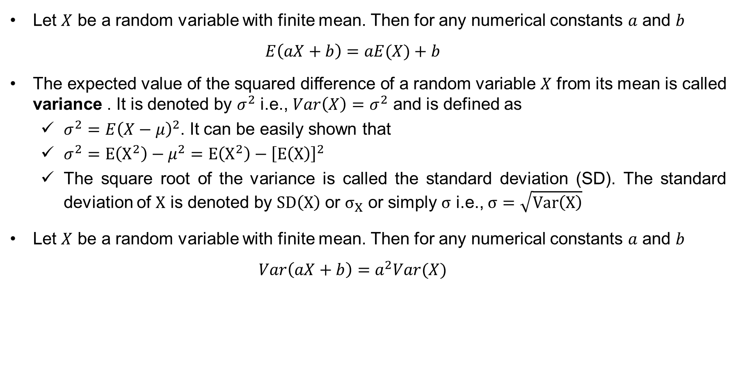
Properties Mathematical Expectation
Let $X$ be a random variable with finite mean. Then for any numerical constants $a$ and $b$
$$E\left(aX+b\right)=aE(X)+b$$
The expected value of the squared difference of a random variable $X$ from its mean is called variance . It is denoted by $σ^{2}$ i.e., $Var\left(X\right)=σ^{2}$ and is defined as
$σ^{2}=E{\left(X−μ\right)}^{2}$. It can be easily shown that
$σ^{2}=E\left(X^{2}\right)−μ^{2}=E\left(X^{2}\right)−{\left[E\left(X\right)\right]}^{2}$
The square root of the variance is called the standard deviation (SD). The standard deviation of $X$ is denoted by $SD\left(X\right)$ or $σ_{X}$ or simply $σ$ i.e., $σ=\sqrt{Var\left(X\right)}$
Let $X$ be a random variable with finite mean. Then for any numerical constants $a$ and $b$
$$Var\left(aX+b\right)=a^{2}Var(X)$$

Slide 13
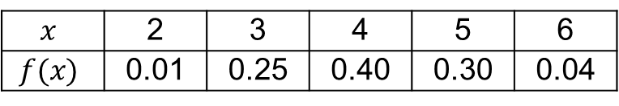
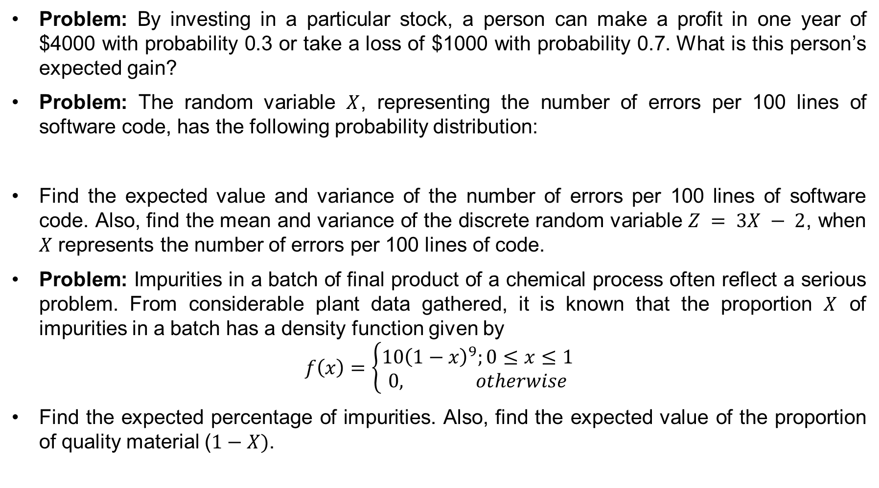
Practice Problems on Mathematical Expectation
Problem: By investing in a particular stock, a person can make a profit in one year of $4000 with probability 0.3 or take a loss of $1000 with probability 0.7. What is this person’s expected gain?
Problem: The random variable $X$, representing the number of errors per 100 lines of software code, has the following probability distribution:
Find the expected value and variance of the number of errors per 100 lines of software code. Also, find the mean and variance of the discrete random variable $Z = 3X − 2$, when $X$ represents the number of errors per 100 lines of code.
Problem: Impurities in a batch of final product of a chemical process often reflect a serious problem. From considerable plant data gathered, it is known that the proportion $X$ of impurities in a batch has a density function given by
$$f\left(x\right)=\left\{\begin{aligned}10{\left(1−x\right)}^{9};0≤x≤1 \\ &0, otherwise\end{aligned}\right.$$
Find the expected percentage of impurities. Also, find the expected value of the proportion of quality material ($1−X)$.
$$x$$ | 2 | 3 | 4 | 5 | 6
$$f(x)$$ | 0.01 | 0.25 | 0.40 | 0.30 | 0.04

Slide 14
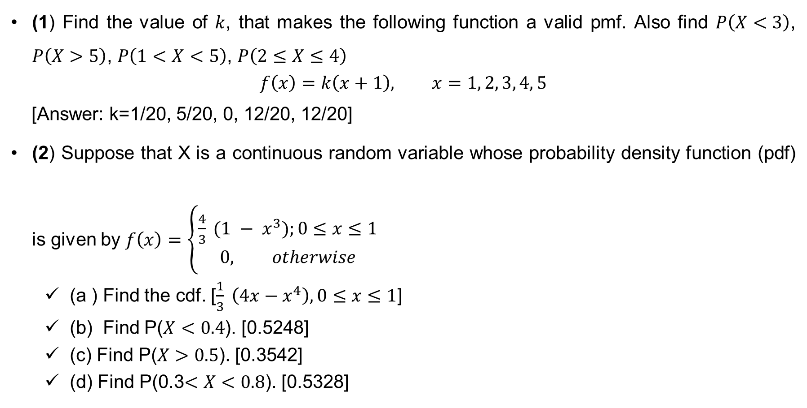
Exercise
(1) Find the value of $k$, that makes the following function a valid pmf. Also find $P\left(X<3\right)$, $P\left(X>5\right)$, $P\left(1<X<5\right)$, $P\left(2≤X≤4\right)$
$$f\left(x\right)=k\left(x+1\right), x=1, 2, 3, 4, 5$$
[Answer: k=1/20, 5/20, 0, 12/20, 12/20]
(2) Suppose that X is a continuous random variable whose probability density function (pdf) is given by $f\left(x\right)=\left\{\begin{aligned}\frac{4}{3} (1 − x^{3});0≤x≤1 \\ &0, otherwise\end{aligned}\right.$
(a ) Find the cdf. [$\frac{1}{3} \left(4x−x^{4}\right), 0≤x≤1$]
(b) Find P($X<0.4$). [0.5248]
(c) Find P($X>0.5$). [0.3542]
(d) Find P(0.3$<X<0.8$). [0.5328]

Slide 15
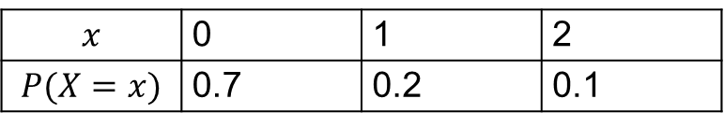
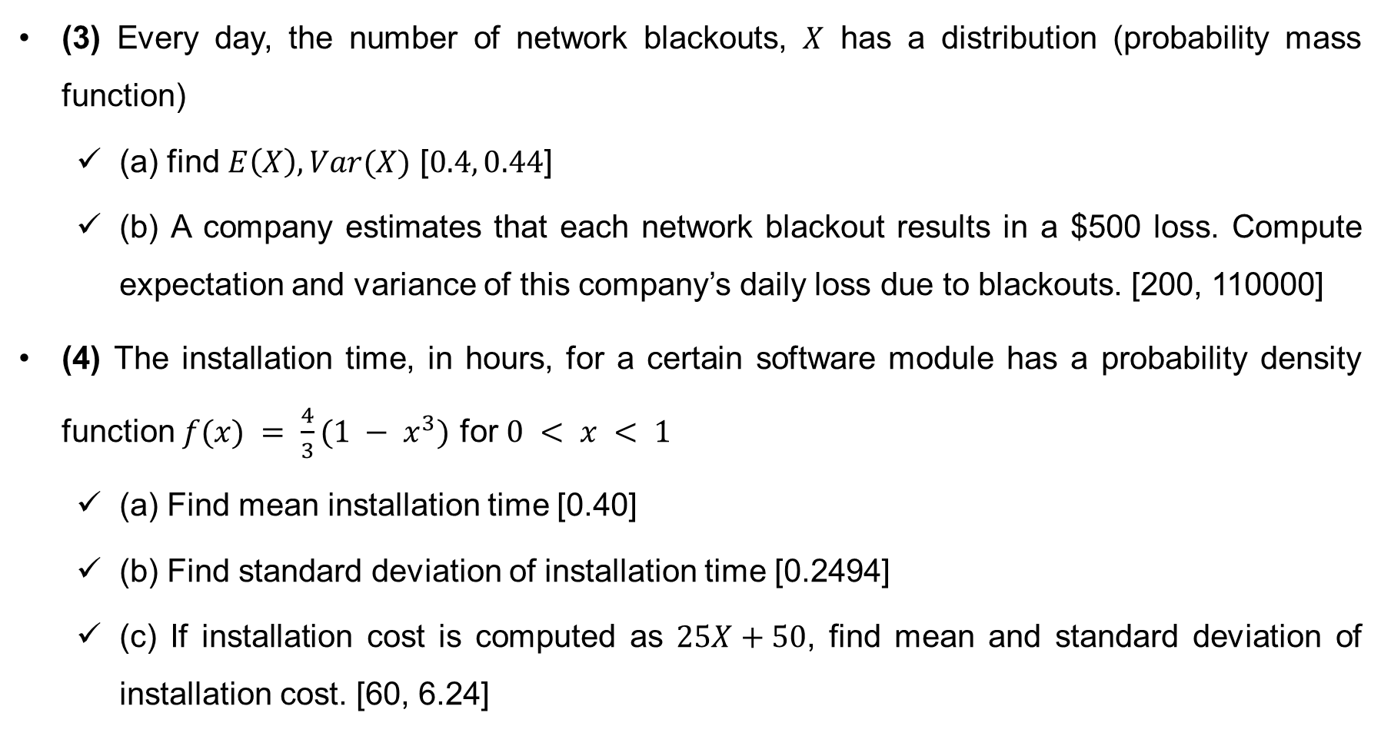
Exercise
(3) Every day, the number of network blackouts, $X$ has a distribution (probability mass function)
(a) find $E\left(X\right), Var(X)$ [$0.4, 0.44$]
(b) A company estimates that each network blackout results in a $500 loss. Compute expectation and variance of this company’s daily loss due to blackouts. [200, 110000]
(4) The installation time, in hours, for a certain software module has a probability density function $f(x) = \frac{4}{3}(1 − x^{3})$ for $0 < x < 1$
(a) Find mean installation time [0.40]
(b) Find standard deviation of installation time [0.2494]
(c) If installation cost is computed as $25X+50$, find mean and standard deviation of installation cost. [60, 6.24]
$$x$$ | 0 | 1 | 2
$$P(X=x)$$ | 0.7 | 0.2 | 0.1

Slide 16
Thank You

