Slide 1
COURSE TITLE: : Statistics and Probability COURSE CODE: STA 102 Topics: Some Special Probability Distributions
Instructor: Md. Ershadul Haque, PhD
Professor, Department of Statistics, DU
&
Adjunct Faculty, EWU, Bangladesh

Slide 2
The Binomial Distribution
The binomial distribution is one of the most widely used probability distributions in applied statistics.
The distribution is derived from a process known as a Bernoulli trial,
When a random process or experiment, called a trial, can result in only one of two mutually exclusive outcomes: success or failure (heads or tails, defective or non-defective, dead or alive, or many other possible pairs), the trial is called a Bernoulli trial.

Slide 3
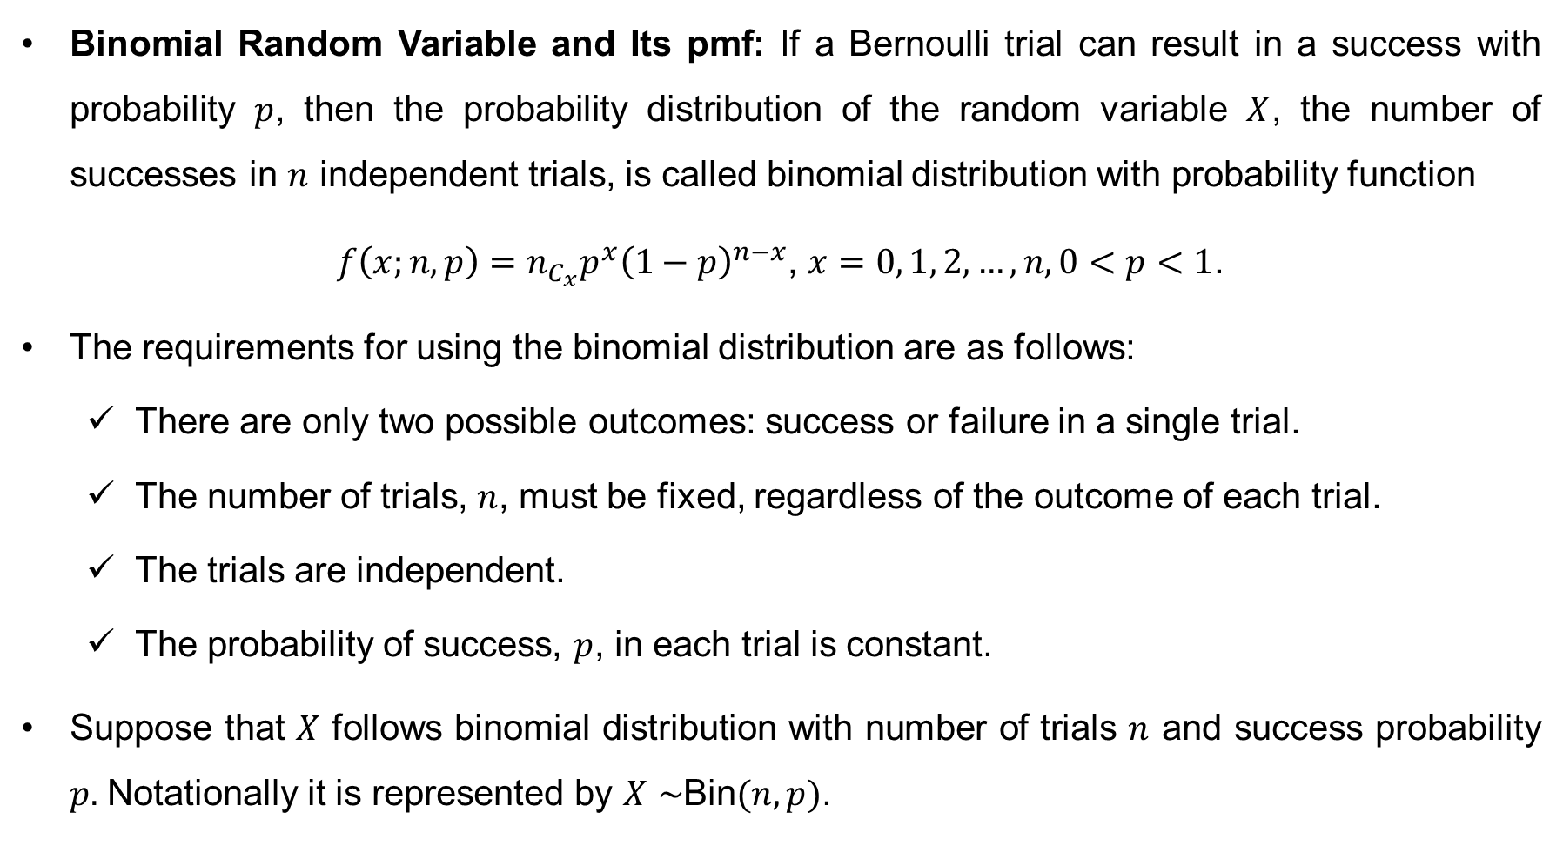
The Binomial Distribution (Cont…)
Binomial Random Variable and Its pmf: If a Bernoulli trial can result in a success with probability $p$, then the probability distribution of the random variable $X$, the number of successes in $n$ independent trials, is called binomial distribution with probability function
$f\left(x;n,p\right)=n_{C_{x}}p^{x}{\left(1−p\right)}^{n−x}$, $x=0, 1, 2, …, n, 0<p<1$.
The requirements for using the binomial distribution are as follows:
There are only two possible outcomes: success or failure in a single trial.
The number of trials, $n$, must be fixed, regardless of the outcome of each trial.
The trials are independent.
The probability of success, $p$, in each trial is constant.
Suppose that $X$ follows binomial distribution with number of trials $n$ and success probability $p.$ Notationally it is represented by $X∼$Bin$(n,p)$.

Slide 4
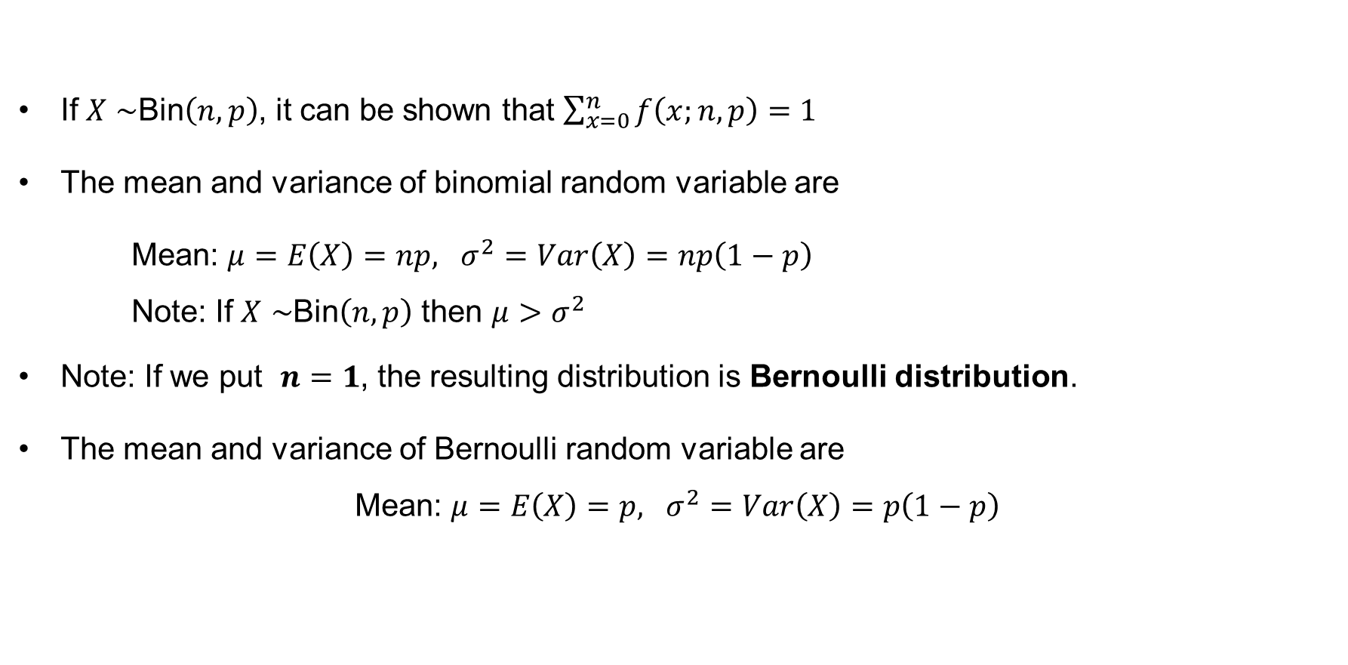
The Binomial Distribution (Cont…)
If $X∼$Bin$\left(n,p\right)$, it can be shown that $\sum_{x=0}^{n}{f\left(x;n,p\right)=1}$
The mean and variance of binomial random variable are
Mean: $μ=E\left(X\right)=np, σ^{2}=Var\left(X\right)=np\left(1−p\right)$
Note: If $X∼$Bin$\left(n,p\right)$ then $μ>σ^{2}$
Note: If we put $n=1$, the resulting distribution is Bernoulli distribution.
The mean and variance of Bernoulli random variable are
Mean: $μ=E\left(X\right)=p, σ^{2}=Var\left(X\right)=p\left(1−p\right)$

Slide 5
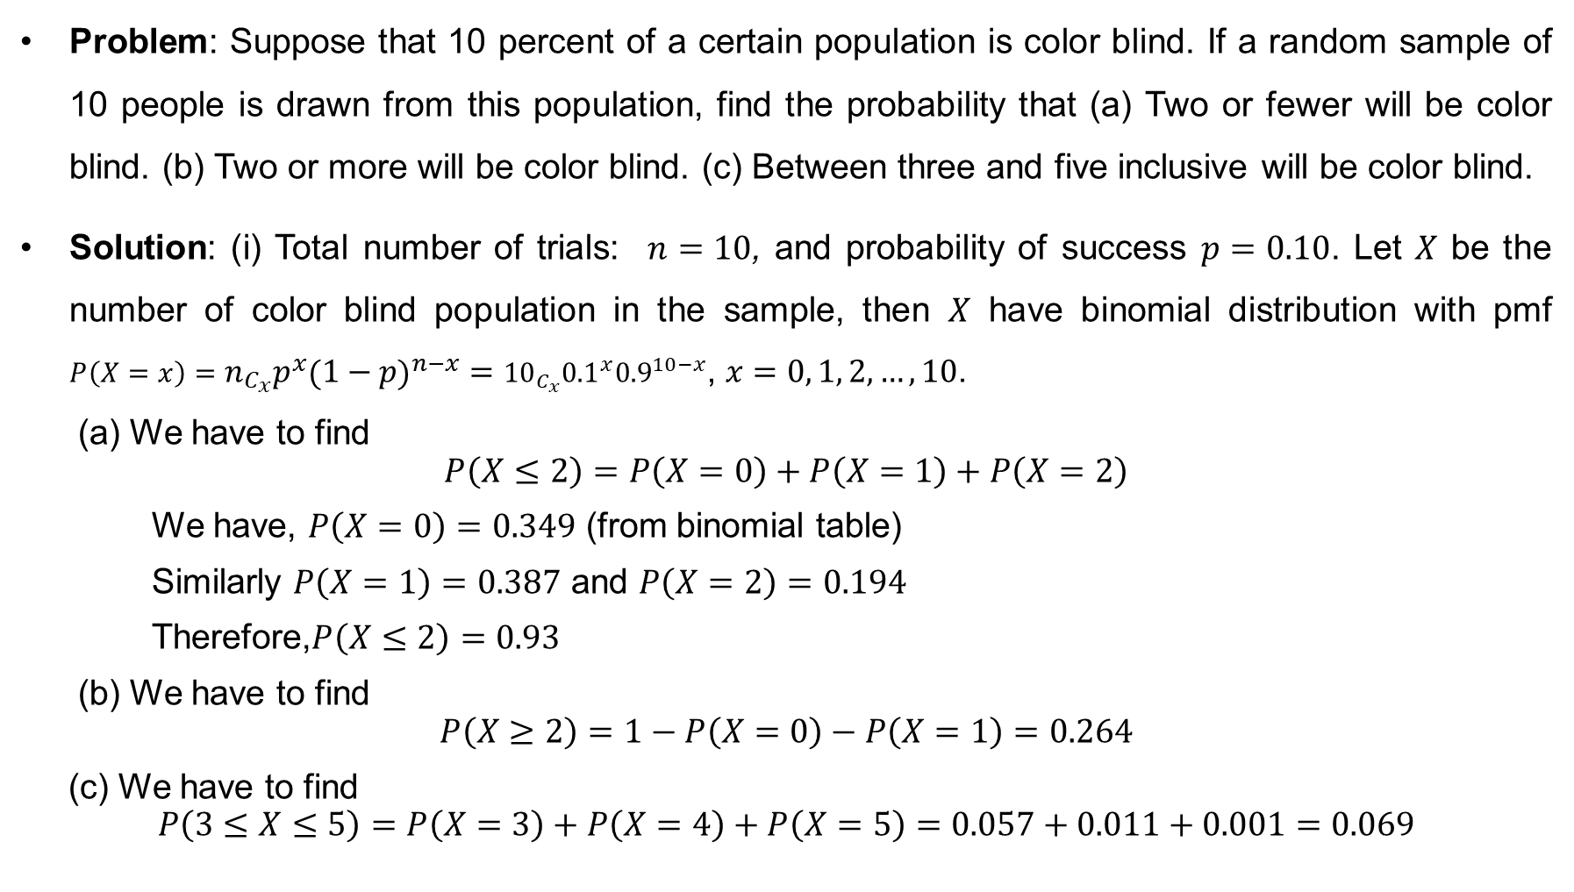
The Binomial Distribution (Cont…)
Problem: Suppose that 10 percent of a certain population is color blind. If a random sample of 10 people is drawn from this population, find the probability that (a) Two or fewer will be color blind. (b) Two or more will be color blind. (c) Between three and five inclusive will be color blind.
Solution: (i) Total number of trials: $n=10$, and probability of success $p=0.10$. Let $X$ be the number of color blind population in the sample, then $X$ have binomial distribution with pmf $P\left(X=x\right)=n_{C_{x}}p^{x}{\left(1−p\right)}^{n−x}={10}_{C_{x}}{0.1}^{x}{0.9}^{10−x}$, $x=0, 1, 2, …, 10$.
(a) We have to find
$$P\left(X≤2\right)=P\left(X=0\right)+P\left(X=1\right)+P\left(X=2\right)$$
We have, $P\left(X=0\right)=0.349$ (from binomial table)
Similarly $P\left(X=1\right)=0.387$ and $P\left(X=2\right)=0.194$
Therefore,$P\left(X≤2\right)=0.93$
(b) We have to find
$$P\left(X≥2\right)=1−P\left(X=0\right)−P\left(X=1\right)=0.264$$
(c) We have to find
$$P\left(3≤X≤5\right)=P\left(X=3\right)+P\left(X=4\right)+P\left(X=5\right)=0.057+0.011+0.001=0.069$$

Slide 6
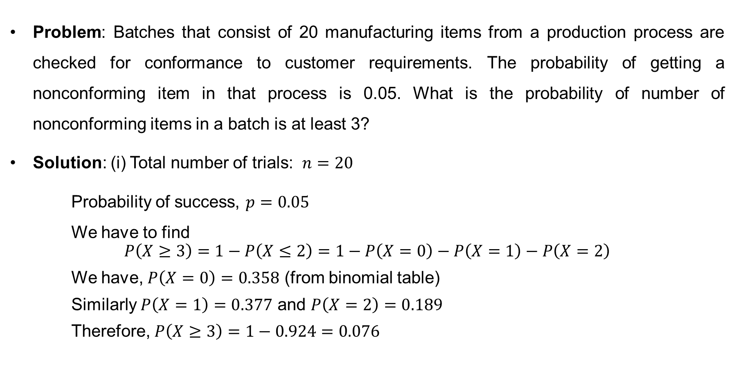
Binomial Distribution (cont…)
Problem: Batches that consist of 20 manufacturing items from a production process are checked for conformance to customer requirements. The probability of getting a nonconforming item in that process is 0.05. What is the probability of number of nonconforming items in a batch is at least 3?
Solution: (i) Total number of trials: $n=20$
Probability of success, $p=0.05$
We have to find
$$P\left(X≥3\right)=1−P\left(X≤2\right)=1−P\left(X=0\right)−P\left(X=1\right)−P\left(X=2\right)$$
We have, $P\left(X=0\right)=0.358$ (from binomial table)
Similarly $P\left(X=1\right)=0.377$ and $P\left(X=2\right)=0.189$
Therefore, $P\left(X≥3\right)=1−0.924=0.076$

Slide 7
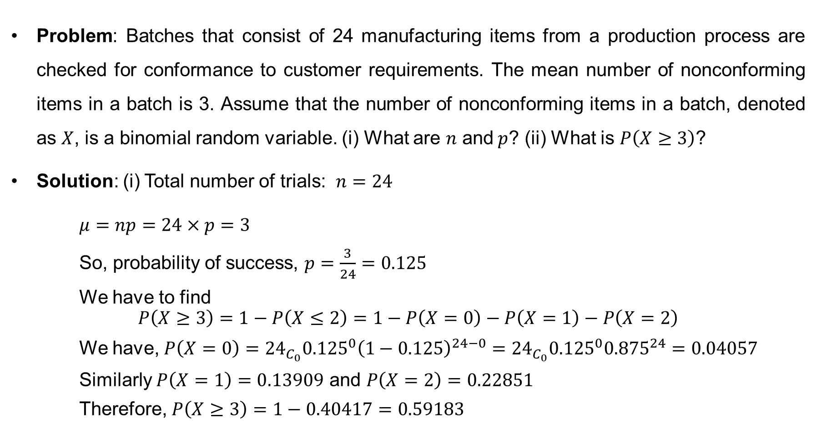
Binomial Distribution (cont…)
Problem: Batches that consist of 24 manufacturing items from a production process are checked for conformance to customer requirements. The mean number of nonconforming items in a batch is 3. Assume that the number of nonconforming items in a batch, denoted as $X$, is a binomial random variable. (i) What are $n$ and$p$? (ii) What is $P\left(X≥3\right)$?
Solution: (i) Total number of trials: $n=24$
$μ=np=24×p=3$
So, probability of success, $p=\frac{3}{24}=0.125$
We have to find
$$P\left(X≥3\right)=1−P\left(X≤2\right)=1−P\left(X=0\right)−P\left(X=1\right)−P\left(X=2\right)$$
We have, $P\left(X=0\right)={24}_{C_{0}}{0.125}^{0}{\left(1−0.125\right)}^{24−0}={24}_{C_{0}}{0.125}^{0}{0.875}^{24}=0.04057$
Similarly $P\left(X=1\right)=0.13909$ and $P\left(X=2\right)=0.22851$
Therefore, $P\left(X≥3\right)=1−0.40417=0.59183$

Slide 8
Poisson Distribution
Poisson Distribution: Situations often arise where the variable of interest is the number of occurrences of a particular event in a given interval of space or time. The events are often defects, accidents or unusual natural happenings, such as earthquakes, where in theory there is no upper limit on the number of events. Some examples are
the number of cars passing a point on a road in a time interval of 1 minute
the number of telephone calls received at a switchboard per minute
the number of misprints on each page of a book,
the number of radioactive particles emitted by a radioactive source in a time interval of 1 second.
The number of plants infected with a particular disease in a plot of field.

Slide 9
Poisson Distribution
The Poisson distribution is often known as the distribution of rare events. Given an interval of real numbers, assume counts occur at random throughout the interval. If the interval can be partitioned into subintervals of small enough length such that
For a small interval the probability of the event occurring is proportional to the size of the interval.
The probability of more than one occurrence in the small interval is negligible (i.e. they are rare events). Events must not occur simultaneously
Each occurrence must be independent of others and must be at random.
The random experiment is called a Poisson process.

Slide 10
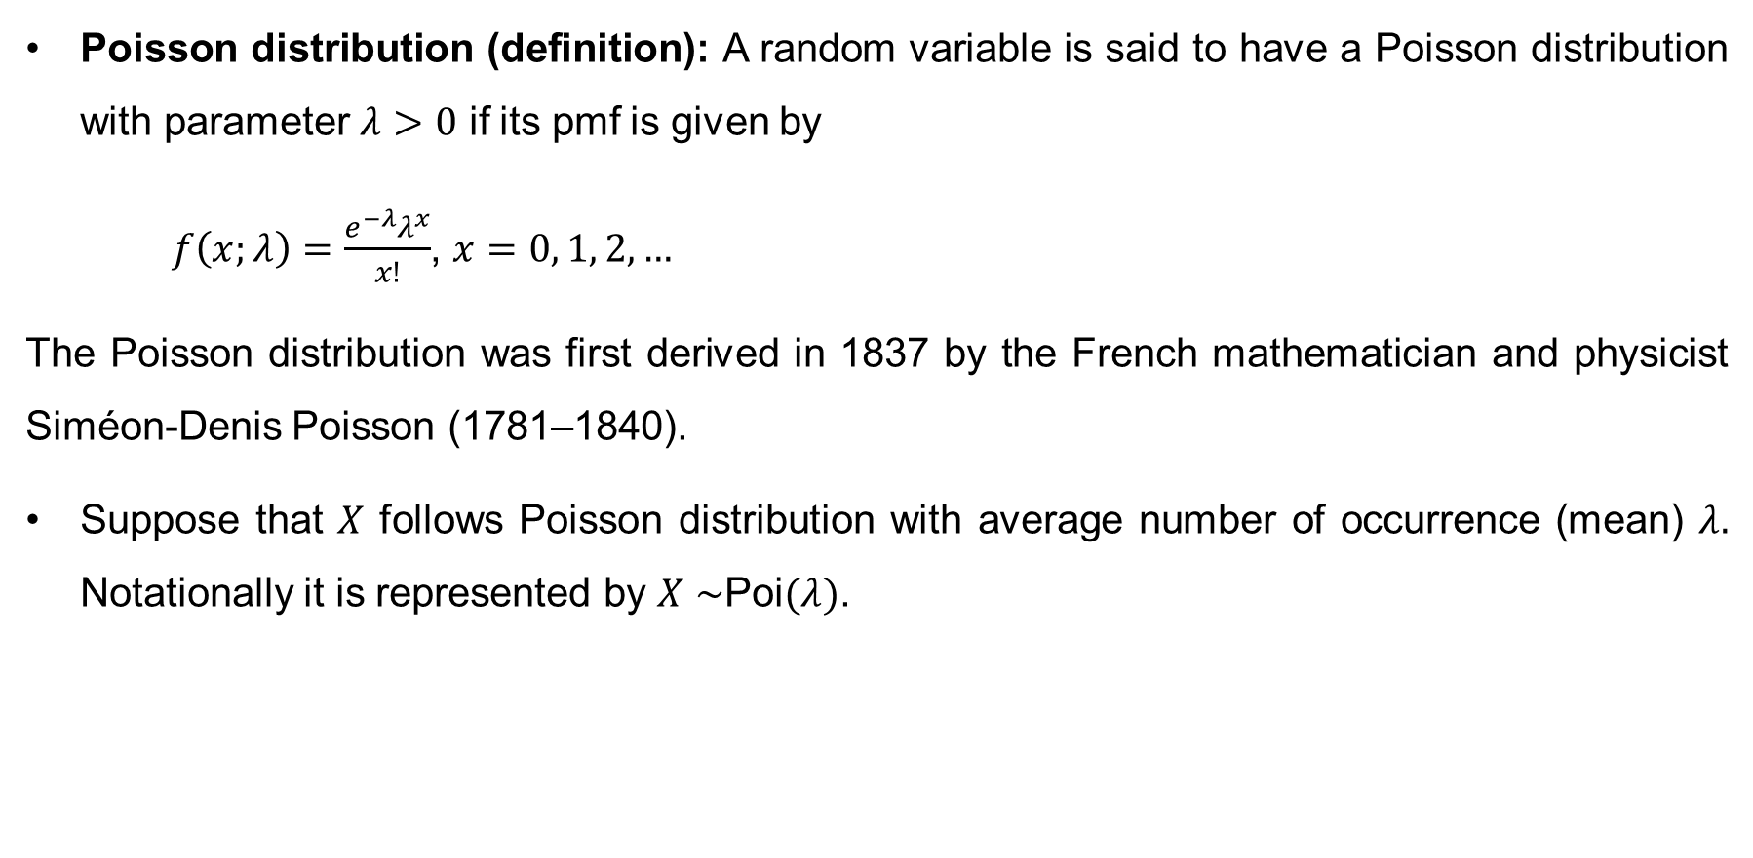
The Poisson Distribution (cont…)
Poisson distribution (definition): A random variable is said to have a Poisson distribution with parameter $λ>0$ if its pmf is given by
$f\left(x;λ\right)=\frac{e^{−λ}λ^{x}}{x!}$, $x=0, 1, 2, …$
The Poisson distribution was first derived in 1837 by the French mathematician and physicist Siméon-Denis Poisson (1781–1840).
Suppose that $X$ follows Poisson distribution with average number of occurrence (mean) $λ.$ Notationally it is represented by $X∼$Poi$(λ)$.

Slide 11
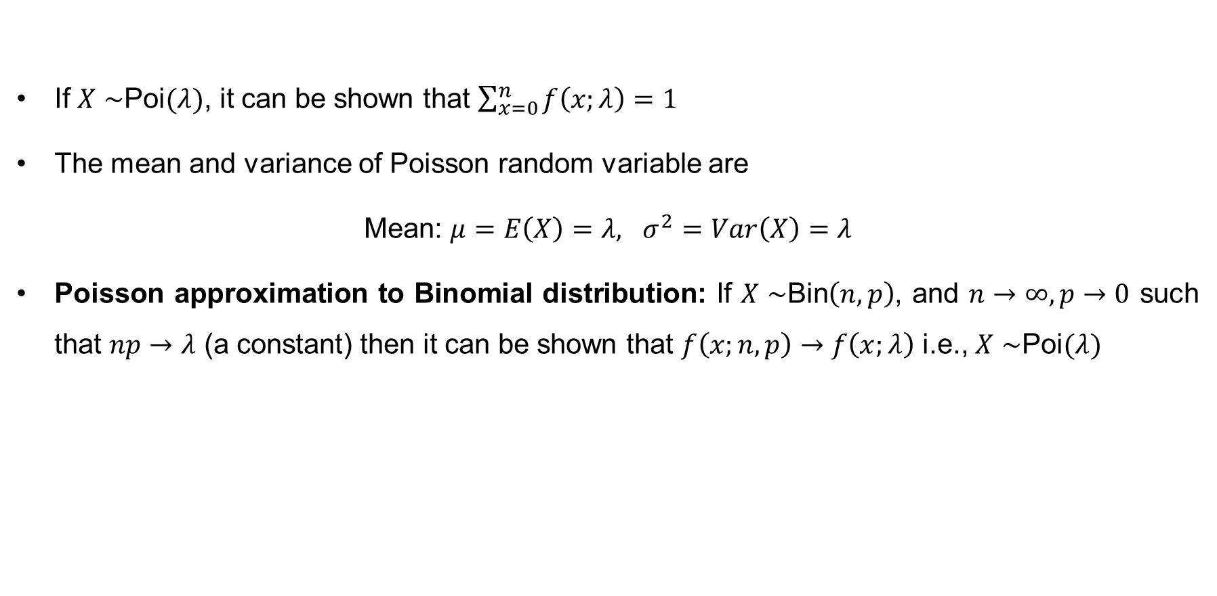
The Poisson Distribution (Cont…)
If $X∼$Poi$(λ)$, it can be shown that $\sum_{x=0}^{n}{f\left(x;λ\right)=1}$
The mean and variance of Poisson random variable are
Mean: $μ=E\left(X\right)=λ, σ^{2}=Var\left(X\right)=λ$
Poisson approximation to Binomial distribution: If $X∼$Bin$\left(n,p\right)$, and $n→∞, p→0$ such that $np→λ$ (a constant) then it can be shown that $f\left(x;n,p\right)→f\left(x;λ\right)$ i.e., $X∼$Poi$(λ)$

Slide 12
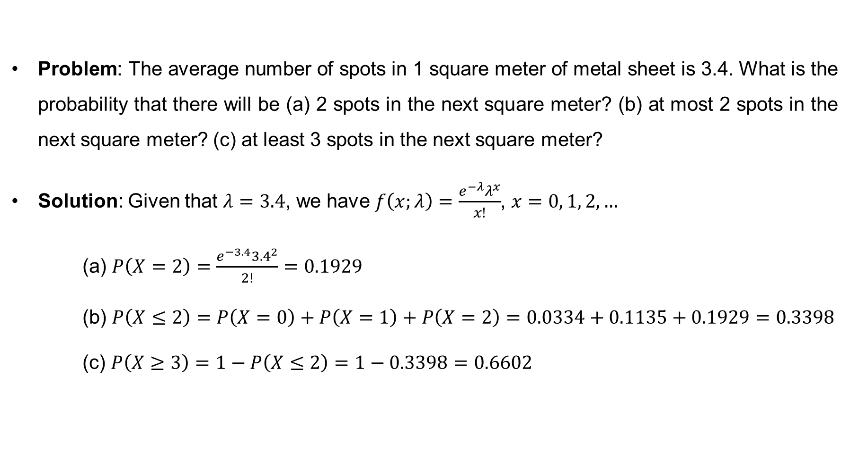
Poisson Distribution (cont…)
Problem: The average number of spots in 1 square meter of metal sheet is 3.4. What is the probability that there will be (a) 2 spots in the next square meter? (b) at most 2 spots in the next square meter? (c) at least 3 spots in the next square meter?
Solution: Given that $λ=3.4$, we have $f\left(x;λ\right)=\frac{e^{−λ}λ^{x}}{x!}$, $x=0, 1, 2, …$
(a) $P\left(X=2\right)=\frac{e^{−3.4}{3.4}^{2}}{2!}=0.1929$
(b) $P\left(X≤2\right)=P\left(X=0\right)+P\left(X=1\right)+P\left(X=2\right)=0.0334+0.1135+0.1929=0.3398$
(c) $P\left(X≥3\right)=1−P\left(X≤2\right)=1−0.3398=0.6602$

Slide 13
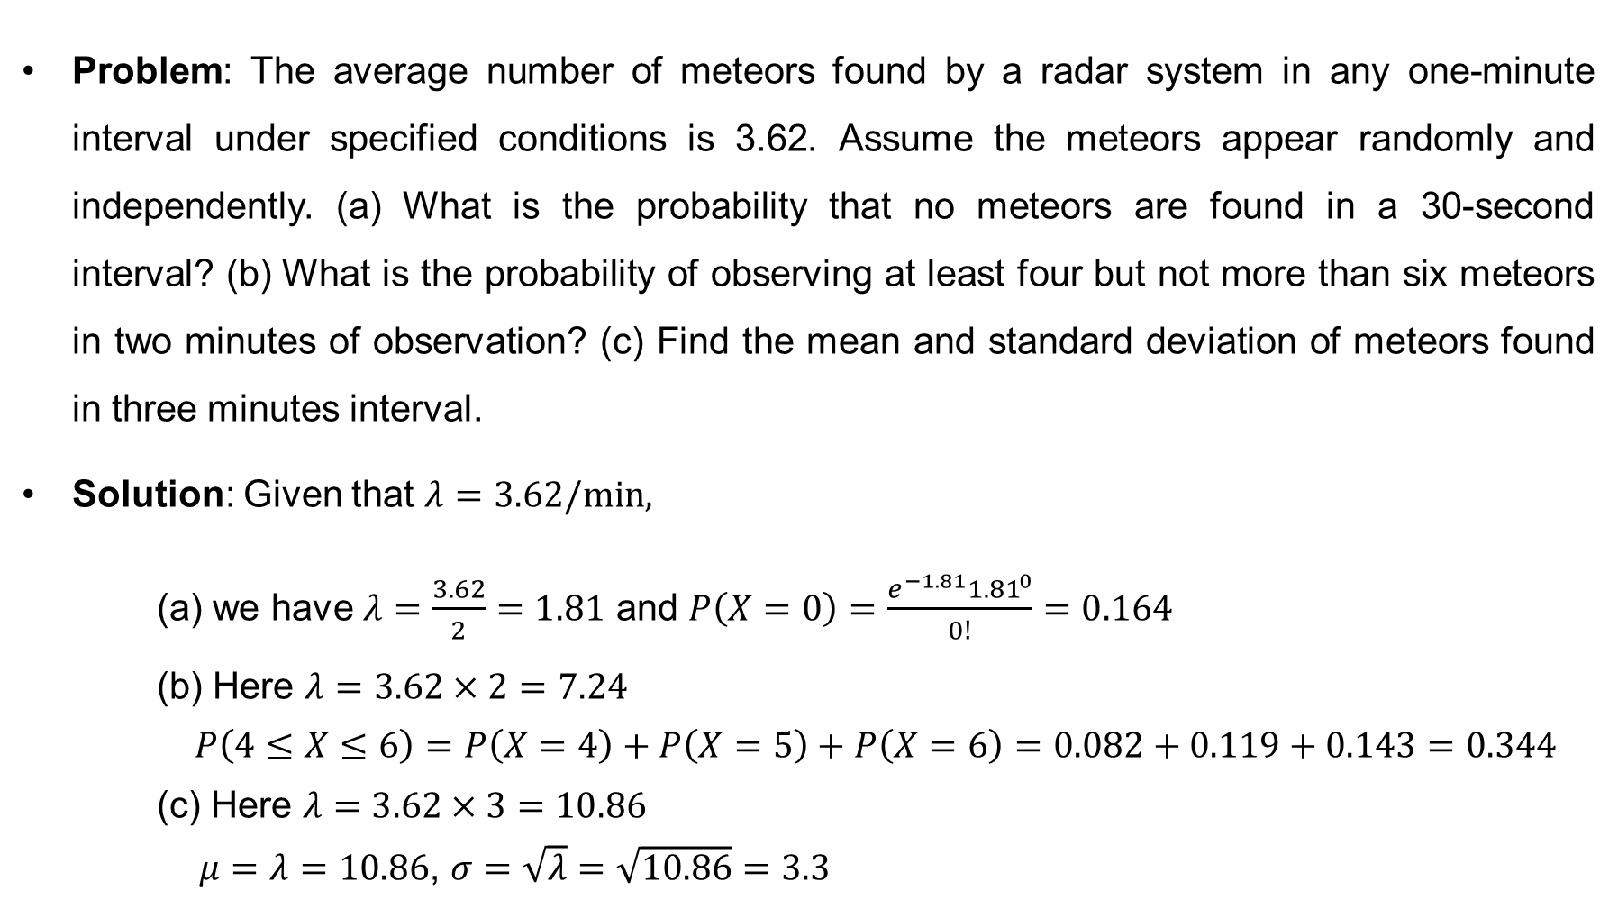
Poisson Distribution (cont…)
Problem: The average number of meteors found by a radar system in any one-minute interval under specified conditions is 3.62. Assume the meteors appear randomly and independently. (a) What is the probability that no meteors are found in a 30-second interval? (b) What is the probability of observing at least four but not more than six meteors in two minutes of observation? (c) Find the mean and standard deviation of meteors found in three minutes interval.
Solution: Given that $λ=3.62/min,$
(a) we have $λ=\frac{3.62}{2}=1.81$ and $P\left(X=0\right)=\frac{e^{−1.81}{1.81}^{0}}{0!}=0.164$
(b) Here $λ=3.62×2=7.24$
$P\left(4≤X≤6\right)=P\left(X=4\right)+P\left(X=5\right)+P\left(X=6\right)=0.082+0.119+0.143=0.344$
(c) Here $λ=3.62×3=10.86$
$μ=λ=10.86$, $σ=\sqrt{λ}=\sqrt{10.86}=3.3$

Slide 14
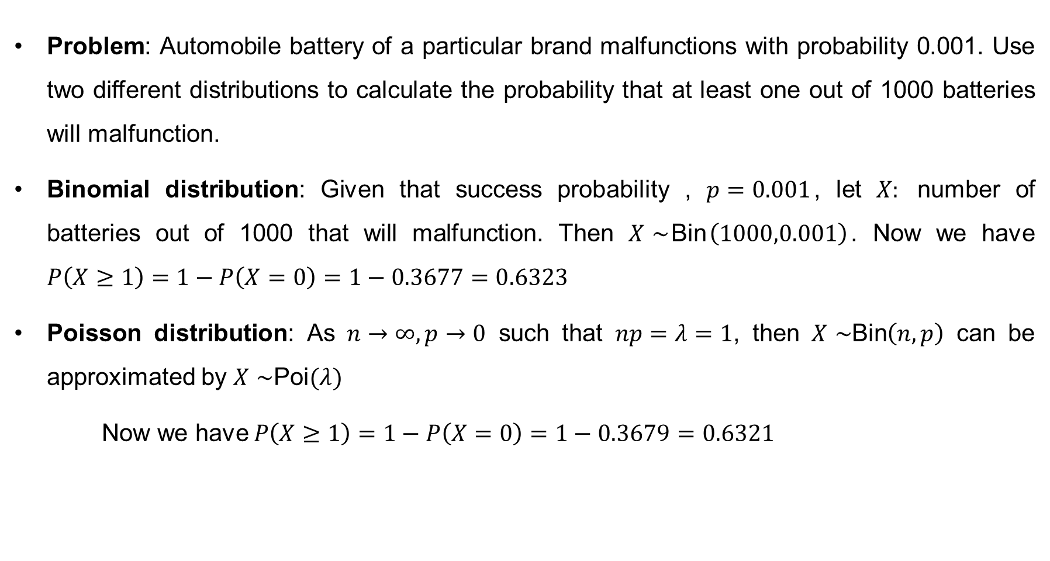
Poisson Distribution (cont…)
Problem: Automobile battery of a particular brand malfunctions with probability 0.001. Use two different distributions to calculate the probability that at least one out of 1000 batteries will malfunction.
Binomial distribution: Given that success probability , $p=0.001$, let $X:$ number of batteries out of 1000 that will malfunction. Then $X∼$Bin$\left(1000,0.001\right)$. Now we have $P\left(X≥1\right)=1−P\left(X=0\right)=1−0.3677=0.6323$
Poisson distribution: As $n→∞, p→0$ such that $np=λ=1$, then $X∼$Bin$\left(n,p\right)$ can be approximated by $X∼$Poi$(λ)$
Now we have $P\left(X≥1\right)=1−P\left(X=0\right)=1−0.3679=0.6321$

Slide 15
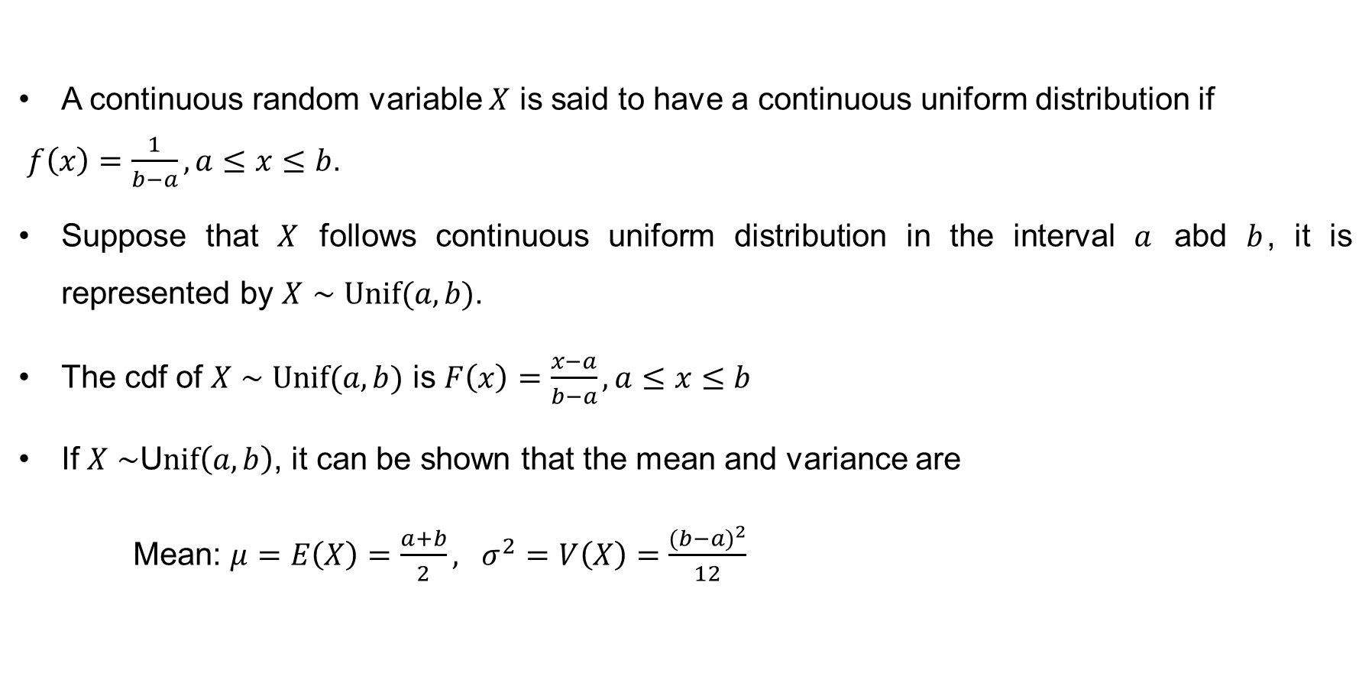
Continuous Uniform Distribution
A continuous random variable $X$ is said to have a continuous uniform distribution if
$f\left(x\right)=\frac{1}{b−a},a≤x≤b$.
Suppose that $X$ follows continuous uniform distribution in the interval $a$ abd $b$, it is represented by $X∼Unif(a, b)$.
The cdf of $X∼Unif(a, b)$ is $F\left(x\right)=\frac{x−a}{b−a}, a≤x≤b$
If $X∼$U$nif\left(a, b\right)$, it can be shown that the mean and variance are
Mean: $μ=E\left(X\right)=\frac{a+b}{2}, σ^{2}=V\left(X\right)=\frac{{(b−a)}^{2}}{12}$

Slide 16
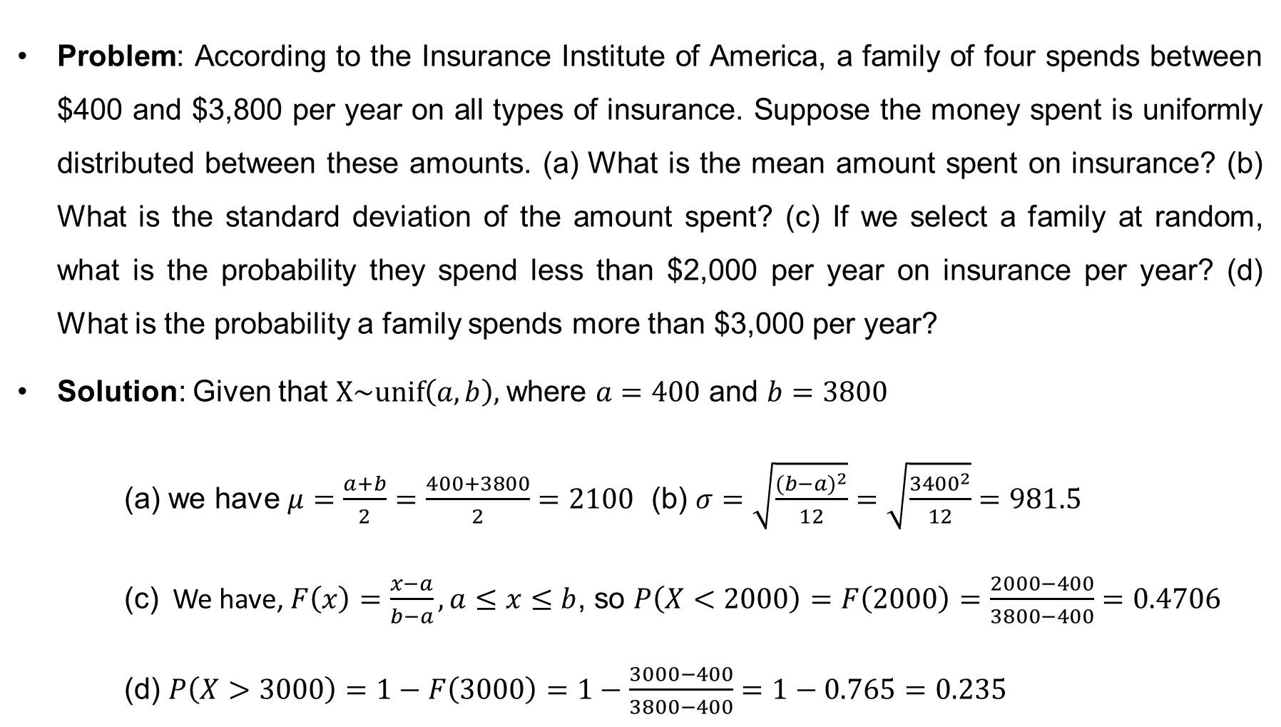
Continuous Uniform Distribution (cont…)
Problem: According to the Insurance Institute of America, a family of four spends between $400 and $3,800 per year on all types of insurance. Suppose the money spent is uniformly distributed between these amounts. (a) What is the mean amount spent on insurance? (b) What is the standard deviation of the amount spent? (c) If we select a family at random, what is the probability they spend less than $2,000 per year on insurance per year? (d) What is the probability a family spends more than $3,000 per year?
Solution: Given that $X\sim unif\left(a,b\right),$where $a=400$ and $b=3800$
(a) we have $μ=\frac{a+b}{2}=\frac{400+3800}{2}=2100$ (b) $σ=\sqrt{\frac{{(b−a)}^{2}}{12}}=\sqrt{\frac{{3400}^{2}}{12}}=981.5$
(c) We have, $F\left(x\right)=\frac{x−a}{b−a}, a≤x≤b$, so $P\left(X<2000\right)=F\left(2000\right)=\frac{2000−400}{3800−400}=0.4706$
(d) $P\left(X>3000\right)=1−F\left(3000\right)=1−\frac{3000−400}{3800−400}=1−0.765=0.235$

Slide 17
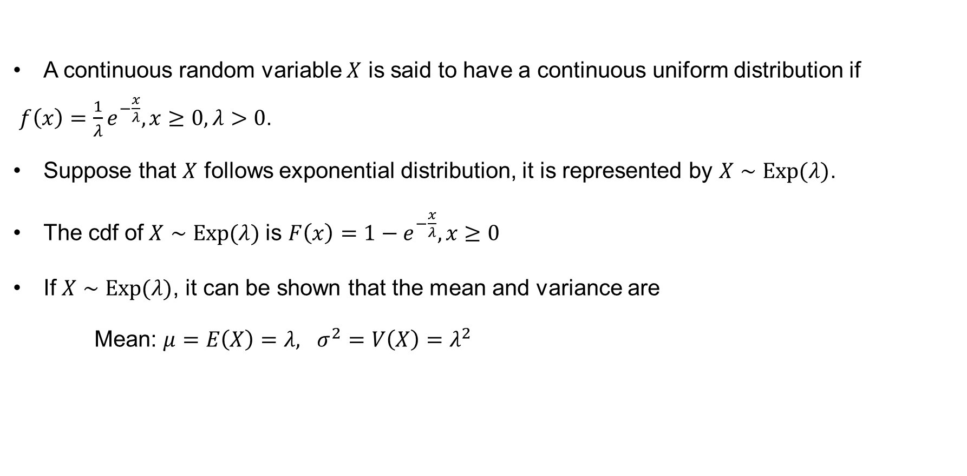
Exponential Distribution
A continuous random variable $X$ is said to have a continuous uniform distribution if
$f\left(x\right)=\frac{1}{λ}e^{−\frac{x}{λ}}, x≥0,λ>0$.
Suppose that $X$ follows exponential distribution, it is represented by $X∼Exp(λ)$.
The cdf of$X∼Exp(λ)$ is $F\left(x\right)=1−e^{−\frac{x}{λ}},x≥0$
If $X∼Exp(λ)$, it can be shown that the mean and variance are
Mean: $μ=E\left(X\right)=λ, σ^{2}=V\left(X\right)=λ^{2}$

Slide 18
Continuous Uniform Distribution (cont…)
Problem: Waiting times to receive food after placing an order at a local sandwich shop follow an exponential distribution with a mean of 60 seconds. Calculate the probability a customer waits:
a. Less than 30 seconds.
b. More than 120 seconds.
c. Between 45 and 75 seconds.
d. Fifty percent of the patrons wait less than how many seconds? What is the median?

Slide 19

Normal Distribution
A continuous random variable $X$ is said to have a normal distribution if its pdf is
$$f\left(x;μ,σ^{2}\right)=\frac{1}{σ\sqrt{2π}}e^{−\frac{1}{2}{\left(\frac{x−μ}{σ}\right)}^{2}},−∞<x<∞,$$
where $μ$ is the mean of the distribution and $σ^{2}$ is the variance of $X$.
Suppose that $X$ follows normal distribution with mean $μ$and variance $σ^{2}$, it is represented by $X∼N(μ,σ^{2})$.
Normal distribution is a symmetrical distribution (symmetrical about the point $μ$). The normal distribution with mean 100 and variance 4 is shown in the following figure

Slide 20
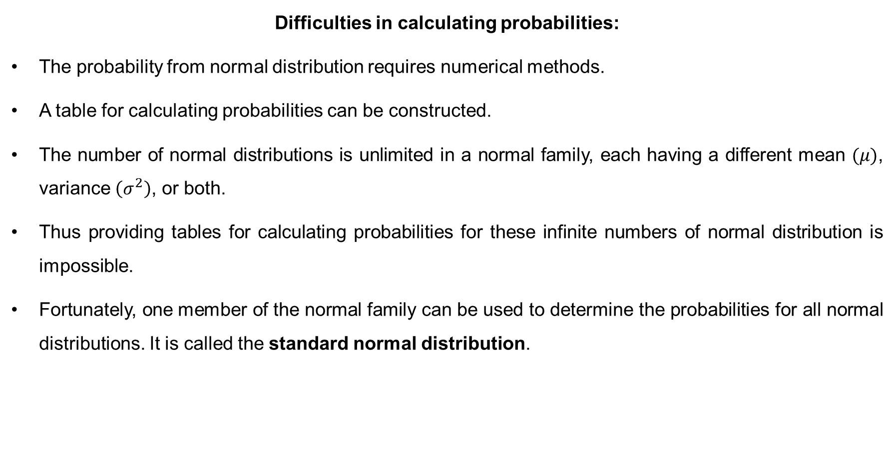
Normal Distribution (cont…)
Difficulties in calculating probabilities:
The probability from normal distribution requires numerical methods.
A table for calculating probabilities can be constructed.
The number of normal distributions is unlimited in a normal family, each having a different mean $(μ)$, variance $\left(σ^{2}\right)$, or both.
Thus providing tables for calculating probabilities for these infinite numbers of normal distribution is impossible.
Fortunately, one member of the normal family can be used to determine the probabilities for all normal distributions. It is called the standard normal distribution.

Slide 21
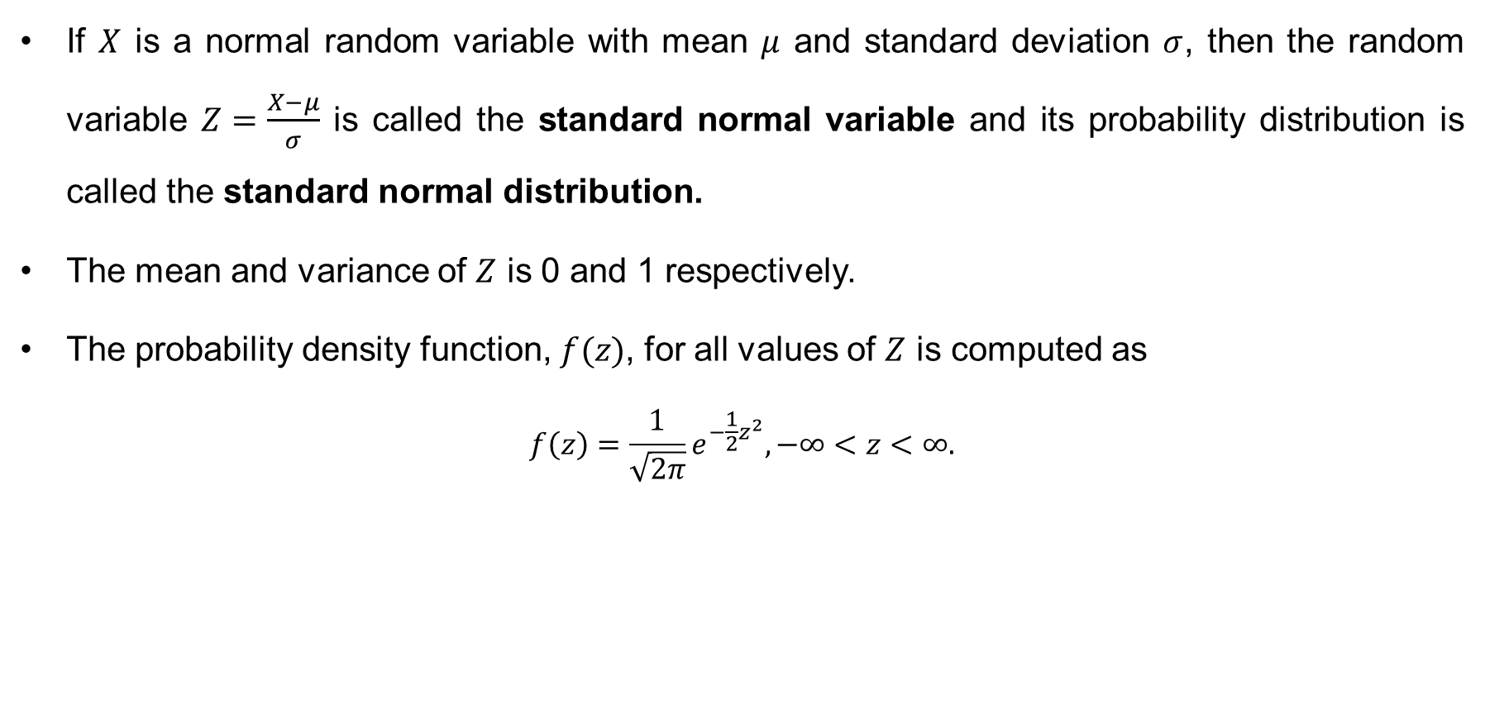
Standard Normal Distribution
If $X$ is a normal random variable with mean $μ$ and standard deviation $σ$, then the random variable $Z=\frac{X−μ}{σ}$ is called the standard normal variable and its probability distribution is called the standard normal distribution.
The mean and variance of $Z$ is 0 and 1 respectively.
The probability density function, $f(z)$, for all values of $Z$ is computed as
$$f\left(z\right)=\frac{1}{\sqrt{2π}}e^{−\frac{1}{2}z^{2}},−∞<z<∞.$$

Slide 22

Computing Probability from Normal Distribution
Step-1: Express $P\left(x_{1}<X<x_{2}\right)$ as $P\left(z_{1}<Z<z_{2}\right)$
Step-2: These probabilities for different intervals of a standard random variable (Z) can be calculated by using a standard normal table.

Slide 23
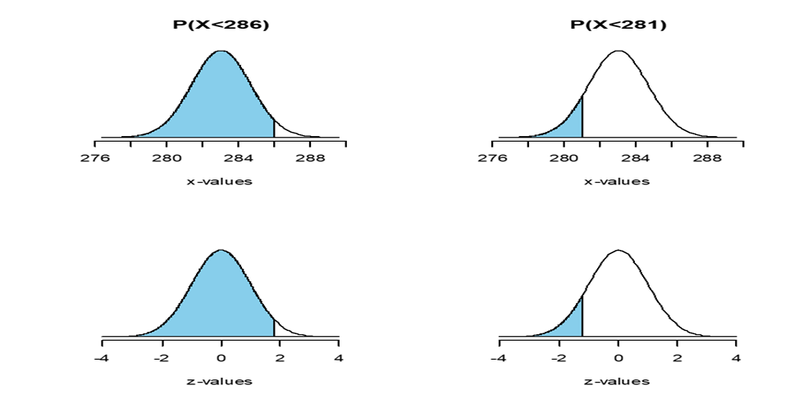

Problem on Normal Distribution
Example: Suppose a random variable have a normal distribution with mean 283 and standard deviation 1.65. Then $P(X<286)$ is equivalent to $P\left(Z<1.82\right)$, and $P(X<281)$ is equivalent to $P\left(Z<−1.21\right)$ as shown below
$P\left(X<286\right)=P\left(\frac{X−μ}{σ}<\frac{286−μ}{σ}\right)=P\left(Z<\frac{286−283}{1.65}\right)=P\left(Z<1.82\right)=F\left(1.82\right)=0.9656$
$P\left(X<281\right)=P\left(\frac{X−μ}{σ}<\frac{281−μ}{σ}\right)=P\left(Z<\frac{281−283}{1.65}\right)=P\left(Z<−1.21\right)=F\left(−1.21\right)=0.1131$

Slide 24
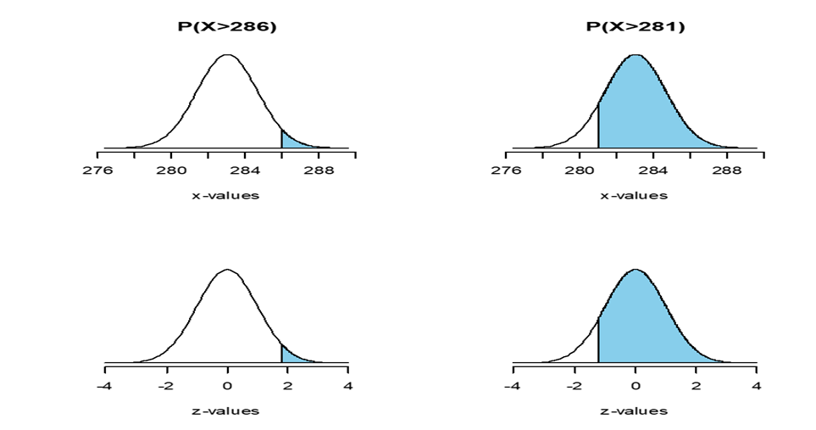

Example (Cont…)
Similarly
$$P\left(X>286\right)=P\left(Z>1.82\right)=1−F\left(1.82\right)=1−0.9656=0.0344$$
$$P\left(X>281\right)=P\left(Z>−1.21\right)=1−F\left(−1.21\right)=1−0.1131=0.8869$$

Slide 25
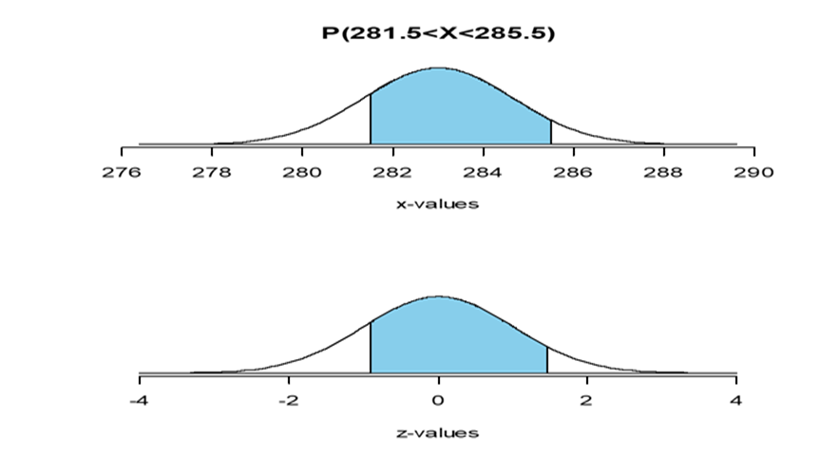

Example (Cont…)
Similarly
$$P\left(281.5<X<285.4\right)=P\left(\frac{281.5−μ}{σ}<\frac{X−μ}{σ}<\frac{285.4−μ}{σ}\right)=P\left(−0.91<Z<1.45\right)$$
$$=F\left(1.45\right)−F\left(−0.91\right)=0.9265−0.1814=0.7451$$

Slide 26
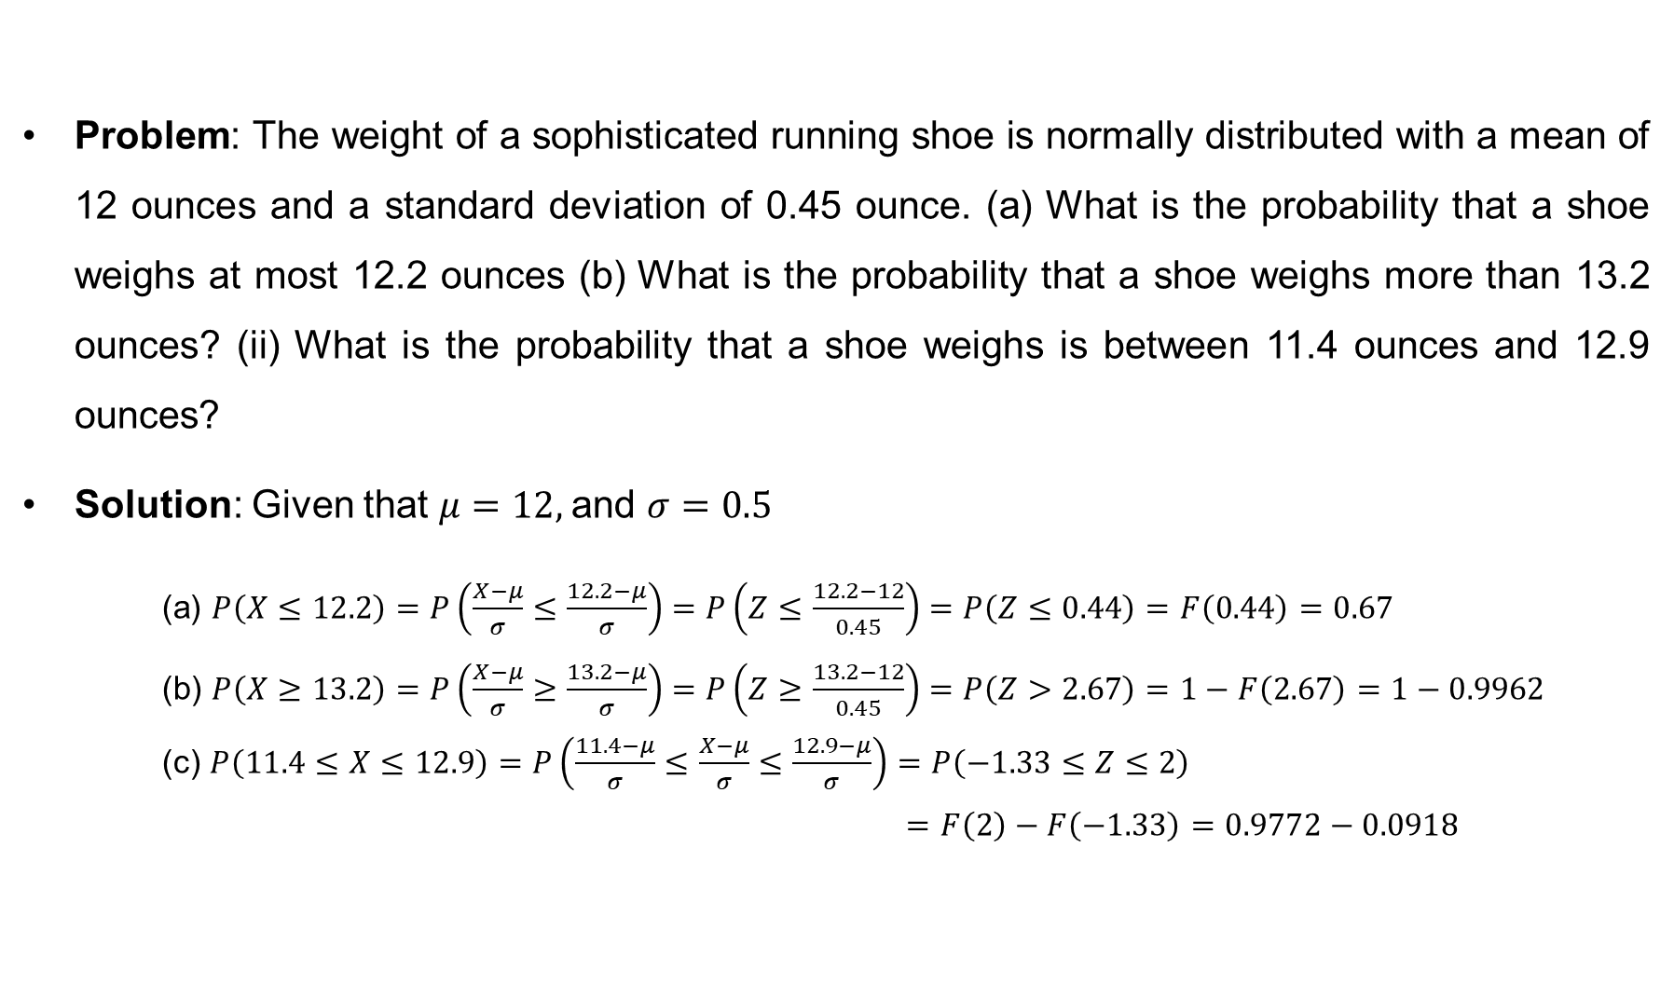
Problem on Normal Distribution
Problem: The weight of a sophisticated running shoe is normally distributed with a mean of 12 ounces and a standard deviation of 0.45 ounce. (a) What is the probability that a shoe weighs at most 12.2 ounces (b) What is the probability that a shoe weighs more than 13.2 ounces? (ii) What is the probability that a shoe weighs is between 11.4 ounces and 12.9 ounces?
Solution: Given that $μ=12,$and $σ=0.5$
(a) $P\left(X≤12.2\right)=P\left(\frac{X−μ}{σ}≤\frac{12.2−μ}{σ}\right)=P\left(Z≤\frac{12.2−12}{0.45}\right)=P\left(Z≤0.44\right)=F\left(0.44\right)=0.67$
(b) $P\left(X≥13.2\right)=P\left(\frac{X−μ}{σ}≥\frac{13.2−μ}{σ}\right)=P\left(Z≥\frac{13.2−12}{0.45}\right)=P\left(Z>2.67\right)=1−F\left(2.67\right)=1−0.9962$
(c) $P\left(11.4≤X≤12.9\right)=P\left(\frac{11.4−μ}{σ}≤\frac{X−μ}{σ}≤\frac{12.9−μ}{σ}\right)=P\left(−1.33≤Z≤2\right)$
$=F\left(2\right)−F\left(−1.33\right)=0.9772−0.0918$

Slide 27
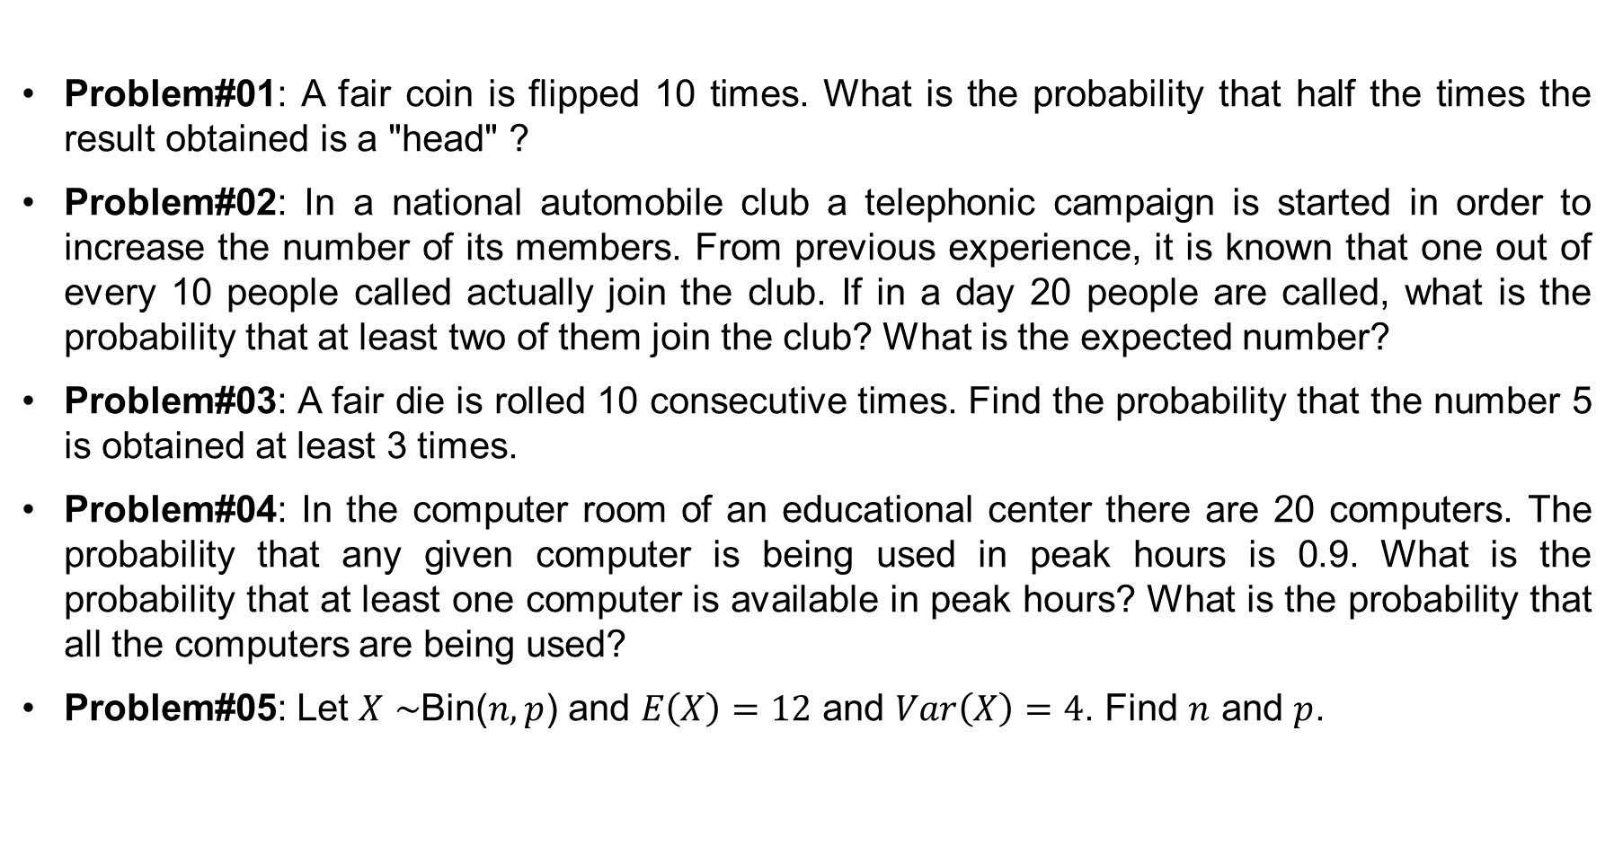
Exercise
Problem#01: A fair coin is flipped 10 times. What is the probability that half the times the result obtained is a "head" ?
Problem#02: In a national automobile club a telephonic campaign is started in order to increase the number of its members. From previous experience, it is known that one out of every 10 people called actually join the club. If in a day 20 people are called, what is the probability that at least two of them join the club? What is the expected number?
Problem#03: A fair die is rolled 10 consecutive times. Find the probability that the number 5 is obtained at least 3 times.
Problem#04: In the computer room of an educational center there are 20 computers. The probability that any given computer is being used in peak hours is 0.9. What is the probability that at least one computer is available in peak hours? What is the probability that all the computers are being used?
Problem#05: Let $X∼$Bin($n, p$) and $E\left(X\right)=12$ and $Var\left(X\right)=4$. Find $n$ and $p$.

Slide 28
Exercise (cont…)
Problem#06: Suppose 1.5 percent of the antennas on new Nokia cell phones are defective. For a random sample of 200 antennas, find the probability that: a. None of the antennas is defective. b. Three or more of the antennas are defective. ? Ans: (a) 0.0498 (b) 0.5768
Problem#07: The academic head of a faculty in a University receive an average of two emails per hour. a. What is the probability that she received exactly 1 email between 4 P.M. and 5 P.M. yesterday? b. What is the probability she received 5 or more emails during 4 P.M. to 6 P.M.? c. What is the probability she did not receive any emails during 3 P.M. to 3:30 P.M.?
Problem#08: A student arrives at the bus station at 6:00 AM sharp knowing that the bus will arrive any moment, uniformly distributed between 6:00 AM and 6:20 AM. What is the probability that the student must wait more than 5 minutes? If at 6:10 AM the bus has not arrived yet, what is the probability that the student has to wait at least 5 more minutes? Hints. Compute the conditional probability that if the bus arrive after 6:10P.M. then what is the probability that it arrive after 6:15 P.M.
Problem#09: The lifetime of a printer is an Exponential random variable with the expectation 5.2 years. What percentage of the printers have a lifetime (i) less than 7 years? (ii) More than 3 years? (iii) Between 3 and 7 years?

Slide 29
Exercise (cont…)
Problem#10: A study of phone calls made from customer service revealed the length of the calls, in minutes, follows the exponential probability distribution. The mean length of time per call was 3.2 minutes. (i) What proportion of the calls last below 3 minutes? (ii) What proportion of the calls last more than 4 minutes? (iii) What proportion of the calls last between 2 and 5 minutes? (iii) As part of her report to the president, the director of communications would like to report the length of the longest (in duration) 10 percent of the calls. What is this time?
Problem#11: The time it takes a printer to print a job is is a normal random variable with mean of 45 seconds and standard deviation 7 seconds. You send a job to the printer at 10:00 am, what is the probability that your job will be ready before 10:01?
Problem#12: Suppose that the number of kilometers that an automobile travels before its battery runs out is distributed exponentially with a mean value of 10,000 km. (i) If a person wants to travel 5,000 km, what is the probability that the person finishes his trip without having to change the battery? (ii) After running 1,000 km without any trouble of the battery, the person changes his trip and wants to travel additional 5,000 km, what is the probability that the person finishes his changed-trip without having to change the battery? (iii) Is the answer for part-(i) and part-(ii) are same? What is your comment about it.

Slide 30
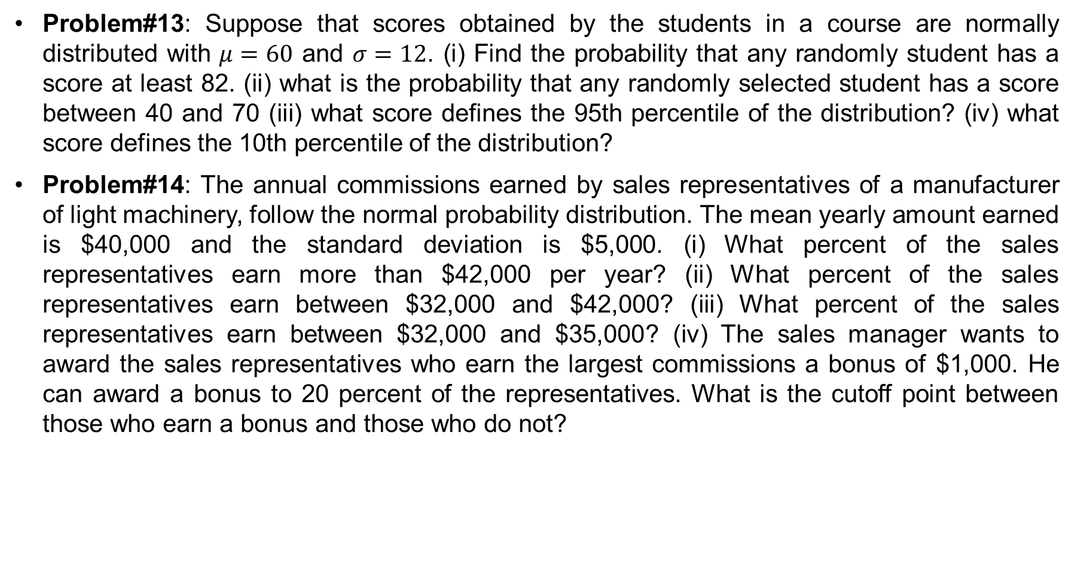
Exercise (cont…)
Problem#13: Suppose that scores obtained by the students in a course are normally distributed with $μ=60$ and $σ=12$. (i) Find the probability that any randomly student has a score at least 82. (ii) what is the probability that any randomly selected student has a score between 40 and 70 (iii) what score defines the 95th percentile of the distribution? (iv) what score defines the 10th percentile of the distribution?
Problem#14: The annual commissions earned by sales representatives of a manufacturer of light machinery, follow the normal probability distribution. The mean yearly amount earned is $40,000 and the standard deviation is $5,000. (i) What percent of the sales representatives earn more than $42,000 per year? (ii) What percent of the sales representatives earn between $32,000 and $42,000? (iii) What percent of the sales representatives earn between $32,000 and $35,000? (iv) The sales manager wants to award the sales representatives who earn the largest commissions a bonus of $1,000. He can award a bonus to 20 percent of the representatives. What is the cutoff point between those who earn a bonus and those who do not?

