Slide 1
COURSE TITLE: : Statistics and Probability COURSE CODE: STA 102 Topics: Inference: Estimation and Test of Hypothesis
Instructor: Md. Ershadul Haque, PhD
Professor, Department of Statistics, DU
&
Adjunct Faculty, EWU, Bangladesh

Slide 2
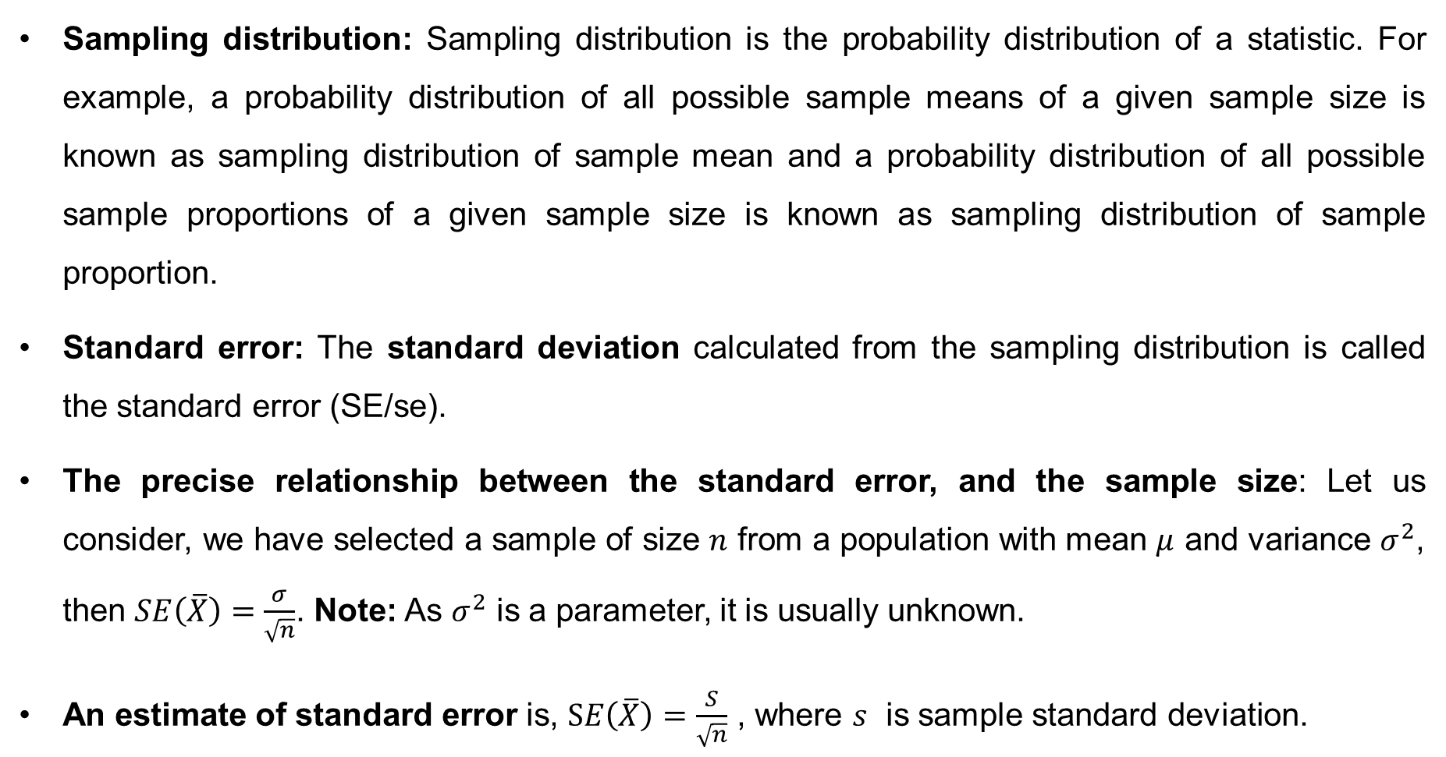
Sampling Distribution and Estimation
Sampling distribution: Sampling distribution is the probability distribution of a statistic. For example, a probability distribution of all possible sample means of a given sample size is known as sampling distribution of sample mean and a probability distribution of all possible sample proportions of a given sample size is known as sampling distribution of sample proportion.
Standard error: The standard deviation calculated from the sampling distribution is called the standard error (SE/se).
The precise relationship between the standard error, and the sample size: Let us consider, we have selected a sample of size $n$ from a population with mean $μ$ and variance $σ^{2}$, then $SE\left(\overline{X}\right)=\frac{σ}{\sqrt{n}}$. Note: As $σ^{2}$ is a parameter, it is usually unknown.
An estimate of standard error is, $SE\left(\overline{X}\right)=\frac{S}{\sqrt{n}}$ , where $s$ is sample standard deviation.

Slide 3
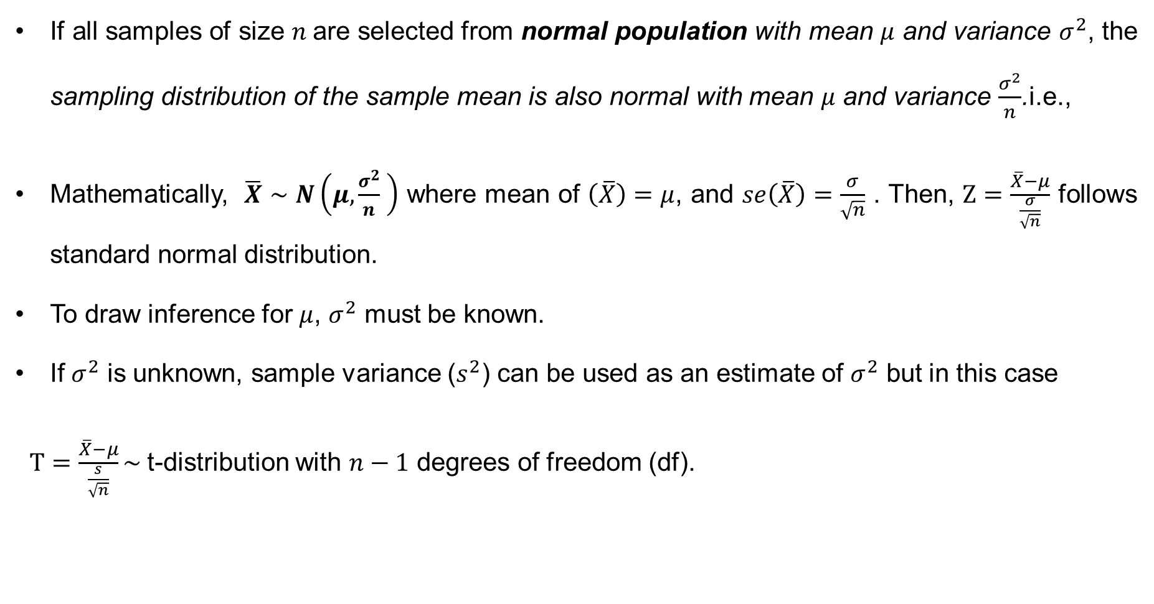
Properties of normal population
If all samples of size $n$are selected from normal population with mean $μ$ and variance $σ^{2}$, the sampling distribution of the sample mean is also normal with mean $μ$ and variance $\frac{σ^{2}}{n}$.i.e.,
Mathematically, $\overline{X}∼N\left(μ,\frac{σ^{2}}{n} \right)$ where mean of $\left(\overline{X}\right)=μ$, and $se\left(\overline{X}\right)=\frac{σ}{\sqrt{n}}$ . Then, $Z=\frac{\overline{X}−μ}{\frac{σ}{\sqrt{n}}}$ follows standard normal distribution.
To draw inference for $μ$, $σ^{2}$ must be known.
If $σ^{2}$ is unknown, sample variance ($s^{2}$) can be used as an estimate of $σ^{2}$ but in this case
$T=\frac{\overline{X}−μ}{\frac{s}{\sqrt{n}}}\sim$t-distribution with $n−1$ degrees of freedom (df).

Slide 4
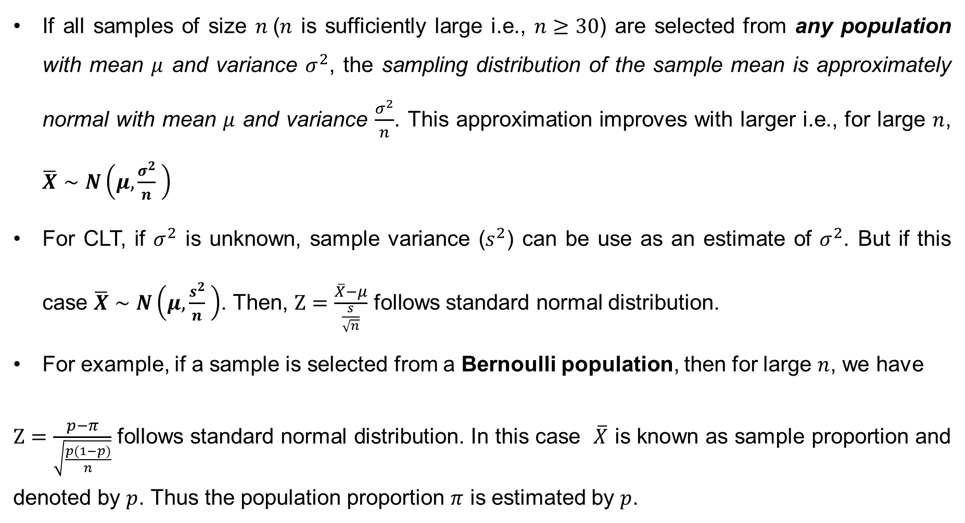
The Central Limit Theorem (CLT)
If all samples of size $n$($n$ is sufficiently large i.e., $n≥30$) are selected from any population with mean $μ$ and variance $σ^{2}$, the sampling distribution of the sample mean is approximately normal with mean $μ$ and variance $\frac{σ^{2}}{n}$. This approximation improves with larger i.e., for large $n$, $\overline{X}∼N\left(μ,\frac{σ^{2}}{n} \right)$
For CLT, if $σ^{2}$ is unknown, sample variance ($s^{2}$) can be use as an estimate of $σ^{2}$. But if this case $\overline{X}∼N\left(μ,\frac{s^{2}}{n} \right)$. Then, $Z=\frac{\overline{X}−μ}{\frac{s}{\sqrt{n}}}$ follows standard normal distribution.
For example, if a sample is selected from a Bernoulli population, then for large $n$, we have
$Z=\frac{p−π}{\sqrt{\frac{p(1−p)}{n}}}$ follows standard normal distribution. In this case $\overline{X}$ is known as sample proportion and denoted by $p$. Thus the population proportion $π$ is estimated by $p$.

Slide 5
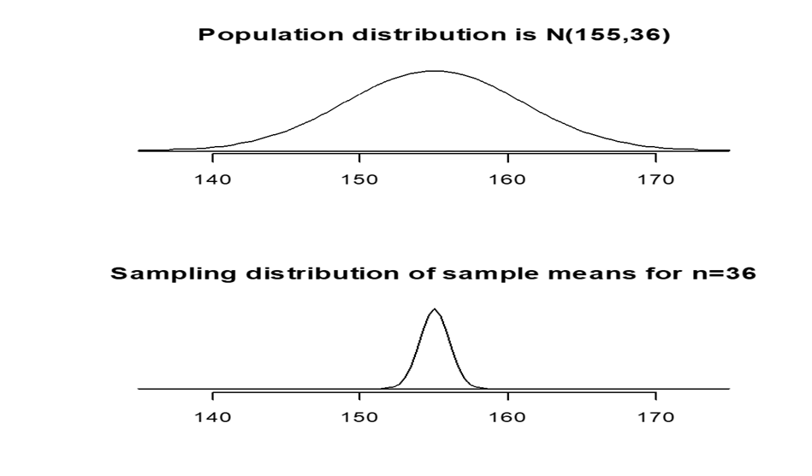
Visualizing CLT

Slide 6
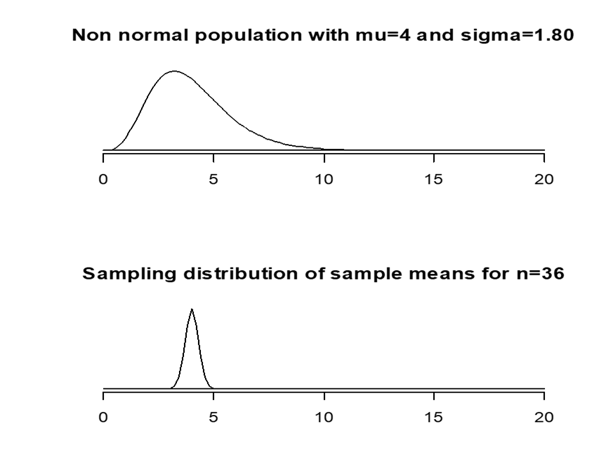
Visualizing CLT (cont…)

Slide 7
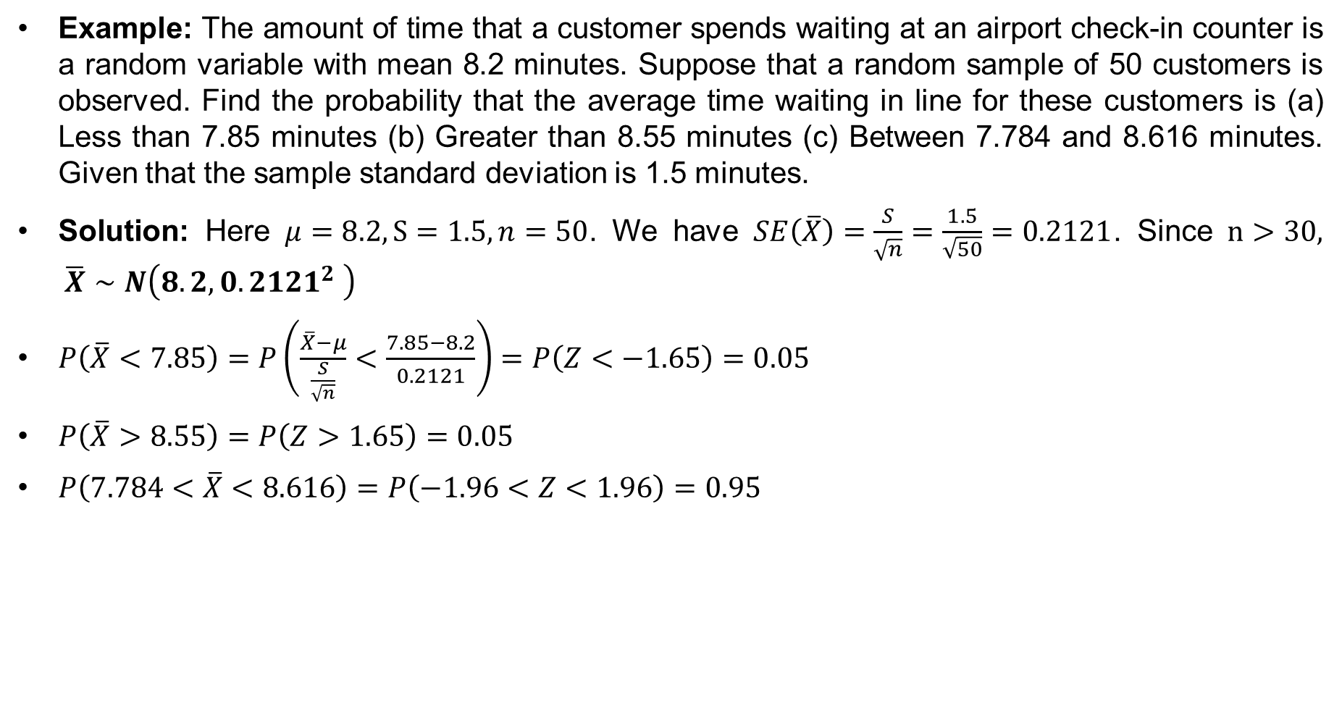
Probability of Observing Sample Values for a Hypothetical Population
Example: The amount of time that a customer spends waiting at an airport check-in counter is a random variable with mean 8.2 minutes. Suppose that a random sample of 50 customers is observed. Find the probability that the average time waiting in line for these customers is (a) Less than 7.85 minutes (b) Greater than 8.55 minutes (c) Between 7.784 and 8.616 minutes. Given that the sample standard deviation is 1.5 minutes.
Solution: Here $μ=8.2, S=1.5, n=50$. We have $SE\left(\overline{X}\right)=\frac{S}{\sqrt{n}}=\frac{1.5}{\sqrt{50}}=0.2121$. Since $n>30, \overline{X}∼N\left(8.2, 0{.2121}^{2} \right)$
$P\left(\overline{X}<7.85\right)=P\left(\frac{\overline{X}−μ}{\frac{S}{\sqrt{n}}}<\frac{7.85−8.2}{0.2121}\right)=P\left(Z<−1.65\right)=0.05$
$P\left(\overline{X}>8.55\right)=P\left(Z>1.65\right)=0.05$
$P\left(7.784<\overline{X}<8.616\right)=P\left(−1.96<Z<1.96\right)=0.95$

Slide 8
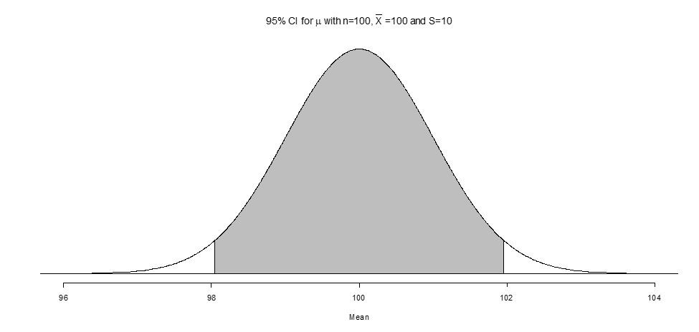

Confidence Interval
Constructing a CI: It is easy to construct a CI by using the margin of error. For Z-distribution, the margin of error is computed as $MoE=Z×SE$, where the $Z$ value is determined from the specified probability. For example, for a 95% CI$,$ the $MoE=Z_{0.025}×SE$and the 95% CI for $μ$: $[\overline{X}−MoE, \overline{X}+ MoE]$

Slide 9
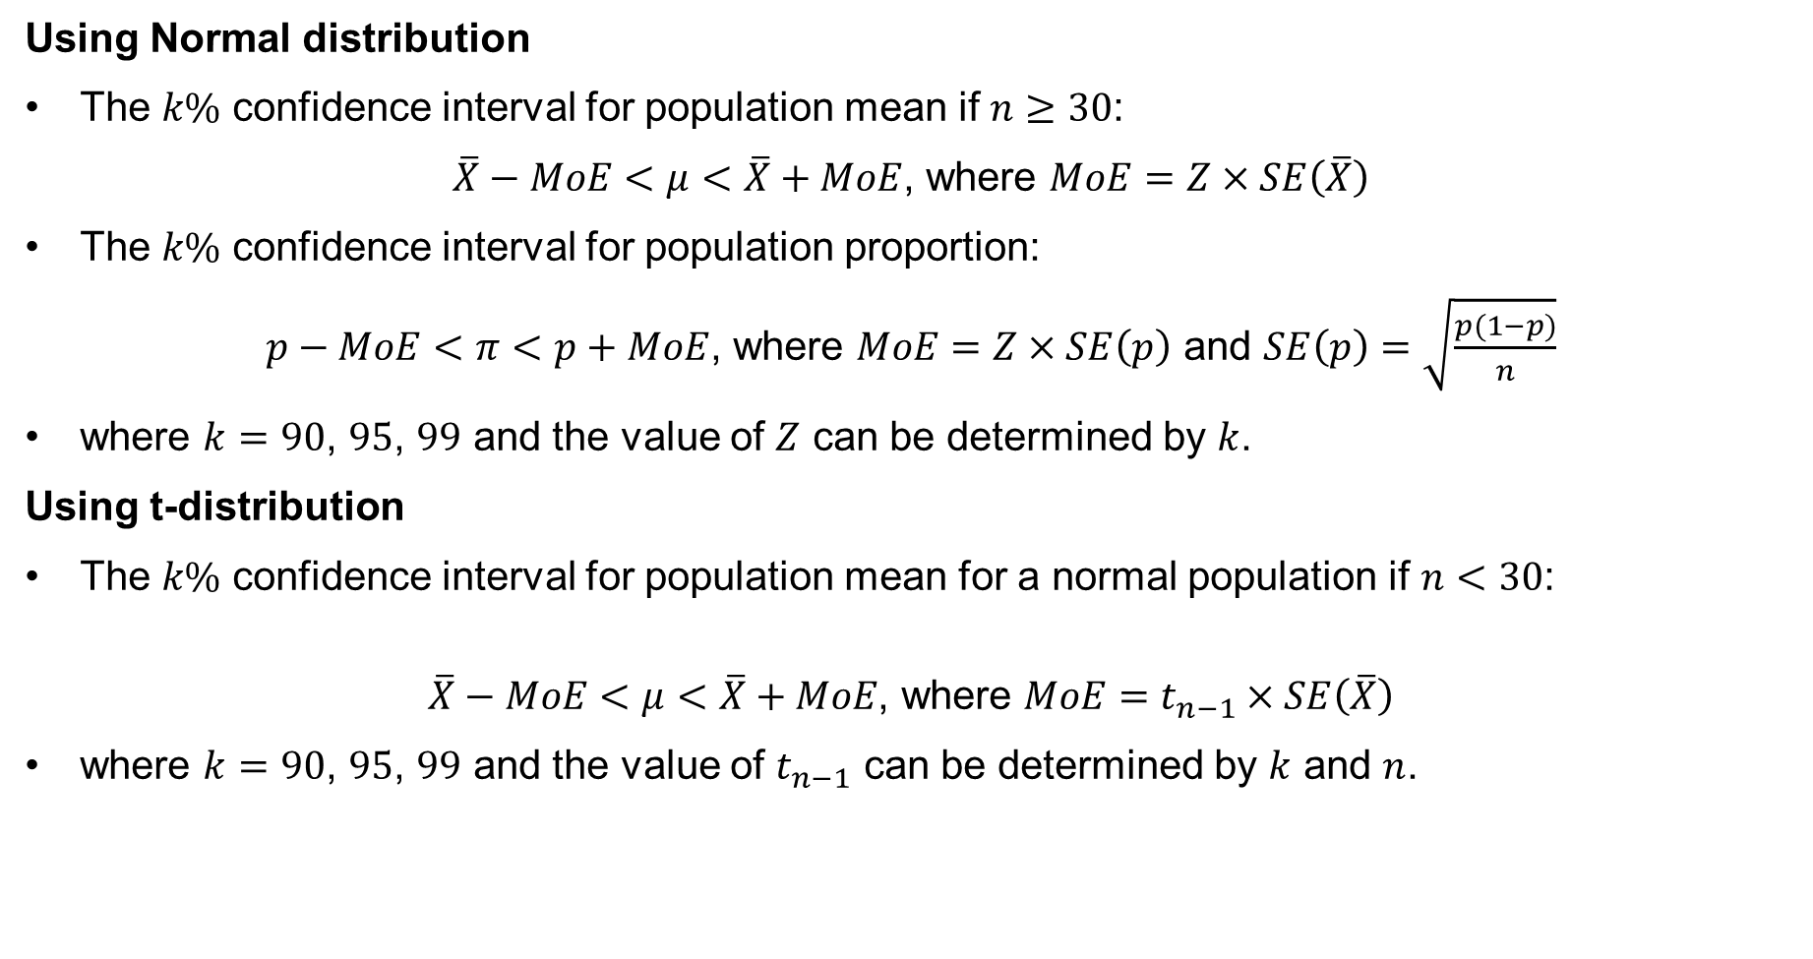
Confidence Interval (cont…)
Using Normal distribution
The $k\%$ confidence interval for population mean if $n≥30$:
$\overline{X}−MoE<μ<\overline{X}+MoE$, where $MoE=Z×SE\left(\overline{X}\right)$
The $k\%$ confidence interval for population proportion:
$p−MoE<π<p+MoE$, where $MoE=Z×SE\left(p\right)$ and $SE\left(p\right)=\sqrt{\frac{p(1−p)}{n}}$
where $k=90$, $95$, $99$ and the value of $Z$ can be determined by $k$.
Using t-distribution
The $k\%$ confidence interval for population mean for a normal population if $n<30$:
$$\overline{X}−MoE<μ<\overline{X}+MoE\text{, }\text{where} MoE=t_{n−1}×SE\left(\overline{X}\right)$$
where $k=90$, $95$, $99$ and the value of $t_{n−1}$ can be determined by $k$ and $n$.

Slide 10
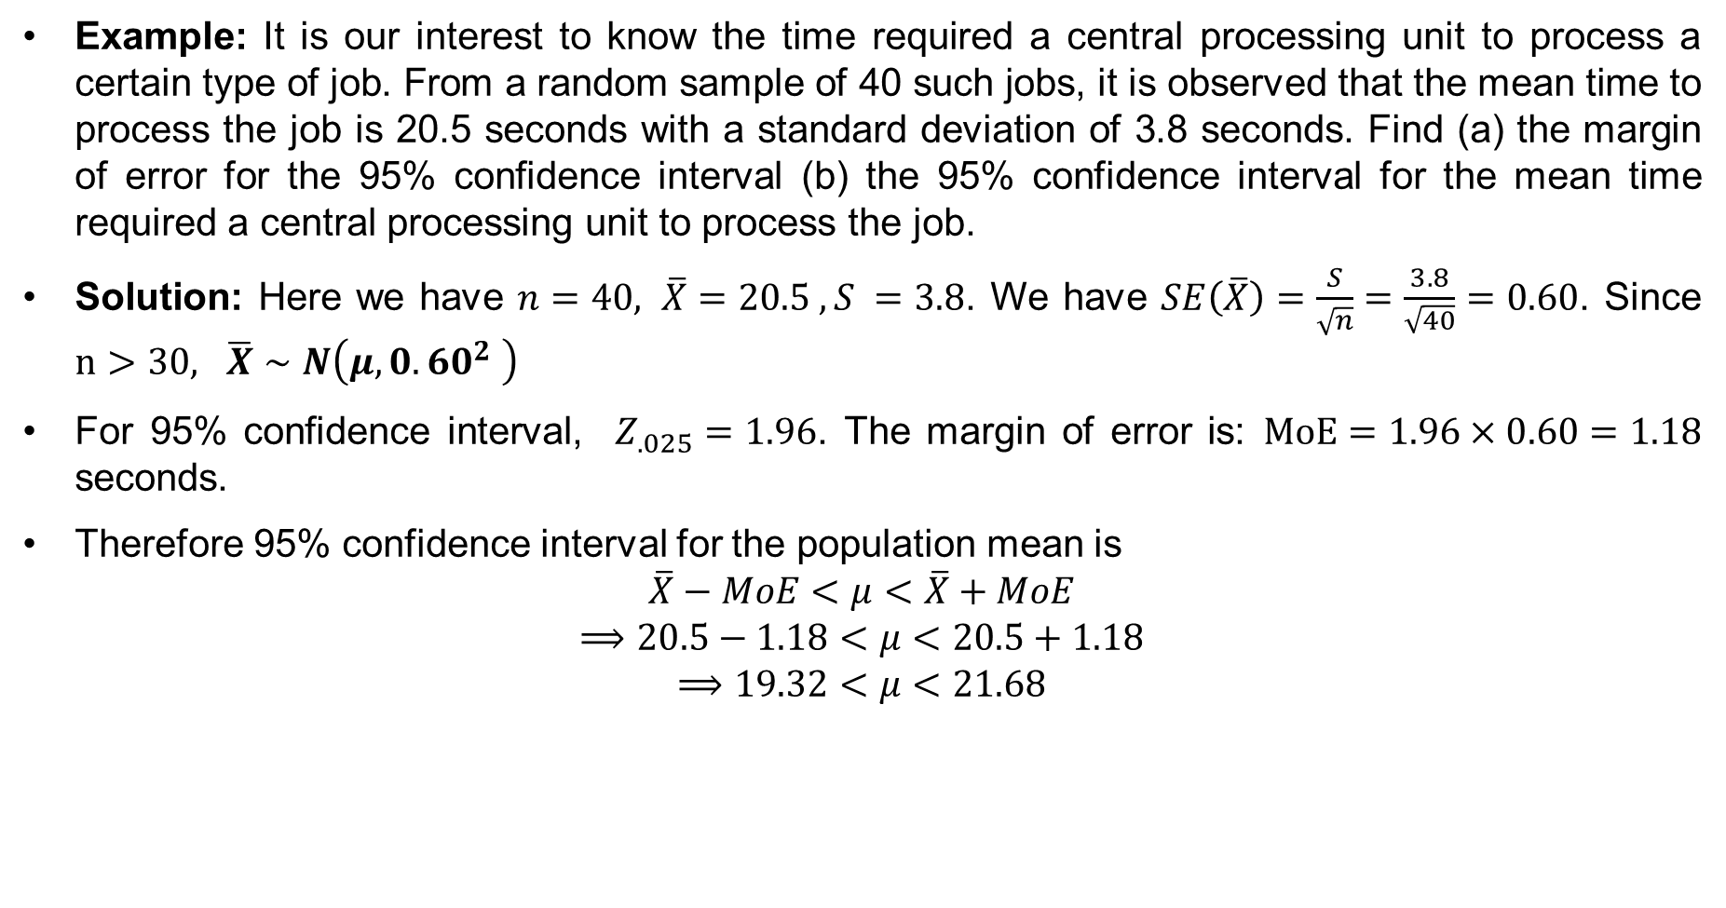
Sampling Distribution and Estimation (cont…)
Example: It is our interest to know the time required a central processing unit to process a certain type of job. From a random sample of 40 such jobs, it is observed that the mean time to process the job is 20.5 seconds with a standard deviation of 3.8 seconds. Find (a) the margin of error for the 95% confidence interval (b) the 95% confidence interval for the mean time required a central processing unit to process the job.
Solution: Here we have $n=40, \overline{X}=20.5 , S =3.8$. We have $SE\left(\overline{X}\right)=\frac{S}{\sqrt{n}}=\frac{3.8}{\sqrt{40}}=0.60$. Since $n>30, \overline{X}∼N\left(μ, 0{.60}^{2} \right)$
For 95% confidence interval, $Z_{.025}=1.96$. The margin of error is: $MoE=1.96×0.60=1.18$ seconds.
Therefore 95% confidence interval for the population mean is
$$\overline{X}−MoE<μ<\overline{X}+MoE$$
$$⟹20.5−1.18<μ<20.5+1.18$$
$$⟹19.32<μ<21.68$$

Slide 11
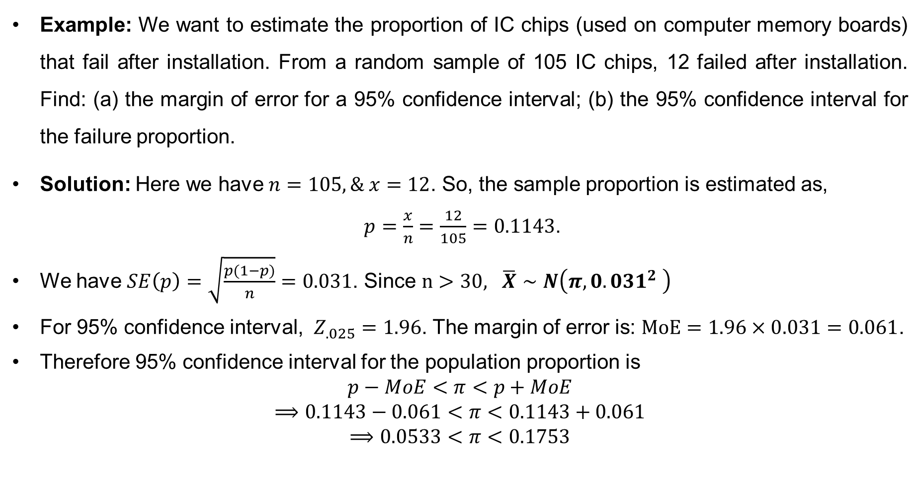
Sampling Distribution and Estimation (cont…)
Example: We want to estimate the proportion of IC chips (used on computer memory boards) that fail after installation. From a random sample of 105 IC chips, 12 failed after installation. Find: (a) the margin of error for a 95% confidence interval; (b) the 95% confidence interval for the failure proportion.
Solution: Here we have $n=105, \& x=12$. So, the sample proportion is estimated as,
$p=\frac{x}{n}=\frac{12}{105}=0.1143$.
We have $SE\left(p\right)=\sqrt{\frac{p(1−p)}{n}}=0.031$. Since $n>30, \overline{X}∼N\left(π, 0{.031}^{2} \right)$
For 95% confidence interval, $Z_{.025}=1.96$. The margin of error is: $MoE=1.96×0.031=0.061$.
Therefore 95% confidence interval for the population proportion is
$$p−MoE<π<p+MoE$$
$$⟹0.1143−0.061<π<0.1143+0.061$$
$$⟹0.0533<π<0.1753$$

Slide 12
Hypothesis:
A statement about a population parameter (population mean, population proportion, etc.) subject to verification.
The purpose of hypothesis testing is to draw a conclusion about the population parameters for which we do not have complete knowledge.
Examples:
A production manager claims that a 500 mg tablet is overfilled.
A physician may hypothesize that the recommended drug is effective in more than 90% cases.
A bulb’s manufacturing company claims that a new bulb it has developed has an average lifetime that exceeds the current industry average of 8,000 hours.

Slide 13
Test of a Statistical Hypothesis:
A two-action decision rule based on sample observations. The rule can be used to determine whether the hypothesis is a reasonable statement.
The two-actions being the acceptance or rejection of the hypothesis under consideration.
If the hypothesis is reasonable, we would accept it, otherwise it would be rejected.
Two mutually exclusive and opposite hypothesis can be formulated: null hypothesis and alternative hypothesis.

Slide 14
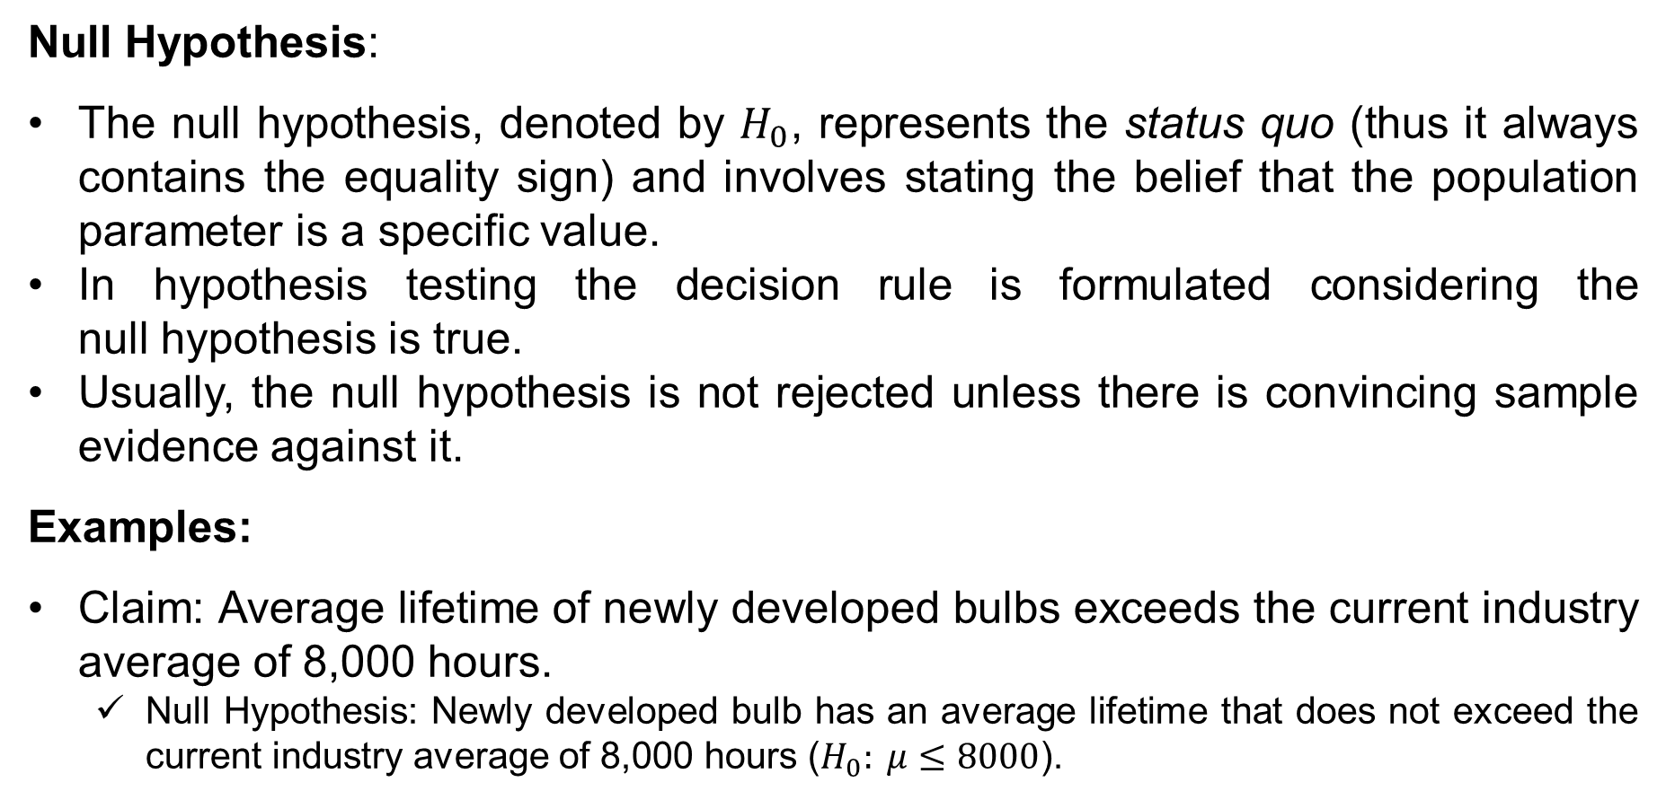
Null Hypothesis:
The null hypothesis, denoted by $H_{0}$, represents the status quo (thus it always contains the equality sign) and involves stating the belief that the population parameter is a specific value.
In hypothesis testing the decision rule is formulated considering the null hypothesis is true.
Usually, the null hypothesis is not rejected unless there is convincing sample evidence against it.
Examples:
Claim: Average lifetime of newly developed bulbs exceeds the current industry average of 8,000 hours.
Null Hypothesis: Newly developed bulb has an average lifetime that does not exceed the current industry average of 8,000 hours ($H_{0}: μ≤8000$).

Slide 15
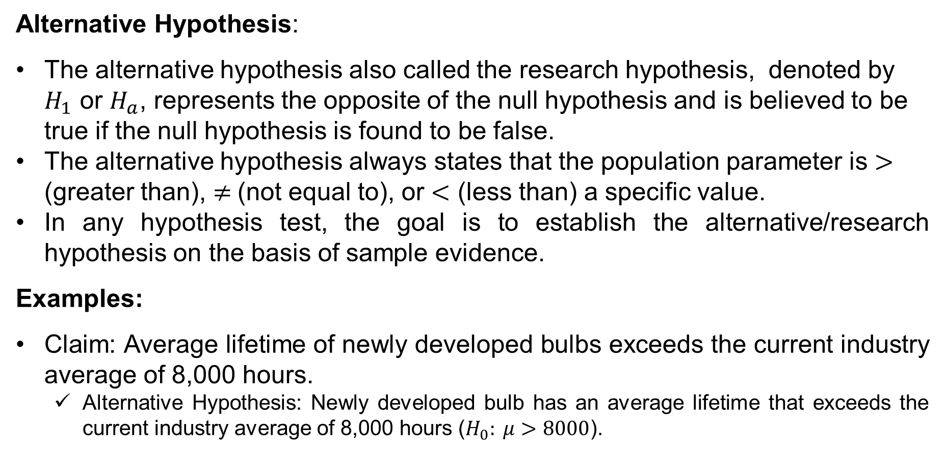
Alternative Hypothesis:
The alternative hypothesis also called the research hypothesis, denoted by $H_{1}$ or $H_{a}$, represents the opposite of the null hypothesis and is believed to be true if the null hypothesis is found to be false.
The alternative hypothesis always states that the population parameter is $>$ (greater than), $≠$(not equal to), or $<$ (less than) a specific value.
In any hypothesis test, the goal is to establish the alternative/research hypothesis on the basis of sample evidence.
Examples:
Claim: Average lifetime of newly developed bulbs exceeds the current industry average of 8,000 hours.
Alternative Hypothesis: Newly developed bulb has an average lifetime that exceeds the current industry average of 8,000 hours ($H_{0}: μ>8000$).

Slide 16
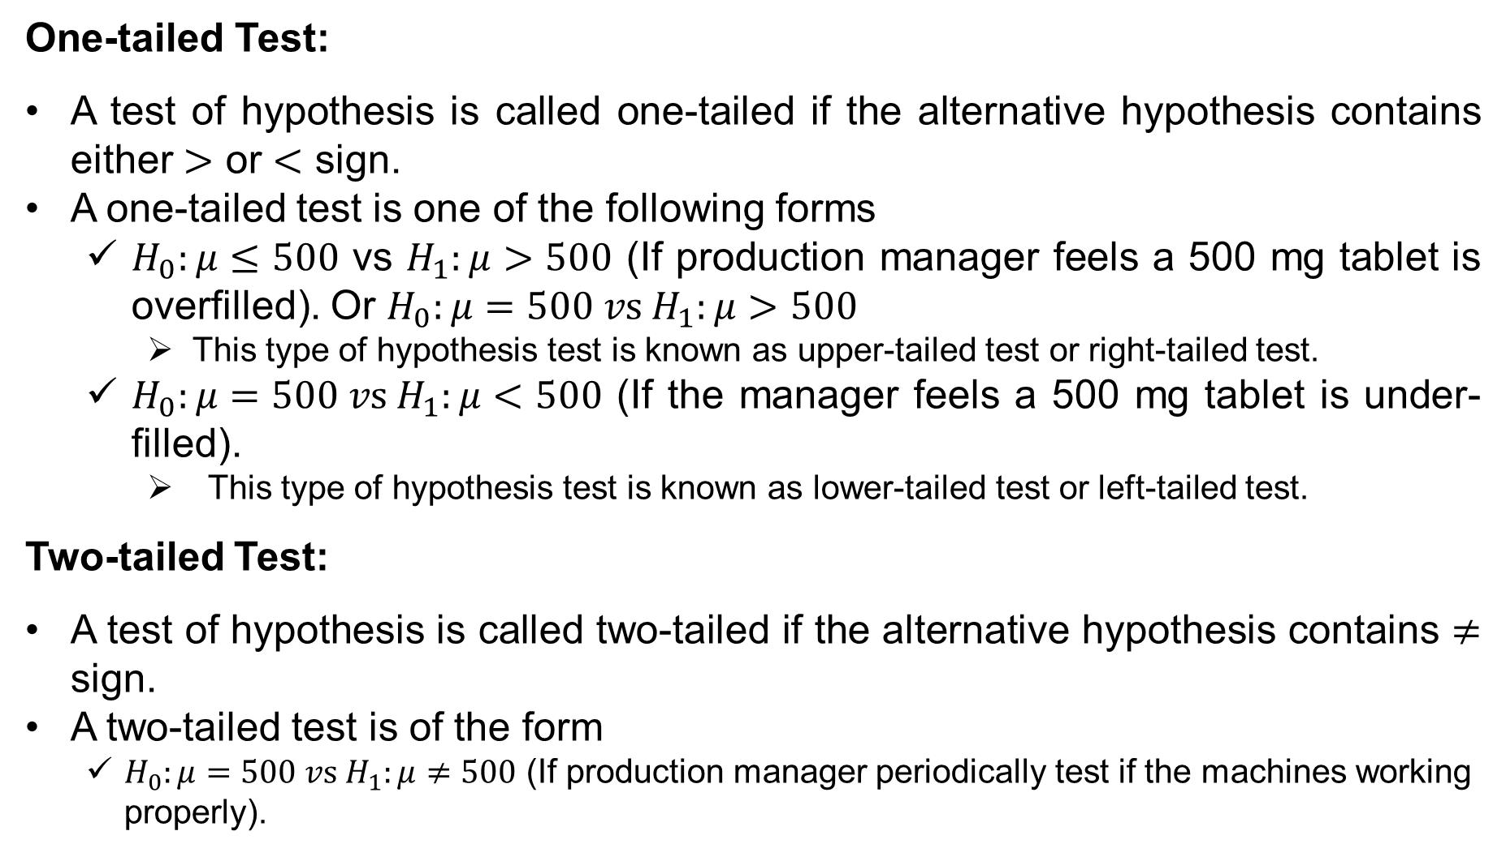
One-tailed Test:
A test of hypothesis is called one-tailed if the alternative hypothesis contains either $>$ or $<$ sign.
A one-tailed test is one of the following forms
$H_{0}:μ≤500$ vs $H_{1}:μ>500$ (If production manager feels a 500 mg tablet is overfilled). Or $H_{0}:μ=500 vs H_{1}:μ>500$
This type of hypothesis test is known as upper-tailed test or right-tailed test.
$H_{0}:μ=500 vs H_{1}:μ<500$ (If the manager feels a 500 mg tablet is under-filled).
This type of hypothesis test is known as lower-tailed test or left-tailed test.
Two-tailed Test:
A test of hypothesis is called two-tailed if the alternative hypothesis contains $≠$ sign.
A two-tailed test is of the form
$H_{0}:μ=500 vs H_{1}:μ≠500$ (If production manager periodically test if the machines working properly).

Slide 17
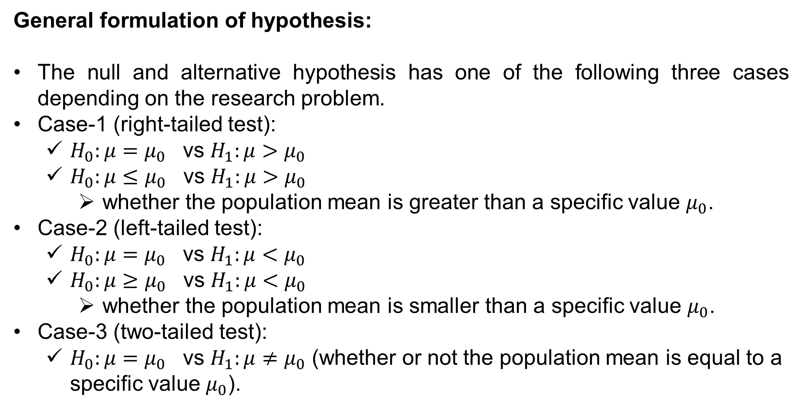
General formulation of hypothesis:
The null and alternative hypothesis has one of the following three cases depending on the research problem.
Case-1 (right-tailed test):
$H_{0}:μ=μ_{0}$ vs $H_{1}:μ>μ_{0}$
$H_{0}:μ≤μ_{0}$ vs $H_{1}:μ>μ_{0}$
whether the population mean is greater than a specific value $μ_{0}$.
Case-2 (left-tailed test):
$H_{0}:μ=μ_{0}$ vs $H_{1}:μ<μ_{0}$
$H_{0}:μ≥μ_{0}$ vs $H_{1}:μ<μ_{0}$
whether the population mean is smaller than a specific value $μ_{0}$.
Case-3 (two-tailed test):
$H_{0}:μ=μ_{0}$ vs $H_{1}:μ≠μ_{0}$ (whether or not the population mean is equal to a specific value $μ_{0}$).

Slide 18
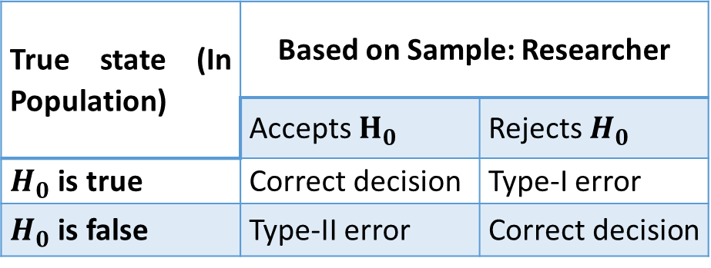
Types of Error in a Hypothesis Test
In a hypothesis testing, there is always a risk of committing two types of errors.
The following table summarizes the decisions the researcher could make and the possible consequences
True state (In Population) | Based on Sample: Researcher
 | Accepts $H_{0}$ | Rejects $H_{0}$
$H_{0}$ is true | Correct decision | Type-I error
$H_{0}$ is false | Type-II error | Correct decision
The error committed by rejecting $H_{0}$, when it is true is called type-I error.
The error committed by accepting $H_{0}$, when it is false is called type-II error.

Slide 19
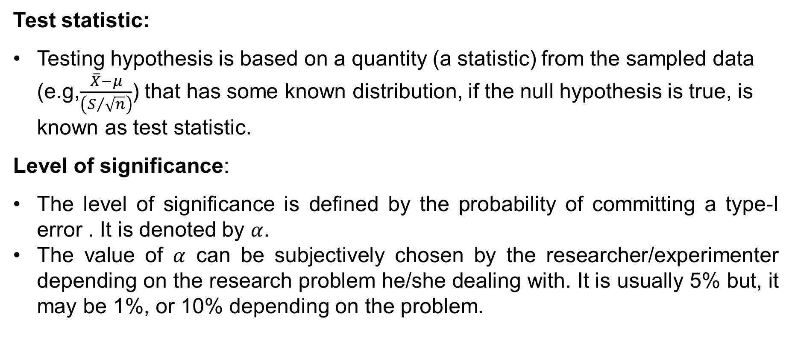
Test statistic:
Testing hypothesis is based on a quantity (a statistic) from the sampled data (e.g,$\frac{\overline{X}−μ}{\left(S/{\sqrt{n}}\right)}$) that has some known distribution, if the null hypothesis is true, is known as test statistic.
Level of significance:
The level of significance is defined by the probability of committing a type-I error . It is denoted by $α$.
The value of $α$ can be subjectively chosen by the researcher/experimenter depending on the research problem he/she dealing with. It is usually 5% but, it may be 1%, or 10% depending on the problem.

Slide 20
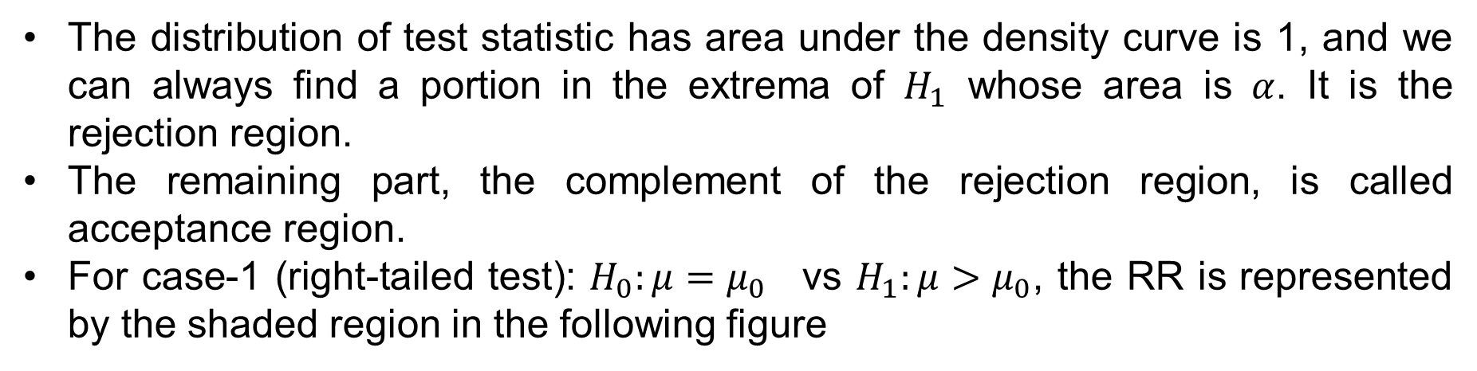
Acceptance Region (AR) versus Rejection Region (RR)
The distribution of test statistic has area under the density curve is 1, and we can always find a portion in the extrema of $H_{1}$ whose area is $α$. It is the rejection region.
The remaining part, the complement of the rejection region, is called acceptance region.
For case-1 (right-tailed test): $H_{0}:μ=μ_{0}$ vs $H_{1}:μ>μ_{0}$, the RR is represented by the shaded region in the following figure

Slide 21
Acceptance Region versus Rejection Region (cont…)
For case-2 (left-tailed test): $H_{0}:μ=μ_{0}$ vs $H_{1}:μ<μ_{0}$, the RR is represented by the shaded region in the following figure
For case-3 (two-tailed test): $H_{0}:μ=μ_{0}$ vs $H_{1}:μ≠μ_{0}$, the RR is represented by the shaded region in the following figure

Slide 22
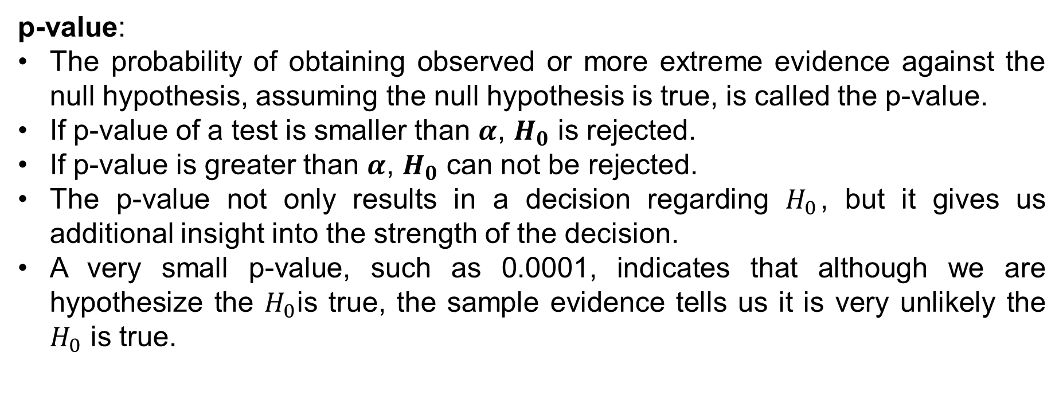
p-value:
The probability of obtaining observed or more extreme evidence against the null hypothesis, assuming the null hypothesis is true, is called the p-value.
If p-value of a test is smaller than $α$, $H_{0}$ is rejected.
If p-value is greater than $α$, $H_{0}$ can not be rejected.
The p-value not only results in a decision regarding $H_{0}$, but it gives us additional insight into the strength of the decision.
A very small p-value, such as 0.0001, indicates that although we are hypothesize the $H_{0}$is true, the sample evidence tells us it is very unlikely the $H_{0}$ is true.

Slide 23
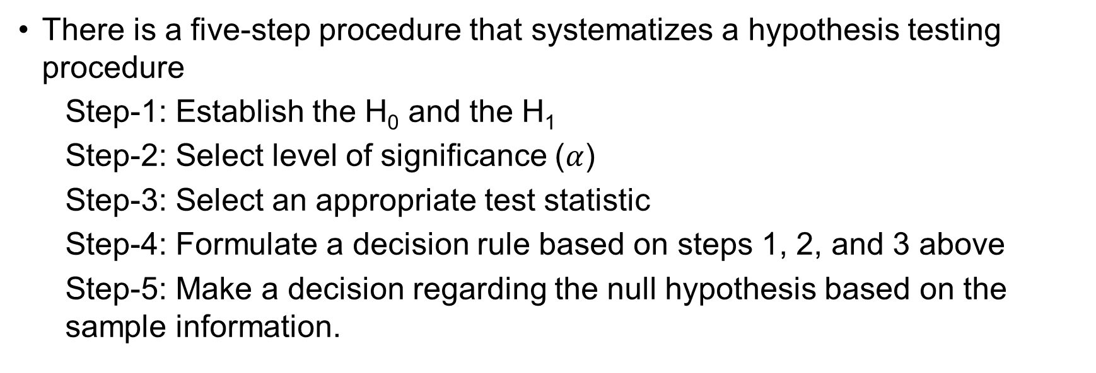
Steps to conduct a hypothesis test
There is a five-step procedure that systematizes a hypothesis testing procedure
Step-1: Establish the H₀ and the H₁
Step-2: Select level of significance ($α$)
Step-3: Select an appropriate test statistic
Step-4: Formulate a decision rule based on steps 1, 2, and 3 above
Step-5: Make a decision regarding the null hypothesis based on the sample information.

Slide 24
Choosing a test statistic:
Various test statistic can be derived depending the nature of the hypothesis and the assumptions made about the data.
Common test of hypothesis are as follows
1: Z-test
2: T-test

Slide 25
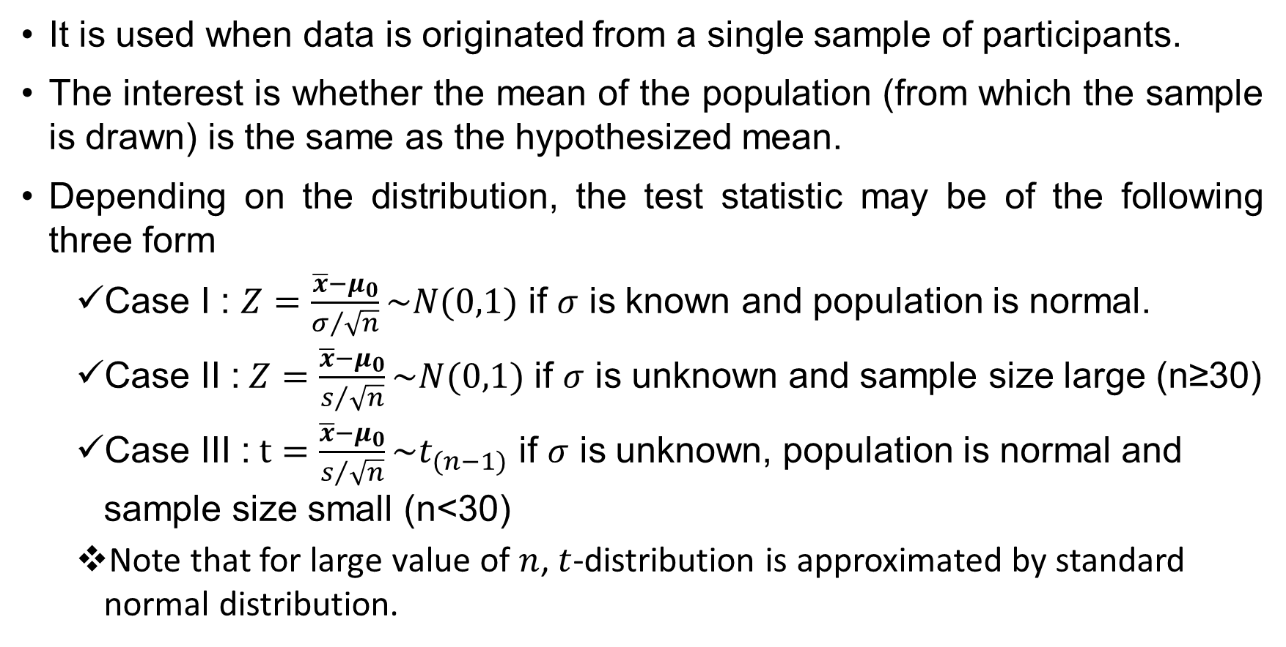
One-Sample Mean Test
It is used when data is originated from a single sample of participants.
The interest is whether the mean of the population (from which the sample is drawn) is the same as the hypothesized mean.
Depending on the distribution, the test statistic may be of the following three form
Case I : $Z=\frac{\overline{x}−μ_{0}}{σ/{\sqrt{n}}}\sim N(0,1)$ if $σ$ is known and population is normal.
Case II : $Z=\frac{\overline{x}−μ_{0}}{s/{\sqrt{n}}}\sim N(0,1)$ if $σ$ is unknown and sample size large (n≥30)
Case III : $t=\frac{\overline{x}−μ_{0}}{s/{\sqrt{n}}}\sim t_{(n−1)}$ if $σ$ is unknown, population is normal and sample size small (n<30)
Note that for large value of $n$, $t$-distribution is approximated by standard normal distribution.

Slide 26
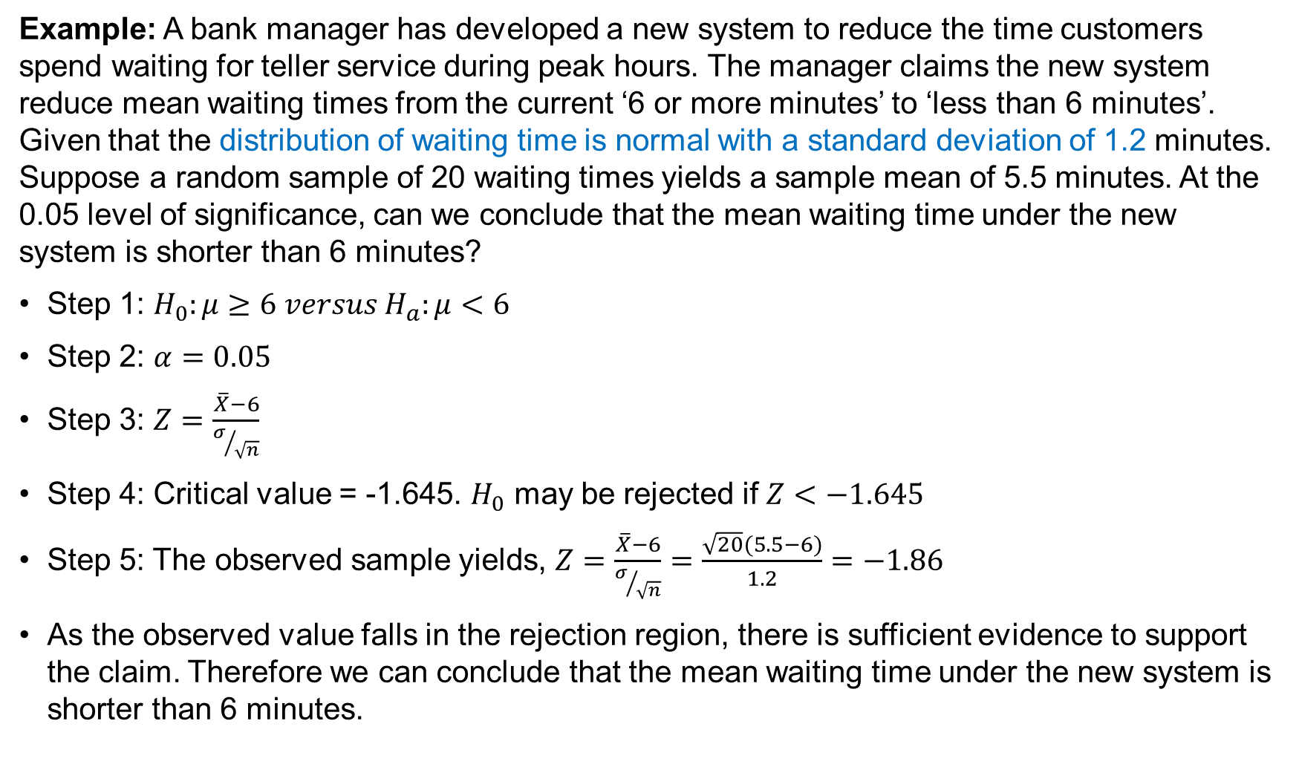
Problems on One-Sample Mean Test
Example: A bank manager has developed a new system to reduce the time customers spend waiting for teller service during peak hours. The manager claims the new system reduce mean waiting times from the current ‘6 or more minutes’ to ‘less than 6 minutes’. Given that the distribution of waiting time is normal with a standard deviation of 1.2 minutes. Suppose a random sample of 20 waiting times yields a sample mean of 5.5 minutes. At the 0.05 level of significance, can we conclude that the mean waiting time under the new system is shorter than 6 minutes?
Step 1: $H_{0}:μ≥6 versus H_{a}:μ<6$
Step 2: $α=0.05$
Step 3: $Z=\frac{\overline{X}−6}{σ/{\sqrt{n}}}$
Step 4: Critical value = -1.645. $H_{0}$ may be rejected if $Z<−1.645$
Step 5: The observed sample yields, $Z=\frac{\overline{X}−6}{σ/{\sqrt{n}}}=\frac{\sqrt{20}(5.5−6)}{1.2}=−1.86$
As the observed value falls in the rejection region, there is sufficient evidence to support the claim. Therefore we can conclude that the mean waiting time under the new system is shorter than 6 minutes.

Slide 27
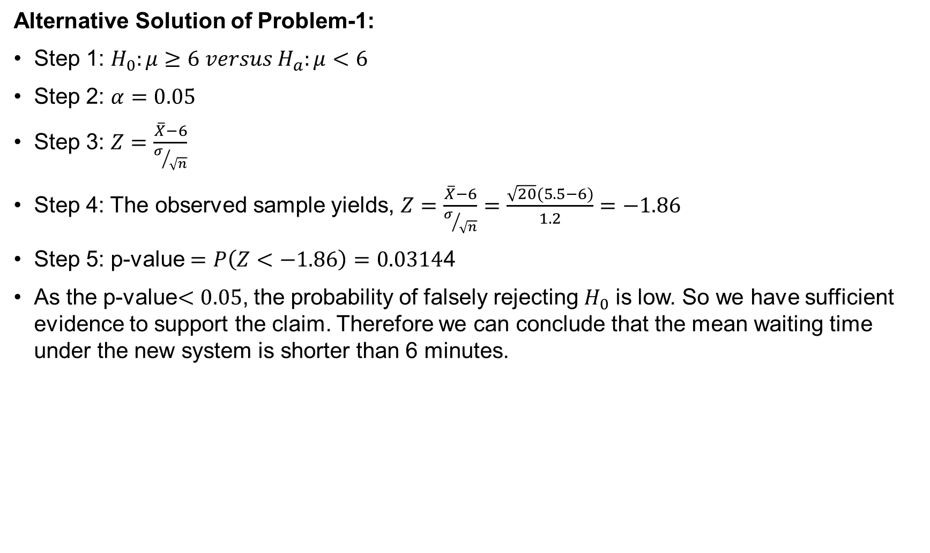
Problems on One-Sample Mean Test (Cont…)
Alternative Solution of Problem-1:
Step 1: $H_{0}:μ≥6 versus H_{a}:μ<6$
Step 2: $α=0.05$
Step 3: $Z=\frac{\overline{X}−6}{σ/{\sqrt{n}}}$
Step 4: The observed sample yields, $Z=\frac{\overline{X}−6}{σ/{\sqrt{n}}}=\frac{\sqrt{20}(5.5−6)}{1.2}=−1.86$
Step 5: p-value $=P\left(Z<−1.86\right)=0.0314$4
As the p-value$<0.05$, the probability of falsely rejecting $H_{0}$ is low. So we have sufficient evidence to support the claim. Therefore we can conclude that the mean waiting time under the new system is shorter than 6 minutes.

Slide 28
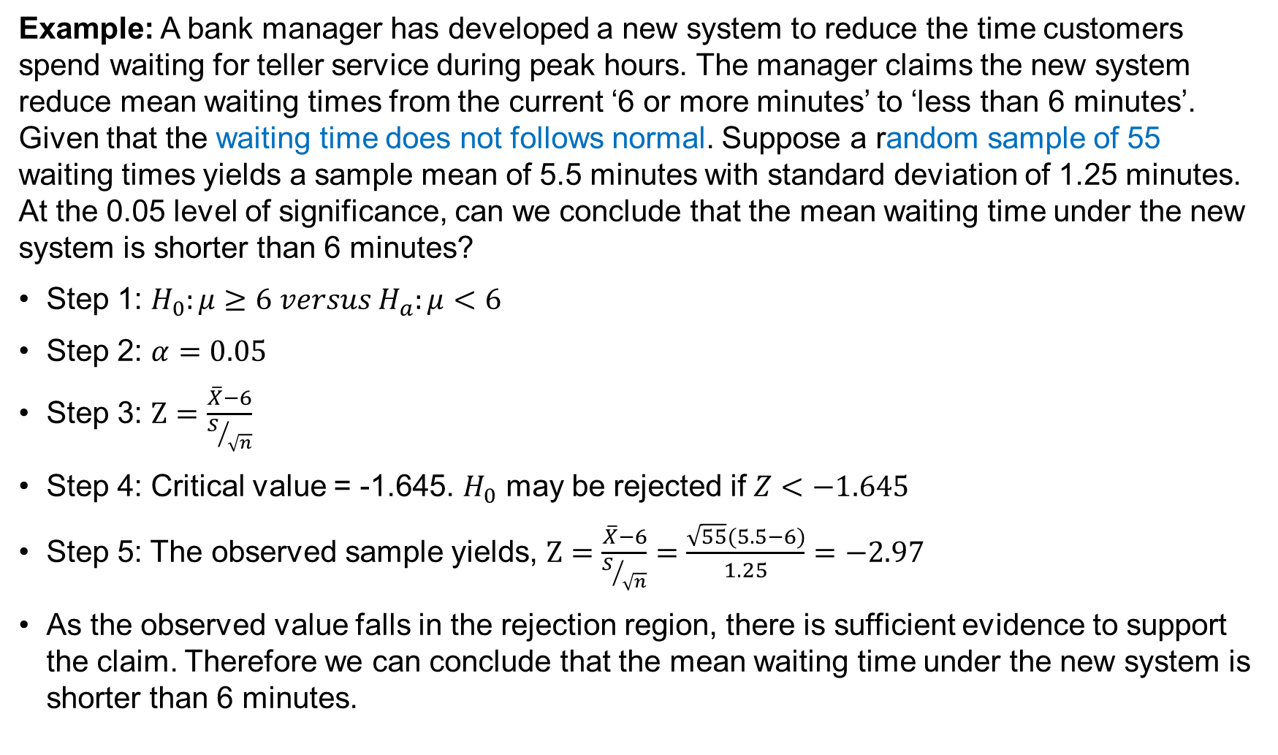
Problems on One-Sample Mean Test (Cont…)
Example: A bank manager has developed a new system to reduce the time customers spend waiting for teller service during peak hours. The manager claims the new system reduce mean waiting times from the current ‘6 or more minutes’ to ‘less than 6 minutes’. Given that the waiting time does not follows normal. Suppose a random sample of 55 waiting times yields a sample mean of 5.5 minutes with standard deviation of 1.25 minutes. At the 0.05 level of significance, can we conclude that the mean waiting time under the new system is shorter than 6 minutes?
Step 1: $H_{0}:μ≥6 versus H_{a}:μ<6$
Step 2: $α=0.05$
Step 3: $Z=\frac{\overline{X}−6}{S/{\sqrt{n}}}$
Step 4: Critical value = -1.645. $H_{0}$ may be rejected if $Z<−1.645$
Step 5: The observed sample yields, $Z=\frac{\overline{X}−6}{S/{\sqrt{n}}}=\frac{\sqrt{55}(5.5−6)}{1.25}=−2.97$
As the observed value falls in the rejection region, there is sufficient evidence to support the claim. Therefore we can conclude that the mean waiting time under the new system is shorter than 6 minutes.

Slide 29
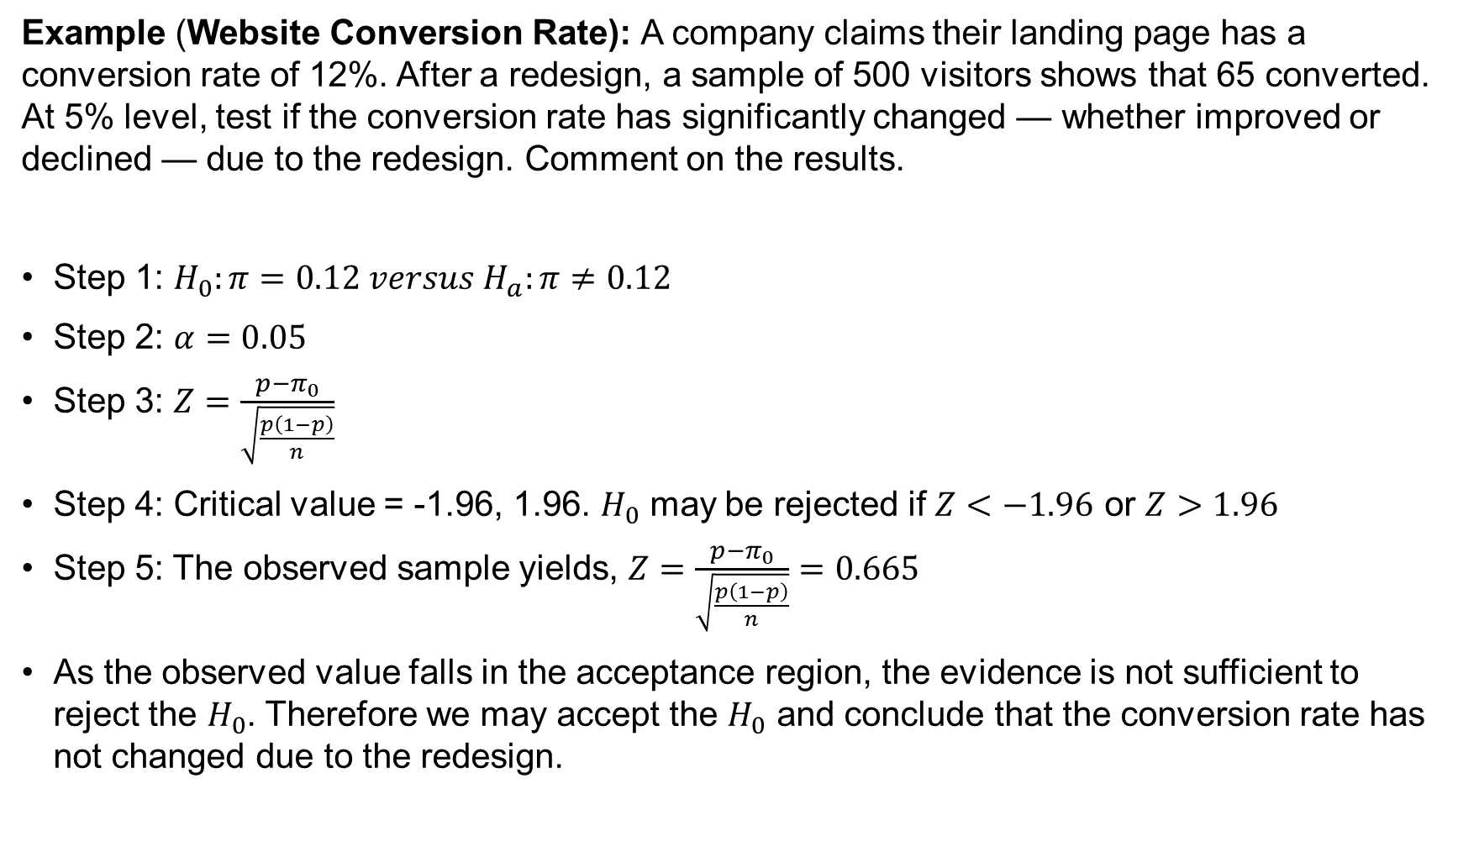
Problems on Proportion Test
Example (Website Conversion Rate): A company claims their landing page has a conversion rate of 12%. After a redesign, a sample of 500 visitors shows that 65 converted. At 5% level, test if the conversion rate has significantly changed — whether improved or declined — due to the redesign. Comment on the results.
Step 1: $H_{0}:π=0.12 versus H_{a}:π≠0.12$
Step 2: $α=0.05$
Step 3: $Z=\frac{p−π_{0}}{\sqrt{\frac{p\left(1−p\right)}{n}}}$
Step 4: Critical value = -1.96, 1.96. $H_{0}$ may be rejected if $Z<−1.96$ or $Z>1.96$
Step 5: The observed sample yields, $Z=\frac{p−π_{0}}{\sqrt{\frac{p\left(1−p\right)}{n}}}=0.665$
As the observed value falls in the acceptance region, the evidence is not sufficient to reject the $H_{0}$. Therefore we may accept the $H_{0}$ and conclude that the conversion rate has not changed due to the redesign.

Slide 30
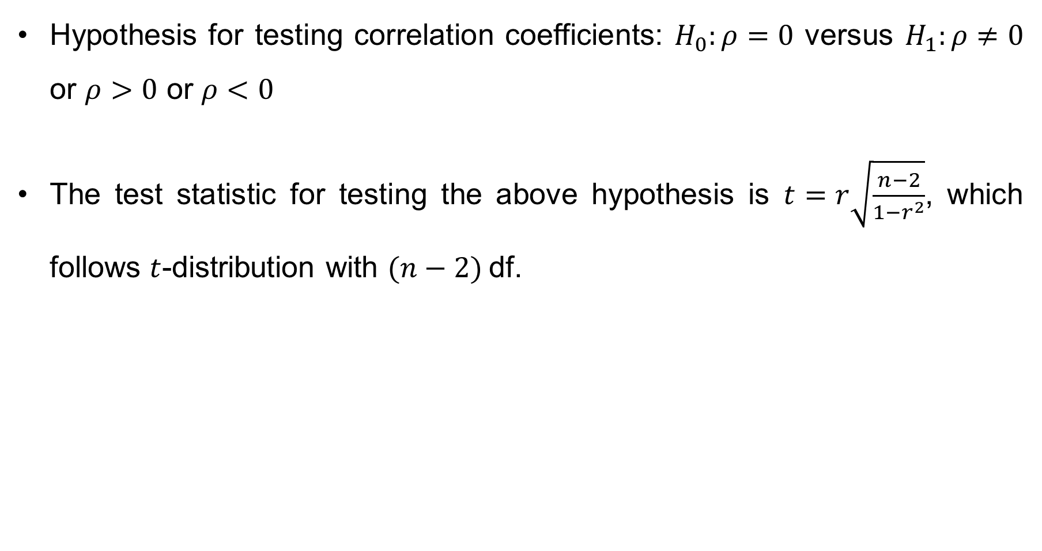
Hypothesis for Testing Correlation Coefficient
Hypothesis for testing correlation coefficients: $H_{0}:ρ=0$ versus $H_{1}:ρ≠0$ or $ρ>0$ or $ρ<0$
The test statistic for testing the above hypothesis is $t=r\sqrt{\frac{n−2}{1−r^{2}}}$, which follows $t$-distribution with $(n−2)$df.

Slide 31
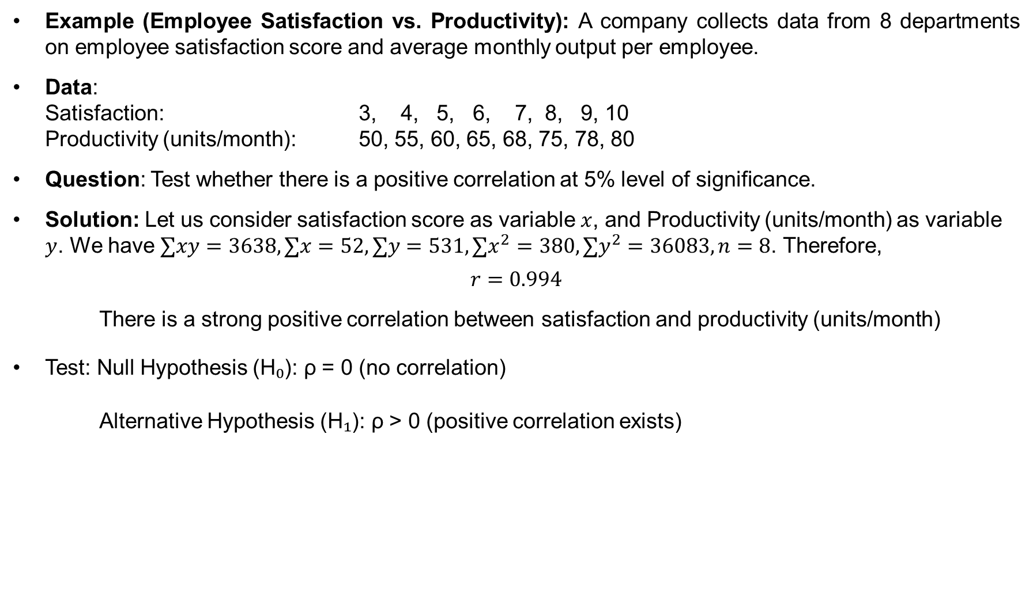
Hypothesis Testing (cont…)
Example (Employee Satisfaction vs. Productivity): A company collects data from 8 departments on employee satisfaction score and average monthly output per employee.
Data: Satisfaction: 3, 4, 5, 6, 7, 8, 9, 10 Productivity (units/month): 50, 55, 60, 65, 68, 75, 78, 80
Question: Test whether there is a positive correlation at 5% level of significance.
Solution: Let us consider satisfaction score as variable $x$, and Productivity (units/month) as variable $y$. We have $∑xy=3638, ∑x=52, ∑y=531, ∑x^{2}=380, ∑y^{2}=36083, n=8$. Therefore,
$$r=0.994$$
There is a strong positive correlation between satisfaction and productivity (units/month)
Test: Null Hypothesis (H₀): ρ = 0 (no correlation)
Alternative Hypothesis (H₁): ρ > 0 (positive correlation exists)

Slide 32
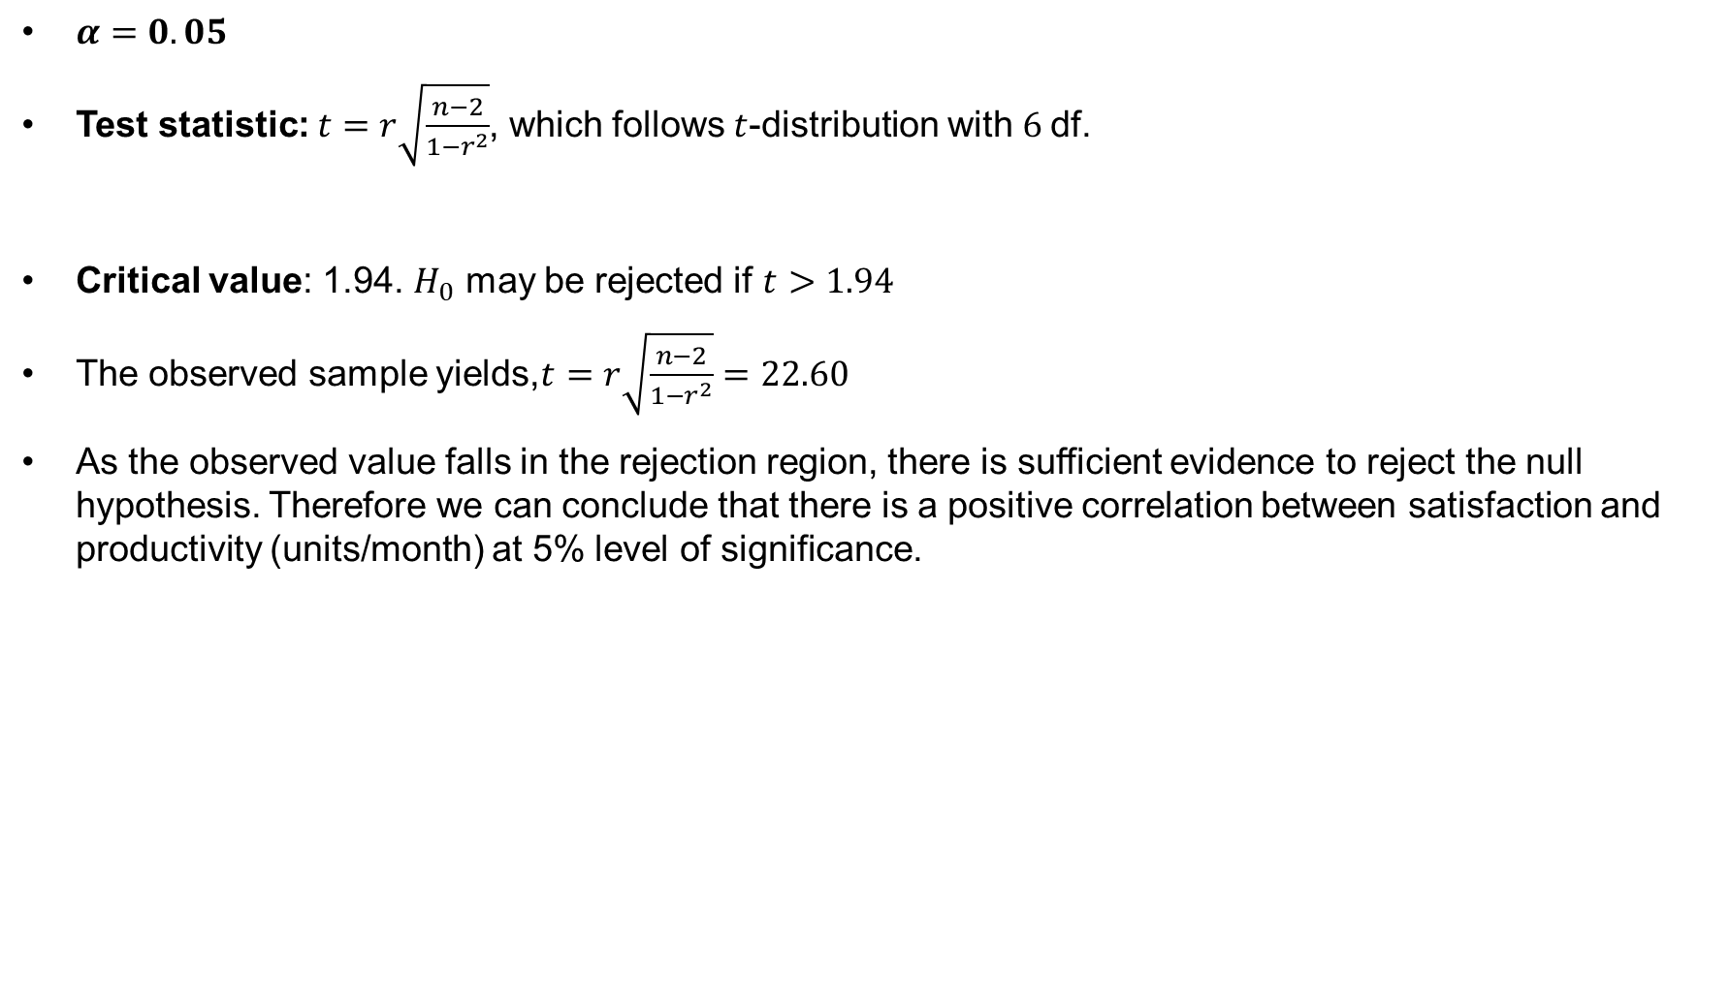
Coefficient of Correlation (cont…)
$α=0.05$
Test statistic: $t=r\sqrt{\frac{n−2}{1−r^{2}}}$, which follows $t$-distribution with $6$df.
Critical value: 1.94. $H_{0}$ may be rejected if $t>1.94$
The observed sample yields,$t=r\sqrt{\frac{n−2}{1−r^{2}}}=22.60$
As the observed value falls in the rejection region, there is sufficient evidence to reject the null hypothesis. Therefore we can conclude that there is a positive correlation between satisfaction and productivity (units/month) at 5% level of significance.

Slide 33
Exercise
Problem-1: The strength of steel wire made by an existing process is normally distributed with a mean of 1250 and a standard deviation of 150. A batch of wire is made by a new process, and a random sample consisting of 25 measurements gives an average strength of 1312. Assume that the standard deviation does not change. Is there evidence at the 5% level of significance that the new process gives a larger mean strength than the old? What is the 95% confidence interval for the population mean strength?
Problem-2: An articulation test has conducted among a random sample of 184 children. The sample mean and standard deviation were 48.8 and 12.4 respectively. At the 5% significance level, do the data provide sufficient evidence to conclude that the population mean is different from 50? Find the 95% confidence interval for the population mean?
Problem-3: An exciting computer game is released. Some of the players who complete all the levels will buy an advanced version of the game. In a random sample of 500 players, it is observed that 120 of them buy the advanced version. At the 5% significance level, do the data provide sufficient evidence to conclude that the population proportion is greater than 20%? Find the 95% confidence interval for the population proportion?

