Slide 1
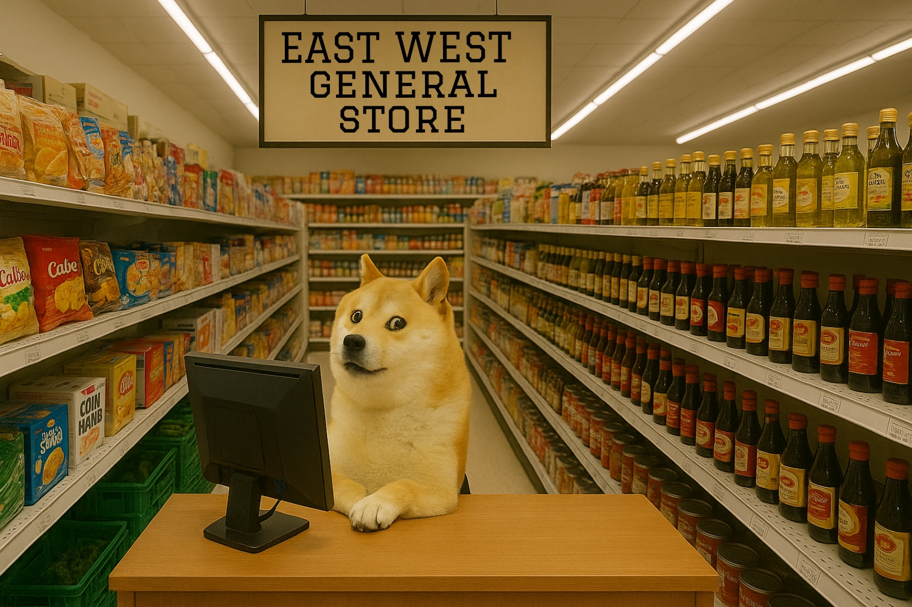
SuperShop Grocery Billing System
Project Overview
• Manage a supermarket's inventory and customer billing
• User login system for admin control
• Real-time stock updates and billing
• Daily sales tracking and reporting

Slide 2
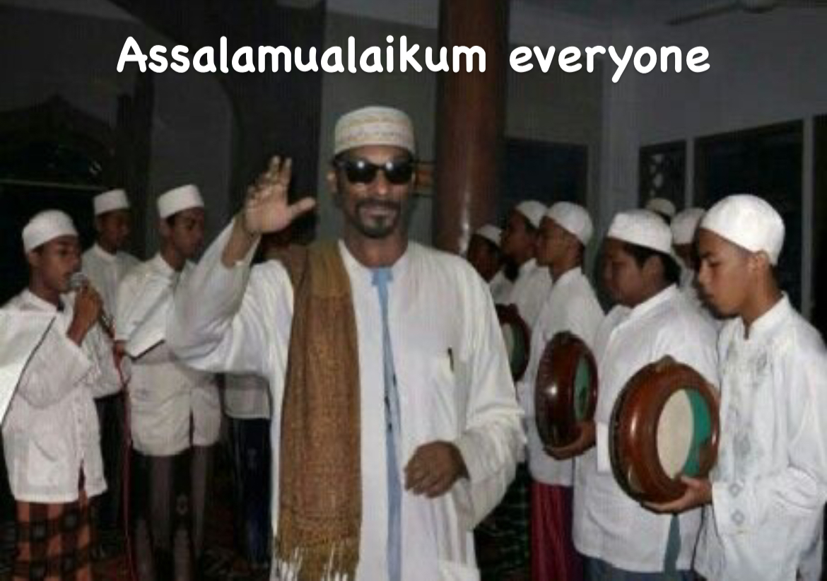

Slide 3


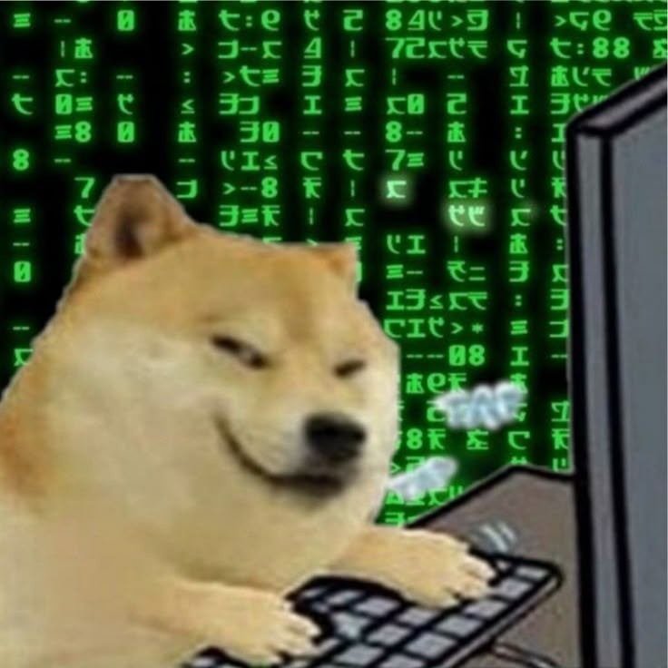
Implented Inventory Management
MD ATIQUR RAHMAN
ID: 2025-1-60-056
MEET OUR TEAM
THE HECKERS
SADMAN SHOWMIK ANIK
ID: 2025-1-60-055
Implemented Customer Billing

Slide 4


MAHMUDUR RAHMAN HARRY
ID: 2025-1-60-061
MEET OUR TEAM
Implemented Daily Sales Report
THE HECKERS
SABINA KHATUN
(GPT KHATUN)
ID: 2025-1-60-062
Implemented Login System

Slide 5

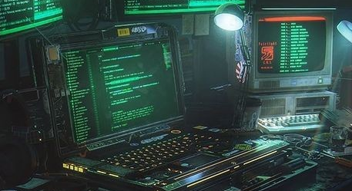
🔐 1. Login System
📦 2. Inventory Management
FUNCTIONALITIES OF
OUR CODE
🛒 3. Customer Billing
📁4. Stock Update
📈 5. Sales Report

Slide 6
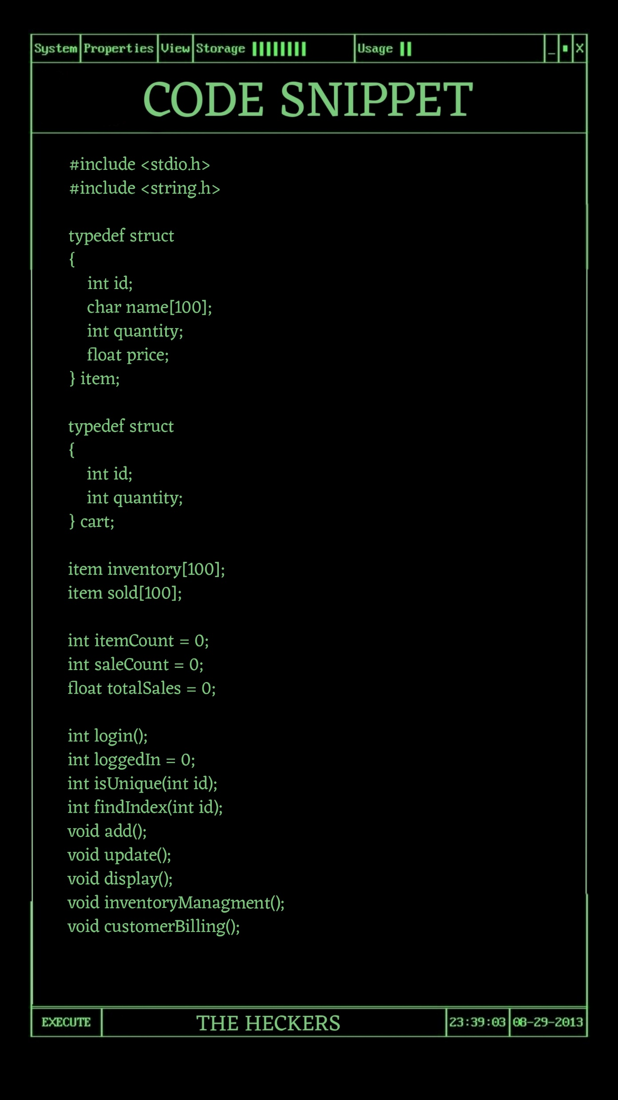

STARTING……….
GLOBAL VARIABLE
🔐 1. Login System
int itemCount = 0; Tracks how many items are in inventory
int saleCount = 0; Tracks total number of individual sold entries
float totalSales = 0; Accumulates total revenue with Vat
int login(); Handles secure login
int loggedIn = 0; Status flag for login session
int isUnique(int id); Ensures no duplicate product IDs
int findIndex(int id); Finds index of a product by ID
void add(); Adds new product to inventory
void update(); Updates existing product info
void display(); Shows all items in inventory
void inventoryManagment(); Menu to manage inventory
void customerBilling(); Handles billing and VAT calculation
#include <string.h>
📦 2. Inventory Management
Used for string manipulation functions like strcmp() and strcpy() which are essential for login verification and managing item names.
typedef struct item
Represents a product/item in the store.
id: Unique identifier for the item.
name: Product name (e.g., "Rice", "Soap").
quantity: Current stock available.
price: Unit price of the item.
🛒 3. Customer Billing
typedef struct cart
Temporarily stores a customer's selected items during billing.
Helps track item ID and quantity for VAT calculation and bill printing.
📈 4. Sales Report
Summary
These declarations form the foundation of the billing system, handling:
Inventory tracking
Real-time stock updates
Secure access control
Customer interaction
Sales record management
Arrays
inventory[]: Acts as the main database for stock.
sold[]: Records each sale transaction for daily reports.
🔄 5. User Interaction Loop

Slide 7
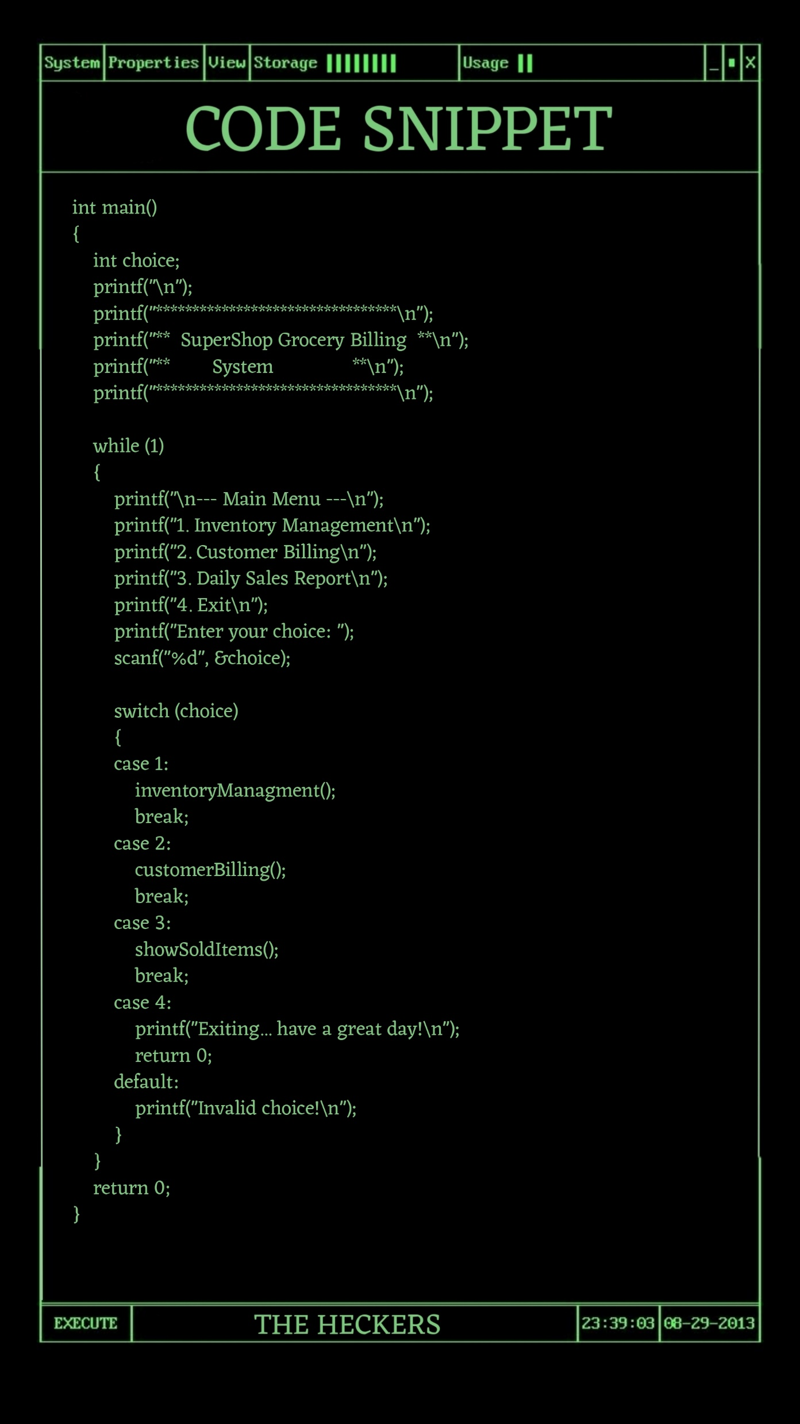
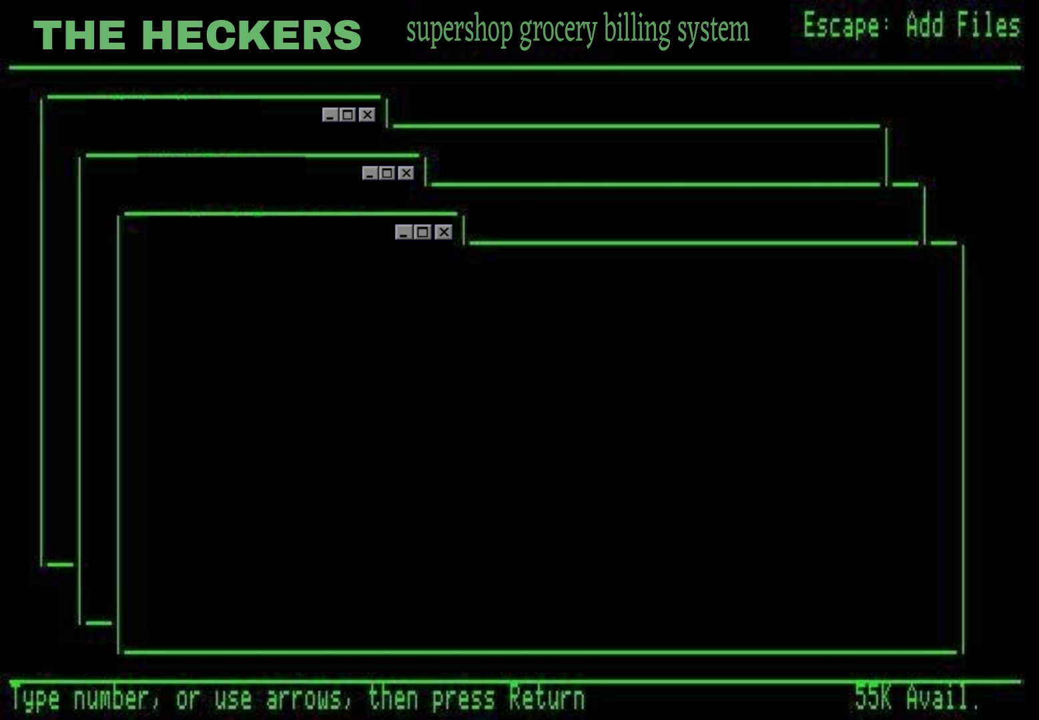
📦 2. Inventory Management
📈 4. Sales Report
🛒 3. Customer Billing
🔐 1. Login System
MAIN FUNCTION
Super shop grocery billing system
MAIN FUNCTION
EXPLAINATION
The while (1) loop keeps the system running continuously until the user selects "4. Exit".
The switch statement handles different operations based on the user's menu input:
1 for inventory functions.
2 for billing with VAT.
3 for showing daily sales.
4 to exit.

Slide 8

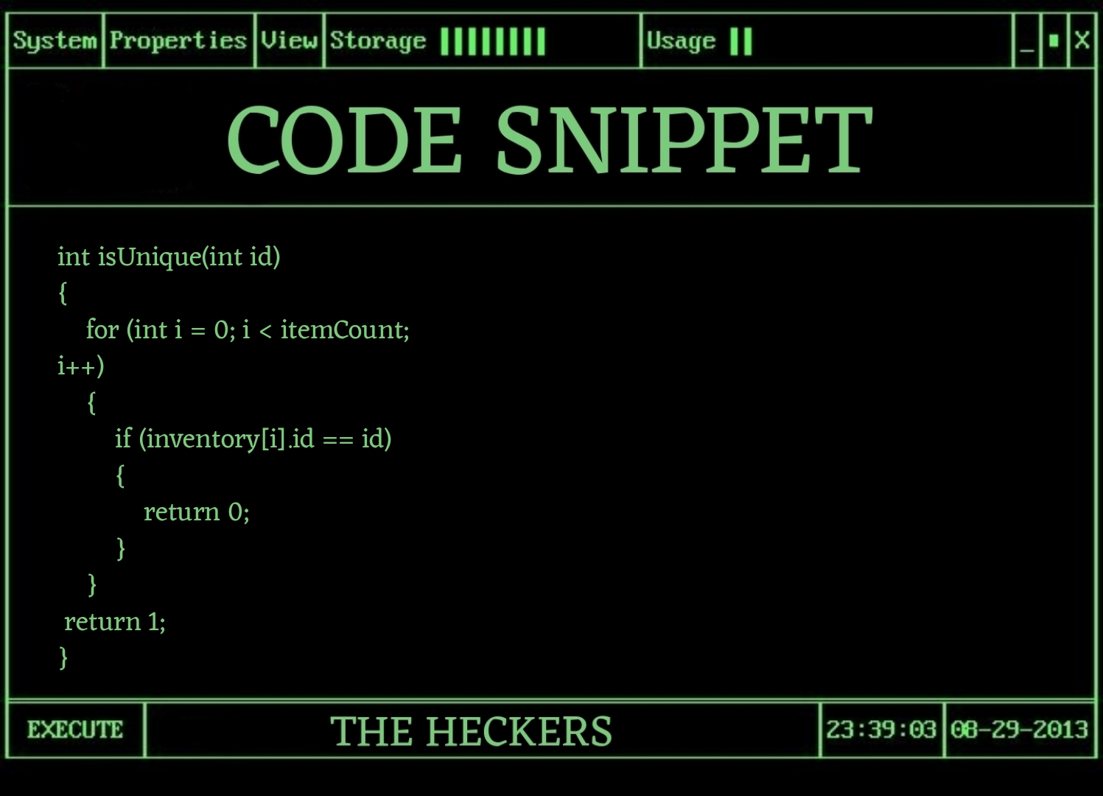
📦 2. Inventory Management
📈 4. Sales Report
🛒 3. Customer Billing
🔐 1. Login System
int isUnique(int id)
Checks if the given id exists in the inventory array.
Returns 1 if unique (not found), otherwise returns 0.

Slide 9
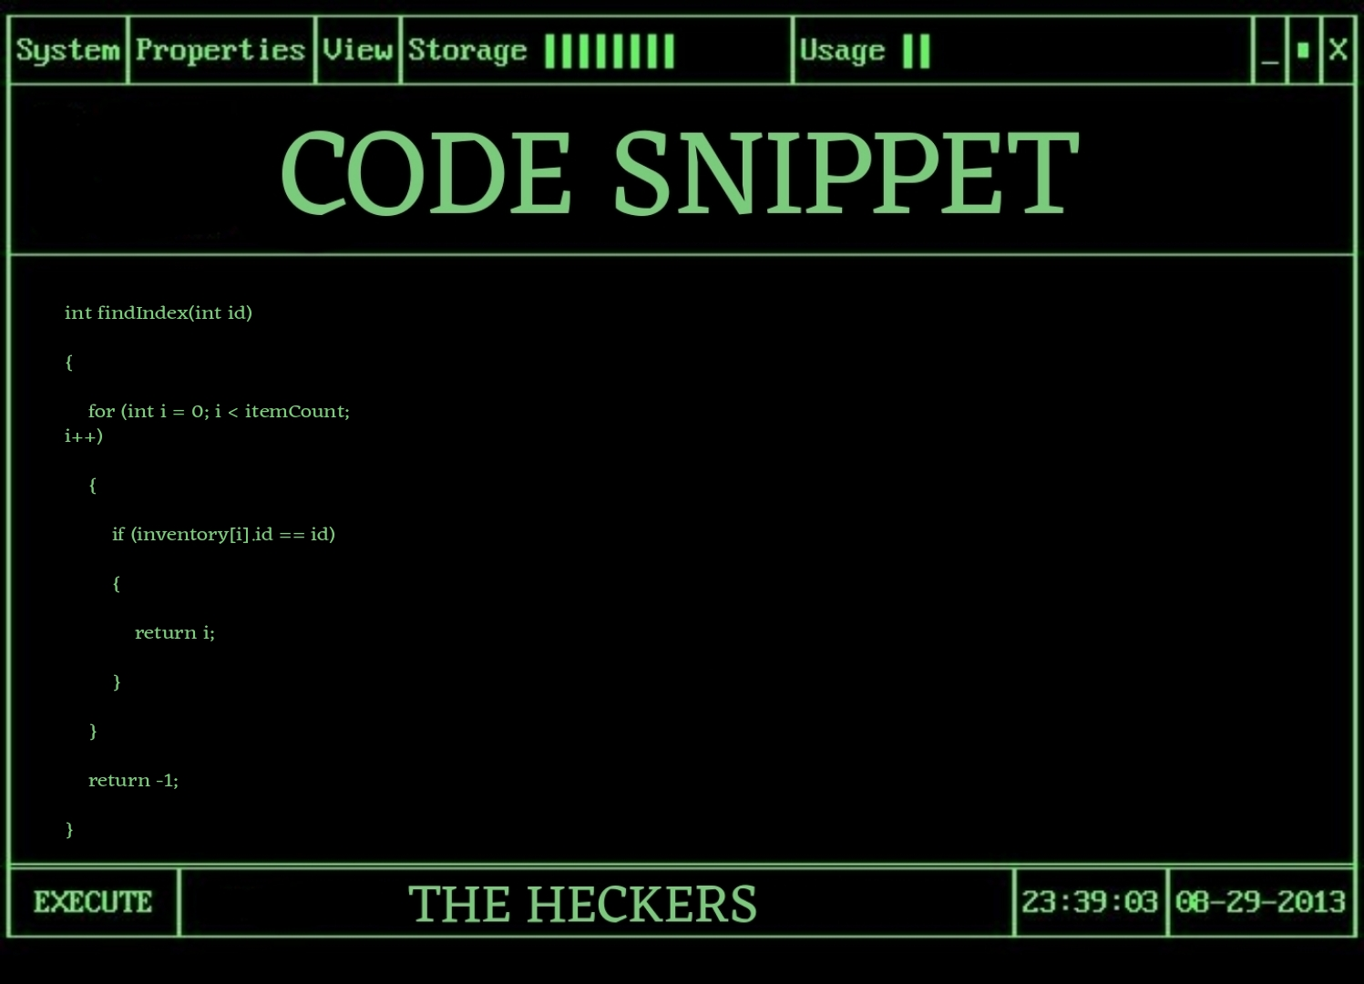
📦 2. Inventory Management
📈 4. Sales Report
🛒 3. Customer Billing
🔐 1. Login System
int findIndex(int id)
Searches the inventory array for the given id.
Returns the index if found, otherwise returns -1 if not found.

Slide 10
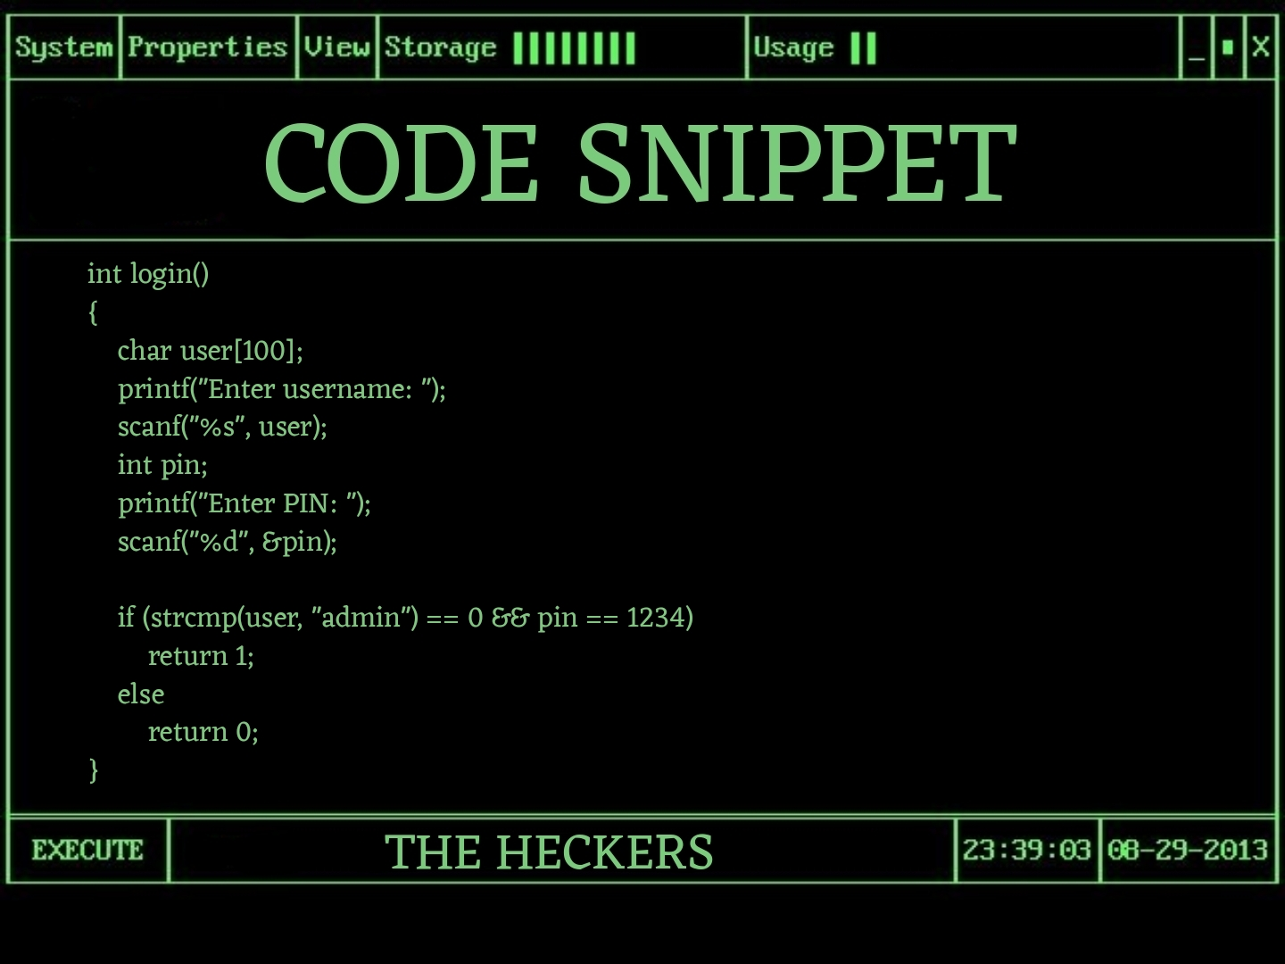
📦 2. Inventory Management
🔐 1. Login System
Super shop grocery billing system
Login system
🛒 3. Customer Billing
EXPLAINATION
Ensures only authorized users (admin) can access inventory functions.
Uses string comparison and a fixed PIN for authentication.
📈 4. Sales Report
Improves system security by preventing unauthorized access.
🔄 5. User Interaction Loop

Slide 11
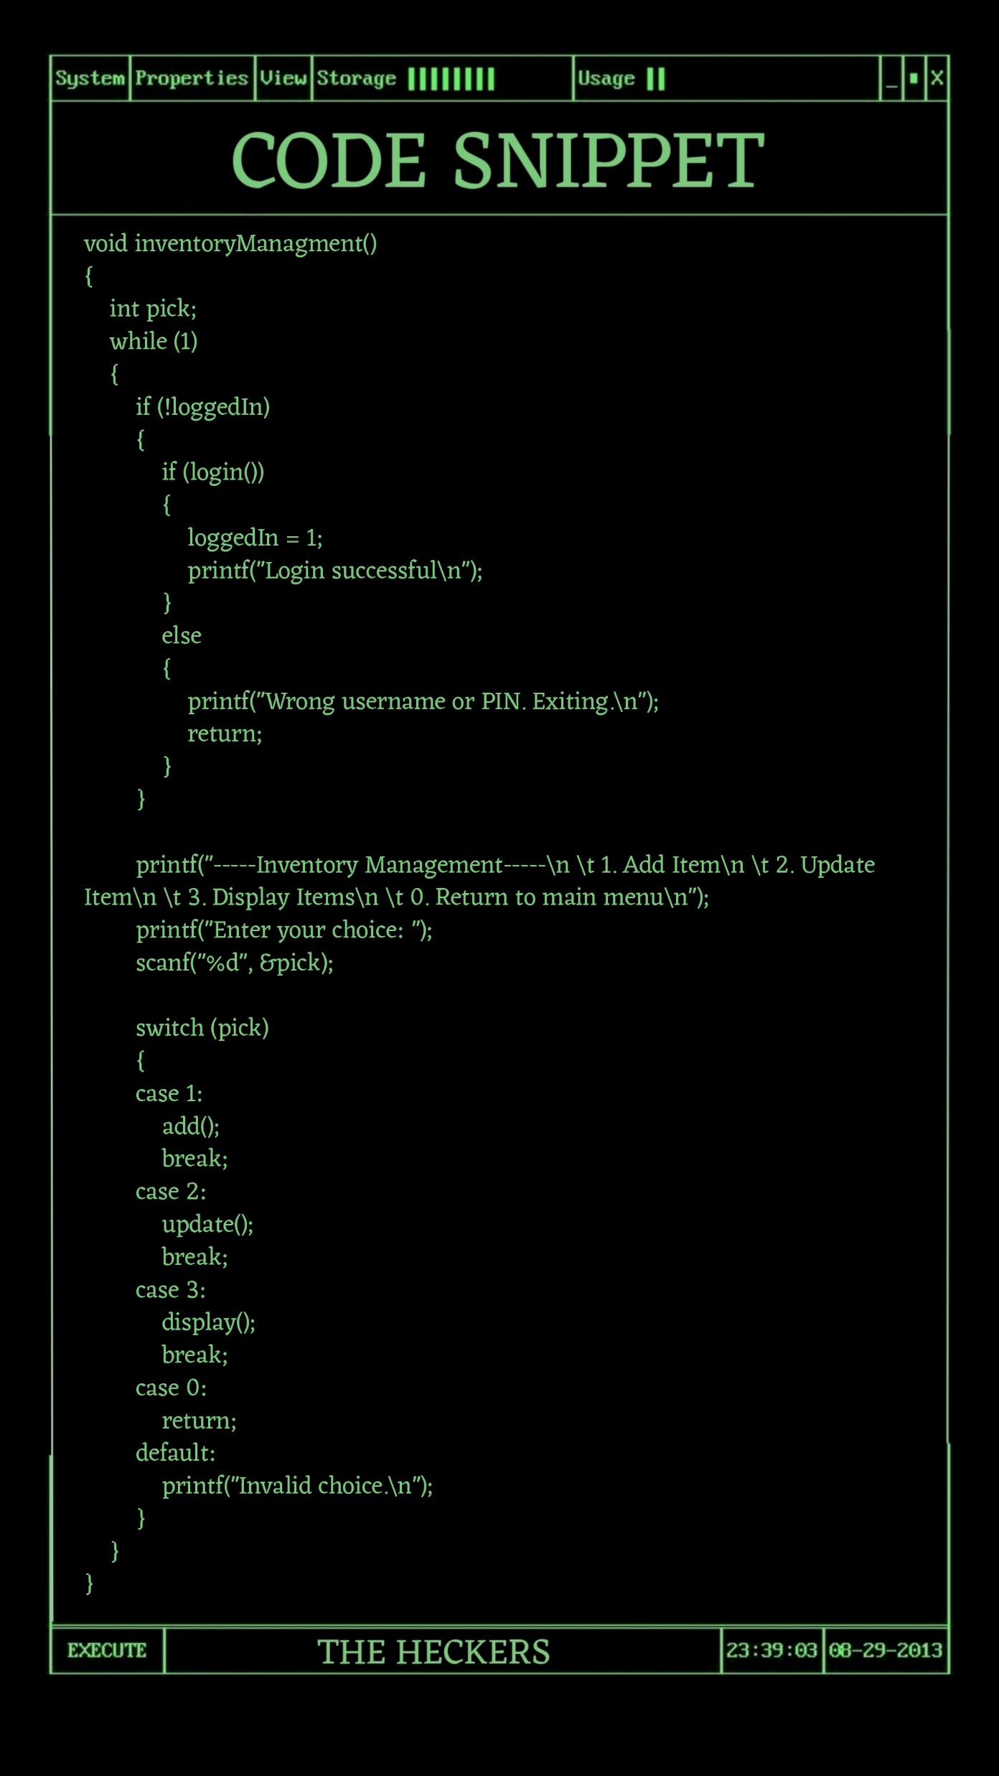
🔐 1. Login System
🛒 3. Customer Billing
📦 2. Inventory Management
Super shop grocery billing system
Inventory Management
EXPLAINATION
Adds new items with unique ID, name, price, and stock quantity.
Update items price and quantity.
Display added items.
📈 4. Sales Report
🔄 5. User Interaction Loop

Slide 12
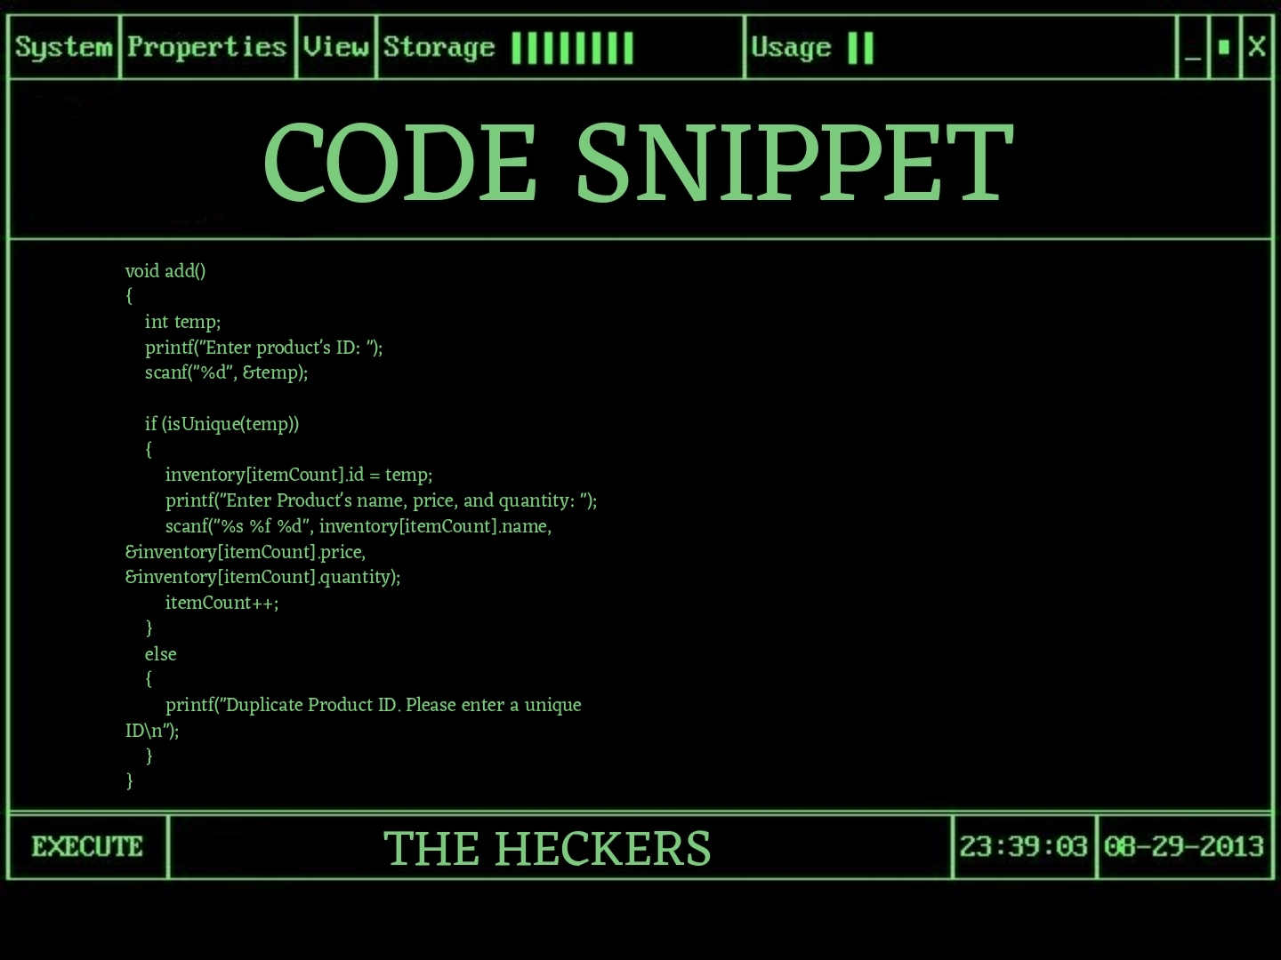
🔐 1. Login System
2.1 ADD
📦 2. Inventory Management
🛒 3. Customer Billing
Sure! Here's a 4-bullet explanation of the add() function:
Prompts the user to enter a product ID and stores it in temp.
Calls isUnique(temp) to check if the ID already exists in the inventory.
If unique, takes product name, price, and quantity as input and stores them in inventory[itemCount], then increments itemCount.
If not unique, displays a message saying the product ID is duplicate.
📈 4. Sales Report
🔄 5. User Interaction Loop

Slide 13
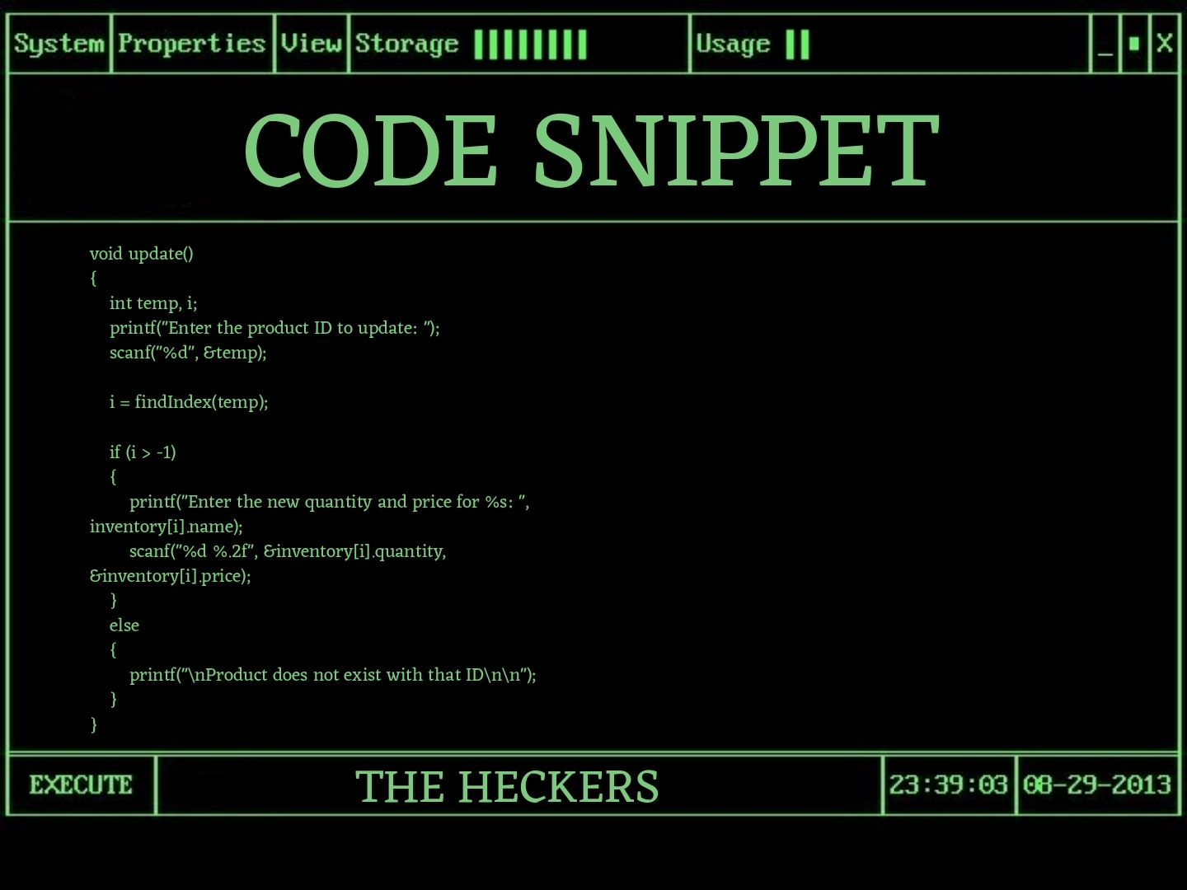
🔐 1. Login System
2.2 UPDATE
2.1 ADD
📦 2. Inventory Management
🛒 3. Customer Billing
Prompts the user to enter a product ID to update.
Uses findIndex(temp) to locate the product in the inventory.
If found, asks for and updates the new quantity and price.
If not found, displays a message that the product does not exist.
📈 4. Sales Report
🔄 5. User Interaction Loop

Slide 14
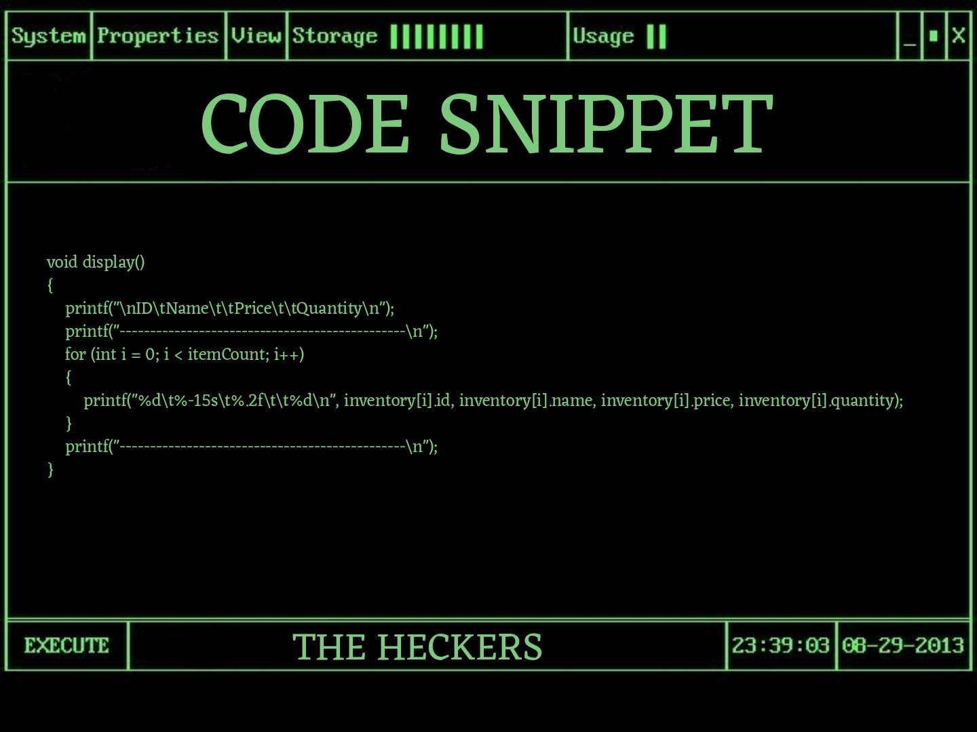
🔐 1. Login System
2.3 DISPLAY
2.2 UPDATE
2.1 ADD
📦 2. Inventory Management
🛒 3. Customer Billing
Loops through all items in the inventory and prints their ID, name, price, and quantity.
Formats the output as a table with headers and separator lines.
📈 4. Sales Report
🔄 5. User Interaction Loop

Slide 15
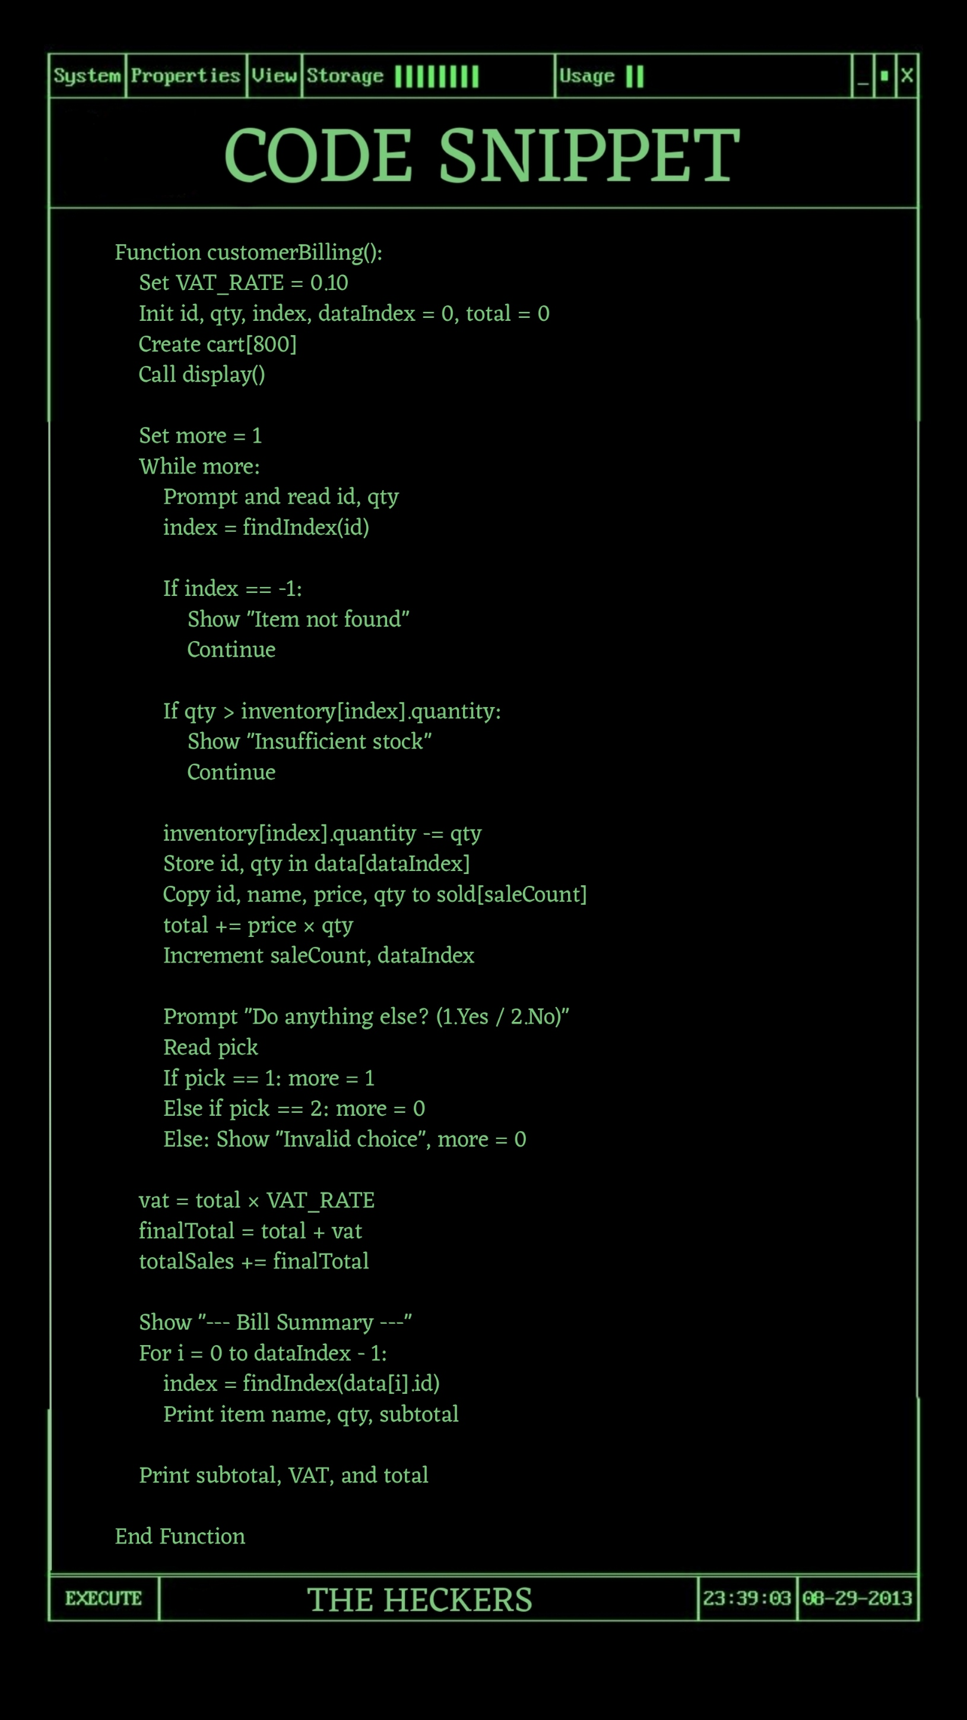
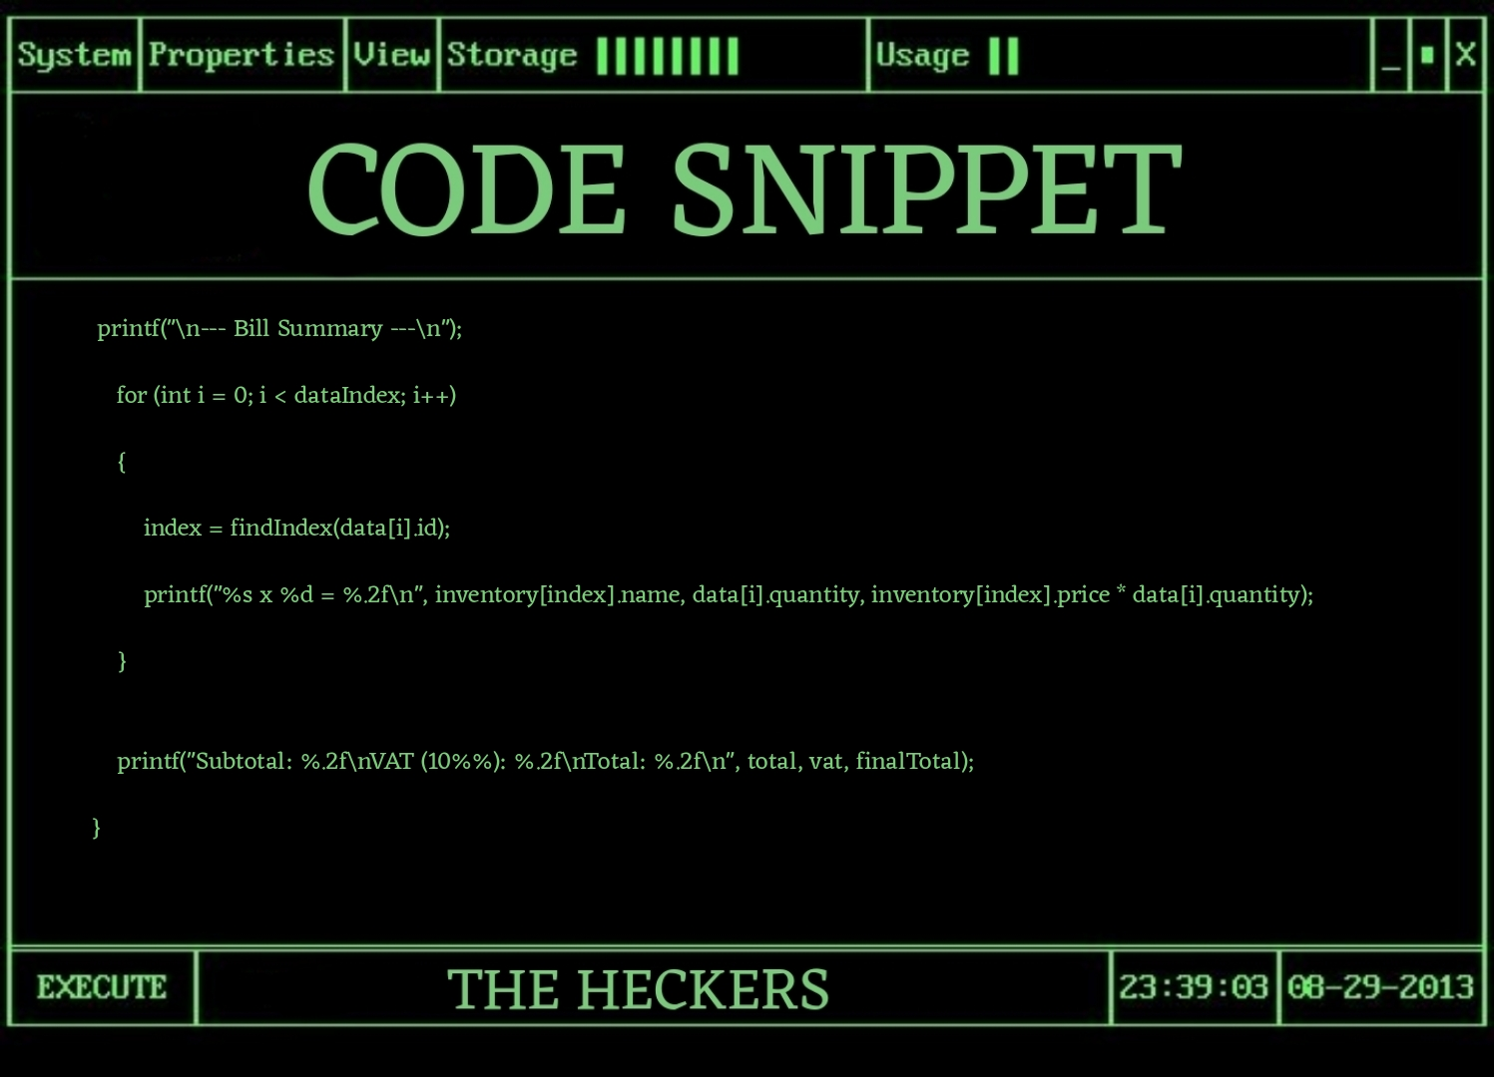
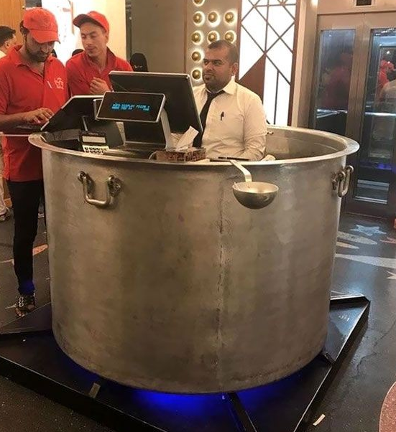
📦 2. Inventory Management
🔐 1. Login System
🛒 3. Customer Billing
📈 4. Sales Report
Super shop grocery billing system
Customer Billing
EXPLAINATION
Adds a 10% VAT to the subtotal.
VAT_RATE is defined as a constant for easy adjustment.
Ensures customers are billed accurately with tax included.
🔄 5. User Interaction Loop

Slide 16
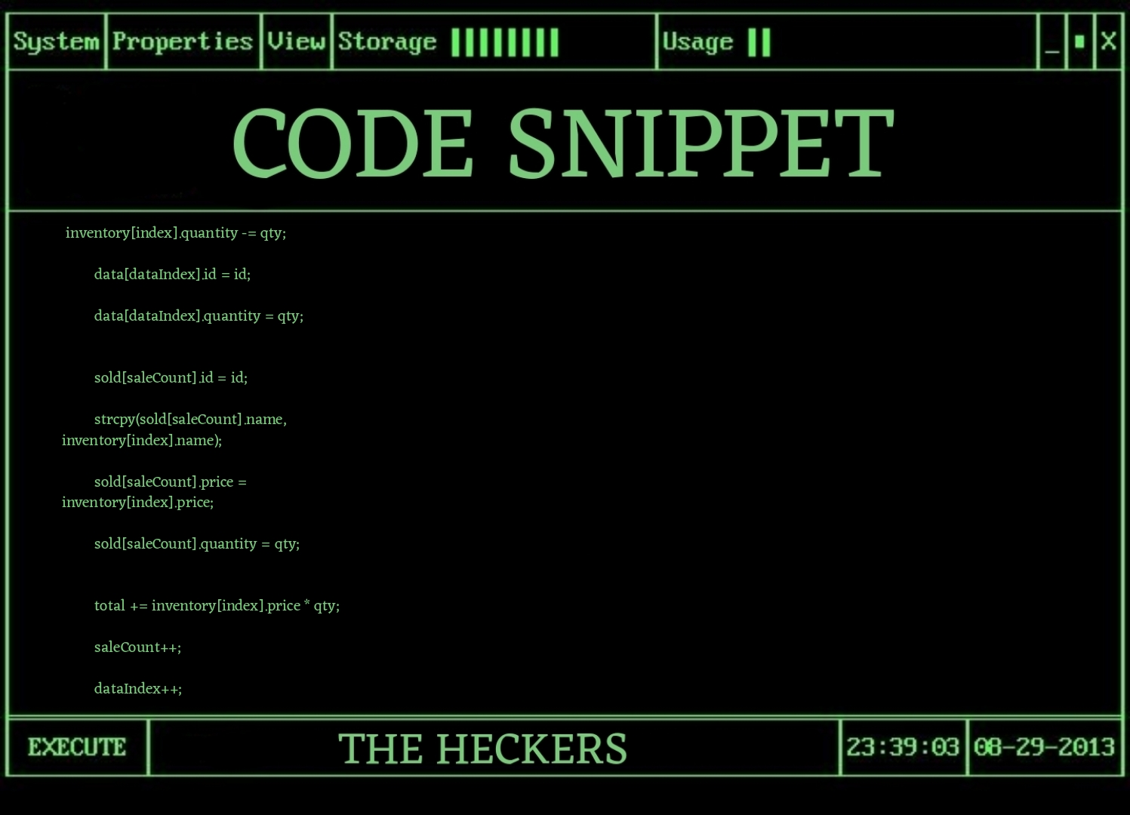
📦 2. Inventory Management
🔐 1. Login System
📈 4. Sales Report
📁4. Stock Update
Super shop grocery billing system
Customer Billing
EXPLAINATION
* Updates the inventory by reducing quantity, then stores the item ID and quantity in `data[]` and sale details in `sold[]`.
* Increases the `total` bill and increments both `saleCount` and `dataIndex` counters.
🛒 3. Customer Billing
🔄 5. User Interaction Loop

Slide 17
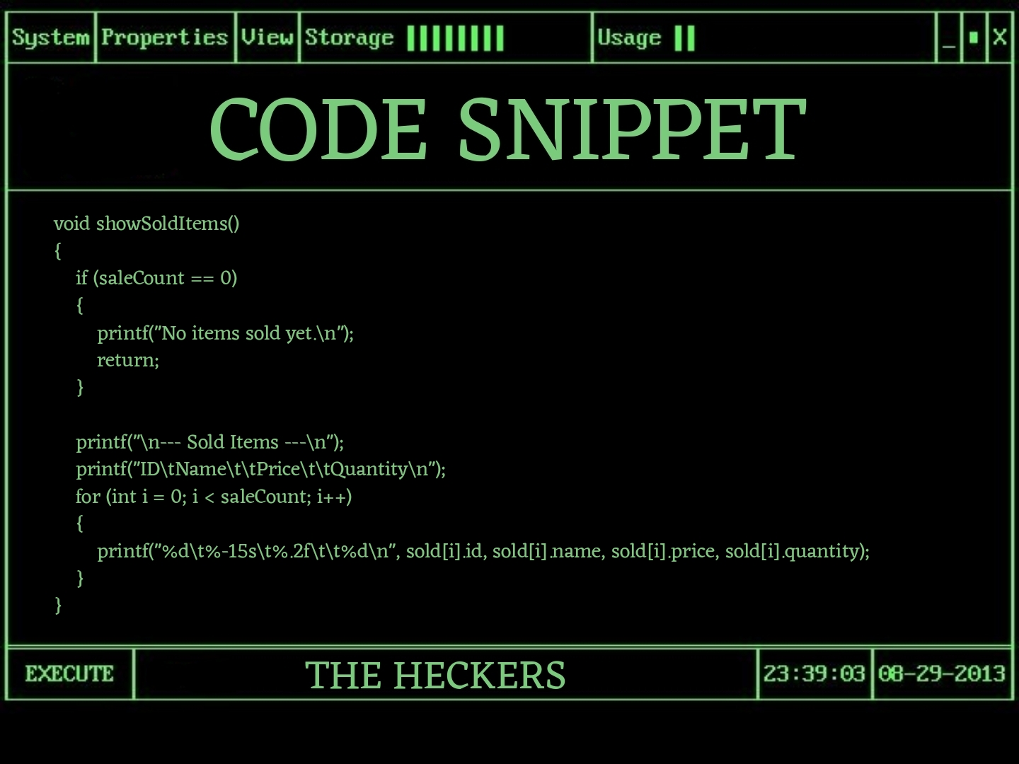
🛒 3. Customer Billing
📦 2. Inventory Management
🔐 1. Login System
🔄 5. User Interaction Loop
📈 5. Sales Report
Super shop grocery billing system
Sales Report
EXPLAINATION
Checks if the requested quantity is available in stock.
If yes, deducts sold quantity from current inventory.
Prevents overselling and keeps inventory data accurate.

Slide 18
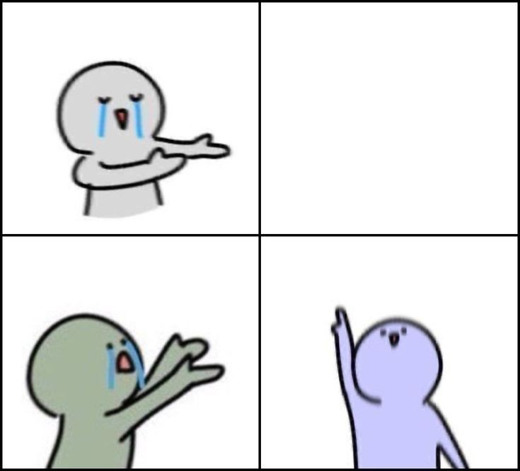
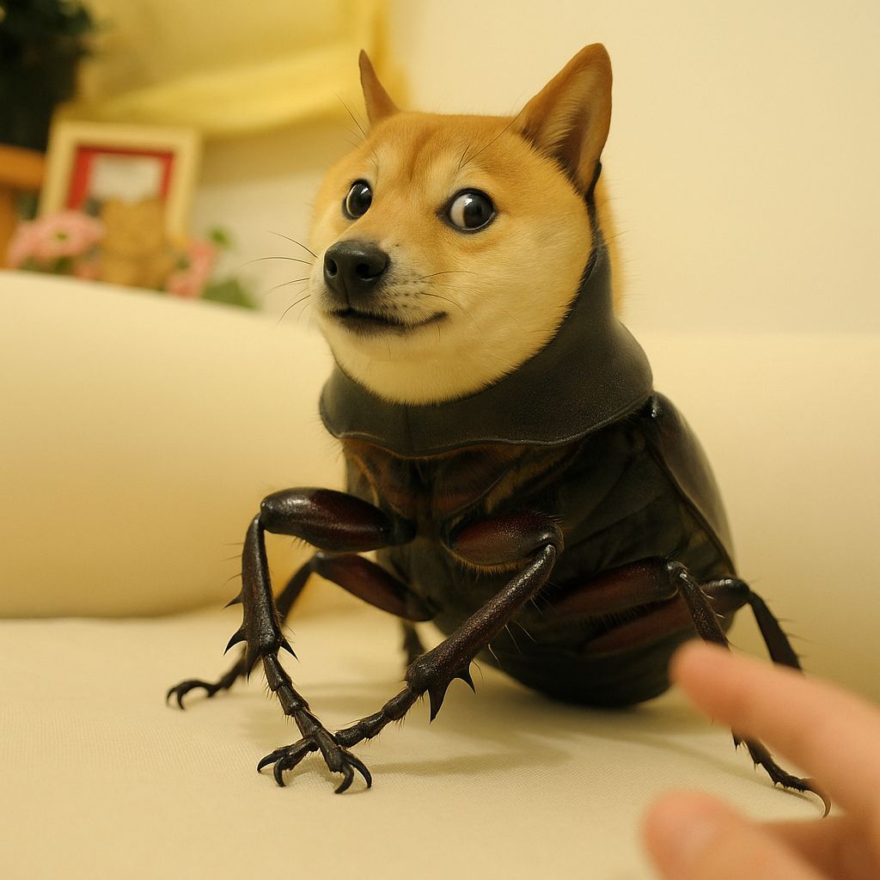
BUG FIX
Bug: Sales were not recorded properly when multiple items were purchased in one transaction.
Fix: Used dataIndex in customerBilling() to track cart items properly.
Code Correction:
BUG
int dataIndex = 0;
Replaced fixed loop with while(more) to dynamically handle multiple entries
Other Fixes:
Added stock validation.
Prevented billing if quantity exceeded.
Handled invalid choices gracefully.

Slide 19
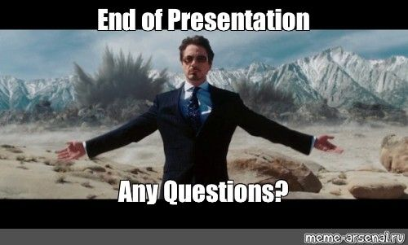
(PLEASE DON’T ASK😭)

